Slide 1
Abstractive Text Summarizer
Group members:
Birhang Borgoyary (202102023126) (CSE)
Pritam Sutradahar (202102021002) (CSE)
Jim Brahma (202102023130) (CSE)
: Abstractive Text Summarizer
20th July 2023

Slide 2
Contents
Introductioon
Problem Statement
Literature Survey / Related Works
Objective
System Architecture
Methodology
Implementation and Results
References
: Abstractive Text Summarizer
20th July 2023

Slide 3
Introduction
Text summarization is the process of condensing a longer piece of text, such as an article
There are two main approaches to text summarization
Extractive Summarization: In extractive summarization, the summary is generated by selecting and combining important sentences or phrases directly from the original text.
Abstractive Summarization: Abstractive summarization goes a step further by generating summaries that may contain words, phrases, or even sentences that were not present in the original text.
Extractive summarization tends to preserve the original wording and is often more coherent, but it may not be able to generate entirely new information.
Abstractive summarization, on the other hand, has the potential to create more concise and human-like summaries, but it can be challenging to ensure grammatical correctness and maintain the intended meaning.
: Abstractive Text Summarizer
20th July 2023

Slide 4
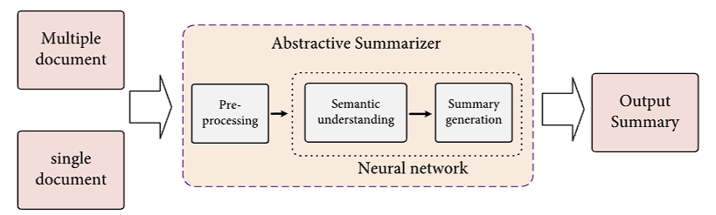
Problem Statement
Given a long piece of text, such as an article, document, or news story, generate a concise and coherent summary that captures the main ideas and key information from the original text using abstractive text summarization.
The generated summary should be a human-like representation of the original text, using paraphrasing and natural language generation techniques to produce new sentences that effectively convey the meaning and essence of the source text
Figure for better understanding
: Abstractive Text Summarizer
20th July 2023

Slide 5
Literature Survey / Related Works
Sl. No. | Article | Author |  | Conclusion
1. | "Text Summarization Techniques: A Brief Survey." | Mehdi Allahyari, Elizabeth D Trippe, and Juan B Gutierrez.(2017) |  | This paper discusses extractive approaches for single and multi-document summarization, including topic representation, frequency-driven methods, graph-based techniques, and machine learning techniques. While not comprehensive, it provides insight into recent trends and advances in automatic summarization methods.
2. | A Neural Attention Model for Abstractive Sentence Summarization" | Alexander M. Rush et al. (2015) |  | Presents a neural attention-based model for generating abstractive summaries
3. | "Pointer-Generator Networks" | Abigail See et al. (2017) |  | Introduces a pointer-generator network that can handle both extraction and generation of words for abstractive summarization.
: Abstractive Text Summarizer
20th July 2023

Slide 6
Literature Survey / Related Works
Sl. No. | Article | Author |  | Conclusion
4. | BART: Denoising Sequence-to-Sequence Pre-training for Natural Language Generation, Translation, and Comprehension | Mike Lewis Yinhan Liu Naman Goyal Marjan Ghazvininejad, Abdelrahman Mohamed, Omer Levy, Ves Stoyanov Luke Zettlemoyer Facebook AI (2019) |  | BART is a pre-training method that maps corrupted documents to their original, achieving similar performance to RoBERTa and offering new text generation results.
5. | Text Summarization with Pretrained Encoders | Yang Liu and Mirella Lapata |  | This paper presents pretrained BERT for text summarization, introducing a document-level encoder and a general framework for abstractive and extractive summarization. Experimental results show state-of-the-art results, with potential for language generation in the future.
6. | "PEGASUS: Pre-training with Extracted Gap-sentences for Abstractive Summarization | Jingqing Zhang Yao Zhao Mohammad Saleh , Peter J. Liu (2020) |  | PEGASUS is a sequence-to-sequence model with gap-sentences generation as a pretraining objective for abstractive text summarization. The optimal strategy is principle sentence selection. The model adapts quickly to unseen datasets and achieves strong results in as little as 1000 examples.
: Abstractive Text Summarizer
20th July 2023

Slide 7
Objectives
Conciseness: The summary should be significantly shorter than the original text while retaining the key points and main ideas.
Coherence: The generated summary should maintain coherence and readability.
Information Preservation: The summarizer should strive to preserve the crucial information from the original text in the generated summary
Language Fluency: An abstractive text summarizer should generate summaries that are fluent and natural-sounding
Novelty: One of the objectives of an abstractive text summarizer is to produce summaries that go beyond mere extraction of sentences from the original text
Contextual Understanding: The summarizer should demonstrate an understanding of the context and meaning of the original text.
Evaluation Metrics: Another objective is to evaluate the quality of the generated summaries using appropriate evaluation metrics such as ROUGE (Recall-Oriented Understudy for Gisting Evaluation)
: Abstractive Text Summarizer
20th July 2023

Slide 8
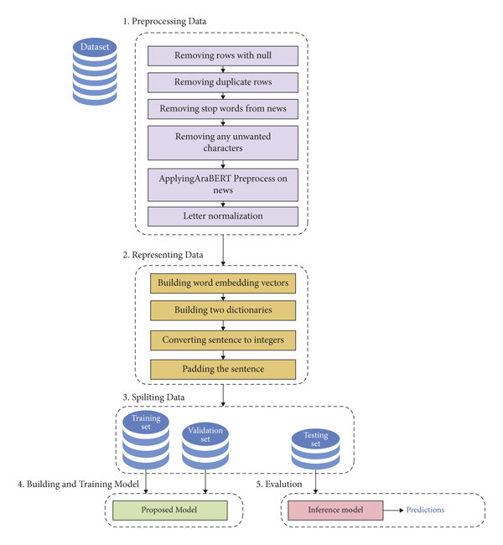
System Architecture
Dropping the unwanted columns
Removing the contractions
Removing the Stopwords
Removing the extra spaces ,special characters etc
Preprocessing
Representing Data
Splitting Data
Building and training model
Evaluation
Convert the text in lowercase
Saving the cleaned text in .pkl file
Loading the .pkl files
Creating new dataframe
Inserting the clean text from file to new columns of dataframe
Adding <sostok> and <eostok> at the beginning and end of summary
: Abstractive Text Summarizer
20th July 2023

Slide 9
Methodology
Data Collection and Preprocessing: Gather a large dataset of articles or documents along with their corresponding summaries. Clean the data by removing any unnecessary characters, formatting, or noise. Perform preprocessing tasks such as sentence tokenization, word tokenization, and removing stop words.
Encoder-Decoder Architecture: Construct an encoder-decoder architecture, often based on recurrent neural networks (RNNs) or transformer models. The encoder processes the input text and captures the contextual information, while the decoder generates the summary word by word.
Embeddings and Word Representations: Utilize word embeddings, such as Word2Vec or GloVe, to represent words as continuous vectors. These embeddings capture semantic and syntactic information, which can help the model understand the meaning and relationships between words.
Training the Model: Train the model using the preprocessed dataset. The training involves feeding the input text and target summary pairs to the model and optimizing the model parameters using techniques like backpropagation and gradient descent. Use suitable loss functions, such as cross-entropy, to guide the learning process.
Evaluation: Evaluate the quality of the generated summaries using evaluation metrics such as ROUGE (Recall-Oriented Understudy for Gisting Evaluation).These metrics measure the overlap between the generated summaries and reference summaries written by humans.
Deployment and Application: Deploy the trained model in a production environment, where it can accept new input texts and generate summaries in real-time. Use the abstractive text summarizer for various applications such as news summarization, document summarization, or social media summarization.
: Abstractive Text Summarizer
20th July 2023

Slide 10
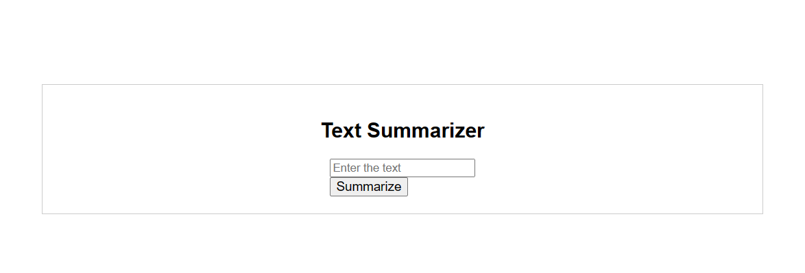
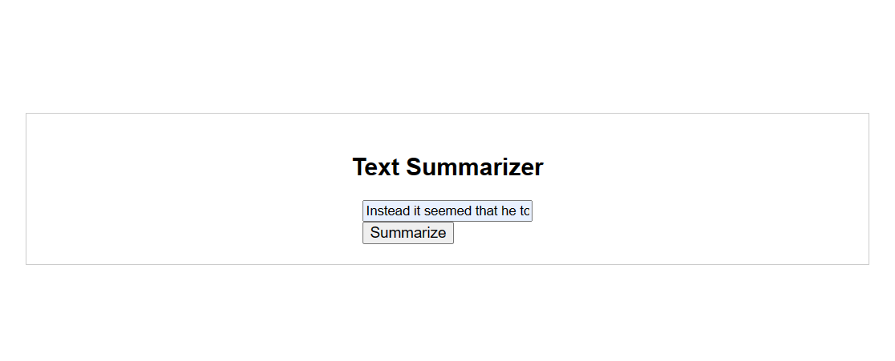
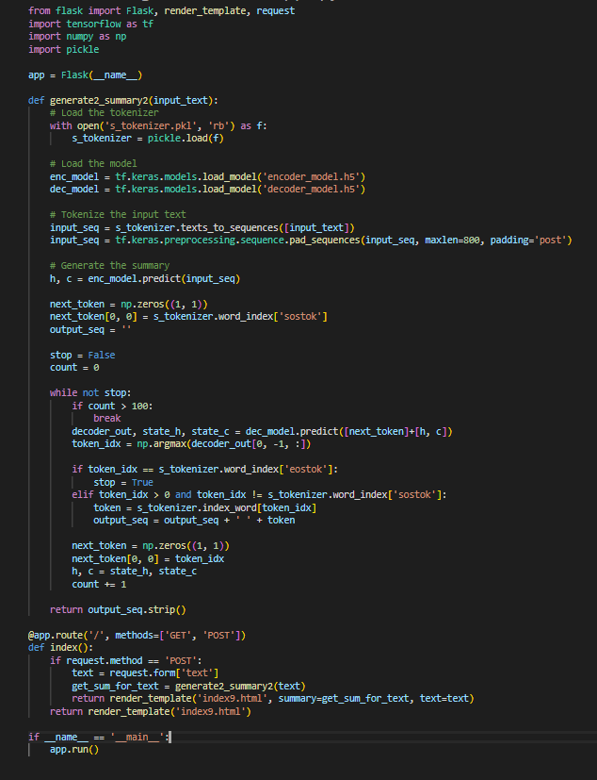
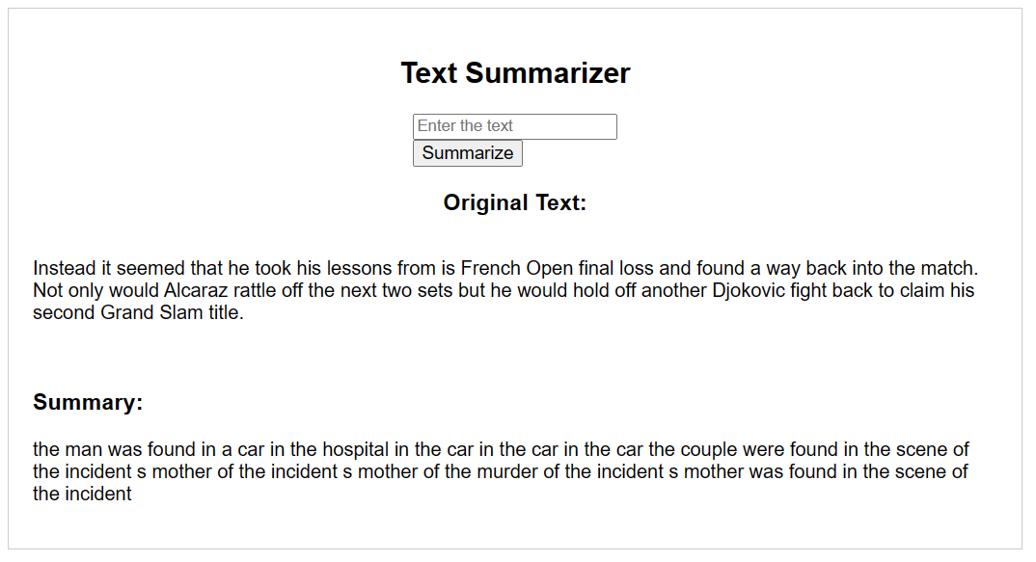
Implementation and Results
Web Framework
Inserting text to summarize
Implementation code
Generated summary
: Abstractive Text Summarizer
20th July 2023

Slide 11
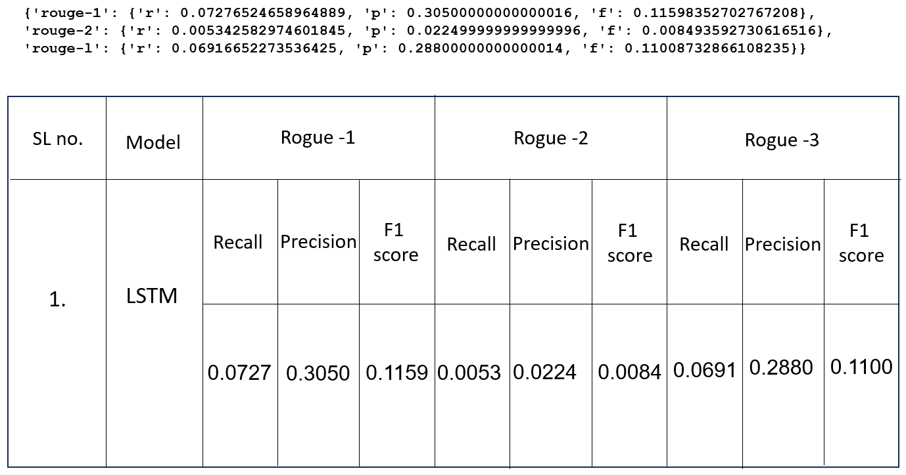
Rogue Score
: Abstractive Text Summarizer
20th July 2023

Slide 12
References
NLTK (Natural Language Toolkit): NLTK is a widely used library for NLP tasks in Python. It provides various modules and functionalities for text preprocessing, tokenization, part-of-speech tagging, and more.
https://www.nltk.org/
Gensim: Gensim is a popular open-source library for topic modeling and document similarity analysis. It provides an implementation of the TextRank algorithm, which can be used for extractive summarization.
https://radimrehurek.com/gensim/
Transformers (Hugging Face): It consists many state-of-the-art language models like BERT, GPT, and T5. The library also provides pre-trained models and utilities for text generation and summarization.
https://huggingface.co/transformers/
spaCy: spaCy is a modern and efficient NLP library that provides various functionalities, including tokenization, named entity recognition, and dependency parsing.
https://spacy.io/
: Abstractive Text Summarizer
20th July 2023

Slide 13
Thank you
: Abstractive Text Summarizer
20th July 2023

