Slide 1
Corona Awareness And Help Portal With Live Patient Cases
Presented By :-
1. Pritam Turalkar
2. Pratik Utekar
3. Siddharth Soni
Guided By
Prof.R.V.Sangle

Slide 2
Introduction
The 'Corona Awareness and Help Portal With Live Patient Cases' has been help to override the problems prevailing in the practicing manual system.
This website can lead to error-free,secure,reliable and fast management system.
This website can help to provide Information about Covid-19,their Symptoms and how to prevent from this disease.
If someone has found symptoms of Covid-19 mention in website,then they can register through our website to get the Treatment.

Slide 3
Problem Statement
The old system of Covid-19 was Suffering from drawbacks.
Since the wole of the system was to be maintained with hands the process of keeping,maintaining and retrieving the information was very tedious and lenthy.
There would always be unnecessary consumption of time while entering records and retrieving records.
For this reason,we have build this website to help people to know about Covid-19 and data entry of persons who has covid-19 symptoms.

Slide 4
Requirements And Specifications
Hardware Requirement :-
I5(processor)
Hard Disk 5 GB
Laptop
Software Requirements:-
Web Technologies - Brackets
Language - HTML,CSS,PHP,JAVASCRIPT
Database - MYSQL
Web Server - XAMPP
Operating System - Windows10,Linux

Slide 5
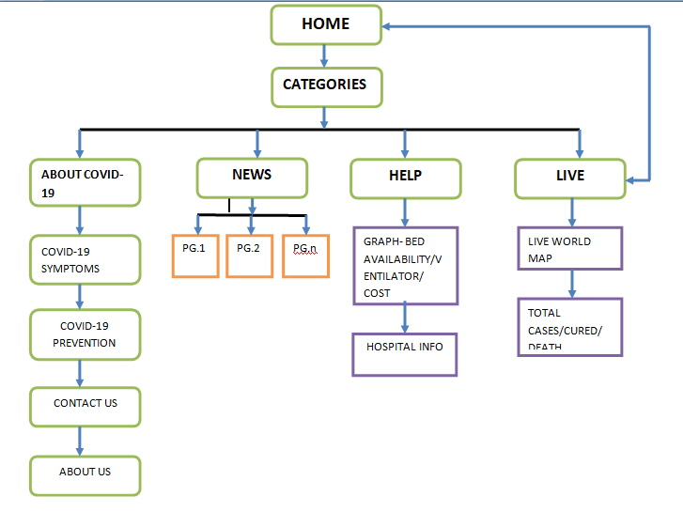
Design And Flow Of System

Slide 6

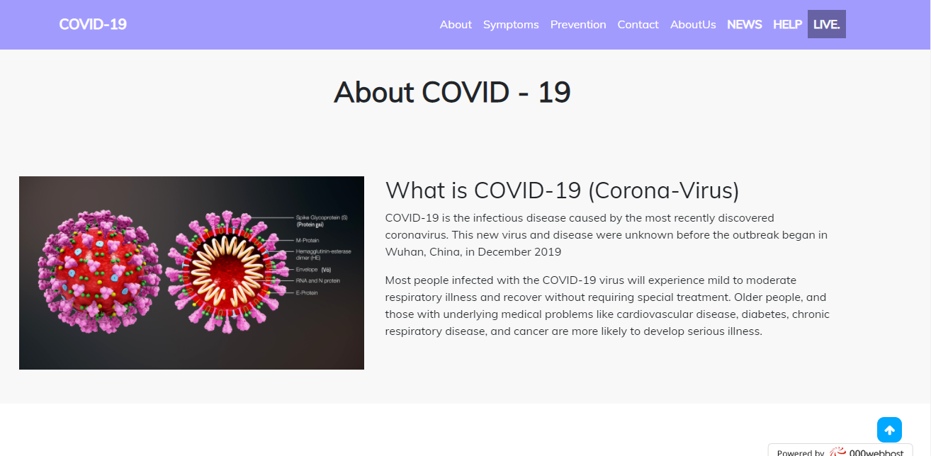
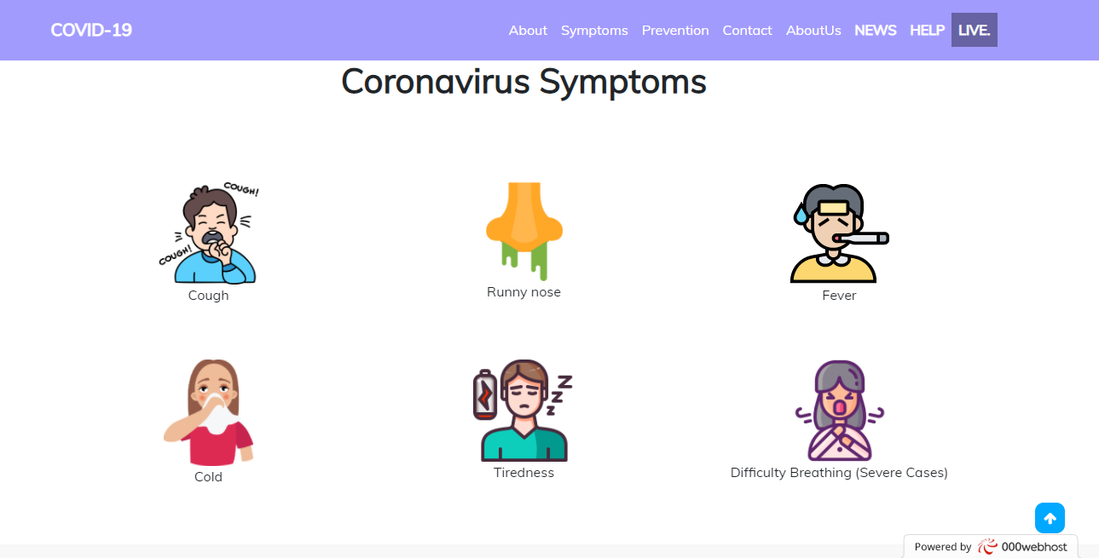
Result And Snapshots

Slide 7
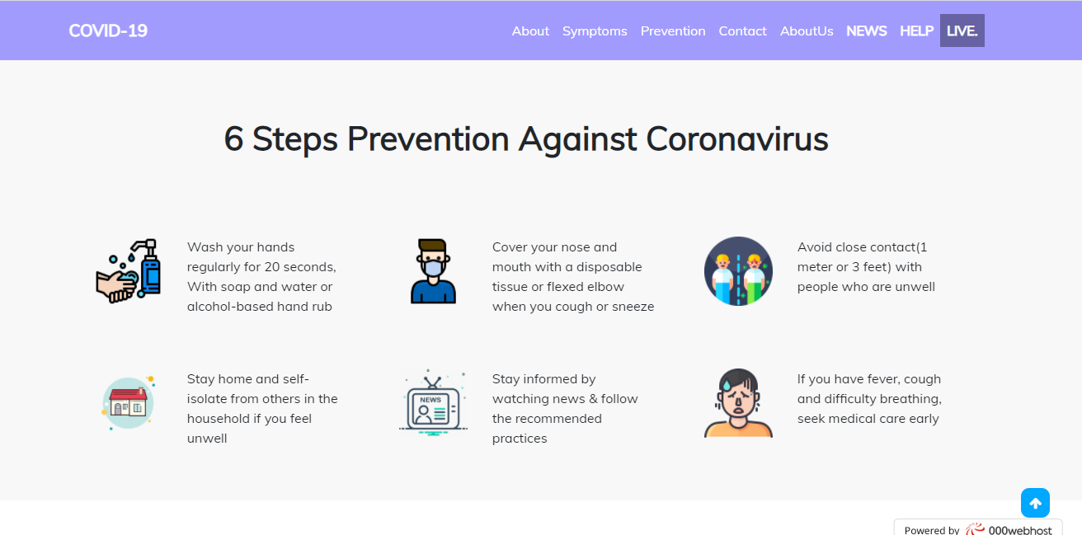
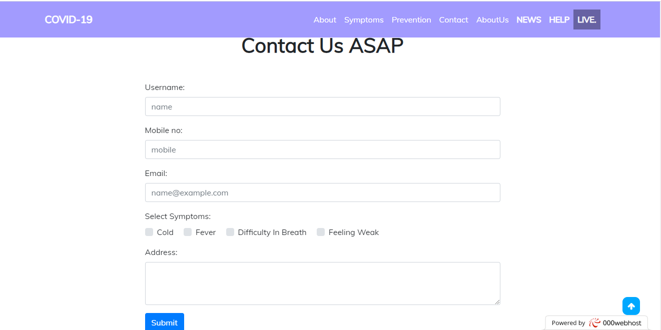
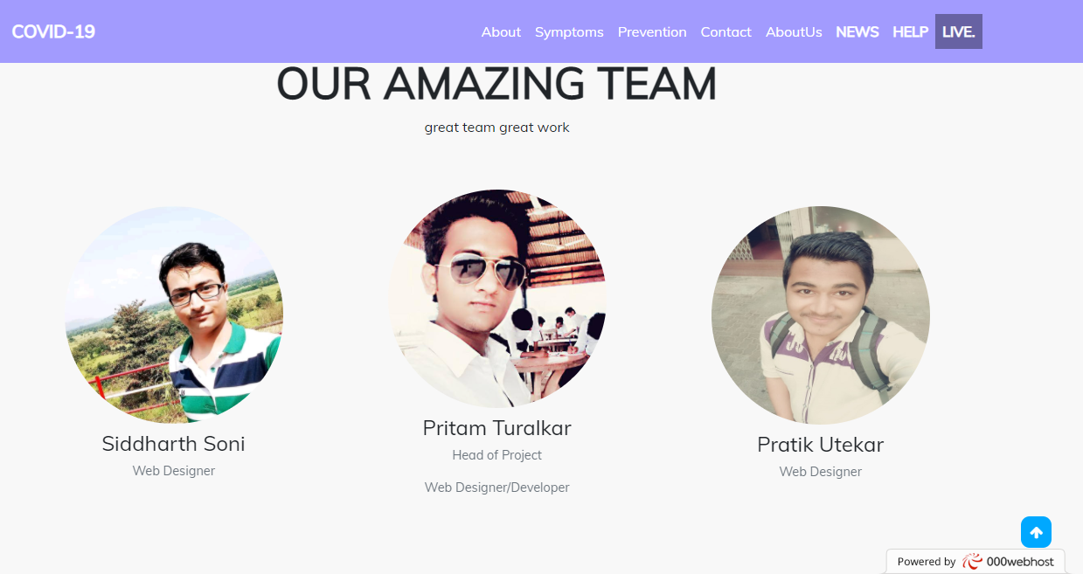

Slide 8
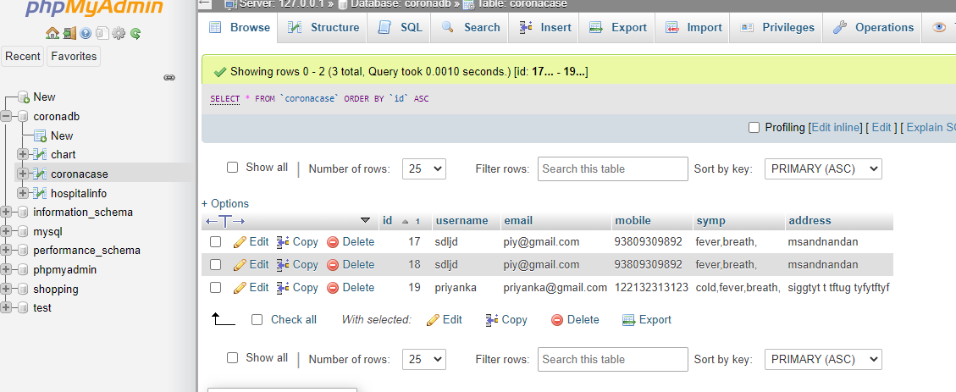
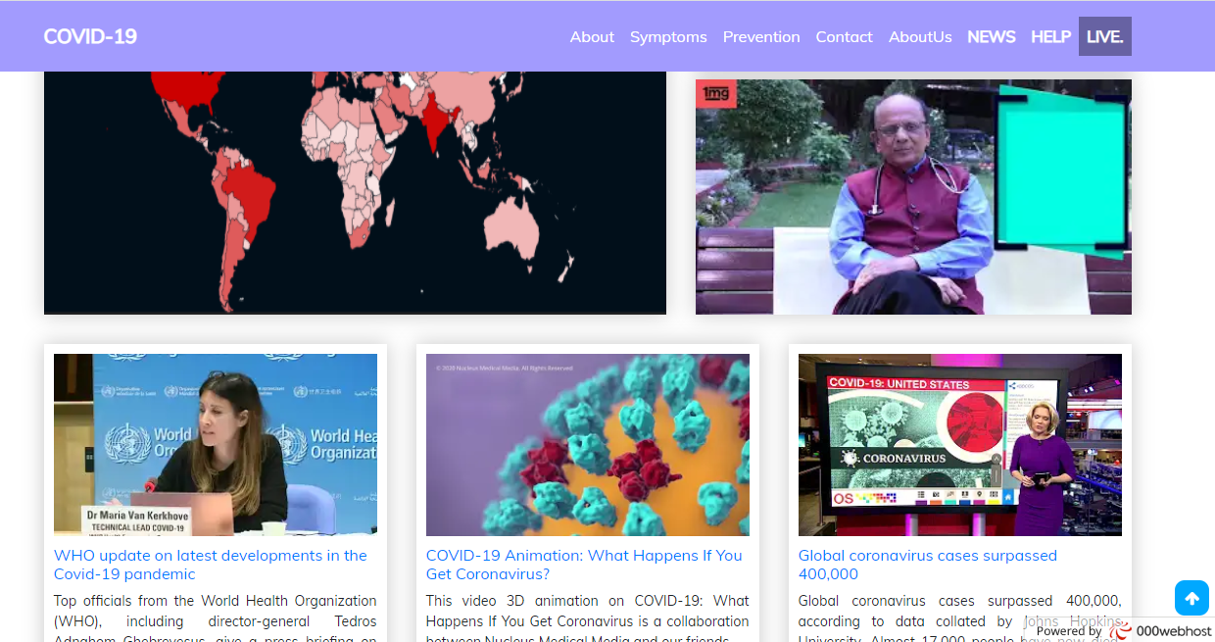
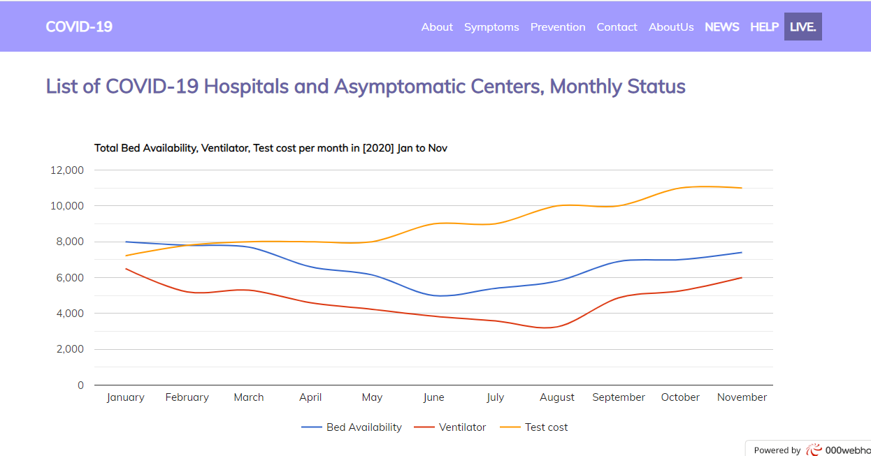

Slide 9
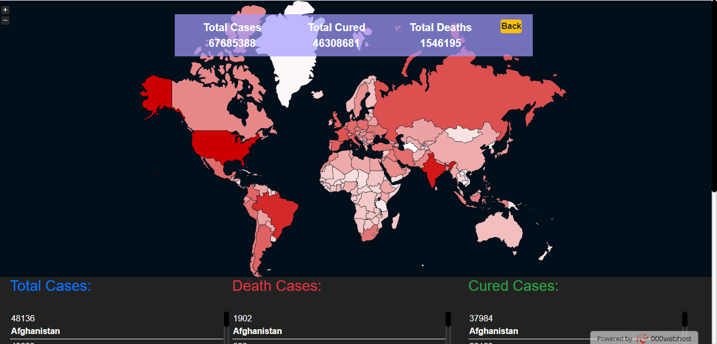
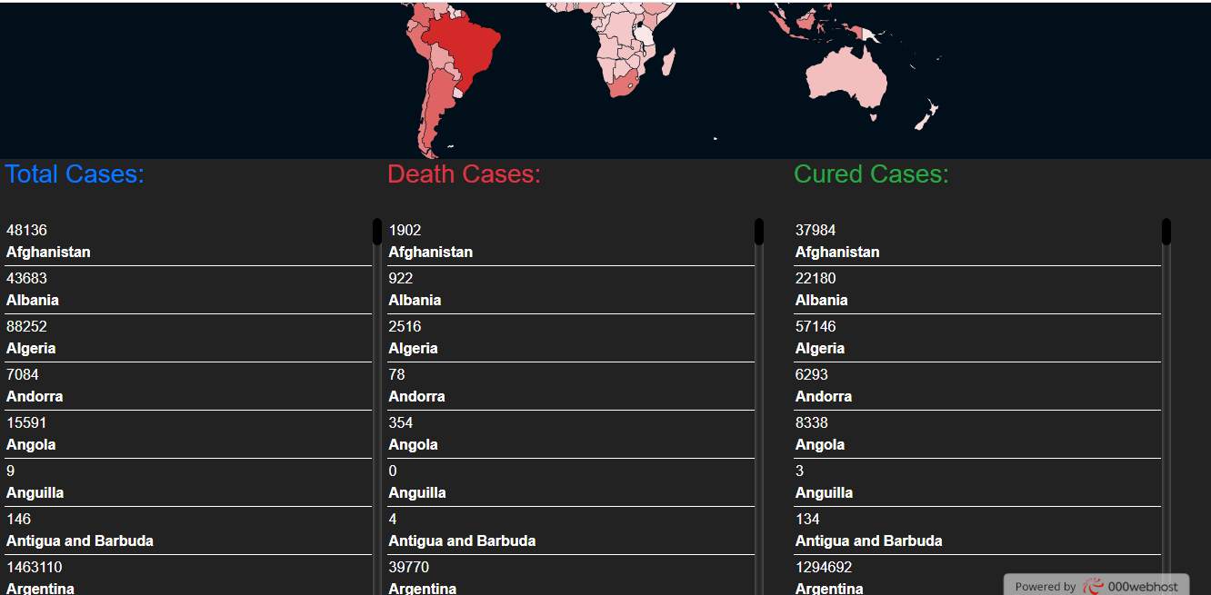

Slide 10
Conclusion
Our project is only a humble venture to satisfy the need to manage their project work.
Several user-friendly coding has also adopted. This package shall prove to be a powerful package in satisfying all the requirements.
The objective of the website planning is to provide a framework that enables the manager to make reasonable estimates made within a limited time frame at the beginning of the website project and should be updated regularly as the project progresses.

Slide 11
Future Scope
Social awareness about COVID-19.
Provide correct information about COVID-19.
Scaling up country readiness and response operations.
Health care management Professionals will see newer possibilities and scope in the health care Industry.

Slide 12
References
www.wikipedia.com
www.slideshare.net
www.w3schools.com
www.tutorialspoint.com
www.youtube.com/jpweb
www,github.com

