Slide 1
Arduino Remote Control
Konkan Gyanpeeth College Of Engineering
TE - IT
Project By:
Prathamesh Chikane (01)
Subodh Halpatrao (33)
Sutej Kulkarni (44)
Project Guide:
Prof. S.S. GIRI

Slide 2
Introduction
What is IOT?
The word "Internet of Things" has two main parts; Internet being the backbone of connectivity, and Things meaning objects / devices . In a simple way to put it, You have "things" that sense and collect data and send it to the internet. In simple language, IoT converts a normal device into smart device.

Slide 3
Introduction to ARC
ARC stands for Arduino Remote Control.
ARC – Arduino Remote Control is a system designed to control computer applications in a remotely fashion from a limited distance via Bluetooth on a smartphone.
The system has its own android APK software for android smartphones which will allow the user to control various computer applications.
ARC system is signal receiving and processing unit which uses a Bluetooth module and an Arduino UNO board to receive Bluetooth signals and parse it and perform actions on the computer or any other workstation.

Slide 4
Objective
To help users control their personal computers without actually accessing/using the keyboard/mouse physically.
With this the person doesn't need to stay in front of the computer to execute a certain task.
Our main aim was to develop a system which would reduce the physical efforts of disabled people. So that they don’t need to take efforts for such small task.
Also at places like cyber café where one person needs to handle several systems this project would the person to control them all with an ease.

Slide 5
Purpose, Scope and Applicability
As it is a controller itself, it was developed in such a way that the physical human efforts should be reduced.
The application we are going to develop should be able to communicate with the Arduino and it should be able to pass strings to Arduino which will be then sent to python code or read by python code and depending on what string is passed certain tasks on the computer will be executed.
Peoples who use their computers for day-to-day tasks like listening to music, playing videos, browsing on internet can use this to ease their task, we can also use this application to control PPT’s during seminars.

Slide 6
Literature Survey
Project MADE BY AVISHKAR ORG - HC 05/06 works on serial communication. Here the android app is designed sending serial data to the Bluetooth module when a certain button is pressed. The Bluetooth module at other end receives the data and send to Arduino through the TX pin of the Bluetooth module (RX pin of Arduino). The Code fed to Arduino check the received data and compares. If received data is 1 the LED turns on turns OFF when received data is 0
System developed by DIY solutions. Using a Bluetooth module to control the Lightings of the home or office .with the help of Arduino board as core part for and multiple light detecting sensors and motion sensors to detect the intensity of light as well as the presence of an entity in the room

Slide 7
Requirement Specification
Software
Hardware
Windows 7 or up
Android Studio
Python 3.7 (IDE)
Arduino IDE
Arduino UNO
Bluetooth HC-05 module
Android Device
4 GB ram min
Connecting Cables
Jumping Wires(Male-Female)

Slide 8
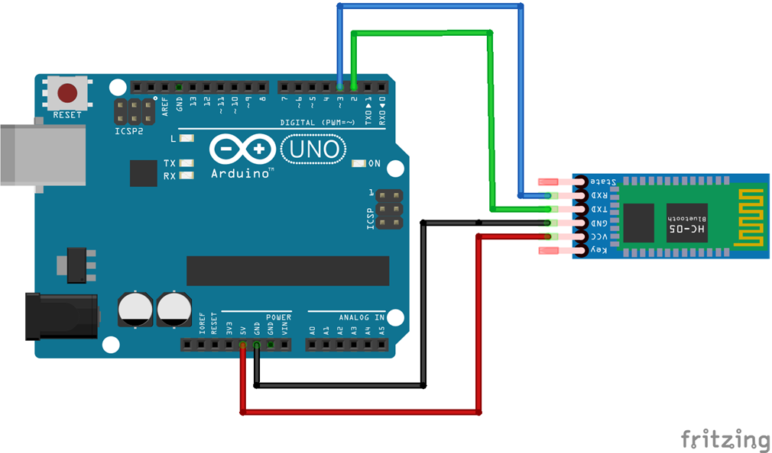
System Design
Circuit Diagram
In the following circuit diagram we can see how the Arduino board is connected to HC-05 Bluetooth module.

Slide 9
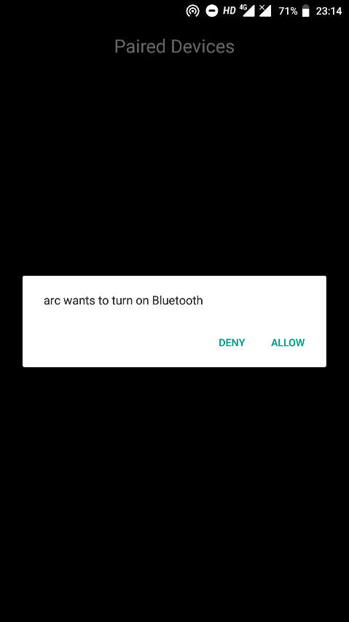
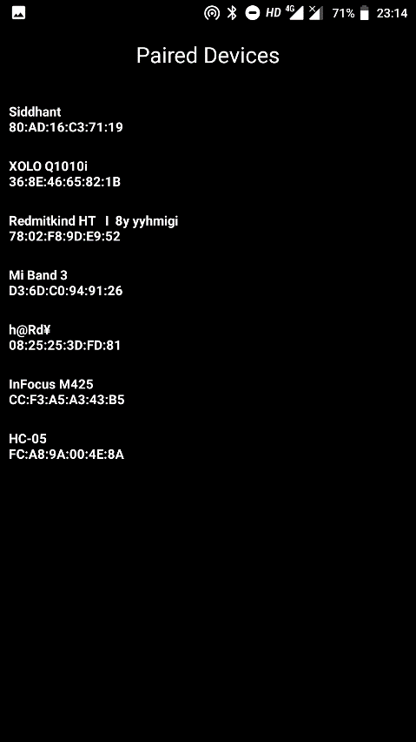
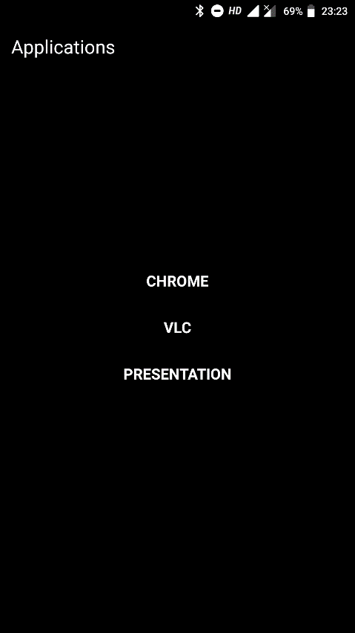
App User Interface

Slide 10
Implementation
Hardware Implementation:
The main communication takes place between the Bluetooth chip and Android device.
With the help of the ‘arc’ APK, we pass a string value to Arduino via Bluetooth chip.
The Arduino reads the value it gets from the chip and then prints it on the serial monitor/window.
The value printed on the serial monitor is a string.

Slide 11
Software Implementation:
Android app - The app works as a bridge between the user and computer application.
When you first run the app it will ask you to turn on the Bluetooth if it is off, then it will display all paired Bluetooth devices (If you have not paired your HC-05 chip then first pair it in device settings).
We have provided 3 computer applications in the android app - Chrome, vlc, and Presentation.
Each of the three apps in list contains buttons, shortcuts to various task inside the application on the computer.
For example, open a new tab in chrome, play/pause video, etc. Whenever a user clicks any button string value will be passed to Arduino which is a combination of key and value.

Slide 12
Limitation
The app triggers shortcuts of keyboards and every app has specific shortcuts predefined.
There is a possibility that two app has same shortcut combinations but different tasks.
For example, in chrome ‘ctrl + t‘ means open new tab but in MS word ‘ctrl + t‘ is create hanging indent so in this case if user clicks on open new tab button in android application but on computer MS word is focused then it will perform MS words shortcut ‘ctrl + t’ instead of chrome’s action open new tab.

Slide 13
Future Scope
Limitations like same shortcuts on different applications which executes app specific tasks can be corrected.
Communication takes place in string format so we can use key value string which consists of key name as application and value as the name of the application.

Slide 14
* Demonstration Of ARC *

Slide 15
Conclusion
We learned how to develop a software and also to develop it in a scheduled manner and a developed a way of controlling computer applications via Bluetooth using Arduino.
So we can develop more interactive and future ready smart controlling systems which can help us to reduce physical efforts and also to help physically disabled peoples.

Slide 16
Reference
www.wikipedia.com
www.howmechworks.com
Project MADE BY AVISHKAR ORG
System developed by DIY solutions

