Slide 1
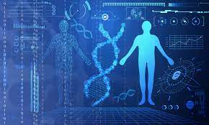
Unit 6: Applications of Bioinformatics
Dr. Pritam Chattopadhyay
Department of Botany
MUC Women’s College

Slide 2
Introduction
© Dr. Pritam Chattopadhyay

Slide 3
Major Applications:
Drug discovery
Drug Designing
Microbial genome application
Crop improvement
© Dr. Pritam Chattopadhyay

Slide 4
Structural Bioinformatics in Drug Discovery
© Dr. Pritam Chattopadhyay

Slide 5
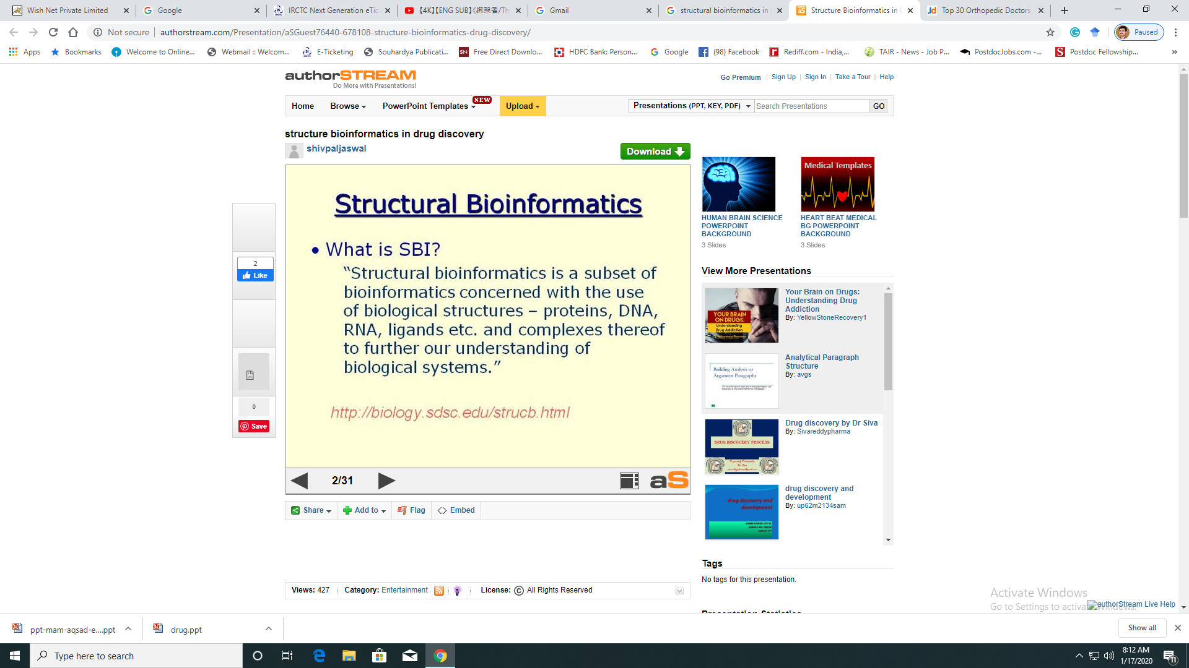
© Dr. Pritam Chattopadhyay

Slide 6
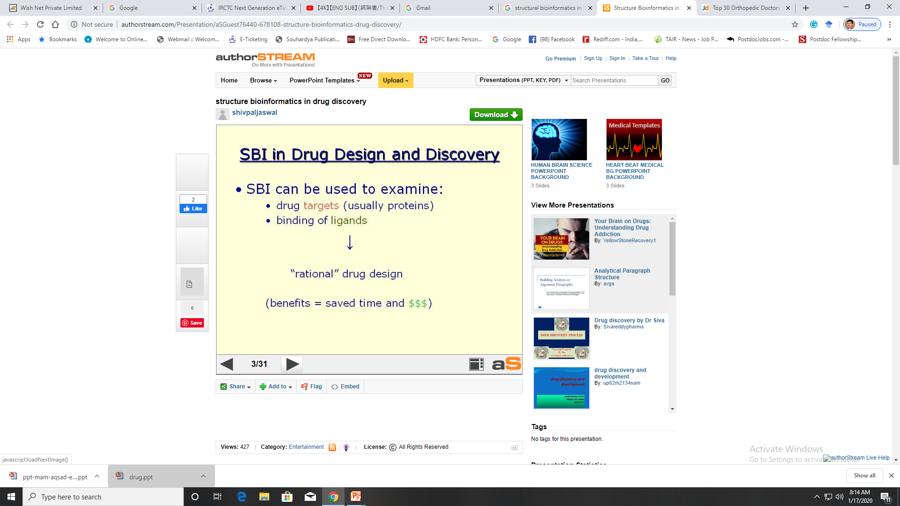
© Dr. Pritam Chattopadhyay

Slide 7
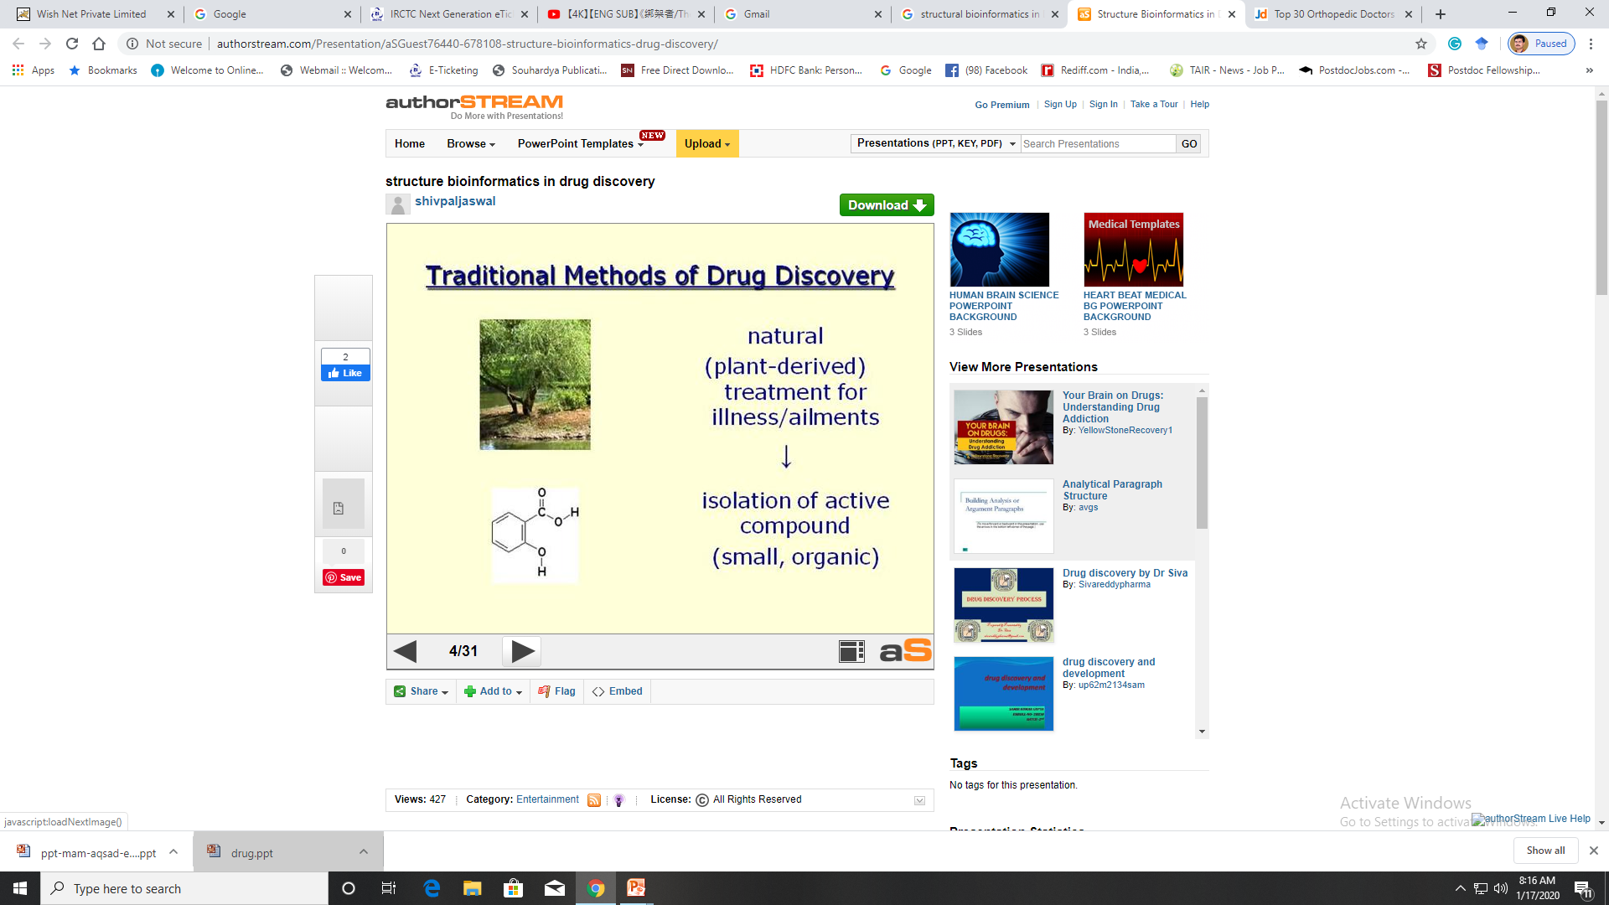
© Dr. Pritam Chattopadhyay

Slide 8
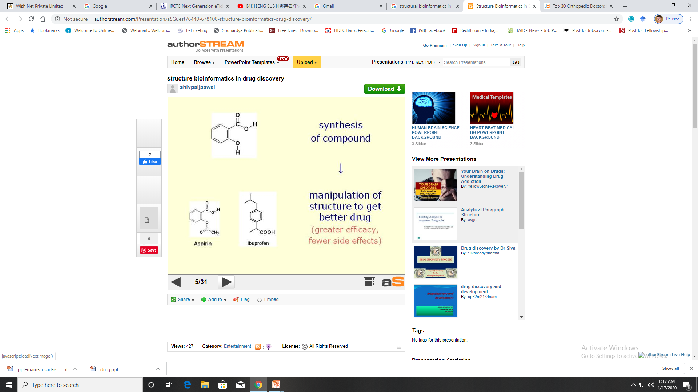
© Dr. Pritam Chattopadhyay

Slide 9
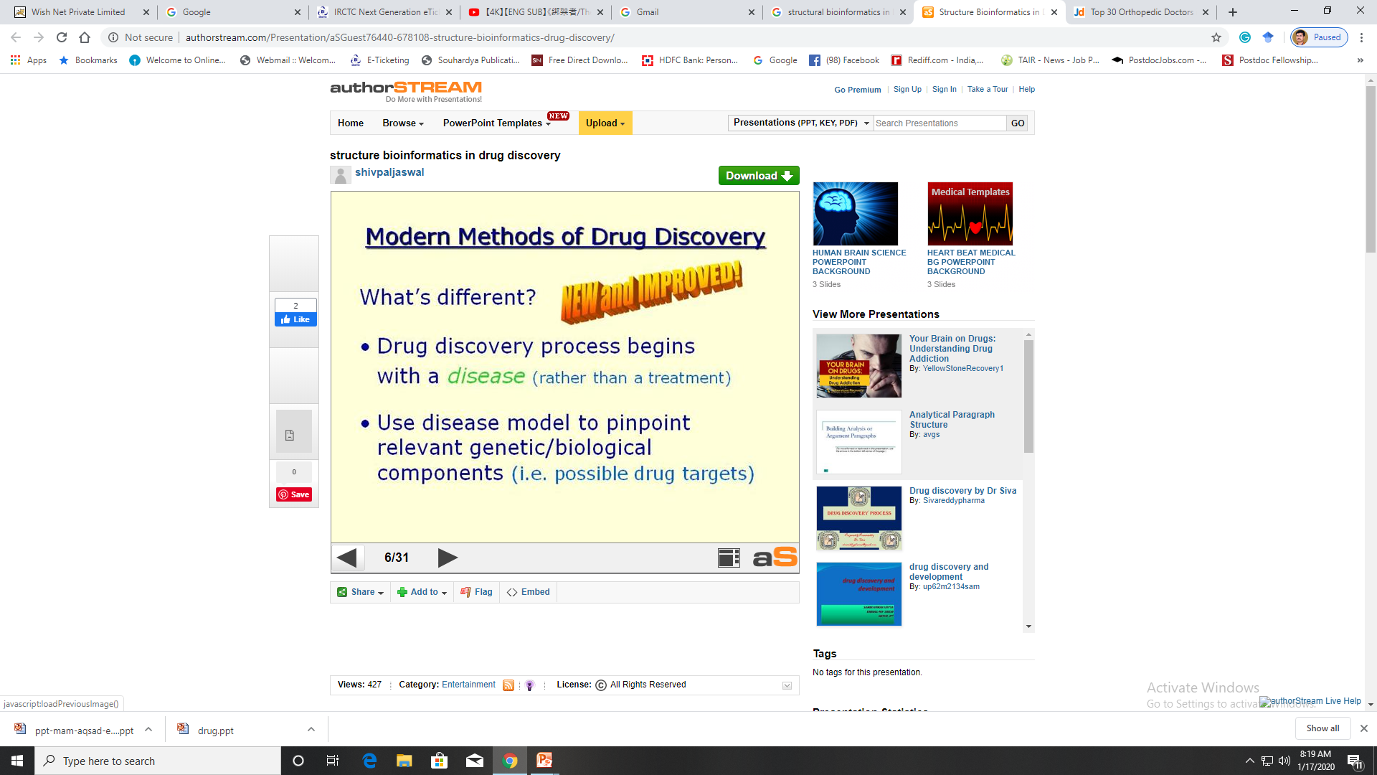
© Dr. Pritam Chattopadhyay

Slide 10
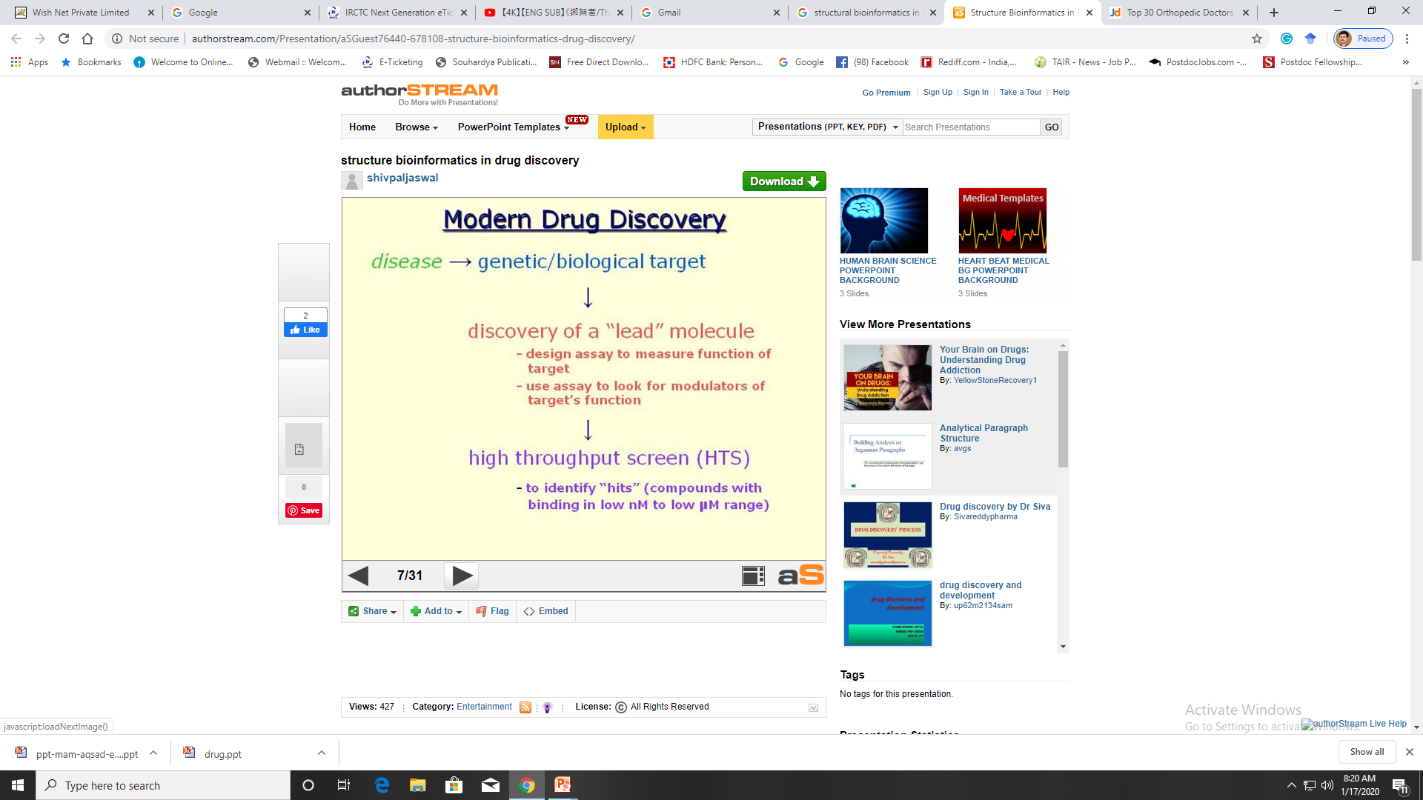
© Dr. Pritam Chattopadhyay

Slide 11
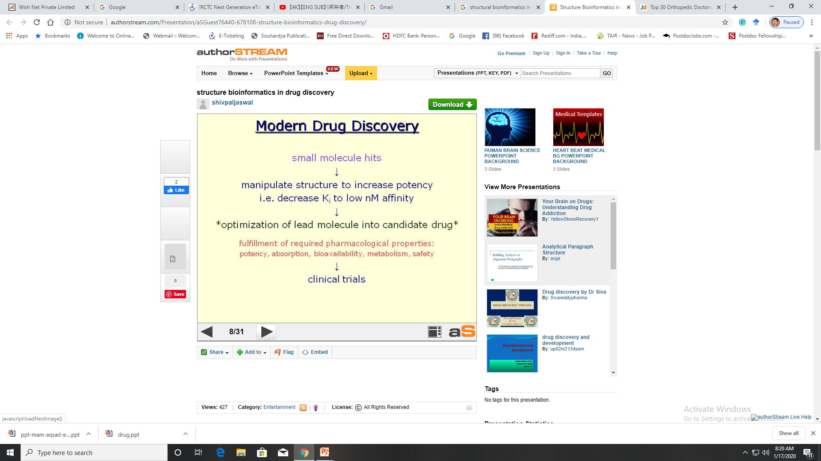
© Dr. Pritam Chattopadhyay

Slide 12
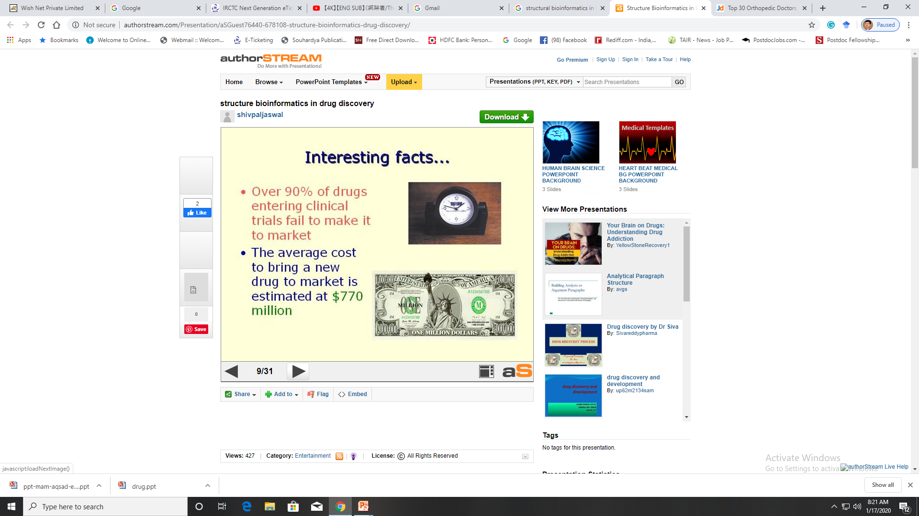
© Dr. Pritam Chattopadhyay

Slide 13
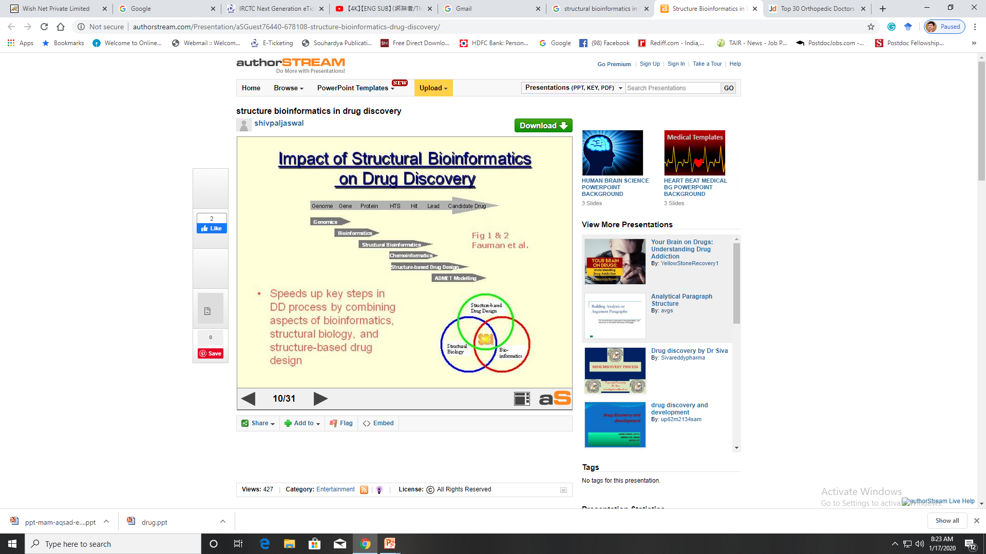
© Dr. Pritam Chattopadhyay

Slide 14
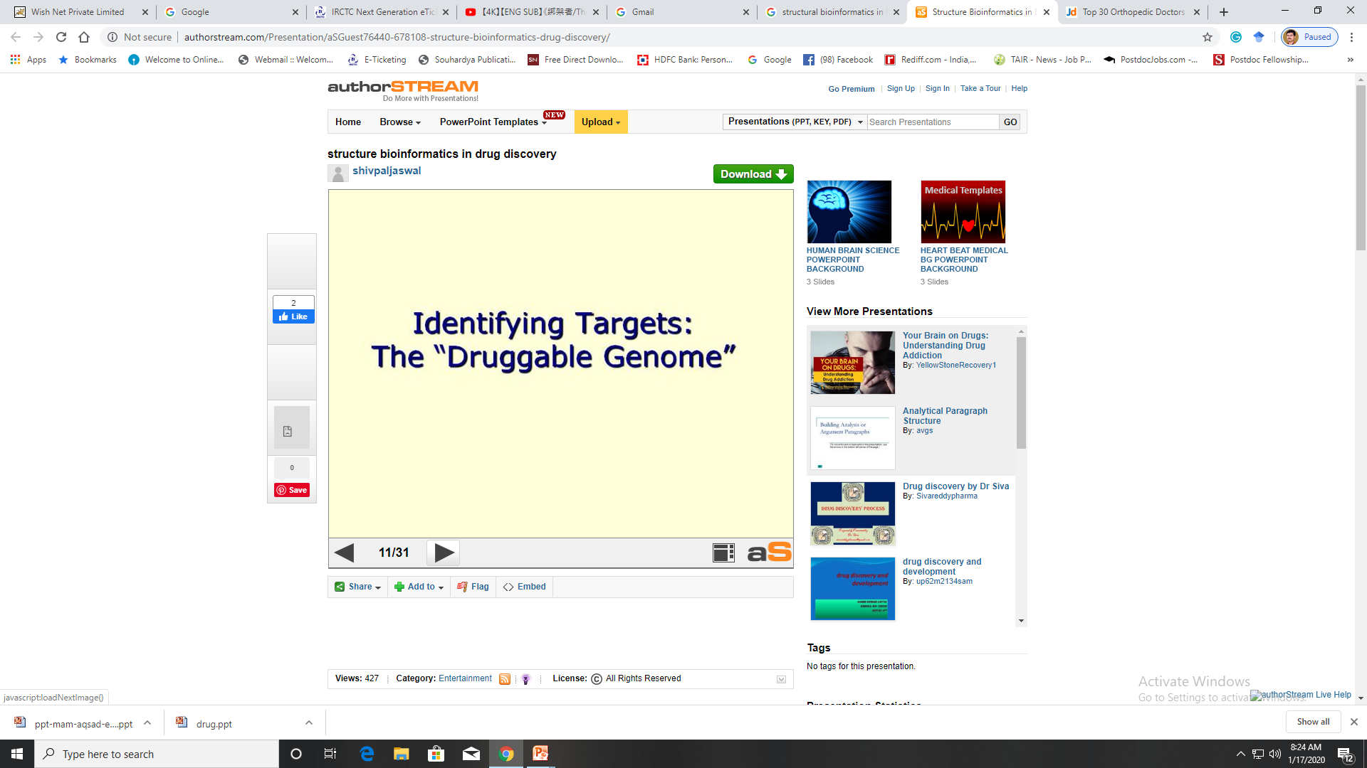
© Dr. Pritam Chattopadhyay

Slide 15
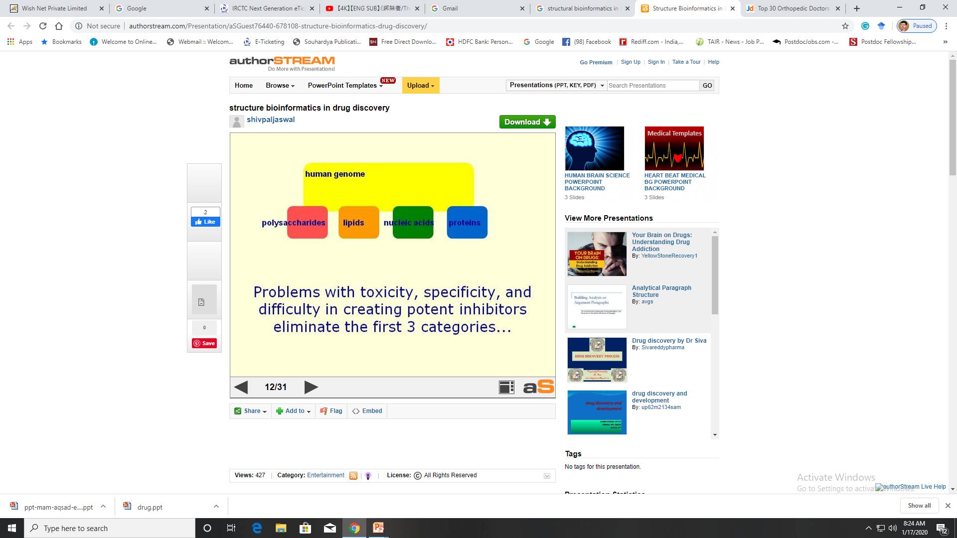
© Dr. Pritam Chattopadhyay

Slide 16
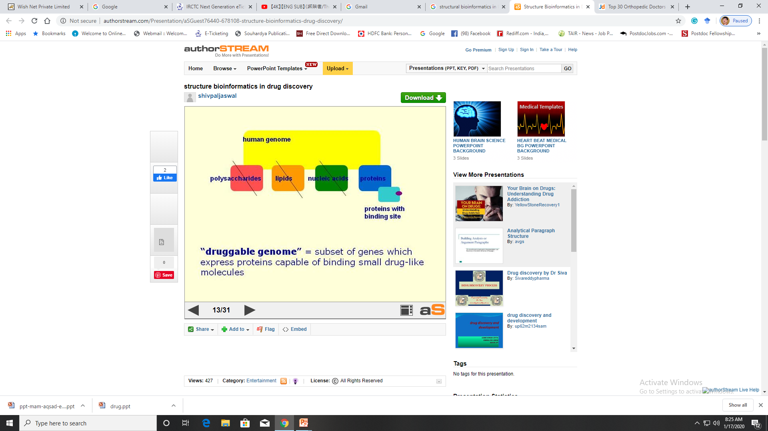
© Dr. Pritam Chattopadhyay

Slide 17
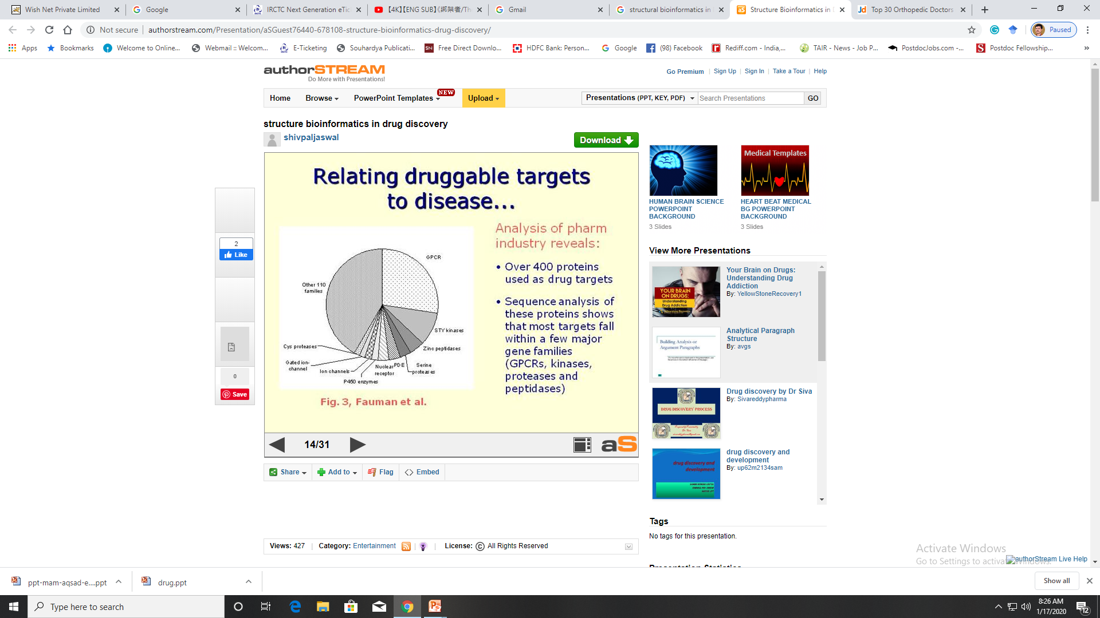
© Dr. Pritam Chattopadhyay

Slide 18
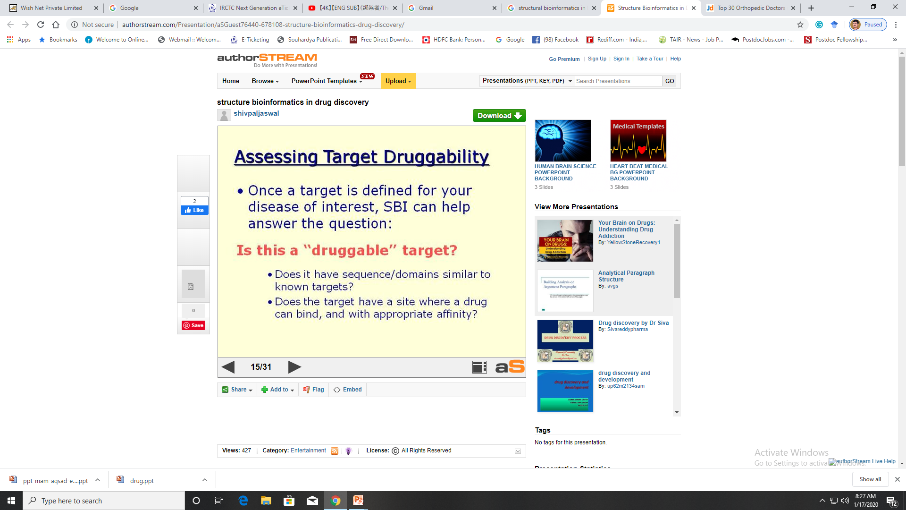
© Dr. Pritam Chattopadhyay

Slide 19
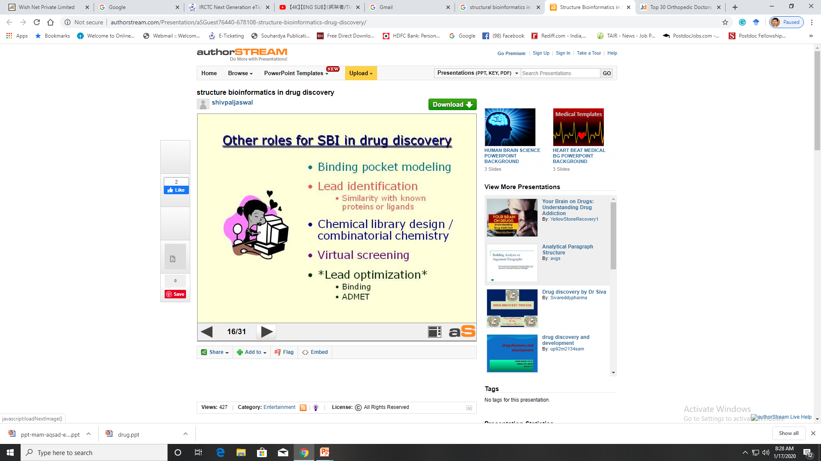
© Dr. Pritam Chattopadhyay

Slide 20
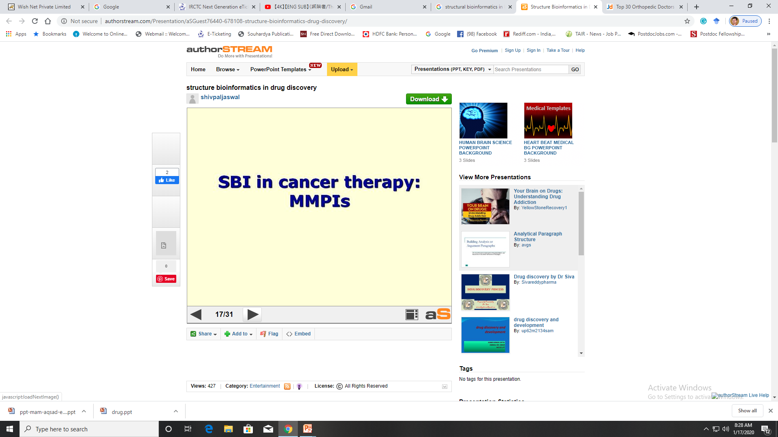
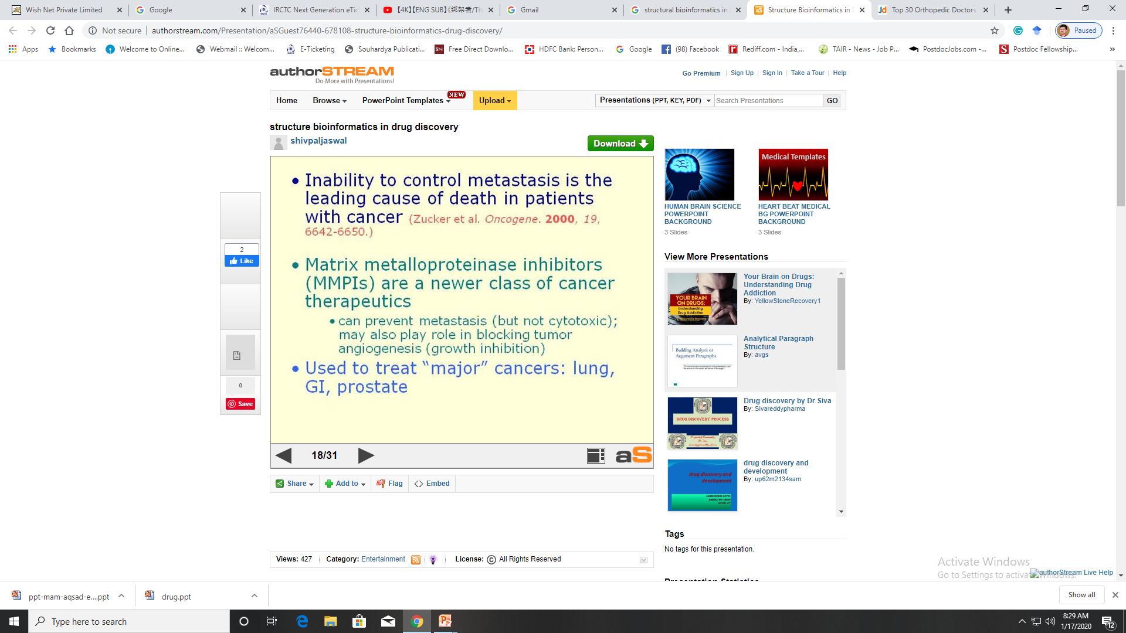
© Dr. Pritam Chattopadhyay

Slide 21
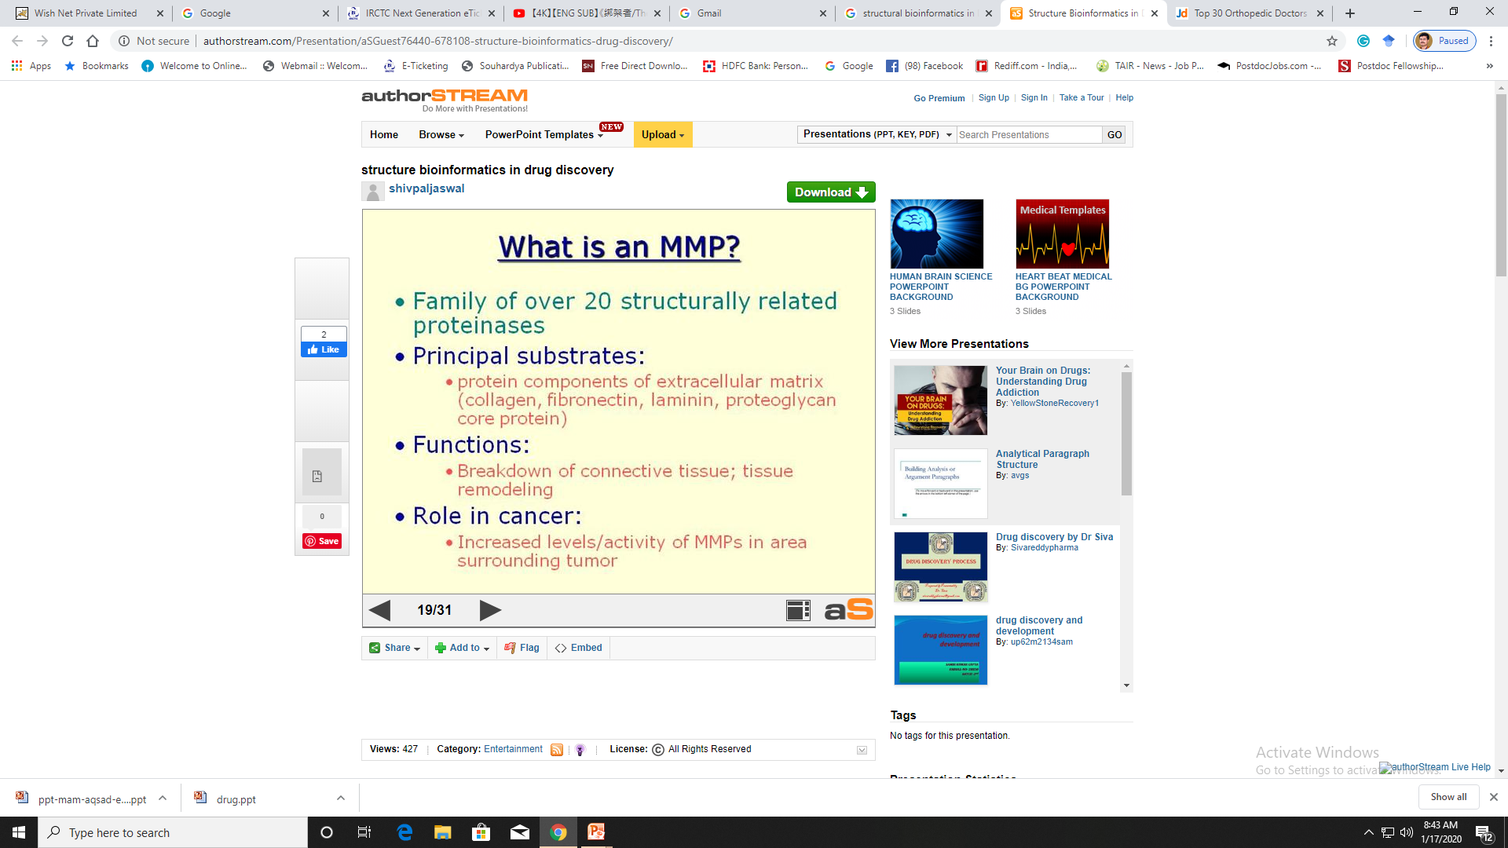
© Dr. Pritam Chattopadhyay

Slide 22
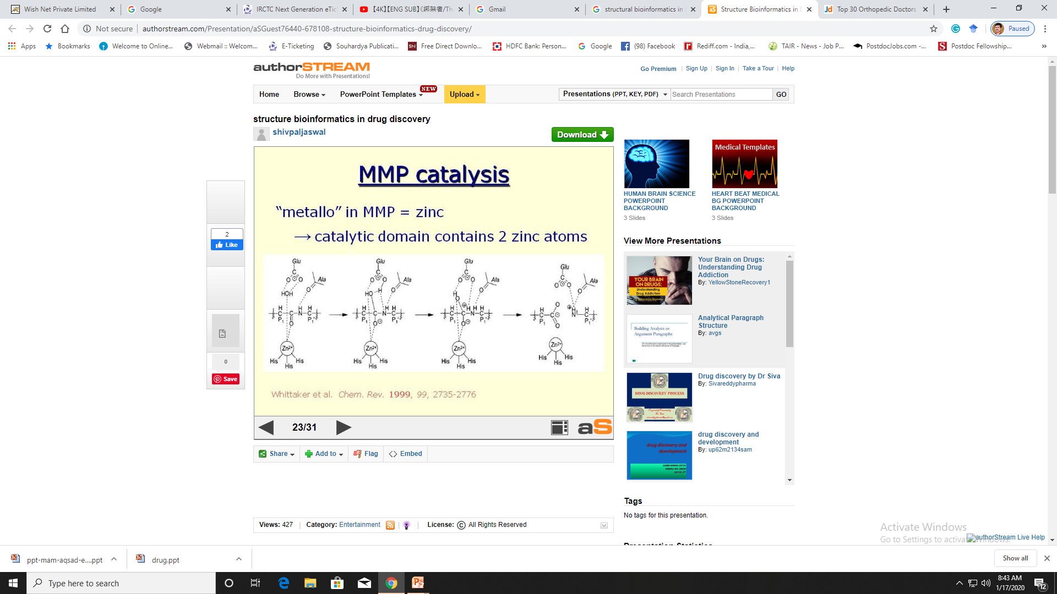
© Dr. Pritam Chattopadhyay

Slide 23
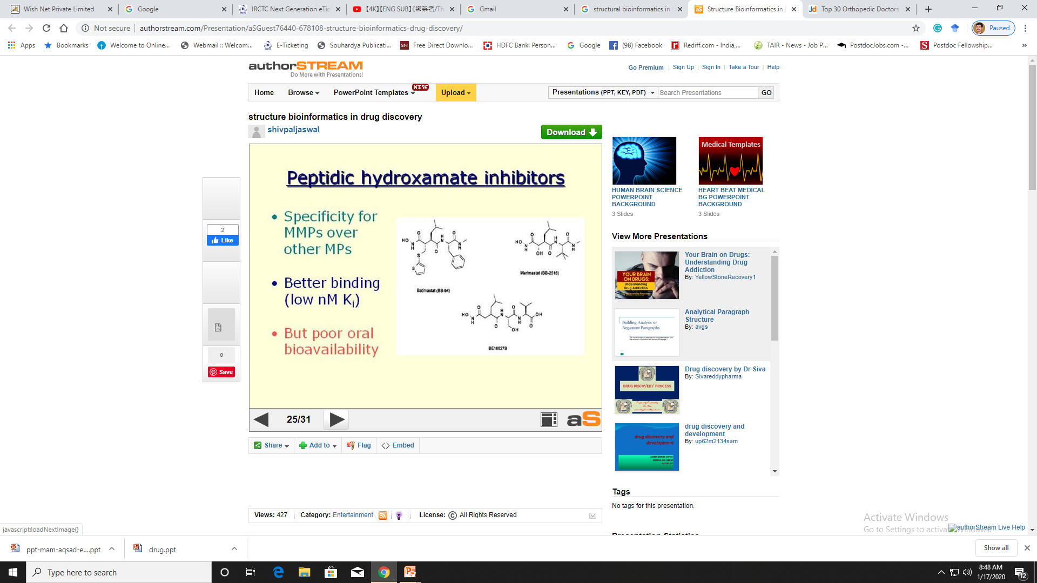
© Dr. Pritam Chattopadhyay

Slide 24
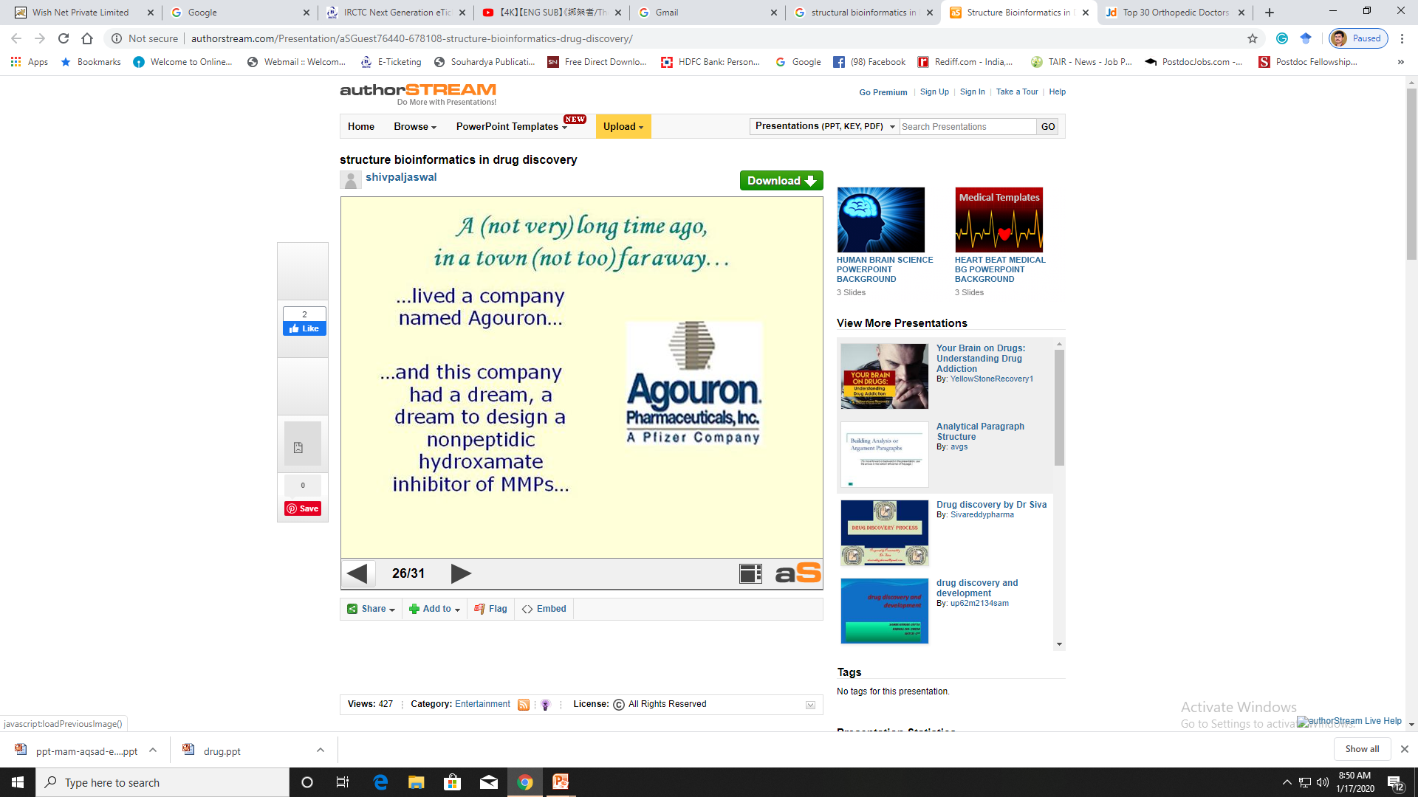
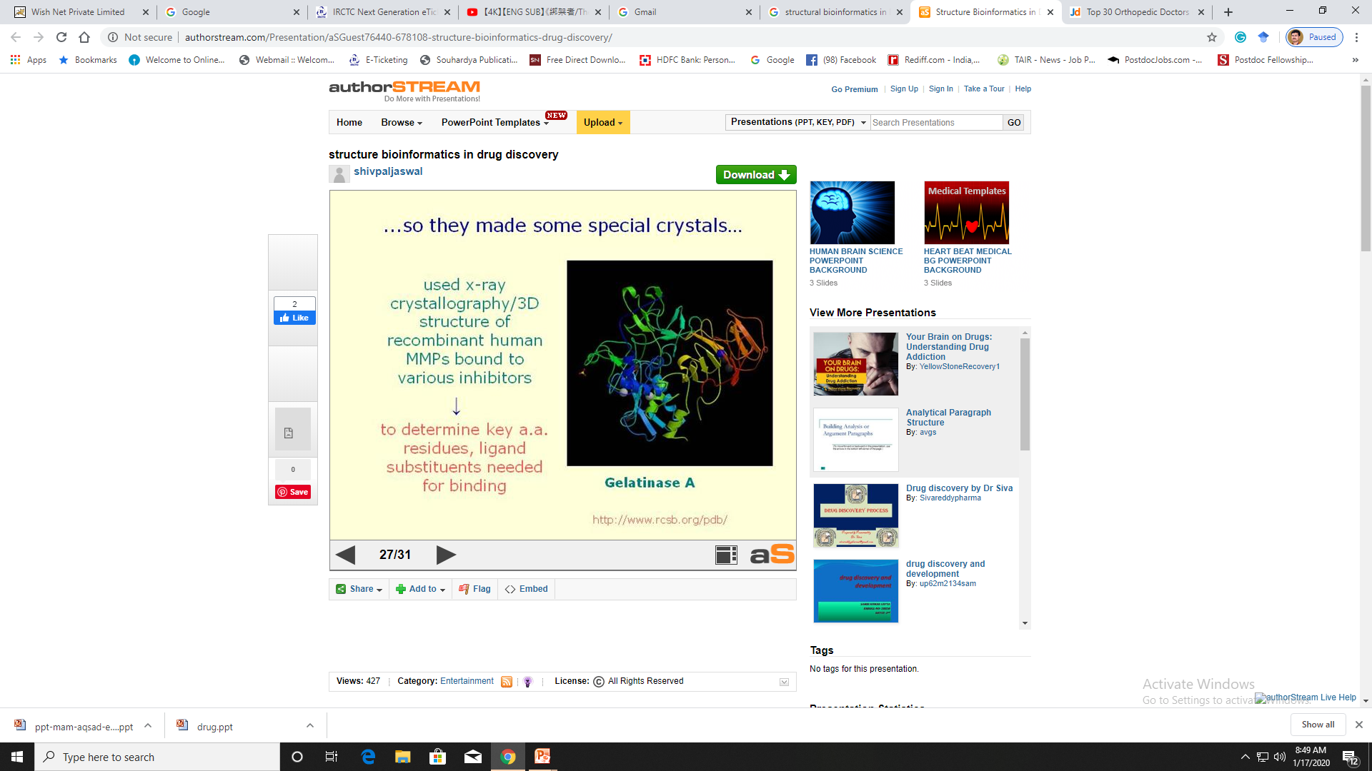
© Dr. Pritam Chattopadhyay

Slide 25
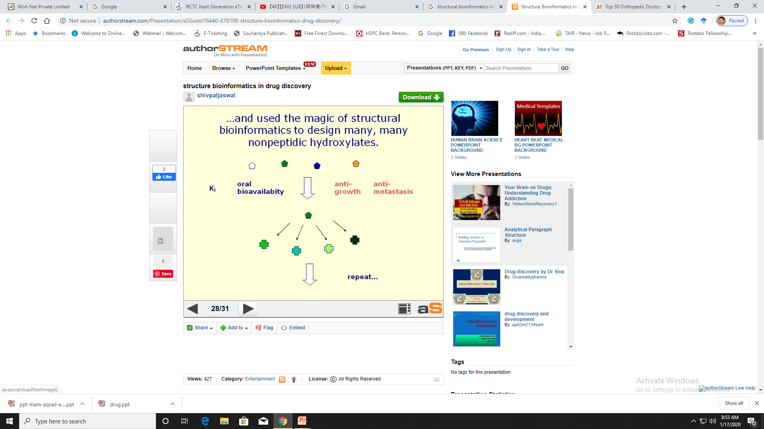
© Dr. Pritam Chattopadhyay

Slide 26
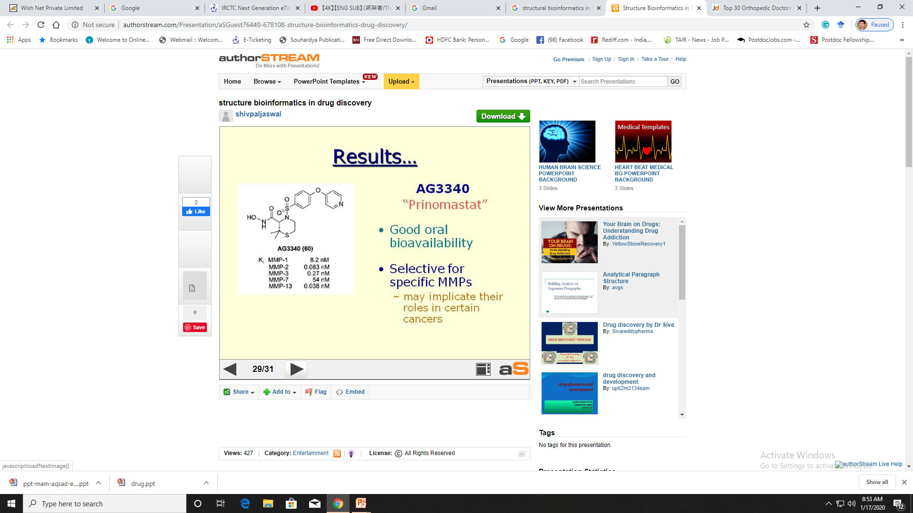
© Dr. Pritam Chattopadhyay

Slide 27
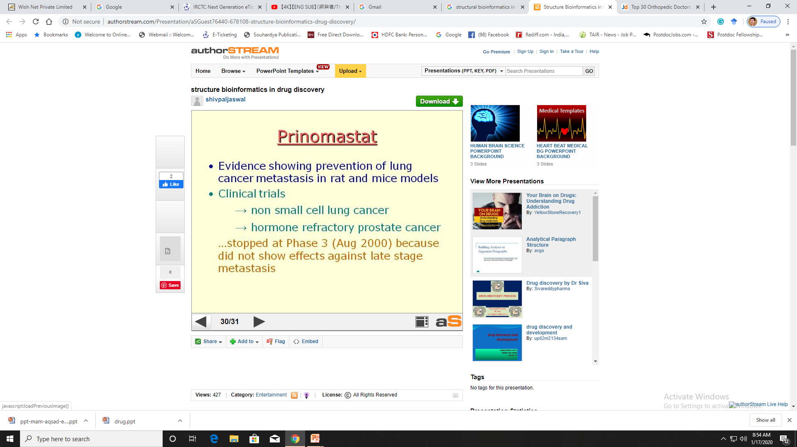
© Dr. Pritam Chattopadhyay

Slide 28
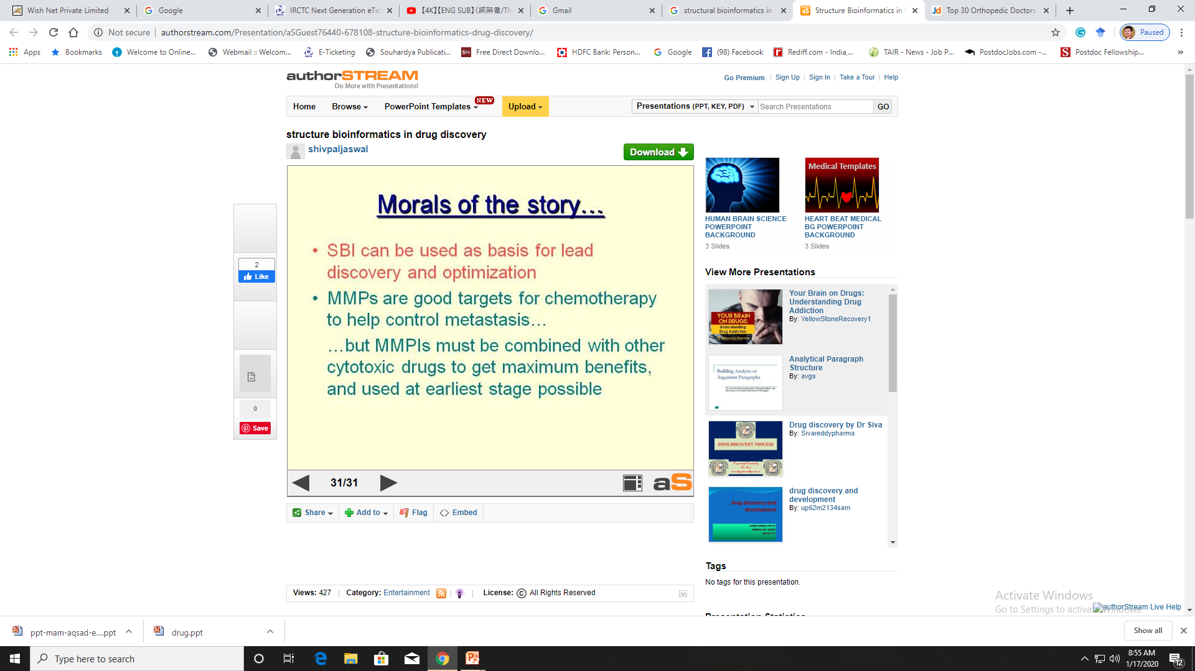
© Dr. Pritam Chattopadhyay

Slide 29
Benefits of Bioinformatics
To the patient:
  Better drug, better treatment
To the pharma:
  Save time, save cost, make more $
To the scientist:
  Better science
© Dr. Pritam Chattopadhyay

Slide 30
Quantitative structure-activity relationship (QSAR) techniques in Drug Design
© Dr. Pritam Chattopadhyay

Slide 31
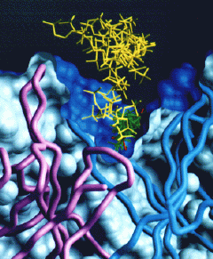
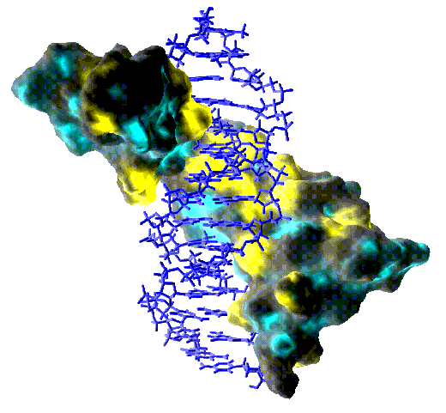
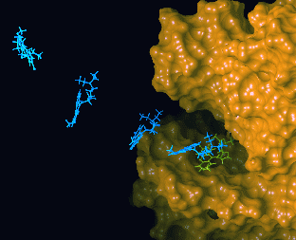
Drug Designing
Understanding How Structures Bind Other Molecules (Function)
Designing Inhibitors
Docking, Structure Modeling
  (From left to right, figures adapted from Olsen Group Docking Page at Scripps, Dyson NMR Group Web page at Scripps, and from Computational Chemistry Page at Cornell Theory Center).
© Dr. Pritam Chattopadhyay

Slide 32
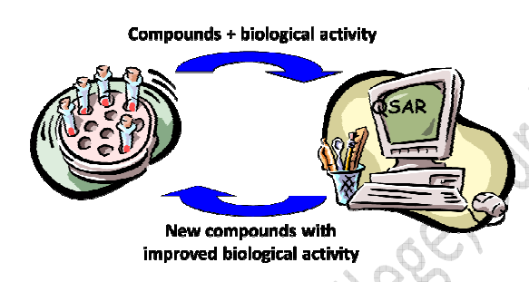
QSAR
Quantative Structure-Activity Relationships
© Dr. Pritam Chattopadhyay

Slide 33
Why QSAR?
The number of compounds required for synthesis in order to place 10 different groups in 4 positions of benzene ring is 10⁴
Solution: synthesize a small number of compounds and from their data derive rules to predict the biological activity of other compounds.
© Dr. Pritam Chattopadhyay

Slide 34
QSAR and Drug Design
Compounds + biological activity
QSAR
New compounds with improved biological activity
© Dr. Pritam Chattopadhyay

Slide 35
What is QSAR?
A QSAR is a mathematical relationship between a biological activity of a molecular system and its geometric and chemical characteristics.
QSAR attempts to find consistent relationship between biological activity and molecular properties, so that these “rules” can be used to evaluate the activity of new compounds.
© Dr. Pritam Chattopadhyay

Slide 36
Statistical Concepts
Input: n descriptors P₁,..P_{n} and the value of biological activity (EC50 for example) for m compounds.
P_{n} |  |  |  | ... | P₂ | P₁ | BioA
 |  |  |  |  |  | 3.7 | 0.7 | Cpd1
 |  |  |  |  |  | 0.4 | 3.2 | Cpd2
 |  |  |  |  |  |  |  | …
 |  |  |  |  |  |  |  | Cpdm
© Dr. Pritam Chattopadhyay

Slide 37
Statistical Concepts
The problem of QSAR is to find coefficients C₀,C₁,...C_{n} such that:
Biological activity = C₀+(C₁*P₁)+...+(C_{n}*P_{n})
and the prediction error is minimized for a list of given m compounds.
Partial least squares (PLS) is a technique used for computation of the coefficients of structural descriptors.
© Dr. Pritam Chattopadhyay

Slide 38
3D-QSAR
Structural descriptors are of immense importance in every QSAR model.
Common structural descriptors are pharmacophores and molecular fields.
Superimposition of the molecules is necessary.
3D data has to be converted to 1D in order to use PLS.
© Dr. Pritam Chattopadhyay

Slide 39
3D-QSAR Assumptions
The effect is produced by modeled compound and not it’s metabolites.
The proposed conformation is the bioactive one.
The binding site is the same for all modeled compounds.
The biological activity is largely explained by enthalpic processes.
Entropic terms are similar for all the compounds.
The system is considered to be at equilibrium, and kinetics aspects are usually not considered.
Pharmacokinetics: solvent effects, diffusion, transport are not included.
© Dr. Pritam Chattopadhyay

Slide 40



QSAR and 3D-QSAR Software
Tripos – CoMFA, VolSurf
MSI – Catalyst, Serius
Docking Software
DOCK – Kuntz
Flex – Lengauer
LigandFit – MSI Catalyst
© Dr. Pritam Chattopadhyay

Slide 41
3D molecular fields
A molecular field may be represented by 3D grid.
Each voxel represents attractive and repulsive forces between an interacting partner and a target molecule.
An interacting partner can be water, octanol or other solvents.
© Dr. Pritam Chattopadhyay

Slide 42
Common 3D molecular fields
MEP – Molecular Electrostatic Potential (unit positive charge probe).
MLP – Molecular Lipophilicity Potential (no probe necessary).
GRID – total energy of interaction: the sum of steric (Lennard-Jones), H-bonding and electrostatics (any probe can be used).
CoMFA – standard: steric and electrostatic, additional: H-bonding, indicator, parabolic and others.
© Dr. Pritam Chattopadhyay

Slide 43
Comparative Molecular Field Analysis (CoMFA) - 1988
Compute molecular fields grid
Extract 3D descriptors
Compute coefficients of QSAR equation
© Dr. Pritam Chattopadhyay

Slide 44
CoMFA molecular fields
A grid wit energy fields is calculated by placing a probe atom at each voxel.
The molecular fields are:
Steric (Lennard-Jones) interactions
Electrostatic (Coulombic) interactions
A probe is sp³ carbon atom with charge of +1.0
© Dr. Pritam Chattopadhyay

Slide 45
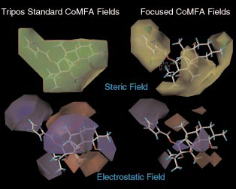
© Dr. Pritam Chattopadhyay

Slide 46
CoMFA 3D-QSAR
Each grid voxel corresponds to two variables in QSAR equation: steric and electrostatic.
The PLS technique is applied to compute the coefficients.
Problems:
Superposition: the molecules must be optimally aligned.
Flexibility of the molecules.
© Dr. Pritam Chattopadhyay

Slide 47
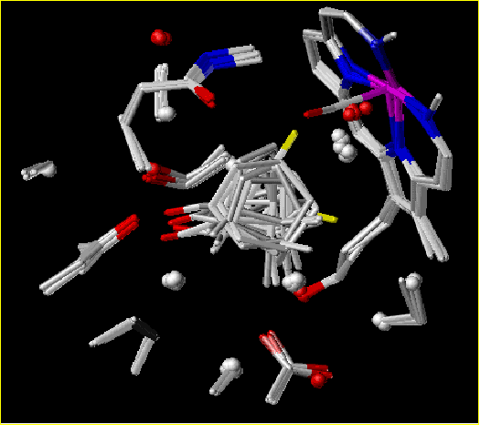
3D-QSAR of CYP450_{cam} with CoMFA
Training dataset from 15 complexes of CYP450 with different compounds was used.
The alignment of the compounds was done by aligning of the CYP450 proteins from the complexes.
© Dr. Pritam Chattopadhyay

Slide 48
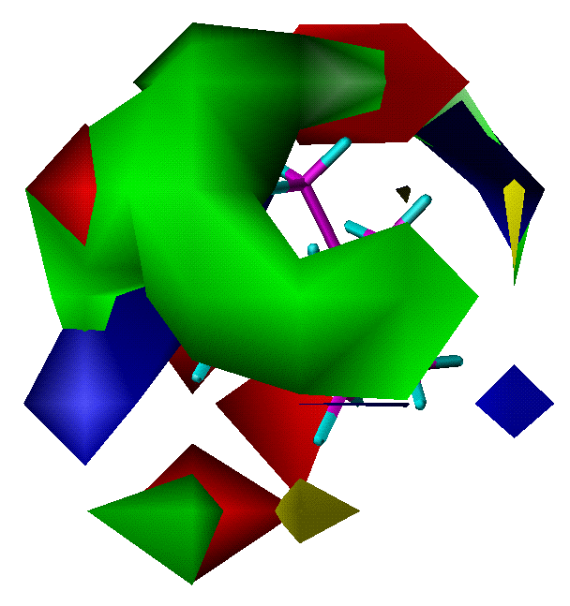
3D-QSAR of CYP450_{cam} with CoMFA
Maps of electrostatic fields:
BLUE - positive charges
RED - negative charges
Maps of steric fields:
GREEN - space filling areas for best Kd
YELLOW - space conflicting areas
© Dr. Pritam Chattopadhyay

Slide 49
VOLSURF
The VolSurf program predicts a variety of ADME properties based on pre-calculated models. The models included are:
drug solubility
Caco-2 cell absorption
blood-brain barrier permeation
distribution
© Dr. Pritam Chattopadhyay

Slide 50
VOLSURF
VolSurf reads or computes molecular fields, translates them to simple molecular descriptors by image processing techniques.
These descriptors quantitatively characterize size, shape, polarity, and hydrophobicity of molecules, and the balance between them.
© Dr. Pritam Chattopadhyay

Slide 51
VOLSURF Descriptors
Size and shape: volume V, surface area S, ratio volume surface V/S, globularity S/S_{equiv} (S_{equiv} is the surface area of a sphere of volume V).
Hydrophilic: hydrophilic surface area HS, capacity factor HS/S.
Hydrophobic: like hydrophilic LS, LS/S.
Interaction energy moments: vectors pointing from the center of the mass to the center of hydrophobic/hydrophilic regions.
Mixed: local interaction energy minima, energy minima distances, hydrophilic-lipophilic balance HS/LS, amphiphilic moments, packing parameters, H-bonding, polarisability.
© Dr. Pritam Chattopadhyay

Slide 52
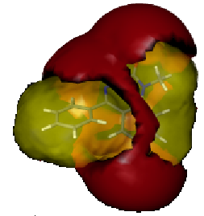
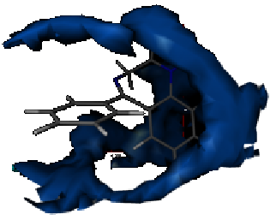
VOLSURF
hydrophobic (blue) and hydrophilic (red) surface area of diazepam.
© Dr. Pritam Chattopadhyay

Slide 53
Catalyst
Catalyst develops 3D models (pharmacophores) from a collection of molecules possessing a range of diversity in both structures and activities.
Catalyst specifies hypotheses in terms of chemical features that are likely to be important for binding to the active site.
Each feature consists of four parts:
  Chemical function
  Location and orientation in 3D space
  Tolerance in location
  Weight
© Dr. Pritam Chattopadhyay

Slide 54
Catalyst Features
HB Acceptor and Acceptor-Lipid
HB Donor
Hydrophobic
Hydrophobic aliphatic
Hydrophobic aromatic
Positive charge/Pos. Ionizable
Negative charge/Neg. Ionizable
Ring Aromatic
© Dr. Pritam Chattopadhyay

Slide 55
Catalyst HipHop
Feature-based pharmacophore modeling:
uses ONLY active ligands
no activity data required
identifies binding features for drug-receptor interactions
generates alignment of active leads
the flexibility is achieved by using multiple conformers
alignment can be used for 3D-QSAR analysis
© Dr. Pritam Chattopadhyay

Slide 56
Catalyst HipoGen
Activity-based pharmacophore modeling:
uses active + inactive ligands
activity data required (concentration)
identifies features common to actives missed by inactives
used to “predict” or estimate activity of new ligands
© Dr. Pritam Chattopadhyay

Slide 57
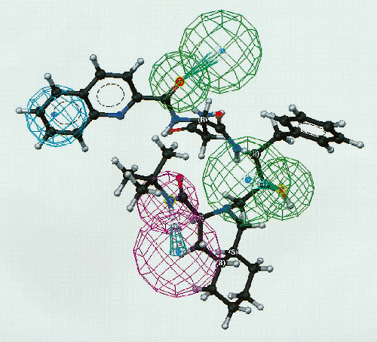
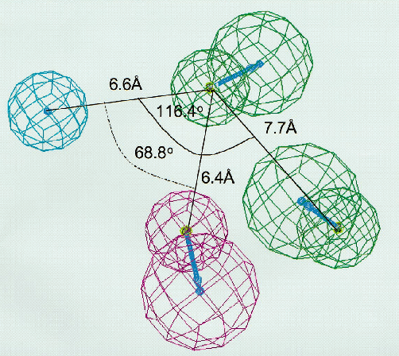
Catalyst CYP3A4 substrates pharmacophore
Hydrophobic area, h-bond donor, 2 h-bond acceptors
Saquinavir (most active compound) fitted to pharmacophore
© Dr. Pritam Chattopadhyay

Slide 58
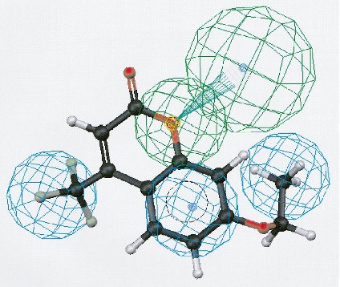
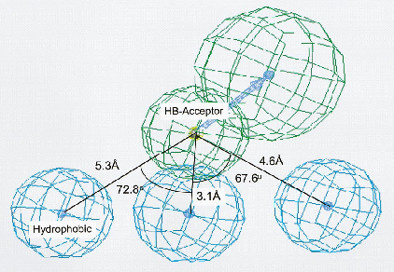
Catalyst CYP2B6 substrates pharmacophore
7-ethoxy-4-trifluoromethylcoumarin fitted to pharmacophore
3 hydrophobic areas, h-bond acceptor
© Dr. Pritam Chattopadhyay

Slide 59
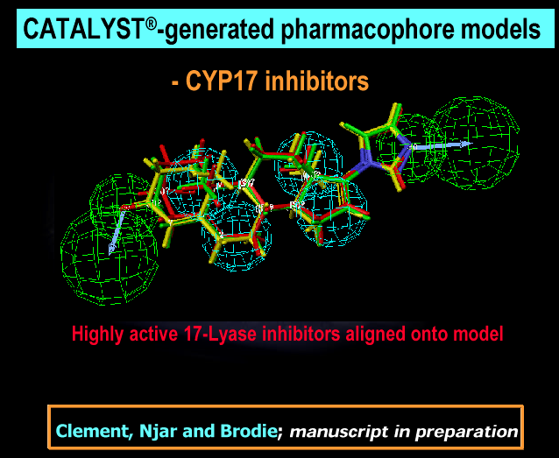
© Dr. Pritam Chattopadhyay

Slide 60
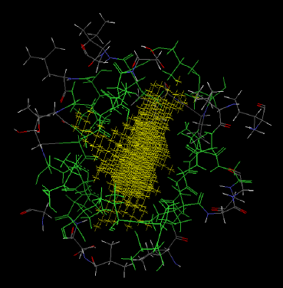
Catalyst Docking – Ligand Fit
Active site finding
Conformation search of ligand against site
Rapid shape filter
determines which
conformations should be scored
Grid-based scoring for those
conformations passing the filter
© Dr. Pritam Chattopadhyay

Slide 61
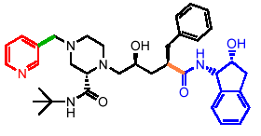
Catalyst Docking – Ligand Flexibility
Monte Carlo search in torsional space
Multiple torsion changes simultaneously
The random window size depends on the number of rotating atoms
© Dr. Pritam Chattopadhyay

Slide 62
Catalyst Docking – Scoring
pKi = – c – x (vdW_Exact/ Grid_Soft)
+ y (C+_pol)
– z (Totpol^ 2)
vdW = softened Lennard-Jones 6-9 potential
C+_pol = buried polar surface area involved in attractive ligand-protein interactions
Totpol^ 2 = buried polar surface area involved in both attractive and repulsive protein-ligand interactions
© Dr. Pritam Chattopadhyay

Slide 63
3D-QSAR of CYP450_{cam} with DOCK
Goal:
Test the ability of DOCK to discriminate between substrates and non-substrates.
Assumption:
Non-substrate candidate is a compound that doesn’t fit to the active site of CYP, but fits to the site of it’s L244A mutant.
© Dr. Pritam Chattopadhyay

Slide 64
Methods
Docking of 20,000 compounds to ‘bound’ structure of CYP and L244A mutant.
11 substrate candidates were selected from 500 high scoring compounds for CYP.
6 non-substrate candidates were selected from a difference list of L244A and CYP.
Optimization of compounds 3D structures by SYBYL molecular mechanics program and re-docking. As a result 2 compounds move from “non-substrate” list to “substrate” list and one in the opposite direction.
© Dr. Pritam Chattopadhyay

Slide 65
Prediction Results
All compounds predicted as “non-substrates” shown no biological activity.
4 of the 11 molecules predicted as “substrates” were found as non-substrates.
The predictions of DOCK are sensitive to the parameter of minimum distance allowed between an atom of the ligand and the receptor (penetration constrains).
© Dr. Pritam Chattopadhyay

Slide 66
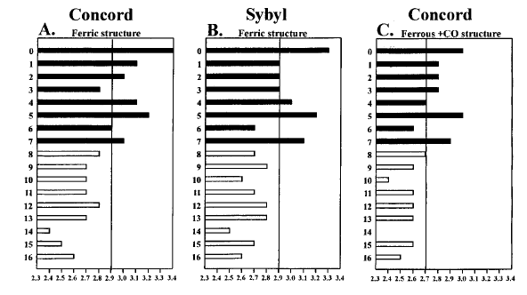
Prediction Results
© Dr. Pritam Chattopadhyay

Slide 67
Microbial genome applications
© Dr. Pritam Chattopadhyay

Slide 68
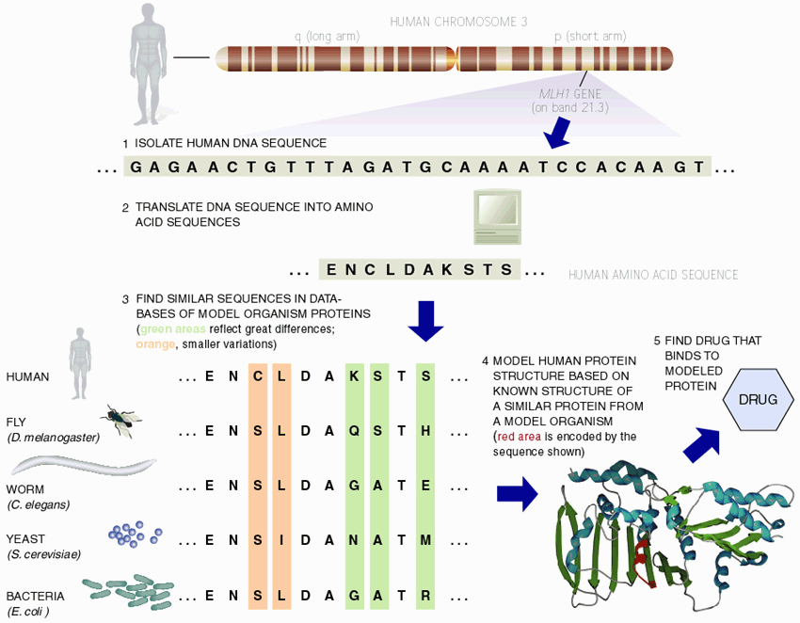
Finding Homologues
Implicated in
Colorectal cancer
© Dr. Pritam Chattopadhyay

Slide 69
Finding Homologues
Find Similar Ones in Different Organisms
Human vs. Mouse vs. Yeast
  Easier to do expts. on latter!
  (Section from NCBI Disease Genes Database Reproduced Below.)
Best Sequence Similarity Matches to Date Between Positionally Cloned
Human Genes and S. cerevisiae Proteins
Human Disease MIM # Human GenBank BLASTX Yeast GenBank Yeast Gene
Gene Acc# for P-value Gene Acc# for Description
Human cDNA Yeast cDNA
Hereditary Non-polyposis Colon Cancer 120436 MSH2 U03911 9.2e-261 MSH2 M84170 DNA repair protein
Hereditary Non-polyposis Colon Cancer 120436 MLH1 U07418 6.3e-196 MLH1 U07187 DNA repair protein
Cystic Fibrosis 219700 CFTR M28668 1.3e-167 YCF1 L35237 Metal resistance protein
Wilson Disease 277900 WND U11700 5.9e-161 CCC2 L36317 Probable copper transporter
Glycerol Kinase Deficiency 307030 GK L13943 1.8e-129 GUT1 X69049 Glycerol kinase
Bloom Syndrome 210900 BLM U39817 2.6e-119 SGS1 U22341 Helicase
Adrenoleukodystrophy, X-linked 300100 ALD Z21876 3.4e-107 PXA1 U17065 Peroxisomal ABC transporter
Ataxia Telangiectasia 208900 ATM U26455 2.8e-90 TEL1 U31331 PI3 kinase
Amyotrophic Lateral Sclerosis 105400 SOD1 K00065 2.0e-58 SOD1 J03279 Superoxide dismutase
Myotonic Dystrophy 160900 DM L19268 5.4e-53 YPK1 M21307 Serine/threonine protein kinase
Lowe Syndrome 309000 OCRL M88162 1.2e-47 YIL002C Z47047 Putative IPP-5-phosphatase
Neurofibromatosis, Type 1 162200 NF1 M89914 2.0e-46 IRA2 M33779 Inhibitory regulator protein
Choroideremia 303100 CHM X78121 2.1e-42 GDI1 S69371 GDP dissociation inhibitor
Diastrophic Dysplasia 222600 DTD U14528 7.2e-38 SUL1 X82013 Sulfate permease
Lissencephaly 247200 LIS1 L13385 1.7e-34 MET30 L26505 Methionine metabolism
Thomsen Disease 160800 CLC1 Z25884 7.9e-31 GEF1 Z23117 Voltage-gated chloride channel
Wilms Tumor 194070 WT1 X51630 1.1e-20 FZF1 X67787 Sulphite resistance protein
Achondroplasia 100800 FGFR3 M58051 2.0e-18 IPL1 U07163 Serine/threoinine protein kinase
Menkes Syndrome 309400 MNK X69208 2.1e-17 CCC2 L36317 Probable copper transporter
© Dr. Pritam Chattopadhyay

Slide 70
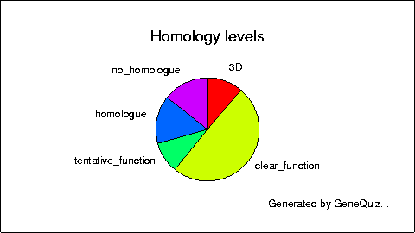
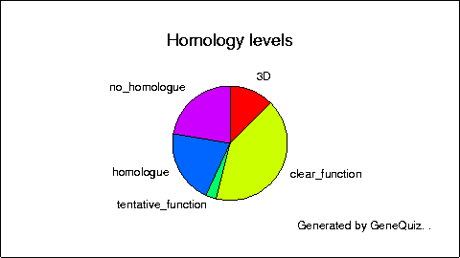
Overall Genome Characterization
Overall Occurrence of a certain feature in the genome
  e.g. how many kinases in Yeast
Compare Organisms and Tissues
  Expression levels in Cancerous vs Normal Tissues
Relationships within a specie and across species
© Dr. Pritam Chattopadhyay

Slide 71
Web resources for microbial genomes
TIGR CMR
  Comprehensive microbial resource
NCBI
  BLAST
  Individual species sites
Custom websites
  Subtilist
  Colibri
© Dr. Pritam Chattopadhyay

Slide 72
Microbial Genomes Applications
Features
Analysis
Role of high-throughput sequencing
Yeast - the eukaryotic model microbe
Databases
  TIGR CMR
  NCBI Microbial Genomes
© Dr. Pritam Chattopadhyay

Slide 73
Genome of the week - Haemophilus influenzae
First microbial genome completely sequenced.
  Took one year from start to finish. (E. coli took 7).
First genome sequenced by the shotgun method.
Sequenced at TIGR in 1995.
Started 4 years after the E. coli genome sequencing project and finished 2 years ahead!
© Dr. Pritam Chattopadhyay

Slide 74
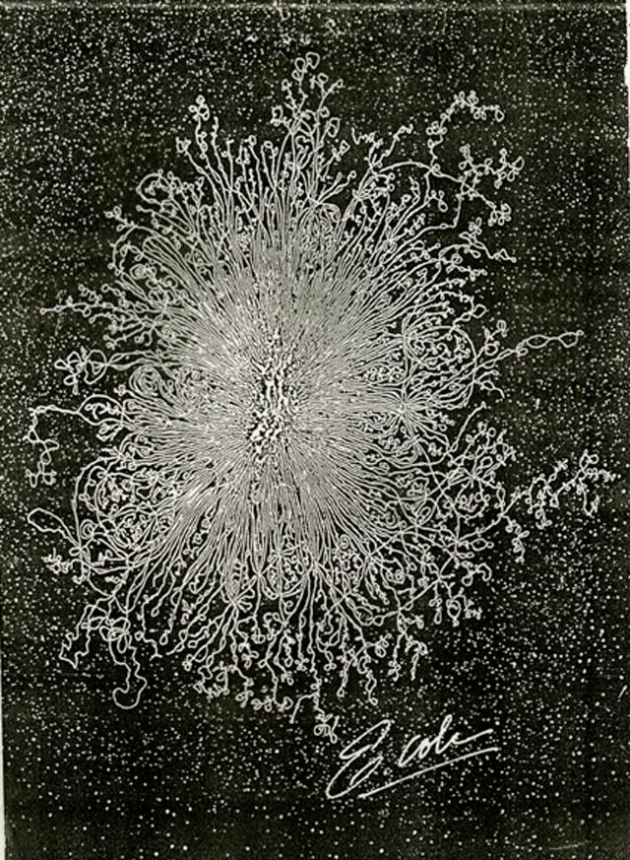
E. coli nucleoid
© Dr. Pritam Chattopadhyay

Slide 75
Microbial Genome - old view (E. coli)
Single chromosome.
Circular.
Replication initiates from a single fixed origin.
Little or no horizontal gene transfer.
© Dr. Pritam Chattopadhyay

Slide 76
Microbial Genome - new view
Bacteria can contain more than one chromosome.
Bacterial chromosomes can be linear.
Horizontal gene transfer is common!
© Dr. Pritam Chattopadhyay

Slide 77
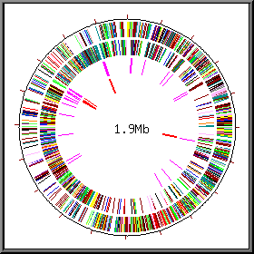
Features of microbial genomes
4 bases -A,G,C,T
© Dr. Pritam Chattopadhyay

Slide 78
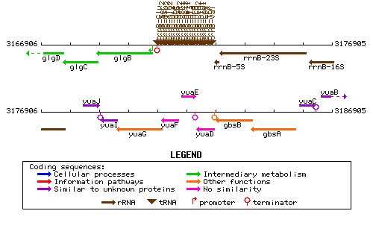
© Dr. Pritam Chattopadhyay

Slide 79
Establishing gene function - bioinformatics can only get you so far
Book - claims that over 75% of genes can be assigned function.
  Genomes in table 1.4 - doesn’t support this claim.
  Many annotations suggest biochemical role, not biological function.
  Many annotations need to be verified experimentally.
  Some annotations are wrong.
© Dr. Pritam Chattopadhyay

Slide 80
Microbial genome sequencing projects
330 bacteria, 23 archaea, 60 eukaryotic genome projects available for analysis at the NCBI website.
487microbial genomes completed or currently being sequenced.
© Dr. Pritam Chattopadhyay

Slide 81
Why sequence so many microbial genomes?
  Develop technology for human genome project
  Examine the genomes of a wide range of microbes
    Novel drug/vaccine targets
    Identify new agricultural and industrial important enzymes
    Comparative genomics/evolution
    Sequence microbes that have no genetics
    Sequence microbes we can’t culture - metagenomics
  Because we can.
    Financially feasible to sequence entire genomes.
© Dr. Pritam Chattopadhyay

Slide 82
Minimal Genome
Fewest amount of genes necessary for life.
~250-350
  Experimentally - disrupting every gene in a genome.
  Bioinformatics - comparative analysis of sequenced.
© Dr. Pritam Chattopadhyay

Slide 83

© Dr. Pritam Chattopadhyay

Slide 84
Crop improvement
© Dr. Pritam Chattopadhyay

Slide 85
Application of Bioinformatics in Crop Plants
Bioinformatics have number of applications in plants:
1. Single gene analysis - Single gene analysis include DNA, RNA and protein sequences. These are the most fundamental at the molecular level.
2. Biochemical pathways - KEGG (Kyoto Encyclopedia of Genes and Genomes) is a database that contain contains all the metabolic pathways which help in understanding the high level function and utilities of the biological system.
3. Molecular techniques - There are some online tools for the designing of primer. Eg: primer premier, Primer3, GenScript.
© Dr. Pritam Chattopadhyay

Slide 86
4. Sequence similarity -NCBI (National Centre for Biotechnology Information) tool and BLAST (Basic Local Alignment Search Tool) use dynamic programming algorithm which helps in searching of similarity between two different species. The dynamic programming finds the similarity between two species sequences by the use of substitution matrix and gap penalties.
5. Modelling of protein: Protein structure can be easily determined by the use of various tools of bioinformatics like Swiss Model from the sequence. There are number of tools available for the modelling of the protein.
© Dr. Pritam Chattopadhyay

Slide 87
Role of Bioinformatics in Plant Sciences Research
1. Crop improvement: The storage and interrogating the data has become an expanding challenge after the introduction of next generation sequencing techniques. Bioinformatic techniques have replaced the molecular marker technology with high throughput screening. But now bioinformatics which has developed number of database.
By the use of bioinformatics we can easily identify the short sequence repeats and can bring improvement in crop. The most important database EST (expressed sequence tag) database consists of ESTs drawn from the multiple cDNA.
© Dr. Pritam Chattopadhyay

Slide 88
EST has an application in the discovery of new genes, genomes and identification of the coding regions in the genomic sequences.
EST is highly polymorphic due the mutation which affects number of units. They are highly polymorphic due to mutation affecting the number of repeat units.
SSRs are the short stretches of DNA sequence which are present at the tandem repeats.
These short sequences help in genetic co-dominance.
The hyper- variability of short sequence repeats among related organisms makes them excellent markers for genotype identification, analysis of genetic diversity, phenotype mapping and marker assisted selection.
© Dr. Pritam Chattopadhyay

Slide 89
2. Insect resistance: Plants are made resistant to insects by incorporating desire gene to the plant. The first resistant plant was made by incorporating the cry gene from Bacillus thuringiensis (Bt). It is bacterial species which increases the soil fertility and protect the plant from pests. The genes of the Bt can be incorporated into the plant gene.
3. Plant breeding: Plant genomics helps in understanding the genetic and molecular basis of all biological process. Now-a-days the Genome program is an important tool for the plant improvement.
This genome programme helps in identifying the key genes and their function.
This genome project generates data, which includes sequence information, markers etc.
© Dr. Pritam Chattopadhyay

Slide 90
These data are then distributed to the multinational research community.
The bioinformatics helps in the submission of all data through ENTREZ Global Query Cross-Database Search System to the public domain. This helps in retrieving sequence from the NCBI. The bioinformatics helps in providing rational annotation of genes, proteins and phenotypes. By the use of bioinformatics tools relationship between plant data can be elaborated.
© Dr. Pritam Chattopadhyay

Slide 91
4. Improve nutritional quality: There are various ways of improving nutrition quality. It can be improved by the redirection of the cellular activity, by the modification of the enzymatic transport and by regulating the function of the cell. Various tools are available to identify the genes. With the advances in the proteomics and glycomics, there are various tools for the analysis of primary and secondary metabolic pathways.
© Dr. Pritam Chattopadhyay

Slide 92
5. Development of drought resistant varieties: Drought resistant varieties can be developed by identifying the drought tolerance genes and alleles. Various tools have been developed to study the physiology, expression profiling, comparative genomics. The KEGG database contains all the metabolic pathways like the pathway for the carbohydrate production. Genes in the ABA production pathway are important for the development of drought resistant varieties. KEGG databases can be important in identifying the pathway for carbohydrate production and ABA production. After the identification of the pathway the genes involved in the same pathway are studied for the development.
© Dr. Pritam Chattopadhyay

Slide 93
Challenges in bioinformatics
Explosion of information
  Need faster, automated analysis to process large amounts of data
  Need for integration between different types of information (sequences, literature, annotations, protein levels, RNA levels etc…)
  Need for “smarter” software to identify interesting relationships in very large data sets
Lack of “bioinformaticians”
  Software needs to be easier to access, use and understand
  Biologists need to learn about the software, its limitations, and how to interpret its results
© Dr. Pritam Chattopadhyay
Notes:
There is a lot of interest in bioinformatics and there is no doubt that the techniques being developed are becoming widespread in molecular biology, from small scale sequence analysis to the large scale study of whole genomes.
One of the challenges in bioinformatics is keeping up with the rapid pace of growth in sequence data. Genbank doubles every 14 months, whereas the computing power to analyze the information currently doubles only every 18 months. The future of bioinformatics analysis therefore cannot rely solely on developments in computer technology, but is also dependent on the development of faster, more efficient analysis methods and of “expert systems” for the automatic detection of interesting information in large amounts of data with a minimum of human input.
It is important to realize that the bioinformatics discovery process has to be driven by biology. Information technology may provide the means and techniques but ultimately biologists are the ones who have to use the tools and apply their knowledge of biology to the formulation of the problems to be solved using bioinformatics, and the interpretation of the results from bioinformatics analyses. Bioinformatics software is certainly becoming easier to use, but it is important that biologists understand the assumptions and limitations underlying the software tools they are using in order to make the best use of them.

