Slide 1
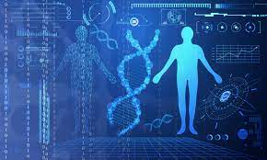
Unit 2: Databases in Bioinformatics
Dr. Pritam Chattopadhyay
Department of Botany
MUC Women’s College

Slide 2
Introduction
© Dr. Pritam Chattopadhyay

Slide 3
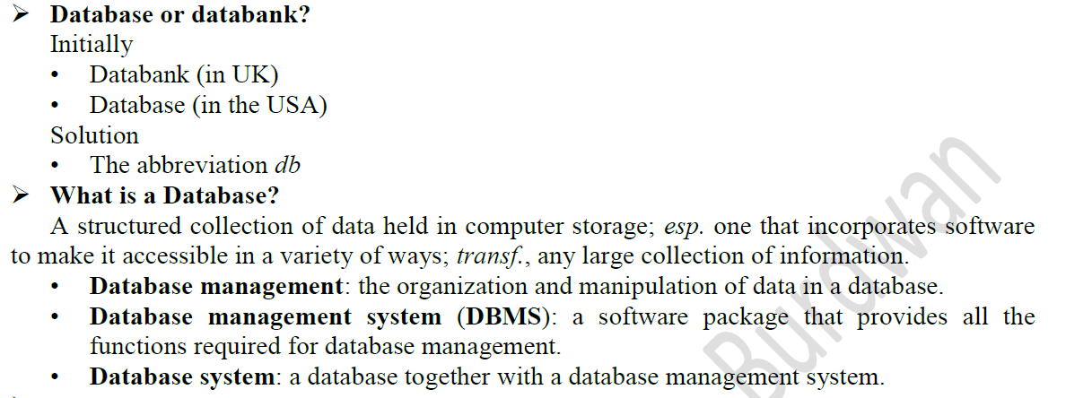
What is Data?
Data is raw , unorganized facts need to be processed.
• Example: Each students test score is one piece of data.
What is Database?
Database: collection and storage of information in organized manner.
Database or Databank?
© Dr. Pritam Chattopadhyay

Slide 4
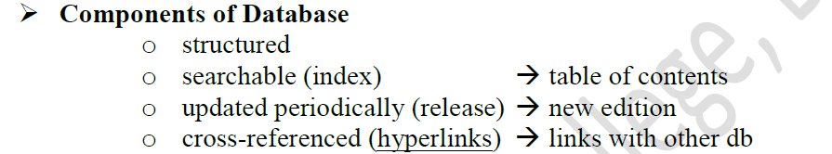
Properties of Database?
© Dr. Pritam Chattopadhyay

Slide 5
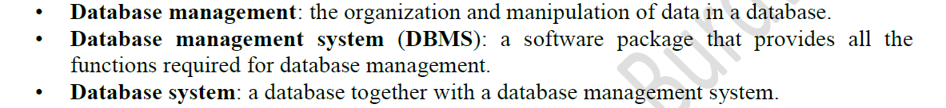
What is Database Management System?
DBMS Tasks
GET DATA: Data Submission
ORGANISE AND STORE DATA
GIVE IT BACK: Data Retrieval
© Dr. Pritam Chattopadhyay

Slide 6
Technical Design Types of Database
FLAT FILE
Complete Information is stored in the form of flat files.
For eg, Student record in one page
RELATIONAL
Complete Information is stored in the form of tables.
For eg, Name and Adress of Student
© Dr. Pritam Chattopadhyay

Slide 7
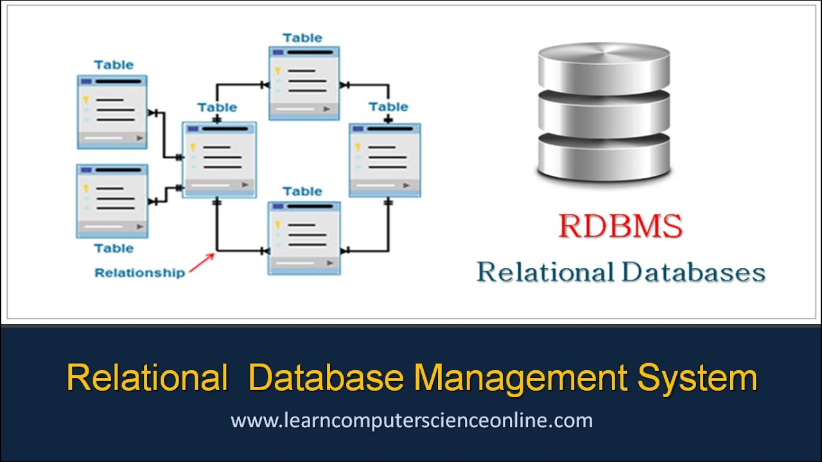
Example: Relational Databases Tables
© Dr. Pritam Chattopadhyay

Slide 8
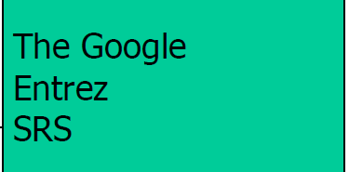
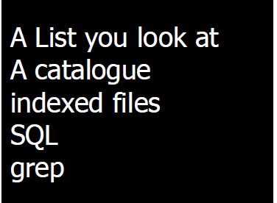
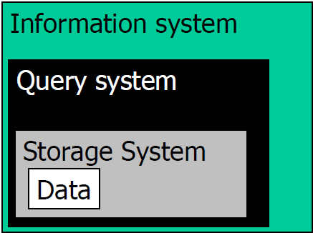
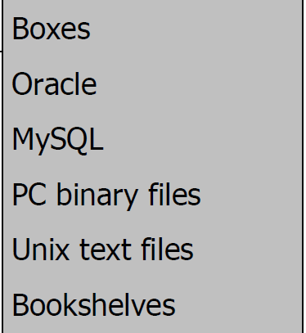
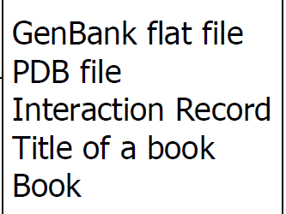
Database Architecture
© Dr. Pritam Chattopadhyay

Slide 9
Biological Databases
© Dr. Pritam Chattopadhyay

Slide 10
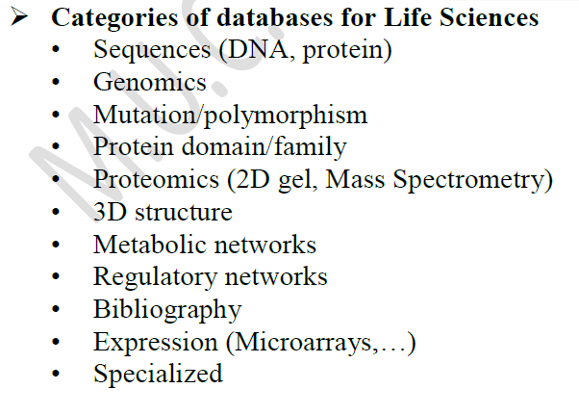
Biological Data
© Dr. Pritam Chattopadhyay

Slide 11
Biological Database
Biological databases are libraries of biological sciences, collected from scientific experiments, published literature, high-throughput experiment technology, and computational analysis.
The main purpose of a biological database is to store and manage biological data and information in computer readable forms.
Biological data are complex, exception-ridden, vast and incomplete.
© Dr. Pritam Chattopadhyay

Slide 12
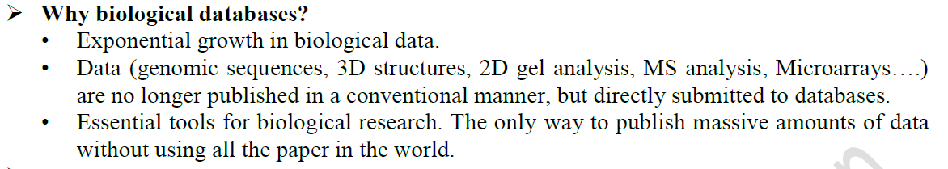
Why Biological Database?
© Dr. Pritam Chattopadhyay

Slide 13
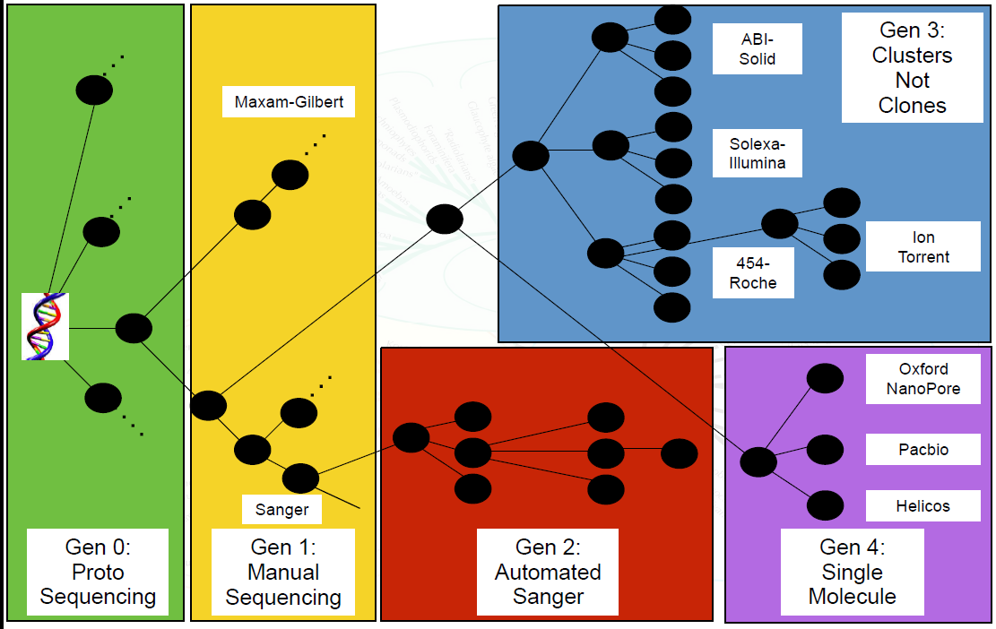
Evolution of Sequencing Technology
NGS
© Dr. Pritam Chattopadhyay

Slide 14
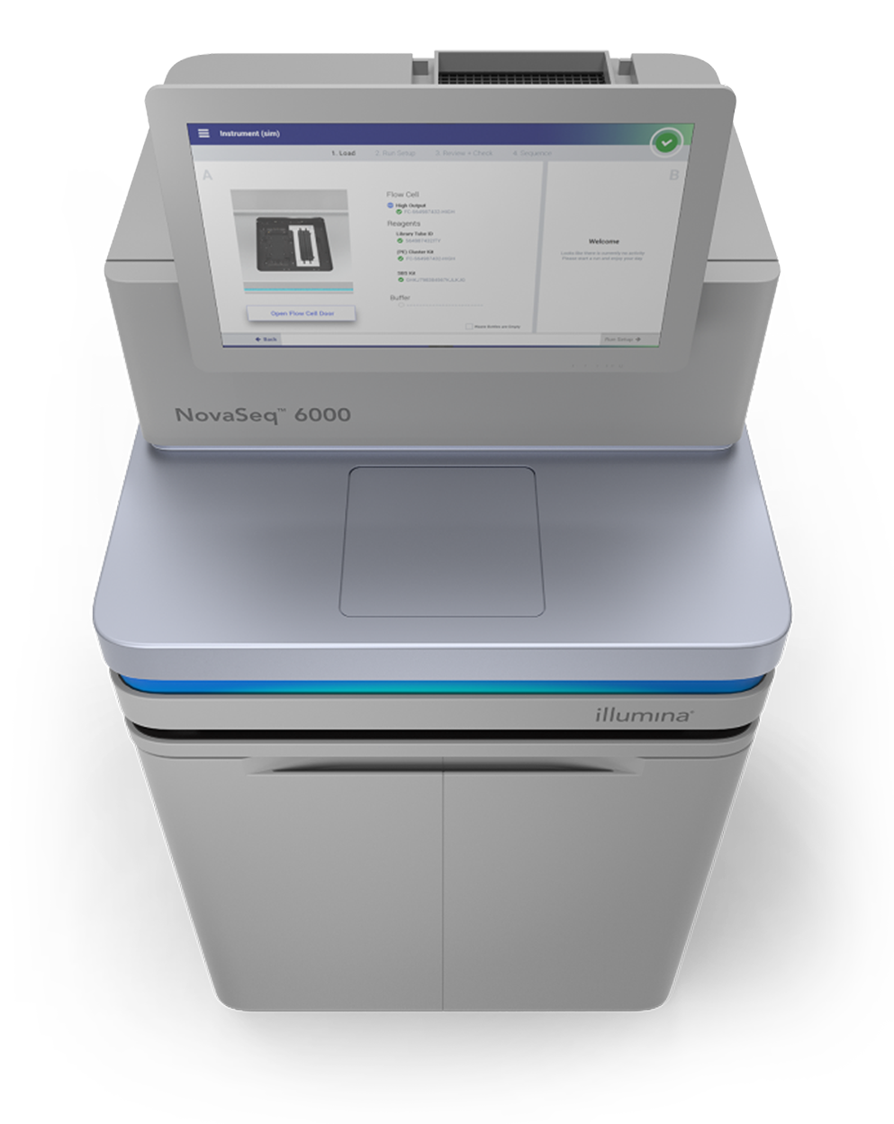
Example:
Illumina NovaSeq 600
Output of up to 6 Tb and 20 B reads in < 2 days
Suitable for Large Whole-Genome Sequencing (human, plant, animal)
Human Genome Project (HGP)
Human Genome (Genetic Makeup):
0.00625 Tb that includes 6.4 B reads
HGP uses Automated Sanger Method (2nd Generation)
No of individual: 1 (RP11) 70% + HapMap from 270 individual
Time taken: 13 years
© Dr. Pritam Chattopadhyay

Slide 15
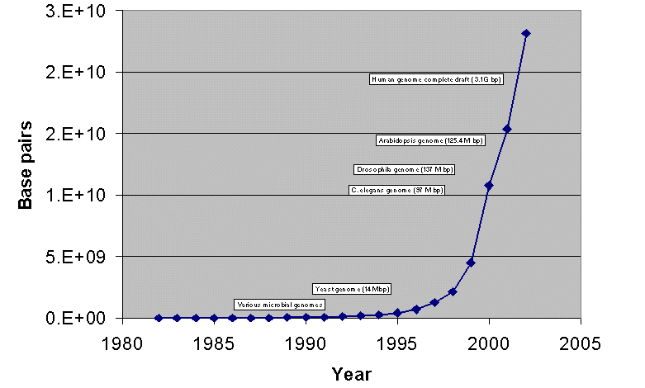
The trend of data growth
Genbank NCBI
August 15 2004, GenBank releases 143.0 contains 37343937 loci, 41808045653 bases, from 37343937 reported sequences .
Uncompressed, the Release 142.0 flatfiles require approximately 140 gigabytes
© Dr. Pritam Chattopadhyay

Slide 16
The trend of data growth
21st century is a century of biotechnology and OMICS:
Genomics: New sequence information is being
produced at increasing rates. (The
contents of GenBank double every year)
Transcriptomics: Microarray: Global expression analysis: RNA levels of every gene in the genome analyzed in parallel.
Progressively replaced by RNA-seq
Proteomics: Global protein analysis generates by large mass
spectra libraries.
Metabolomics: Global metabolite analysis: 25,000 secondary metabolites characterized
© Dr. Pritam Chattopadhyay

Slide 17
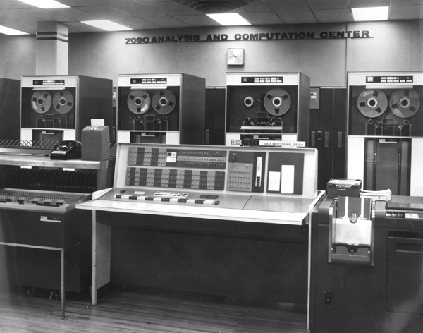
History OF BIOLOGICAL DATABASE
In1960s: the birth of bioinformatics
IBM 7090 computer
Margaret Oakley Dayhoff created:
  The first protein database
  The first program for sequence assembly
There is a need for computers and algorithms that allow:
Access, processing, storing, sharing, retrieving, visualizing, annotating…
© Dr. Pritam Chattopadhyay
Notes:
The 1960s marked the beginning of bioinformatics. Prior to the advent of high-level computer languages in 1957, programmers needed a detailed knowledge of a computer’s design and were forced to use languages that were unintuitive to humans. High-level computer languages allowed computer scientists to spend more time designing complex algorithms and less time worrying about the technical details of the particular computer model they were using. By the 1960s, mainframe computers like the one pictured in the slide were becoming common at universities and research institutions, giving academics unprecedented access to computers. (As useful as these computers were, they filled entire rooms and had processing power far below that of consumer-grade personal computers today!) Margaret Oakley Dayhoff and colleagues took advantage of these developments and the accumulation of protein sequence data to create some of the first bioinformatics applications. For example, Dayhoff wrote the first computer program to automate sequence assembly, enabling a task that previously took human workers months to be accomplished in minutes. She and her colleagues also published (in paper form) the first protein sequence database and performed many groundbreaking studies regarding phylogeny and scoring sequence comparisons. For these reasons, she is considered one of the great pioneers of computational biology and bioinformatics.

Slide 18
Challenges of Biological Databases
Types of Tools
Sequence
Structure
Function
© Dr. Pritam Chattopadhyay

Slide 19
Challenges of Biological Databases
Storage
  Indexing, physical layout, memory management
Modeling
  Relational, hierarchical, semi-structured
Efficiency
  Update, query, analysis
Interpretation
  Visualization
Therefore several databases has been created and interpreted to ensure unambiguous results.
© Dr. Pritam Chattopadhyay

Slide 20
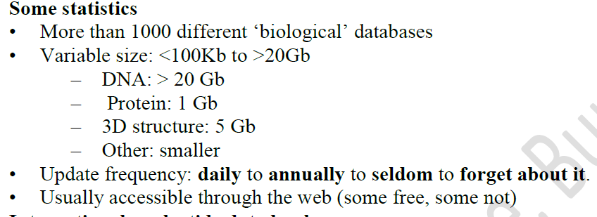
© Dr. Pritam Chattopadhyay

Slide 21
Classification format of Biological Databases
© Dr. Pritam Chattopadhyay

Slide 22
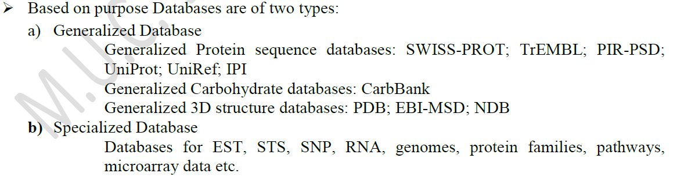
Types of Biological Databases
On the basis of purpose:
© Dr. Pritam Chattopadhyay

Slide 23
Types of Biological Databases
On the basis of source:
Biological Databases
Primary
Databases
Secondary
Databases
Composite
Databases
Examples
Examples
Examples
Nucleotide database
of NCBI
EMBL Nucleotide Sequence
UniPrac of Uni-Prot
UniProt Knowledgebase (sequence and functional information on proteins)
Ensembl (variation, function, regulation and more layered onto whole genome sequences)
NCBI
EMBL
DDBJ
Uni-Prot
© Dr. Pritam Chattopadhyay

Slide 24
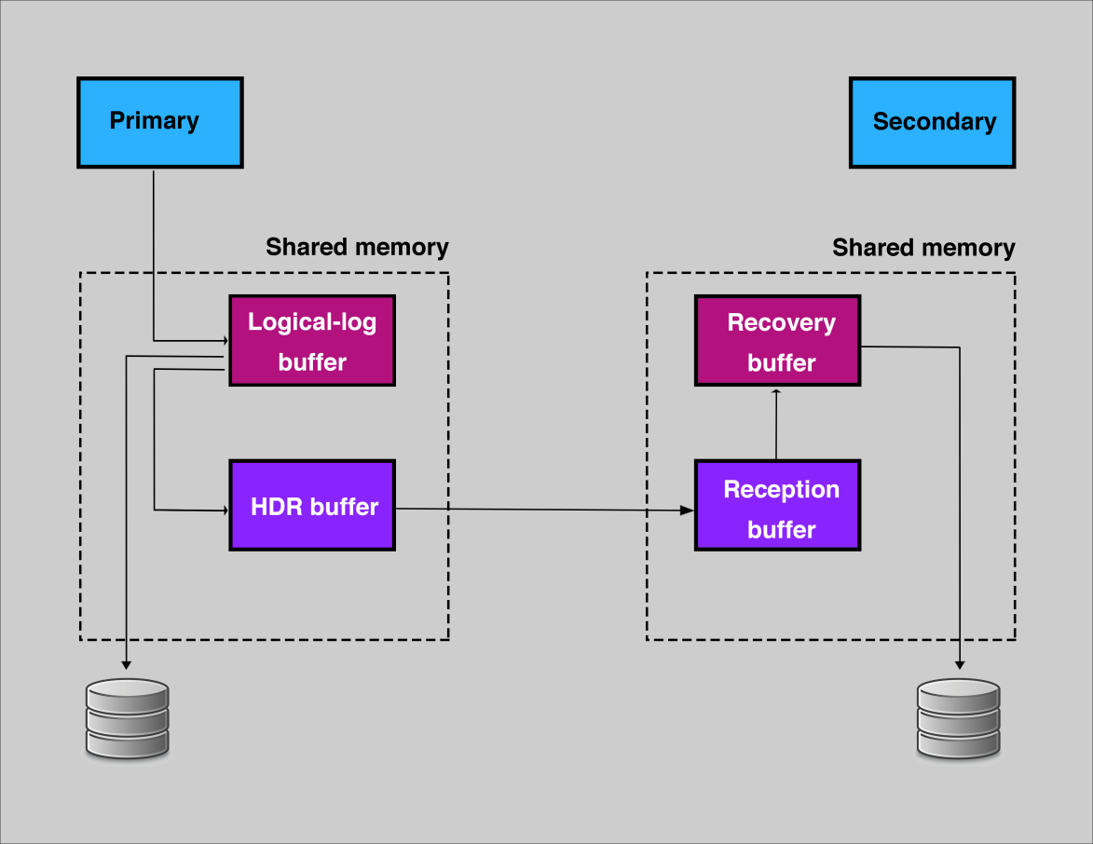
Primary Databases
They contains bimolecular data in its original form.
Experimental results are submitted directly into the database by researchers, and the data are essentially archival in nature.
Once a database accession no. is given to an kind of data in primary database then that data can’t be changed further.
May be redundant.
Examples
Nucleotide database of NCBI
EMBL Nucleotide Sequence
UniPrac of Uni-Prot
© Dr. Pritam Chattopadhyay

Slide 25
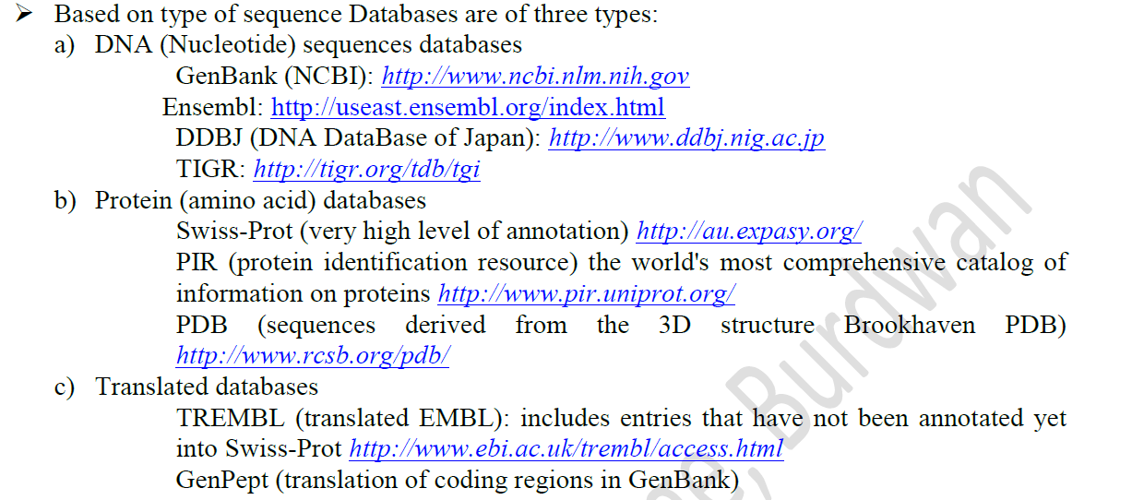
Types of Primary/Sequence Databases
© Dr. Pritam Chattopadhyay

Slide 26
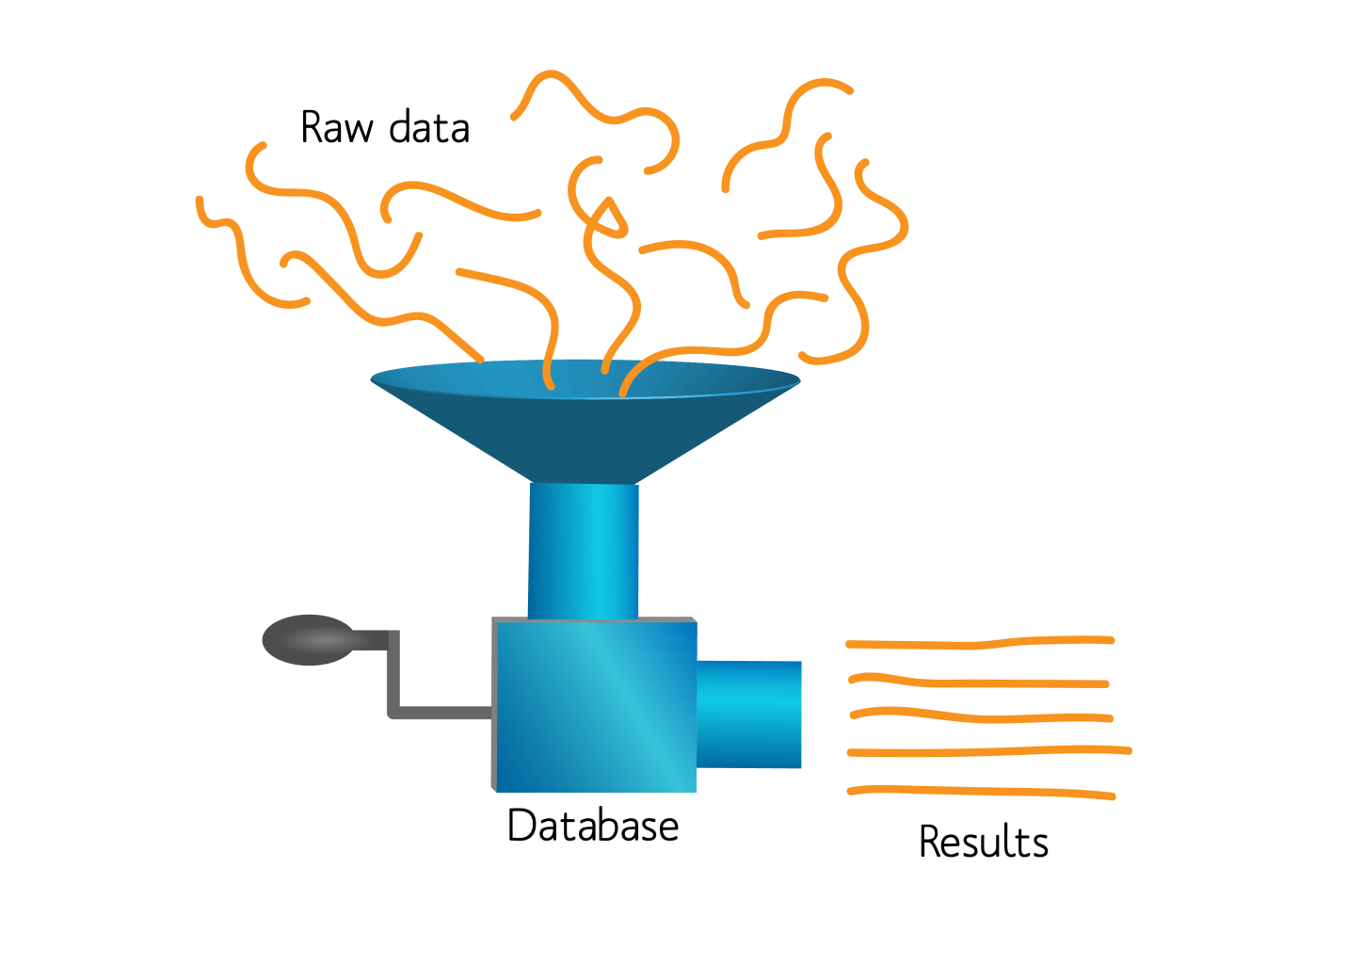
Secondary Databases
It contains Data derived from results of analyzed primary data.
The data in secondary database is either manually curated or generated automatically.
Non-redundant
© Dr. Pritam Chattopadhyay

Slide 27
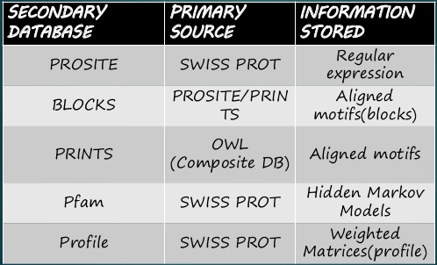
Examples
© Dr. Pritam Chattopadhyay

Slide 28
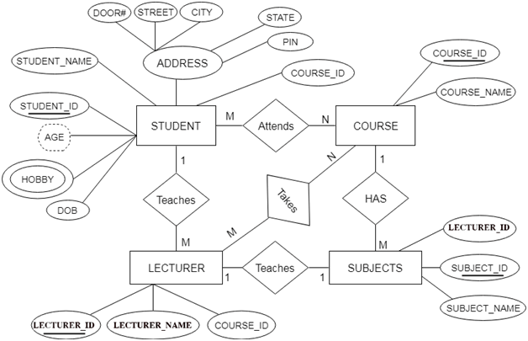
Composite Databases
It contains a variety of primary and/or secondary databases, which eliminates the need to search each one separately.
Each composite database has different search algorithms and data structures.
Examples
OWL
NCBI
EMBL
DDBJ
Uni-Prot
© Dr. Pritam Chattopadhyay

Slide 29

OWL
http://130.88.97.239/bioactivity/owlinfo.html
OWL is a non-redundant composite of 4 publicly-available primary sources: SWISS-PROT, PIR (1-3), GenBank (translation) and NRL-3D . SWISS-PROT is the highest priority source, all others being compared against it to eliminate identical and trivially-different sequences.
© Dr. Pritam Chattopadhyay

Slide 30
NCBI
https://www.ncbi.nlm.nih.gov
© Dr. Pritam Chattopadhyay

Slide 31
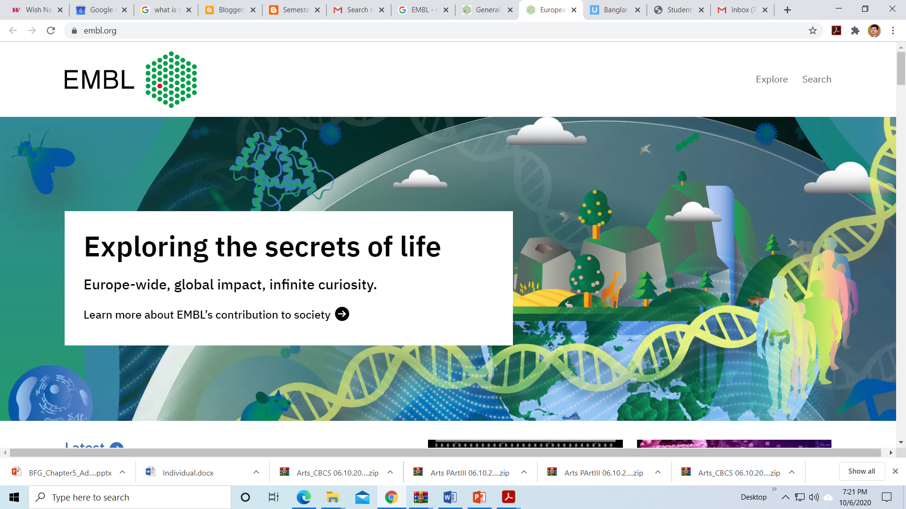
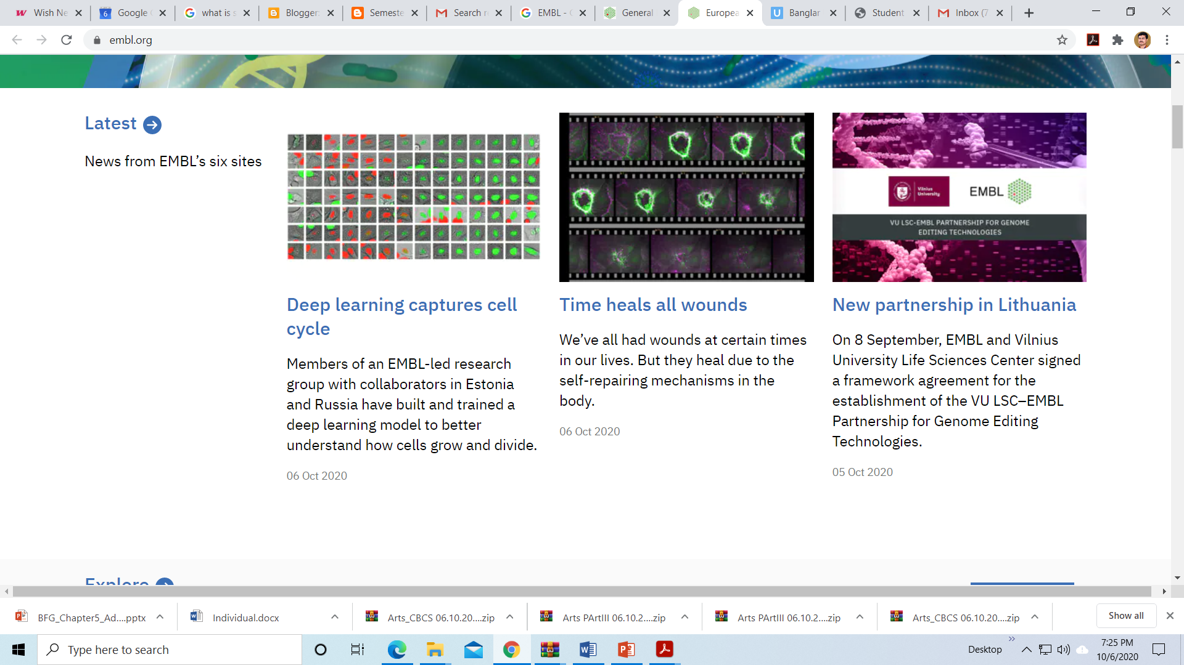
EMBL
https://www.embl.org
© Dr. Pritam Chattopadhyay

Slide 32
DDBJ
https://www.ddbj.nig.ac.jp/index-e.html
Currently, DDBJ Center is in operation at Research Organization of Information and System National Institute of Genetics(NIG) in Mishima, Japan with endorsement of MEXT; Japanese Ministry of Education, Culture, Sports, Science and Technology.
DDBJ Center is reviewed and advised by its own advisory board, DNA Database Advisory Committee (an outside committee of NIG), and also by the advisory board to INSDC, International Advisory Committee.
© Dr. Pritam Chattopadhyay

Slide 33
UniProt
https://www.uniprot.org
© Dr. Pritam Chattopadhyay

Slide 34
Types of Biological Databases
On the basis of type of data
Examples
Literature Databases:
Nucleotide Databases:
Protein Databases:
Gene Expression Databases:
Metabolic Pathway Databases:
Nutrient Databases:
Species Specific Databases:
Omics Databases:
Specialized Databases:
PubMed, PubMed Central
Nuceotide, Gene, Genome databases
Uni-Prot, Prosite, SCOP
GEO, GXD, MGED
KEGG, PathDB, EMP
USDA-NND, NFSD, ENDB
PomBase, Wormpep, ACEDB
OmicsDI, NutriGenomeDB, PharmGKB
TGI, GSOB, GPCRD
© Dr. Pritam Chattopadhyay

Slide 35
Nucleotide Databases
Primary Nucleotide Databases of
NCBI ( http://www.ncbi.nlm.nih.gov)
EMBL (http:// www.ebi.ac.uk/embl)
DDBJ (http://www.ddbj.nig.ac.jp/)
Since 1982 Work in collaboration.
Collect information from their region.
Automatically update each other every 24 hours. To organize huge amount of information, the database has been split into numerous divisions (17) and each division has specific 3-letter code.
For example:
Human HUM
Virus VRL
Fungi FUN
© Dr. Pritam Chattopadhyay

Slide 36
Protein Databases
Protein Databases
Primary
Str. Databases
Secondary
Str. Databases
Tertiary/Quaternary
Str. Databases
Examples
Examples
Examples
UniPrac of Uni-Prot
Proetin database of NCBI
Prosite
BLOCKS
COG
SCOP
CATH
© Dr. Pritam Chattopadhyay

Slide 37
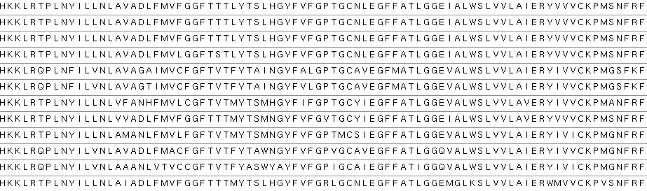
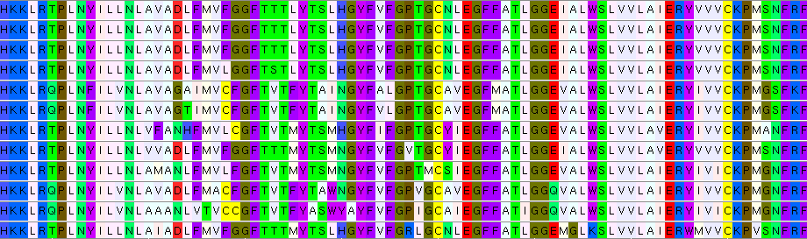
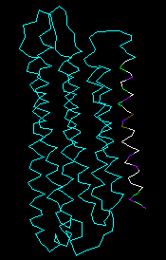
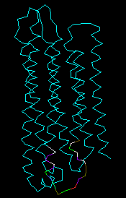
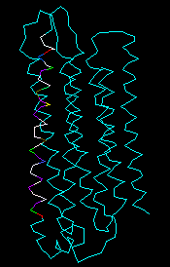
Protein Databases
Primary
Str. Databases
Secondary
Str. Databases
Tertiary
Str. Databases
© Dr. Pritam Chattopadhyay

Slide 38
Primary Str. Databases
Primary Protein DATABASE
PIR (http://pir.georgetown.edu/)
Swissprot/Uniprot (http:// www.ebi.ac.uk/swissprot)
Protein Data Bank (http:// www.rcsb.org/pdb)
Unlike nucleotide databases, they are not mirror of one another.
Both databanks are cross-referenced with the nucleotide databases by Acc. No. and PID.
© Dr. Pritam Chattopadhyay

Slide 39
Secondary Str. Databases
From sequence, identify characteristics of a protein
  Active sites
  Families (e.g. globin)
  Blocks
  Domains
  Folds
  Motifs
  Etc.
Secondary Pattern Databases
PROSITE SWISS-PROT Regular expressions (patterns)
PRINTS SWISS-PROT/TrEMBL Aligned motifs (fingerprints)
Pfam SWISS-PROT/TrEMBL Hidden Markov Models (HMMs)
Profiles SWISS-PROT Weight matrices (profiles)
BLOCKS PRINTS/InterPro/Domo Weighted motifs (blocks)
IDENTIFY PRINTS/InterPro Permissive regular expressions
© Dr. Pritam Chattopadhyay

Slide 40
Single motif methods
Fuzzy regex (IDENTIFY)
Exact regex (PROSITE)
Full domain alignment methods
Profiles
(PROFILE LIBRARY)
HMMs
(Pfam)
Identity matrices
(PRINTS)
Multiple motif methods
Weight matrices
(BLOCKS)
© Dr. Pritam Chattopadhyay

Slide 41
PRIMARY AND SECONDARY PROTEIN DATABASES
PRIMARY PROTEINDATABASES
SECONDARY PROTEIN DATABASES
These databases are primary source of information and can be consider as reservoir of protein or peptide sequence information.
These are the primary repository centre for the newly discovered sequence.
They are key to the secondary protein database
Eg., Protein sequence database at NCBI, EMBL, DDBJ
These databases derives the information by resolving the primary protein databases.
They express any particular attribute of the primary protein databases (like motif, pattern etc)
They add the value to the information present in the primary databases.
Eg., pfam, BLOCK, prints etc.
© Dr. Pritam Chattopadhyay

Slide 42
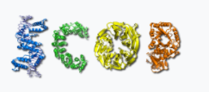
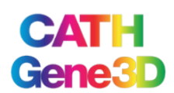
Tertiary/Quaternary Str. Databases
Tertiary structure refers to the three-dimensional structure created by a single protein molecule (a single polypeptide chain).
Quaternary structure is the three-dimensional structure consisting of the aggregation of two or more individual polypeptide chains (subunits) that operate as a single functional unit (multimer).
The resulting multimer is stabilized by the same non-covalent interactions and disulfide bonds as in tertiary structure.
https://scop.mrc-lmb.cam.ac.uk
The SCOP database aims to provide a detailed and comprehensive description of the structural and evolutionary relationships between proteins whose three-dimensional structure is known and deposited in the Protein Data Bank.
https://www.cathdb.info/
151 million protein domains classified into 5,481 superfamilies
© Dr. Pritam Chattopadhyay

Slide 43
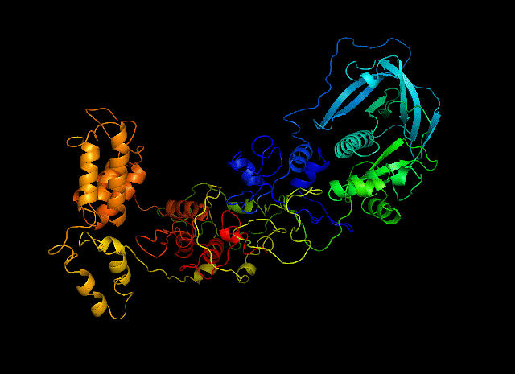
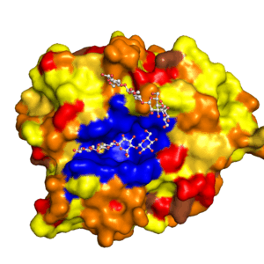
Protein 3D Models
© Dr. Pritam Chattopadhyay

Slide 44
Species Specific Databases
  PomBase is a compilation of data relating to the organism Schizosaccharomyces pombe
  Wormpep predicted proteins from the C. elegans genome sequencing project.
  ACEDB is an acronym for "A Caenorhabditis elegans DataBase". It can refer to a database and data concerning the nematode C. elegans, or to the database software alone.
  Other groups may adapt existing, or create own. For example, David Hall’s workflow project at UGA for Neurospora
© Dr. Pritam Chattopadhyay

Slide 45
Biological Database Retrieval System
© Dr. Pritam Chattopadhyay

Slide 46
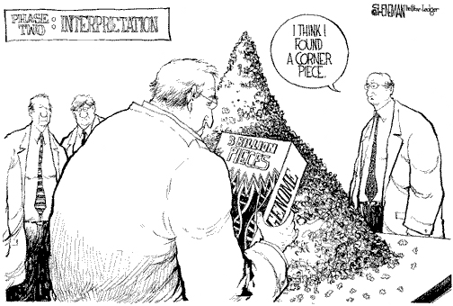
How to handle large amount of Biological Data
Drew Sheneman, New Jersey--The Newark Star Ledger
Answer: bioinformatics and Internet
© Dr. Pritam Chattopadhyay

Slide 47
Why do we need the Internet?
“omics” projects and the information associated with involve a huge amount
of data that is stored on computers all over the world.
Because it is impossible to maintain up-to-date copies of all relevant
databases within the lab. Access to the data is via the internet.
© Dr. Pritam Chattopadhyay

Slide 48
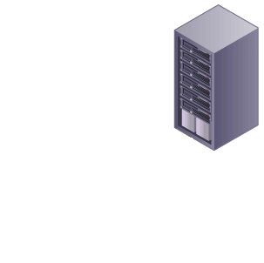
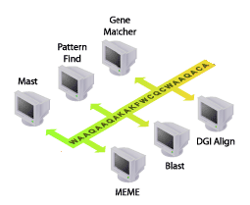

Database storage
Results
Your request
You are here
© Dr. Pritam Chattopadhyay

Slide 49
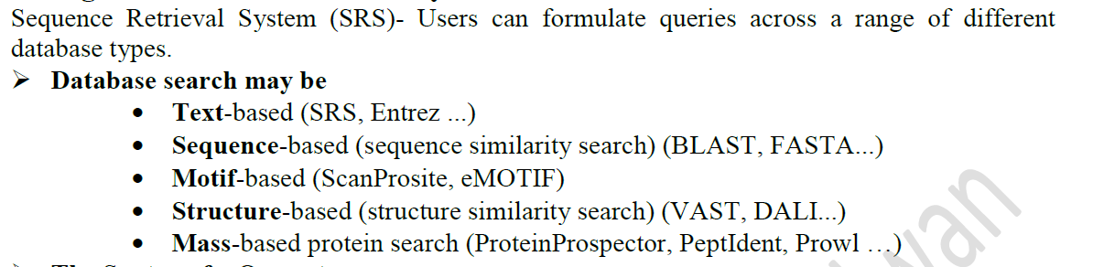
Biological Databases Retrieval System (BDRS)
© Dr. Pritam Chattopadhyay

Slide 50
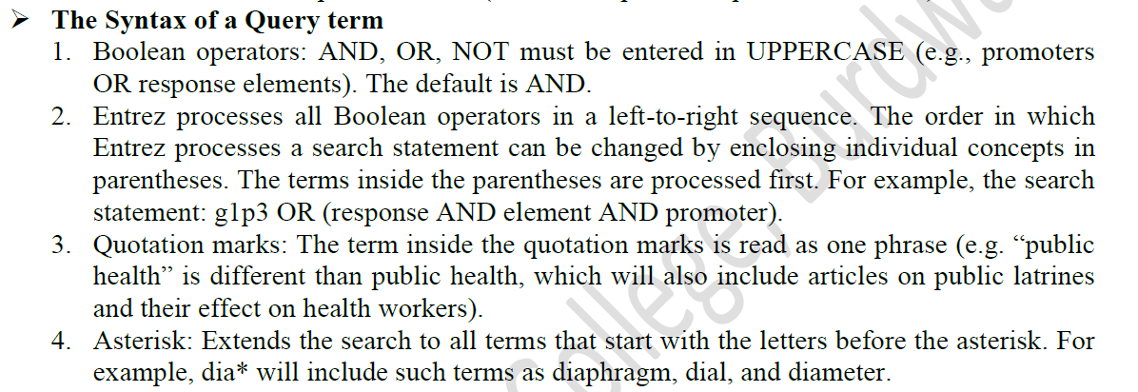
Query for BDRS
© Dr. Pritam Chattopadhyay

Slide 51
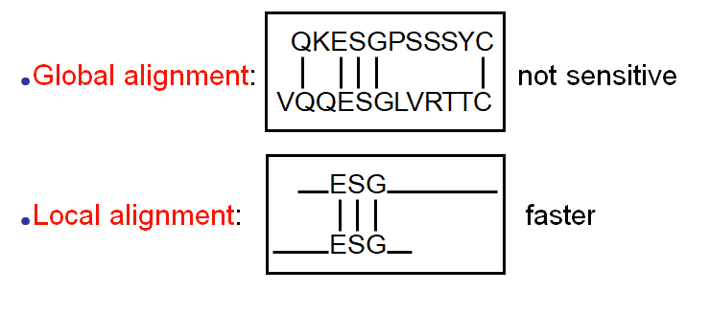
Database Search Methods: Sequence Allignment
Two broad classes of sequence alignments exist:
The most widely used local similarity algorithms are:
Smith-Waterman (http://www.ebi.ac.uk/MPsrch/)
Basic Local Alignment Search Tool (BLAST, http://www.ncbi.nih.gov)
Fast Alignment (FASTA, http://fasta.genome.jp; http://www.ebi.ac.uk/fasta33/;
http://www.arabidopsis.org/cgi-bin/fasta/nph-TAIRfasta.pl)
© Dr. Pritam Chattopadhyay

Slide 52
Which algorithm to use for database similarity search?
Speed:
BLAST > FASTA > Smith-Waterman (It is VERY SLOW and uses a
LOT OF COMPUTER POWER)
Sensitivity/statistics:
FASTA is more sensitive, misses less homologues
Smith-Waterman is even more sensitive.
BLAST calculates probabilities
FASTA more accurate for DNA-DNA search then BLAST
© Dr. Pritam Chattopadhyay

Slide 53
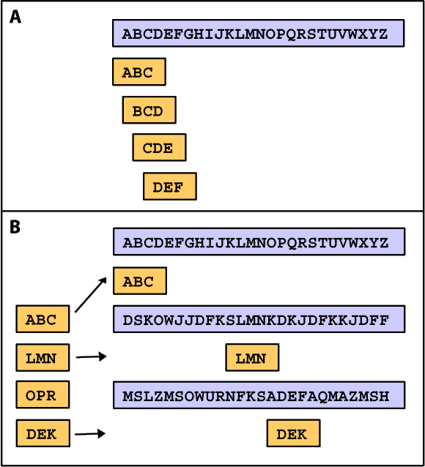
Κ-tuple methods provide optimal alignments
These methods are faster and excellent in comparing sequences.
BLAST and FASTA programs are based on Κ-tuple algorithms:
1-Using query sequence, derive a list of
words of length w (e.g., 3)
2-Keep high-scoring words using a
scoring matrix(e.g. BLOSUM 62)
3-High-scoring words are compared
with database sequences
4-Sequences with many matches to
high-scoring words are used for final
alignments
© Dr. Pritam Chattopadhyay

Slide 54
Tools to search databases
The dilemma: DNA or protein?
Search by similarity
Using nucleotide seq.
Using amino acid seq.
Is the comparison of two nucleotide sequences accurate?
By translating into amino acid sequence, are we losing information?
The genetic code is degenerate (Two or more codons can represent
the same amino acid)
Very different DNA sequences may code for similar protein sequences
We certainly do not want to miss those cases!
© Dr. Pritam Chattopadhyay

Slide 55
Reasons for translating
Comparing DNA sequences give more random matches:
A good alignment with end-gaps
A very poor alignment
Almost 50% identity!
Conservation of protein in evolution (DNA similarity decays faster!)
Conclusion:
It is almost always better to compare coding sequences in their amino acid form,
especially if they are very divergent.
Very highly similar nucleotide sequences may give better results.
© Dr. Pritam Chattopadhyay

Slide 56
BLAST and FASTA variants
FASTA: Compares a DNA query to DNA database, or a protein query
to protein database
FASTX: Compares a translated DNA query to a protein database
TFASTA: Compares a protein query to a translated DNA database
BLASTN: Compares a DNA query to DNA database.
BLASTP: Compares a protein query to protein database.
BLASTX: Compares the 6-frame translations of DNA query to protein
database.
TBLASTN: Compares a protein query to the 6-frame translations of a DNA
database. You can however define your frame of interest
TBLASTX: Compares the 6-frame translations of DNA query to the 6-frame
translations of a DNA database (each sequence is comparable to
BLASTP searches!)
PSI-BLAST: Performs iterative database searches. The results from each round
are incorporated into a 'position specific' score matrix, which is
used for further searching

Slide 57
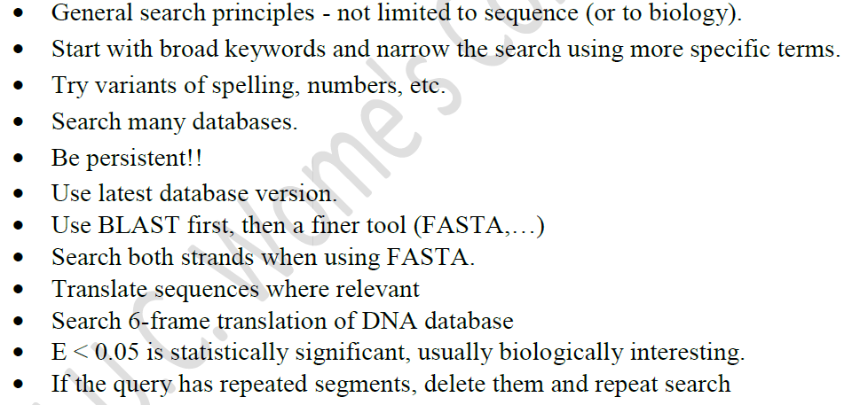
Biological Database Searching Strategies
© Dr. Pritam Chattopadhyay

