Slide 1
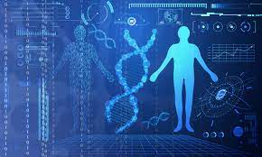
Introduction to Bioinformtics
Dr. Pritam Chattopadhyay
Department of Botany
MUC Women’s College

Slide 2
Introduction
© Dr. Pritam Chattopadhyay

Slide 3
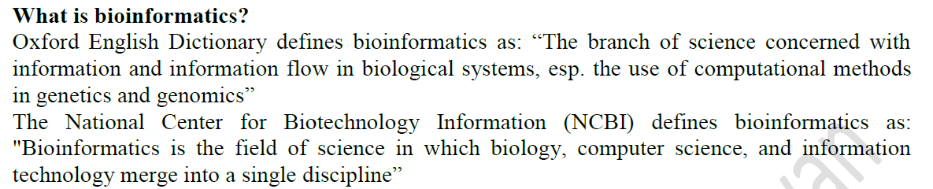
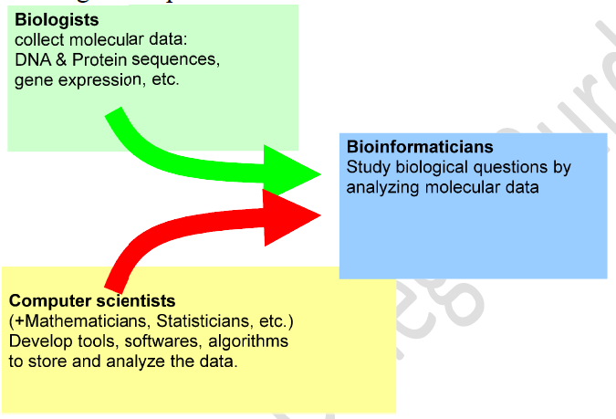
© Dr. Pritam Chattopadhyay

Slide 4
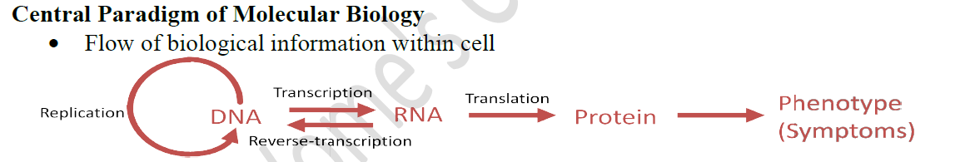
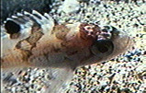


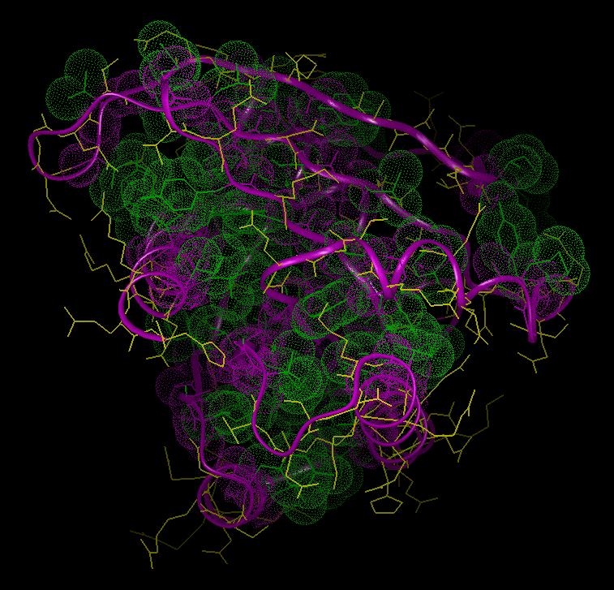
Concept 1
Central dogma
DNA
(Genotype)
Protein
Phenotype
© Dr. Pritam Chattopadhyay

Slide 5
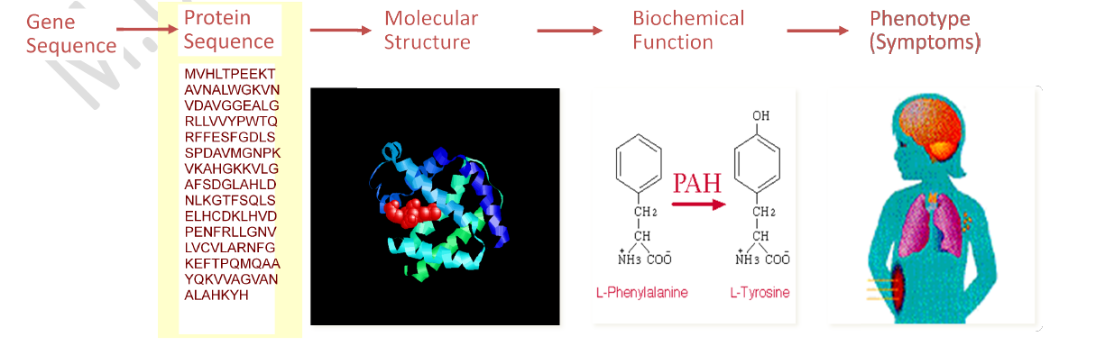
Concept 1
© Dr. Pritam Chattopadhyay

Slide 6
Concept 1
Primary Flows of Information and Substance in Cell
DNA
creation
regulation
mRNA
transcription
factors
splicing
factors
Receptors
Enzymes
structural
proteins
signaling
molecules
structural
sugars
structural
lipids
Environment
& other cells
© Dr. Pritam Chattopadhyay

Slide 7
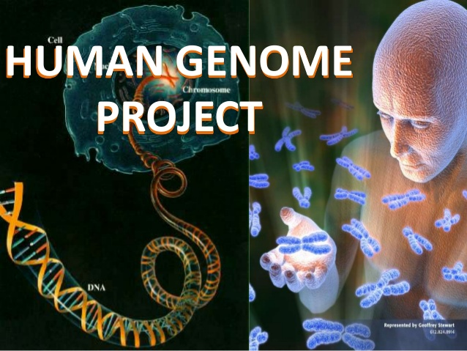
Concept 2
Omics
Most Important Milestone
Central Dogma
Concept 1
© Dr. Pritam Chattopadhyay

Slide 8
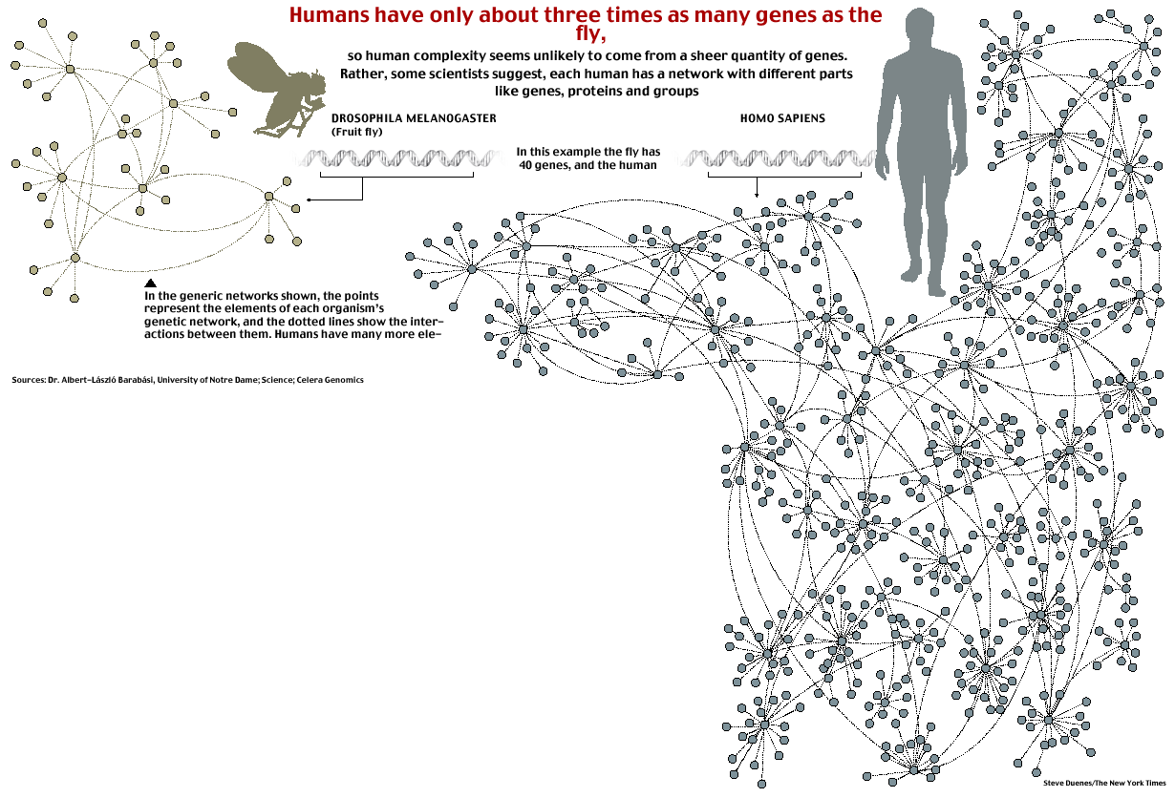
New York Times
Concept 2
Complex systems
Made of many non-identical elements connected by diverse interactions.
NETWORK
© Dr. Pritam Chattopadhyay

Slide 9
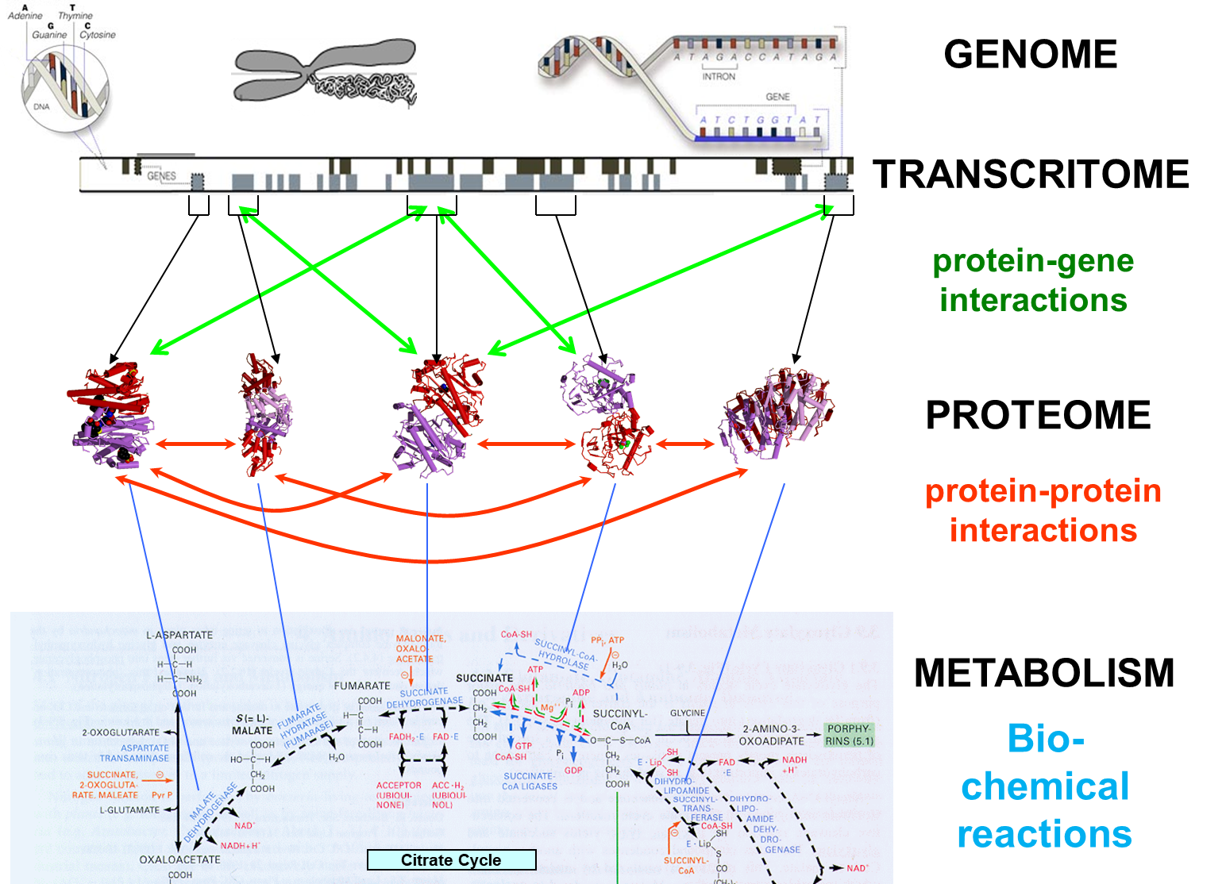
Concept 2
Omics
Genomics
Transcriptomics
Proteomics
Metabolomics
© Dr. Pritam Chattopadhyay

Slide 10
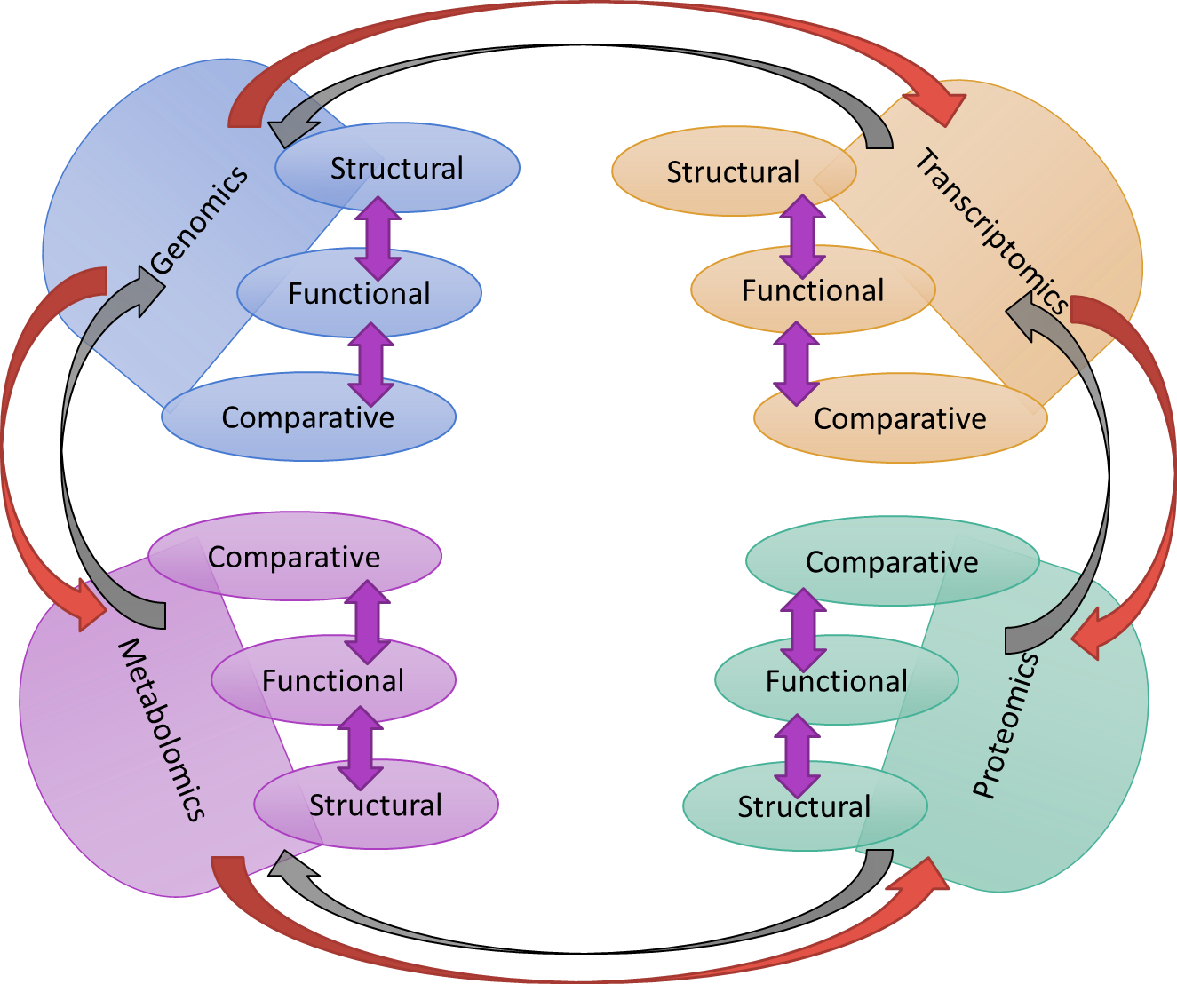
Bioinformatics is a tool that bridges cross omic (inter- & intra-) domains
© Dr. Pritam Chattopadhyay

Slide 11
Components of Bioinformatics
Bioinformatics =
Data Mgmt +
Knowledge Discovery +
Sequence Analysis +
Physical Modelling + ….
Knowledge Discovery =
Statistics + Algorithms + Databases
© Dr. Pritam Chattopadhyay

Slide 12
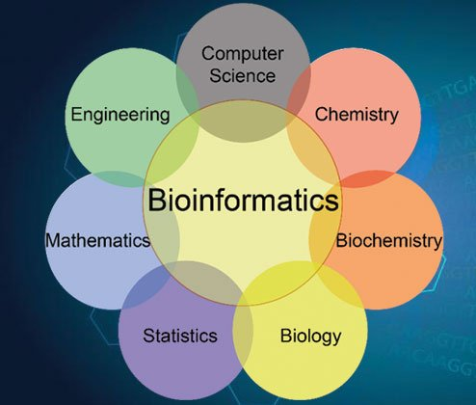
Components of Bioinformatics
© Dr. Pritam Chattopadhyay

Slide 13
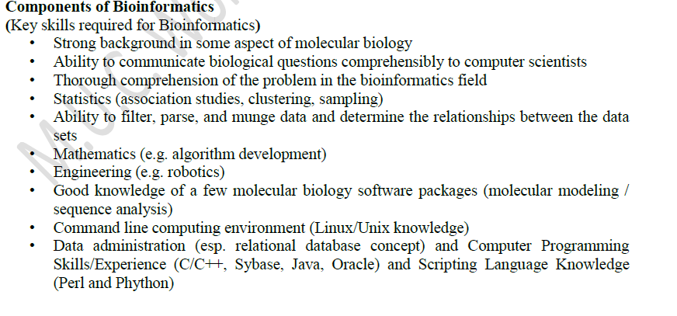
Components of Bioinformatics
© Dr. Pritam Chattopadhyay

Slide 14
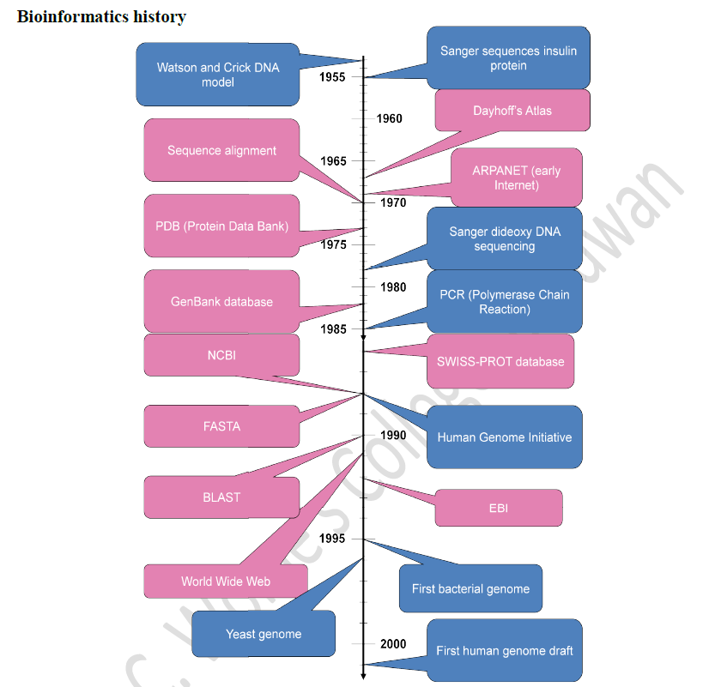
History of Bioinformatics
© Dr. Pritam Chattopadhyay

Slide 15
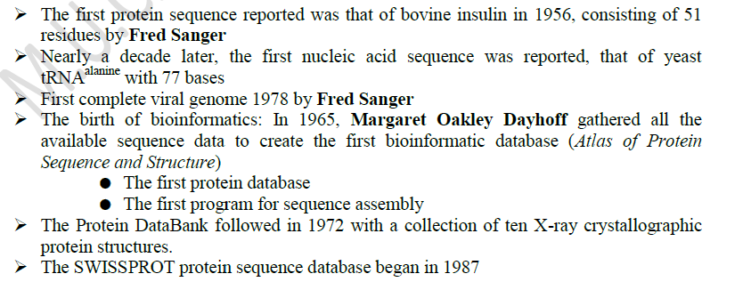
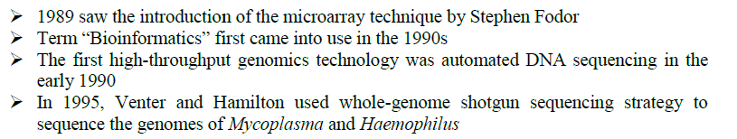
© Dr. Pritam Chattopadhyay

Slide 16
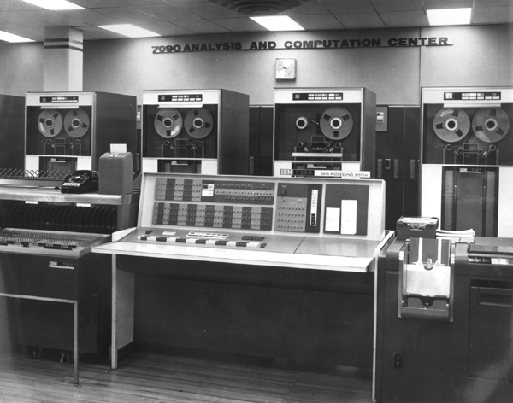
Bioinformatics history
In1960s: the birth of bioinformatics
IBM 7090 computer
Margaret Oakley Dayhoff created:
  The first protein database
  The first program for sequence assembly
There is a need for computers and algorithms that allow:
Access, processing, storing, sharing, retrieving, visualizing, annotating…
© Dr. Pritam Chattopadhyay

Slide 17
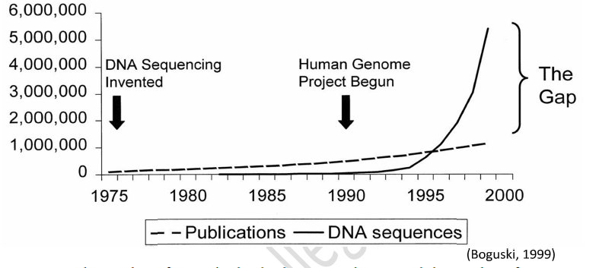
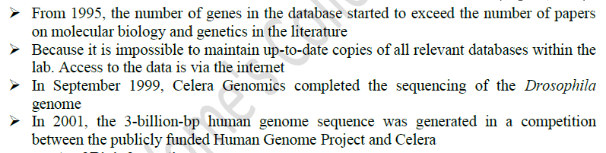
© Dr. Pritam Chattopadhyay

Slide 18
Branches of Bioinformatics
© Dr. Pritam Chattopadhyay

Slide 19
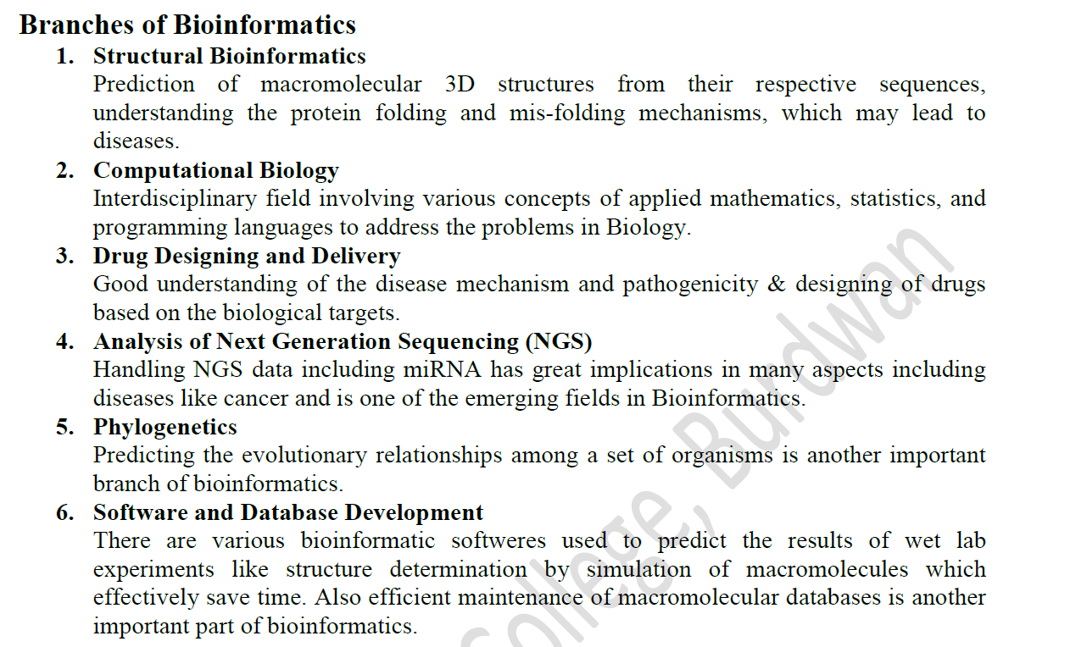
© Dr. Pritam Chattopadhyay

Slide 20
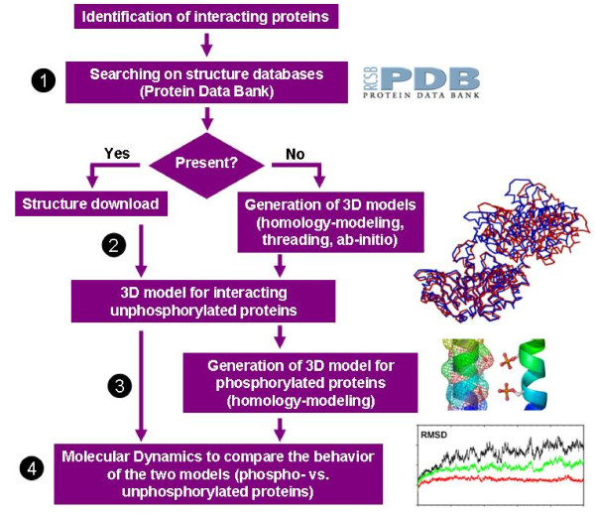
Structural Bioinformatics
© Dr. Pritam Chattopadhyay

Slide 21
Computational Biology
Computational Biology
Bioinformatics
“Computational biology is a discipline of biology concerned with the processes and patterns of biological evolution especially in relation to the diversity of organisms and how they change over time.” (Merriam-Webster)
“Computational biology is theoretical, analytical, and applied computational approaches to a broad range of fundamental problems in molecular biology and medicine.” (NCBI)
“Bioinformatics is the collection, classification, storage, and analysis of biochemical and biological information using computers especially as applied to molecular genetics and genomics.” (Merriam-Webster)
"Bioinformatics is the field of science in which biology, computer science, and information technology merge into a single discipline.” (NCBI)
Computational biology is a discipline
Bioinformatics is a tool
© Dr. Pritam Chattopadhyay

Slide 22
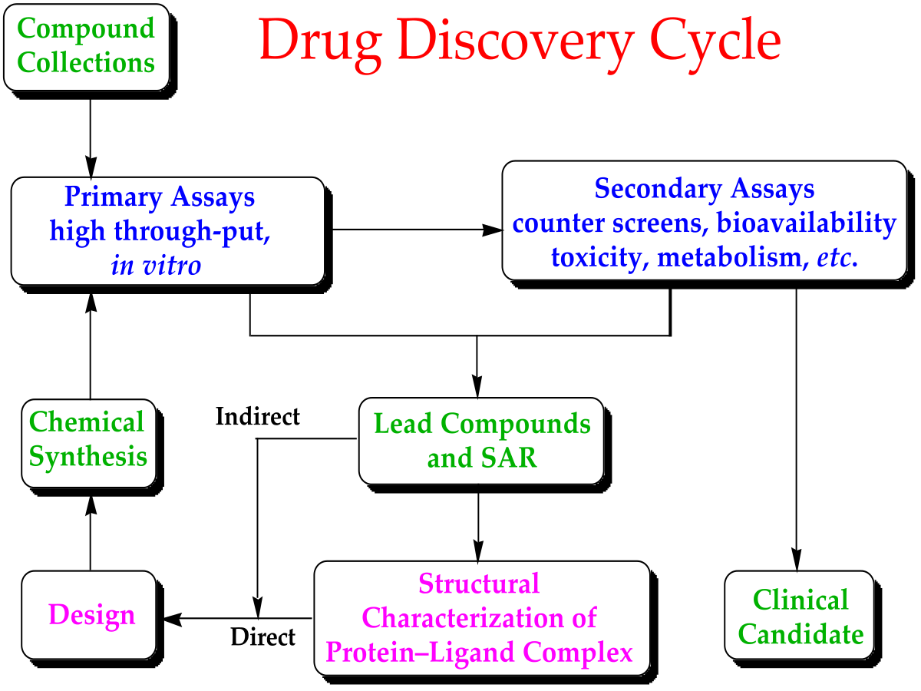
Drug Designing & Discovery
© Dr. Pritam Chattopadhyay

Slide 23
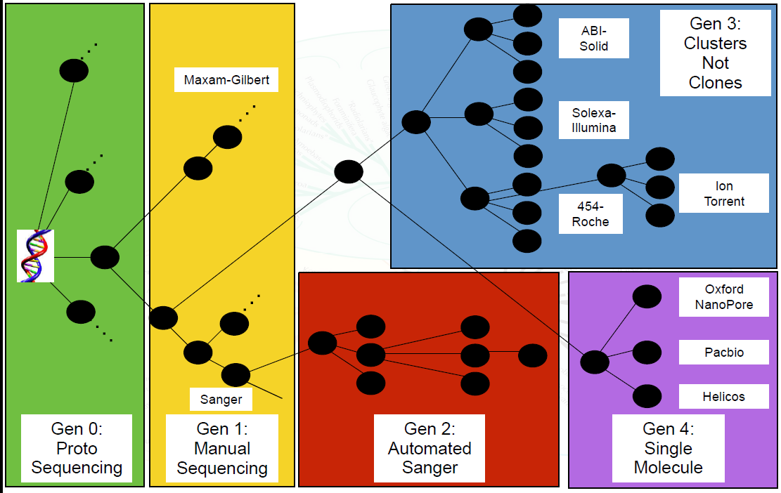
Evolution of Sequencing Technology
NGS
© Dr. Pritam Chattopadhyay

Slide 24
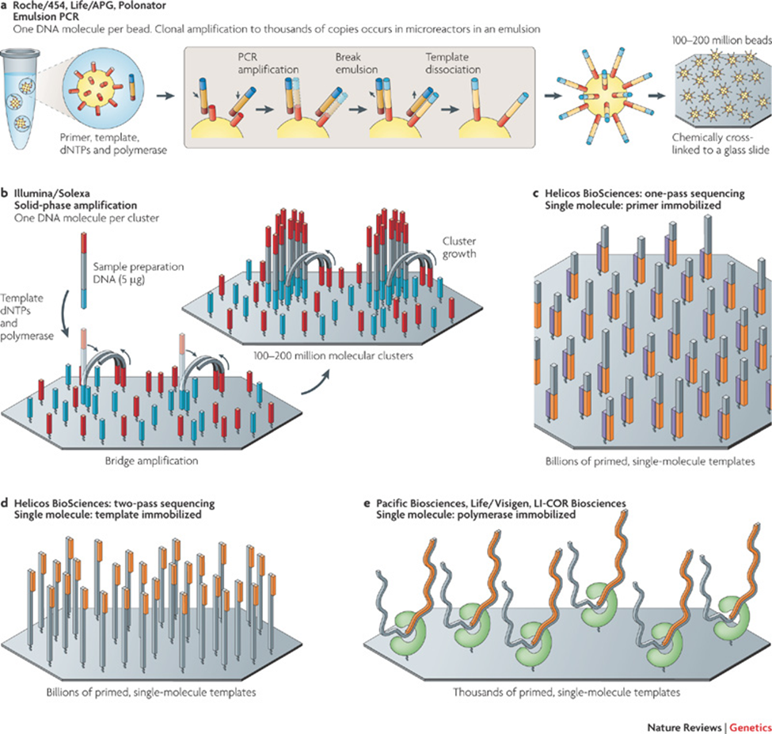
Next Generation Sequencing
© Dr. Pritam Chattopadhyay

Slide 25
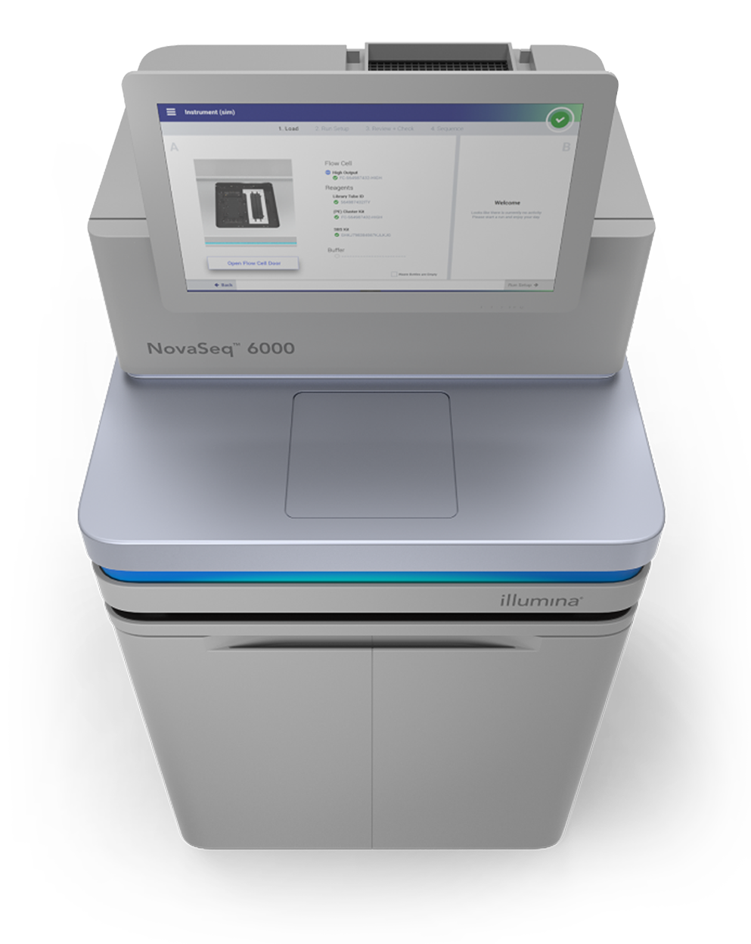
Illumina NovaSeq 600
Output of up to 6 Tb and 20 B reads in < 2 days
Suitable for Large Whole-Genome Sequencing (human, plant, animal)
Human Genome Project (HGP)
Human Genome (Genetic Makeup):
0.00625 Tb that includes 6.4 B reads
HGP uses Automated Sanger Method (2nd Generation)
No of individual: 1 (RP11) 70% + HapMap from 270 individual
Time taken: 13 years
© Dr. Pritam Chattopadhyay

Slide 26
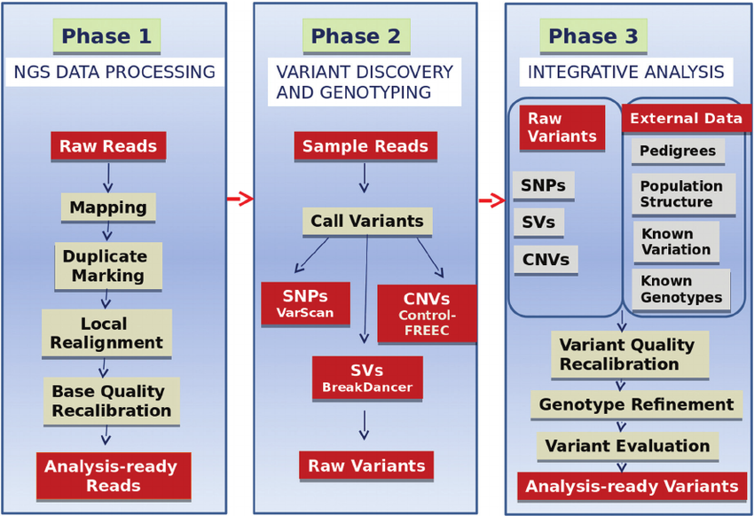
Analysis of NGS
© Dr. Pritam Chattopadhyay

Slide 27
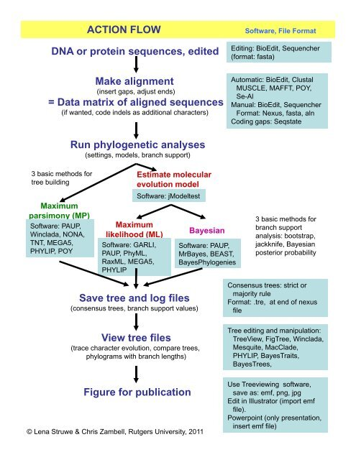
Phylogenetics
© Dr. Pritam Chattopadhyay

Slide 28
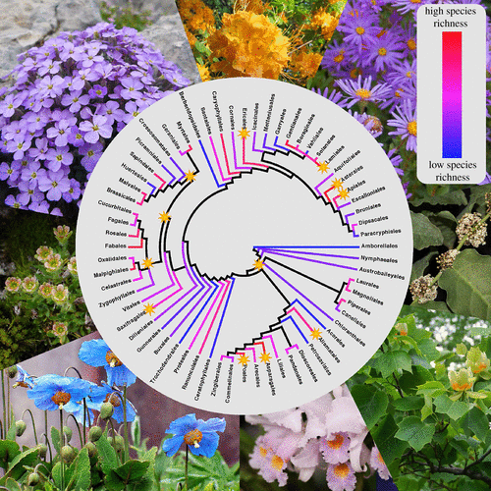
Phylogenetics
© Dr. Pritam Chattopadhyay

Slide 29
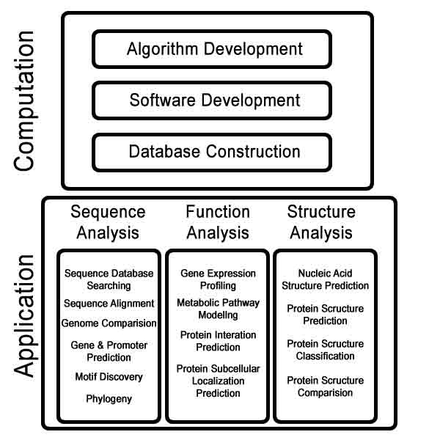
Software & Database Development
© Dr. Pritam Chattopadhyay

Slide 30
Aim, Scope & Research areas of Bioinformatics
© Dr. Pritam Chattopadhyay

Slide 31
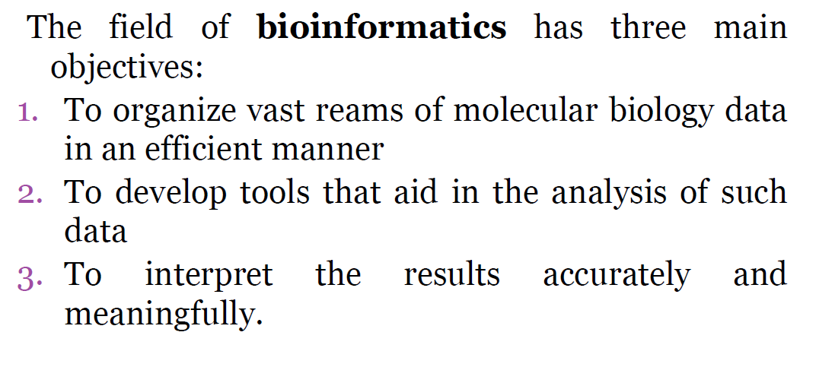
Aim of Bioinformatics
© Dr. Pritam Chattopadhyay

Slide 32
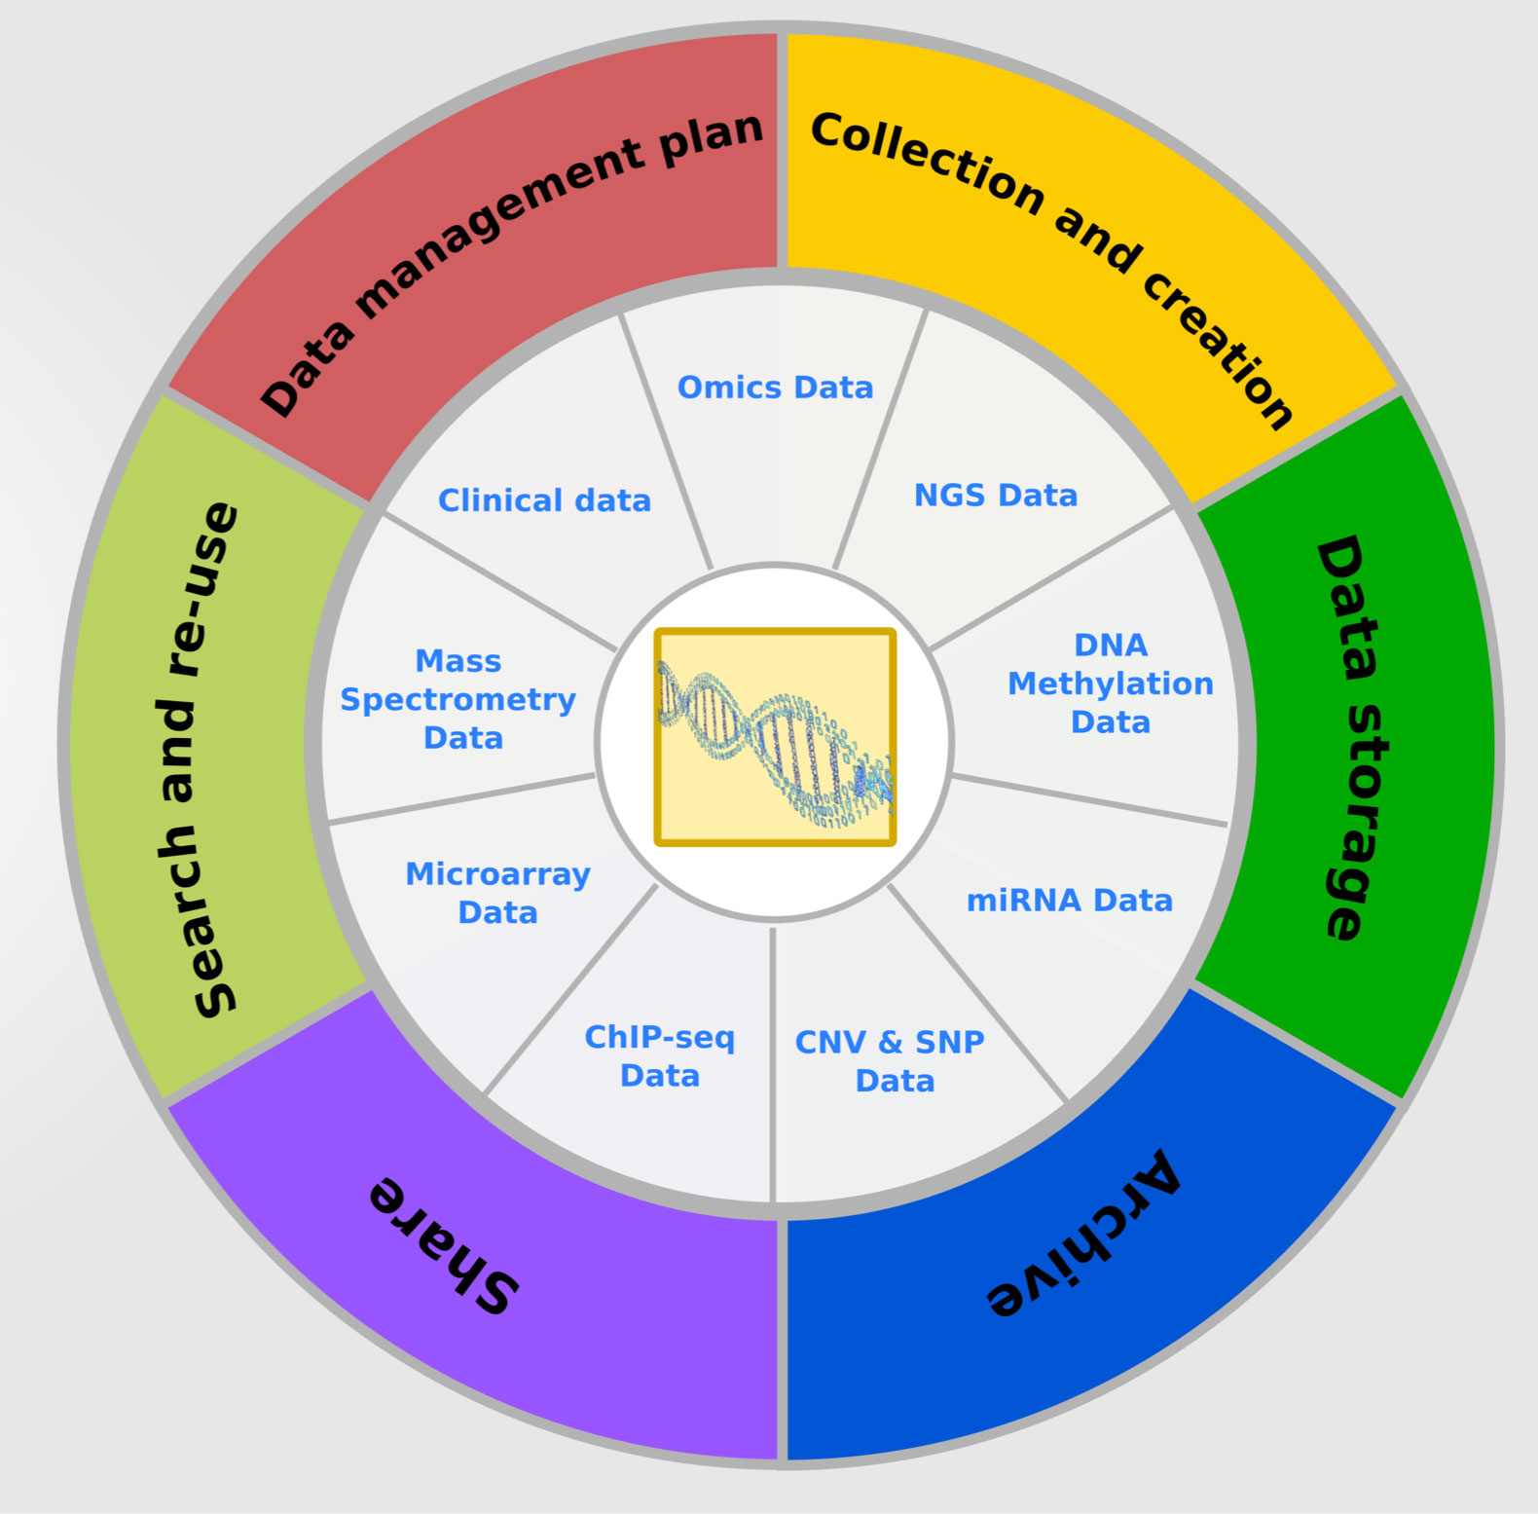
Biological Data Management
First, at its simplest bioinformatics organizes data in a way that allows researchers to access existing information and to submit new entries as they are produced, eg the Protein Data Bank for 3D macromolecular structures. While data- curation is an essential task, the information stored in these databases is essentially useless until analyzed. Thus the purpose of bioinformatics extends much further.
© Dr. Pritam Chattopadhyay

Slide 33
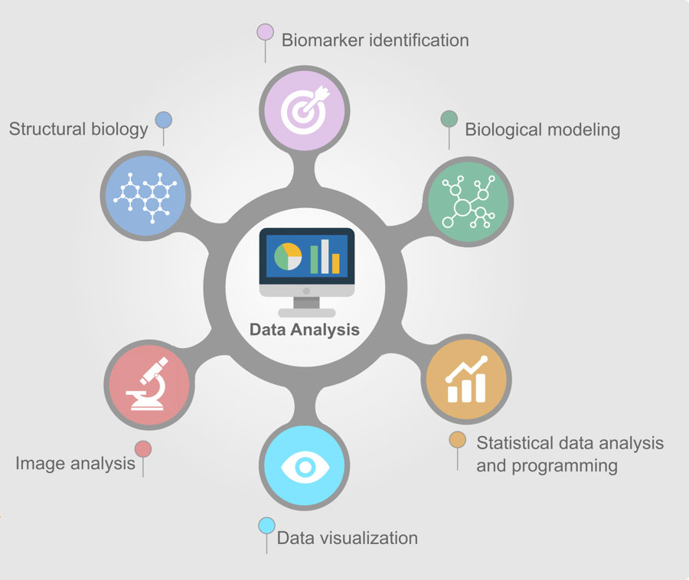
Biological Data Analysis
The second aim is to develop tools and resources that aid in the analysis of data. For example, having sequenced a particular protein, it is of interest to compare it with previously characterized sequences. This needs more than just a simple text-based search and programs such as FASTA and PSI-BLAST must consider what comprises a biologically significant match. Development of such resources dictates expertise in computational theory as well as a thorough understanding of biology.
© Dr. Pritam Chattopadhyay

Slide 34
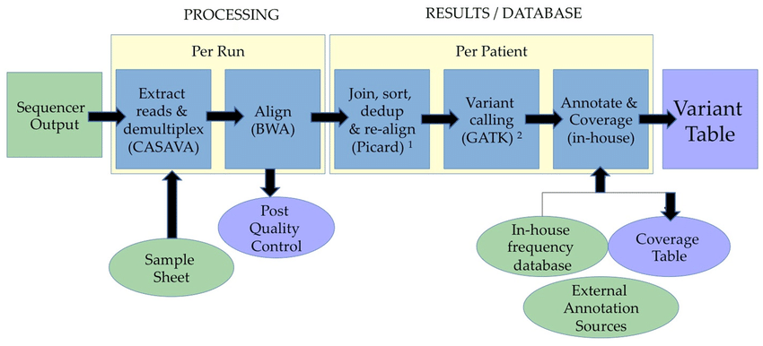
Biological Data Interpretation
The third aim is to use these tools to analyze the data and interpret the results in a biologically meaningful manner. Traditionally, biological studies examined individual systems in detail, and frequently compared them with a few that are related. In bioinformatics, we can now conduct global analyses of all the available data with the aim of uncovering common principles that apply across many systems and highlight novel features.
Data interpretation pipeline. Example of DNA-seq Bioinformatics Pipeline for Illumina
© Dr. Pritam Chattopadhyay

Slide 35
Biological Data Interpretation
Applying algorithms to analyze genomics data
-Accession #?
-Annotation?
Is it already in databases?
Protein characteristics?
Other information?
-Sub-localization
-Soluble?
-3D fold
-Expression profile?
-Mutants?
You have just cloned a gene
Is there conserved regions?
Is there similar sequences?
Evolutionary relationship?
-Alignments?
-Domains?
-% identity?
-Family member?
-Phylogenetic tree
A critical failure of current bioinformatics is the lack of a single software package that can perform all of these functions.
© Dr. Pritam Chattopadhyay

Slide 36
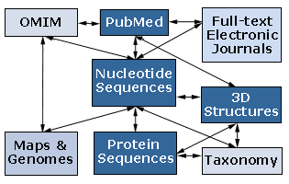
Biological Data Interpretation
Biological data integration
Classification and supervised machine learning
© Dr. Pritam Chattopadhyay

Slide 37
Scope of Bioinformatics
The Commercial Market
Current bioinformatics market is worth 300 million / year (Half software)
Prediction: $2 billion / year in 5-6 years
~50 Bioinformatics companies:
Genomatrix Software, Genaissance Pharmaceuticals, Lynx, Lexicon Genetics, DeCode
Genetics, CuraGen, AlphaGene, Bionavigation, Pangene, InforMax, TimeLogic,
GeneCodes, LabOnWeb.com, Darwin, Celera, Incyte, BioResearch Online, BioTools,
Oxford Molecular, Genomica, NetGenics, Rosetta, Lion BioScience, DoubleTwist,
eBioinformatics, Prospect Genomics, Neomorphic, Molecular Mining, GeneLogic,
GeneFormatics, Molecular Simulations, Bioinformatics Solutions….
© Dr. Pritam Chattopadhyay

Slide 38
Scope of Bioinformatics
Job prospects for Bioinformaticians are applicable to a variety of sectors
*Medical Sector:
Understand life processes in healthy and disease state
Gene therapy
Forensic
*Pharmaceutical and biotech Industry:
1. To find (develop) new and better drugs
2. Gene based or structure based drug design
*Agricultural Applications:
1. Pest, disease, drought resistance plants
2. Higher yield crops
*IT Industry:
Database & Software development, management, maintenance
Clinical Data Management
© Dr. Pritam Chattopadhyay

Slide 39
Scope of Bioinformatics
*Energy Sector
Biofulel cells
*Mining Industry
1. Biomining & Bioleaching
* Environmental Sector
Bioremidiation
Pollution control
Climate change
*Futuristic Industry:
Space Biology
Terraforming
Bioweapon
© Dr. Pritam Chattopadhyay

Slide 40
Scope of Bioinformatics
The various positions that a candidate can hold with a degree in bioinformatics are:
    *Proteomix
    *Scientific curator
    *Researcher
    *Sequence analyst
    *Pharmacology
    *Computational chemist
    *Pharmacogenomics
    *Bioanalysts
    *Content editor
    *Bioinformatician
© Dr. Pritam Chattopadhyay

Slide 41
Scope of Bioinformatics
List of Institutes in India offering Bioinformatics
  *Institute of Bioinformatics and Applied Biotechnology, Bangalore
  *Jawaharlal Nehru University, New Delhi
  *Madurai Kamaraj University
  *Bioinformatics Institute of India, Noida
  *Bharati Vidyapeeth University, Pune
  *Indian Institute of Information Technology (IIIT), Allahabad
  *University of Hyderabad
  *Bioinformatics Institute of India, Noida
  *Jamia Millia Islamia University, New Delhi
  *Kerala University, Thiruvananthapuram
© Dr. Pritam Chattopadhyay

Slide 42
Scope of Bioinformatics
Top companies that hire Bioinformaticians in India:
      *Ranbaxy
      *GVK Biosciences
      *Torrent Pharmaceuticals
      *Astra Zeneca Research Center
      *Biscon
      *Dr. Reddy’s Laboratories
      *Strand Life Sciences
      *Cura Gen
      *Celera Genomics
      *Avestha Gengraine Technologies Pvt. Ltd.
© Dr. Pritam Chattopadhyay

Slide 43
Research areas of Bioinformatics
These are some of the important fields in bioinformatics
1. Structural Bioinformatics:
Predicting the 3D structure of a protein from its protein sequence. Homology modelling is the best method for predicting the protein structures by using already structured or crystallized protein as a template. MODELLER is one of the best software for Homology modelling. Protein Data Bank is the data base for 3D co-ordinates of a protein.
2. Drug Designing:
Drug design is the approach of finding drugs by design, based on their biological targets. Typically a drug target is a key molecule involved in a particular metabolic or signalling pathway that is specific to a disease condition or pathology, or to the infectivity or survival of a microbial pathogen. Computer-assisted drug design uses computational chemistry to discover, enhance, or study drugs and related biologically active molecules.
© Dr. Pritam Chattopadhyay

Slide 44
Research areas of Bioinformatics
3. Phylogenetics:
Predicting the genetic or evolutionary relation of set of organisms. Mitochondrial SNPs and Microsatellites ( DNA repeats) are mostly used in Phylogenetics. MEGA, PAUP are some of the important softwares. Maximum Parsimony and Maximum Likelyhood are mostly used methods.
4. Computational biology:
Computational biology is an interdisciplinary field that applies the techniques of computer science, applied mathematics, and statistics to address problems inspired by biology.
5. Population Genetics:
Population Genetics is a study of genotype frequency distribution and the change in the genotype frequencies under the influence of Natural selection, genetics drift, mutation and gene flow. Coalescent theory is one of the most used theory to predict the most recent ancester. Arlequin is one of the best and most used software in population gentics.
© Dr. Pritam Chattopadhyay

Slide 45
Research areas of Bioinformatics
6. Genotype Analysis:
Genotype = Genetic variation, SNP, Mutation ....
1. Studying Genotype and phenotype association.
2. Studying Genotype frequencies. There is no specific software for genotype analysis. But its called the "Generation Next Market using Bioinformatics....". Genotyping is mostly done using Illumina and Affy microarry chips.
7. Splicing Site prediction:
Splicing prediction is a very important application of Bioinformatics which is very important in Gene expression studies. Visit also Alternative Splicing site Predictior.
© Dr. Pritam Chattopadhyay

Slide 46
Research areas of Bioinformatics
8. MiRNA prediction:
MiRNA = MicroRNA. MiRNA emerged as a new Gene regulatory element and gained more space in research. 20 -23 base pair RNA which regulates a gene or genes. So many methods and softwares have been developed to predicting this tiny RNAs. But still they are not precise in predicting. It means that we need some more information from experimental labs to predict. MiRNA binds to the gene and regulates the gene. Most of the time it down regulate the gene expression. Predicting the MiRNA target is also a very important problem in Bioinformatics.
9. RNA Structure prediction:
The functional form of single stranded RNA molecules frequently requires a specific tertiary structure. The scaffold for this structure is provided by secondary structural elements which are hydrogen bonds within the molecule. This leads to several recognizable "domains" of secondary structure like hairpin loops, bulges and internal loops. There has been a significant amount of bioinformatics research directed at the RNA structure prediction problem.
© Dr. Pritam Chattopadhyay

Slide 47
Research areas of Bioinformatics
10. Gene Prediction:
Predicting the Gene by the predefined conditions. Comparative genomics is the best method for predicting the gene.
11. Transcription factor binding site prediction:
Predicting the transcription factor. Most common method is to use "Comparative genomics". And finding clusters of motifs in the noncoding part of gene.
12. Genome Annotation:
Predicting the genes, coding and noncoding sequences are called genome annotation. Most of the people follow comparative genomics to annotate the newly sequenced genomes.
© Dr. Pritam Chattopadhyay

Slide 48
Research areas of Bioinformatics
13. Ancestry Prediction:
Predicting the Ancestry of an individual based on his/her genetic signatures or SNPs. Mitochondrial SNPs are used in predicting Maternal ancestry because Mitochondria is passed ONLY through mother to the child. Y chromosome SNPs are used in predicting paternal ancestry becuase Y chromsome is passed from Father to the child. Ancestry is one of the successful field in Bioinformatics. Genography project by Dr. Spencer Wells is one of the finest one.
14. Mathematical Modelling:
Using mathemetics to predict the out come of some complex real time problems which cannot be done in lab or in reality. Ex: population dynamics.
15. Ethnicity Prediction:
Predicting the ethnicity of an individual by using genetics variations. Each ethnicity is defined by a set of genetic variations.
© Dr. Pritam Chattopadhyay

Slide 49
Research areas of Bioinformatics
16. Functional Domains prediction:
Predicting the protein domains which are functionaly important from its protein sequence like active sites in a protein.
17. Motif Prediction /Pattern matching:
Predicting the motifs or motif clusters which are functionaly important.
Ex: regulatory motifs, Binding site motifs ...miRNA motics ..repeat motis ...Microsatellites are also a kind of motifs.
18. Protein - protein interaction:
19. Protein folding:
One of the famous and most important and still unsolved problem.
© Dr. Pritam Chattopadhyay

Slide 50
Research areas of Bioinformatics
20. Database development:
In some sense Bioinformatics is called as "Comparative Method". Because Bioinformatics depends on Databases for all of its analysis. So developing data base is a very important project. Many companies surviving by devloping and updating the databases. NCBI , PDB and UCSC genome browser are some of the very important databases.
21. Software development:
Incorporating the usage of Softwares in Biological analysis is called "Bioinformatics".
22. Primer designing:
23. Genome wide Association Studies:
24. Systems Biology:
© Dr. Pritam Chattopadhyay

