Slide 1

Unit 4: Sequence Alignments
Dr. Pritam Chattopadhyay
Department of Botany
MUC Women’s College

Slide 2
Introduction
© Dr. Pritam Chattopadhyay

Slide 3
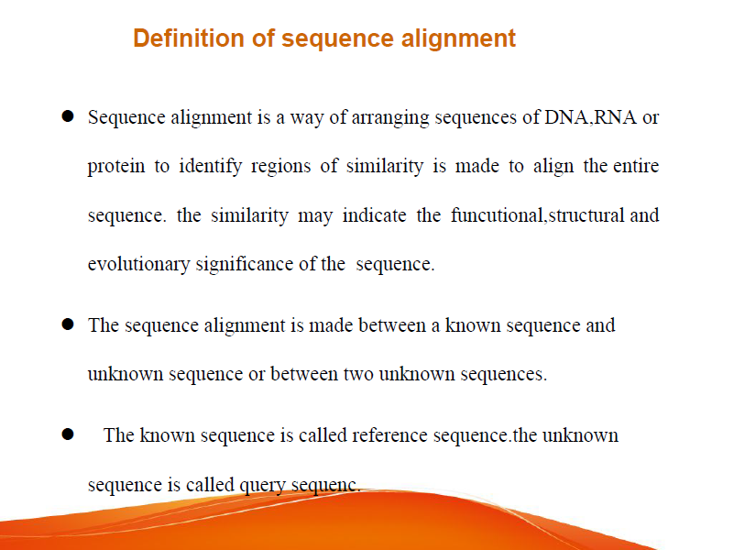
© Dr. Pritam Chattopadhyay

Slide 4
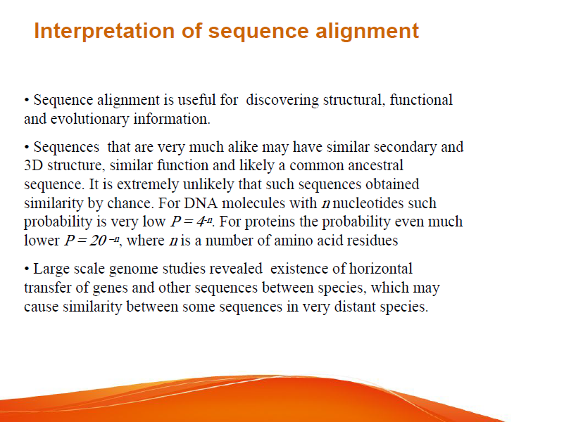

Slide 5
Concepts of Sequence Alignments
© Dr. Pritam Chattopadhyay

Slide 6
Concept of Sequence Alignments
DNA is blue print for living organisms
Evolution is related to changes in DNA
By comparing DNA sequences we can infer evolutionary relationships between the sequences .
Foundation for inferring function, active site, and key mutations
© Dr. Pritam Chattopadhyay

Slide 7
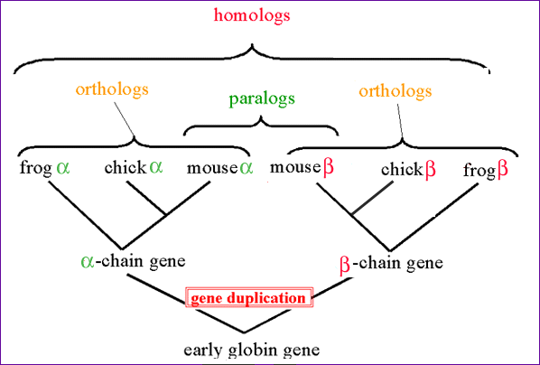
Motivations for Sequence Comparison
© Dr. Pritam Chattopadhyay

Slide 8
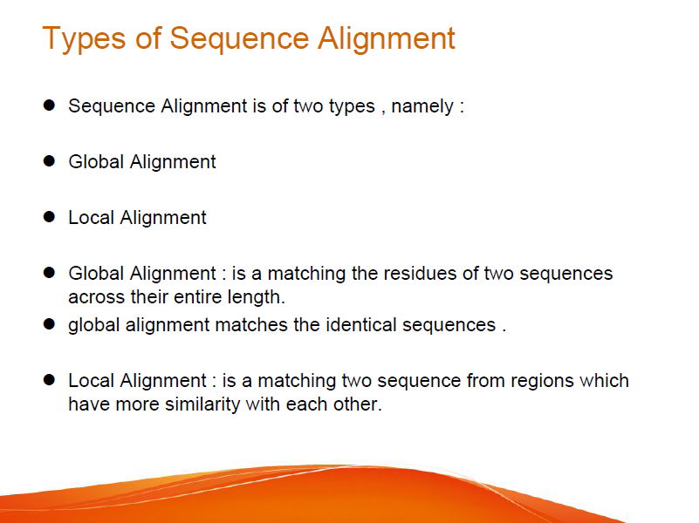
© Dr. Pritam Chattopadhyay

Slide 9
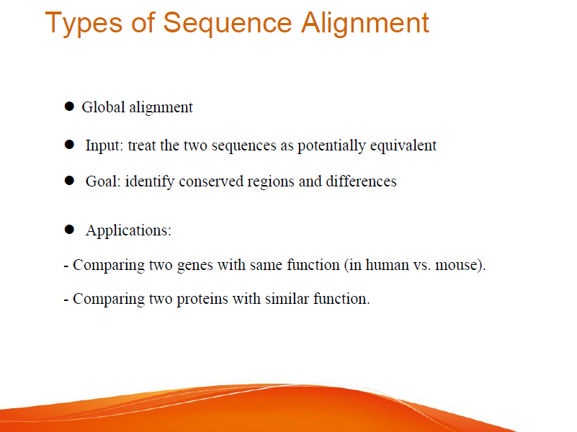
© Dr. Pritam Chattopadhyay

Slide 10
Sequence Alignment
Pairwise alignments
Multiple sequence alignments
© Dr. Pritam Chattopadhyay

Slide 11
Pairwise Sequence Alignment
Pairwise sequence alignment methods are used to find the best-matching piecewise (local or global) alignments of two query sequences.
Given two DNA or AA sequences, find the best way to “line them up”
  Biology allows for variation
  Gaps, mismatches, etc..
HEAGAWGHEE
PAWHEAE
HEAGAWGHE-E
HEAGAWGHE-E
P-A--W-HEAE
--P-AW-HEAE
© Dr. Pritam Chattopadhyay

Slide 12
Pairwise alignments can only be used between two sequences at a time, but they are efficient to calculate and are often used for methods that do not require extreme precision (such as searching a database for sequences with high similarity to a query).
The three primary methods of producing pairwise alignments are dot-matrix methods, dynamic programming, and word methods.
Although each method has its individual strengths and weaknesses, all three pairwise methods have difficulty with highly repetitive sequences of low information content - especially where the number of repetitions differ in the two sequences to be aligned.
One way of quantifying the utility of a given pairwise alignment is the 'maximum unique match' (MUM), or the longest subsequence that occurs in both query sequences. Longer MUM sequences typically reflect closer relatedness.
However, multiple sequence alignment techniques can also align pairs of sequences.
© Dr. Pritam Chattopadhyay

Slide 13
Pairwise Alignments
SIM (Protein only) - k best non-intersecting alignments (EXPASY)
ALIGN - optimal global alignment with no short-cuts (EERIE)
LALIGN - calculates the N-best local alignments (EERIE)
LFASTA - local similarity searches showing local alignments (EERIE)
BLAST 2 - local alignment using BLAST (NCBI)
LAP2 - local DNA to protein alignment with LAP2 (MTU)
© Dr. Pritam Chattopadhyay

Slide 14
Multiple Sequence Alignment (MSA)
© Dr. Pritam Chattopadhyay

Slide 15
Multiple Sequence Alignments
A multiple sequence alignment (MSA) is a sequence alignment of three or more biological sequences, generally protein, DNA, or RNA.
Multiple sequence alignment is often used to assess sequence conservation of protein domains, tertiary and secondary structures, and even individual amino acids or nucleotides.
MSAs require more sophisticated methodologies than pairwise alignment because they are more computationally complex.
Most multiple sequence alignment programs use heuristic methods rather than global optimization because identifying the optimal alignment between more than a few sequences of moderate length is prohibitively computationally expensive.
© Dr. Pritam Chattopadhyay

Slide 16
Multiple alignments are often used in identifying conserved sequence regions across a group of sequences hypothesized to be evolutionarily related.
Such conserved sequence motifs can be used in conjunction with structural and mechanistic information to locate the catalytic active sites of enzymes.
Alignments are also used to aid in establishing evolutionary relationships by constructing phylogenetic trees.
Multiple sequence alignments are computationally difficult to produce and most formulations of the problem lead to NP-complete combinatorial optimization problems.
Nevertheless, the utility of these alignments in bioinformatics has led to the development of a variety of methods suitable for aligning three or more sequences.
© Dr. Pritam Chattopadhyay

Slide 17
Salient features of MSA
• MSA is an alignment generated from three or more sequences.
• MSA is usually a global alignment, i.e., the aim is to align homologous residues (nucleotides or amino acids) in columns across the length of the whole sequences.
                A--GT
                AC-GT
                ACGGT
                -CGGT
Align-ability of sequences
• If the similarity of sequences drops too low, sequences can’t be reliably aligned (accuracy drops below acceptable).
– For proteins <20% similarity
– For DNA <~75% similarity
• This cut-off is called twilight zone.
• In other words, twilight zone marks the sequence similarity below which the observed similarity is mainly due to random variation, and not due to evolution.
© Dr. Pritam Chattopadhyay

Slide 18
Multiple Sequence Alignments
ClustalW 1.7 (DNA/Protein) - Global progressive (BCM)
CAP Sequence Assembly (DNA) - Contig Assembly
MAP (DNA/Protein) - Global progressive in linear space
PIMA 1.4 (Protein only) - Pattern-Induced (local) Multiple Alignment (BCM)
MSA 2.1 (Protein only) - Near-optimal sum-of-pairs global (WashU)
BLOCK MAKER (Protein only) - Finds conserved blocks in seq sets (FHCRC)ClustalW 1.7 (DNA/Protein) - Global progressive (BCM)
MEME 2.2 (DNA/Protein) - Multiple EM for Motif Elicitation (SDSC)
© Dr. Pritam Chattopadhyay

Slide 19
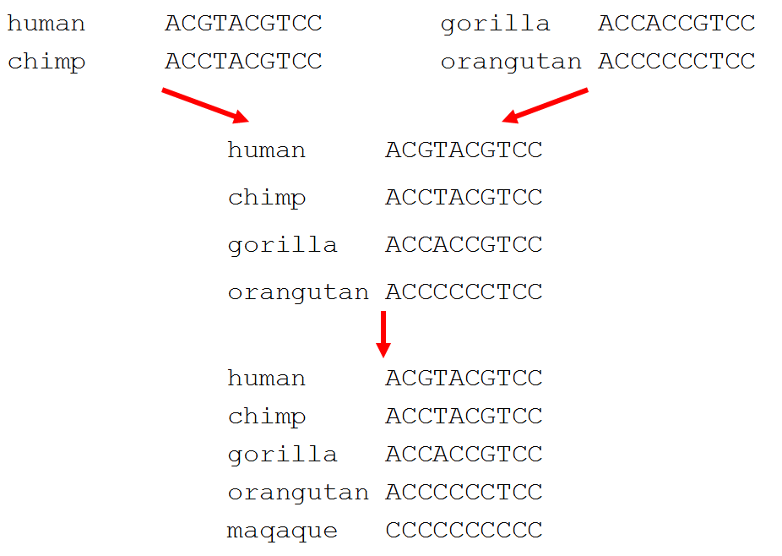
Constructing MSA
© Dr. Pritam Chattopadhyay

Slide 20
MSA by CLUSTALW
© Dr. Pritam Chattopadhyay

Slide 21
CLUSTAL
Clustal is a series of widely used computer programs used in Bioinformatics for multiple sequence alignment. The guide tree in the initial programs was constructed via a UPGMA cluster analysis of the pairwise alignments, hence the name CLUSTAL. The first four versions in 1988 had Arabic numerals (1 to 4), whereas with the fifth version Des Higgins switched to Roman numera lV in 1992. In 1994 and in 1997, for the next two versions, the letters after the letter V were used and made to correspond to W for Weighted and X for X Window.
There have been many variations of the Clustal software, all of which are listed below:
Clustal: The original software for multiple sequence alignments, created by Des Higgins in 1988, was based on deriving phylogenetic trees from pairwise sequences of amino acids or nucleotides.
ClustalV: The second generation of the Clustal software was released in 1992 and was a rewrite of the original Clustal package. It introduced phylogenetic tree reconstruction on the final alignment, the ability to create alignments from existing alignments, and the option to create trees from alignments using a method called Neighbor joining.

Slide 22
ClustalW: The third generation, released in 1994, greatly improved upon the previous
versions. It improved upon the progressive alignment algorithm in various ways, including allowing individual sequences to be weighted down or up according to similarity or divergence respectively in a partial alignment. It also included the ability to run the programin batch mode from the command line.
ClustalW2: This is a general purpose DNA or protein multiple sequence alignment
program for three or more sequences. For the alignment of two sequences please instead use our pairwise sequence alignment tools. The ClustalW2 services have been retired.
ClustalX: This version, released in 1997, was the first to have a graphical user interface.
ClustalΩ (Omega): The current standard version included new MSA tool that uses
seeded guide trees and HMM profile-profile techniques to generate alignments. Suitable for medium-large alignments. The name omega was chosen to mark a change from the previous ones. Clustal Omega has the widest variety of operating systems out of all the Clustal tools.

Slide 23
ClustalW
ClustalW like the other Clustal tools is used for aligning multiple nucleotide or protein sequences in an efficient manner.
It uses progressive alignment methods, which align the most similar sequences first and work their way down to the least similar sequences until a global alignment is created.
ClustalW is a matrix-based algorithm, whereas tools like Tcoffee and Dialign are consistency-based.
ClustalW has a fairly efficient algorithm that competes well against other software. This program requires three or more sequences in order to calculate a global alignment, for pairwise sequence alignment (2 sequences) use tools similar to EMBOSS, LALIGN.
© Dr. Pritam Chattopadhyay

Slide 24
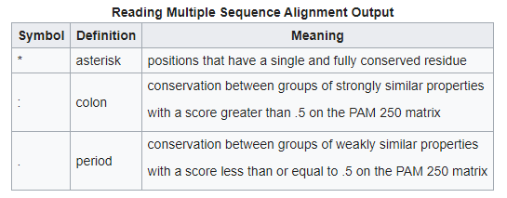
MSA by CLUSTAL W
[A] Input/Output
This program accepts a wide range of input formats, including NBRF/PIR, FASTA,
EMBL/Swiss-Prot, Clustal, GCC/MSF, GCG9 RSF, and GDE.
The output format can be one or many of the following: Clustal,
NBRF/PIR, GCG/MSF, PHYLIP, GDE, or NEXUS.
The same symbols are shown for both DNA/RNA alignments and protein alignments, so
while * (asterisk) symbols are useful to both, the other consensus symbols should be ignored
for DNA/RNA alignments.
© Dr. Pritam Chattopadhyay

Slide 25
[B] Progressive alignment method
ClustalW uses progressive alignment methods as stated above. In these, the sequences with the best alignment score are aligned first, then progressively more distant groups of sequences are aligned.
This heuristic approach is necessary due to the time and memory demand of finding the global optimal solution.
The first step to the algorithm is computing a rough distance matrix between each pair of sequences, also known as pairwise sequence alignment.
The next step is a neighbor-joining method that uses midpoint rooting to create an overall guide tree.
The process it uses to do this is shown in the detailed diagram for the method to the right.
The guide tree is then used as a rough template to generate a global alignment.
© Dr. Pritam Chattopadhyay

Slide 26
[C] Combine pairwise alignment and global alignment
ClustalW was one of the first algorithms to combine pairwise alignment and global alignment in an attempt to be speed efficient, and it worked, but there is a loss in accuracy that other software doesn't have due to this.
[D] Clustering through neighbor-joining method = time complexity
ClustalW has a time complexity of because of its use of the neighbor-joining method. In the updated version (ClustalW2) there is an option built into the software to use UPGMA which is faster with large input sizes. For example, on a standard desktop, running UPGMA on 10,000 sequences would produce results in less than a minute while neighbor-joining would take over an hour.
© Dr. Pritam Chattopadhyay

Slide 27
Limitations of ClustalW
The algorithm ClustalW uses provides a close-to-optimal result almost every time.
However, it does exceptionally well when the data set contains sequences with varied degrees of divergence.
This is because in a data set like this, the guide tree becomes less sensitive to noise.
ClustalW, when compared to other MSA algorithms, performed as one of the quickest while still maintaining a level of accuracy.
There is still much to be improved compared to its consistency-based competitors like T-Coffee.
The accuracy for ClustalW when tested against MAFFT, T-Coffee, Clustal Omega, and other MSA implementations had the lowest accuracy for full-length sequences.
It had the least RAM memory demanding algorithm out of all the ones tested in the study.
While ClustalW recorded the lowest level of accuracy among its competitors, it still maintained what some would deem acceptable.
There have been updates and improvements to the algorithm that are present in ClustalW2 that work to increase accuracy while still maintaining its greatly valued speed.
© Dr. Pritam Chattopadhyay

Slide 28
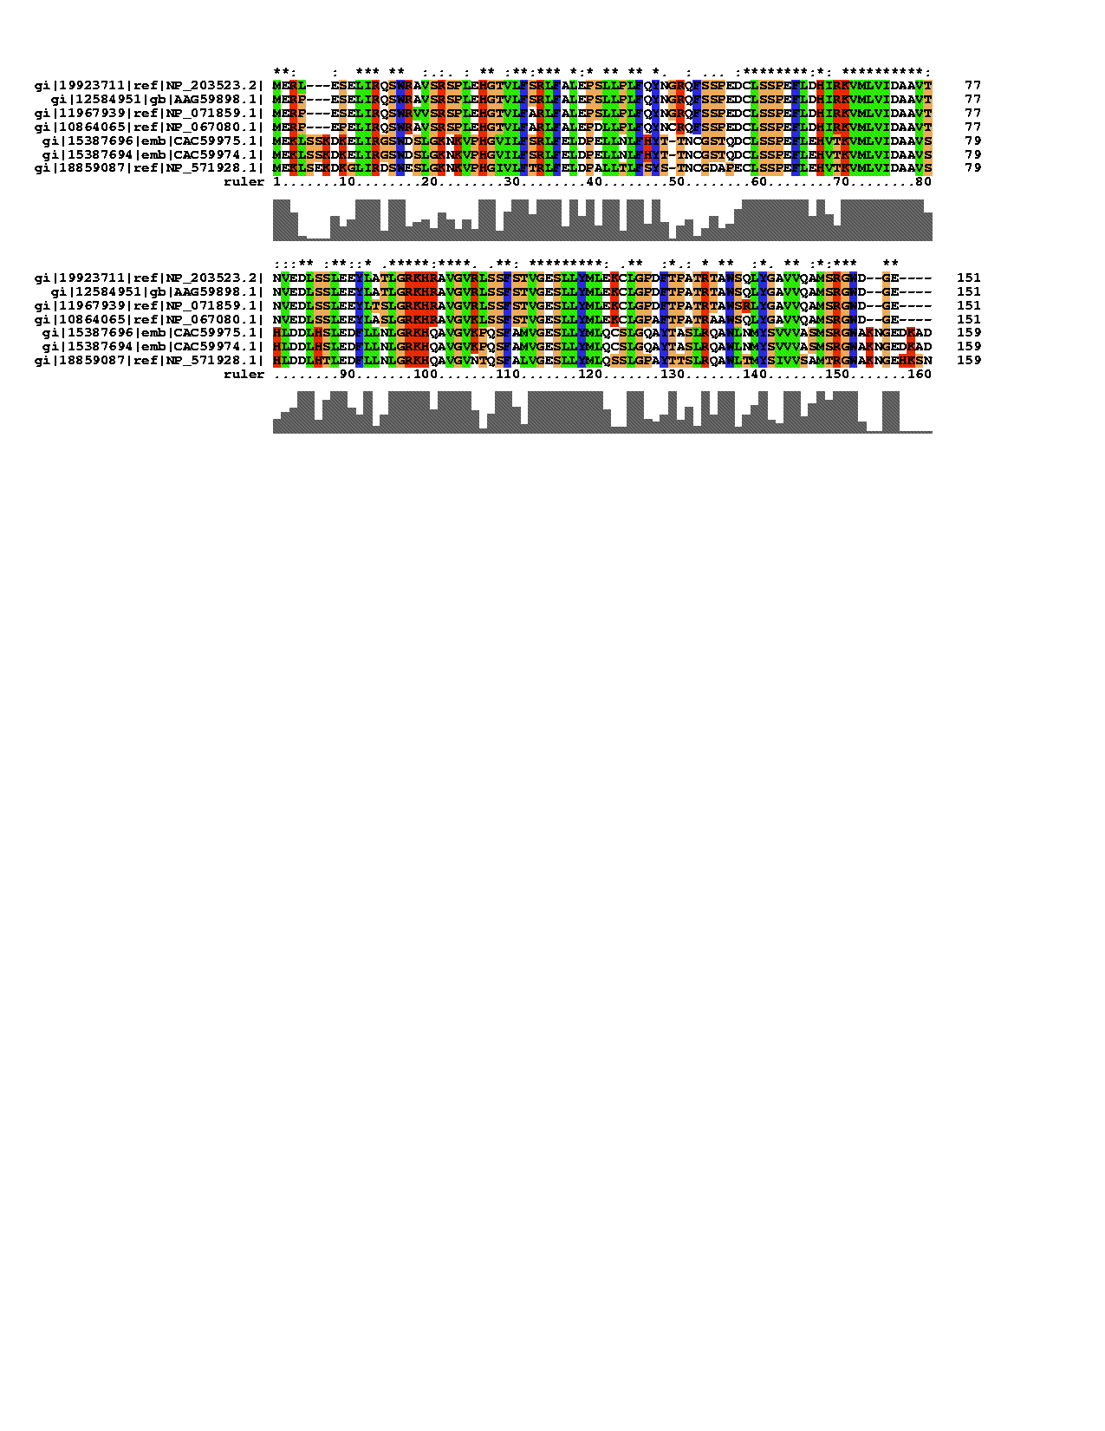
Multiple Sequence Alignment in Clustal w
Extend pairwise problem to multiple sequences
© Dr. Pritam Chattopadhyay

Slide 29
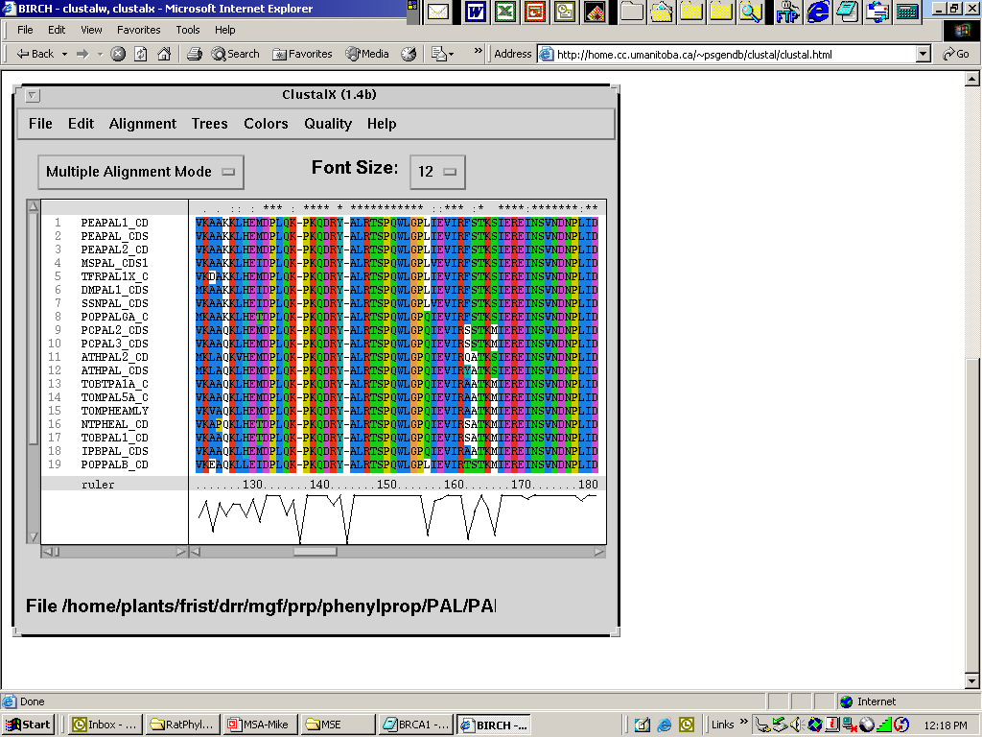
Unix version of ClustalX, the graphical interface to ClustalW, run locally.
Note colors for amino acid qualities and score indicator.
© Dr. Pritam Chattopadhyay

Slide 30
  >FOSB_MOUSE Protein fosB
  MFQAFPGDYD SGSRCSSSPS AESQYLSSVD SFGSPPTAAA SQECAGLGEM PGSFVPTVTA ITTSQDLQWL VQPTLISSMA QSQGQPLASQ PPAVDPYDMP GTSYSTPGLS AYSTGGASGS GGPSTSTTTS GPVSARPARA RPRRPREETL TPEEEEKRRV RRERNKLAAA KCRNRRRELT DRLQAETDQL EEEKAELESE IAELQKEKER LEFVLVAHKP GCKIPYEEGP GPGPLAEVRD LPGSTSAKED GFGWLLPPPP PPPLPFQSSR DAPPNLTASL FTHSEVQVLG DPFPVVSPSY TSSFVLTCPE VSAFAGAQRT SGSEQPSDPL NSPSLLAL
  >FOSB_HUMAN Protein fosB
  MFQAFPGDYD SGSRCSSSPS AESQYLSSVD SFGSPPTAAA SQECAGLGEM PGSFVPTVTA ITTSQDLQWL VQPTLISSMA QSQGQPLASQ PPVVDPYDMP GTSYSTPGMS GYSSGGASGS GGPSTSGTTS GPGPARPARA RPRRPREETL TPEEEEKRRV RRERNKLAAA KCRNRRRELT DRLQAETDQL EEEKAELESE IAELQKEKER LEFVLVAHKP GCKIPYEEGP GPGPLAEVRD LPGSAPAKED GFSWLLPPPP PPPLPFQTSQ DAPPNLTASL FTHSEVQVLG DPFPVVNPSY TSSFVLTCPE VSAFAGAQRT SGSDQPSDPL NSPSLLAL
  >FOS_CHICK Proto-oncogene protein c-fos
  MMYQGFAGEY EAPSSRCSSA SPAGDSLTYY PSPADSFSSM GSPVNSQDFC TDLAVSSANF VPTVTAISTS PDLQWLVQPT LISSVAPSQN RGHPYGVPAP APPAAYSRPA VLKAPGGRGQ SIGRRGKVEQ LSPEEEEKRR IRRERNKMAA AKCRNRRREL TDTLQAETDQ LEEEKSALQA EIANLLKEKE KLEFILAAHR PACKMPEELR FSEELAAATA LDLGAPSPAA AEEAFALPLM TEAPPAVPPK EPSGSGLELK AEPFDELLFS AGPREASRSV PDMDLPGASS FYASDWEPLG AGSGGELEPL CTPVVTCTPC PSTYTSTFVF TYPEADAFPS CAAAHRKGSS SNEPSSDSLS
  >FOS_RAT Proto-oncogene protein c-fos
  MMFSGFNADY EASSSRCSSA SPAGDSLSYY HSPADSFSSM GSPVNTQDFC ADLSVSSANF IPTVTAISTS PDLQWLVQPT LVSSVAPSQT RAPHPYGLPT PSTGAYARAG VVKTMSGGRA QSIGRRGKVE QLSPEEEEKR RIRRERNKMA AAKCRNRRRE LTDTLQAETD QLEDEKSALQ TEIANLLKEK EKLEFILAAH RPACKIPNDL GFPEEMSVTS LDLTGGLPEA TTPESEEAFT LPLLNDPEPK PSLEPVKNIS NMELKAEPFD DFLFPASSRP SGSETARSVP DVDLSGSFYA ADWEPLHSSS LGMGPMVTEL EPLCTPVVTC TPSCTTYTSS FVFTYPEADS FPSCAAAHRK GSSSNEPSSD SLSSPTLLAL
  >FOS_MOUSE Proto-oncogene protein c-fos
  MMFSGFNADY EASSSRCSSA SPAGDSLSYY HSPADSFSSM GSPVNTQDFC ADLSVSSANF IPTVTAISTS PDLQWLVQPT LVSSVAPSQT RAPHPYGLPT QSAGAYARAG MVKTVSGGRA QSIGRRGKVE QLSPEEEEKR RIRRERNKMA AAKCRNRRRE LTDTLQAETD QLEDEKSALQ TEIANLLKEK EKLEFILAAH RPACKIPDDL GFPEEMSVAS LDLTGGLPEA STPESEEAFT LPLLNDPEPK PSLEPVKSIS NVELKAEPFD DFLFPASSRP SGSETSRSVP DVDLSGSFYA ADWEPLHSNS LGMGPMVTEL EPLCTPVVTC TPGCTTYTSS FVFTYPEADS FPSCAAAHRK GSSSNEPSSD SLSSPTLLAL
Sequence data for two related genes: fosB from mouse and human; c-fos from chicken, mouse, and rat.

Slide 31
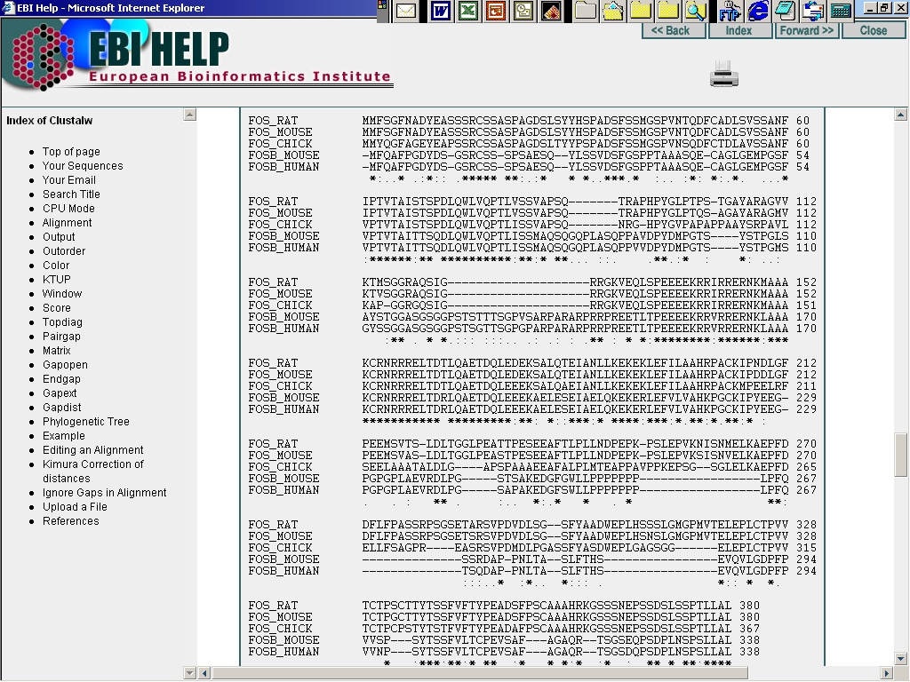
Significant differences between FosB and C-Fos.
Rat and mouse C-Fos sequences differ from chicken C-Fos.
Long conserved region between~130 and 225.
Symbols:
“*” Identity across all sequences
“:” Conservation of amino acid characteristics
“.” Semi-conserved substitutions

Slide 32
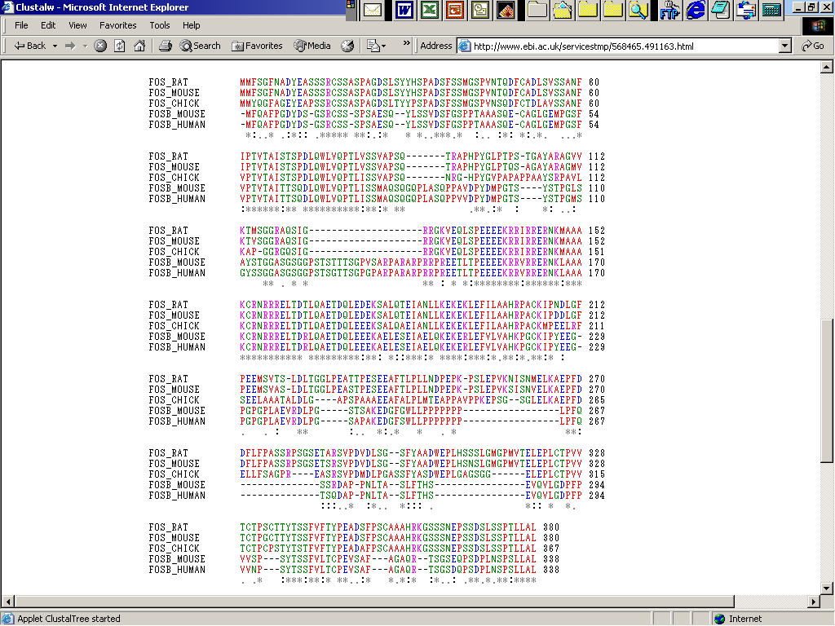
To better visualize conservation, colors can be used.
Color code:
AVFPMILW: RED, Small (small+ hydrophobic (incl.aromatic -Y))
DE: BLUE, Acidic
RHK: MAGENTA, Basic
STYHCNGQ: GREEN, Hydroxyl + Amine + Basic – Q
Others: Grey
Differences between the genes and species are more apparent.

Slide 33
Known Problems of Multiple Alignments
Important sites could be misaligned by the software used for the sequence alignment. That will affect the significance of the site - and the tree. For example: ATG as start codon, or specific amino acids in functional domains.
Gaps - Are treated differently by different alignment programs and should play no part in building trees.
Alignment of a coding region should be compared with the alignment of their protein sequences, to be sure about the placement of gaps.
© Dr. Pritam Chattopadhyay

Slide 34
Scoring Matrices
© Dr. Pritam Chattopadhyay

Slide 35
Scoring Matrices
Score of alignment
1234
ACGT
ACGA
AGGA
If we presume, match=1 & mismatch=0, then we can calculate MSA score for each position of nucleotide
1: A-A + A-A + A-A = 1+1+1 = 3
2: C-C + C-G + C-G =1+0+0 = 1
3: G-G + G-G + G-G = 1+1+1 = 3
4: T-A + A-A + T-A = 0+0+1 =1
• S(alignment) = S(1) + S(2) + S(3) + S(4) = 3+1+3+1 = 8
• The higher the score, the better the alignment
© Dr. Pritam Chattopadhyay

Slide 36
An example of a DNA matrix
Gap penalties
• Gap are evolutionarily expensive.
– Opening is more costly than extension
– Affine gap model
• Mathematically
– P = c + gd
– P is the total gap penalty
– c is gap opening penalty
– d is extension penalty
– g is the (lenght of the gap - 1)
© Dr. Pritam Chattopadhyay

Slide 37
How to calculate an alignment score?
      • match: +4
      • mismatch: -5
      • gap opening: -16
      • gap extension: -4
      • 4+4+(-5)+4+(-16)+4+4+4+4+4 = 11
© Dr. Pritam Chattopadhyay

Slide 38
An example of a Protein matrix
A C D E
A
C
D
E
2 -2 0 0
12 -5 -5
4 3
4
20 different amino acids
  Physical and chemical properties of some are similar.
Aliphatic - G, A, V, L, I, P
Aromatic - F, Y, W
Uncharged polar - S, T, N, Q
Charged - D, E, H, K, R
Sulfur-containing - C, M
Accounts for the observation that some amino acid substitutions are better tolerated than others.
Other types of substitutions are rare.
© Dr. Pritam Chattopadhyay

Slide 39
Uses of matrices
• Sequence alignment
• Database searches
• Phylogenetics
-> Distances between sequences
-> As evolutionary models
• For DNA: IUB (match 1.9, mismatch 0, For local alignments: gap opening
-16 and extension of -4 are typically used.)
• For amino acids: PAM (PAM matrices are based on an explicit evolutionary
model), Blosum (BLOSUM matrices are based on an implicit model)
N.B.: For evolutionary work, matrices are replaced by mathematical models
© Dr. Pritam Chattopadhyay

Slide 40
Percent Accepted Mutation (PAM)
© Dr. Pritam Chattopadhyay

Slide 41
Percent Accepted Mutation
(PAM)
Assumptions
PAM matrices are based on a simple evolutionary model
Only mutations are allowed
Sites evolve independently
Evolution at each site occurs according to a simple (“first-order”) Markov process
Next mutation depends only on current state and is independent of previous mutations
Mutation probabilities are given by a substitution matrix M = [m_{XY}], where m_{xy} = Prob(X → Y mutation) = Prob(Y|X)
Mutation probabilities depend on evolutionary distance
Suppose M corresponds to one unit of evolutionary time.
Let f be a frequency vector (fi = frequency of a.a. i in sequence). Then
– M.f = frequency vector after one unit of evolution.
– If we start with just amino acid i (a probability vector with a 1 in position i and 0s in all others) column i of M is the probability vector after one unit of evolution.
– After k units of evolution, expected frequencies are given by M^{k}.f
© Dr. Pritam Chattopadhyay

Slide 42

PAM matrices
• Percent Accepted Mutation: Unit of evolutionary change for protein sequences
[Dayhoff78].
Acceptable mutations -conserved function
  Number of changes of each amino acid into every other amino acid was counted
  Takes into account the frequency of occurrence of each amino acid (not all amino acids are equally abundant).
Results in a 20 X 20 matrix of probabilities for each possible amino acid substitution.
• A PAM unit is the amount of evolution that will on average change 1% of the amino
acids within a protein sequence.
• Let M be a PAM 1 matrix. Then,
• Reason: M_{ii}’s are the probabilities that a given amino acid does not change, so (1-M_{ii}) is the probability of mutating away from i.
© Dr. Pritam Chattopadhyay

Slide 43
The PAM Family
• Define a family of substitution matrices — PAM 1, PAM 2, etc. — where PAM n is used to compare sequences at distance n PAM.
PAM n = (PAM 1)^{n}
• Do not confuse with scoring matrices!
• Scoring matrices are derived from PAM matrices to yield log-odds scores.
• Initial matrix is derived from very similar proteins.
• However, not all homologs are very similar.
• Extrapolate to encompass greater divergence by multiplication of original matrix
• Results in a series of PAM matrices representing different levels of similarity.
• PAM250,PAM120,PAM80, and PAM60 correspond to 20, 40, 50 and 60 percent similarity, respectively.
• As proteins being compared decrease in similarity, the numerical value of the PAM matrix should increase.
© Dr. Pritam Chattopadhyay

Slide 44
PAM250 mutation probability matrix
Top: original amino acid
Side: replacement amino acid
© Dr. Pritam Chattopadhyay

Slide 45
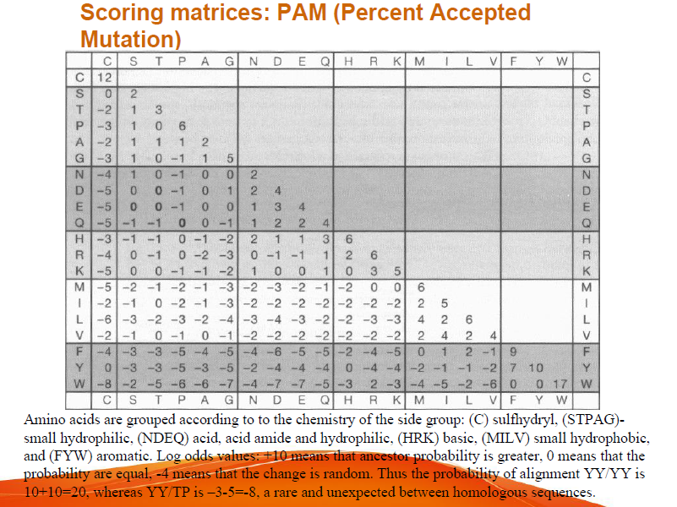
© Dr. Pritam Chattopadhyay

Slide 46
Blocks of Amino Acid Substitution Matrix (BLOSUM)
© Dr. Pritam Chattopadhyay

Slide 47
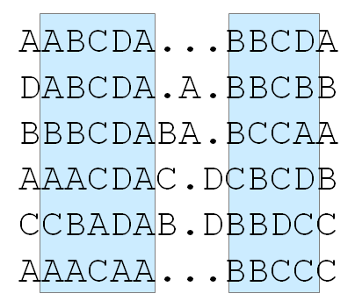
Blocks of Amino Acid Substitution Matrix (BLOSUM)
  Developed from large number of conserved amino acid patterns, termed BLOCKS
  BLOCKS: conserved, ungapped amino acids identified in related proteins
  ~2000 conserved blocks-- thought to act as signatures for families of related proteins.
  BLOSUM 62 matrix derived from BLOCKS exhibiting 62% similarity--
  Higher the number, the greater the similarity opposite of PAM matrix.
Conserved blocks in alignments
© Dr. Pritam Chattopadhyay

Slide 48
Assumptions
  • BLOck SUbstitution Matrix
  • Based on comparisons of blocks of sequences derived from the Blocks database
  • The Blocks database contains multiply aligned ungapped segments corresponding to the most highly conserved regions of proteins (local alignment versus global alignment)
  • BLOSUM matrices are derived from blocks whose alignment corresponds to the BLOSUM-,matrix number
  • Scores for each position are obtained frequencies of substitutions in blocks of local alignments of protein sequences [Henikoff & Henikoff92].
  • For example BLOSUM62 is derived from sequence alignments with no more than 62% identity.
© Dr. Pritam Chattopadhyay

Slide 49
Constructing BLOSUM r
To avoid bias in favor of a certain protein, first eliminate sequences that are more than r% identical
The elimination is done by either
  removing sequences from the block, or
  finding a cluster of similar sequences and replacing it by a new sequence that represents the cluster.
BLOSUM r is the matrix built from blocks with no more the r% of similarity
  E.g., BLOSUM62 is the matrix built using sequences with no more than 62% similarity.
  Note: BLOSUM 62 is the default matrix for protein BLAST
© Dr. Pritam Chattopadhyay

Slide 50
Collecting substitution statistics
Count amino acids pairs in each column; e.g.,
  6 AA pairs, 4 AB pairs, 4 AC, 1 BC, 0 BB, 0 CC.
  Total = 6+4+4+1=15
Normalize results to obtain probabilities (p_{X}’s and q_{XY}’s)
Compute log-odds score matrix from probabilities:
s(X,Y) = log (q_{XY} / (p_{X} p_{y}))
A
A
B
A
C
A
© Dr. Pritam Chattopadhyay

Slide 51
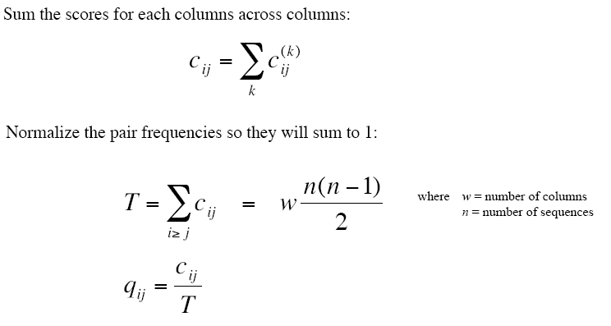
Computing probabilities
From http://www.csit.fsu.edu/~swofford/bioinformatics_spring05/lectures/lecture03-blosum.pdf
© Dr. Pritam Chattopadhyay

Slide 52
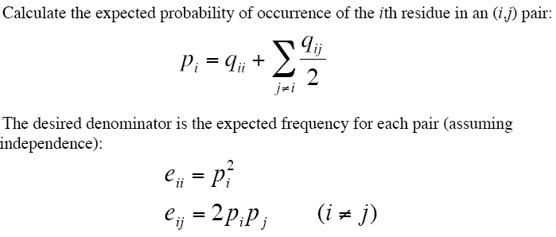
Computing probabilities
© Dr. Pritam Chattopadhyay

Slide 53
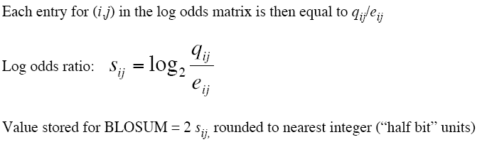
Computing probabilities
© Dr. Pritam Chattopadhyay

Slide 54
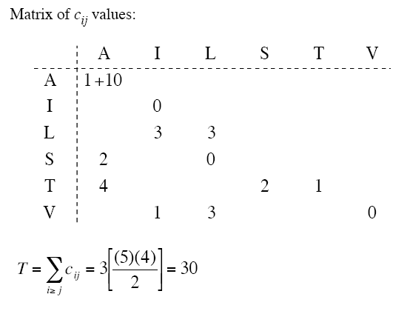
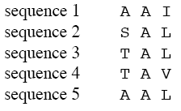
Example
From http://www.csit.fsu.edu/~swofford/bioinformatics_spring05/lectures/lecture03-blosum.pdf
© Dr. Pritam Chattopadhyay

Slide 55
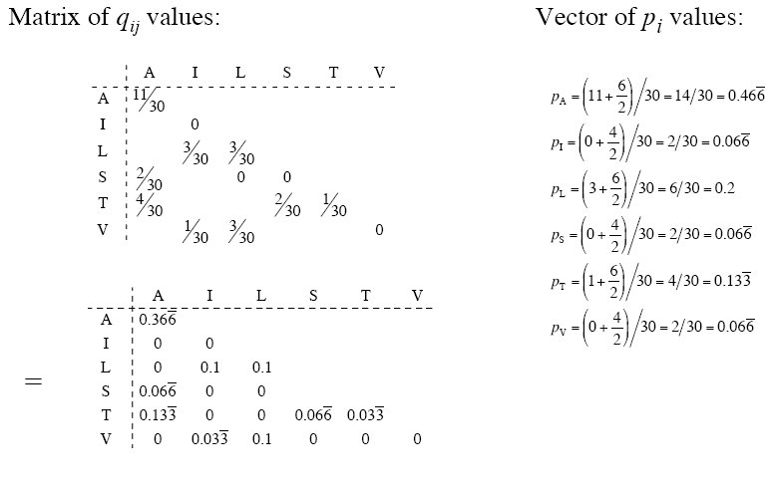
Example
© Dr. Pritam Chattopadhyay

Slide 56
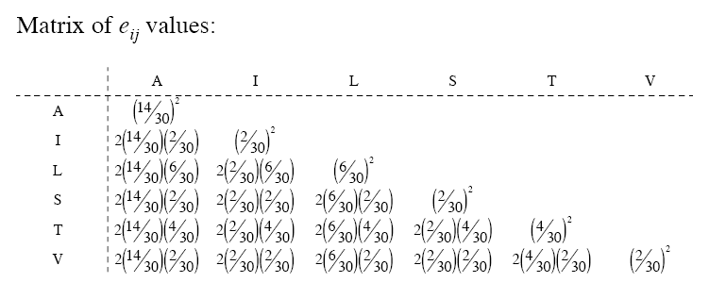
Example
© Dr. Pritam Chattopadhyay

Slide 57
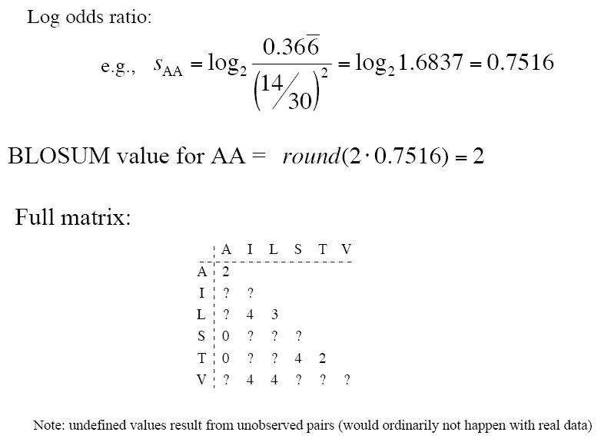
Example
© Dr. Pritam Chattopadhyay

Slide 58
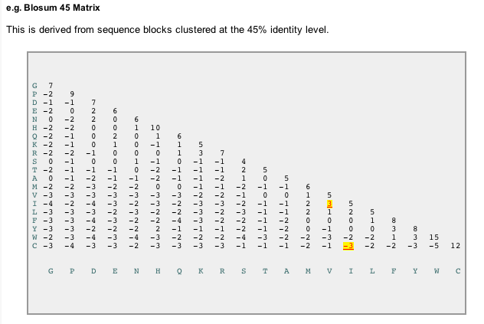
© Dr. Pritam Chattopadhyay

Slide 59
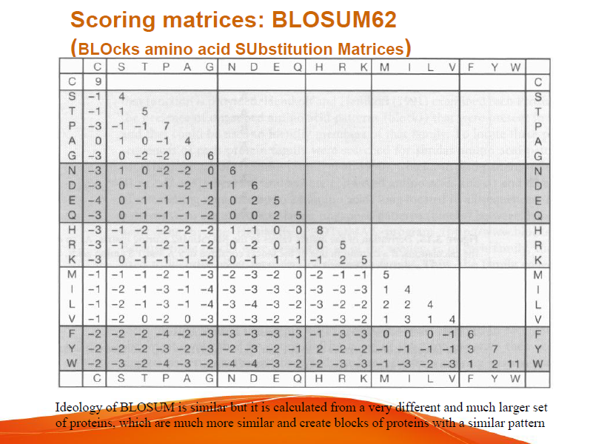
© Dr. Pritam Chattopadhyay

Slide 60

Comparison
PAM is based on an evolutionary model using phylogenetic trees
BLOSUM assumes no evolutionary model, but rather conserved “blocks” of proteins
© Dr. Pritam Chattopadhyay

Slide 61
Equivalent PAM and Blossum matrices (according to H)
PAM100 ==> Blosum90
PAM120 ==> Blosum80
PAM160 ==> Blosum60
PAM200 ==> Blosum52
PAM250 ==> Blosum45
© Dr. Pritam Chattopadhyay

