Slide 1

Unit 5: Molecular Phylogeny
Dr. Pritam Chattopadhyay
Department of Botany
MUC Women’s College

Slide 2
Introduction
© Dr. Pritam Chattopadhyay

Slide 3
Introduction
Phylogeny is the evolution of genetically related group of organisms. Phylogenetics is the study of relationships between collection of "things" (genes, proteins, organs..) that are derived from a common ancestor.
Purpose of phylogenetics:
With the aid of sequences, it should be possible to find the genealogical ties between organisms. Experience learns that closely related organisms have similar sequences; more distantly related organisms have more dissimilar sequences.
One objective is to reconstruct the evolutionary relationship between species.
Another objective is to estimate the time of divergence between two organisms since they last shared a common ancestor.
© Dr. Pritam Chattopadhyay

Slide 4
Phylogenetic Analysis
Study relationships between organisms
  Characteristic similarity
  Sequence similarity
  Whole genome comparison
© Dr. Pritam Chattopadhyay

Slide 5
Molecular phylogenies
In the last thirty years, numerous interesting ex-amples of evolutionary relationships deciphered by sequence analysis have been accumulated
These studies have had important implications in medicine, agriculture, conservation of the species
It is likely that a particular drug effective against a certain type of infection is also effective on infections caused by related organisms
Easy transfer of resistance factors to parasites among closely related plant species Possibility of determining whether a given population of organisms is distinguished enough to be classified as a separate species, to eventually deserve it a special protection
© Dr. Pritam Chattopadhyay

Slide 6
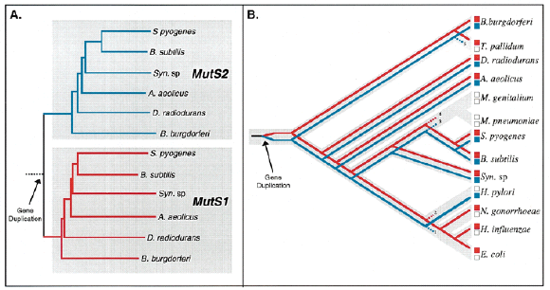
Phylogenetic Analysis
© Dr. Pritam Chattopadhyay

Slide 7
Terminology:
node: a node represents a taxonomic unit. This can be a taxon (an existing species) or an ancestor (unknown species: represents the ancestor of 2 or more species).
terminal nodes: represent the data (e.g sequences) under comparison (A,B,C,D,E), also known as OTUs, (Operational Taxonomic Units).
internal nodes: represent inferred ancestral units (usually without empirical data), also known as HTUs, (Hypothetical Taxonomic Units).
branch: defines the relationship between the taxa in terms of descent and ancestry.
topology: is the branching pattern.
branch length : often represents the number of changes that have occurred in that branch.
root: is the common ancestor of all taxa.
distance scale: scale which represents the number of differences between sequences (e.g. 0.1 means 10 % differences between two sequences)
© Dr. Pritam Chattopadhyay

Slide 8
© Dr. Pritam Chattopadhyay

Slide 9
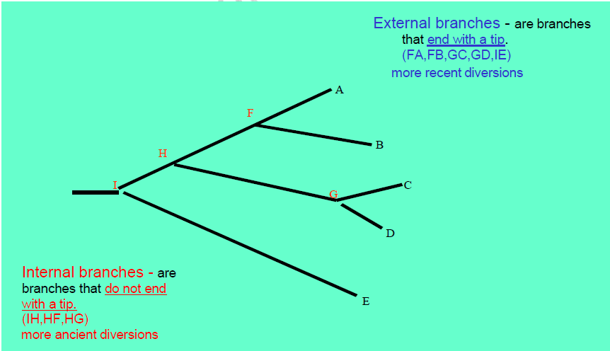
© Dr. Pritam Chattopadhyay

Slide 10
Relationships of phylogenetic analysis and sequences analysis
When 2 sequences found in 2 organisms are very similar, we assume that they have derived from one ancestor. The sequence alignments reveal which positions are conserved from the ancestor sequence.
If two sequences of length N differ from each other at n sites, then their degree of divergence is: n/N or n/N*100%.
The progressive multiple alignment of a group of sequences, first aligns the most similar pair. Then it adds the more distant pairs. The alignment is influenced by the “most similar” pairs and arranged accordingly, but….it does not always correctly represent the evolutionary history of the occurred changes. Not all phylogenetic methods work thisway.
Most phylogenetic methods assume that each position in a sequence can change independently from the other positions. Gaps in alignments represent mutations in sequences such as: insertion, deletion, and genetic rearrangments. Gaps are treated in various ways by the phylogenetic methods. Most of them ignore gaps.
Another approach to treat gaps is by using sequences similarity scores as the base for the phylogenetic analysis, instead of using the alignment itself, and trying to decide what happened at each position. The similarity scores based on scoring matrices (with gaps scores) are used by the DISTANCE methods.
© Dr. Pritam Chattopadhyay

Slide 11
The molecular clock hypothesis
All the mutations occur in the same rate in all the tree branches.
The rate of the mutations is the same for all positions along the sequence.
The Molecular Clock Hypothesis is most suitable for closely related species. Example: DNA Barcoding loci
Theoretical implication of mutation on phylogeny
Orhhologs: genes related by speciation events. Meaning same genes in different species.
Paralogs: genes related by duplication events. Meaning duplicated genes in same species.
© Dr. Pritam Chattopadhyay

Slide 12
Selecting sequences for phylogenetic analysis
(What type of sequence to use, Protein or DNA?)
The rate of mutation is assumed to be the same in both coding and non-coding regions. However, there is a difference in the substitution rate.
Non-coding DNA regions have more substitution than coding regions.
Proteins are much more conserved since they "need" to conserve their function.
So it is better to use sequences that mutate slowly (proteins) than DNA. However, if the genes are very small, or they mutate slowly, we can use them for building the trees.
Sequences that are being compared belong together (orthologs).
If no ancestral sequence is available you may use an "outgroup" as a reference to measure distances.
In such a case, for an outgroup you need to choose a close relative to the group being compared. For example: if the group is of mammalian sequences then the outgroup should be a sequence from birds and not plants.
© Dr. Pritam Chattopadhyay

Slide 13
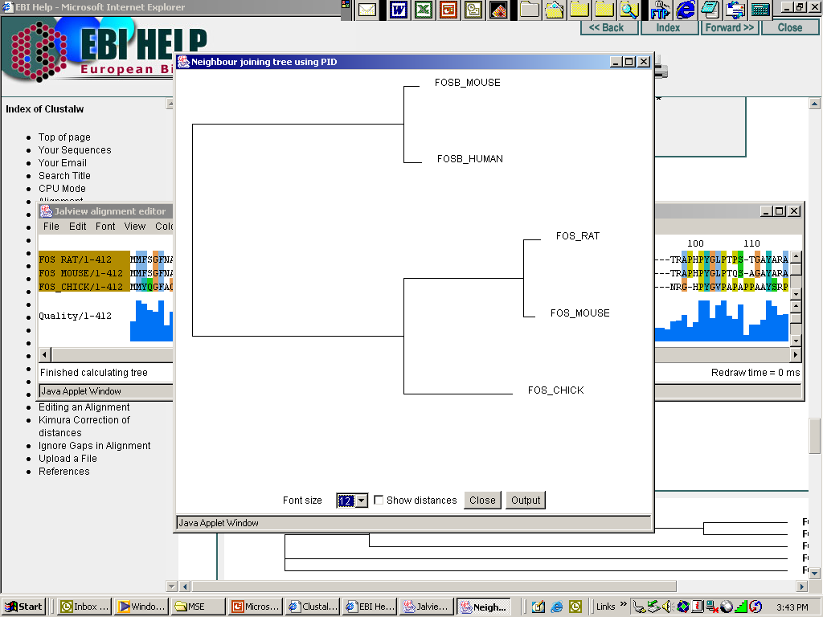
Neighbor Joining tree constructed with a web-ClustalW applet (Jalview)
FosB & c-Fos can be distinguished
Rat & mouse cluster apart from chicken, with respect to c-Fos
© Dr. Pritam Chattopadhyay

Slide 14
Possible ways of drawing a tree:
Trees can be drawn in different ways. There are trees with unscaled branches and with scaled branches.
Unscaled branches: the length is not proportional to the number of changes. Sometimes, the numbers of changes are indicated on the branches with numbers. The nodes represent the divergence event on a time scale.
Scaled branches: the length of the branch is proportional to the number of changes. The distance between 2 species is the sum of the length of all branches connecting them.
It is also possible to draw these trees with or without a root. For rooted trees, the root is the common ancestor. For each species, there is a unique path that leads from the root to that species. The direction of each path corresponds to evolutionary time. An unrooted tree specifies the relationships among species and does not define the evolutionary path.
© Dr. Pritam Chattopadhyay

Slide 15
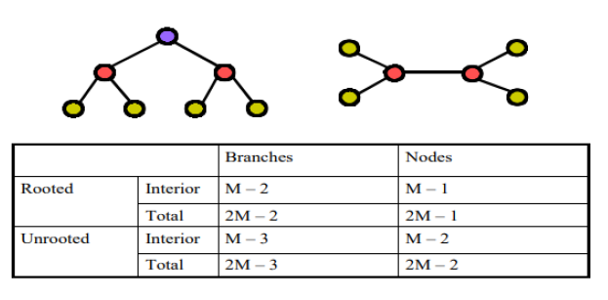

Rooted tree vs. Unrooted tree
The number of tree topologies of rooted tree is much higher than that of the unrooted tree for the same number of OTUs. Therefore, the error of the unrooted tree topology is smaller than that of the rooted tree.
© Dr. Pritam Chattopadhyay

Slide 16
Methods of Phylogeny
© Dr. Pritam Chattopadhyay

Slide 17
Methods of phylogenetic analysis:
There are two major groups of analyses to examine phylogenetic relationships between n sequences:
Phenetic methods:
Ttrees are calculated by similarities of sequences and are based on distance methods. The resulting tree is called a dendrogram and does not necessarily reflect evolutionary relationships. Distance methods compress all of the individual differences between pairs of sequences into a single number. The resulting tree is unrooted and is called a phenogram.
Cladistic methods:
This methods use each alignment position as evolutionary information to build a tree. Trees are calculated by considering the various possible pathways of evolution and are based on parsimony or likelihood methods. The resulting tree is rooted and is called a cladogram.
© Dr. Pritam Chattopadhyay

Slide 18
Phenetic methods
Phenetic methods are based on distances.
Starting from an alignment, pairwise distances are calculated between DNA sequences as the sum of all base pair differences between two sequences (the most similar sequences are assumed to be closely related).
This creates a distance matrix. All base changes can be considered equally or a matrix of the possible replacements can be used.
Insertions and deletions are given a larger weight than replacements. Insertions or deletions of multiple bases at one position are given less weight than multiple independent insertions or deletions.
It is possible to correct for multiple substitutions at a single site.
From the obtained distance matrix, a phylogenetic tree is calculated with clustering algorithms.
These cluster methods construct a tree by linking the least distant pair of taxa, followed by successively more distant taxa.
© Dr. Pritam Chattopadhyay

Slide 19
Phenetic methods
UPGMA clustering (Unweighted Pair Group Method using Arithmetic averages):this is the simplest method
Neighbor Joining: this method tries to correct the UPGMA method for its assumption that the rate of evolution is the same in all taxa.
© Dr. Pritam Chattopadhyay

Slide 20
Cladistic methods
Parsimony: For each position in the alignment, all possible trees are evaluated and are given a score based on the number of evolutionary changes needed to produce the observed sequence changes. The most parsimonious tree is the one with the fewest evolutionary changes for all sequences to derive from a common ancestor. This is a more time-consuming method than the distance methods.
Maximum Likelihood: This method also uses each position in an alignment, evaluates all possible trees, and calculates the likelihood for each tree using an explicit model of evolution (<-> Parsimony just looks for the fewest evolutionary changes). The likelihood's for each aligned position are then multiplied to provide a likelihood for each tree. The tree with the maximum likelihood is the most probable tree. This is the slowest method of all but seems to give the best result and the most information about the tree.
© Dr. Pritam Chattopadhyay

Slide 21
Building phylogenetic trees
Main methods:
Distances matrix methods
◆ UPGMA,
◆ Neighbour Joining
Character based methods:
◆ Parsimony methods
◆ Maximum Likelihood method
Validation method:
◆ Bootstrapping
◆ Jack Knife
© Dr. Pritam Chattopadhyay

Slide 22
Distance based methods
Distance-based methods must transform the sequence data into a pairwise similarity matrix for use during tree inference
Given such an input matrix we want to find an edge-weighted tree where the leafs of the tree correspond to the species and the distances measured between two leaves corresponds to the corresponding matrix value for the leaves
© Dr. Pritam Chattopadhyay

Slide 23
UPGMA
(Unweighted Pair Group Method with Arithmetic mean)
The oldest distance matrix method
Uses a distance matrix representing measure of genetic distance between pairs of species being considered
Clusters the two closest species  Compute new distance matrix using arithmetic mean to first cluster
Repeat until all species grouped
Scaled trees, where the length of the branches correspond to the degree to which sequences have diverged are called cladograms
© Dr. Pritam Chattopadhyay

Slide 24
UPGMA (Cont.)
If rates of evolution are assumed to be constant in all lineages then internal nodes are placed at equal distances from each of the species they give rise to on a bifurcating tree (UPGMA ex.)
So UPGMA is very simple and generates rooted trees, however…
    • Major weakness is that the algorithm assumes that rates of evolution are the same among different lineages
• This does not fit existing biological data, so probably shouldn’t use UPGMA to build phylogenetic trees
Several distance matrix-based alternatives to UPGMA allow different rates of evolution within different lineages e.g. Neighbour Joining.
© Dr. Pritam Chattopadhyay

Slide 25
NJ (Neighbor Joining)
This methods start with all species arranged in a star tree.
The pair of nodes pulled out (grouped) at each iteration are chosen so that the total length of the branches on the tree is minimized
After a pair of nodes is pulled out, it forms a cluster in the tree and is included in further rounds of iteration (and a new distance matrix is generated)
© Dr. Pritam Chattopadhyay

Slide 26
Character based methods
All character based methods assume that each character substitution is independent of its neighbors.
Parsimony
The concept of parsimony (from the Latin word parcere, to save) is central for the character-based methods for phylogenetic reconstruction
In the biological sense, the term is used to describe the process that leads to prefer a particular evolution-ary path based on the lowest number of predicted mutational events
The two premises that underlie the concept of bio-logical parsimony can be summarized as:
  mutations are extremely rare events
  a model that postulates unlikely events, is probably incorrect.
Those relationships that require the fewest number of mutations to explain the current status of the considered sequences are the most likely correct
© Dr. Pritam Chattopadhyay

Slide 27
Philosophical principle enunciated in the fourteenth century by William of Ockham
Among different ex-planations, the simplest is preferable; it looks need-less to resort to many assumptions if the same event can be explained by few hypotheses
Entia non sunt multiplicanda praeter necessitatem
God created all things, and God would not have created anything complex if he could reach the same task in a simpler way
Ockham’s razor: It represents the basic principle of the modern scientific thought; in its most immediate form suggests the futility of formulating more theories of those that are strictly necessary to explain a given phenomenon
Natural selection favors rapid adaptations, that is obtained through the least possible number of evolutionary steps
Statistically speaking, evolutionary changes are rare, so it is unlikely that they occur many times
© Dr. Pritam Chattopadhyay

Slide 28
Maximum parsimony is an optimality criterion under which the phylogenetic tree that minimizes the total number of character-state changes must be preferred
In general, in order for a position to be informative, regardless of how many sequences are aligned, it must contain at least two different nucleotides, each of which must be present at least twice
The non-informative positions are simply discarded and not considered in the subsequent parsimony analysis
Vice versa, non-informative positions do contribute to pairwise similarity scores used in distance-based approaches
Very different conclusions can be drawn depending on the chosen method (distance or character-based)
© Dr. Pritam Chattopadhyay

Slide 29
© Dr. Pritam Chattopadhyay

Slide 30
© Dr. Pritam Chattopadhyay

Slide 31
© Dr. Pritam Chattopadhyay

Slide 32
© Dr. Pritam Chattopadhyay

Slide 33
© Dr. Pritam Chattopadhyay

Slide 34
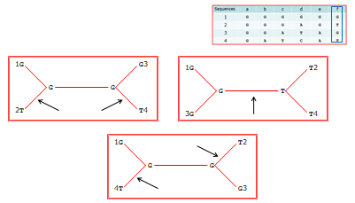
© Dr. Pritam Chattopadhyay

Slide 35
Software for Phylogenetic Analyses
© Dr. Pritam Chattopadhyay

Slide 36
Software for Phylogenetic Analysis
There are software for phylogenetic analysis using different methods and there are software for drawing phylogenetic tree and to view those trees. For example, phylogenetic analysis software that uses distances matrix methods include:
Clustalw, Phylo_win, Paup
Paupsearch, distances (In the GCG software package)
DNADist, PROTDist, Fitch, Kitch, Neighbor (In the Phylip package)
Example of software for drawing phylogenetic trees include:
DRAWGRAM (for drawing unrooted trees in the Phylip package)
FigTree (A stand-alone programme)
Example of software for viewing phylogenetic trees include:
TreeView
© Dr. Pritam Chattopadhyay

Slide 37
Software for Phylogenetic Analysis (Cont.)
However there are popular software packages which includes all the popular methods of phylogenetic analysis along with software for drawing and viewing phylogenetic trees. Example includes:
DAMBE,
MEGA,
PHYLIP,
PAUP
I would recommend MEGA for a start to read in the alignment and have pull-down menus for various types of phylogenetic reconstructions.
© Dr. Pritam Chattopadhyay

Slide 38
Consistency of Molecular Phylogenetic Prediction
© Dr. Pritam Chattopadhyay

Slide 39
Consistency of Molecular Phylogenetic Prediction
Known problems of phylogenetic analysis:
Order of the input data (sequences) - The order of the input sequences effects the tree construction. You can "correct" this effect in some of the programs (like phylip), using the Jumble option. (J in phylip set to 10).
The number of possible trees is huge for large datasets. Often it is not possible to construct all trees, but can guarantee only "a good" tree not the "best tree".
The definition of "best tree" is ambiguous. It might mean the most likely tree, or a tree with the fewest changes, or a tree best fit to a known model, etc.
The trees that result from various methods differ from each other.
Never the less, in order to compare trees, one needs to assume some evolutionary model so that the trees may be tested.
© Dr. Pritam Chattopadhyay

Slide 40
Consistency of Molecular Phylogenetic Prediction (Cont.)
The amount of data used for the tree construction is not always "informative".
For example, if we compare proteins that are 100% similar in a site, we do not have information to infer to phylogenetic relationships between these proteins.
Population effects are often to be considered, especially if we have a lot of variety (e.g. large number of alleles for one protein).
For each dataset it is recommended to build more than one tree. Build a tree using a distance method and if possible also use a character-based method, like maximum parsimony.
The core of the tree should be similar in both methods; otherwise you may suspect that your tree is incorrect.
© Dr. Pritam Chattopadhyay

Slide 41
Consensus tree
A consensus tree provides an estimate for the level of support for each clade in the final tree.
It is built by combining clades which occurred in at least a certain percentage of the resampled trees.
This percentage is called the consensus support threshold.
  A 100% support threshold results in a strict consensus tree which is a tree where the included clades are those that are present in all the trees of the original set.
  A 50% threshold results in a majority rule consensus tree that
  includes only those clades that are present in the majority of the trees in the original set.
  A threshold less that 50% gives rise to a Greedy consensus tree.
© Dr. Pritam Chattopadhyay

Slide 42
Consensus trees (Cont.)
In constructing a Greedy consensus tree clades are first ordered according to the number of times they appear (i.e. the amount of support they have), then the consensus tree is constructed progressively to include all those clades whose support is above the threshold and that are compatible with the tree constructed so far.
The length of the consensus tree branches is computed from the average over all trees containing the clade.
The lengths of tip branches are computed by averaging over all trees. The above definitions apply to rooted trees.
The same principles can be applied to unrooted trees by replacing “clades” with “splits”.
Each branch (edge) in an unrooted tree corresponds to a different split of the taxa that label the leaves of this tree.
© Dr. Pritam Chattopadhyay

Slide 43
Bootstrap analysis
The most popular validation method to check consistency of molecular phylogenetic analysis is bootstrapping analysis.
Bootstrapping is a method for testing how good a dataset fits an evolutionary model.
This method can check the branch arrangement (topology) of a phylogenetic tree.
In Bootstrapping, the program re-samples columns in a multiple aligned group of sequences, and creates many new alignments, (with replacement the original dataset). These new sets represent the population.
The process is done at least 100 times.
I Phylogenetic trees are generated from all the sets.
I Part of the results will show the # of times a particular branch point occurred out of all the trees that were built.
The higher the number - the more valid the branching point.
© Dr. Pritam Chattopadhyay

Slide 44
Example:
Given the following tree, estimate the confidence of the two internal branches
© Dr. Pritam Chattopadhyay

