Slide 1

Project Title - Seasonal Agriculture Performance Analysis
Student Name-PRITAM PATRA
College Name-HALDIA INSTITUTE OF TECHNOLOGY
AICTE STU ID : STU66bcbf100bf251723645712

Slide 2

PROBLEM STATEMENT
Agricultural activities are influenced by seasonal variations in environmental conditions, farming practices, resource availability and market conditions. As a result, agricultural performance may differ from one season to another. However, raw agricultural data does not clearly explain how agricultural performance changes across seasons or what patterns can be observed in different seasonal conditions. The problem is to analyze the given agricultural dataset and investigate seasonal differences in agricultural performance by identifying meaningful patterns, trends, relationships and variations within the available data.

Slide 3
Project Description
Agriculture is highly dependent on seasonal variations, as environmental conditions, farming practices, resource availability, and market factors change throughout the year. These seasonal changes significantly influence agricultural productivity, crop yields, resource utilization, and overall farm performance. However, raw agricultural datasets often do not clearly reveal how agricultural activities and outcomes vary across different seasons, making it difficult to identify meaningful trends and patterns.
The primary objective of this project is to analyze an agricultural dataset and investigate seasonal differences in agricultural performance. The study focuses on examining how various factors such as temperature, rainfall, humidity, soil conditions, cultivation practices, input usage, and market dynamics influence agricultural outcomes during different seasons. By applying data analysis and visualization techniques, the project aims to uncover hidden patterns, seasonal trends, correlations, and variations within the available data.
The analysis involves data preprocessing, classification of records into seasonal categories, exploratory data analysis (EDA), statistical evaluation, and visualization of key performance indicators. Comparative analysis is performed across seasons to identify periods of high and low agricultural productivity, determine the impact of environmental conditions on crop performance, and understand relationships between multiple agricultural variables.

Slide 4

WHO ARE THE END USERS?
The primary end users of the Seasonal Analysis of Agricultural Performance project are:
Farmers
  Understand which seasons provide higher crop yields.
  Plan crop cultivation based on seasonal trends.
  Optimize resource usage such as water, fertilizers, and labor.
Agricultural Researchers
  Study seasonal patterns and their impact on agricultural productivity.
  Identify relationships between environmental factors and crop performance.
Agricultural Officers and Extension Workers
  Provide data-driven recommendations to farmers.
  Develop seasonal farming strategies and awareness programs.
Government and Policymakers
  Formulate agricultural policies based on seasonal performance insights.
  Plan subsidies, irrigation projects, and resource allocation.
Agribusiness Companies
  Forecast demand for seeds, fertilizers, pesticides, and farming equipment.
  Make informed business and supply chain decisions.
Agricultural Planners and Analysts
  Monitor seasonal agricultural performance.
  Identify high-performing and low-performing seasons for better planning.
Students and Academic Institutions
  Use the analysis for research, learning, and educational projects in agriculture and data analytics.

Slide 5

Technology Used
Microsoft Excel
Data cleaning and preprocessing
Sorting and filtering seasonal data
Basic statistical analysis
Python
Pandas: Data cleaning and manipulation
NumPy: Numerical computations
Matplotlib and Seaborn: Data visualization
Scikit-learn: Correlation analysis and predictive modeling
Methodology / Analysis Process
Data Collection
  Import agricultural dataset.
Data Cleaning
  Handle missing values.
  Remove duplicates.
  Standardize seasonal labels.
Exploratory Data Analysis (EDA)
  Analyze crop yield, rainfall, temperature, and resource utilization.
  Identify seasonal patterns.
Data Visualization
  Seasonal yield comparison charts.
  Rainfall vs. production graphs.
  Heatmaps and trend lines.

Slide 6
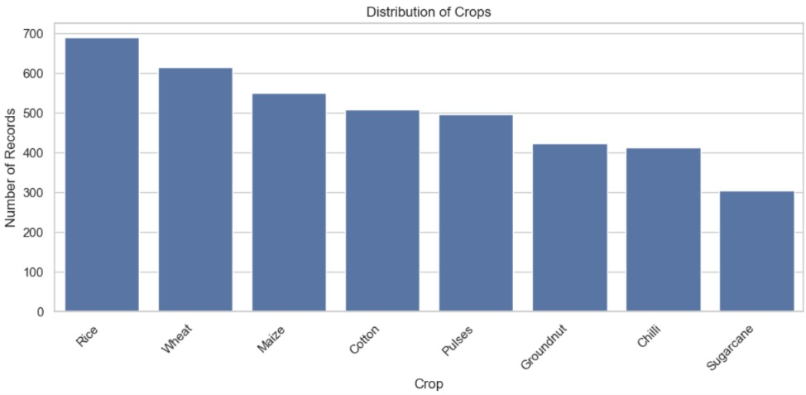
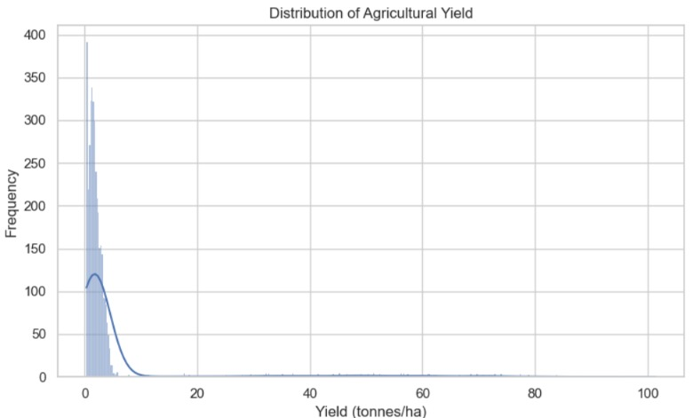
RESULTS

Slide 7
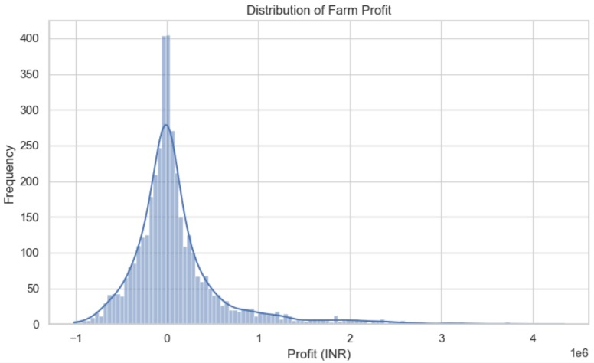
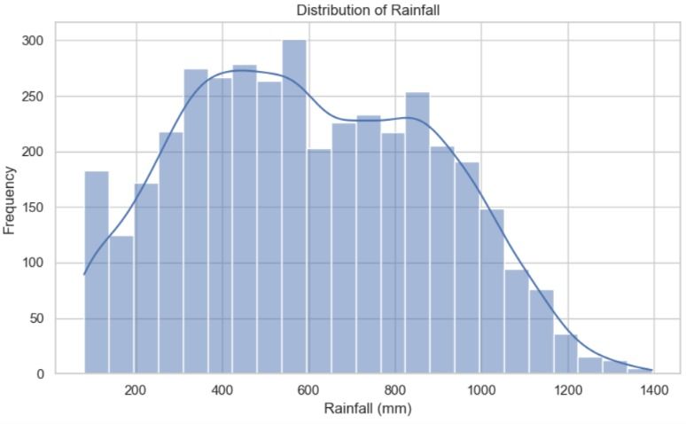
RESULTS

Slide 8
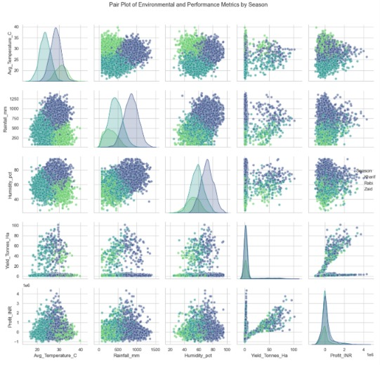
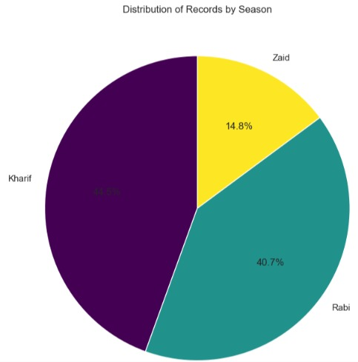
RESULTS

Slide 9
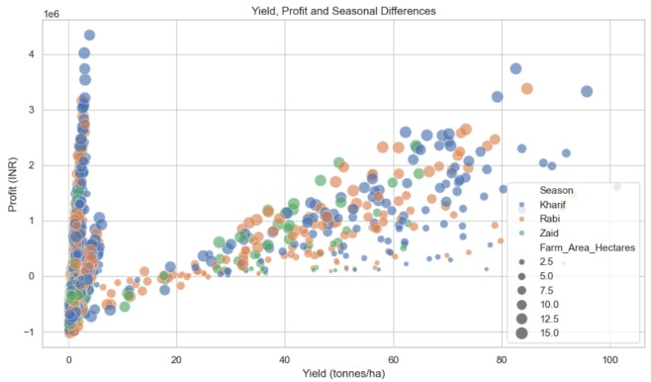
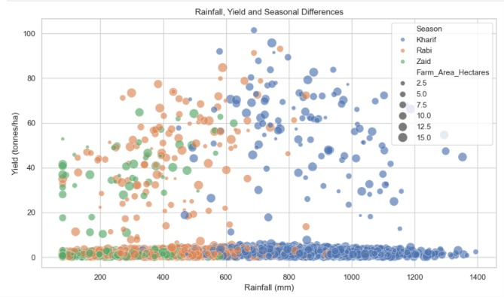
RESULTS

Slide 10
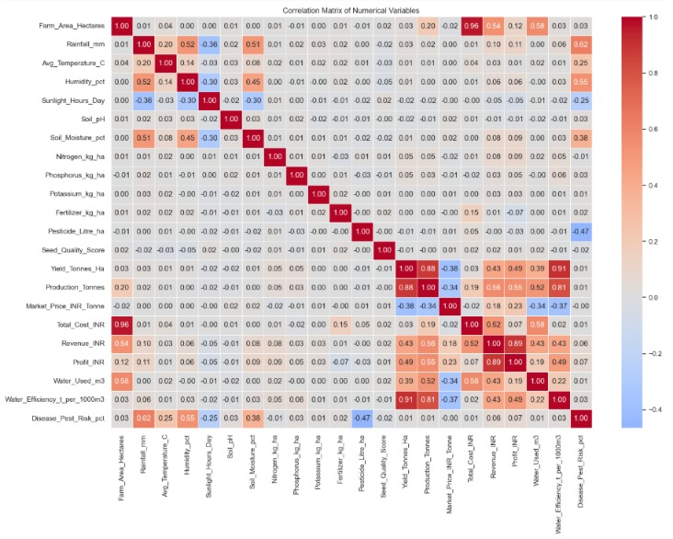
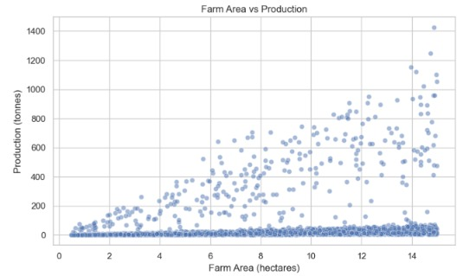
RESULTS

Slide 11
Future scope
The Seasonal Analysis of Agricultural Performance project can be further enhanced by incorporating advanced technologies and larger datasets to improve agricultural decision-making and productivity.
Predictive Analytics
  Develop machine learning models to predict crop yield and agricultural performance for upcoming seasons.
  Forecast production trends based on historical seasonal data.
Real-Time Weather Integration
  Integrate real-time weather data such as rainfall, temperature, and humidity.
  Provide dynamic insights and recommendations for farmers.
Crop Recommendation System
  Suggest suitable crops for specific seasons and environmental conditions.
  Help farmers maximize yield and profitability.
Geospatial Analysis
  Use GIS and satellite imagery to analyze agricultural performance across different regions.
  Identify region-specific seasonal patterns and challenges.
IoT-Based Smart Farming
  Incorporate sensor data from soil moisture, temperature, and irrigation systems.
  Enable real-time monitoring and automated decision-making.
Market Price Forecasting
  Analyze seasonal market trends and predict crop prices.
  Assist farmers in planning production and sales strategies.
Interactive Dashboard Development
  Create advanced Power BI dashboards with real-time updates.
  Allow users to explore seasonal trends through interactive visualizations.
Risk Assessment and Early Warning System
  Detect potential risks such as droughts, floods, pests, or diseases.
  Generate early alerts to minimize crop losses.
Mobile Application Integration
  Develop a user-friendly mobile application for farmers.
  Provide seasonal insights, recommendations, and forecasts on smartphones.
Sustainable Agriculture Planning
Analyze resource utilization and environmental impact across seasons.
Support sustainable farming practices and efficient resource management.

Slide 12
GitHub Link:https://github.com/Pritamp2004/Seasonal-Agriculture-Performance-Data-Analytics.git

Slide 13

VOIS Course completion certificate -
Course name- Data Visualization

Slide 14
Thank you
.
.

