Slide 1
A project presentation on Online Application For Selling Handmade Products
Presented By:
Pritee Rajanikant Mahajan(2087)
Mayuri Suresh Kadam(2067)
Mr.Prashant Karhale Mr. Kashinath Patil
Center Co-ordinator Project Guide
Institute for Advanced Computing and Software Development

Slide 2
Points to discuss
Introduction
Motivation
Objectives
System Architecture
Description of system
Application
Advantages and Disadvantages
Screenshots
Conclusion
References

Slide 3
Introduction
Internet technology involves not only in the traditional industry, but also in e-commerce, Online Shopping is a remarkable case.
Online Shopping will not be restricted by time and region, so it is convenient to understand the information of all commodities.
This development model has promoted the economic development greatly. At the same time, the emergence of trading platform such as mobile payment, online payment, these kinds of payment methods are convenient and quick.

Slide 4
Motivation
Due to the pandemic, many people lost their business or shops.
So to make a platform available to the ordinary seller across different states to sell their product we have developed this web application.
Customer can buy state-specific product without travelling.

Slide 5
Objectives
This system provides customer a state-specific handcrafted product at their place.
Ordinary supplier can sell their handcrafted product.
Admin can manage the supplier.

Slide 6
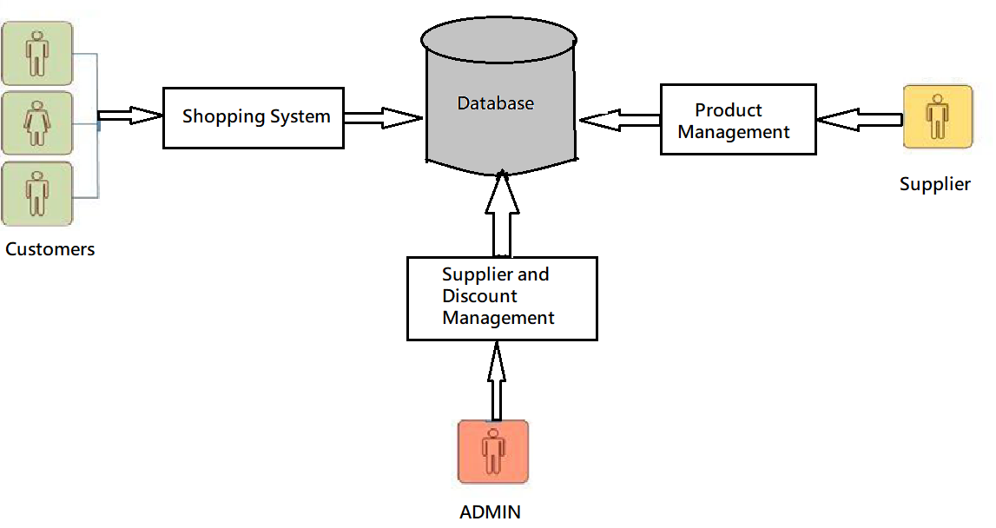
System Architecture

Slide 7
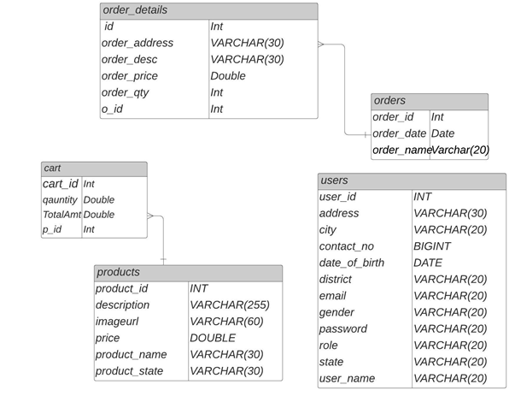
Class Diagram:

Slide 8
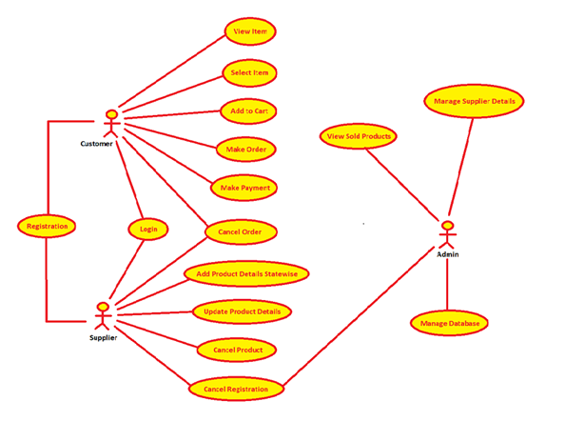
Use Case Diagram:

Slide 9
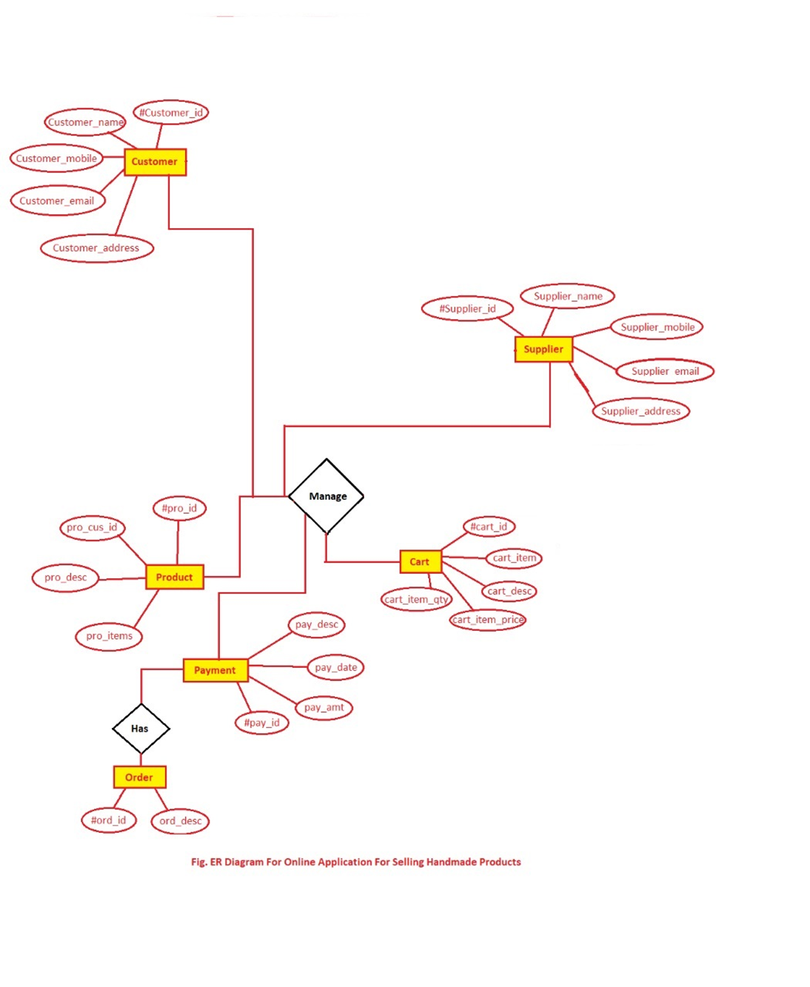

Slide 10
Description of System
This architecture diagram gives us the flow of the overall functionality of the system.
The user of the system selects one product after which the process starts.
This module provides the functionality for customers to place their order. Users of the system, namely customers, must be provided the following functionality:
Create an account.
Log in to the system.
Navigate the gallery.
Add product to cart and can place order.

Slide 11
Application
This system will be implemented as a web application. We have created an Online Handcraft Market website where a gallery of products will be displayed .
As any other Online shopping website, this system will give many options to the user to buy or just view a product .

Slide 12
Advantages and Disadvantages
Advantages:
Can shop for 24/7.
It is more User-Friendly.
It is more time saving
Better service.
Regular monthly discount is available.
Disadvantages:
Not able to touch or try.
Actual product may differ.
Availability of internet is must.

Slide 13
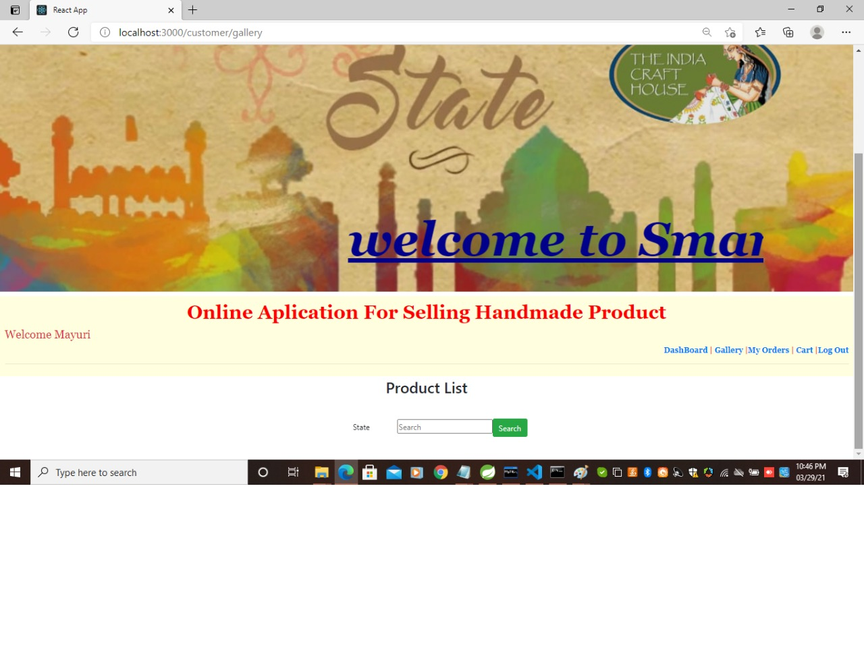
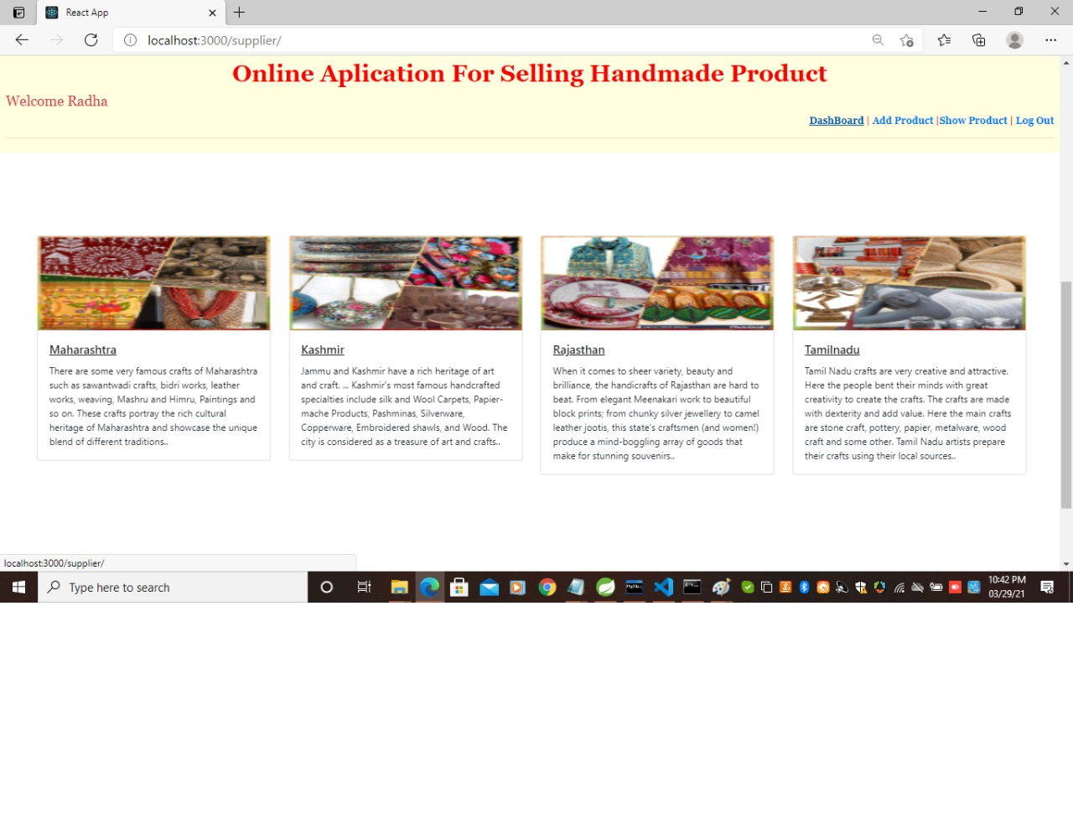
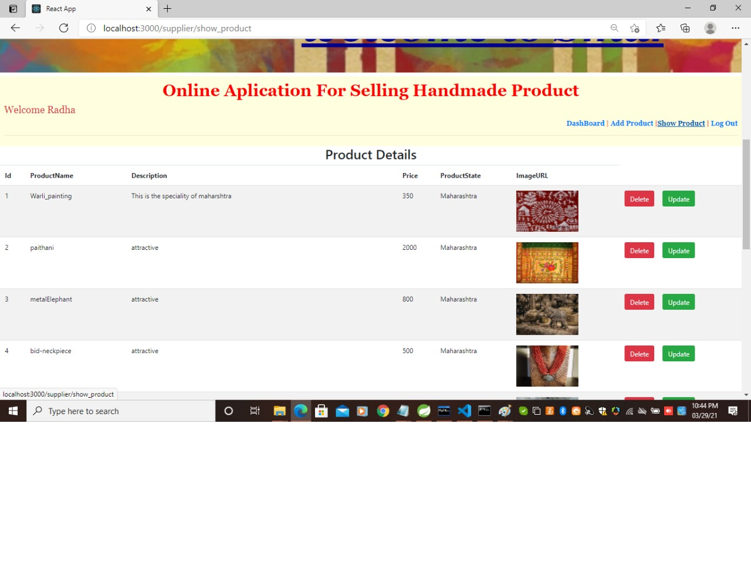
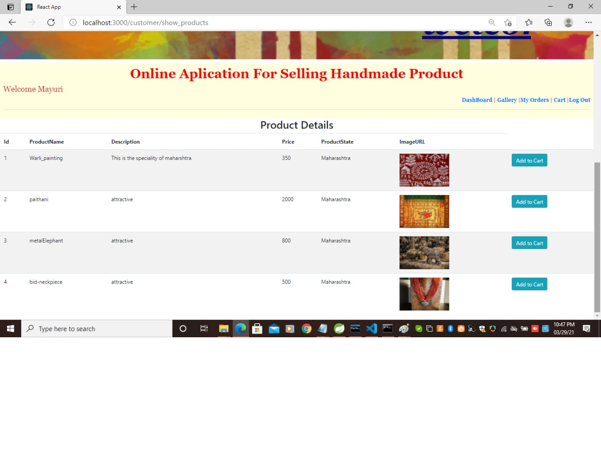

Slide 14
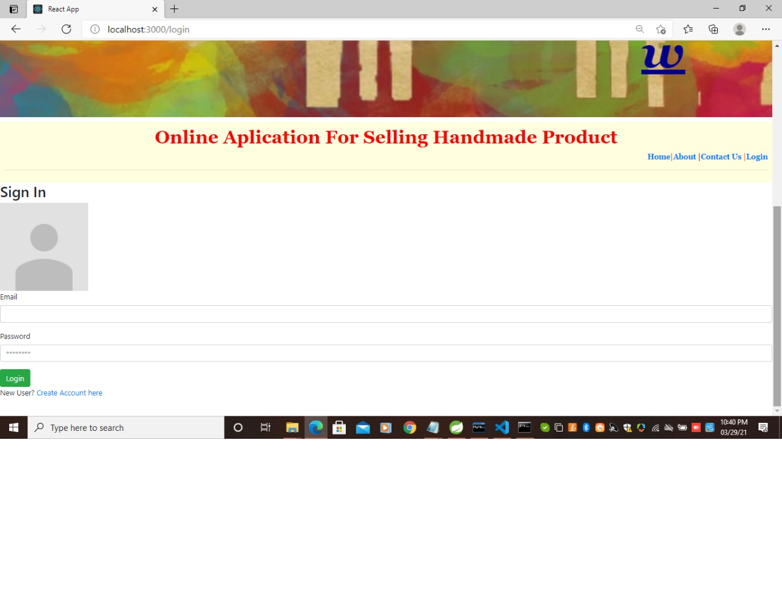
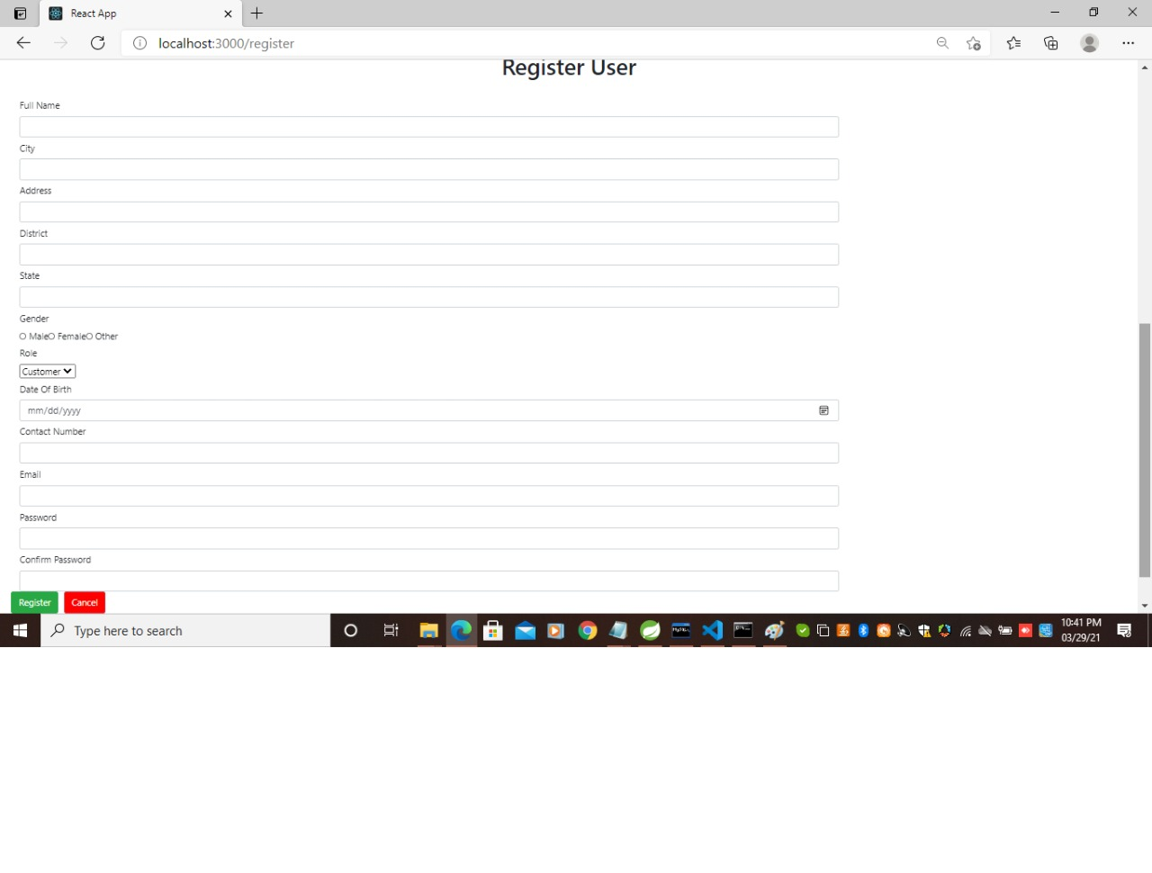
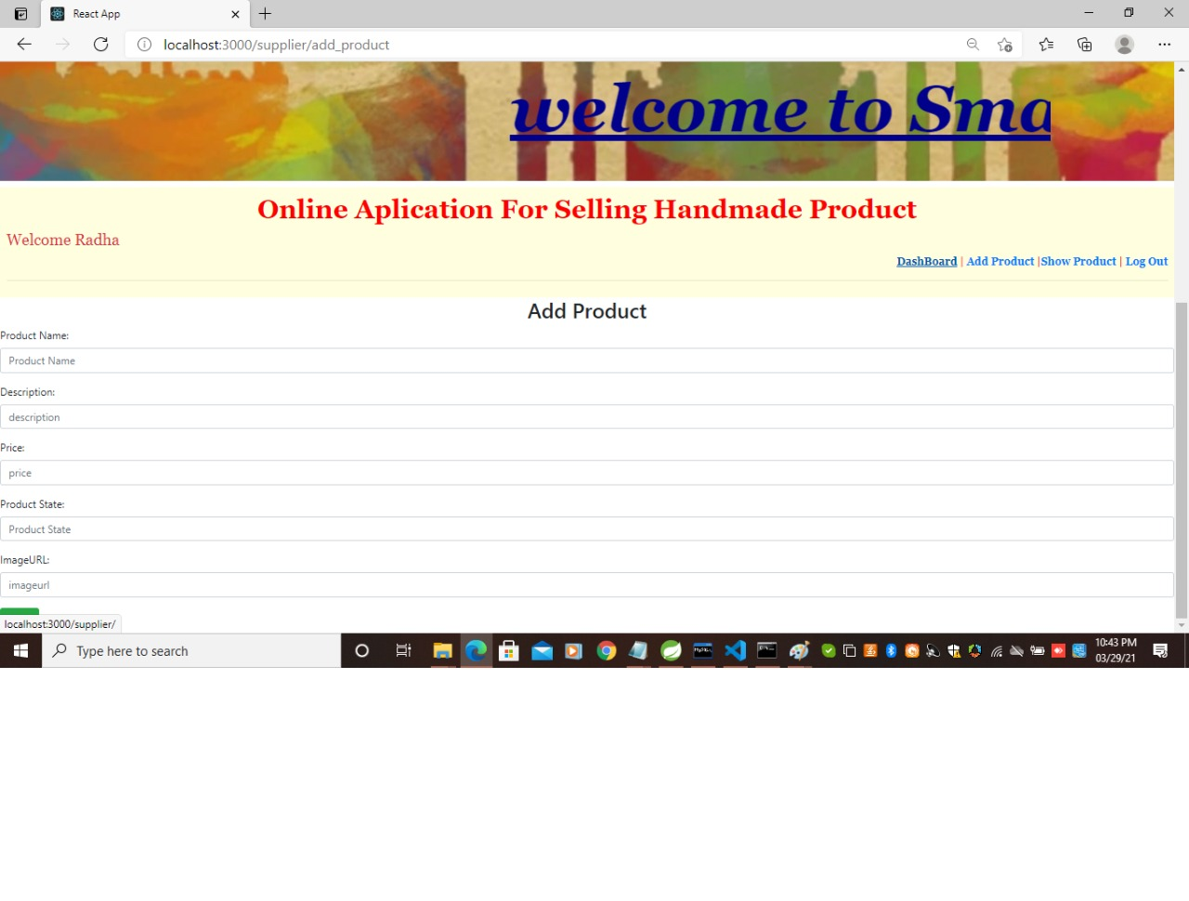

Slide 15
Conclusion
It is user friendly application and promotes user to purchase or shop faster.
Being able to buy anytime anywhere.
Availability of platform to the ordinary seller.
Home delivery you don’t have to travel to shop.

Slide 16
References
Java By Budo Timothy “Understanding Object- Oriented Programming with JAVA” . Pearson,1999
Java By Balgurusamy E “ Programming with JAVA, A Primer” Tata Mcgraw Hill,2006.

Slide 17
THANK YOU!!!!!!

