Slide 1
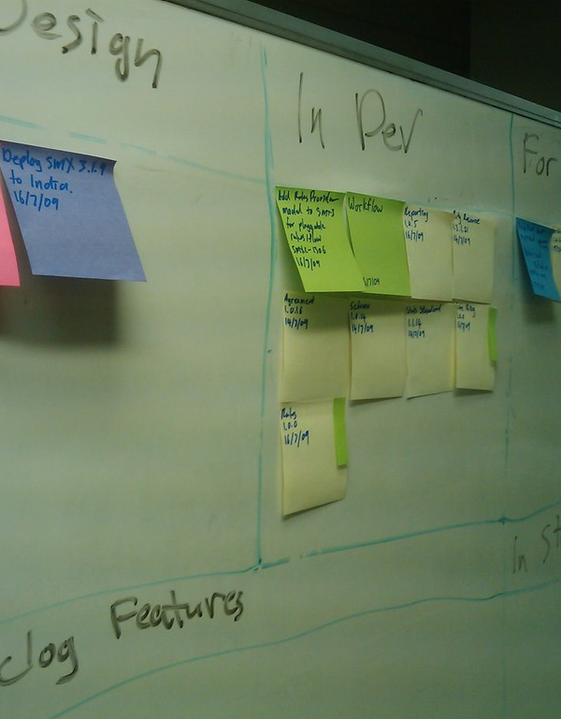
CSYE 7374 Group Project Kanban Board
CSYE
7374
Group
Project
Kanban
Board
CSYE
7374
Group
Project
Kanban
Board
Group 14

Slide 2

PROJECT OVERVIEW

Slide 3
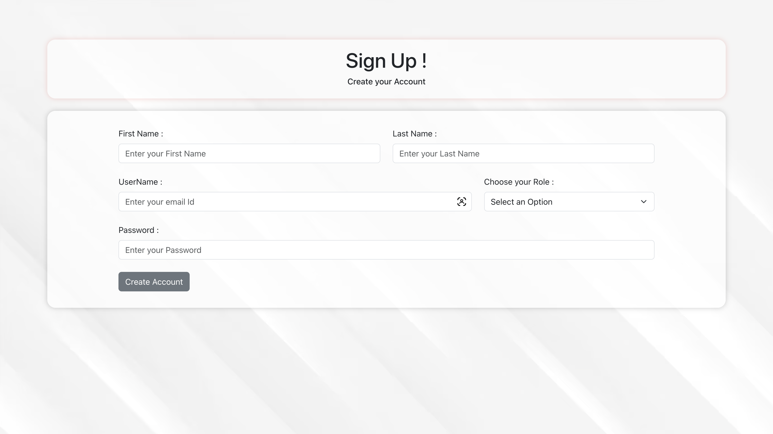

Slide 4
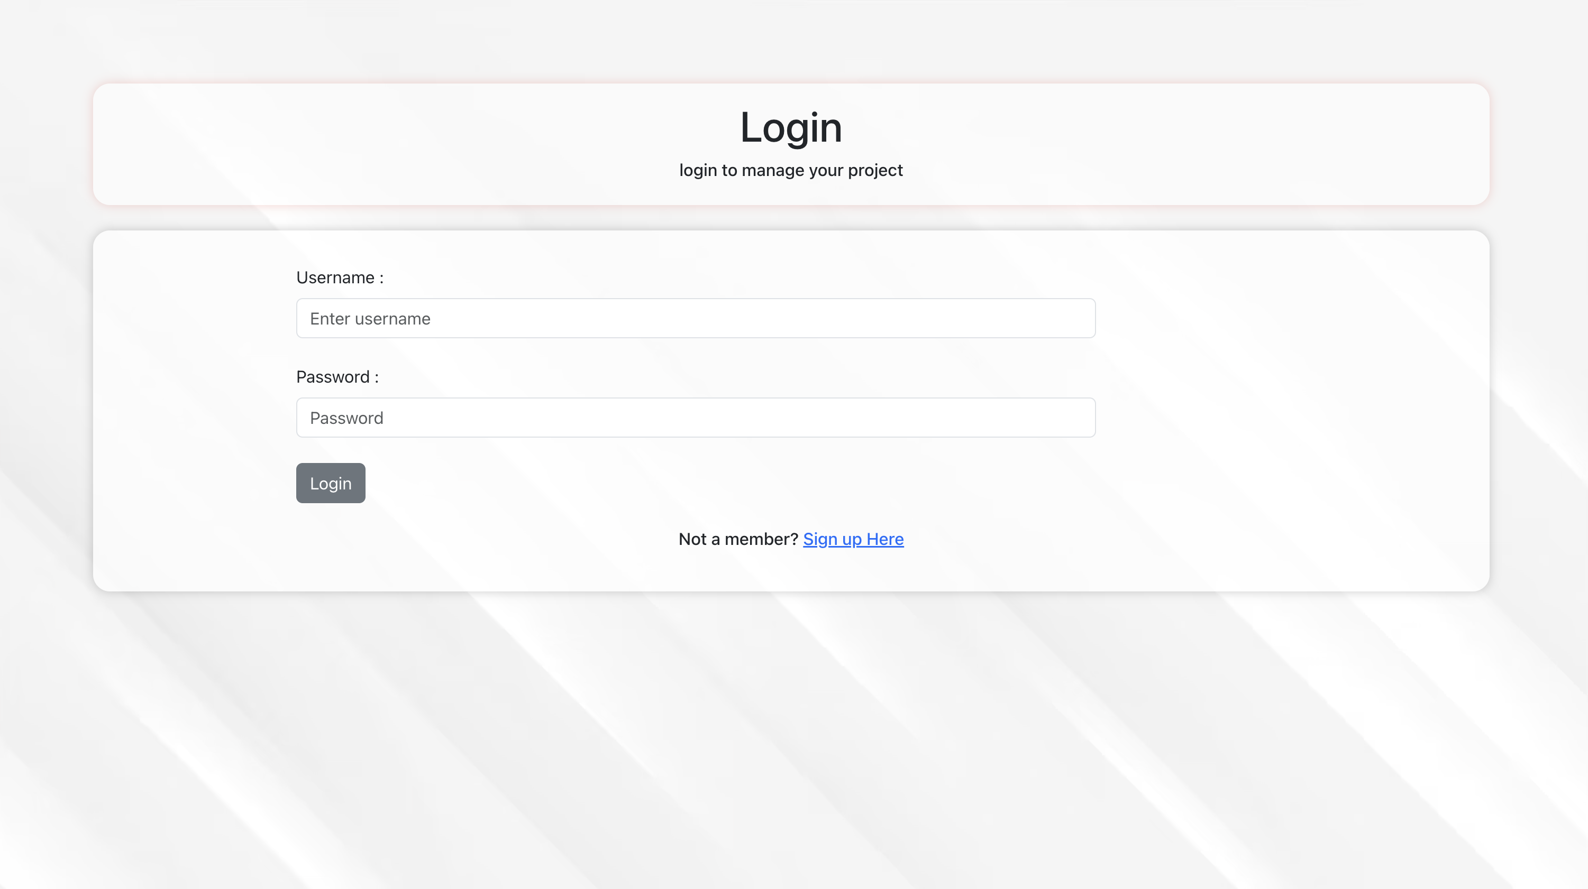

Slide 5
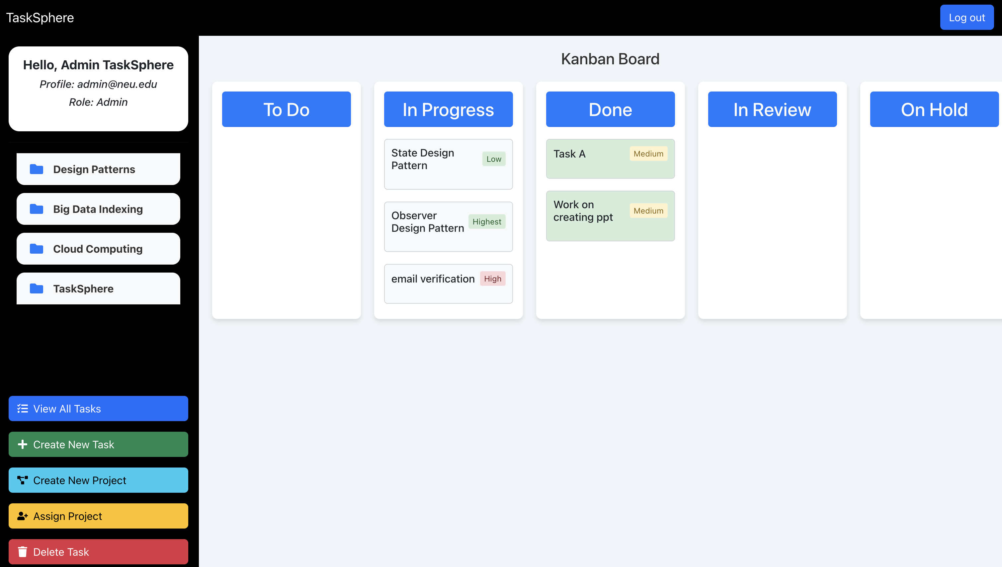

Slide 6
DESIGN PATTERNS
Use Case & Code Snippets

Slide 7
Builder
DESIGN PATTERN
DESIGN PATTERN

Slide 8
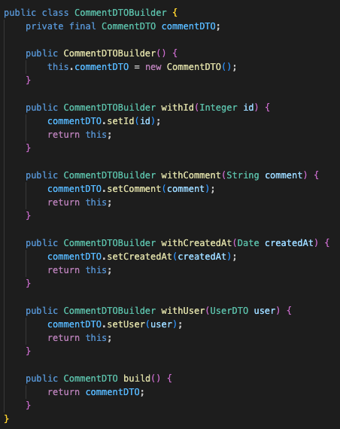
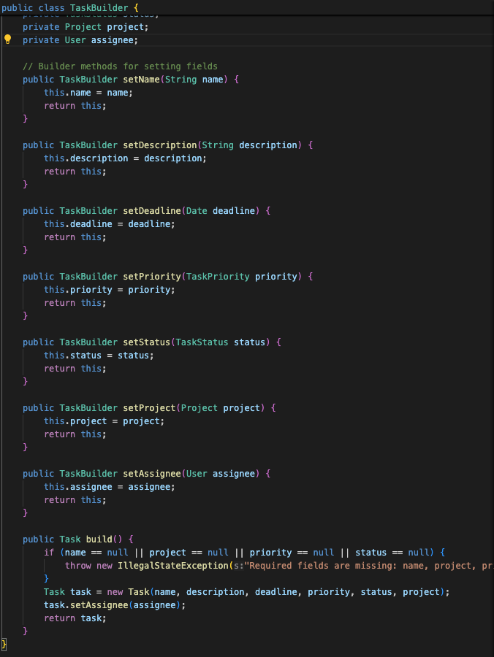
Builder
Use Case:
Structure the API response data for frontend and Persistence Data for the Task
DESIGN PATTERN
DESIGN PATTERN

Slide 9
Builder
DESIGN PATTERN
DESIGN PATTERN

Slide 10
Factory
DESIGN PATTERN
DESIGN PATTERN

Slide 11
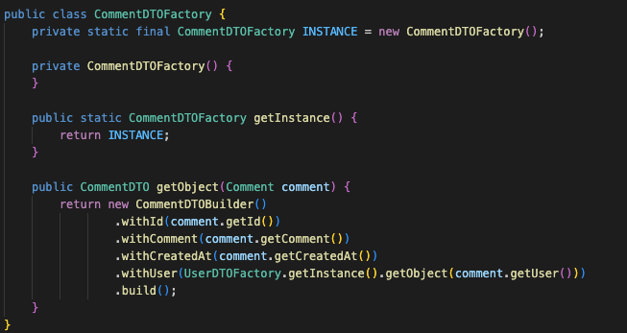
Factory
Use Case:
Abstraction. Hide the new keyword
- Eager Singleton
DESIGN PATTERN
DESIGN PATTERN

Slide 12
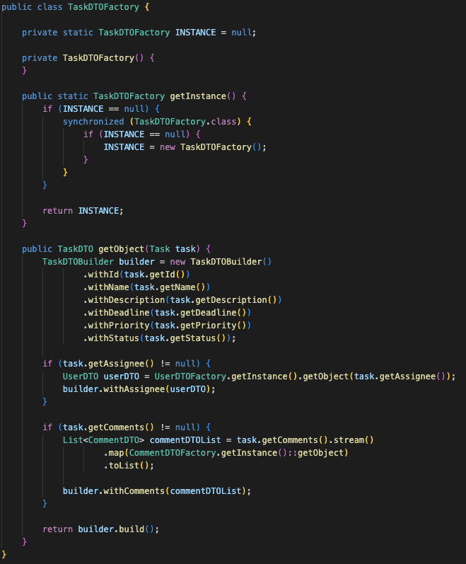
Factory
Use Case:
Abstraction. Hide the new keyword
- Lazy Singleton
DESIGN PATTERN
DESIGN PATTERN

Slide 13
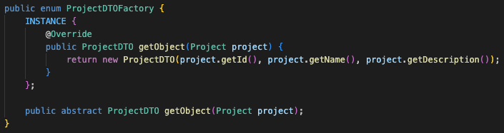
Factory
Use Case:
Abstraction. Hide the new keyword
- Enum Singleton
DESIGN PATTERN
DESIGN PATTERN

Slide 14
Factory
DESIGN PATTERN
DESIGN PATTERN

Slide 15
Observer
DESIGN PATTERN
DESIGN PATTERN

Slide 16
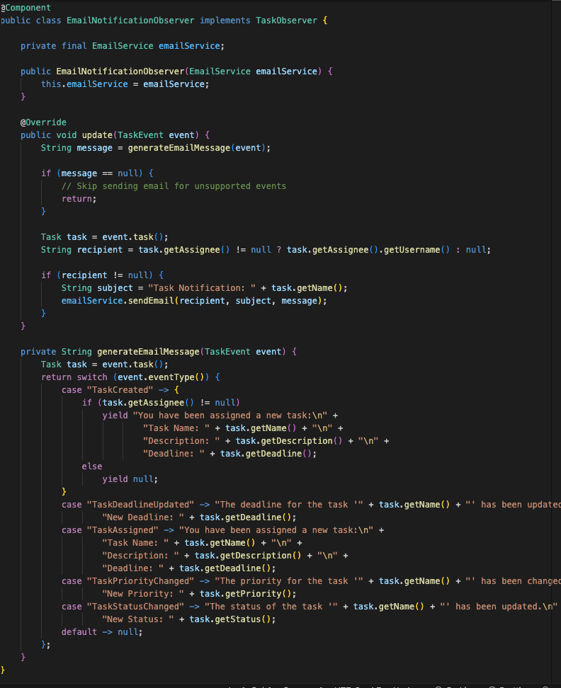
Observer
Use Case:
Sending Email notifications & Adding audit logs on changes on Task
DESIGN PATTERN
DESIGN PATTERN

Slide 17
Observer
DESIGN PATTERN
DESIGN PATTERN

Slide 18
State
DESIGN PATTERN
DESIGN PATTERN

Slide 19
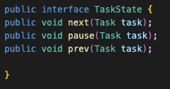
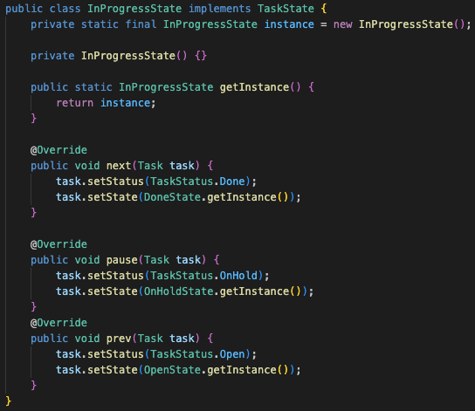
State
Use Case:
Managing changes in Task Status & Enforcing the progress of State transition.
DESIGN PATTERN
DESIGN PATTERN

Slide 20
State
DESIGN PATTERN
DESIGN PATTERN

Slide 21
Strategy
DESIGN PATTERN
DESIGN PATTERN

Slide 22

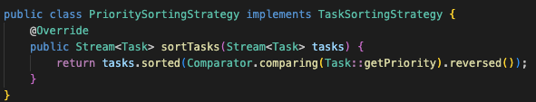

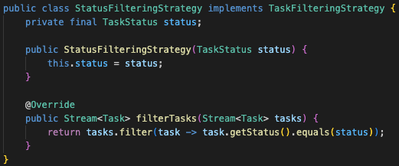
Strategy
Use Case:
Implement different Sorting (due date & priority) and Filtering (priority & status) algorithms
DESIGN PATTERN
DESIGN PATTERN

Slide 23
Strategy
DESIGN PATTERN
DESIGN PATTERN

Slide 24
Decorator
DESIGN PATTERN
DESIGN PATTERN

Slide 25

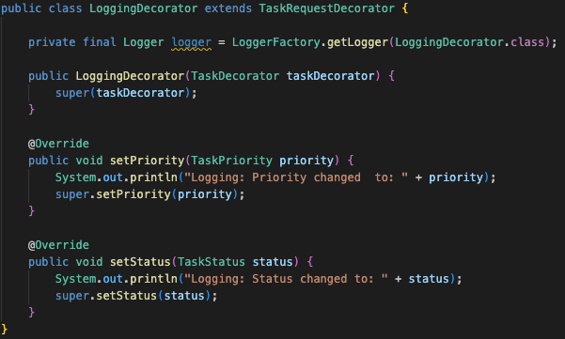
Decorator
Use Case:
Add additional functionalities such as Logging.
DESIGN PATTERN
DESIGN PATTERN

Slide 26
Decorator
DESIGN PATTERN
DESIGN PATTERN

Slide 27
LIVE DEMO

Slide 28
,
Contribution
Pritesh Nimje | Database Management, Front/Backend Integration. State & Strategy Implementation | Shubham Vilas | State Implementation. CSS Styling. UML Diagram.
Nitesh More | Observer, Factory, Builder Implementation. Backend Integration. | Jovin Jojo | Decorator Implementation. React UI Fix and CSS Styling.
Min-Yang Huang | Slides Design. React overview. Factory & Builder Implenmentation. | Venkata Durga | Frontend Design and Styling. Presentation.
Gaurav Gunjal | Frontend React. File I/O system. CSS Styling. Observer implenmentation.
Contribution

Slide 29
’’
Reference
Images:
https://otrs.com/otrsmag/kanban-board/
https://www.meirik.com/articles/what-is-a-kanban-board

