Slide 1
Success & Failure Of Software Companies

Slide 2

➢ Visionary Leadership :- Bill Gates And Paul Allen’s Foresight.
➢ Dominanace In OS :- Providing User-Friendly Interface And Compatibility With Hardware And Software.
➢ Diverse Product Portfolio :- Product Like Microsoft Office( Words,Excel,PowerPoint ) Essential Tools For Business And Individual.
➢ Emphasis On Research And Development :- Significant Investment in R & D, Leading To Advancements in AI.

Slide 3

➢ Pioneering Leadership :- Steve Job’s Vision Emphasized Innovation, Design And User Experience, Reshaping Industries With Groundbreaking Products.
➢ Innovative Product Design :- Apple’s Products Are Known For Their Sleek ,Minimalist Design And Premium Build Quality, Creating A Strong Emotional Connection With Users.
➢ Focus On User Experiences :- Seamless Hardware-Software Integration Provides A Smooth And Intitive User Experencies Across Devices.
➢ Ecosystem & Services :- Integration Of Devices With Services Like ICloud,Apple Music ,Apple Pay And The App Store Enchances The Eco-System.

Slide 4

➢ Dominance In Search And Advertising :- Google Search Is The World’s Most Widely Used Search Engine’s Capturing The Majority Of Global Search Traffic.
➢ Google Ads Generates $64.62 Billion By Advanced Targeting Capabilities.
➢ Diverse Product Portfolio :- Offer A Wide Range Of Popular Services Like Gmail,Youtube,Google Maps,Google Drive & Google Photos.
➢ Cloud Computing :- Google Cloud Has Became A Major Player In The Cloud Computing Industry,Providing Solutions For Business Of All Sizes.

Slide 5

➢ Poor Leadership In Technology And Innovation.
➢ Poor Management Decisions, Missed Opportunities.
➢ Late Entry Into Mobile :- As The Internet Shifted To Mobile Devices, Yahoo Struggled To Adapt Its Services Were Not Optimized For Mobile, Unlike Competitor Like Google And Apple.
➢ Outdated Advertising Strategy :- Yahoo Failed To Innovate In Digital Advertising, Allowing Google And Facebook To Dominate The Market With Better-Targeted Ads.

Slide 6
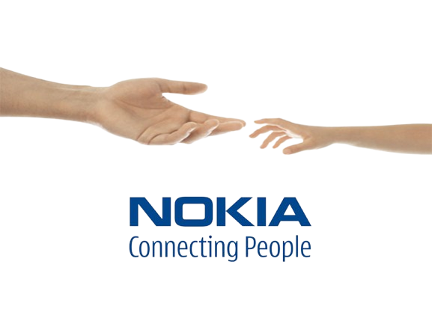
➢ Slow Transition To Smartphone :- Nokia Clung To Its Symbian Os And Underestimated The Rise Of Ios And Android.
➢ Poor Partnership With Microsoft :- Nokia Adopted Windows Phone Os Exclusively Which Had Limited App Support And Failed To Complete With Ios And Android.
➢ Leadership Issue :- Strategic Mistakes And Resistance To Change Contributed To Its Decline.

Slide 7

➢ Slow To Adapt :- Palm Was Slow To Transition From PDAs To Smartphones With Touchscreen And An App Ecosytem, Allowing Apple And Android To Take Over.
➢ WebOs Failure :- Palm’s WebOs Was Seen As Innovate, But The Company Couldn’t Compete With Ios And Android’s Growing Dominance.
➢ Leadership Instability :- Palm Experienced Multiple Leadership Changes And Struggled With A Consistent Long-term Strategy.
➢ Marketing And Sales Struggles :- Palm Struggled To Market Its New Devices Effectively. While It Tried To Built Excitement Around WebOs, It Failed To Create a Strong Brand Presence Or Appeal To The Mass Market In The Same Way Apple Or Android Did.

