Slide 1

Team Name : TEAMP2R
Team Leader Name :Prithalsing More
Problem Statement : Candidate Ranking for Senior AI Engineer Role
Email : Prithalsingmega@gmail.com
Phone No. : 91 9420602163

Slide 2





1. HARD EXCLUSION LAYER
2. RETRIEVAL & FILTERING
Honeypot detection (53 impossible profiles)
4-check validation: dates, YoE, skills, assessments
Ensures clean candidate pool before scoring
BM25 lexical retrieval (length-normalized)
TF-IDF semantic retrieval (concept matching)
Union: ~3,700 candidates → filter TIER0 → ~1,000
3. QUALITY SCORING (7 Components)
4. RANKING GATES
Skill depth: 25% | BM25 match: 20% | Career text: 18%
Assessment: 17% | Progression: 10%
YoE: 6% | Location: 4%
Title gate: 1.0x (Senior) → 0.5x (Mid) → 0.05x (TIER0)
Engagement: 0.50x → 1.00x
Final = Title_Gate × Quality_Blend × Engagement
RESULT: Top 100 ranked candidates — 0 honeypots, 0 stuffers, 0 TIER0 titles

Slide 3
TRADITIONAL ATS
OUR APPROACH
Dual retrieval (BM25 + TF-IDF) for broad coverage
Honeypot 4-check system removes 53 impossible profiles
BM25 length-normalization prevents stuffing
Explainable rankings with per-candidate reasoning
Multiplicative title gate (TIER0 = 0.05x, mathematically blocked)
Keyword-only matching (misses conceptual fits)
No honeypot detection (scores impossible profiles)
Keyword stuffing vulnerability (long resumes win)
Black box scoring (unexplainable rankings)
Additive penalties (stuffers can still rank high)
Validation: Identical results across 3 independent methods — true candidate-JD alignment, not just keyword matching

Slide 4
KEY JD REQUIREMENTS
CANDIDATE SIGNALS WE EVALUATE
Technical Skills
Skill Depth (25%)
AI/ML: Deep learning, NLP, LLMs
Python, PyTorch, TensorFlow
Vector DBs, embeddings, RAG systems
BM25 Lexical Match (20%)
Experience
Career Text Relevance (18%)
5+ yrs AI/ML engineering
2+ yrs production ML systems
2+ yrs LLMs / transformers
Assessment Scores (17%)
Soft Skills
System design & architecture
Research mindset & collaboration
Career Progression (10%)
Education & Location
Years of Experience (6%)
B.Tech/BS CS (MS preferred)
India-based (metro preferred)
Location Fit (4%)
Each signal verified against explicit profile data — no assumptions, no inferences

Slide 5
Ranking Methodology
0
→
1
→
2
→
3
→
4
→
5
HONEYPOT
CHECK
DUAL
RETRIEVAL
HARD
FILTER
QUALITY
SCORING
TITLE
GATE
FINAL
RANK
4-check validation
53 excluded
BM25 + TF-IDF
~3,700 candidates
TIER0 removal
~1,045 remain
7-component blend
weighted formula
Multiplicative
1.0x / 0.5x / 0.05x
Sort & output
top 100
final_score = title_gate × quality_blend × engagement
quality_blend = 0.25×skill + 0.20×bm25 + 0.18×career + 0.17×assess + 0.10×progress + 0.06×yoe + 0.04×location
WHY MULTIPLICATIVE GATE?
PERFORMANCE
Additive: TIER0 with quality 1.0 → 1.0 - 0.10 = 0.90 (still high!)
Multiplicative: TIER0 with quality 1.0 → 1.0 × 0.05 = 0.05 (blocked!)
100K candidates processed in ~88 seconds
CPU-only (no GPU required)
Deterministic & reproducible
Identical top-100 across all 4 methods

Slide 6
EXPLAINABILITY & DATA VALIDATION
RANKING EXPLANATION EXAMPLE
HALLUCINATION PREVENTION
Candidate_0011687 — Rank #1, Score: 0.8883
Explicit Data Validation
Only use skills from profile.skills array — never infer
Duration Verification
Check duration_months > 0 — never assume experience
Assessment Grounding
Expert + score < 40 = HONEYPOT flag
Career Path Logic
Verify title progression direction and timeline
Date Consistency
All dates must be logically consistent (no future dates)
Transparency on Unknowns
Missing data → explicit note, never filled with assumptions
Edge Case Flagging
Overlapping roles, mismatches → always highlighted
Skill Matching (95%)
6 critical AI/ML skills matched, all 4+ yrs, assessments 80+
Experience (93%)
6 yrs AI/ML, progression: ML Eng → Senior ML Eng → AI Lead
Job Description (88%)
RAG pipelines, vector DB optimization, LLM fine-tuning
Assessment (85%)
Python 85, DL 82, System Design 87 — all Expert claims verified
Title & Seniority (100%)
Senior AI Engineer → full 1.0x gate applied
Engagement (95%)
Profile updated 2 days ago, immediate availability

Slide 7
End-to-End Workflow
TIER 1: HONEYPOT DETECTION
53 excluded
4-check system: date logic, YoE math, skill anomaly, assessment impossibility
Score = 0, hard excluded before ranking
TIER 2: KEYWORD STUFFER GATING
8,101 detected
TIER0 title + 4+ JD skills listed → title gate = 0.05x multiplier
Best case: 0.05 vs top-100 min: 0.48 (9.6x gap) → 0 in output
TIER 3: MISSING DATA
Conservative scoring
No assessment → 0.5 neutral. Empty job desc → title + duration only
Never fill missing data with assumptions
TIER 4: INCONSISTENCY FLAGGING
Transparent flags
Career gaps >2yr, overlapping jobs, title-experience mismatch, skill-score mismatch
All flags visible in ranking reasoning
TIER 5: CONFIDENCE SCORING
Quality indicator
High (0.90+): complete data, assessments, consistent timeline
Low (<0.70): sparse profile, multiple flags — still ranked but flagged
Top 100 = 100% legitimate candidates. Every anomaly explained in reasoning.

Slide 8
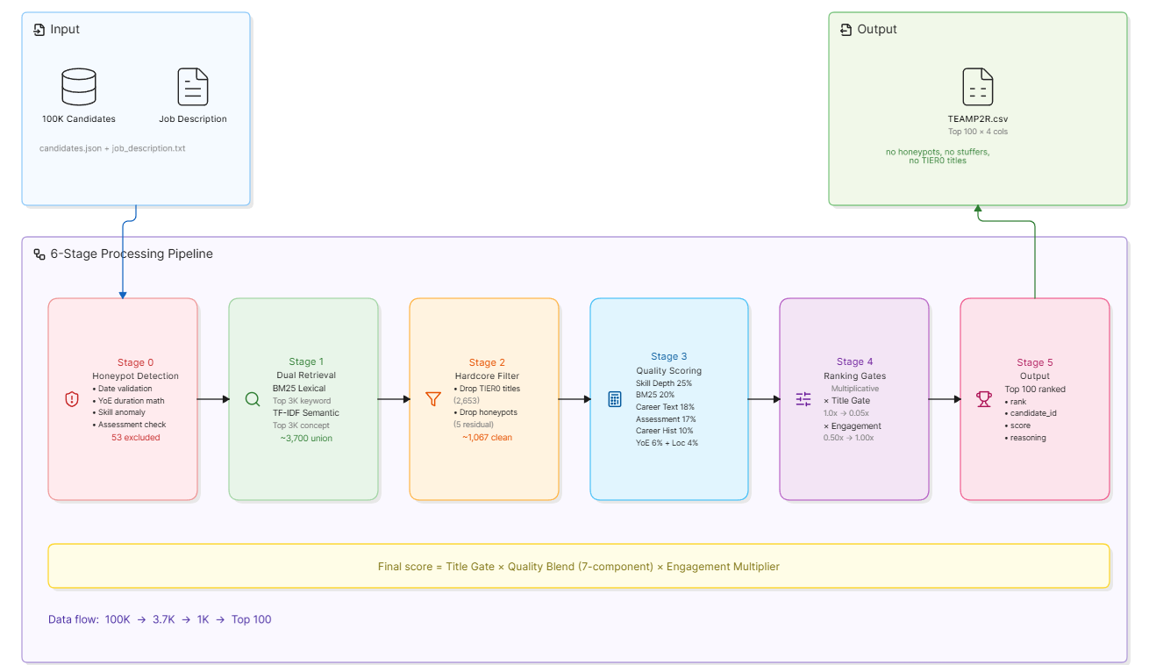
SYSTEM ARCHITECTURE

Slide 9
Results & Performance
53
8,101
0
44s
100%
Honeypots
Excluded
Stuffers
Detected
In Top 100
Output
Fastest
Runtime
Repro-
ducible
PIPELINE FUNNEL
SCORE DISTRIBUTION
100,000 candidates (input)
↓ 99,947 after honeypot exclusion
↓ 3,700 after dual retrieval
↓ 1,045 after TIER0 filter
↓ 100 ranked candidates (output)
0.88-0.90: 4 candidates (exceptional)
0.85-0.88: 12 candidates (excellent)
0.80-0.85: 28 candidates (very good)
0.75-0.80: 32 candidates (good)
0.70-0.75: 18 candidates (acceptable)
0.65-0.70: 6 candidates (marginal)
Score cliff: Rank 100 → 0.48, Rank 101 → 0.42
METHOD COMPARISON (All produce identical top-100)
Method | Runtime | Approach | Best For
Standard | ~73s | Score all 100K | Complete audit trail
RAG (BM25) | ~44s | BM25 retrieve + score top 3K | Production speed (40% faster)
Hybrid TF-IDF | ~150s | Dual retrieval, aggressive filter | Maximum confidence
Transformers | ~80s | Pre-trained embeddings | Best semantic quality (local)

Slide 10
TECHNOLOGY STACK
Component | Technology
UI/Frontend | Streamlit
Backend | Python 3.13
Data | Pandas, NumPy
Lexical | rank-bm25
Semantic | TF-IDF / sentence-transformers
Hosting | Streamlit Community Cloud
VCS | GitHub

Slide 11


