Slide 1
HMI MQTT simulation*
Updated on: 18/09/2023

Slide 2
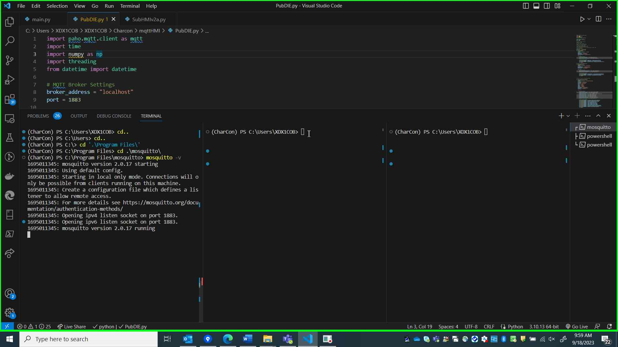
Initiate Mosquitto Broker

Slide 3
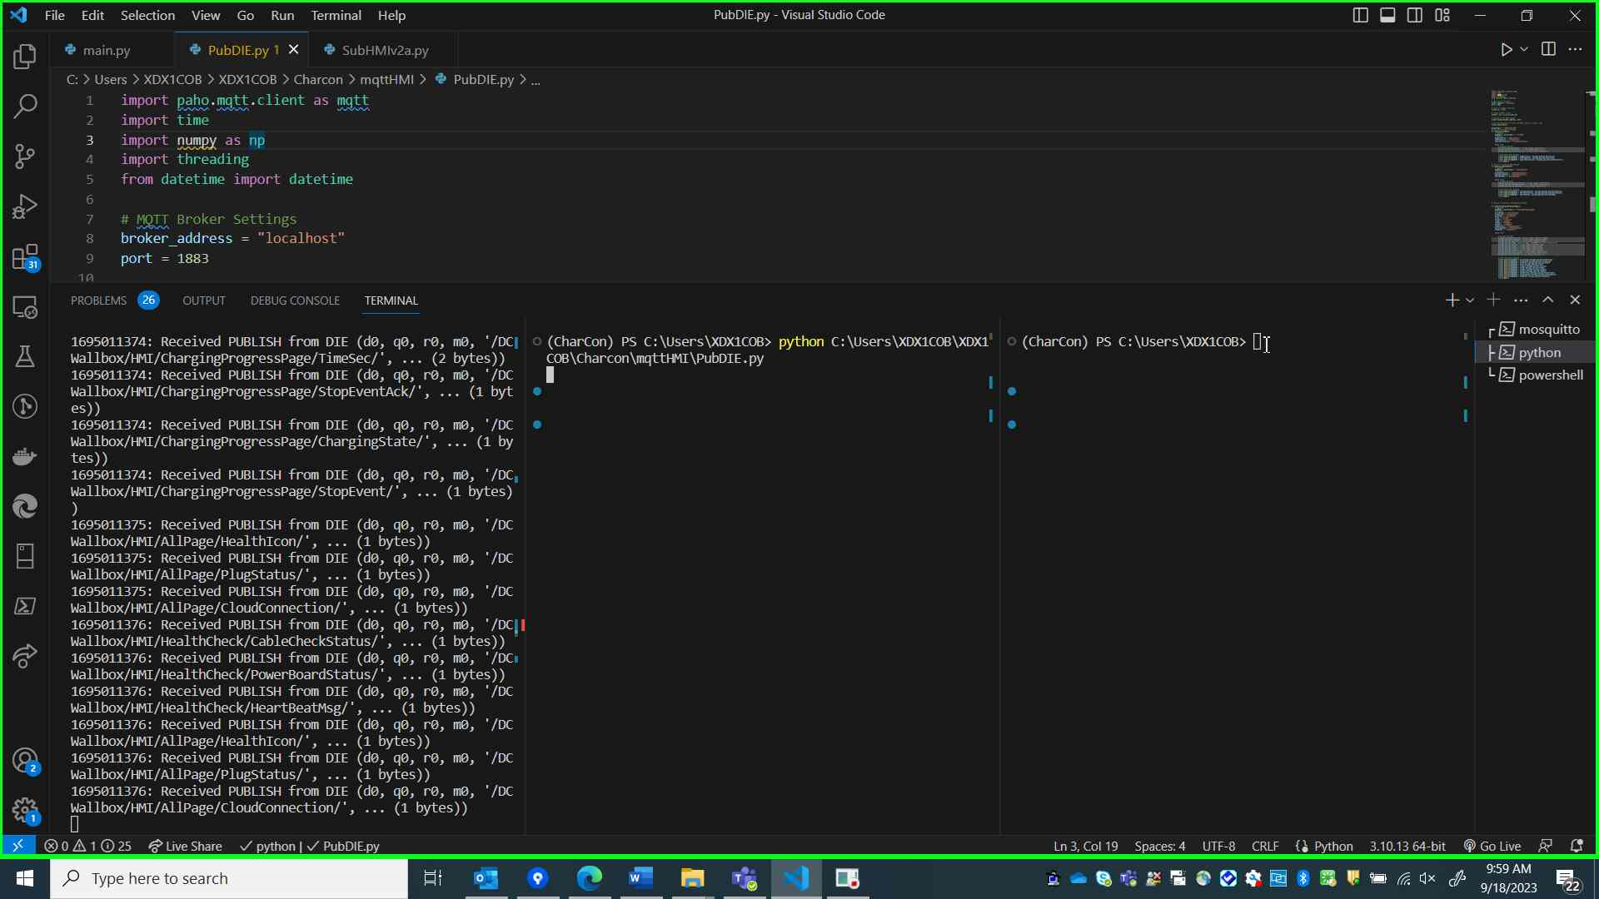
Initiate Emulator PubDIE.py

Slide 4
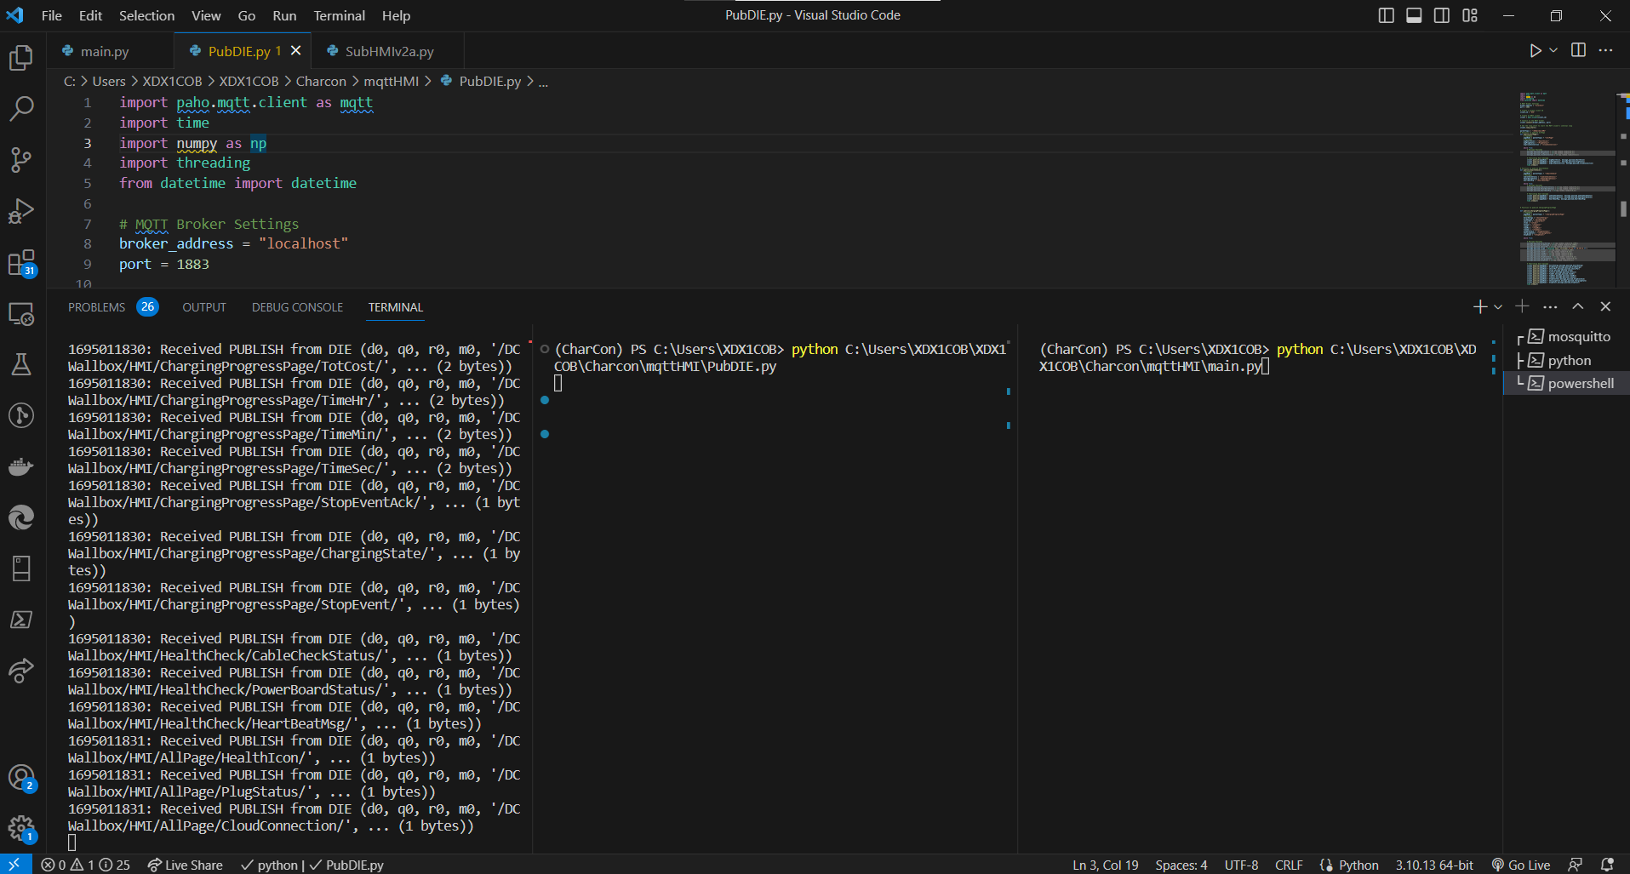
Initiate main.py

Slide 5
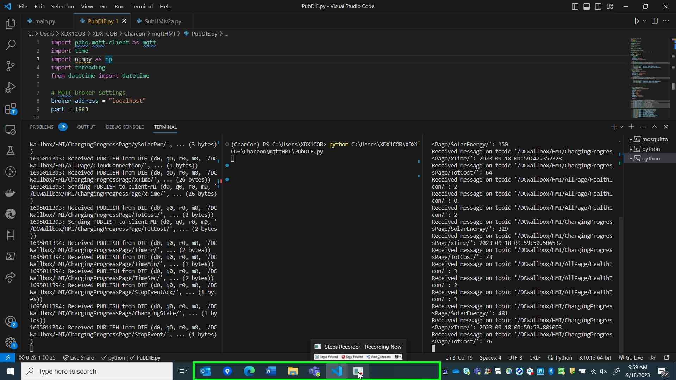
Final Result

Slide 6
Variables needed to be adjusted
Address where the recieved_messages to be saved is hard coded in SubHMIv2a.py
The number of messages needs to be changed based on requirement (max_messages) in SubHMIv2a.py
The subscription system is mentioned in main.py and its time based system unlike PubDIE.py ,so to adjust the time in seconds change value of abort_after variable
Messages needed for subscription has to be updated in the list topics_to_subscribe in main.py

