Slide 1



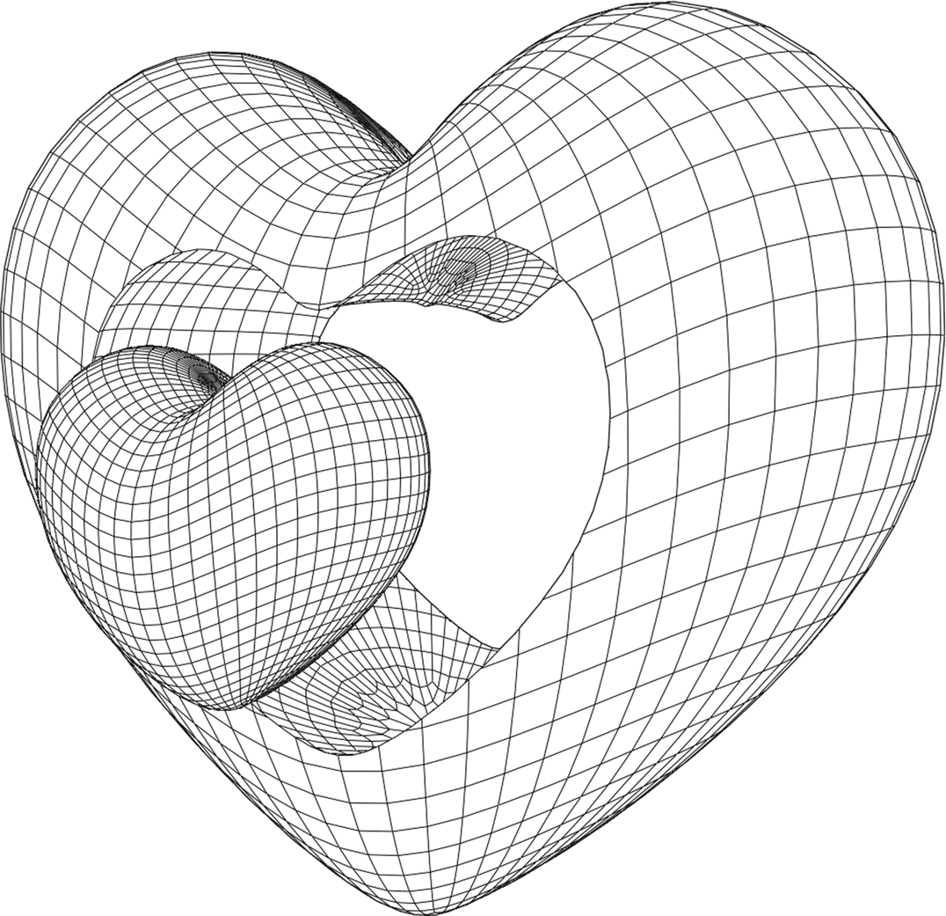
@PRITHEVIKRISHNA MURALI
JULY 2024
ElasticRAG
HARNESSING AI-POWERED NLP FOR SEAMLESS ELASTICSEARCH DATA RETRIEVAL!
1/9

Slide 2
TABLE OF CONTENT
1
OVERVIEW
2
RESOURCES
3
PROCESS
4
OUTCOME
2/9

Slide 3
OVERVIEW
IMAGINE QUERYING VAST AMOUNTS OF INDEXED DATA IN ELASTICSEARCH WITH THE SIMPLICITY OF ASKING A QUESTION! WITH THE LLAMA3 8B MODEL, YOU CAN NOW RETRIEVE DATA EFFORTLESSLY USING NATURAL LANGUAGE. NO MORE COMPLEX QUERIES, JUST ASK, AND THE INSIGHTS FLOW DIRECTLY FROM ELASTICSEARCH. DIVE INTO A SEAMLESS DATA INTERACTION EXPERIENCE AND WATCH YOUR PRODUCTIVITY SOAR. GET READY TO REVOLUTIONIZE THE WAY YOU INTERACT WITH DATA!
3/9

Slide 4
RESOURCES
OLLAMA LLAMA3(LLM)
ELASTICSEARCH(ENGINE)
KIBANA(UI FOR ELASTIC)
LANGCHAIN
OLLAMA NOMIC EMBED TEXT(EMBEDDER)
FAISS
PYTHON
STREAMLIT(UI)
4/9

Slide 5
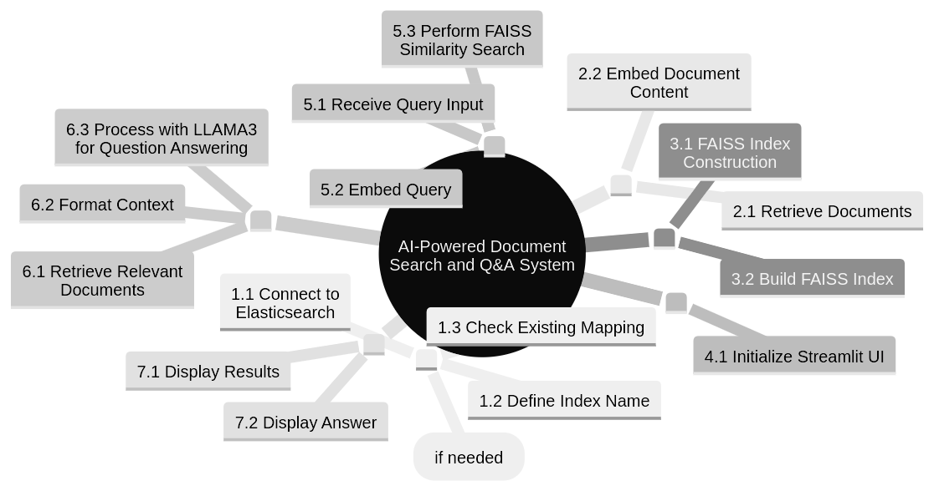
PROCESS
5/9

Slide 6
PROCESS MAP DESCRIPTION
INITIALIZATION:
Connect to Elasticsearch: Establish connection tO ELASTICSEARCH.
DEFINE INDEX NAME: SPECIFY THE ELASTICSEARCH INDEX NAME.
MAPPING CREATION:
CHECK EXISTING MAPPING: DETERMINE IF THE INDEX MAPPING EXISTS IN ELASTICSEARCH.
CREATE DYNAMIC MAPPING: IF NECESSARY, CREATE OR UPDATE THE MAPPING BASED ON SAMPLE DATA (CREATE_DYNAMIC_MAPPING).
DOCUMENT RETRIEVAL AND EMBEDDING:
RETRIEVE DOCUMENTS: FETCH ALL DOCUMENTS FROM ELASTICSEARCH.
EMBED DOCUMENT CONTENT: USE OLLAMA EMBEDDINGS TO EMBED DOCUMENT CONTENT.
FAISS INDEX CONSTRUCTION:
BUILD FAISS INDEX: CONSTRUCT A FAISS INDEX USING DOCUMENT EMBEDDINGS.
USER INTERFACE:
STREAMLIT UI: INTERACT WITH USERS THROUGH A STREAMLIT WEB INTERFACE.
6/9

Slide 7
PROCESS MAP DESCRIPTION
QUERY PROCESSING:
QUERY INPUT: RECEIVE USER QUERY INPUT.
EMBED QUERY: EMBED THE QUERY USING CACHED EMBEDDING FUNCTION.
SIMILARITY SEARCH:
FAISS SEARCH: UTILIZE FAISS FOR SIMILARITY SEARCH BASED ON QUERY EMBEDDINGS (FAISS_SIMILARITY_SEARCH).
ANSWER GENERATION:
RETRIEVE RELEVANT DOCUMENTS: RETRIEVE RELEVANT DOCUMENTS BASED ON SIMILARITY SCORES.
FORMAT CONTEXT: COMBINE RETRIEVED DOCUMENTS INTO A FORMATTED CONTEXT FOR LLAMA3 INPUT.
LLAMA3 QUESTION ANSWERING:
LLAMA3 INTERACTION: INTERACT WITH LLAMA3 MODEL FOR QUESTION ANSWERING.
DISPLAY RESULTS:
DISPLAY ANSWER: PRESENT THE GENERATED ANSWER OR RESPONSES TO THE USER VIA THE STREAMLIT INTERFACE.
7/9

Slide 8
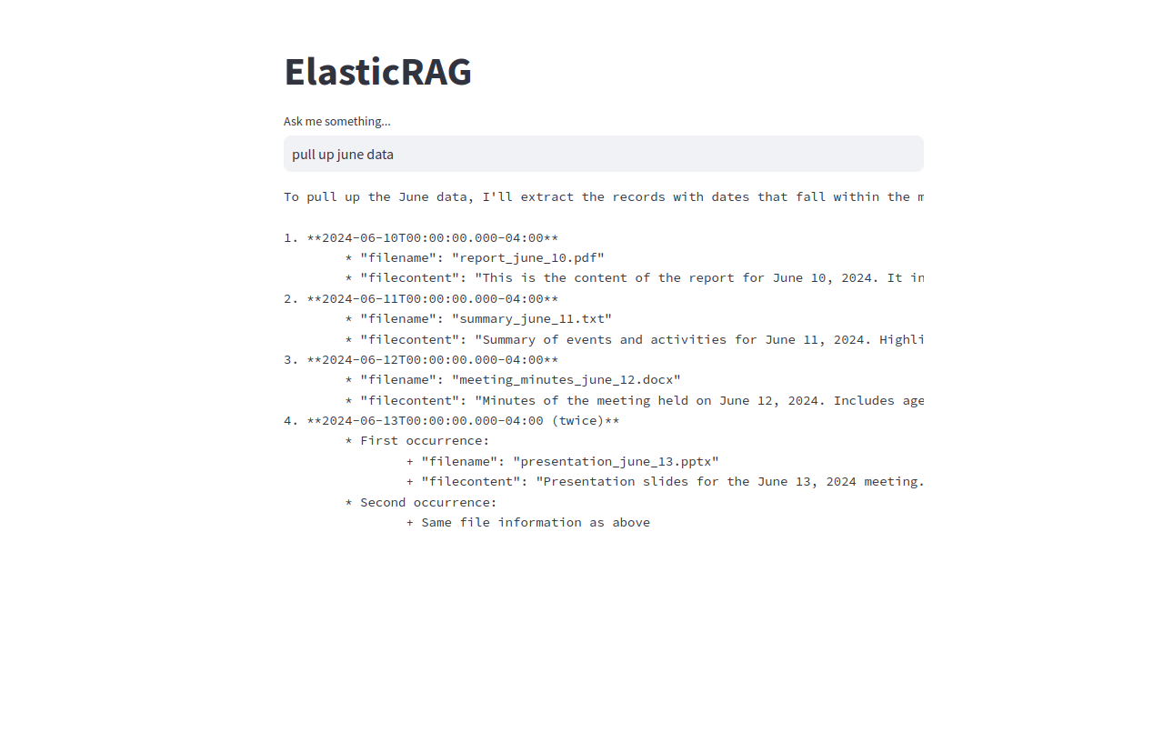
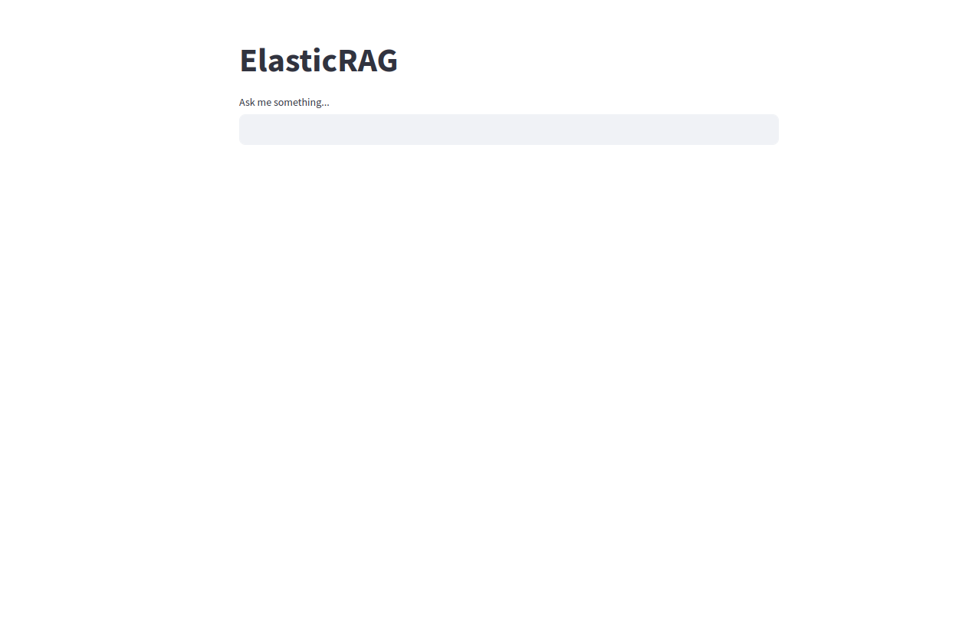
OUTCOME
UI WITH PROMPT
I ASKED THE RAG TO PULL JUNE DATA AND IT PULLED IT PERFECTLY!
HERE THE INDEX TO BE SEARCHED IS ALREADY LOADED USING THE PYTHON CODE, NOW ALL WE HAVE TO DO IS ASK QUESTIONS BASED ON THE DATA.
8/9

Slide 9


THANK YOU
THE PROJECT WAS DONE IN A PERIOD OF 2 WEEKS, FROM SCRATCH BY ME(AN AI & ML STUDENT), WITH NO PRIOR KNOWLEDGE, IT WAS FUN AND CHALLENGING TO ACCOMPLISH THIS.
I WILL LINK BELOW THE RESOURCES AND YOUTUBE CHANNELS THAT HELPED ME LEARN AND COMPLETE THE PROJECT.
9/9

