Slide 1
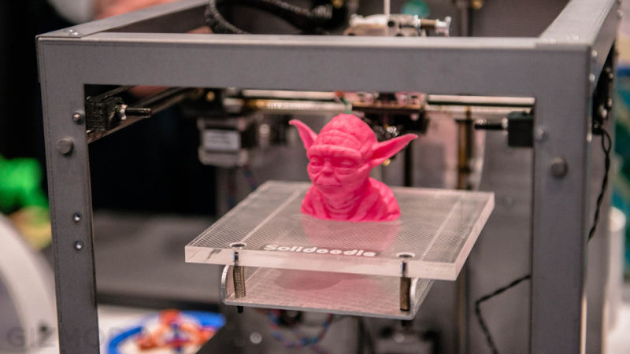
3D PRINTING
Ted talk by Avi Reichental, the CEO of 3D systems.
A major force in the field of rapid prototyping, turning a design from a CAD file into a solid object

Slide 2
What’s 3D printing?
A process of making three dimensional solid objects from a digital file
Add successive layers of material until the object is created.
Each layer is a horizontal cross-section of the eventual object.

Slide 3
Steps in 3D printing:
Make a virtual design of the object you want to create ie, a CAD.
This CAD file is created using a 3D modeling application or with a 3D scanner
Print it with a 3D printer.

Slide 4
Uses:
glasses that fit perfectly to you without hinges
a more feminine robot leg for a paralysed woman
hearing aids are being 3D printed to correct size
ventilated sclerosis splints
knee replacements.

Slide 5
Advantages:
The power of 3D printing is that complexity is free
It is as simple to make a complicated object as a simple one.
It puts this power in the hands of anyone – and to help this there are tools that assist on the 3D modelling side to make it more intuitive.

