Slide 1
Data Privacy and Security
Protect your personal data

Slide 2
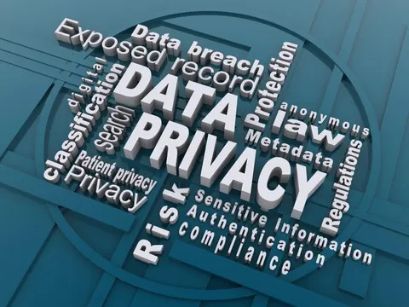
What is Data Privacy?
Data privacy generally refers to an individual's right to control the circumstances around the sharing, communication, and acquisition of their personal information by third parties.
Personal Data includes
  Names
  Addresses
  Phone Numbers
In short, data privacy is about keeping personal information safe and secure.

Slide 3
Why is data privacy important?
For individuals, keeping control over their data is essential to maintaining personal autonomy and freedom.
  When that control is lost, personal security can be compromised, opening the door to risks like manipulation or exploitation.
For businesses, the stakes are just as high – if not higher. If proper data privacy measures aren't taken and a data breach happens, it can
  ruin a company's reputation
  destroy customer trust,
  and lead to hefty fines.
The average cost of a data breach is $4.35 million, and 83% of organizations report facing multiple data breaches.
  These figures highlight why strong data privacy and security are no longer optional — they're essential.

Slide 4
Data privacy in the age of AI
Large Language Models(LLM) and other AI systems need vast datasets to operate, increasing the potential for data and compliance risks.
The challenge lies in balancing AI-driven innovation with robust data privacy measures. This balance is critical for maintaining customer trust and protecting sensitive information.
However, many organizations are struggling to address these challenges, including safeguarding massive data volumes, combating security threats, and ensuring data accuracy and quality.
AI can even play a role here by automating data protection and identifying vulnerabilities. At the same time, organisations must regularly update their privacy policies to address emerging risks.

Slide 5
Benefits of data privacy
Personal Safety: Prevents harmful activities like stalking, blackmail, identity theft, and financial fraud.
Builds Customer Trust: Transparent handling of personal data increases customer loyalty and repeat business.
Legal Compliance: Following rules like the General Data Protection Regulation avoids costly government fines and lawsuits.
Saves Money: Good privacy habits prevent expensive data breaches and the cost of fixing hacked systems.
Better Operations: Collecting only necessary data simplifies database management and reduces storage costs.

Slide 6
Laws & regulations that govern data privacy
General Data Protection Regulation (GDPR): This measure mandates comprehensive measures for handling personal data across EU. These include rights to access, correct, and delete personal information.
California Consumer Privacy Act (CCPA): This act empowers California residents with similar rights to those outlined in the GDPR. However, the CCPA also introduces specific disclosures and business obligations regarding consumer data.
Health Insurance Portability and Accountability Act (HIPAA): This law protects personal health information, ensuring confidentiality and security in the healthcare sector.
Children's Online Privacy Protection Act (COPPA): This regulation safeguards the privacy of children under 13 online, regulating how websites and online services collect and use children's information.

Slide 7
Common data privacy issues & challenges
Keeping up with regulations: Regular updates and continuous monitoring are essential to avoid legal issues and fines.
Establishing a data privacy culture: This means regularly training employees on data privacy practices and establishing clear data governance frameworks – data privacy must be viewed as the responsibility of every employee.
Cost of having a robust strategy: Investing in the right tools, training, and technologies can require significant financial resources.
Internal threats: Employees may inadvertently cause data breaches through poor handling practices or lack of awareness. Continuous training and stringent access controls are necessary to mitigate these risks.
External threats: External threats, including phishing schemes and malware, are constantly adapting and can severely compromise sensitive data. Organizations can implement cybersecurity measures like firewalls and encryption to mitigate these external risks to data privacy.

Slide 8
Data privacy principles & best practices
Collection limitation: There should be limits to how much personal data can be collected
Data quality: Personal data, when collected, should be accurate and related to the purpose it is being used for
Purpose specification: The use for personal data should be specified
Use limitation: Data should not be used for purposes other than what was specified
Security safeguards: Data should be kept secure
Openness: Personal data collection and usage should not be kept secret from individuals
Individual participation: Individuals have a number of rights, including the right to know who has their personal data, to have their data communicated to them, to know why a request for their data is denied, and to have their personal data corrected or erased
Accountability: Anyone who collects data should be held accountable for implementing these principles

Slide 9
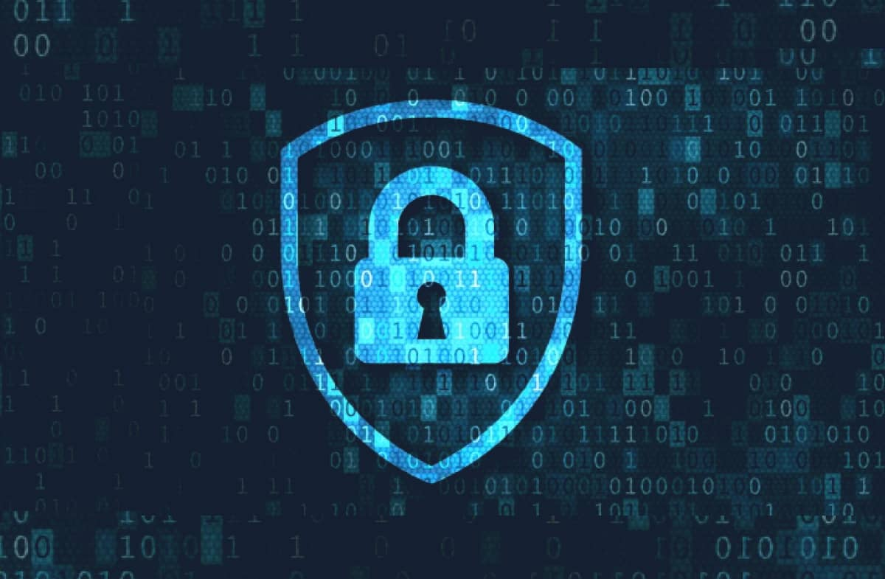
What are some of the most important technologies for data privacy?
Encryption is a way to conceal information by scrambling it so that it appears to be random data. Only parties with the encryption key can unscramble the information.
Access Control ensures that only authorized parties access systems and data. Access control can be combined with data loss prevention(DLP) to stop sensitive data from leaving the network.
Two-Factor Authentication is one of the most important technologies for regular users, as it makes it far harder for attackers to gain unauthorized access to personal accounts.

Slide 10
What is Data Security?
Data security is the process of safeguarding digital information throughout its entire life cycle to protect it from corruption, theft, or unauthorized access. It covers everything—hardware, software, storage devices, and user devices; access and administrative controls; and organizations’ policies and procedures.
Data security uses tools and technologies that enhance visibility of a company's data and how it is being used. These tools can protect data through processes like data masking, encryption, and redaction of sensitive information. The process also helps organizations streamline their auditing procedures and comply with increasingly stringent data protection regulations.
A robust data security management and strategy process enables an organization to protect its information against cyberattacks. It also helps them minimize the risk of human error and insider threats, which continue to be the cause of many data breaches.

Slide 11
Benefits Of Data Security
Keeps your information safe: By adopting a mindset focused on data security and implementing the right set of tools, you ensure sensitive data does not fall into the wrong hands. With a data security program created to meet the specific needs of your organization, this info stays safe and secure.
Helps keep your reputation clean: When people do business with your organization, they entrust their sensitive information to you, and a data security strategy enables you to provide the protection they need.
Gives you a competitive edge: In many industries, data breaches are commonplace, so if you can keep data secure, you set yourself apart from the competition, which may be struggling to do the same.
Saves on support and development costs: If you incorporate data security measures early in the development process, you may not have to spend valuable resources for designing and deploying patches or fixing coding problems down the road.

Slide 12
Biggest Data Security Risks
Accidental data exposure
  Many data breaches are not a result of hacking but through employees accidentally or negligently exposing sensitive information. Employees can easily lose, share, or grant access to data with the wrong person, or mishandle or lose information because they are not aware of their company’s security policies.
Phishing attacks
  This is a type of cyber fraud where criminals send fake messages pretending to be trusted sources to steal personal data, passwords, or money.
Malware
  Malware, short for malicious software, is any program or code designed to damage, disrupt, or gain unauthorized access to a computer system, network, or mobile device.
Ransomware
  Ransomware is a type of malicious software (malware) that locks your device or encrypts your files, making them completely unreadable or inaccessible until you pay a ransom

Slide 13
Critical Data Security Solutions
Access controls
  Access control is about deciding who gets to see or change data. A simple way to think about it is different keys for different rooms; some doors open for everyone, others only for a few people.
Cloud data security
  Cloud data security protects digital information stored, processed, or moving within cloud environments from unauthorized access, theft, loss, or corruption.
Data loss prevention
  Data loss prevention (DLP) enables organizations to detect and prevent potential data breaches.
Key management
  Key management involves the use of cryptographic keys to encrypt data. Public and private keys are used to encrypt then decrypt data, which enables secure data sharing.

Slide 14
Data Security Best Practices
Use long, unique passwords for each account
Turn on multi-factor authentication whenever it’s available
Keep devices and software up to date
Store sensitive files in secure, encrypted locations
Be cautious with emails, links, and attachments
Take security awareness training seriously
Review account activity and statements regularly
Share personal information carefully, especially online

Slide 15
What's the difference between data privacy vs. data security?
Data Privacy
Data security
It focuses on the proper handling, consent, and governance of personal information.
It answers the "why" and "how" of data usage—asking why data is collected and how it is shared.
It gives individuals control over who can access their personal details.
It is maintained through legal notices, consent forms, privacy policies, and user permissions.
It is often overseen by a Data Protection Officer (DPO) or privacy manager.
It focuses on defending data and infrastructure from malicious attacks, theft, and unauthorized access.
It answers the "how" of protection—asking how data is kept safe from bad actors.
It prevents data corruption, deletion, leaks, or breaches.
It is implemented via technical tools like encryption, firewalls, and multi-factor authentication.
Itis typically managed by a Chief Information Security Officer (CISO) and IT security teams.

Slide 16
Conclusion
In conclusion, data security and data privacy are two different concepts with various areas of overlap.
Data security is about protecting the availability and integrity of data, while data privacy concerns your data's confidentiality and use.
Data security covers policies, methods, and the means to protect personal data, while data privacy deals with how that protected data is used.
It's essential to understand both concepts and their differences to implement policies within that address them. Data protection and privacy laws are increasing globally and in the level of strictness with which businesses are expected to comply.
As a business owner, one should employ best practices for both data security and privacy to ensure compliance with major legislation like the GDPR and the CCPA (CPRA).

Slide 17
Thank You

