Slide 1
Project review – October 2026
Reinforcement Learning
Orca-RL in Stonefish: obstacle-aware RL navigation over ROS 2
Vijay Srinivas P (CB.SC.U4AIE23263) · Joel Sahay D (CB.SC.U4AIE23234) · D.K. Preetham Reddy (CB.SC.U4AIE23222) · A Prithvi (CB.SC.U4AIE23201) | Guide: Dr. D. Palmani
Batch and Group Number: C-7
Date of the Presentation:
[Project Review]

Slide 2
Outline
Part A · Why and how: RL
Real-world situations and why this method
The RL objective and reward
How the objective is optimised
Diagnosis of the shipped policy
Training and offline results
Part B · The simulation
Stonefish and the Orca model
The base world with obstacles
Fixing the vehicle model
System identification
From action to thruster force
Part C · Connecting them
Architecture over ROS 2
From Gazebo to Stonefish
Data exchanged, frames, timing
Closed-loop results in 3 worlds
Summary, limits, next phase
[Project Review]

Slide 3
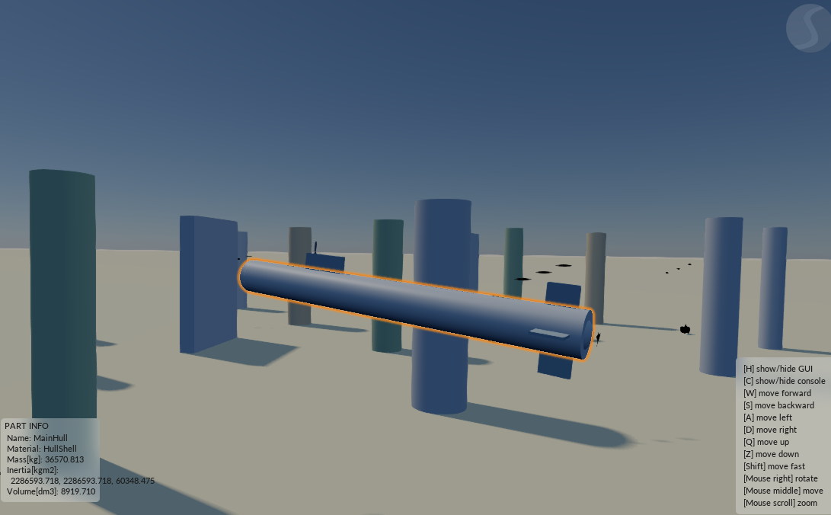
Introduction and Motivation
An extra-large uncrewed submarine such as the Boeing Orca has to survey long distances without GPS, with a position estimate that degrades underwater.
The mid-review delivered a reinforcement-learning stack (physics, sensors, particle filter, safety shield, trained policy) and, separately, a Stonefish simulator with survey scenarios.
The two tracks were not connected: the bridge between them assumed a different simulator (Gazebo) and the Stonefish scenes used a hand-written reactive controller.
This phase connects them: the RL policy now drives the Stonefish Orca over ROS 2 and avoids rocks, fish and other submarines using only its own sonar.
Stonefish: the Orca among rock pinnacles in the obstacle world
[Project Review]

Slide 4
Real-World Situations
Charts are incomplete
2005: a US Navy submarine struck an undersea mountain near Guam that was missing from its charts
2021: another struck an uncharted seamount in the South China Sea
A pre-planned route is not enough: the vehicle must sense and react
No GPS under water
Below the surface only inertial and Doppler (DVL) dead reckoning is available
The error grows with distance; a long-range vehicle cannot keep surfacing
Decisions must be made on an uncertain estimate
Long survey missions
Seabed mapping, pipeline and cable routes, wind-farm sites, search operations
2014: deep-sea vehicles searched the seabed for weeks for flight MH370
Lawnmower lanes, hours of autonomy, limited battery
Shared, moving water
Fish schools, marine mammals, other survey vehicles, ship traffic
Obstacles appear without warning and move
Losing a vehicle is costly: Autosub2 was lost under an Antarctic ice shelf in 2005
[Project Review]

Slide 5
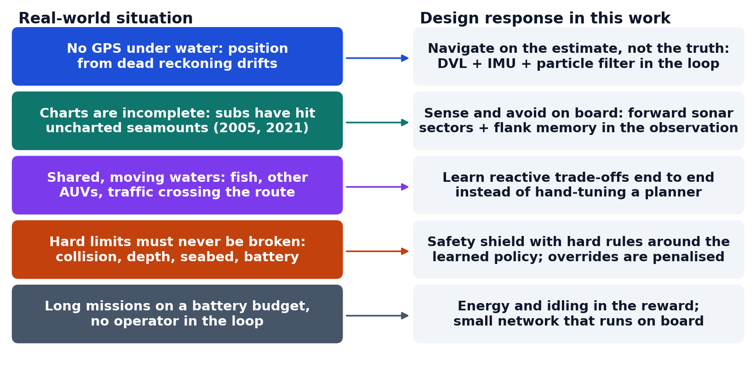
Why This Method Is Proposed
Why reinforcement learning
A hand-tuned planner trades goals against clearance poorly: it collides in 28% of test missions, the learned policy in 13%.
Why a safety shield
Learned behaviour is not a guarantee; hard rules wrap it.
Why simulation first
Collisions cannot be tested on a 50-tonne vehicle; Stonefish gives real physics and sensors.
Each situation on the left maps to one design element of this work.
[Project Review]

Slide 6
Literature Review
Sl No | Title and year | Venue | Methodology | Key findings | Limitations
1 | Evolution Strategies as a Scalable Alternative to RL (2017) | arXiv / OpenAI | Antithetic Gaussian perturbations, rank-shaped fitness | Matches policy-gradient RL on control; trivially parallel | Sample-hungry; slow from scratch on sparse tasks
2 | Proximal Policy Optimization (2017) | arXiv / OpenAI | Clipped surrogate policy gradient | Stable on-policy RL baseline | Needs automatic differentiation and a deep-learning toolchain
3 | Handbook of Marine Craft Hydrodynamics (2011) | Wiley (Fossen) | Rigid-body + hydrodynamic modelling | Standard UUV dynamics used in our fast simulator | Parameters for Orca not public
4 | Stonefish: open-source marine robotics simulator (2019) | IEEE/OES OCEANS | Bullet physics + hydrodynamics + sonar/DVL models | Realistic sensors, ROS interface | Scripted bodies never yield; no run-time reset
5 | UUV Simulator (2016) | IEEE/MTS OCEANS | Gazebo plugins for UUVs | Common ROS UUV stack | Gazebo Classic; the old bridge assumed it
6 | DAgger: imitation learning with no-regret online learning (2011) | AISTATS | Iterative relabelling of learner-visited states | Fixes covariate shift of behaviour cloning | Needs an expert to query
[Project Review]

Slide 7
Objectives
1
Make the Stonefish application ROS 2-aware and drive the real Orca thrusters
2
Rewrite the Python bridge for Stonefish: real sensors in, physical setpoints out
3
Keep the RL methodology: localisation, health monitoring, safety shield, network + ES
4
Give the policy goal and sonar inputs and train it to avoid obstacles
5
Add obstacles, fish schools and a traffic submarine to the base world
6
Verify step by step, and report honestly where it fails
[Project Review]

Slide 8
Part A · RL Formulation
State (observation)
Estimated position, depth, heading
Uncertainty, battery, thruster wear, navigation residual, depth margin
Terrain richness, risk
New: goal bearing and distance, sonar sectors, flank clearances, depth error
Action
a ∈ [-1, 1]³ from a 2 x 64 tanh network
speed, yaw rate, depth rate
scaled to what the vehicle can do
then the safety shield, then ROS 2
Reward
+ progress toward the waypoint
- uncertainty, - risk, - energy
- shield overrides, - idling
+ waypoint bonus
- collision (episode ends)
[Project Review]

Slide 9
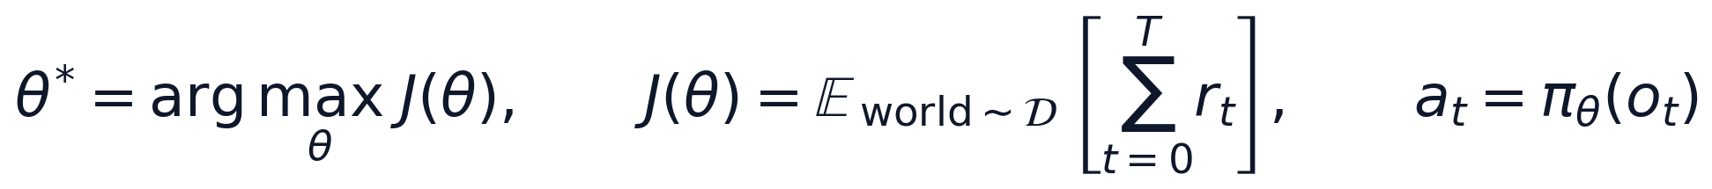
The RL Objective: What Is Optimised
What is optimised
θ: the 5,891 weights and biases of the policy network
J(θ): the expected total reward of one mission
Expectation over random worlds: start, obstacles, fish, currents, waypoints
Episode
1 s per step, up to 420 steps (7 min), 3 waypoints
Ends at the last waypoint, on collision or on time-out
Undiscounted total reward: missions are finite
[Project Review]

Slide 10
The Reward Function, Term by Term
Term | Weight | What it measures | Real-world meaning
Progress Δd | 1.0 per m | drop in estimated distance to the waypoint | get the survey done
Waypoint bonus | 200 | waypoint reached (within 10 m) | mission completion
Uncertainty σ²/100 | 0.0025 | spread of the particle filter (m²) | stay localisable without GPS
Risk ρ | 0.4 | sonar proximity and low altitude, 0 to 1 | keep a safe margin
Energy E/100 | 0.02 | watt-hours used this step | battery endurance
Shield | 1.5 | the safety shield had to override | do not lean on the safety net
Idle | 0.5 | speed below 0.2 m/s | do not stall to avoid penalties
Collision | 300 | hull touched an obstacle; episode ends | losing the vehicle
[Project Review]

Slide 11
From Action to a Safe Command
Limits from the real vehicle model
Top speed 1.1 m/s (40 kN main thruster)
Yaw rate up to 0.045 rad/s, less at higher speed
Depth rate up to 0.3 m/s
Identified on the Stonefish Orca, not assumed
Shield applied after the policy
Original rules: depth rating, battery reserve, localisation
New rules: obstacle stop / slow, seabed floor, depth band
Uses sensor-derived quantities only
Each override costs reward (the shield term)
[Project Review]

Slide 12
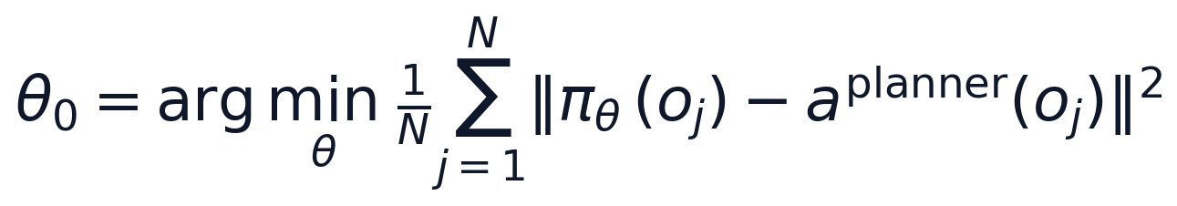
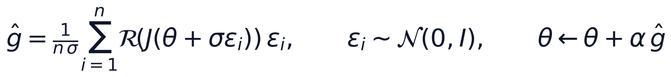
How the Objective Is Optimised
1 Warm start: imitate a classical planner (behaviour cloning + one DAgger round)
111k planner samples + 25k relabelled states; Adam, mean-squared error
2 Optimise J(θ) directly with Evolution Strategies
Settings
n = 48 (24 mirrored pairs)
σ = 0.03, α = 0.01, 200 generations
4 shared episodes per candidate
rank shaping R(·) in [-0.5, 0.5]
No gradient through the simulator is needed; works with the abrupt collision penalty.
Every candidate is an independent mission, so 14 cores evaluate in parallel.
[Project Review]

Slide 13
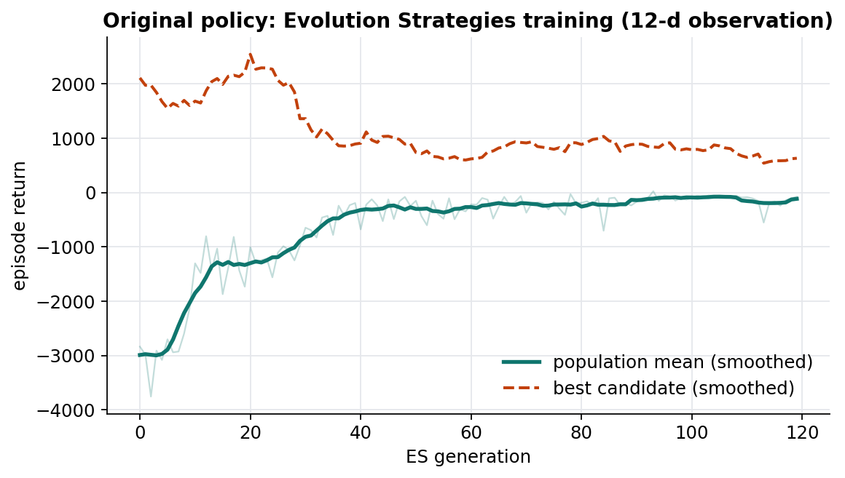
The Shipped Policy: Training
Trained with Evolution Strategies for 120 generations on the original 12-input environment.
Mean return rises from -3000 to about -100: the population learns to avoid penalties, not to reach goals.
We kept this policy unchanged; it can still be selected at run time.
[Project Review]

Slide 14
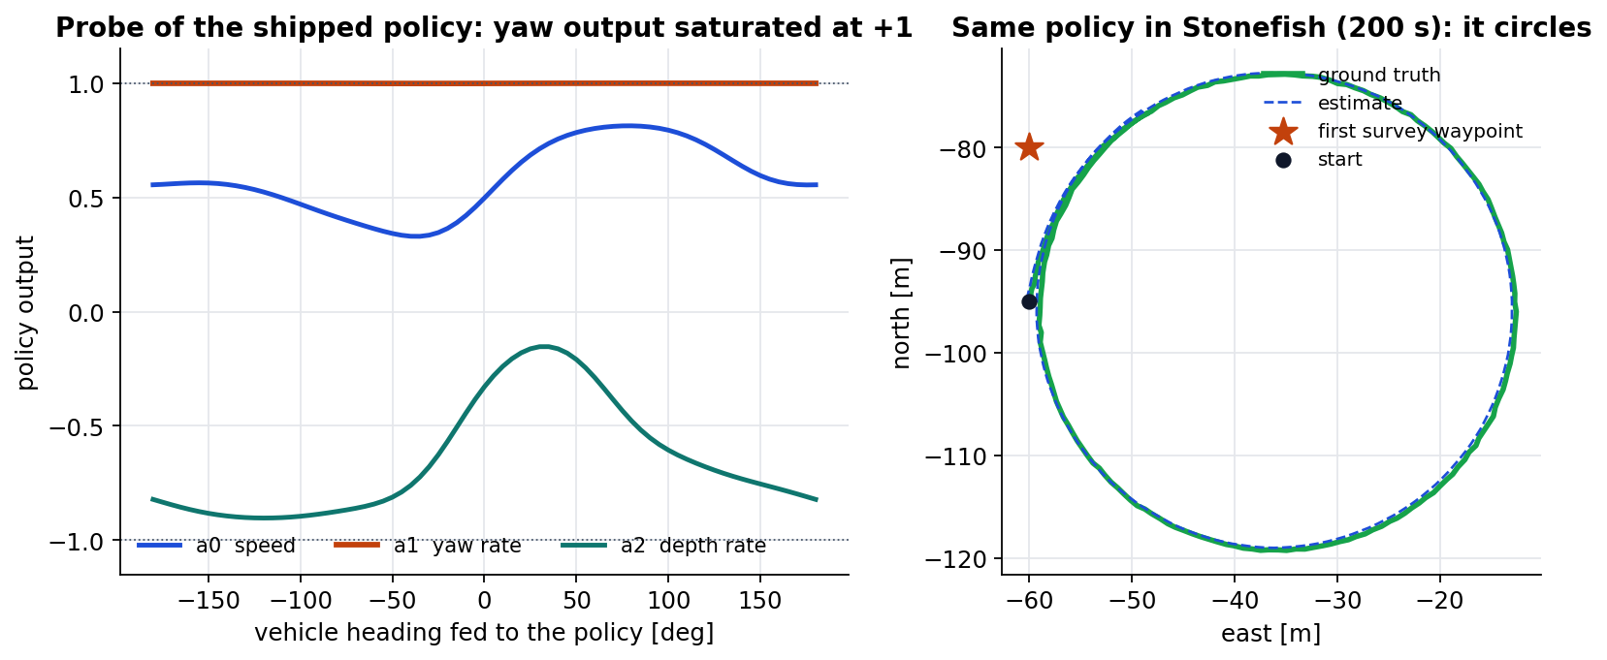
Diagnosis: Why It Cannot Navigate
0 / 5
goals reached in its own evaluation
+1.0
yaw output, for every heading
The observation contains no goal and no obstacle information, so no policy trained on it can steer to a waypoint or around a rock.
In Stonefish it does exactly what the probe predicts: a tight circle near the start (1 of 10 waypoints in 200 s).
[Project Review]

Slide 15
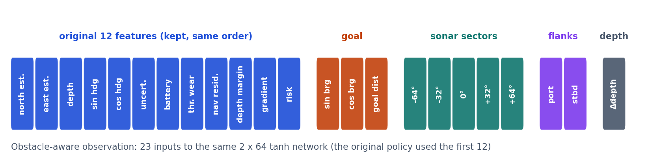
A Sonar-Aware Observation
The first 12 inputs are unchanged, same order and formulas.
+3 goal inputs from the next waypoint, using the estimated position.
+5 profiling-sonar sector clearances (port to starboard) measured from the bow.
+2 hull-flank clearances from a short-term sonar memory.
+1 depth error relative to the mission depth.
Same network type: 23 -> 64 -> 64 -> 3, tanh, about 5.9k parameters.
[Project Review]

Slide 16
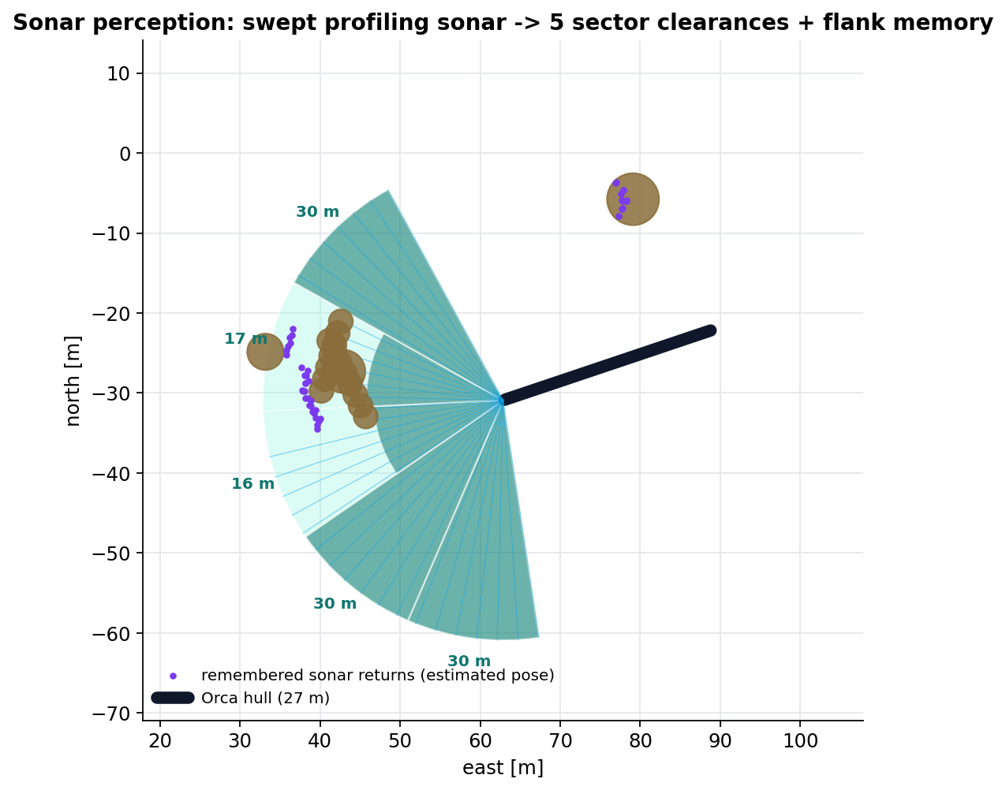
Stonefish-Scale Training Environment
Fast training environment (offline only)
Vehicle limits identified on the Stonefish Orca: 1.1 m/s, speed-dependent yaw rate, time constants.
27 m x 1.3 m hull for collisions; rocks, ridge walls, fish and subs that move.
The same swept sonar as the model: 64 steps over 160° at 10 Hz, in 5° bins as the simulator publishes.
The sonar memory keeps rocks that left the beam; a later beam that sees through a point clears it.
Navigation = DVL dead reckoning into the existing particle filter, exactly as on the vehicle.
[Project Review]

Slide 17
Safety Shield: Original Rules + Obstacle Rules
Rule | Trigger (sensor-derived only) | Override
Depth rating (original) | depth ≥ 98 % of rating | climb
Battery reserve (original) | battery < 8 % | limp-home speed, damped yaw
Localisation (original) | covariance trace > 5000 m² | clamp yaw rate
Obstacle stop | something < 7 m dead ahead | crawl 0.15 m/s, turn hard to the open side
Obstacle slow | something < 12 m in the front sectors | cap speed at 0.45 m/s
Seabed floor | DVL altitude < 3 m | no further descent
Depth band | |depth - mission depth| > 3 m | push back into the band
Every override costs the policy reward, so it learns to avoid needing the shield; the same shield runs in training and on the vehicle.
[Project Review]

Slide 18
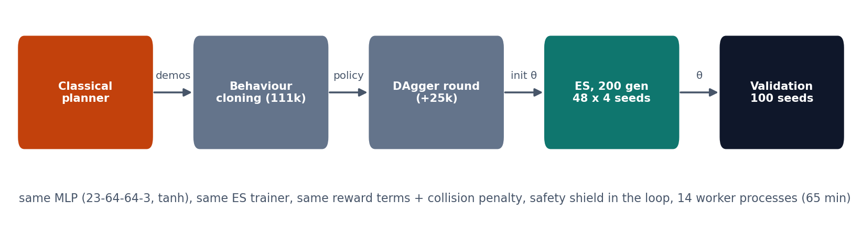
Training Pipeline: Behaviour Cloning + ES
Why a warm start
ES from a random network reached only 8 % of goals after 50 generations
Cloning a classical planner gives a sensible starting behaviour
What ES then optimises
The real reward, collisions included, with σ = 0.03
Shared evaluation episodes per generation, 14 workers in parallel
[Project Review]

Slide 19
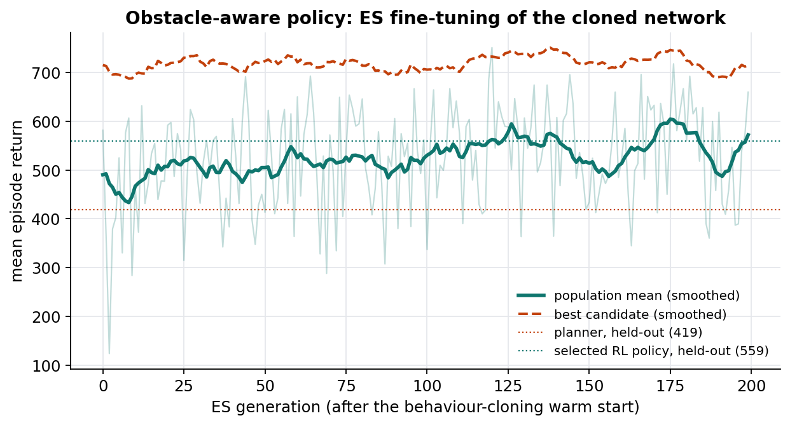
ES Fine-Tuning of the Cloned Policy
200 generations x 48 candidates x 4 episodes (65 min on 14 cores).
Generation-to-generation noise comes from new episodes each generation.
Model selection on 100 validation missions; a later 80-generation fine-tune was worse (16 % vs 8 % collisions) and was rejected.
[Project Review]

Slide 20
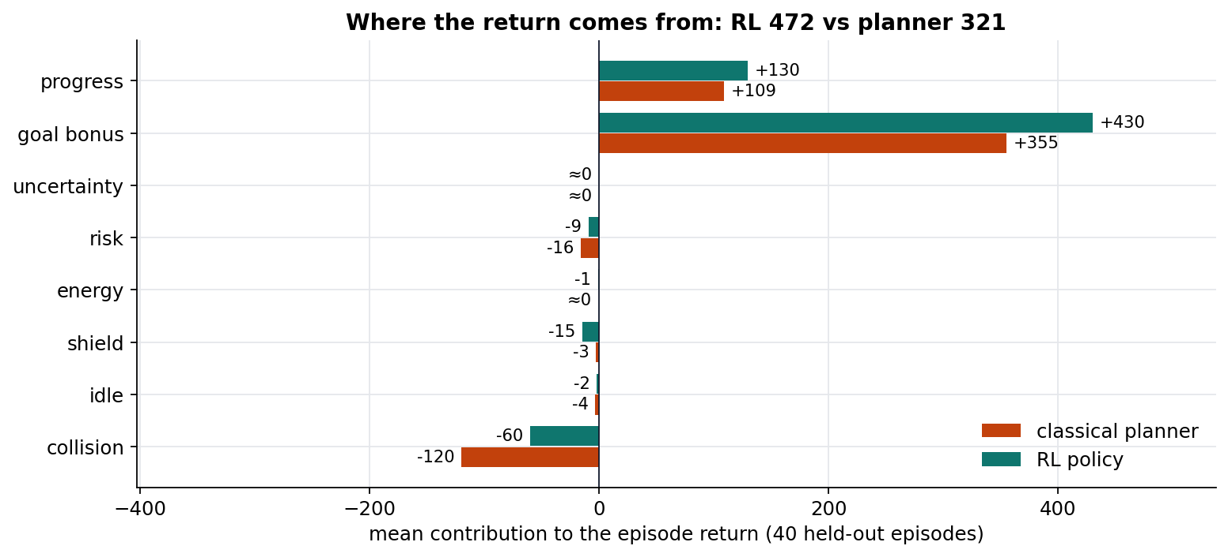
Where the Reward Goes
The RL policy earns more waypoint bonus (430 vs 355) and more progress (130 vs 109).
It halves the collision penalty (-60 vs -120).
It pays a little more for shield overrides: it accepts brief interventions to keep moving.
Uncertainty and energy terms are small at this scale (flat seabeds, 7-minute missions).
Mean contribution of each reward term over 40 held-out missions (energy approximated from speed).
[Project Review]

Slide 21
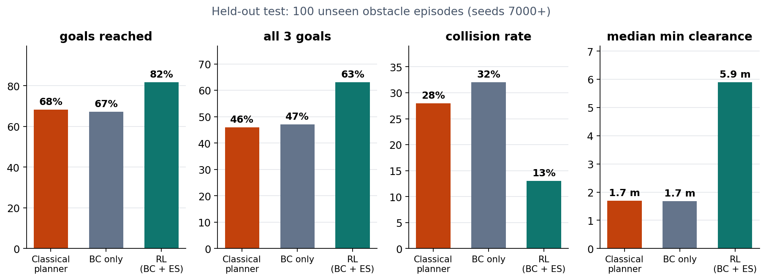
Offline Results: 100 Unseen Missions
82 %
13 %
5.9 m
goals reached (planner 68 %)
collision rate (planner 28 %)
median closest pass (planner 1.7 m)
[Project Review]

Slide 22
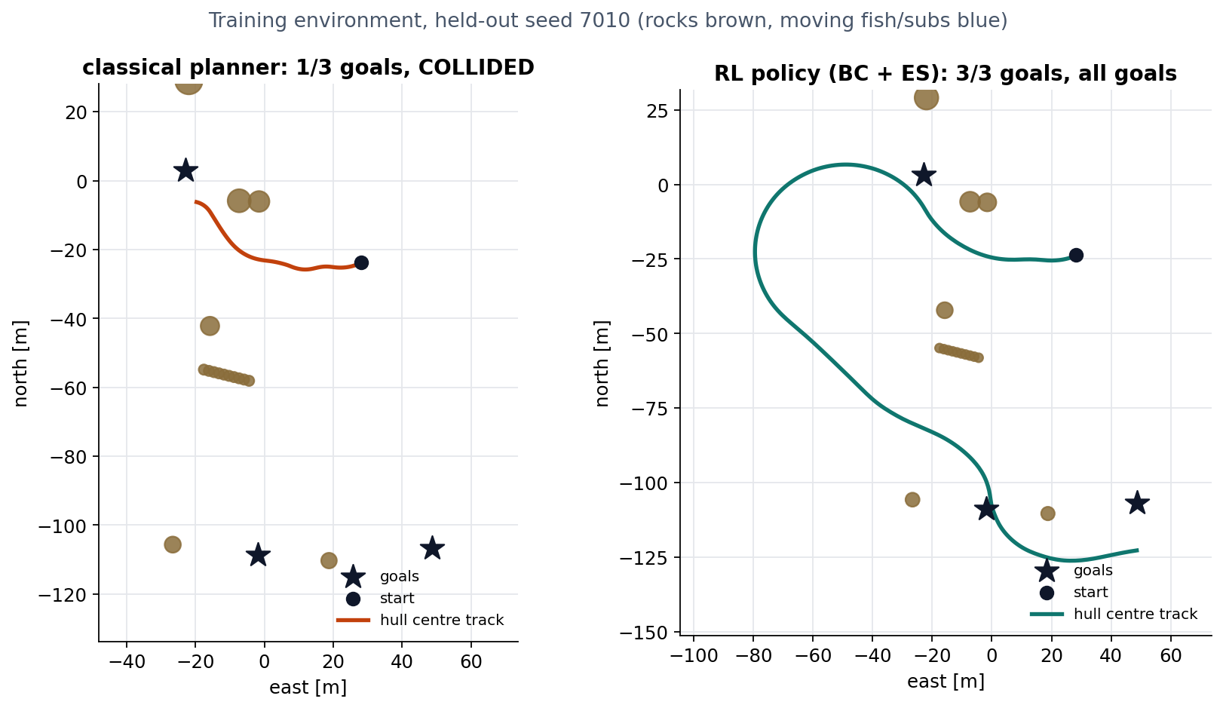
Same Mission, Two Controllers
Classical planner: attraction to the goal, repulsion from close sectors.
It cuts the corner and hits the rocks beside the first goal.
The RL policy slows down, swings wide around the cluster and completes all three goals.
Both read the same observation; only the decision rule differs.
[Project Review]

Slide 23
Part B · Stonefish and the Orca Model
Thrusters
Main thruster (±40 kN)
Yaw thruster at the bow (±8 kN)
Heave thruster through the centre of gravity (±55 kN)
Sensors
Inertial unit · Doppler velocity log · pressure · GPS
Profiling sonar: one swept beam, 160°, 30 m (obstacles)
Multibeam sonar: 120° downward fan (seabed)
The Orca hull in Stonefish (main hull selected: 36.6 t shell)
[Project Review]

Slide 24
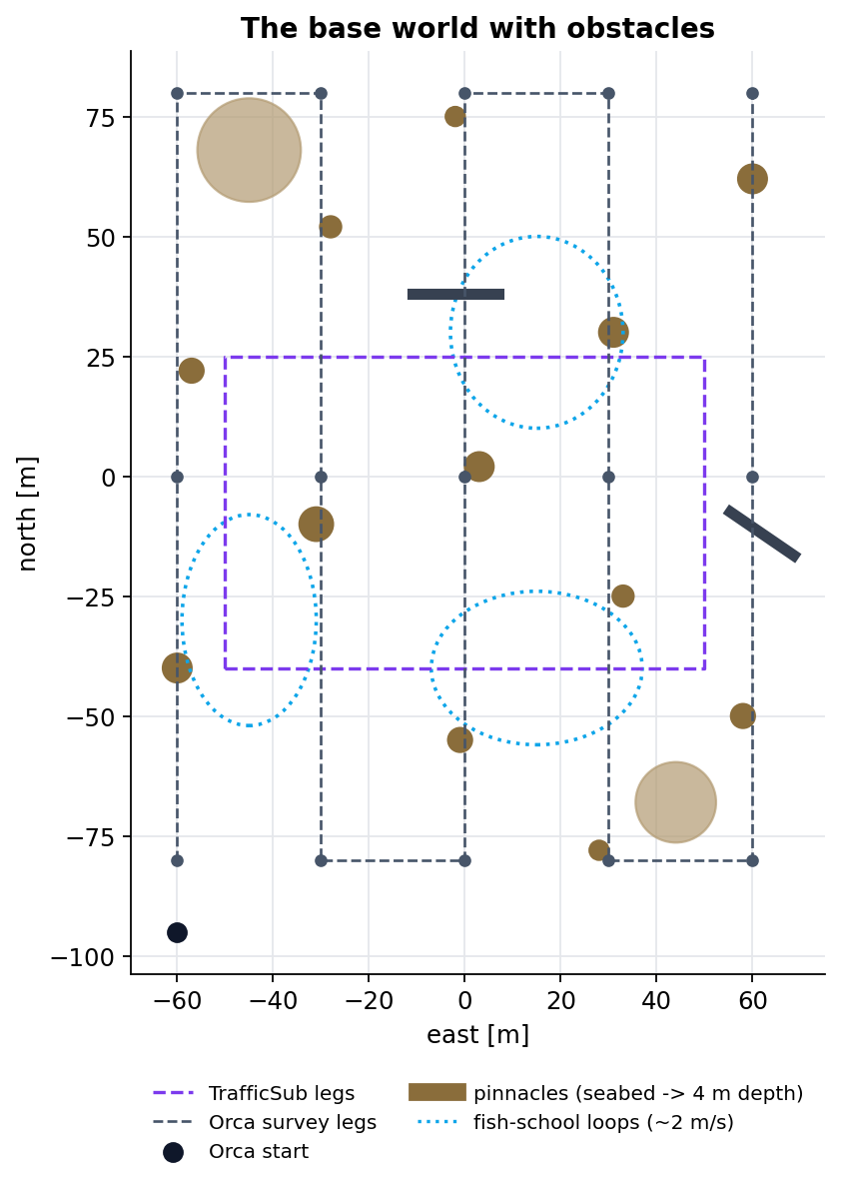

The Base World Now Has Obstacles
Obstacle world (generated procedurally)
12 rock pinnacles and 2 ridge walls rising from the 30 m seabed through the 12 m cruise depth
2 large boulders, 3 fish schools (9 fish, about 2 m/s loops)
A traffic submarine crossing the lanes with its own avoidance
The Orca only learns about any of this through its own sonars and DVL.
[Project Review]

Slide 25
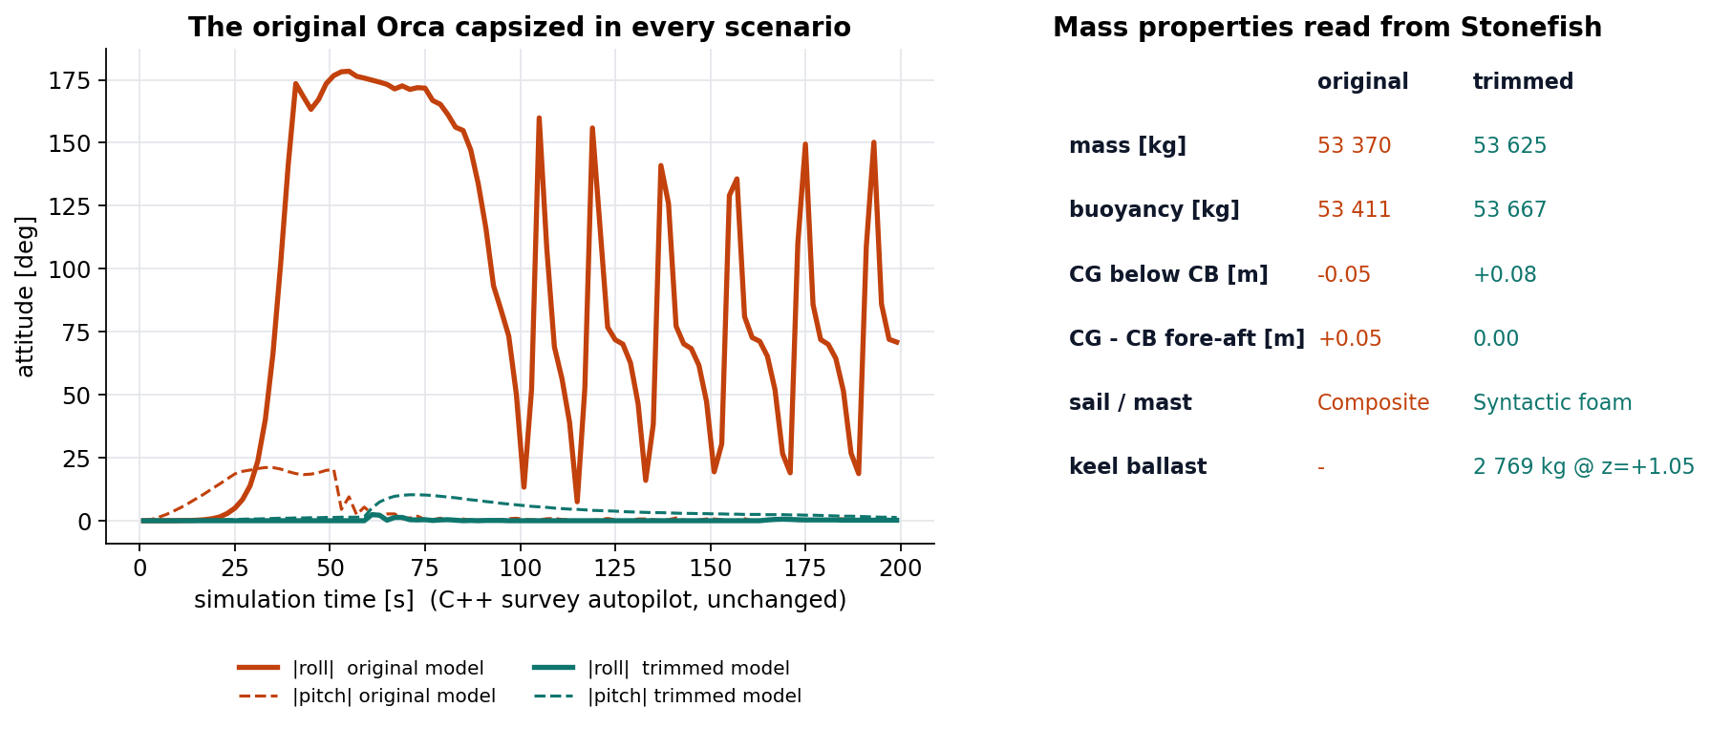
Fix 1: The Original Orca Capsized
Stonefish's own mass properties: the solid sail put the centre of gravity 5 cm above the centre of buoyancy.
Every scenario, the original survey demo included, rolled past 170° within about 35 s.
Fix: foam sail and mast; the removed mass carried as low keel ballast, placed so the two centres line up.
Same net buoyancy; gravity now 8 cm below buoyancy. Same fix for the survey subs.
Verified: the unchanged survey autopilot now completes its lanes with roll ≈ 0° and pitch ≤ 10°.
[Project Review]

Slide 26
Fixes 2-4 Found While Integrating
Problem | Root cause (from the Stonefish source) | Fix
DVL never had bottom lock | only a velocity range was given, leaving the altitude limit at about 10³⁰; the beam search then ran zero steps | explicit altitude range in the vehicle description
Seabed coverage stopped after one fan | the sensor interface returns sample copies whose identifier is always zero | detect new samples by their time stamp
Windowless mode aborted | lights are rejected when running without a window | remove lights after loading the scene
Orca flung out of the water | scripted fish squeeze the hull into the seabed or another hull; the physics engine diverges | watchdog: put the Orca back ~2 s earlier and report it
Two simulators on one network | interleaved sensor data, jumping estimate | warning in the run script; separate ROS domain per run
[Project Review]

Slide 27
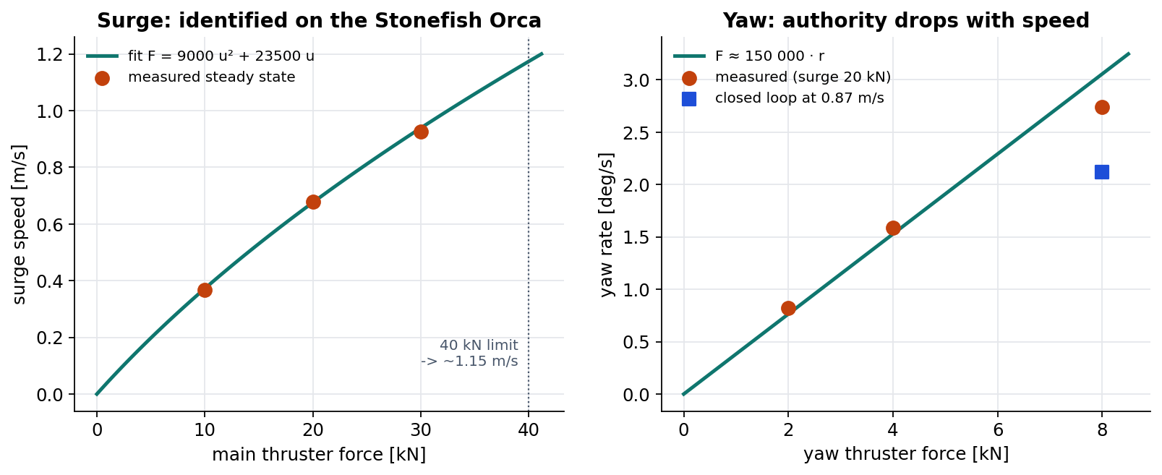
System Identification on the Stonefish Orca
1.15 m/s
top speed (40 kN)
2.7 °/s
Raw thrust steps sent over ROS 2, with the vehicle reset between steps.
The published Orca envelope (4.1 m/s, 3°/s) is not achievable by this model: 1.15 m/s at 40 kN.
max yaw rate at 0.5 m/s
τ ≈ 6.5 s
surge time constant
[Project Review]

Slide 28
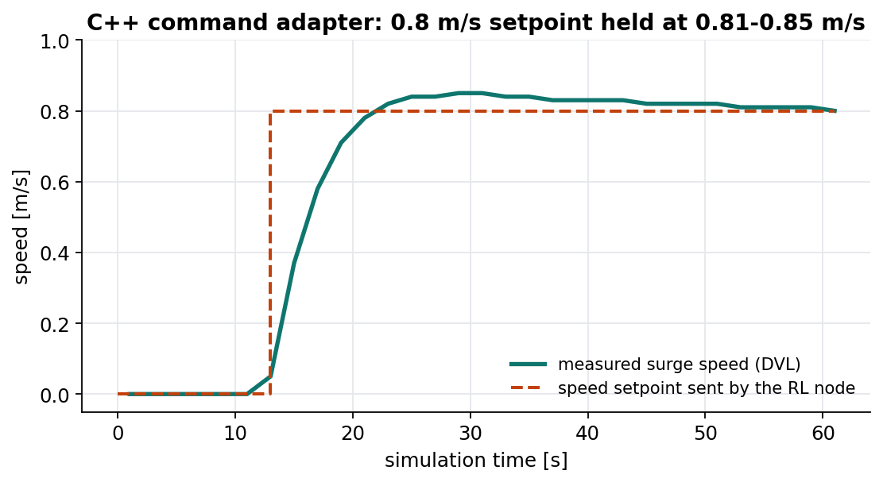
From RL Action to Thruster Force
Command adapter (C++, 300 Hz)
Surge: F = 9000·u|u| + 23500·u feed-forward + PI on DVL speed
Yaw: 150 000·r feed-forward + PI on the measured yaw rate
Depth: integrates the depth-rate command into a reference, held with the autopilot's gains + seabed guard
Drives the existing vehicle controller with its autopilot switched off
3 s watchdog: stop and hold depth if commands stop
Actions are not forces: the policy asks for physical setpoints and the C++ inner loop turns them into thrust using the identified model.
[Project Review]

Slide 29
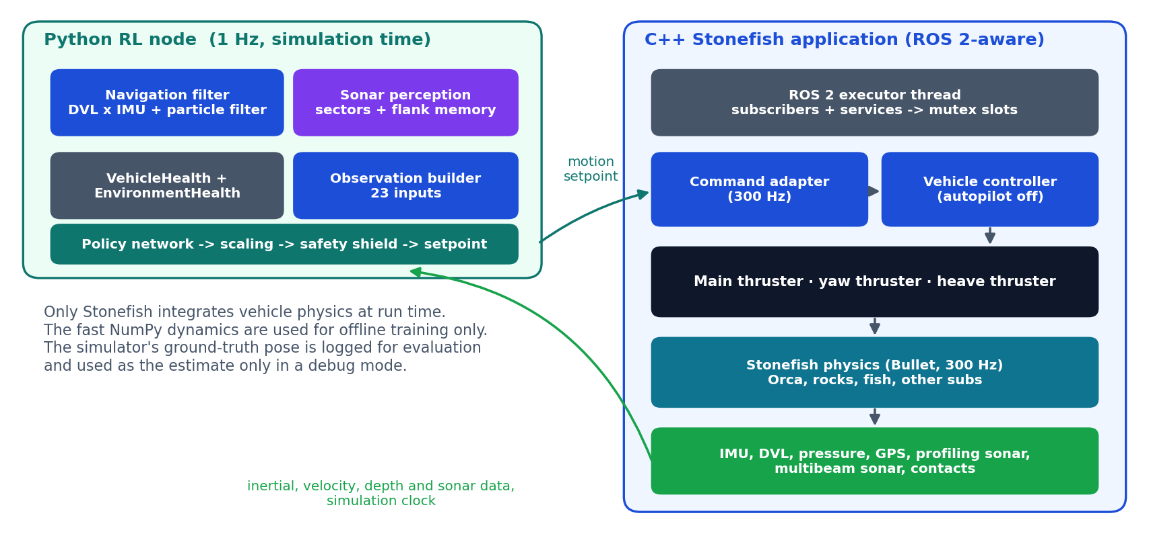
Part C · How RL and Stonefish Connect
[Project Review]

Slide 30
From Gazebo Assumptions to Stonefish
Old assumption (Gazebo / UUV Simulator) | Stonefish replacement
Ground-truth pose fed into the control loop | simulator odometry, labelled ground truth; used only for evaluation or in debug mode
Depth = (pressure - 1 atm) / ρg | Stonefish reports gauge pressure: depth = pressure / ρg (else 10 m error)
Velocity command to a simulator plugin | speed / yaw-rate / depth-rate setpoint, converted to thruster forces in C++
Per-thruster plugin messages | direct thruster forces, kept for manual tests
Fixed heading, zero velocity placeholders | measured heading and DVL velocity into the particle filter
Simulator reset / pause services | the robot is re-spawned at its start pose on the physics thread
Spawning the model into the world | the Orca is loaded from the scenario description
Procedural risk map | risk from the profiling sonar and DVL altitude; terrain richness from the multibeam
[Project Review]

Slide 31
Data Exchanged over ROS 2
Data | Direction | Rate
Motion setpoint (speed, yaw rate, depth rate) | RL -> simulator | 1 Hz
Attitude and turn rate (inertial unit) | simulator -> RL | 100 Hz
Velocity over ground, altitude (DVL) | simulator -> RL | 10 Hz
Depth (pressure) | simulator -> RL | 10 Hz
Position fix (GPS, surface only) | simulator -> RL | 1 Hz
Profiling and multibeam sonar scans | simulator -> RL | 10 / 2 Hz
Contact events | simulator -> RL | 10 Hz
Simulation clock | simulator -> RL | 100 Hz
Reset, autopilot on/off | service | on request
Frames (checked in the source)
World north-east-down, body forward-right-down
The Python simulator already uses the same axes
+ yaw = bow to starboard; depth positive down
Threads and timing
Physics thread: 300 Hz step callback
ROS 2 on its own thread
Only lock-protected data is shared
RL at 1 Hz on simulation time
[Project Review]

Slide 32
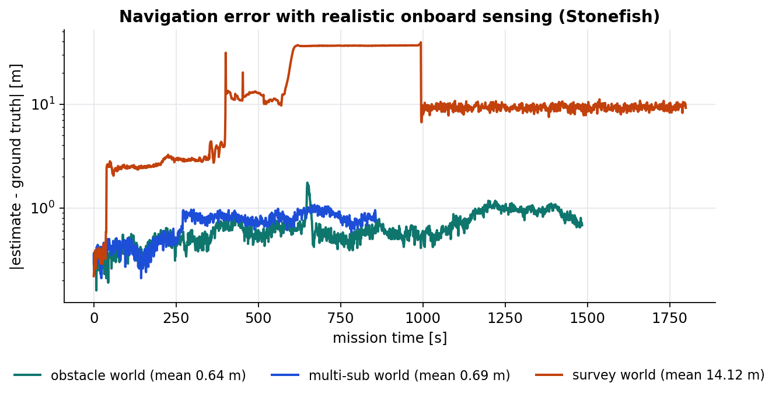
Navigation: Realistic vs. Debug
Realistic sensing (default)
DVL x inertial dead reckoning at 10 Hz
Existing particle filter, GPS at the surface
Ground truth logged only for evaluation
Debug: ground truth
Simulator pose used as the estimate
Connectivity checks only
Warns in the log every 10 s
Under 1 m mean error over 25-minute missions in the obstacle and multi-sub worlds. The survey-world error comes from physics resets, which navigation cannot observe.
[Project Review]

Slide 33
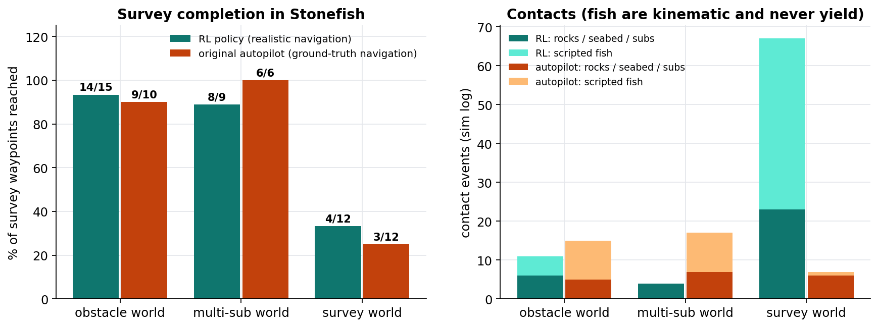
Closed-Loop Results in Stonefish
RL: realistic navigation, 30-minute limit. Autopilot: the original C++ controller using ground-truth position, in the same worlds.
[Project Review]

Slide 34
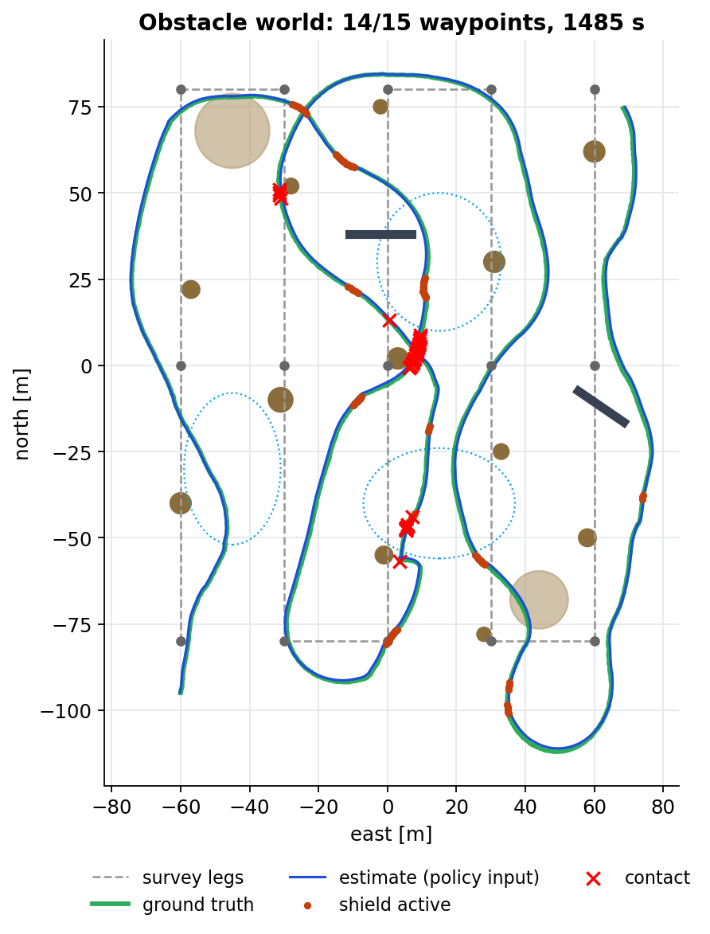
Obstacle World: Full Survey Under RL Control
14 / 15
0.64 m
waypoints (1 skipped: on a rock)
mean navigation error
Detours around pinnacles, ridges and boulders on every lane.
6 static contacts are grazes in tight passes; 5 are scripted fish crossing the hull.
A waypoint the sonar shows to be occupied is skipped, as a real mission manager would.
[Project Review]

Slide 35
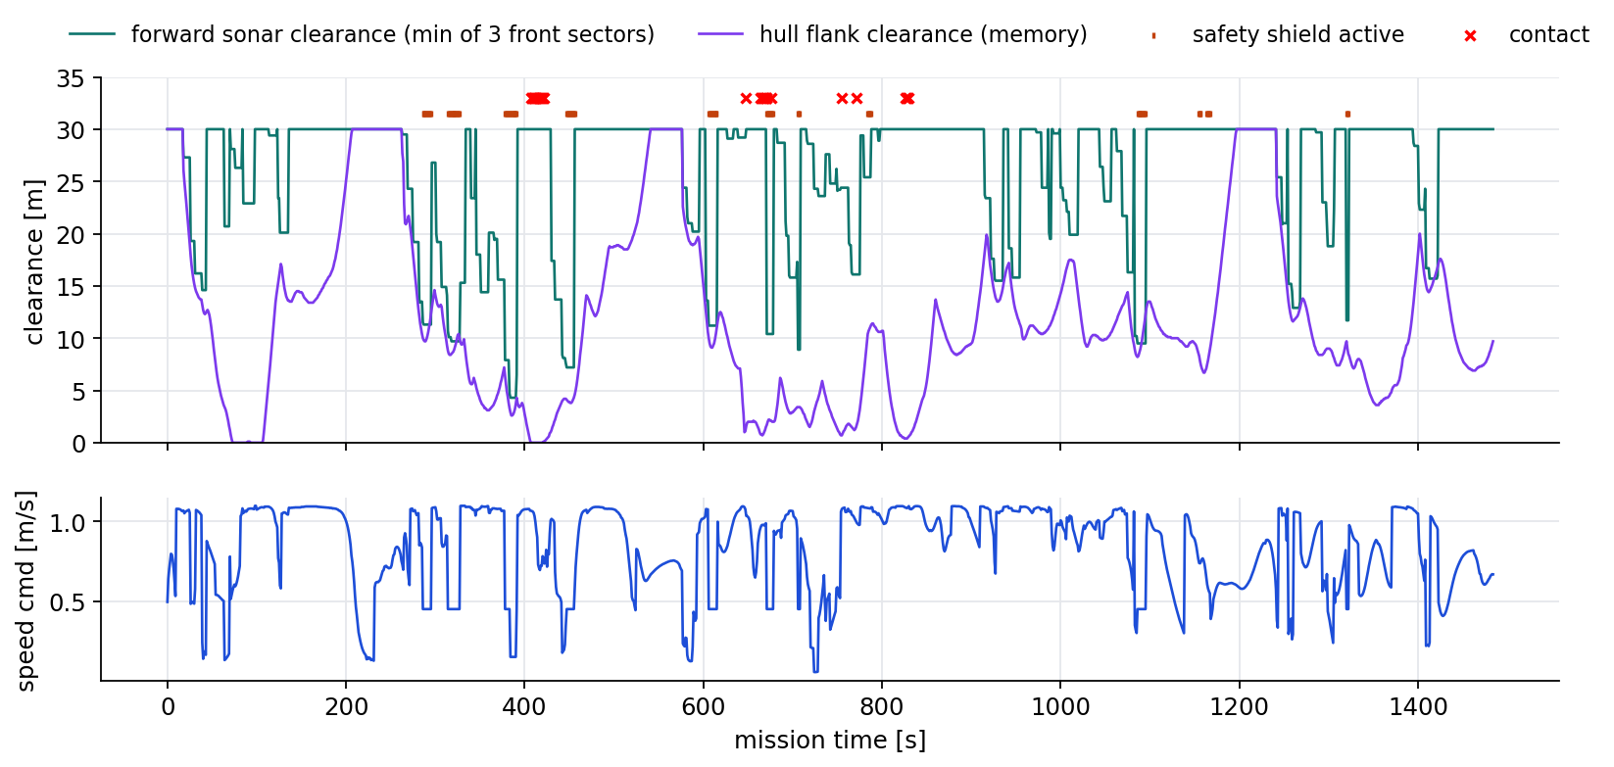
What the Policy Sensed and Did
Speed drops whenever forward clearance shrinks; the shield fires only in brief bursts; the flank memory keeps a rock alongside until the hull has passed it.
[Project Review]

Slide 36
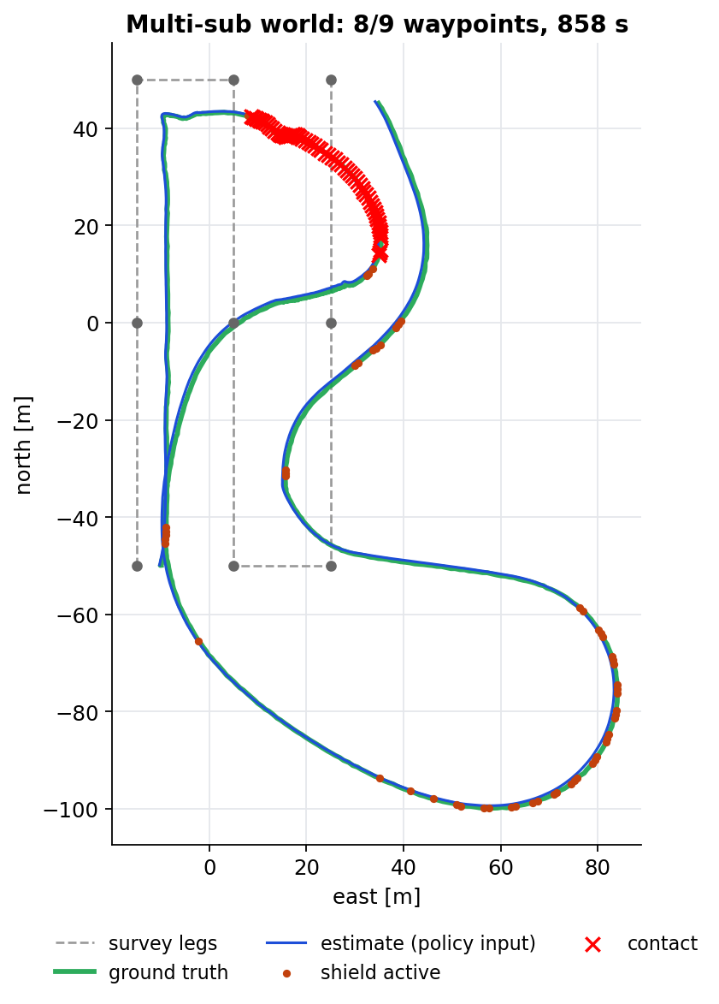
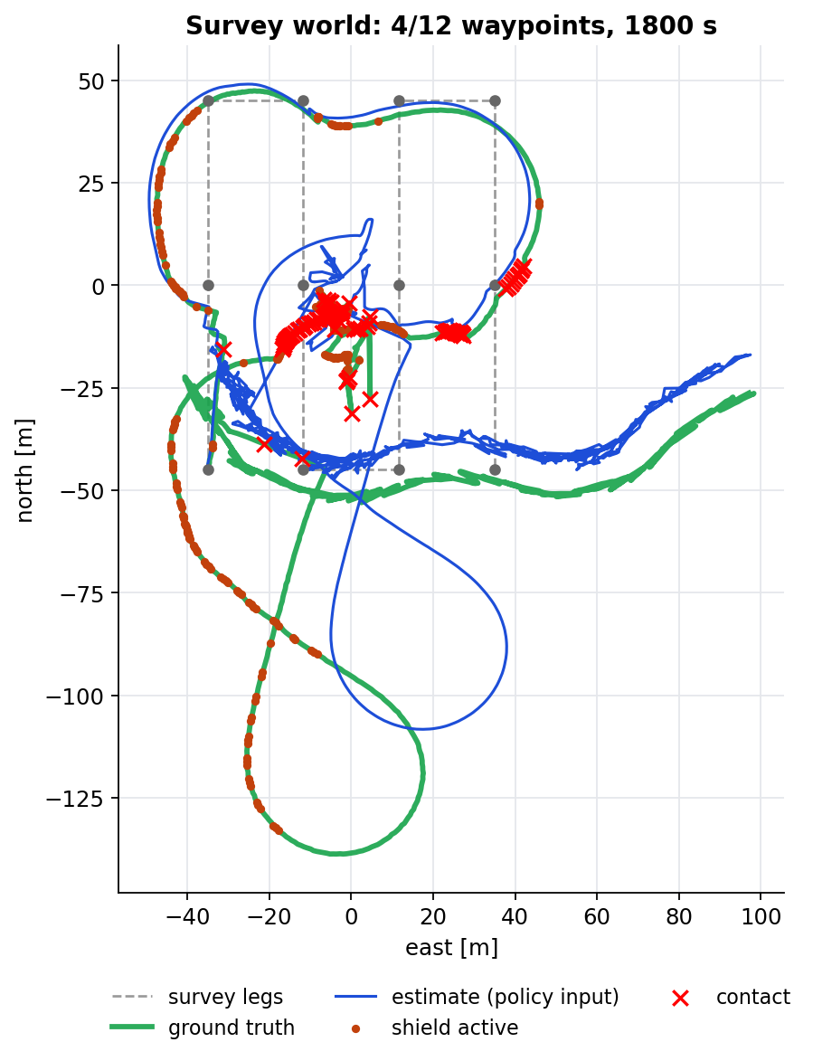
Other Submarines and the Dense Survey Field
Multi-sub world: complete
8/9 waypoints, 4 grazes with another sub, 0.69 m navigation error
Survey world: the open problem
90 x 70 m box for a 26 m hull, lanes 23 m apart
Large scripted fish push the hull into the seabed: 15 physics resets, estimate drifts, legs time out
The C++ autopilot also only reaches 3/12 there
[Project Review]

Slide 37
Interim Summary / Conclusion
ROS 2
82 %
13 %
2 / 3
RL policy <-> Stonefish
offline goals (planner 68 %)
offline collisions (planner 28 %)
Stonefish surveys completed
The policy drives the real Stonefish thrusters through ROS 2 and reads only real Stonefish sensors.
The objective rewards progress and waypoints and penalises uncertainty, risk, energy, shield use and collisions.
Three vehicle-model bugs were found and fixed: capsizing, DVL lock, seabed coverage.
Remaining gap: dense scenes with non-yielding scripted fish, and grazing contacts in tight passes.
[Project Review]

Slide 38
Limitations and Completion Plan
Limitations
Trained in a fast simulator calibrated to Stonefish, not in Stonefish itself
Flat seabeds: terrain-aided navigation carries no information
Scripted fish never yield and can force physics resets
The swept sonar refreshes each bearing only every ~6.4 s
Contacts still occur: 6 grazes in the obstacle world
Next phase
Fine-tune with ES directly in Stonefish, faster than real time, with automatic resets
Randomise obstacle fields for every mission
Real bathymetry charts so terrain-aided navigation helps
Larger flank margin in tight passes
PPO once a deep-learning toolchain is available
[Project Review]

Slide 39
References
T. Salimans et al., "Evolution Strategies as a Scalable Alternative to Reinforcement Learning," arXiv:1703.03864, 2017.
J. Schulman et al., "Proximal Policy Optimization Algorithms," arXiv:1707.06347, 2017.
T. I. Fossen, Handbook of Marine Craft Hydrodynamics and Motion Control, Wiley, 2011.
P. Cieślak, "Stonefish: An Advanced Open-Source Simulation Tool Designed for Marine Robotics, with a ROS Interface," IEEE/OES OCEANS, 2019.
M. M. M. Manhães et al., "UUV Simulator: A Gazebo-Based Package for Underwater Intervention and Multi-Robot Simulation," IEEE/MTS OCEANS, 2016.
S. Ross, G. Gordon, D. Bagnell, "A Reduction of Imitation Learning and Structured Prediction to No-Regret Online Learning," AISTATS, 2011.
S. Macenski et al., "Robot Operating System 2: Design, Architecture, and Uses in the Wild," Science Robotics, 2022.
[Project Review]

Slide 40
Thank you
Questions?
[Project Review]

