Slide 1
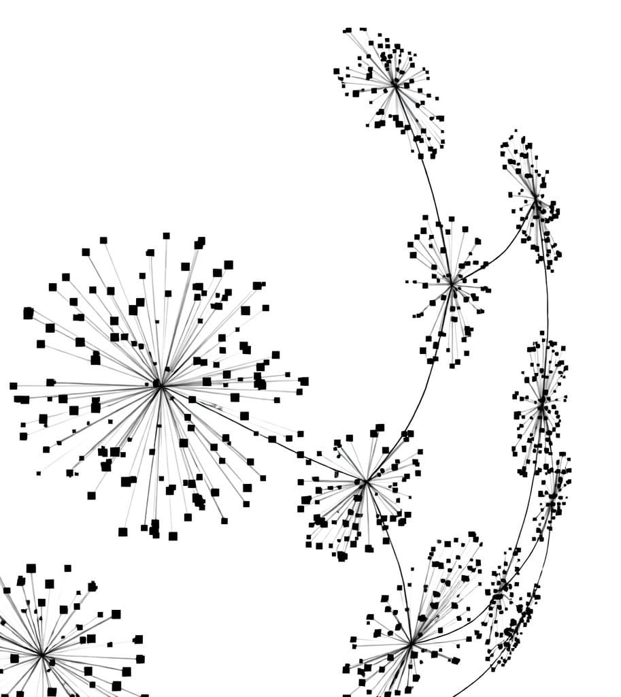
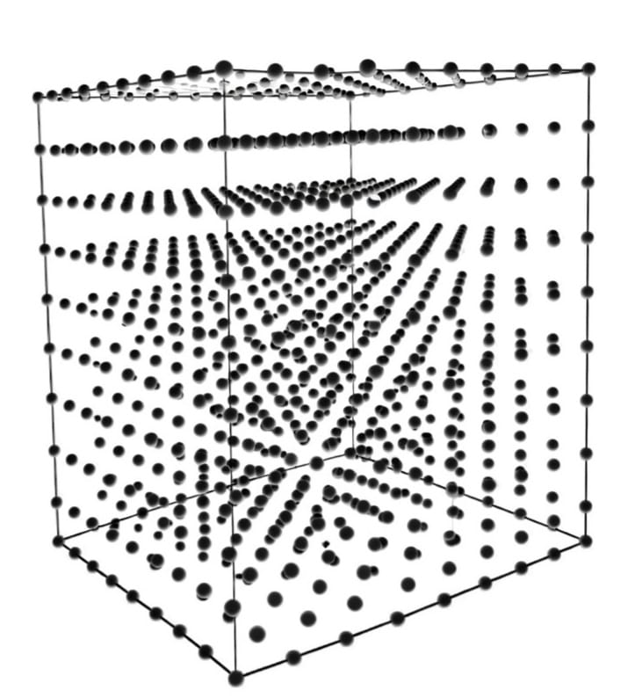
Project on Dimensionality Reduction
By Prithujit Ghosh

Slide 2

Presentation Structure
Overview
Key Findings from t-SNE Implementation
Comparative Analysis: PCA vs. t-SNE
Actionable Insights
Key Findings from PCA Implementation
Introduction to Dataset
Data Cleaning & Preprocessing
Exploratory Data Analysis

Slide 3

Overview
Problem: Student grade data in its raw form is high- dimensional, making it hard to find underlying unique student clusters with basic analysis.
Objective: Applying dimensionality reduction techniques like Principal Component Analysis (PCA) and t-SNE, plotting the results to identify clusters, comparing the results of PCA & t-SNE and lastly providing actionable insights.

Slide 4
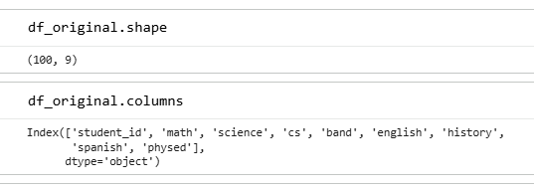

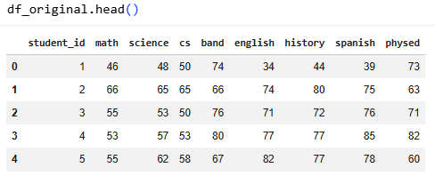
Introduction to Dataset
Number of rows (student entries): 100
Number of columns: 8
Columns:
“student_id”: Unique identifier for each student
“math”: Grades in math
“science”: Grades in science
“cs”: Grades in computer science
“band”: Grades in band
“english”: Grades in English
“history”: Grades in history
“spanish”: Grades in Spanish
“physed”: Grades in physical education

Slide 5

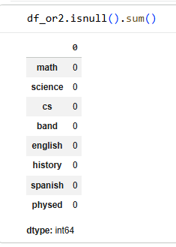

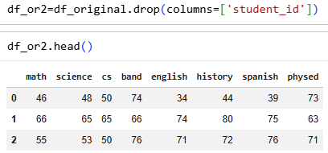

Data Cleaning & Preprocessing
Duplicate Handling: In this case there are no duplicates in the dataset; treatment of duplicates was not required.
Data Quality Assessment: No missing values were found in the dataset.
Removing column “student_id”, since it’s redundant for the next stages.

Slide 6

Exploratory Data Analysis

Slide 7
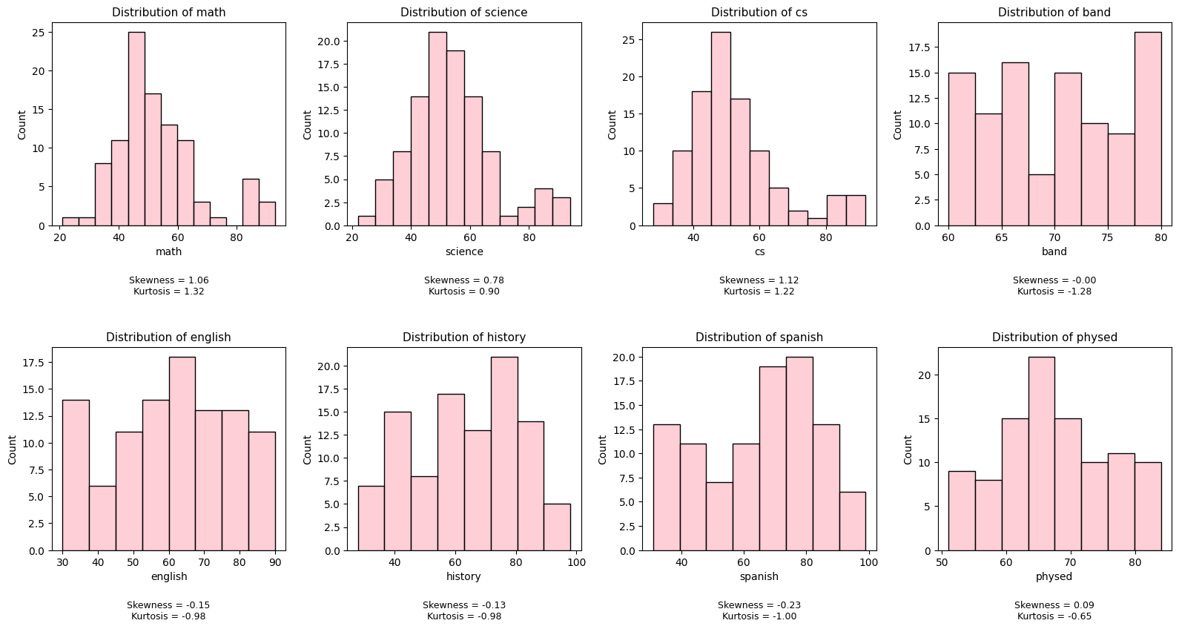
Univariate Analysis : STEM
Difficulty (Hard): Math, Science, and CS (Computer Science) have the lowest averages (approx. 52-53). These distributions are right-skewed (positive skewness), meaning most students scored on the lower end, with only a few high-achievers pulling the mean up.
Distribution: Math and CS (Computer Science) have positive Kurtosis (1.32 and 1.22). This tells us that the scores are heavily concentrated around a specific "average" point with infrequent extreme outliers. It suggests a very standardized level of difficulty where most students hit a "ceiling" or "floor" together.

Slide 8
Univariate Analysis : Humanities
Difficulty (Medium): English, History, and Spanish show moderate performance with means between 59 and 66. These are slightly left-skewed (negative skewness), suggesting that more students are scoring above the average than below it.
Distribution: English, History, and Spanish have negative Kurtosis (around -1.0). These distributions are flatter (Platykurtic). This indicates there isn't one "common" grade; instead, students are spread out across a wide range of scores, possibly indicating that these subjects depend more on individual student effort or interest.

Slide 9
Univariate Analysis : Band & Physical Education
Difficulty (Low): Band and “PhysEd” (physical education) have the highest averages (70 and 67 respectively). These subjects also have the lowest standard deviations, meaning student performance is more consistent and "grouped" together compared to the wide variety of scores in English or History.
Distribution: Band has a Kurtosis of -1.28 and a maximum score of 80 (the lowest "Max" of any subject). This suggests the grading might be capped or the curriculum is designed so that almost everyone reaches a high level of competency but nobody "breaks away" with a 90+.

Slide 10
PCA Implementation

Slide 11
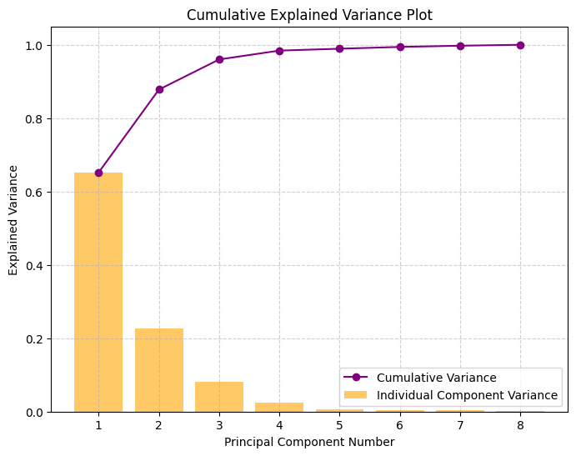
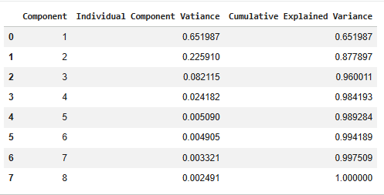
Insights from Scree Plot
From the scree plot and the tabulated data, we can conclude that the first two Principal Components can explain approximately 88% variance collectively.
Hence, we retain only the first two components for further analysis and visualization.

Slide 12


Interpretation of Principal Components
Analysing the First Principal Component:
It has moderate weights (about 0.4) for all core subjects.
But it has very low weights for both Band/Physical Education.
Significance: This component seems to capture a contrast between performance core/traditional subjects and band/physical education. For example, if a student scores high on PC1, it means they are good at core subjects, and possibly less impressive at Band/Physical Education
Analysing the Second Principal Component:
It has very small weights (about 0.4) for all STEM subjects.
And even negative weights for languages/humanities.
But high positive weights for band/physical education.
Significance: If a student scores high on this, we can conclude that they are good at Band/Physical Education (have good artistic abilities or physical fitness) but may have poor performance it traditional subjects (especially in humanities and languages).

Slide 13
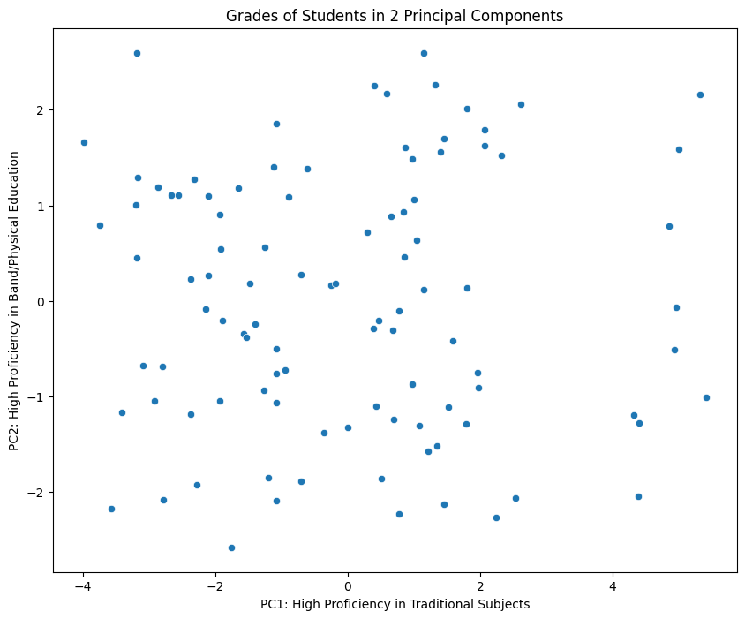
Findings from Scatter Plot
Insights drawn from the Plot:
Uniform Distribution: There are Students of all levels and type of profiencies.
Top-Right Quadrant (High PC1, High PC2):This group of students are simultaneously good at both core subject sand band/physical
Bottom-Right Quadrant (High PC1, Low PC2): Good at academics but poor at band/physical education.
Top-Left Quadrant (Low PC1, High PC2): Good at physical activities or creativity but struggling with academics.
Bottom-Left Quadrant (Low PC1, Low PC2): Poorly performing across both parameters.
A few High Achievers in Studies: There are a few high performers in core subjects, although their excellence in Band/Physical Education varies significantly.

Slide 14
t-SNE Implementation

Slide 15
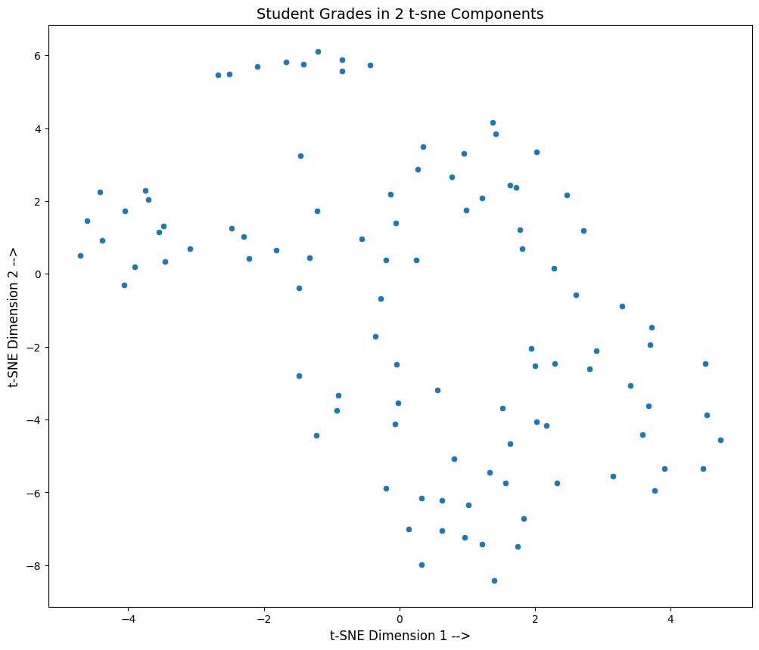
Insights from Scatter Plot
Evidence of Academic "Archetypes":
The most important insight is that the points are not randomly scattered; they form distinct clusters. This suggests that the student population isn't a uniform mix. Instead, students tend to fall into specific academic archetypes—groups that share similar strengths and weaknesses across subjects (e.g., a "STEM-focused" group or a "Humanities-leaning" group).
Identification of Isolated Sub-groups:
The "Top-Tier" or "Unique" Cluster: There is a very distinct, almost horizontal line of points at the top of the plot (y is approximately 5.5). These students have a grade profile that is fundamentally different from everyone else.
Interpretation: These could be the highest overachievers who excel in every subject, or perhaps a niche group that failed specific subjects but aced others.
The Left-Hand Cluster: The grouping around x = -4 represents another unique profile. The physical distance between this group and the main mass on the right indicates their performance patterns are highly dissimilar to the "average" student.
The "Mainstream" Gradient: The large, denser region on the right side of the plot represents the majority of the student body.
Insights: Unlike the isolated clusters, this area shows a more "continuous" spread. This suggests a gradual variation in grades among these students, likely representing those with more balanced or average performance across the board.
Sub-clustering: Within this large mass, one can see smaller "pockets" of density. These represent subtle variations.

Slide 16

Comparative Analysis: PCA vs. t-SNE

Slide 17
On Type and Interpretability of the Axes
PCA
t-SNE
In PCA data is treated as rigid objects and rotates the axes along the direction of maximum variance.
It preserves the global structure.
The lower dimensional axes are intuitively interpretable by looking at the weights of the original features.
It’s a non- linear probabilistic method that aims at bringing similar data points closer.
It preserves the local structure.
The lower dimensional axes don’t carry any inherent meaning.

Slide 18
On Application
PCA
t-SNE
PCA is specialized for dimensionality reduction. Because it is deterministic linear transformation. Hence, the Principal Components can be used in further modeling.
For PCA to be a reliable visual representation, the cumulative EVR of the first two (or three) components should ideally be ≥ 85%.
It’s specialized for visualization as it can visualized underlying groups in the data. Since it’s stochastic, the transformed data can’t be used for further modeling.

Slide 19
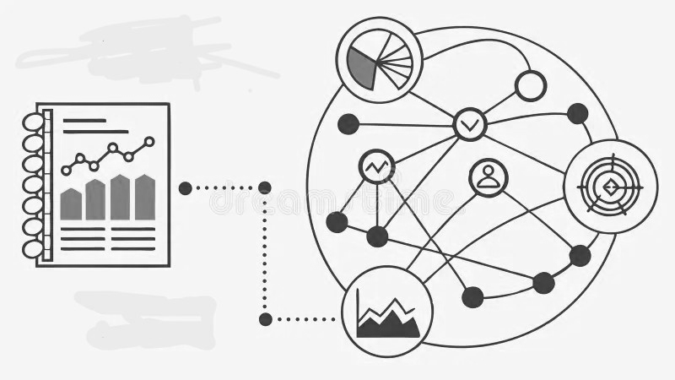
Actionable Insights

Slide 20

Actionable Insights
1. Academic Core Cluster (students grouped tightly on PC1‑like strengths)
Profile: Strong in math, science, CS, languages, and history.
Actionable Insight:
Encourage advanced coursework or enrichment programs (STEM clubs, debate, coding competitions).
Provide opportunities for interdisciplinary projects to keep them challenged and engaged.
2. Creative/Physical Cluster (students grouped on band + physed strengths)
Profile: High proficiency in music, arts, and physical education, less emphasis on traditional academics.
Actionable Insight:
Offer leadership roles in extracurriculars (school band, sports teams).
Integrate creative/kinesthetic learning methods into academic subjects to leverage their strengths.
Consider pathways in performing arts, athletics, or event management.

Slide 21
Actionable Insights
3. Balanced Cluster (students scoring nicely across both dimensions)
Profile: Competent in both academics and creative/physical domains.
Actionable Insight:
Encourage exploration — these students may benefit from exposure to diverse subjects before specialization.
Provide mentorship to help them identify areas of passion and potential career direction.
4. Lower‑Performance Cluster (students with low scores across both components)
Profile: Struggling in both traditional academics and creative/physical subjects.
Actionable Insight:
Identify underlying challenges (study habits, motivation, external factors).
Provide targeted support: tutoring, counseling, or personalized learning plans.
Focus on building confidence through small, achievable goals.

Slide 22

For your attention

