Slide 1
Predicting Market Volatility & Short-Term Trading Signals from r/WallStreetBets
UE24CS352A Machine Learning - Mini-Project
Prithvi Aithal (PES1UG24CS909) | Sagar A Walikar (PES1UG24CS396)

Slide 2
Problem statement
- WSB drove the Jan-2021 GameStop short squeeze
- Can post features predict next-day price direction and volatility?
- Can the predictions drive a simple short-term trading strategy?
- Replicate the CS229 report, then extend it: tuning, strict baselines, leakage-free evaluation, back-test

Slide 3
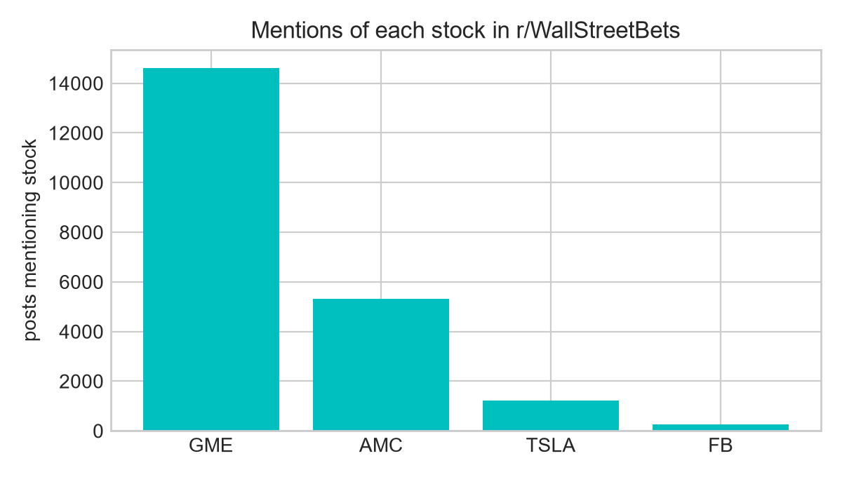
Dataset
- Kaggle gpreda/reddit-wallstreetsbets-posts: 53,187 posts, Sep 2020 - Aug 2021
- Prices: Yahoo Finance daily OHLC (yfinance)
- Mentions: GME 14,619 | AMC 5,310 | TSLA 1,232 | FB 251
- One example per post that mentions the stock

Slide 4
Features and labels
- 7 features: score, comments, length, VADER pos/neu/neg, bias
- Preprocessing: lowercase, strip URLs/handles/special chars, log1p + standardise
- Direction: open(k+1) > open(k)
- Volatility: |move| > training median
- 'paper' vs 'tradable' timing (no look-ahead)
- Chronological 80/10/10 split

Slide 5
Models
- Logistic regression - Newton's method written from scratch (+ small L2)
- Neural net: 3x256 ReLU, sigmoid head, Adam 1e-3, 30 epochs
- Baselines: random guess, majority class
- Tuning: L2 grid (val log-loss); NN random search over depth/width, lr, weight decay, batch (val accuracy)
- NN results averaged over 5 seeds

Slide 6
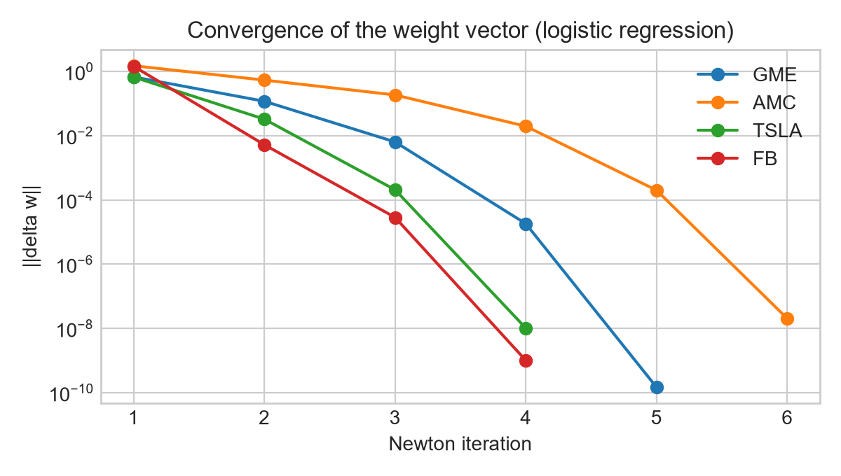
Newton convergence
- ||delta w|| falls below 1e-6 in 4-8 iterations for every stock
- Unlike the report, AMC also converges (6 iterations)

Slide 7
Results: direction (tradable labels)
Stock | n test | NN (report) | NN (tuned) | LogReg (report) | LogReg (tuned) | Majority | Random
GME | 1462 | 0.569 | 0.569 | 0.567 | 0.567 | 0.567 | 0.500
AMC | 531 | 0.350 | 0.353 | 0.411 | 0.388 | 0.653 | 0.500
TSLA | 124 | 0.563 | 0.494 | 0.573 | 0.589 | 0.556 | 0.502
FB | 26 | 0.500 | 0.469 | 0.462 | 0.538 | 0.577 | 0.495

Slide 8
Results: volatility (paper labels)
Stock | n test | NN (report) | NN (tuned) | LogReg (report) | LogReg (tuned) | Majority | Random
GME | 1462 | 0.256 | 0.275 | 0.272 | 0.271 | 0.805 | 0.500
AMC | 531 | 0.869 | 0.960 | 0.902 | 0.902 | 0.960 | 0.499
TSLA | 124 | 0.474 | 0.563 | 0.427 | 0.460 | 0.855 | 0.500
FB | 26 | 0.508 | 0.546 | 0.692 | 0.692 | 0.500 | 0.507

Slide 9
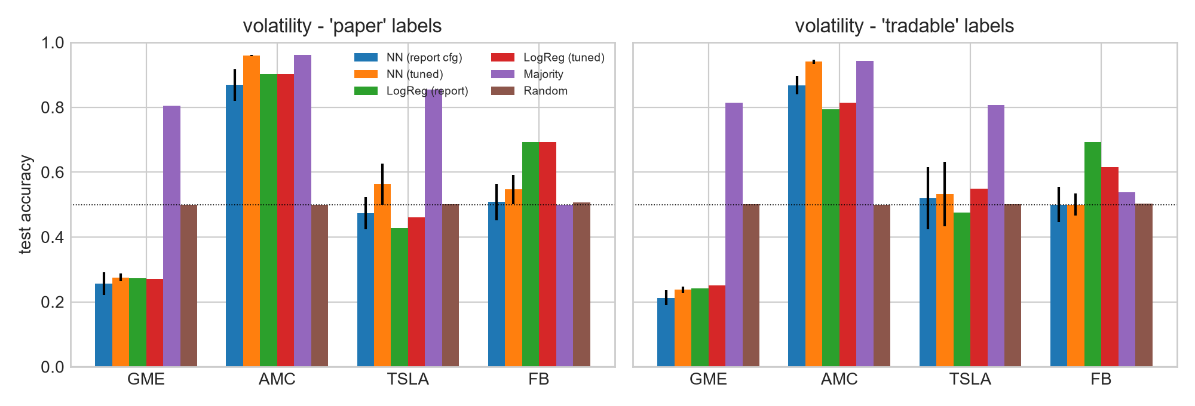
Accuracy overview

Slide 10
Why we do not match the report
- Same-day posts share a label -> shuffled splits can leak; the report's exact split is not stated, so this is a likely, not proven, cause
- NN accuracy shuffled vs chronological: GME 0.77 vs 0.57; AMC 0.78 vs 0.35; TSLA 0.53 vs 0.60; FB 0.68 vs 0.47
- Other differences: data to Aug 2021, our own sentiment/label details. Our chronological split is the honest estimate

Slide 11
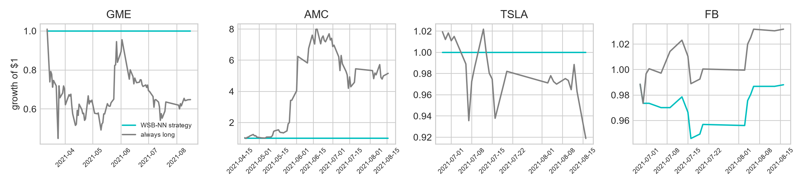
Trading back-test
- Day-level majority vote of post predictions -> long or flat
- Strategy stays flat for GME/AMC/TSLA (never predicts 'up')
- No edge over always-long on FB (13 trades)

Slide 12
Conclusions
- We could not reproduce the report's accuracies; honest (time-ordered) evaluation shows no significant direction edge
- Tuning lifts volatility models to the majority baseline for AMC and above random for TSLA
- Distribution shift (squeeze vs after) and small samples limit what can be learned
- Future: BERT features, daily aggregation, walk-forward CV, cost-aware strategy

Slide 13
Team roles for this review
- Prithvi Aithal: models (Newton logistic regression, neural net), hyperparameter tuning, chronological split and leakage check, conclusions
- Sagar A Walikar: problem and dataset, preprocessing/features/labels, results tables, back-test, live demo
- Both of us can answer questions on any part

Slide 14
Live demo
- python src/demo.py --quick TSLA (live pipeline: posts -> features -> Newton LR + NN -> accuracy vs baselines)
- python src/demo.py --stock GME --title "..." --score 1200 --comments 340
- python src/demo.py --stock TSLA --task volatility --title "..."
- python src/demo.py --replay GME
- (run_experiments.py produces all of results/ and models/; several minutes)

