Slide 1
Coca Cola USA
Presented by : Prathvi Raj Yadav
Last Updated : 21-05-2024

Slide 2
Introduction
Dr. John Pemberton served the world's first Coca‑Cola at Jacobs' Pharmacy in Atlanta, Ga. From that one iconic drink, we've evolved into a total beverage company. More than 2.1 billion servings of our drinks are enjoyed in more than 200 countries and territories each day.
Coca Cola USA is one of the leading beverage companies in the country.

Slide 3
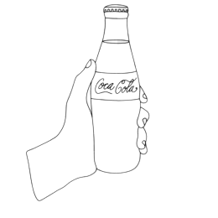
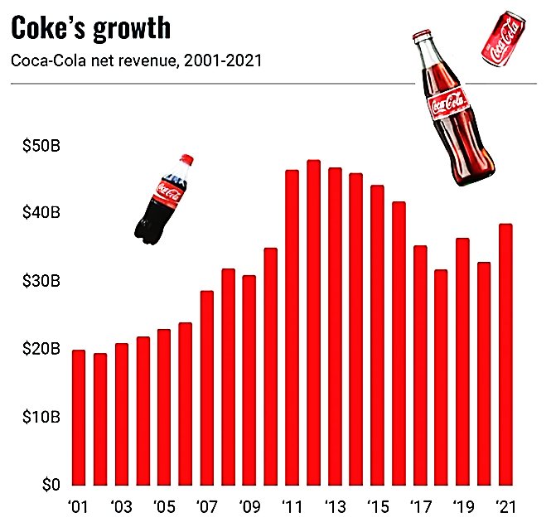
Global revenue and financial results of the Coca-Cola Company from 2010 to 2023 in million U.S. dollars
COCA COLA
3

Slide 4

Sales Performance
Our sales performance metrics indicate strong growth in key markets and product segments.
Their products are enjoyed 1.7 billion times daily worldwide.
First quarter revenue of 2023 was USD 10.98 billion, a 4.66% increase from the previous year.
Fiscal year earnings as of March 31, 2023, were USD 43.493 billion, up 8.39% year-over-year.
In 2022, sales increased by 11.25%, reaching USD 43.004 billion.

Slide 5
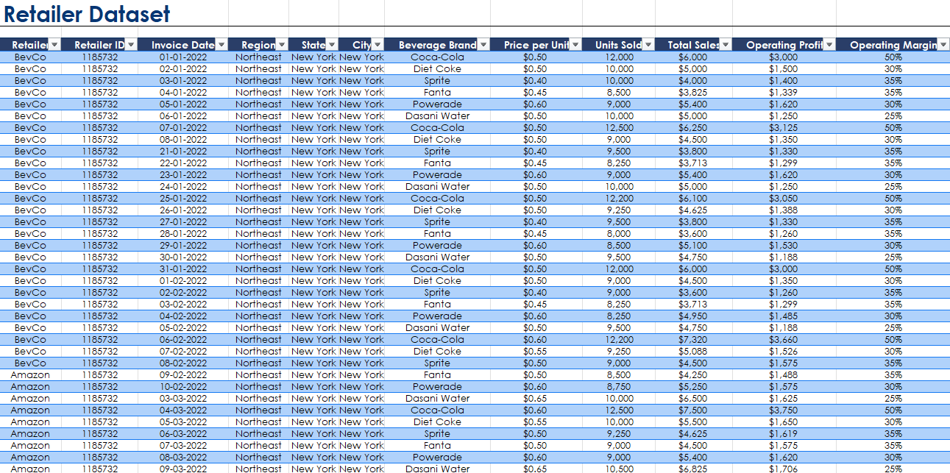
Retailer Data Overview
Our retailer data provides valuable insights into consumer preferences, sales trends, and market analysis.

Slide 6
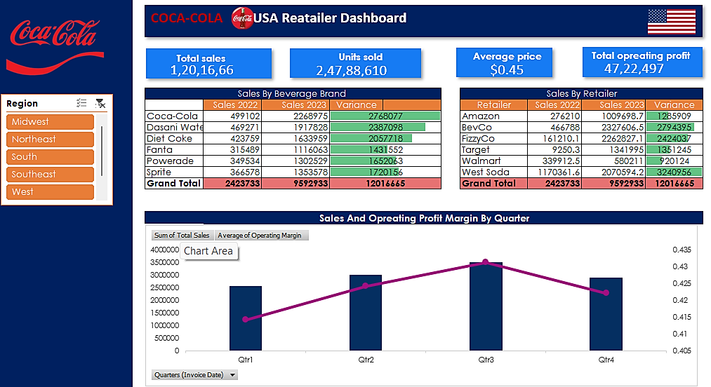

Slide 7
CONCLUSION
In conclusion, Coca Cola USA continues to thrive in the competitive beverage industry, thanks to our robust retailer data and strategic initiatives.

