Slide 1
AUTONOMOUS MOBILE ROBOTICS & DIGITAL TWIN
SesameNav
Vision-Guided Autonomous Quadruped Navigation & 3D Digital Twin
PERCEPTION
Overhead Planar Homography & ArUco Tracking
PLANNING
Dynamic A* Search with 5 cm Safety Margin
CONTROL
Stanley Path-Following & Stride Cadence Sync
SIMULATION
ROS 2 Humble, RViz & Gazebo Digital Twin

Slide 2
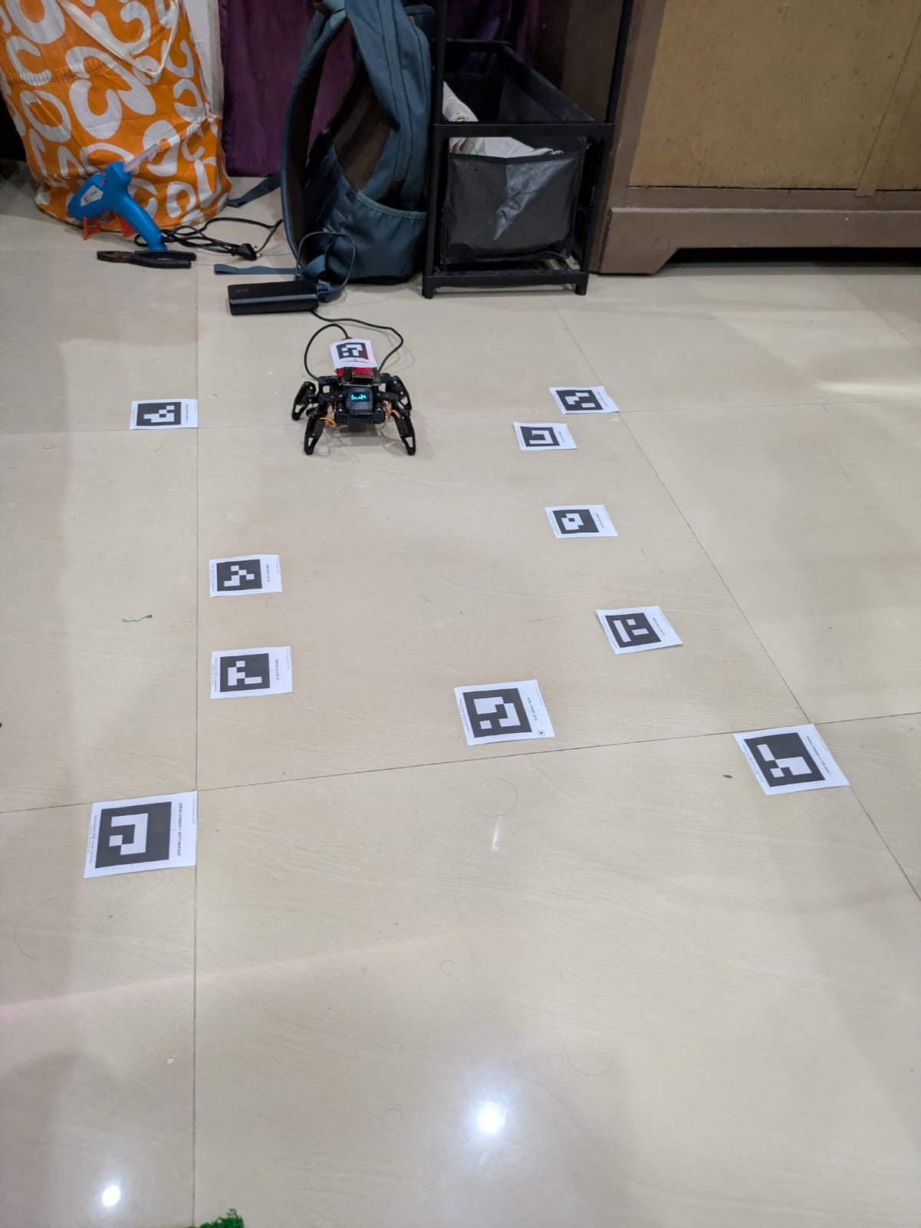
SYSTEM OVERVIEW
What the Project Is & Core Operational Pipeline
▪ Core Objective — Achieve fully autonomous, closed-loop navigation on a lightweight 8-DOF micro-quadruped without relying on heavy or expensive on-board LiDAR or depth sensors.
▪ Overhead Global Perception — An overhead camera captures an unobstructed arena view. Perspective distortion is corrected in real time into an orthogonal metric plane (10 px/cm) using 4-corner ArUco planar homography.
▪ Dynamic A* Path Planning — Computes the optimal shortest collision-free path on a 2D occupancy grid, inflating obstacles by >= 5.0 cm and applying Euclidean line-of-sight shortcutting.
▪ Stanley Path-Following Control — Formulates discrete steering decisions by minimizing heading error and cross-track error (CTE) relative to the planned path trajectory.
▪ Hardware-in-the-Loop Actuation — Translates path decisions into discrete gait commands dispatched over Wi-Fi HTTP (/cmd?go=...) to an on-board ESP32 microcontroller.
▪ Synchronized 3D Digital Twin — Broadcasts real-time telemetry over UDP to ROS 2 Humble, mirroring the physical robot's joint states, path, and obstacle bounds inside RViz.
Physical 100 x 80 cm Arena with Overhead Camera & Quadruped

Slide 3
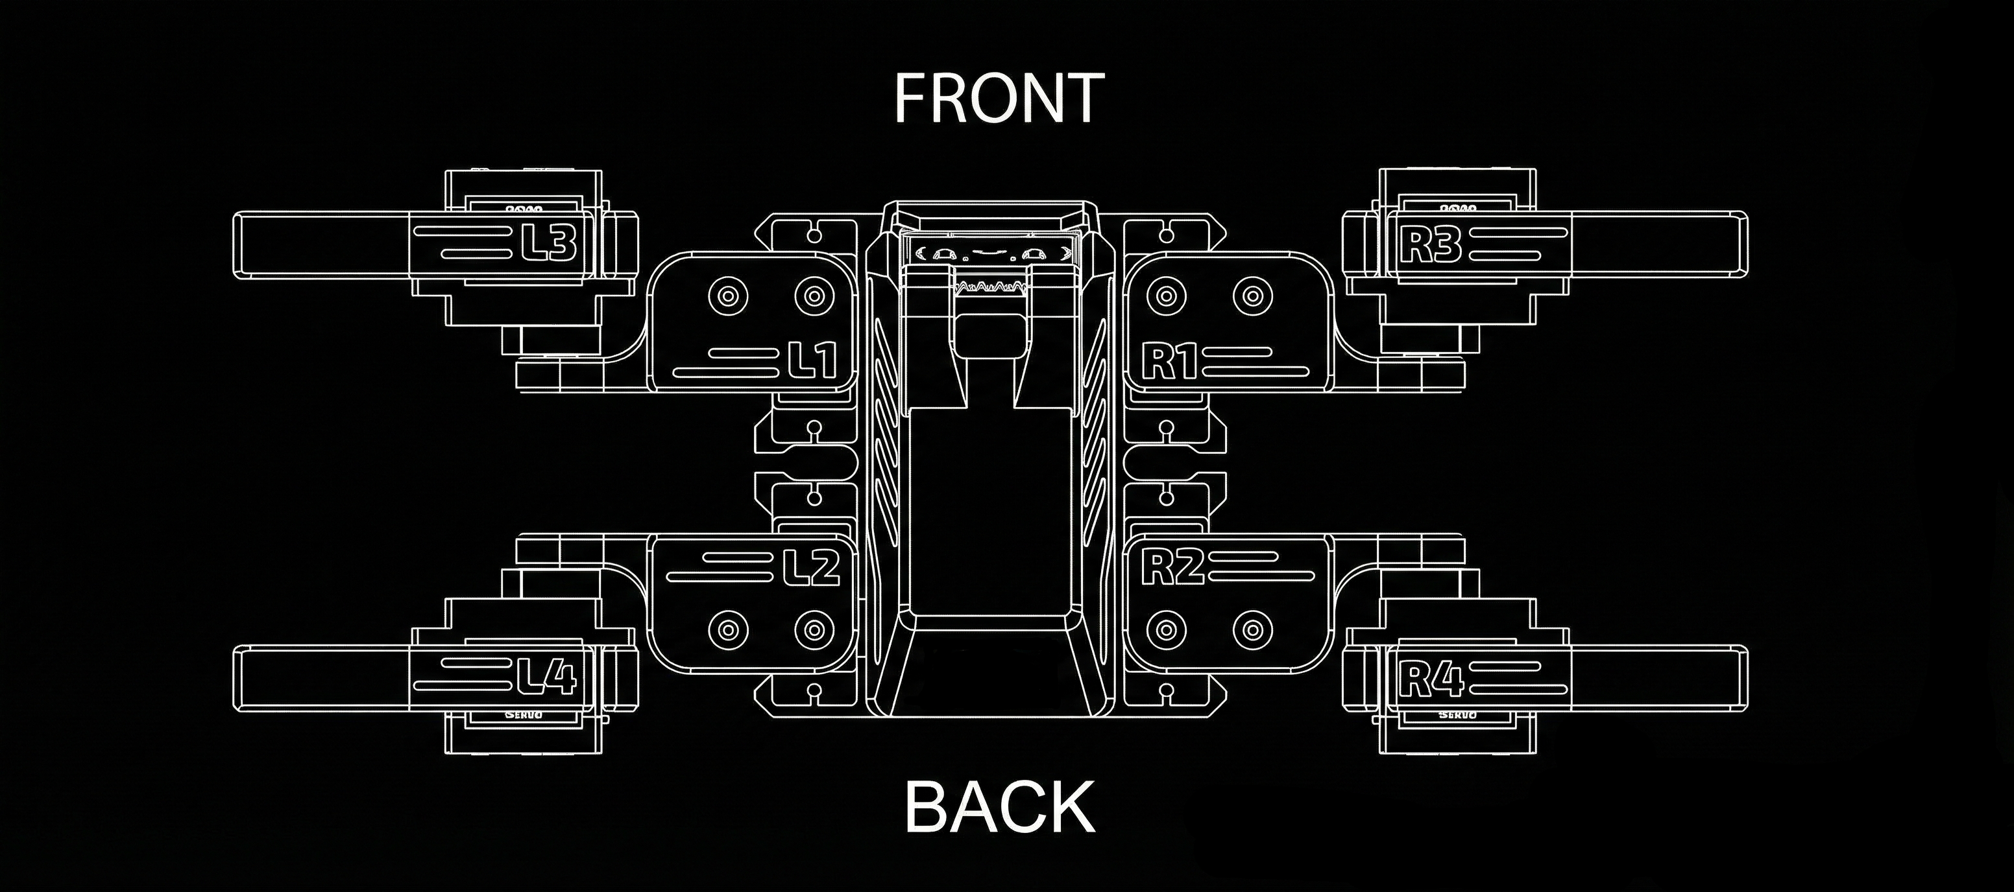
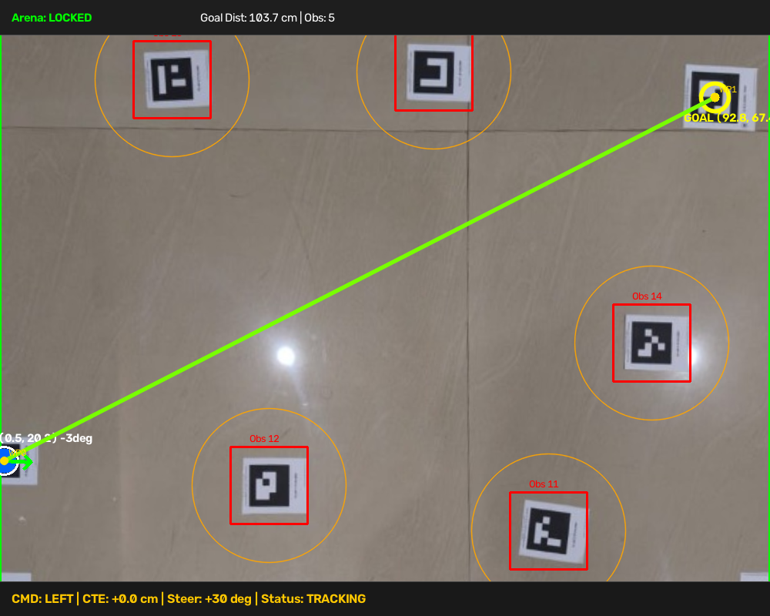
LOCOMOTION MECHANICS
Quadruped Kinematics & Stride Synchronization
▪ 8-DOF Articulated Anatomy — Actuated by 8 independent metal-gear micro-servos: 4 hip servos (R1, R2, L1, L2) controlling horizontal leg sweep, and 4 knee servos (R3, R4, L3, L4) controlling vertical elevation.
▪ 6-Phase Diagonal Trot Gait — Implements a stable crawl-trot sequence alternating diagonal limb pairs (FR+RL, then FL+RR) to ensure the center of mass remains firmly within the static polygon of support.
▪ 1.2-Second Cadence Synchronization — Physical strides require ~1.25s to complete. Pacing controller commands with 1.2s intervals allows full mechanical foot placement, eliminating lateral drift and servo stutter.
▪ Sagittal Flank Mirroring Compensation — Because left and right servos are physically mounted in reverse, right knees extend with increasing angles (87° -> 151°), while left knees extend with decreasing angles (79° -> 19°).
▪ Empirical Angle Calibration Table — Sitting-to-standing joint angle offsets were tuned and mapped to compensate for mechanical spline teeth offsets, guaranteeing a level torso and symmetrical ground contact.
CAD Top-Down Anatomical Joint Configuration
Rectified Planar Homography HUD (10 px/cm Metric Frame)

Slide 4
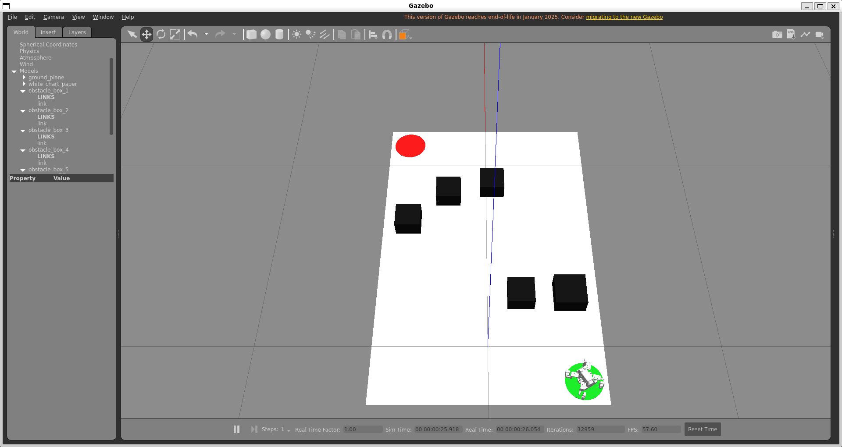
PHYSICS SIMULATION
Gazebo Dynamic Validation & Arena Modeling
▪ Pre-Deployment Kinematic Verification — Provides a safe virtual sandbox to evaluate quadruped stability, center-of-mass trajectory, and obstacle avoidance physics prior to physical hardware execution.
▪ Arena Environment Modeling — Constructed a calibrated simulation world (chartpaper_arena.world) with exact real-world dimensions (100 x 80 cm), realistic ground contact friction, and gravity models.
▪ Rigid-Body Dynamics & URDF Definitions — Incorporates link mass distributions, principal inertia tensors, joint limits, and friction coefficients derived from Fusion 360 CAD specifications.
▪ Interactive Dynamic Obstacle Relocation — Supports live drag-and-drop repositioning of 3D obstacle boxes during runtime to rigorously test dynamic re-planning responsiveness and collision margins.
▪ Sim-to-Real Kinematic Parity — Ensures standard ROS 2 coordinate conventions (+x forward, +y left, +z up) match across simulation and physical hardware actuation.
Gazebo Classic Arena with Sesame Robot & Dynamic Obstacles

Slide 5
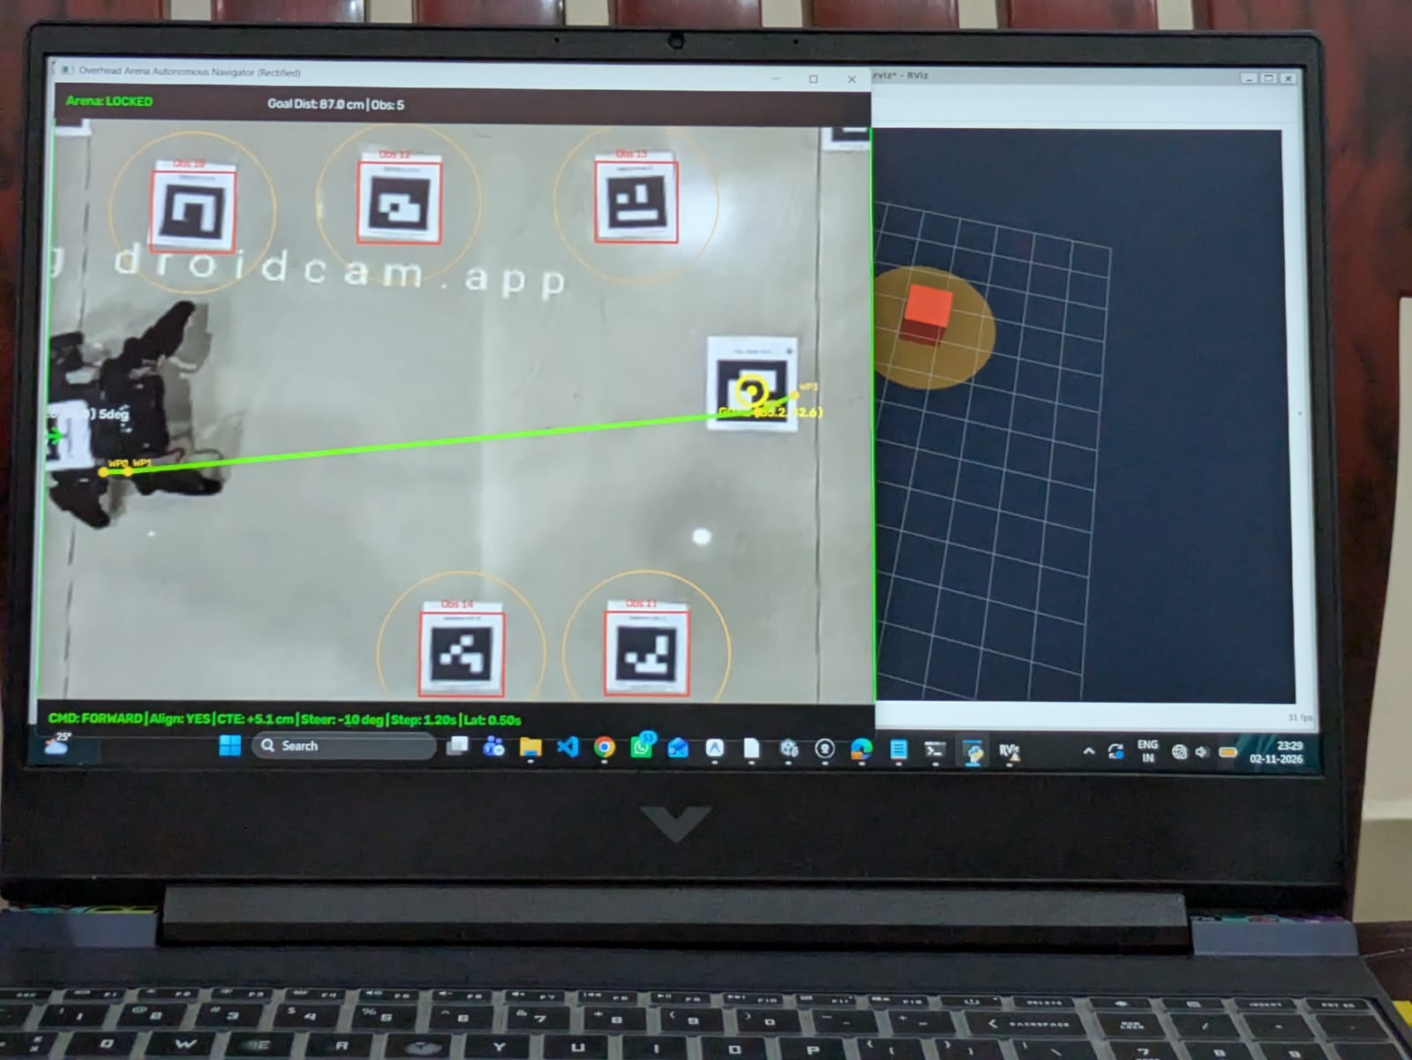
PERCEPTION & TELEMETRY
Planar Homography & Live RViz Digital Twin
▪ Planar Homography Coordinate Rectification — Computes a 3x3 homography matrix (H) from 4 arena corner ArUco markers, continuously rectifying tilted camera perspectives into an orthogonal top-down space (10 px/cm).
▪ Sub-Pixel Temporal Filtering — Applies an Exponential Moving Average (EMA, alpha = 0.65) filter on robot coordinates and heading angles, attenuating camera noise and sub-pixel detection jitter.
▪ Low-Latency UDP State Streaming — Streams robot coordinates, heading, goal, and obstacle boundaries as JSON datagrams over UDP port 9090 from the Windows vision engine to WSL ROS 2.
▪ RViz Digital Twin Synchronization — Subscribes to incoming telemetry and publishes /joint_states, TF frame transforms (/map -> /base_footprint), planned /path, and 3D obstacle markers.
▪ Human Presence Safety Gating — Integrates real-time HSV skin-color detection to pause locomotion automatically whenever a human hand enters the arena to rearrange obstacle blocks.
RViz Digital Twin Displaying Camera Feed, TF Tree & Planned Path

Slide 6
EXPERIMENTAL ANALYSIS
Technical Challenges Faced & Implemented Solutions
▪ 1. Surface Slip & Trajectory Deviation — Challenge: Smooth 3D-printed PLA foot tips suffered from a low coefficient of static friction on polished floor tiles, causing feet to slip and the robot to deviate from straight walking.
Solution: Applied a layer of Fevibond rubberized adhesive to the foot tips and allowed it to dry, forming high-traction rubberized contact pads that eliminated ground slip.
▪ 2. Actuation Flooding & Crab-Walking (Lateral Drift) — Challenge: Streaming high-frequency steering commands (10 Hz) overwhelmed the ESP32 servo queue, interrupting 6-phase step cycles mid-stride and causing erratic crab-like lateral walking.
Solution: Enforced a 1.2-second discrete step cadence matching the hardware's 1.25s physical stride, allowing legs to complete their swing-plant cycle before re-evaluating CTE.
▪ 3. Flank Asymmetry from Mirror-Mounted Servos — Challenge: Symmetrical servo PWM values curled the left leg up while extending the right leg down because opposite flanks have physically inverted mounting orientations.
Solution: Built an empirical joint calibration matrix in firmware, establishing independent left vs. right angle transformation equations for level stance and gait execution.
▪ 4. Sub-Pixel Vision Jitter & Steering Oscillation — Challenge: Natural ambient lighting variations and sub-millimeter visual marker jitter caused rapid, alternating left-right steering chatter.
Solution: Implemented a +/-10° heading deadband in the Stanley controller; within this threshold, the robot commands pure forward walking without unnecessary turns.
▪ 5. Marker Transposition Handling — Challenge: Accidentally swapping physical markers (ID 5 on robot, ID 4 on floor) caused the planner to command the floor target toward the robot.
Solution: Integrated a runtime --swap-ids CLI parameter to dynamically flip robot and goal tracking identities in software without re-taping physical stickers.

Slide 7
CONCLUSION & FUTURE HORIZONS
Project Summary & Future Research Directions
▪ Project Summary — Demonstrated that robust, autonomous closed-loop navigation can be achieved on micro-scale quadrupeds using an overhead global perception architecture, bypassing on-board weight constraints.
▪ Full Pipeline Verification — Successfully validated complete hardware-in-the-loop operation: overhead ArUco homography, dynamic A* path planning, Stanley steering, and wireless ESP32 execution.
▪ Digital Twin Synchronization — Connected real-world locomotion with low-latency ROS 2 Humble RViz telemetry and validated dynamic kinematic constraints within Gazebo Classic simulation.
▪ Pragmatic Engineering — Proved that combining simple physical enhancements (Fevibond friction soles) with disciplined control pacing (1.2s cadence) overcomes low-cost hardware limitations.
▪ Reinforcement Learning (RL) Locomotion — Train deep RL policies (PPO in Isaac Gym or MuJoCo) to replace fixed kinematic trot gaits with adaptive, robust locomotion capable of traversing carpet, gravel, and uneven terrains.
▪ On-Board Inertial Sensor Fusion — Integrate an on-board 6-DOF IMU (MPU6050) with an Extended Kalman Filter (EKF) to fuse overhead vision with on-board acceleration for real-time slip detection and balance recovery.
▪ Dynamic Obstacle Velocity Tracking — Incorporate predictive Kalman filtering and Velocity Obstacle (VO) algorithms to autonomously detect, track, and bypass moving obstacles in dense environments.
▪ Vision-Based Auto-Calibration — Leverage the overhead camera to automatically detect foot contact slip and iteratively tune individual servo PWM offsets without manual trim calibration.

