Slide 1
Movie Recommendation System
Harshad Pardeshi - 001231323
Krutika Deshpande - 001280718
Prithvi Kamath - 001259251
under the guidance of Prof. Dino Konstantopoulos

Slide 2
CONTENTS
Objective
Dataset & Visualization
ALS Algorithm
Results
Conclusion

Slide 3
Objective
To build a movie recommendation system using Spark RDD and MLib

Slide 4
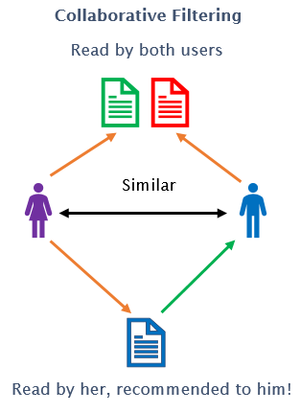
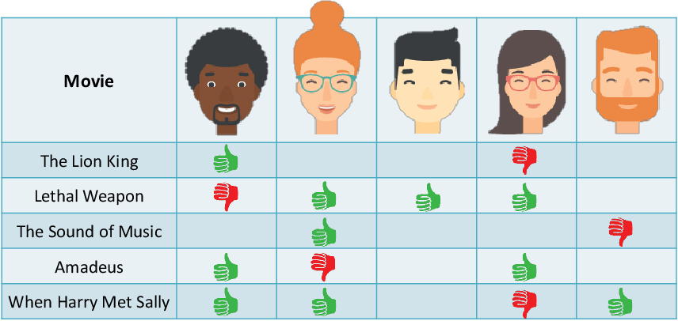
Collaborative Filtering Approach

Slide 5
Data Exploration & Visualization
Data Cleaning
Tableau Visualization
Random down sampling
WordCloud
Sparsity
MLE

Slide 6
ALS Algorithm

Slide 7
Workflow
Representing and extracting data using RDD
Training, validation and testing data
Implementing Alternating Least Square Algorithm
Hyper parameter tuning
Recommending movies to a new user

Slide 8
Results

Slide 9
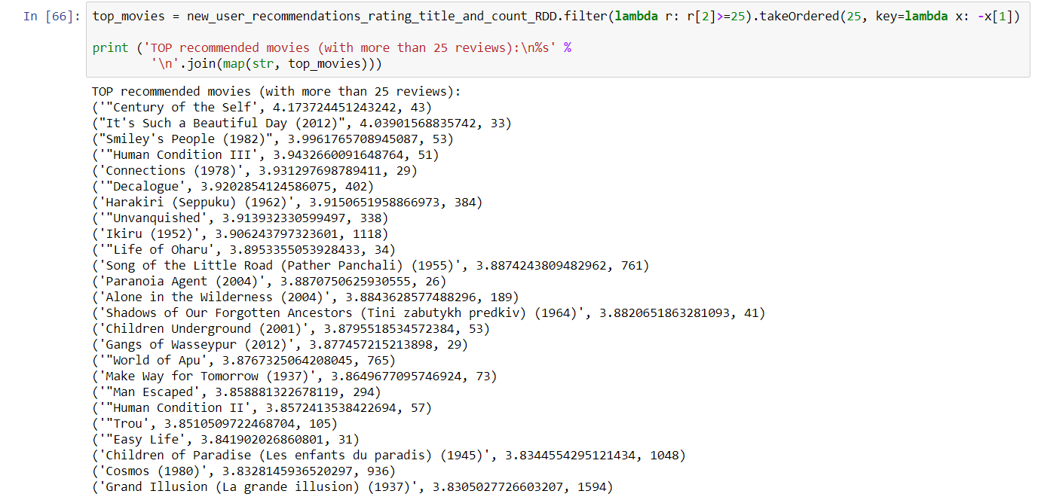
Recommended movies to the new user

Slide 10
Conclusion
Minimum RMSE value achieved
Objective to work and implement Spark framework, recommendation system was achieved successfully

Slide 11
THANK YOU FOR WATCHING

