Slide 1
Working with the Jackals
Aswin Jayaprakash, Prithvi Kambhampati, and James Radwill

Slide 2
Goals of the Project
Finally work with real robots!
Create a URDF Model of the SICK LIDAR.
Integrate the LIDAR and publish the data in an appropriate frame.
Autonomously navigate and map a floor of the EERC.

Slide 3
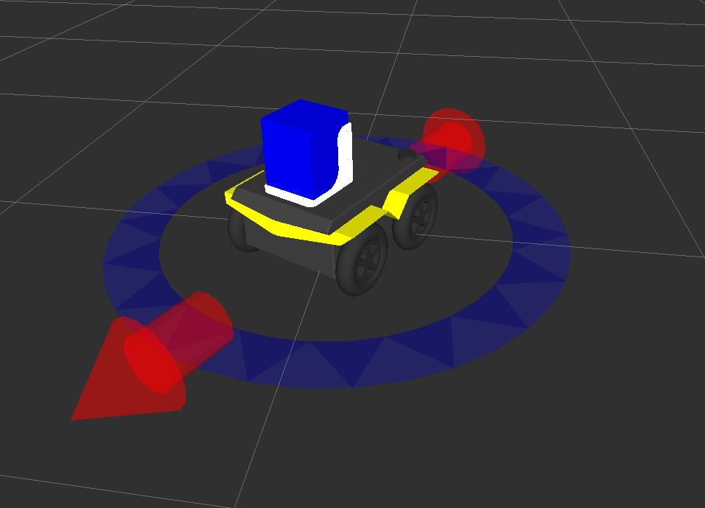
LIDAR URDF
2 links
The bracket (CAD)
The LIDAR (a box)
2 joints
The bracket to the robot
The LIDAR to the bracket
Defined mass and inertia parameters

Slide 4
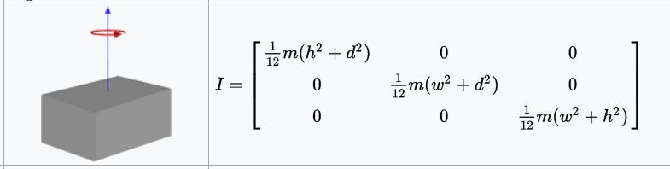
LIDAR Inertia Parameters
Assumed a solid even mass and calculated ixx, iyy, and izz as follows.
wikipedia.com

Slide 5
Integrating LIDAR
Used the sicktoolbox_wrapper
Set the port, baud, and launch.
By naming the body of the LIDAR “laser” and keeping the default frame for the SICK, we were able to avoid publishing a transform.

Slide 6
Navigation
Used a modified version of an algorithm from lab 2.
Originally developed by Derek Chopp, Akhil Kurup, and James Radwill
Bags the /tf and /scan topics
Stops after 10 mins
Sufficient for most cases
Doesn’t do well with chairs and tables.
Also included a second launch file and python script that does playback and mapping. (To be run offline)

Slide 7
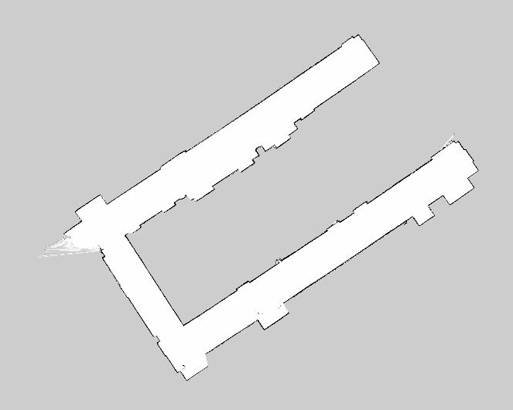
The Map

Slide 8
Problems Encountered
Working outside of WiFi
Don’t set the ROS_IP param and use screen command
Mapping didn’t do well in corners
Had to increase the update rate params for gmapping

Slide 9
Contribution
Aswin – Developed and tested the bagging and mapping portion of the project.
Prithvi – Incorporated and modified the navigation script.
James – Developed the URDF model and integrated the SICK.
Original credit for the navigation algorithm goes to Derek, Akhil, and James.
And of course, a lot of de-bugging and troubleshooting was done by all.

Slide 10
Questions?

