Slide 1
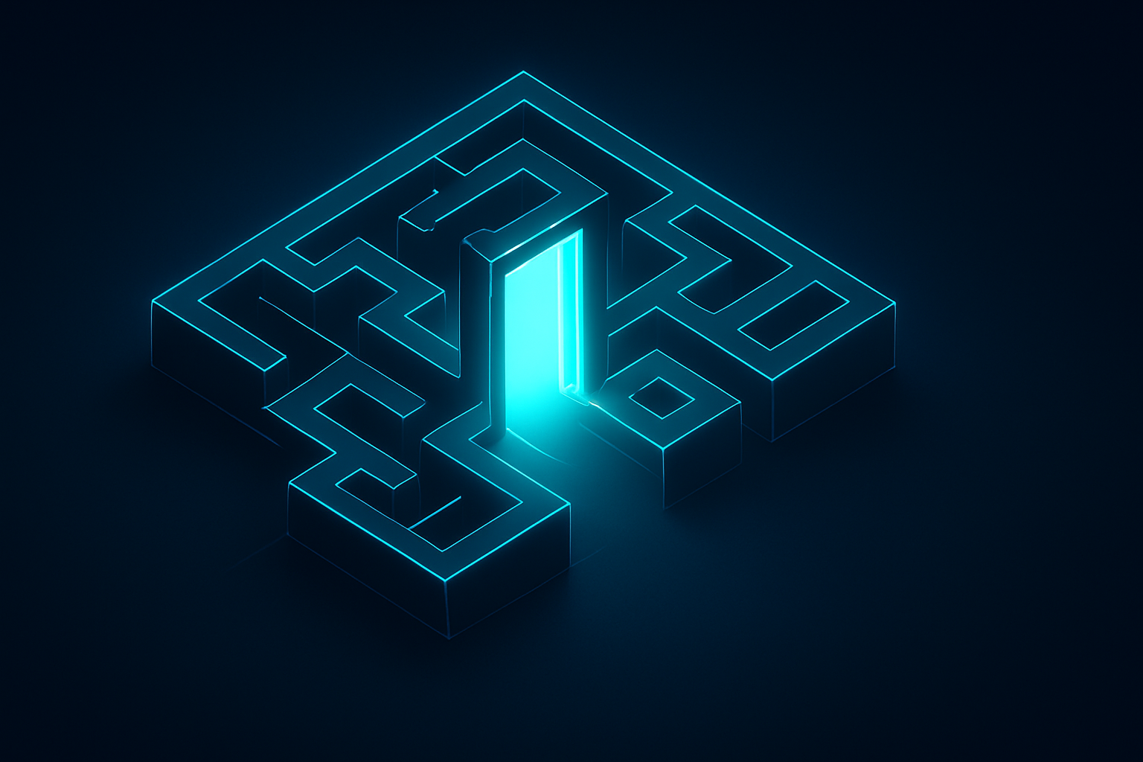
THE QUANTUM MAZE
A Journey into Future Computing
Welcome to the entrance of the most complex maze in science. Today, we leave behind the simple paths of classical computers and step into the world of Quantum.

Slide 2
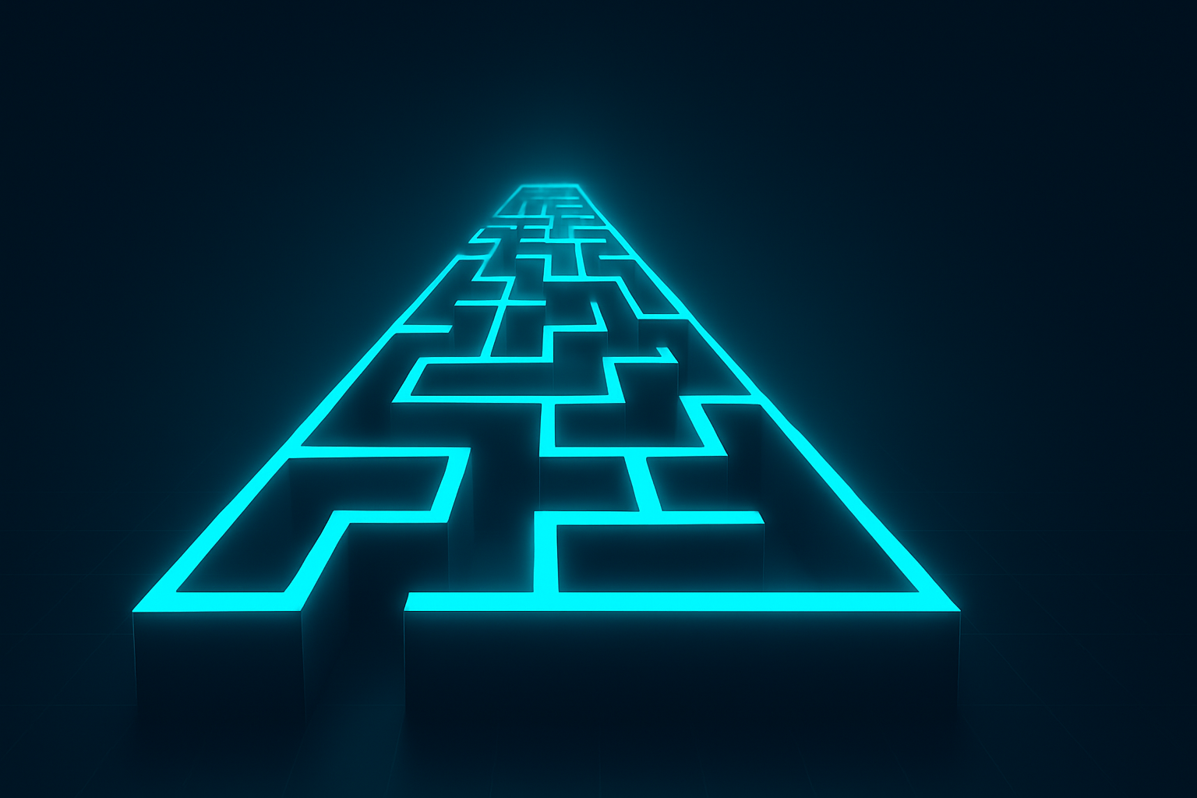
ONE WAY IN: CLASSICAL BITS
Classical computers use bits—0 or 1. Think of it as a straight corridor. You can only be in one spot at a time. The path is certain, but limited.
Every choice is a simple yes or no. In our maze, this means you can only explore one hallway at a time, making complex puzzles take forever to solve.

Slide 3
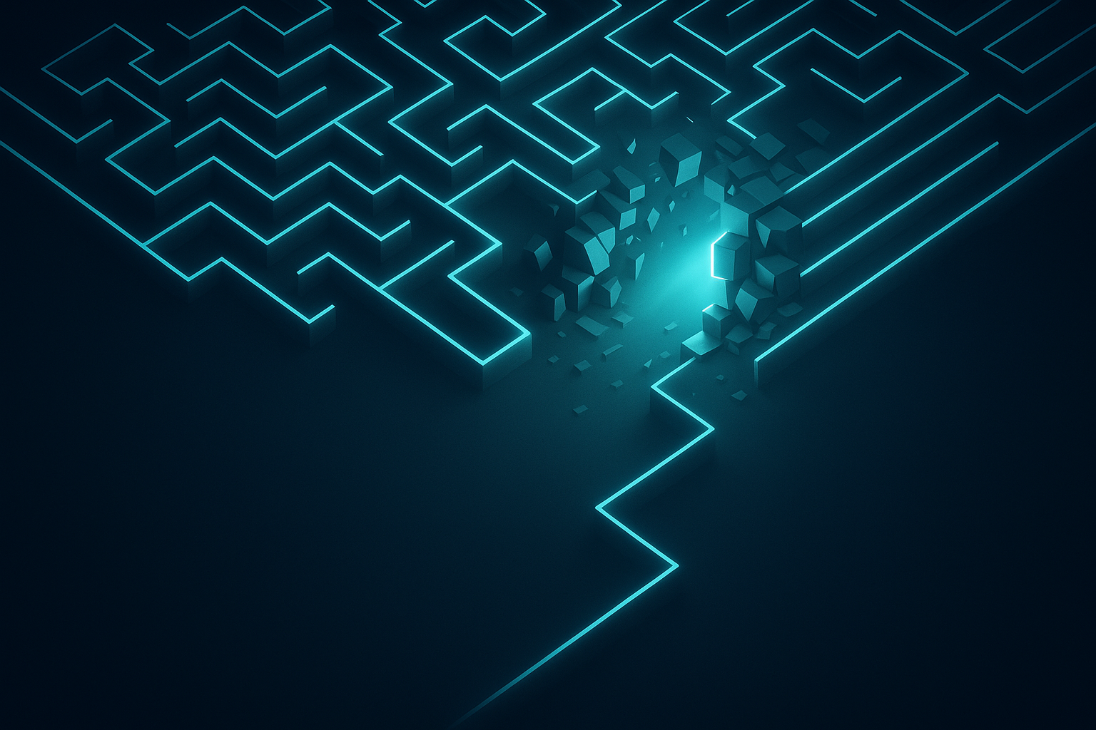
BREAKING THE WALLS
Traditional computers are hitting a physical wall. As components get smaller, they start acting weird. We need a new way to navigate the information maze.
Quantum computing doesn't just walk faster; it changes the rules of the maze entirely, allowing us to find exits that were previously hidden behind solid walls.

Slide 4
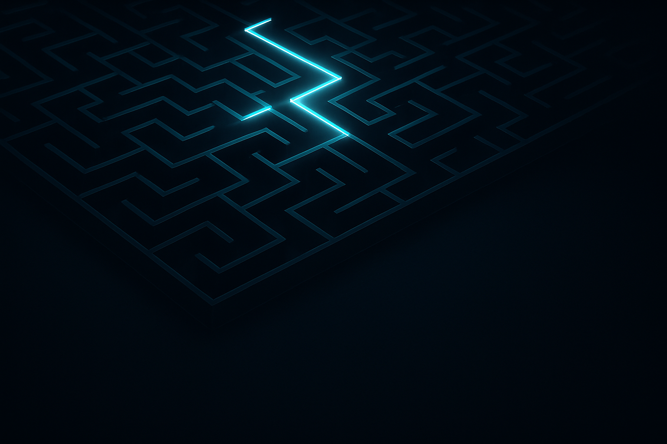
THE FORK: MEET THE QUBIT
A Quantum Bit, or Qubit, is special. Instead of just 0 or 1, it can be both at the same time. In our maze, imagine arriving at a fork and walking down both paths simultaneously.
This isn't magic; it's physics! By being in multiple places at once, the qubit starts to map the maze much faster than any classical bit ever could.
QUIZ CORNER

Slide 5

THE MISTY HALLWAY: SUPERPOSITION
Superposition is the state of being in multiple paths at once. It's like a misty hallway where you exist as a cloud of possibilities until someone looks at you.
Measurement 'collapses' the mist. Once we check the qubit, it picks one path. The goal is to stay in the mist as long as possible to solve the puzzle.

Slide 6
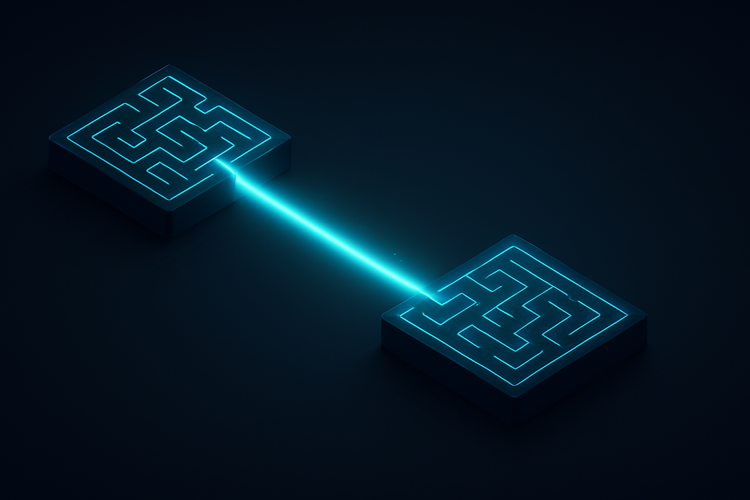
THE LINKED ROOMS: ENTANGLEMENT
Entanglement links two qubits together, no matter how far apart they are in the maze. If you change the direction of one, the other changes instantly.
This is what Einstein called 'spooky action at a distance.' It allows quantum computers to coordinate different parts of the maze with perfect synchronicity.

Slide 7
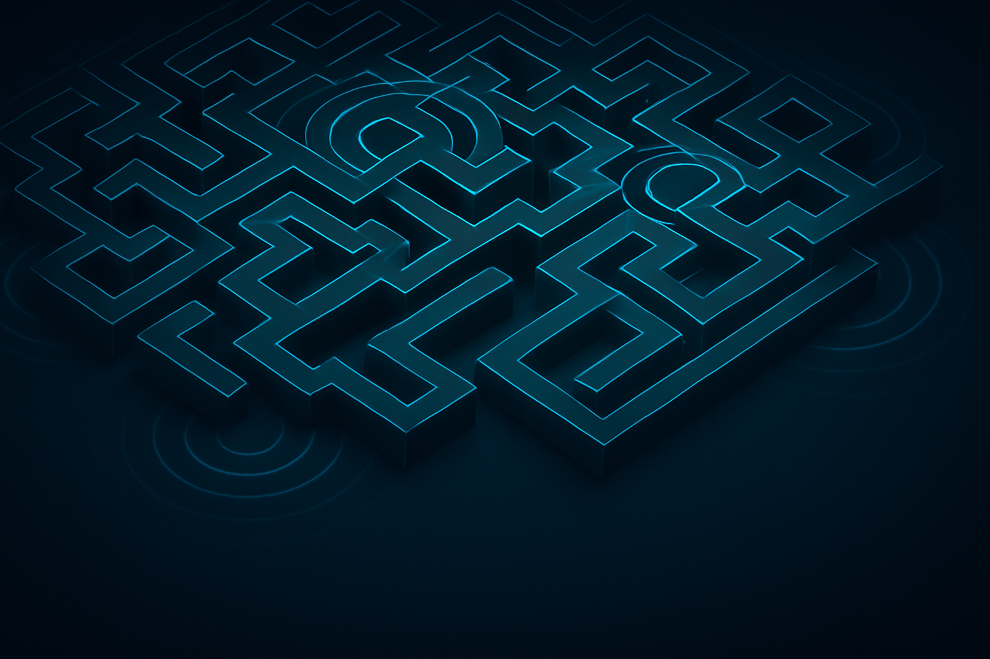
ECHOES: QUANTUM INTERFERENCE
How do we find the right exit? We use interference. We make the wrong paths cancel each other out (like silence) and the right paths get louder (like a glow).
By carefully timing the 'echoes' of our qubits, we ensure the maze leads us exactly where we need to go, filtering out millions of dead ends instantly.

Slide 8
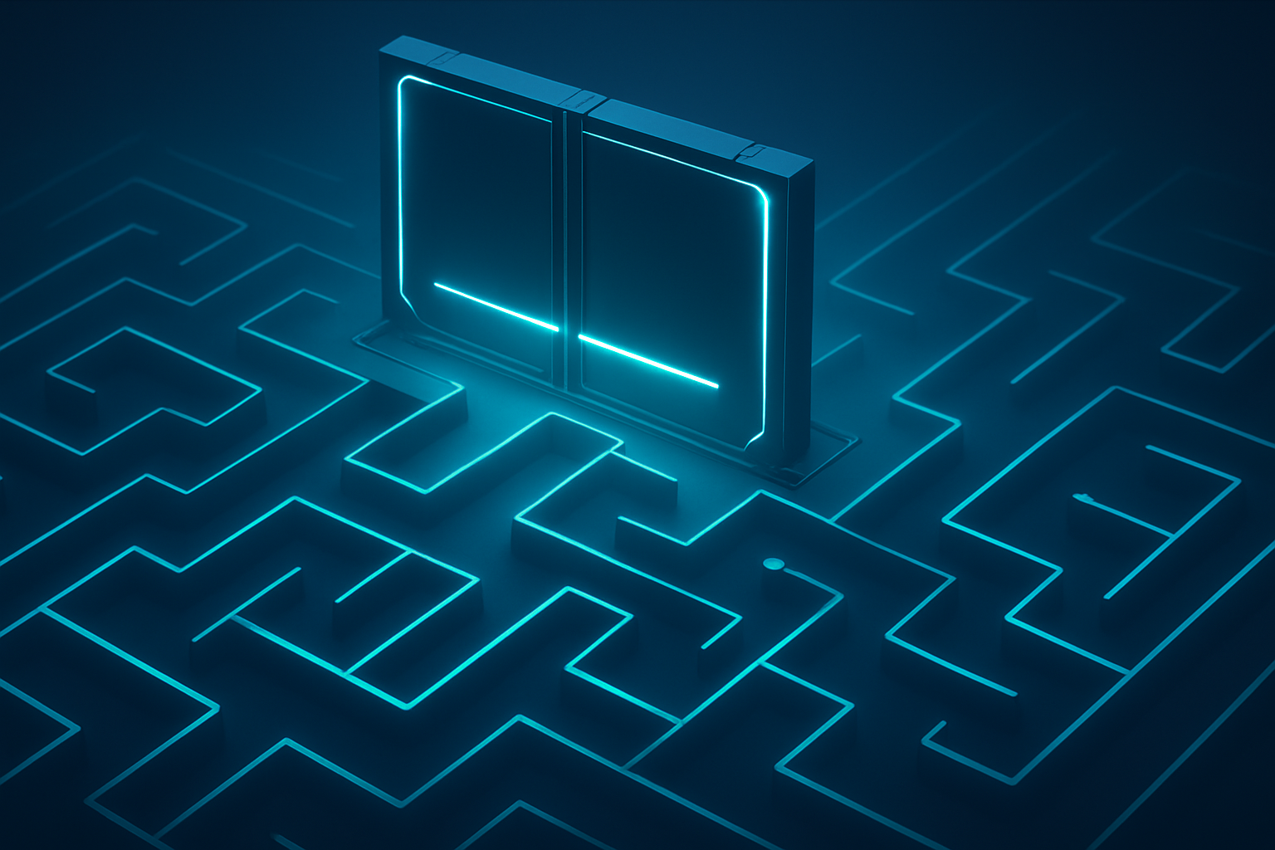
THE SLIDING DOORS: GATES
Quantum Gates are the sliding doors of our maze. They don't just open or close; they rotate and shift our path, allowing us to manipulate superposition.
By combining these gates, we create Quantum Algorithms—mathematical maps that guide us through the most complex mazes in the universe.
QUIZ CORNER

Slide 9
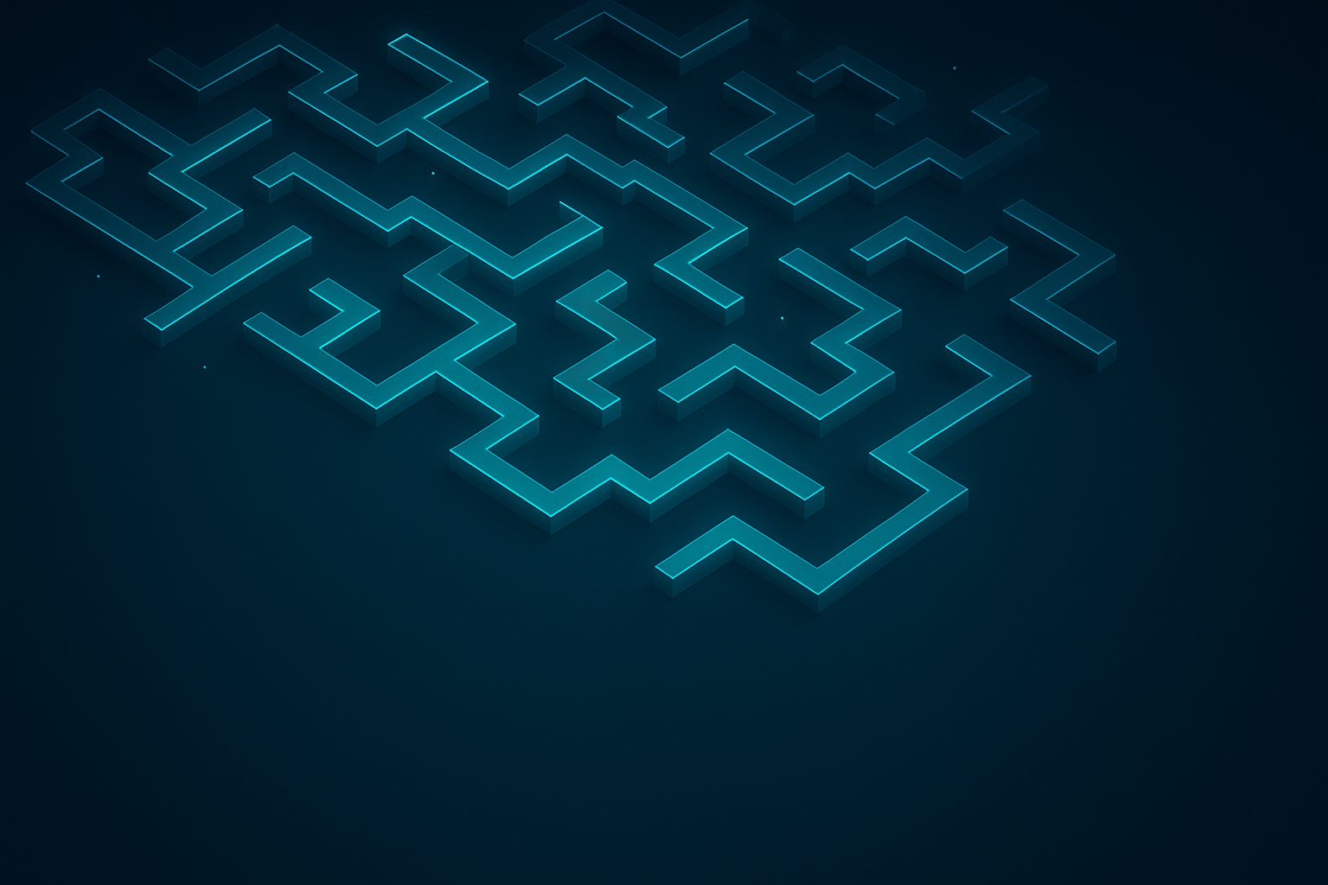
CRUMBLING WALLS: DECOHERENCE
The hardest part? Keeping the maze stable. Heat, light, or even a tiny vibration can cause 'decoherence,' where the quantum paths crumble back into classical ones.
Scientists work at temperatures colder than outer space to keep the maze walls strong. Protecting these fragile paths is the greatest engineering challenge of our time.

Slide 10
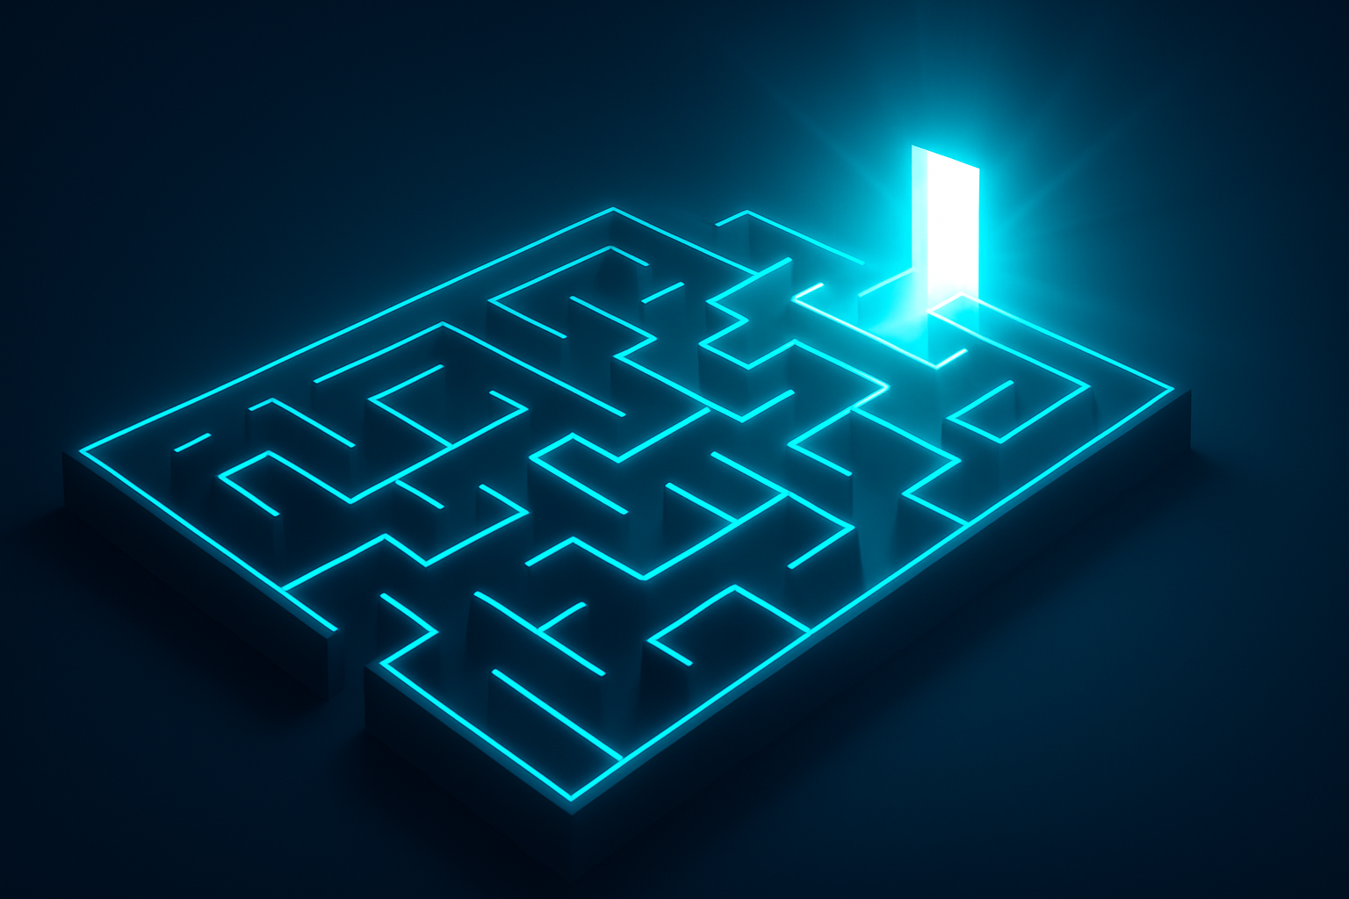
THE EXIT: THE QUANTUM FUTURE
We are just at the exit of the first quantum maze. In the future, these computers will design new medicines, crack impossible codes, and solve climate change.
The maze is huge, and we've only just begun to explore. Now that you know the rules, are you ready to become a quantum navigator?

