Slide 1
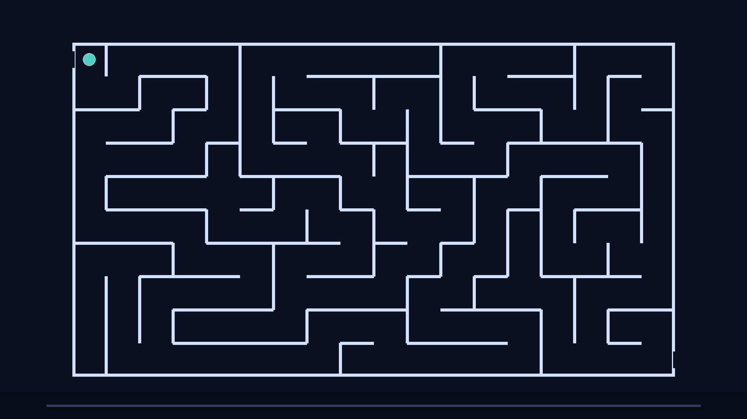
Quantum Computing
A maze-story for high school minds
Imagine a huge maze with a start and an exit. A computer is a machine that follows rules to choose turns. Classical computers usually commit to one corridor at a time. Quantum computers use different rules, so their ‘maze-walk’ can look very strange, yet sometimes it finds the exit faster.
Goal for today Use the maze to picture superposition, entanglement, and why measurement matters.
1/10

Slide 2
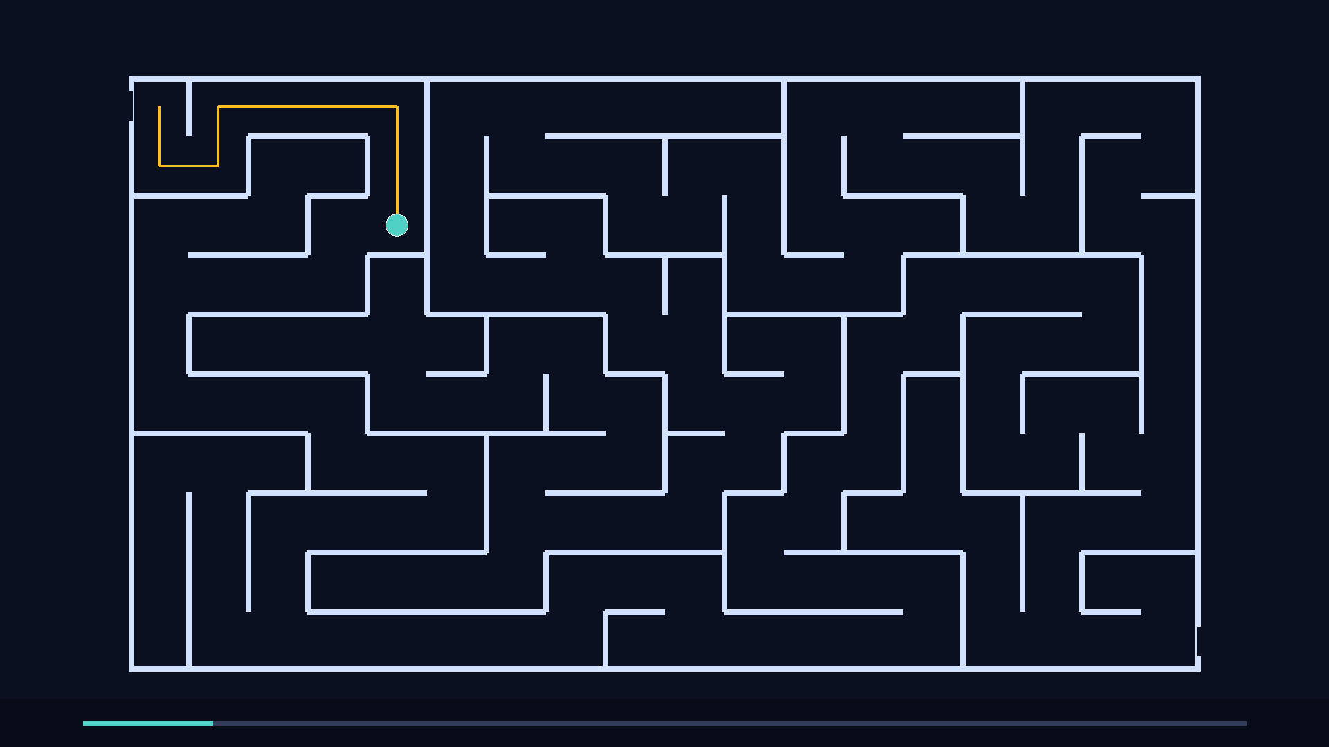
Bits and decisions in a corridor
A classical bit is like a sign that can point Left or Right. When the sign is set, you take one corridor. Your path through the maze is a chain of committed choices.
A qubit is a sign that can be ‘set’ in a way that does not match everyday intuition. It can carry information about multiple potential turns until you force it to answer.
2/10

Slide 3
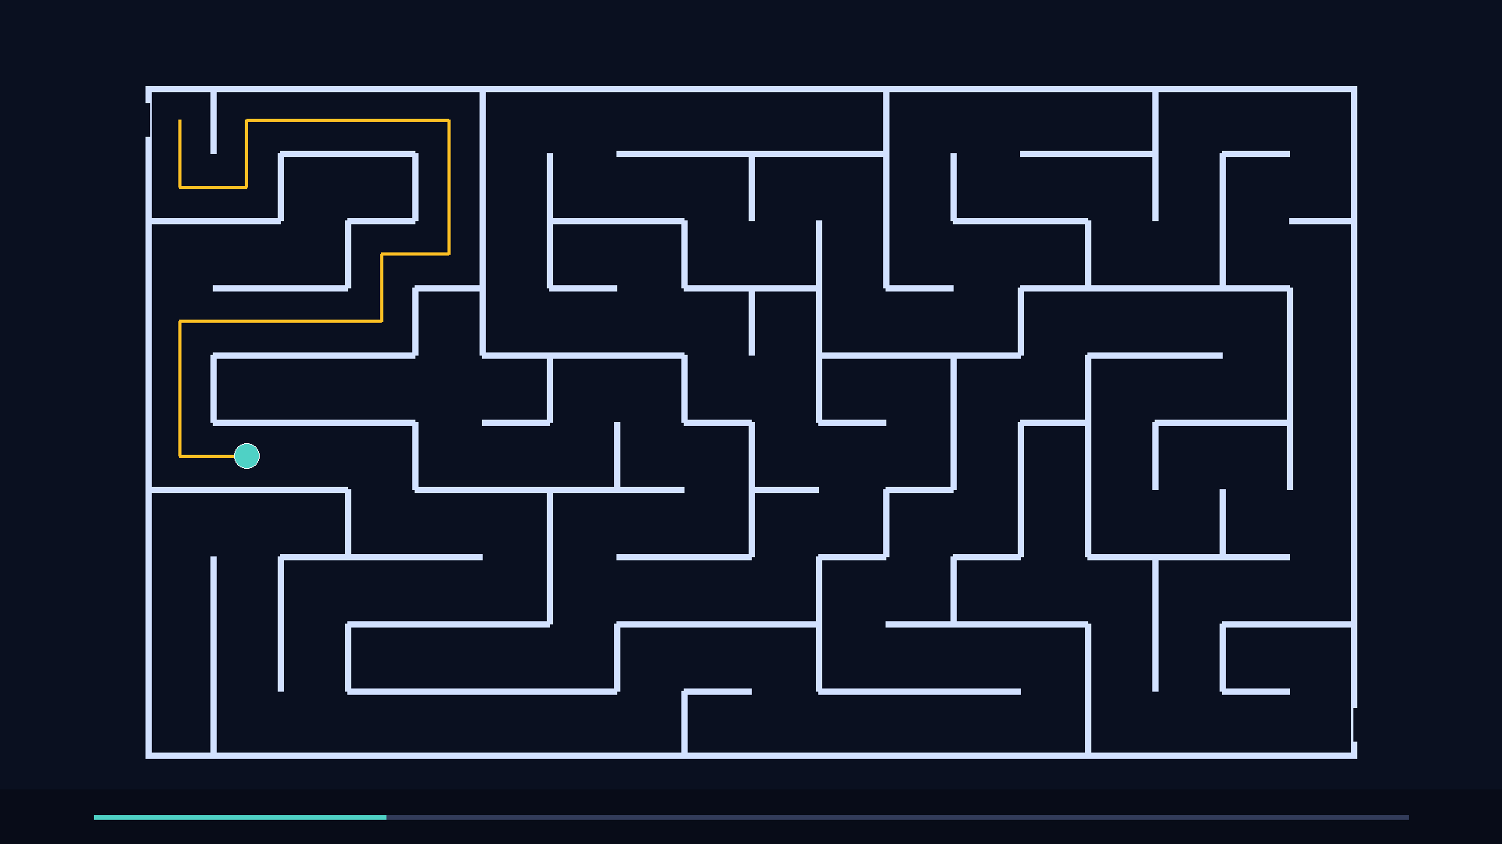
Gates are like moving the walls
A logic gate is a rule that updates your signs. In maze language, it is like shifting a wall so a turn that was blocked becomes open.
Classical gates keep you on a single corridor. Quantum gates rotate a qubit’s ‘direction’ so different corridors can interfere.
Think of a circuit as a maze designer. Each gate is one redesign step, aiming to make the exit easier to reach.
3/10

Slide 4
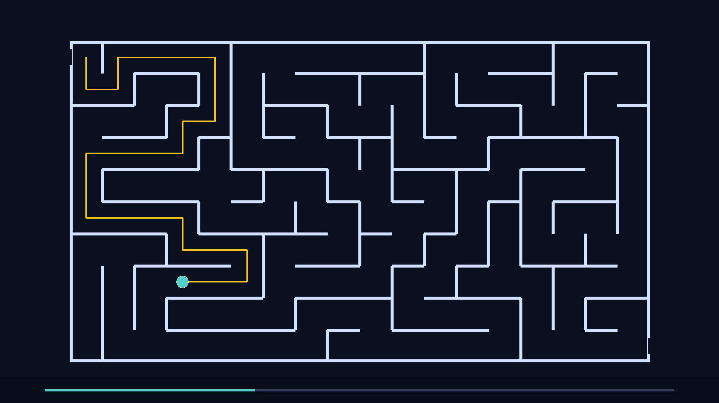
Quiz
Measurement is opening a door
In quantum computing, you do not get a neat ‘map’ of where the qubit is. Measurement is like opening the exit door and demanding: ‘Which corridor are you really in?’ After you open the door, the answer becomes a single concrete path.
Key trade You gain a definite result. You lose the delicate quantum ‘in-between’ state.
4/10

Slide 5
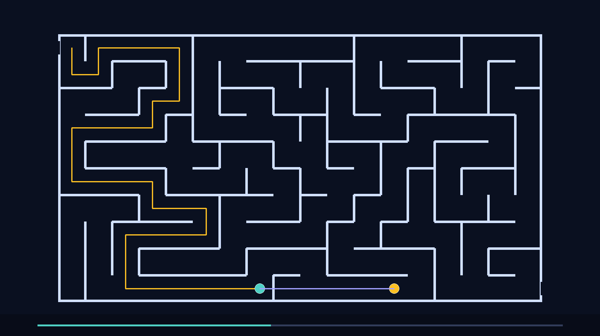
Superposition: the explorer is spread out
Before measurement, a qubit can behave like an explorer that has not picked one corridor. It is closer to a fog that occupies multiple routes at once, with a specific ‘amount’ in each corridor.
Quantum gates can reshape the fog so wrong corridors fade and the right corridor brightens. This is why the design of the gate sequence matters.
5/10

Slide 6
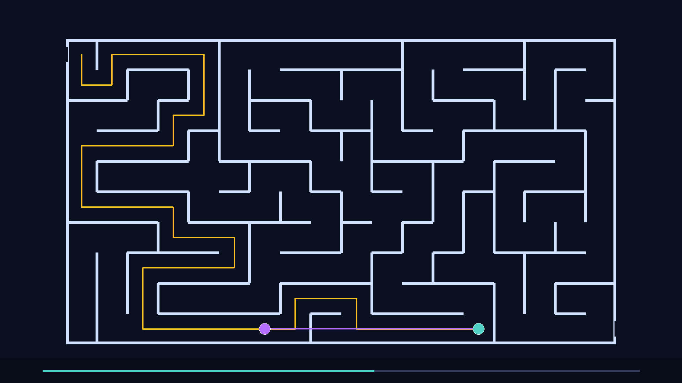
Entanglement: two explorers share one rulebook
Entanglement connects qubits so their outcomes are linked, even if they are far apart in the maze. It is like tying two explorers with an invisible rope: tug one, and the other responds in a perfectly coordinated way.
This does not let you send secret messages faster than light. It gives you correlations that classical maze-walkers cannot copy.
Why it matters Entanglement is fuel for quantum teleportation and many quantum algorithms.
6/10

Slide 7
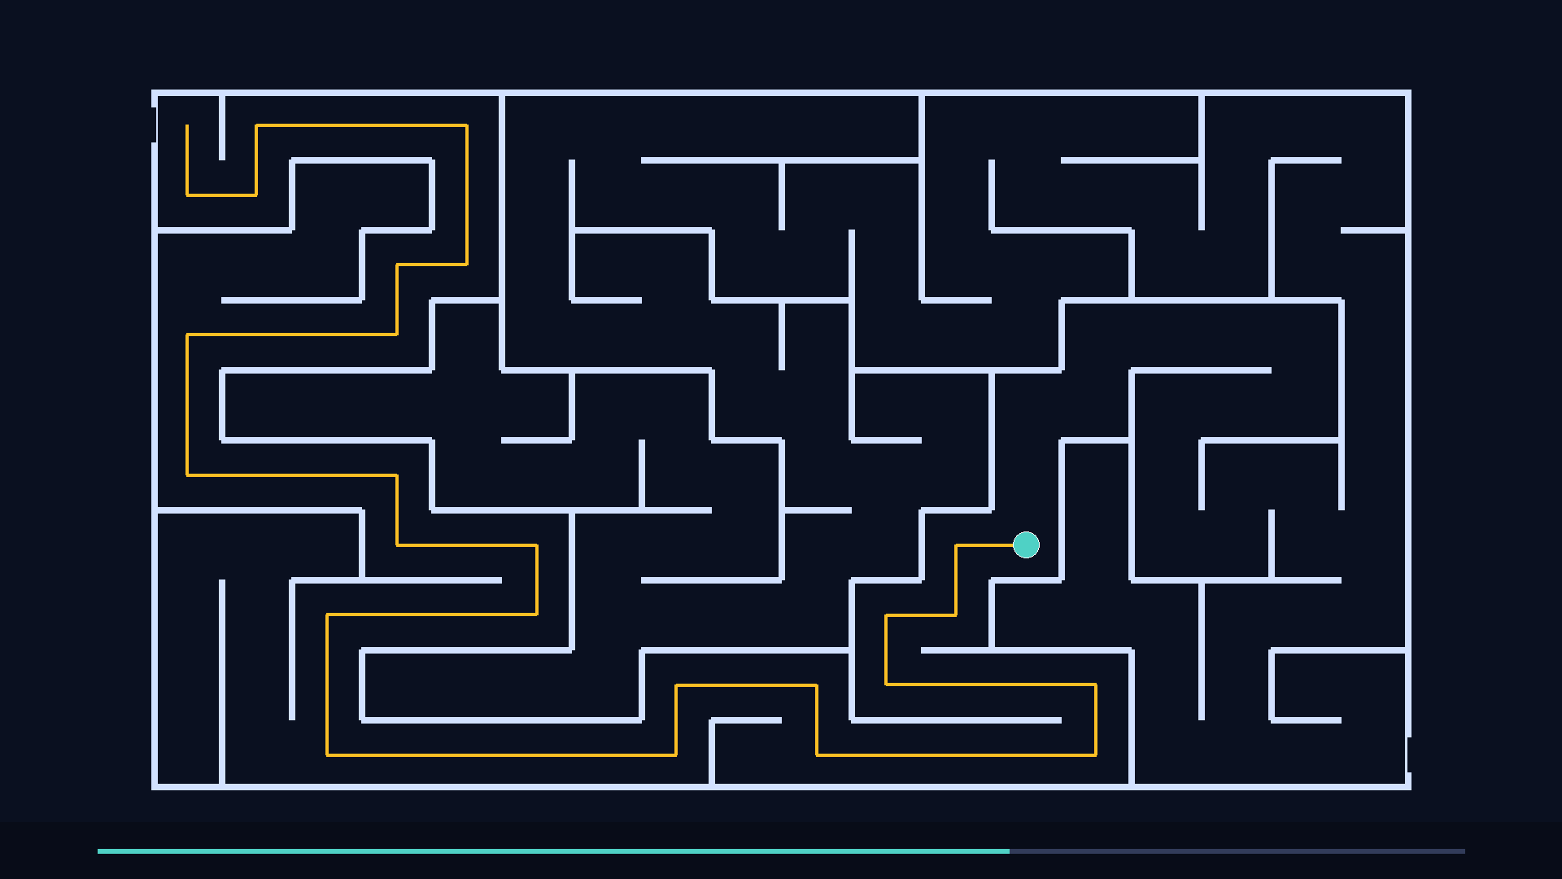
Algorithms: learning the maze’s rhythm
A quantum algorithm is not magic. It is a carefully chosen set of gates that makes the right exit more likely. In maze terms, you are not checking every corridor. You are setting up wave-like patterns so bad routes cancel and good routes reinforce.
Example intuition Grover-style search is like tapping the maze to amplify the corridor that hides the prize.
7/10

Slide 8
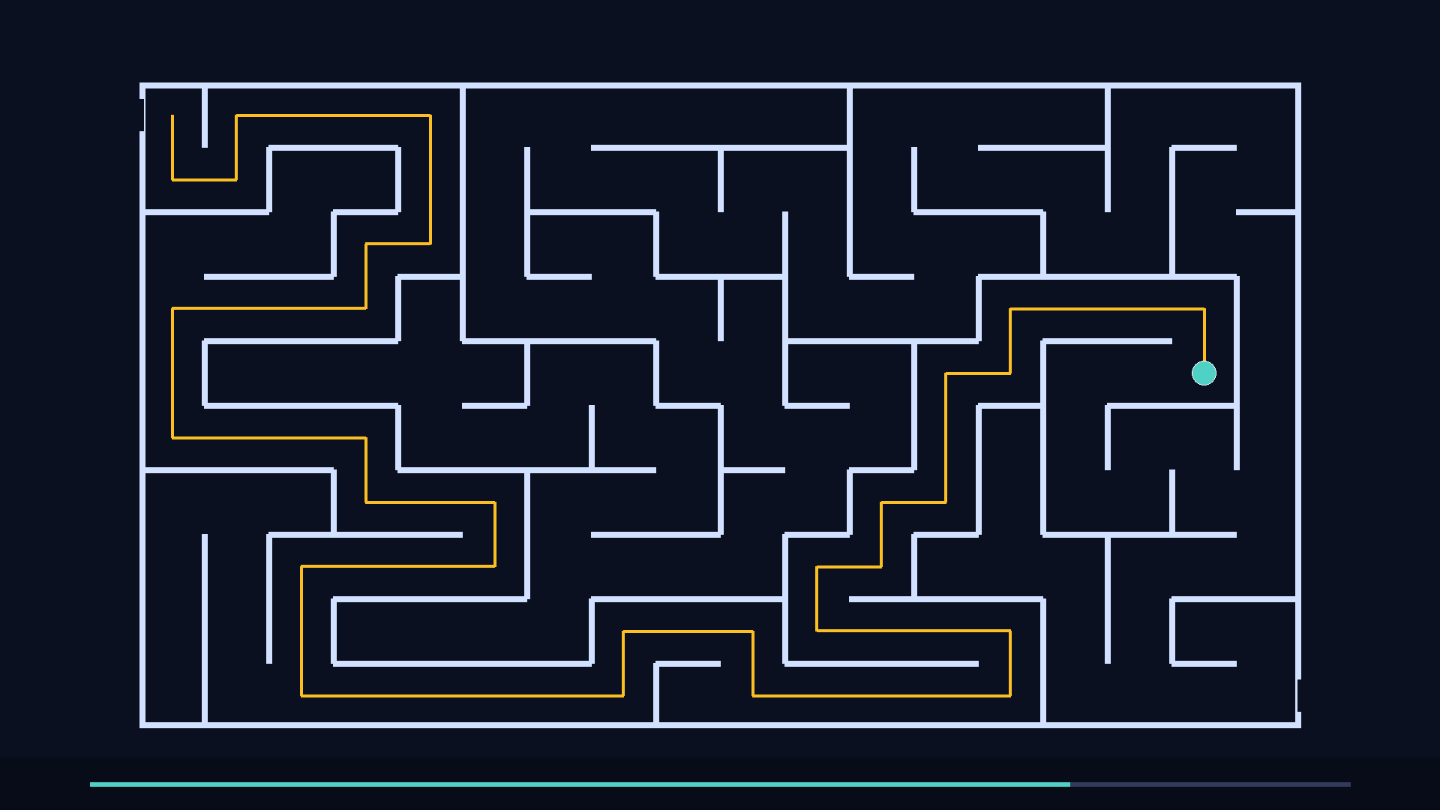
Quiz
Noise: when the maze shakes
Real qubits are fragile. Heat, vibration, and stray electromagnetic fields can nudge the explorer into the wrong corridor. Quantum error correction is like using extra explorers to detect wall cracks without opening the exit door too early.
Important idea You protect information by spreading it across several physical qubits.
8/10

Slide 9
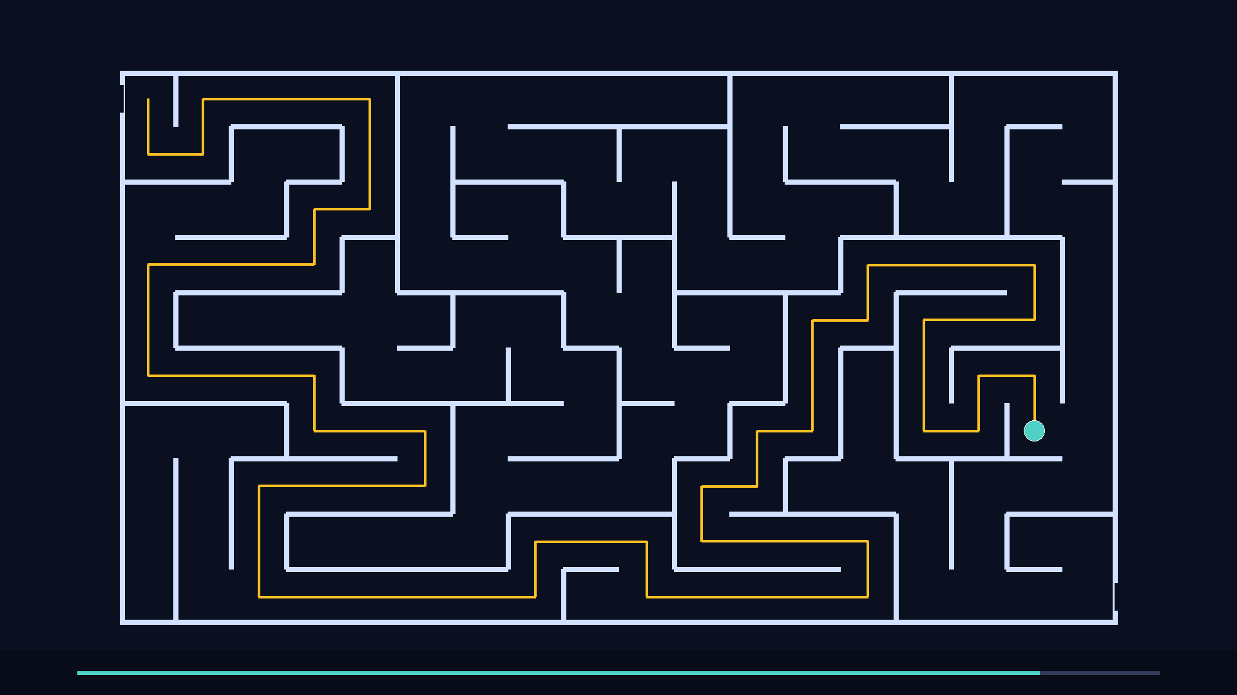
What are qubits made of?
Photons
Trapped ions
Superconducting circuits
Light particles can carry qubits through optical mazes. They travel fast and resist some noise.
Charged atoms in electromagnetic ‘corridors’ can store qubits with high precision, but operations can be slower.
Tiny circuits chilled near absolute zero can act like artificial atoms. They are fast and widely engineered.
9/10

Slide 10
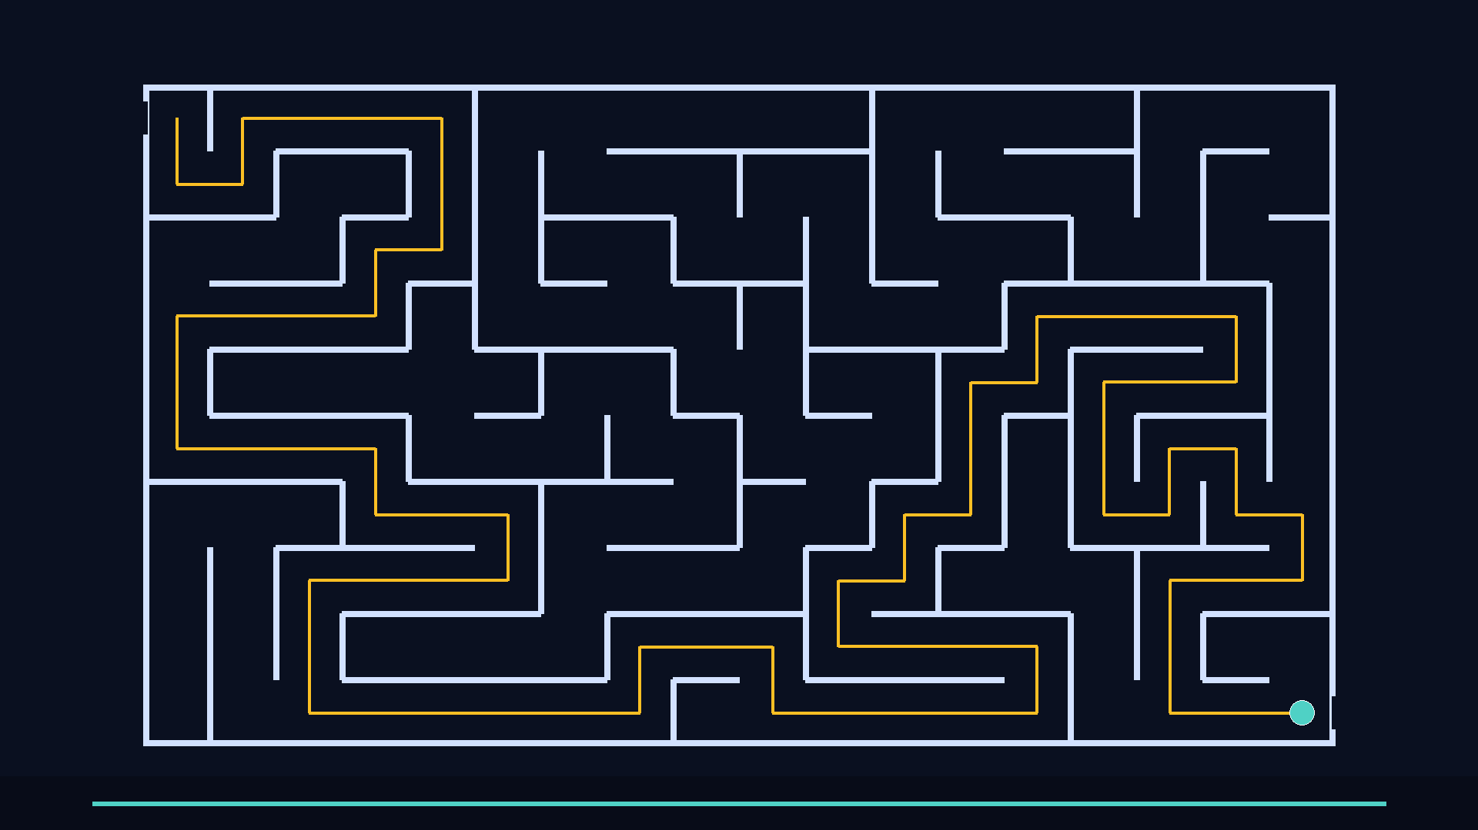
Quiz: choose the right corridor
If a bit is a committed turn, what is a qubit like in the maze story?
What does ‘measurement’ do to the maze explorer?
In one sentence, describe entanglement using the rope idea.
Why can noise ruin a quantum route more easily than a classical route?
Back to Slide 1
10/10

