Slide 1
Group Number 3
DEG

Slide 2



Prithvi AJ
3027871
Contributions:
*Analytical Workflow
*PCA
*KEGG
Prince Gabriel
3055510
Contributions:
*Heat Map
*Volcano Map
Asha Avanigadda
307052
Contributions:
*Reactome
*PPT

Slide 3
Analytical Workflow
Read RNA-seq Data (FPKM)
Differential Gene Expression Analysis(Limma)
Pathway Enrichment Analysis (KEGG & Reactome)
Data Preprocessing (QC, normalization, log transform.)
Significant DEGs identification (adj.P.Val<0.05, [logFC) > 1)

Slide 4
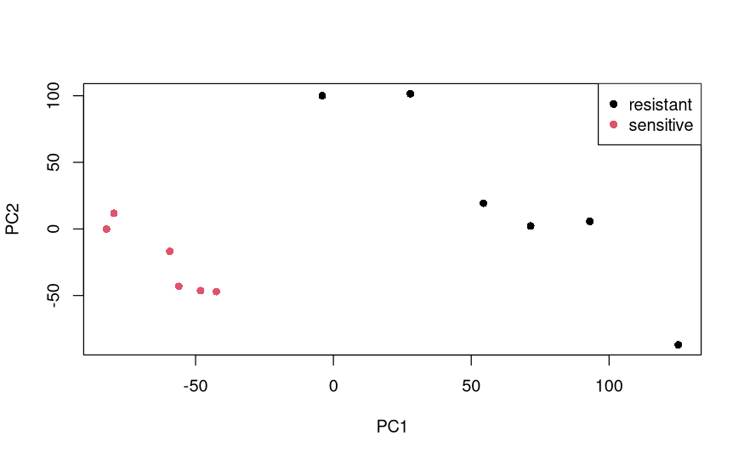
PCA Analysis
1. Clear Separation: Sensitive and resistant samples cluster distinctly,
confirming real biological differences
2. Data Quality Validated: Strong clustering proves downstream gene
and pathway findings are trustworthy

Slide 5
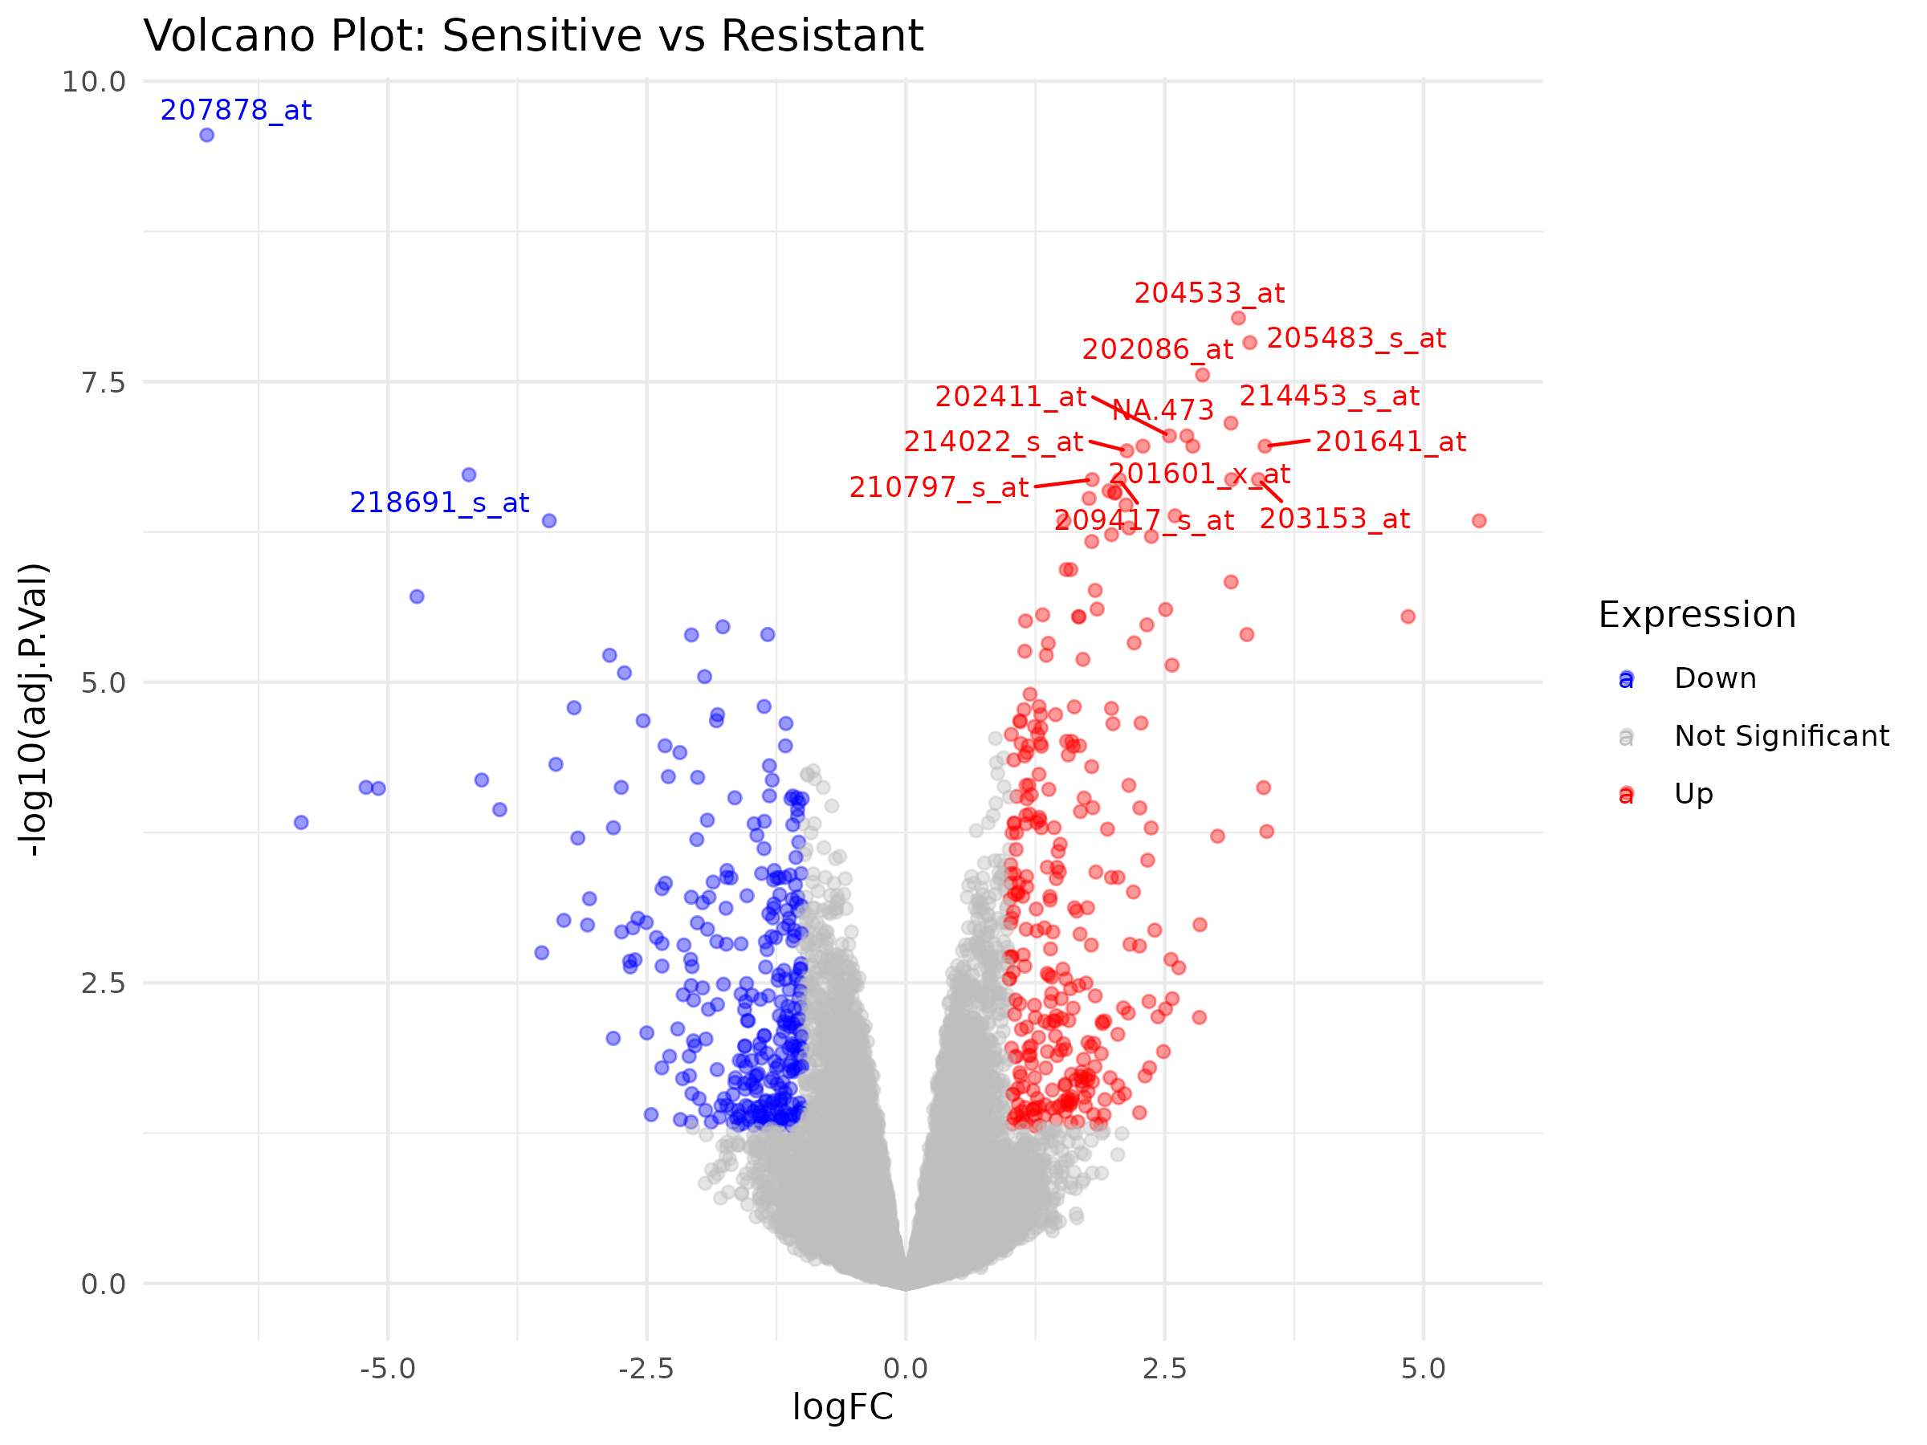
Volcano Plot
Up-regulated in Resistant (Red): Genes with high log FC and low p-values cluster on right—drive radiotherapy resistance mechanisms.
Down-regulated in Resistant (Blue): Genes with low log FC and low p-values cluster on left—suppressed in resistant cells, potentially protective in sensitive cells

Slide 6
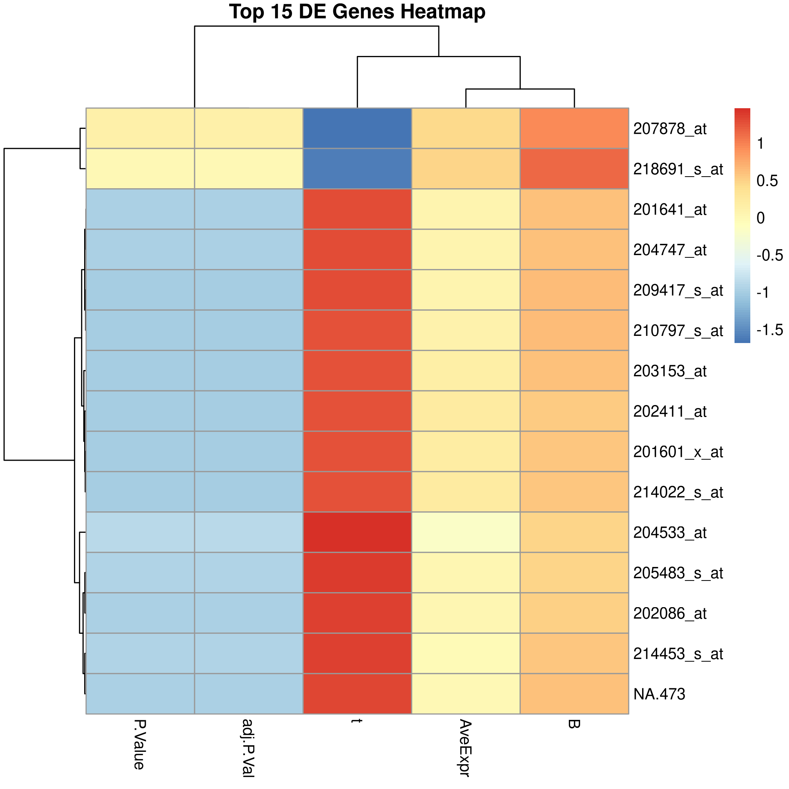
Heat Map of Top 15 Genes
The top 15 DEGs were selected for very strong statistical evidence of differential expression (low p-values, high test statistics).
Rather than showing expression patterns by sample group, this heatmap summarizes how the top genes scored across different analytical metrics.
This visualization helps you compare the statistical strength of differential expression between top-ranked genes using a color gradient.

Slide 7
Differential Gene Expression Results
Significant DEGs (adj.P.Val < 0.05, |logFC| > 1)
Top 15 Significant Genes
Gene_ID | Gene_ID | Gene_ID | Gene_ID | P.Value | adj.P.Val | B | Expression
207878_at | -6.74933884 | 8.09119727 | -44.7062193 | 1.2579E-14 | 2.8029E-10 | 20.6094273 | Down
204533_at | 3.21157514 | 9.28501481 | 31.3255527 | 8.3823E-13 | 9.3391E-09 | 18.2776359 | Up
205483_s_at | 3.32180821 | 12.0492387 | 29.078827 | 2.0111E-12 | 1.4938E-08 | 17.6928978 | Up
202086_at | 2.86482582 | 11.5769821 | 26.9148322 | 4.984E-12 | 2.7765E-08 | 17.0525141 | Up
214453_s_at | 3.13901516 | 9.67172946 | 24.404831 | 1.5675E-11 | 6.9857E-08 | 16.1970743 | Up
NA.473 | 2.71248078 | 9.92393807 | 23.3721807 | 2.5968E-11 | 8.9167E-08 | 15.8044794 | Up
202411_at | 2.54529844 | 12.6582542 | 23.2208999 | 2.8011E-11 | 8.9167E-08 | 15.7447728 | Up
201641_at | 3.46777298 | 10.1582563 | 22.3672293 | 4.3341E-11 | 1.0863E-07 | 15.3967506 | Up
201601_x_at | 2.28881501 | 11.6043905 | 22.2298387 | 4.6565E-11 | 1.0863E-07 | 15.3389212 | Up
214022_s_at | 2.13435869 | 11.7868117 | 21.7939517 | 5.8632E-11 | 1.1877E-07 | 15.1519786 | Up
218691_s_at | -4.21858053 | 6.06207512 | -20.794707 | 1.0115E-10 | 1.8782E-07 | 14.7025813 | Down
204777_s_at | -3.44352873 | 9.04121555 | -18.1018181 | 5.0273E-10 | 4.5372E-07 | 13.328081 | Down
202409_at | -4.7210233 | 9.19439668 | -15.5072999 | 2.9556E-09 | 1.937E-06 | 11.7292721 | Down
207381_at | -1.76743872 | 9.49003311 | -14.4345025 | 6.6651E-09 | 3.4539E-06 | 10.9713633 | Down
206453_s_at | -1.33385073 | 10.0860051 | -14.1894124 | 8.0874E-09 | 4.0047E-06 | 10.789123 | Down

Slide 8
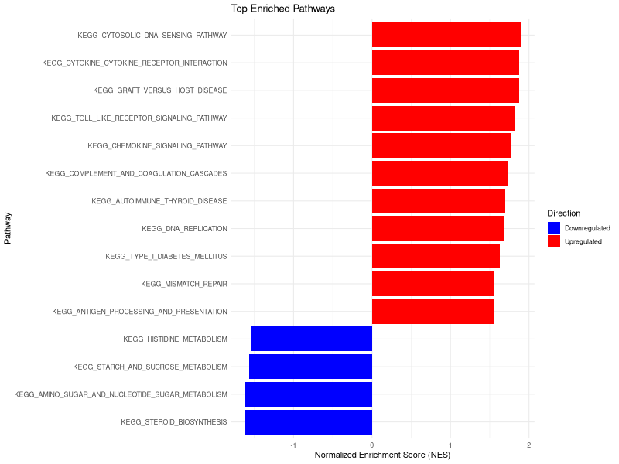
KEGG Enrichment Pathway
Upregulated Pathways (Red): Immune and inflammatory response pathways (cytokine signaling, TLR pathway, DNA sensing) dominate—revealing strong immune activation in resistant samples.
Downregulated Pathways (Blue): Metabolic pathways suppressed—indicating resistant cells redirect resources away from basic metabolism toward survival and stress response.

Slide 9
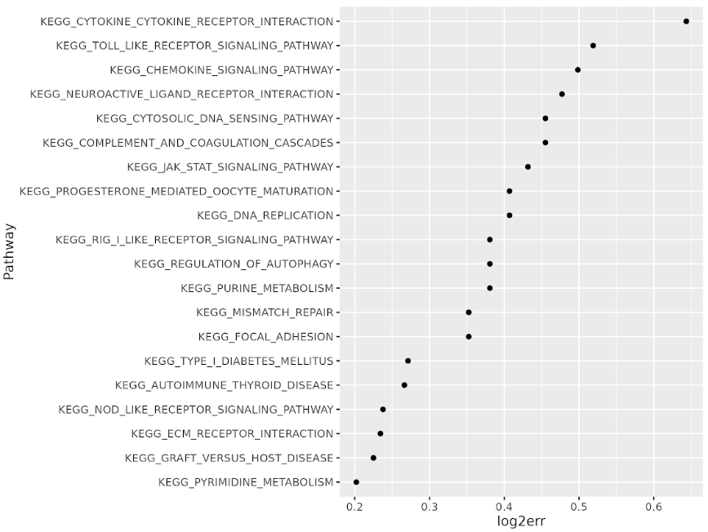
KEGG Pathway Enrichment (Top Pathways)
KEGG pathways ranked by enrichment confidence (log2err).
Immune & inflammatory pathways show strongest, most reliable enrichment.
Confirms immune activation as a key feature of radiotherapy resistance.

Slide 10
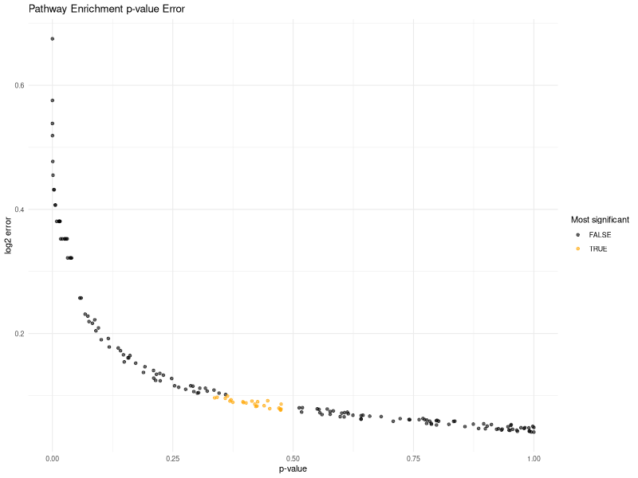
Most Significant KEGG Pathways
KEGG_HOMOLOGOUS_RECOMBINATION
KEGG_B_CELL_RECEPTOR_SIGNALING_PATHWAY
KEGG_BIOSYNTHESIS_OF_UNSATURATED_F ATTY_ACIDS
KEGG_NITROGEN_METABOLISM
KEGG_BASE_EXCISION_REPAIR
KEGG_ACUTE_MYELOID_LEUKEMIA
KEGG_CYSTEINE_AND_METHIONINE_METABOLISM
KEGG_SELENOAMINO_ACID_METABOLISM
KEGG_PANCREATIC_CANCER
KEGG_SMALL_CELL_LUNG_CANCER
KEGG_FC_GAMMA_R_MEDIATED_PHAGOCYTOSIS
KEGG_ETHER_LIPID_METABOLISM
KEGG_PRIMARY_IMMUNODEFICIENCY
KEGG_RENAL_CELL_CARCINOMA
KEGG_BETA_ALANINE_METABOLISM

Slide 11
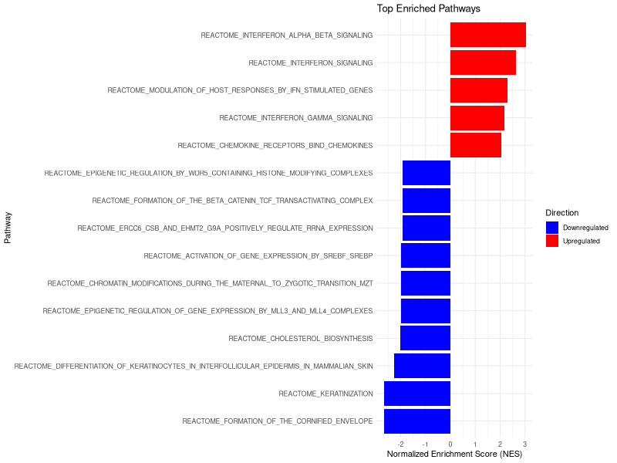
Reactome Enrichment Pathway (Bar Plot)
Upregulated Pathways (Red): Interferon signaling dominates alpha/beta interferon, IFN-stimulated gene responses, and immune modulation pathways strongly activated in resistant samples.
Downregulated Pathways (Blue): Epigenetic and metabolic pathways suppressed histone modifications, gene expression regulation, and steroid biosynthesis reduced, indicating metabolic reprogramming in resistance

Slide 12
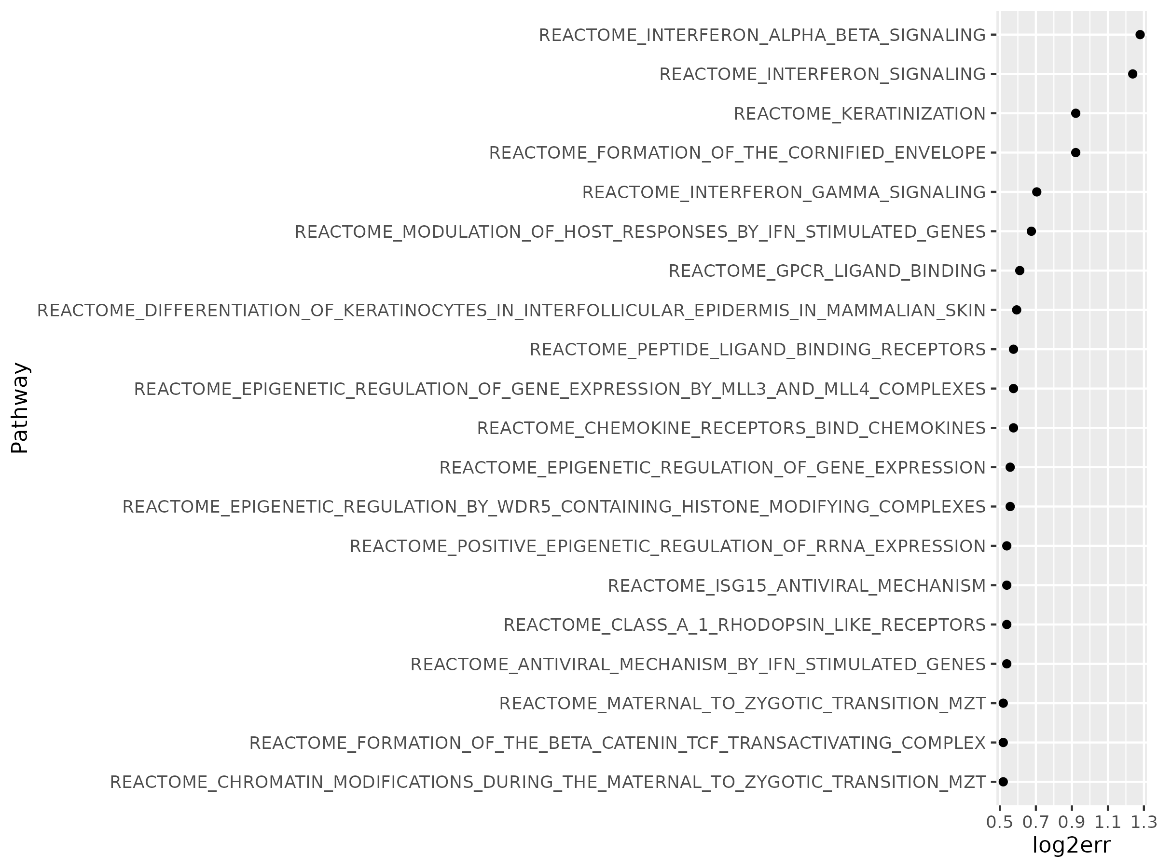
Reactome Pathway Enrichment (Top Pathways)
Interferon Signaling Dominates (Top): Alpha/beta interferon and modulation of IFN-stimulated responses show strongest enrichment—confirming immune activation as central mechanism in radiotherapy resistance.
Epigenetic & Differentiation Pathways: Gene expression regulation, chromatin modifications, and cell differentiation pathways show lower but consistent enrichment—indicating reprogramming in resistant phenotype.

Slide 13
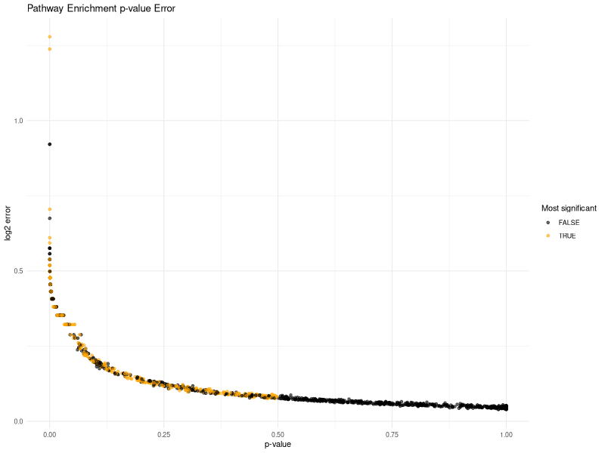
Most Significant Reactome Pathway
REACTOME_CELL_CYCLE_MITOTIC
REACTOME_ABERRANT_REGULATION_OF_MITOTIC_EXIT_IN_CANCER_DUE_TO_RB1_DEFECTS
REACTOME_RHOJ_GTPASE_CYCLE
REACTOME_PI3K_AKT_SIGNALING_IN_CANCER
REACTOME_REGULATION_OF_TP53_ACTIVITY
REACTOME_CD28_DEPENDENT_PI3K_AKT_SIGNALING
REACTOME_SCAVENGING_BY_CLASS_A_RECEPTORS
REACTOME_DISEASES_OF_CARBOHYDRATE_METABOLISM
REACTOME_SLC_MEDIATED_TRANSMEMBRANE_TRANSPORT
REACTOME_SIGNALING_BY_CYTOSOLIC_FGFR1_FUSION_MUTANTS
REACTOME_TRAF6_MEDIATED_NF_KB_ACTIVATION
REACTOME_EPH_EPHRIN_SIGNALING
REACTOME_MITOTIC_G2_G2_M_PHASES
REACTOME_RHOBTB_GTPASE_CYCLE
REACTOME_INTERLEUKIN_RECEPTOR_SHC_SIGNALING

Slide 14
Thank You

