Slide 1
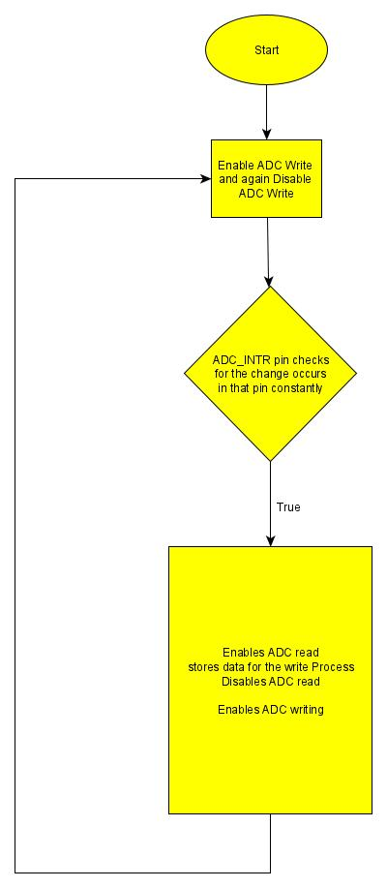
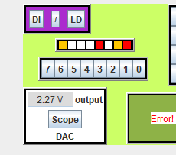
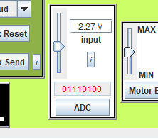
Task 1: ADC through polling
ADC_INTR pin is used for the polling method.
The program is constantly updating the output regardless of any change in the input or not.

Slide 2
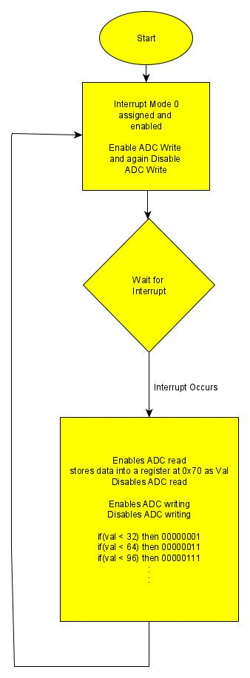
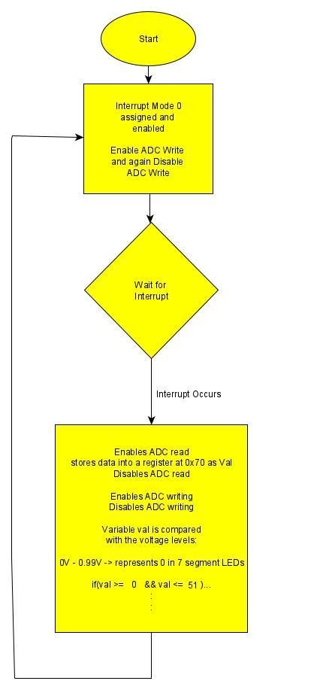
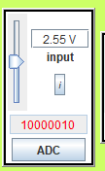


Task 2: Using LED as Indicators/ 7-SEG LEDs
Both of these programs work using Interrupts.
Binary Read Data from ADC is compared to the static binary Value represented as Decimal.

Slide 3
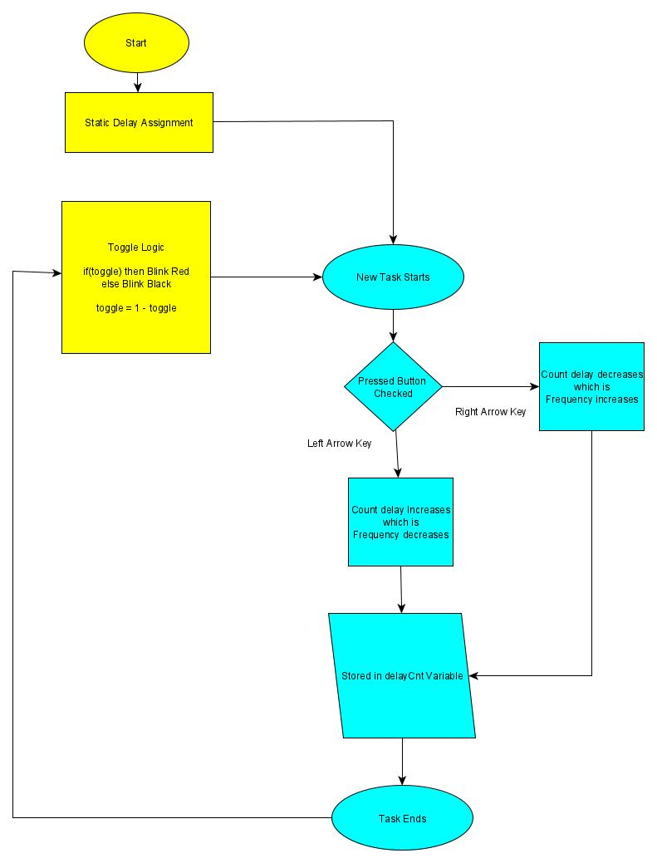
Task 3: LED blinking with variable frequency
A static delay count is assigned at first.
Then A new Task created
Task checks for the left or right key pressed and thus varies frequency accordingly.

Slide 4
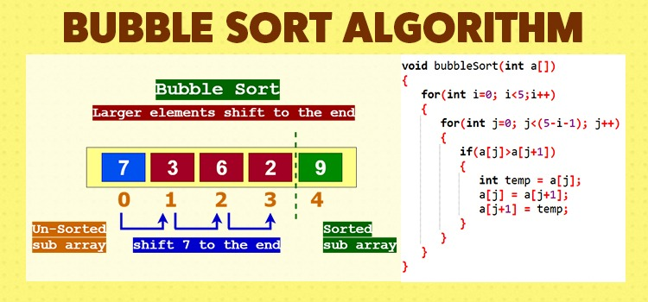
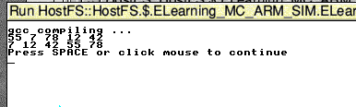
Task 4: Bubble Sort Algorithm
Loops through each number in array and swap the numbers if the current is greater than the next number.

Slide 5
Task 5: Essay
Title: Interfacing Sensors and PLCs using Micro-controllers for Mass Production.
ADC is the primary focus.
Key Comparison:
  EFM8BB1:= 16 inputs ; EFM8LB1 := 20 inputs
  EFM8BB1:= 12, 10, 8-bit modes ; EFM8LB1 := 14, 12, 10-bit modes
  For comparison : 12-bit mode := EFM8BB1 produces about 200K samples/s whereas EFM8LB1 produces up to 1M samples/s.
  Special Methods for conversion:
    EFM8BB1 : Burst mode (sets of 1,4,8,16,32, 64 samples per trigger) – Low Power Consumption
    EFM8LB1 : Single method of conversion := from start to finish, the data is accumulated. Once the input is finished, the accumulated set is transferred.

