Slide 1

Presentation Circuit Design Project
Prithvi Patel - 27890
Mehul Amipara - 25809

Slide 2

Project :- Measurement of the time per rotation of the Turning Table

Slide 3
Motivation
GOAL :- Measurement of the time taken per rotation.
To Do :-
VHDL Program doing the measurement stuffs.
To see this values on the command line terminal.

Slide 4
Equipments need ?

Slide 5
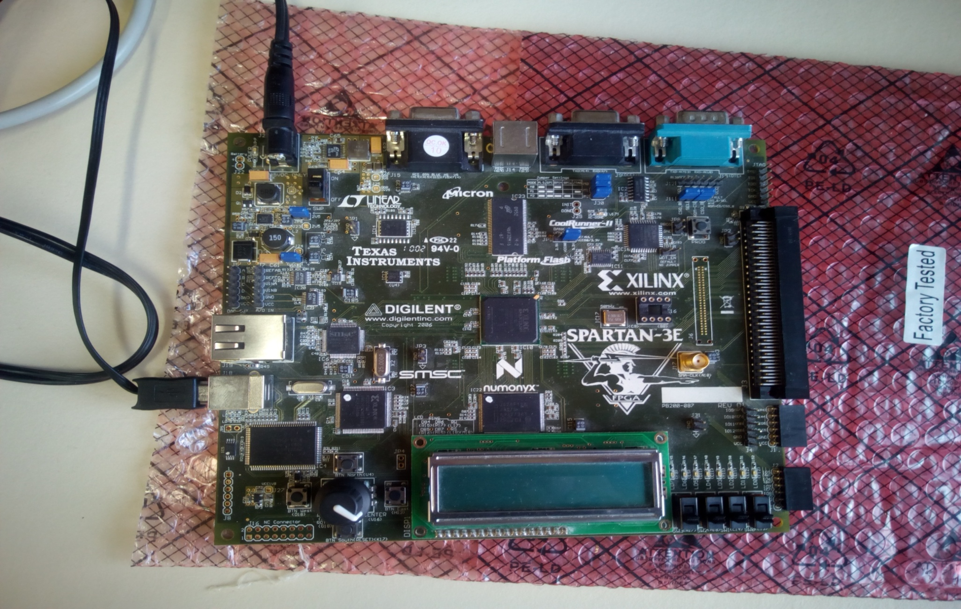
SPARTAN 3E FPGA DEVELOPMENT BOARD

Slide 6
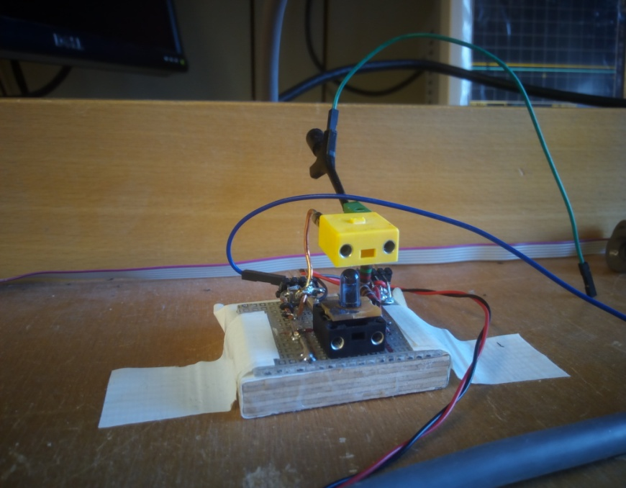
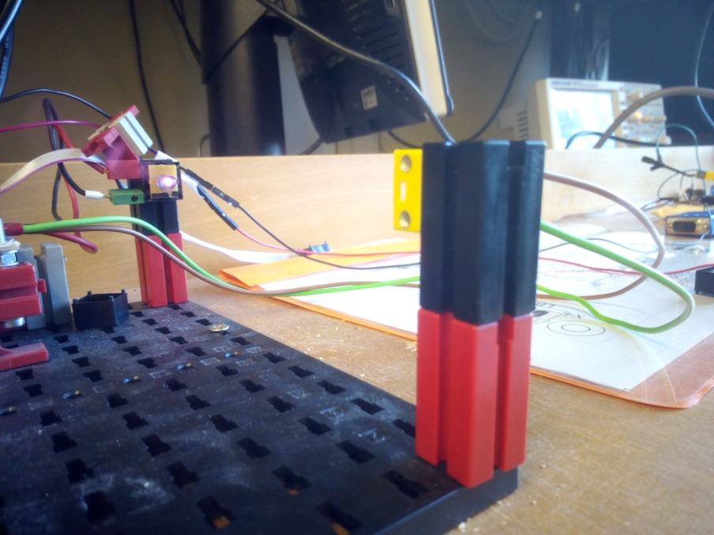
Light Bridge arrangement using IR LED sensor

Slide 7
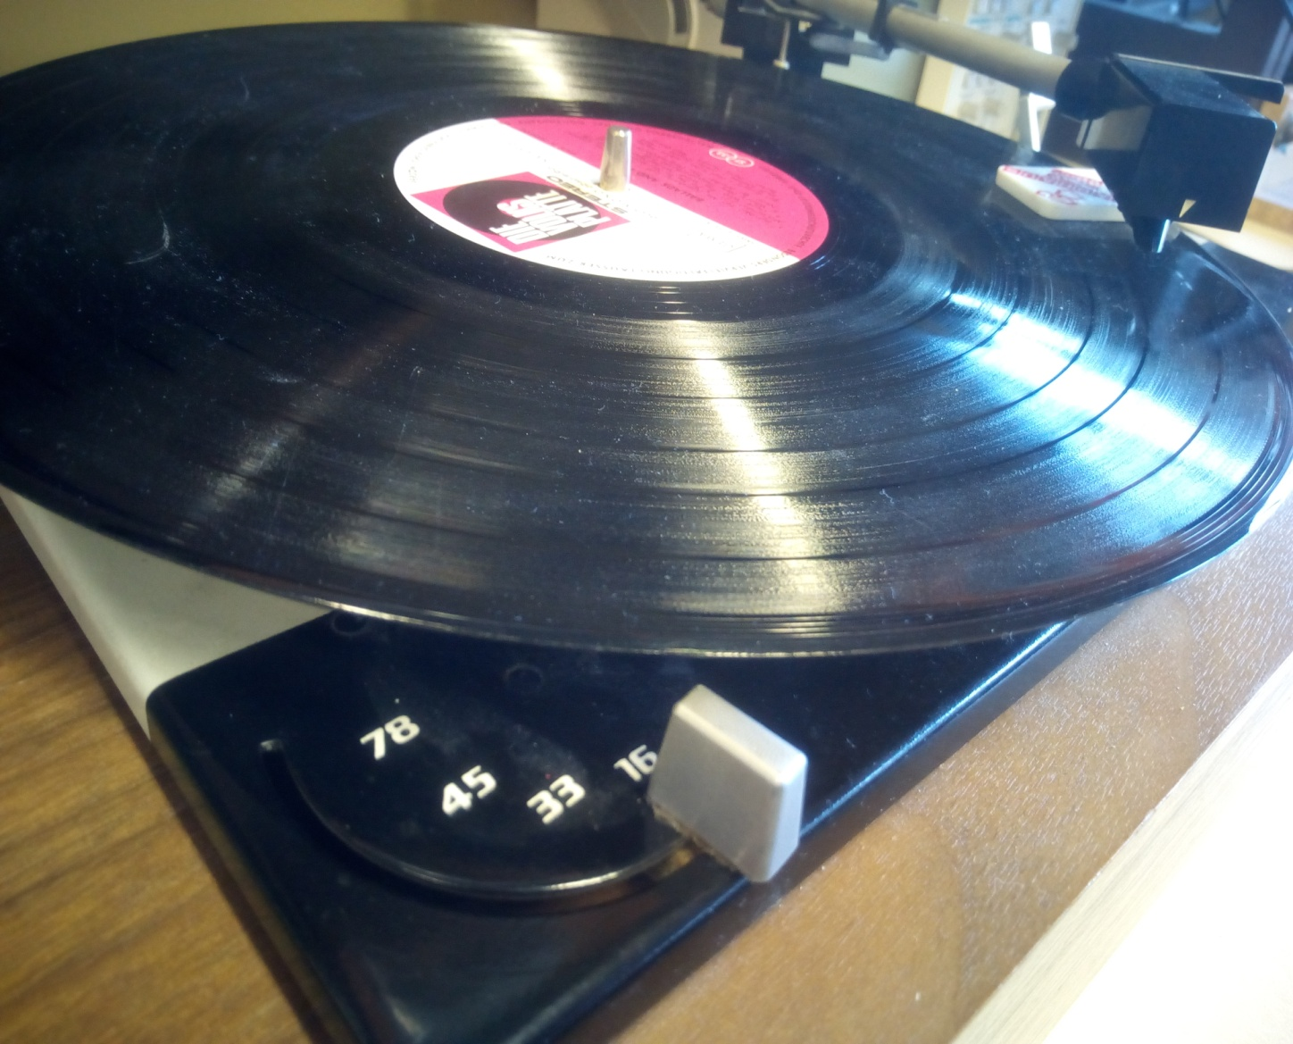
Turning Table

Slide 8


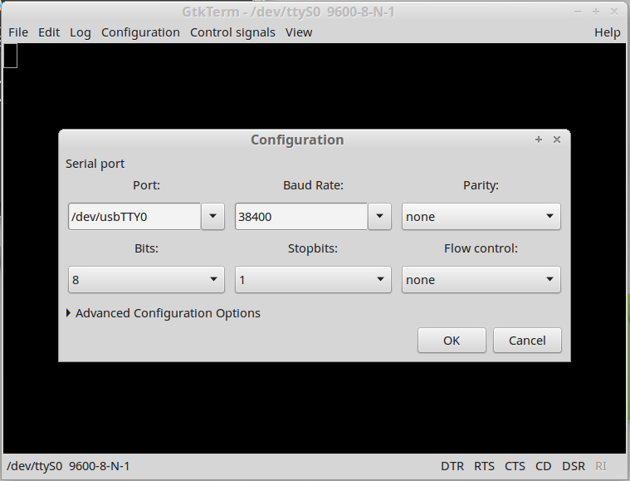
Software Used

Slide 9
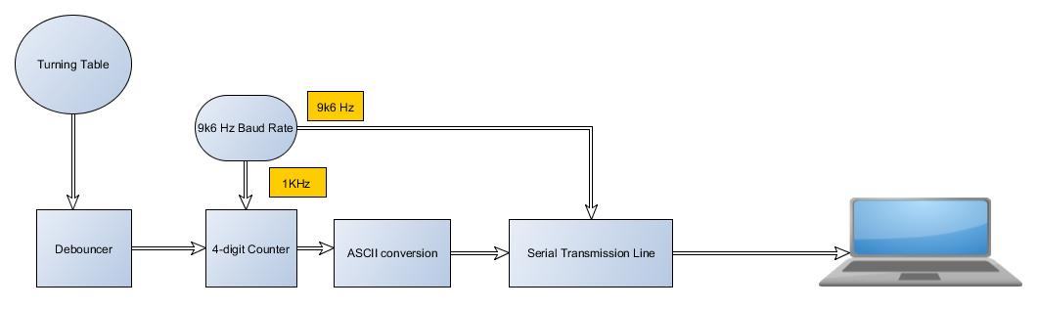
Block diagram
Baud Rate and 1ms pulse Generator

Slide 10
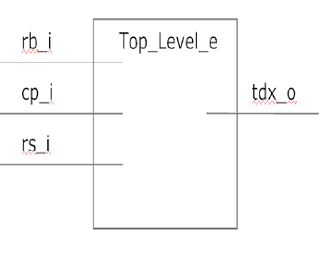
Top Level Entity
Just the main signals has been shown

Slide 11
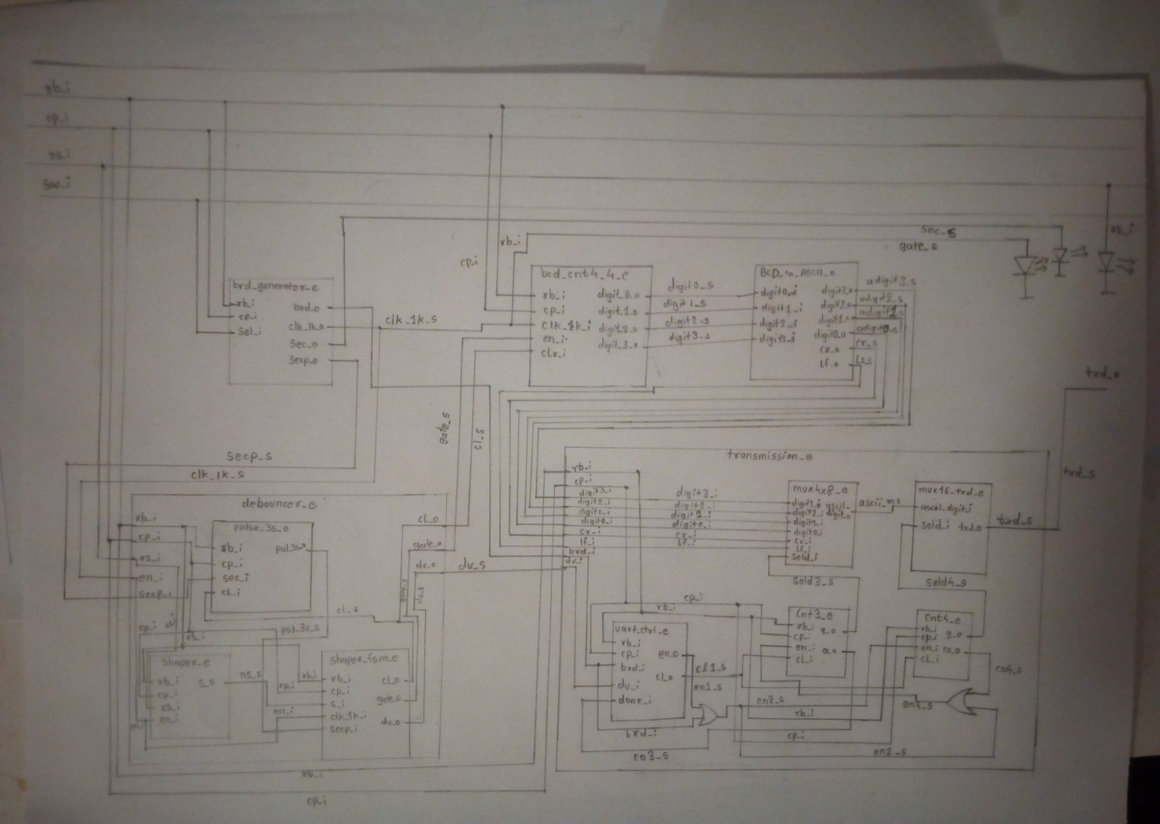
Top level Architecture

Slide 12
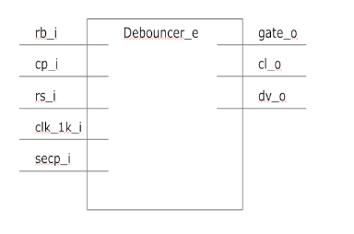
Debouncer :- Entity

Slide 13
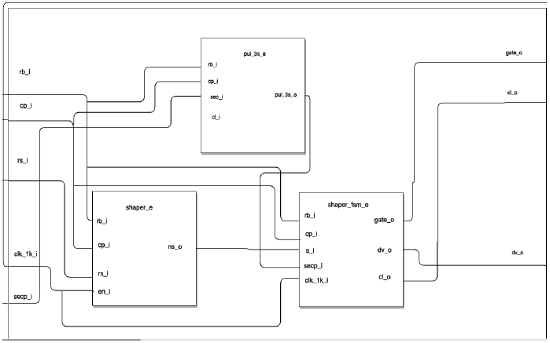
Debouncer :- Architecture

Slide 14
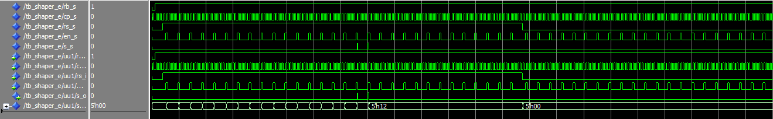
Shaper block

Slide 15
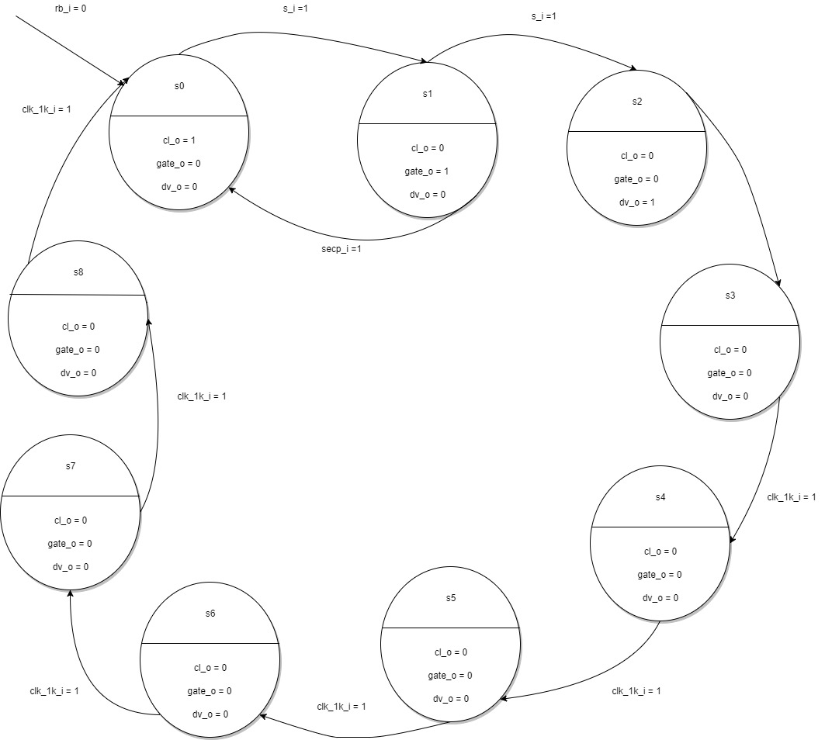
Shaper FSM
Time Delay :
5ms(ca.)

Slide 16
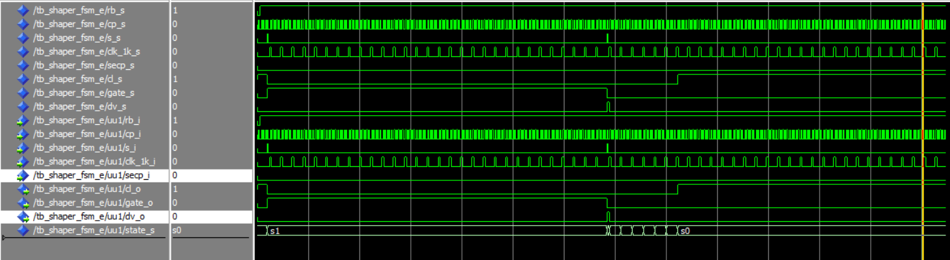
Shaper FSM : Timing behavior

Slide 17
Baud rate generator : Entity
Brd_generator
rb_i
brd_o
cp_i
clk_1k_o
sw_i
sec_o
secp_o

Slide 18
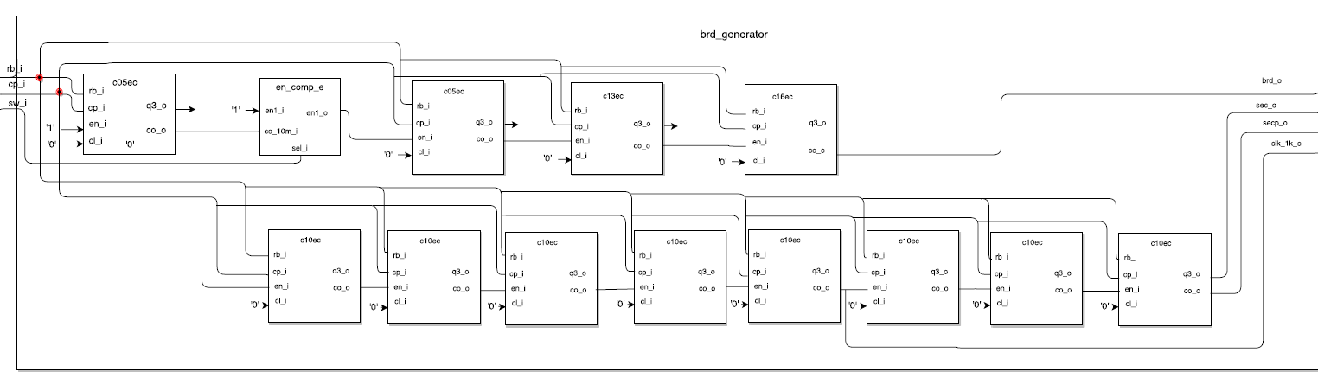
Baud rate Generator - Architecture

Slide 19
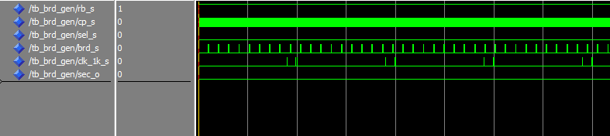
Baud Rate Generator – Timing Behavior

Slide 20
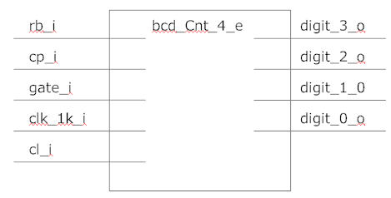
4-digit Counter : Entity

Slide 21
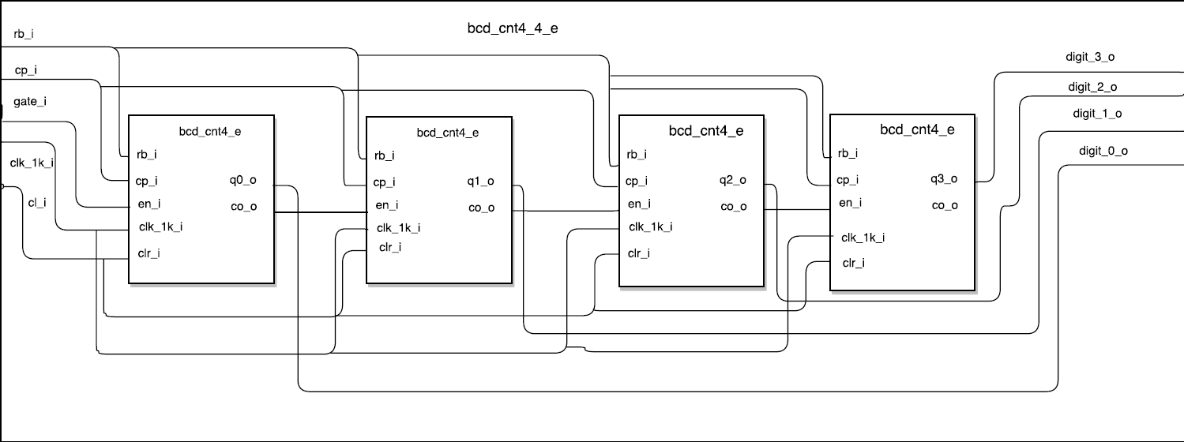
4-digit counter - Architecture

Slide 22
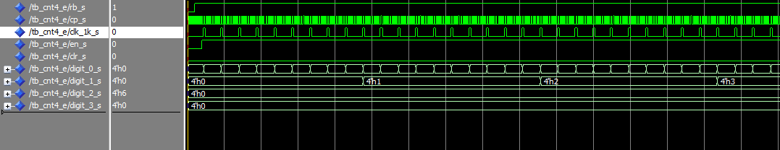
4-digit counter – Timing Behaviour

Slide 23
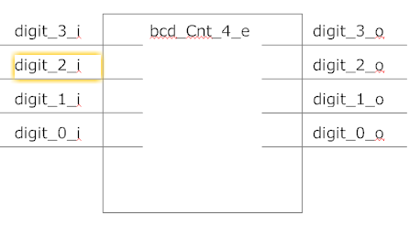
ASCII Conversion : Entitiy

Slide 24
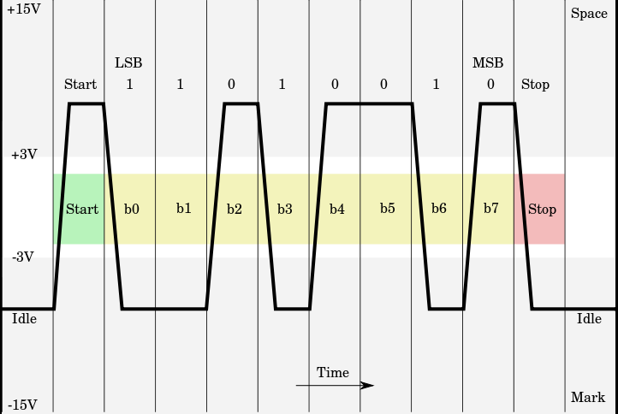
Transmission UART Sequence corresponding to RS232 - Protocol

Slide 25
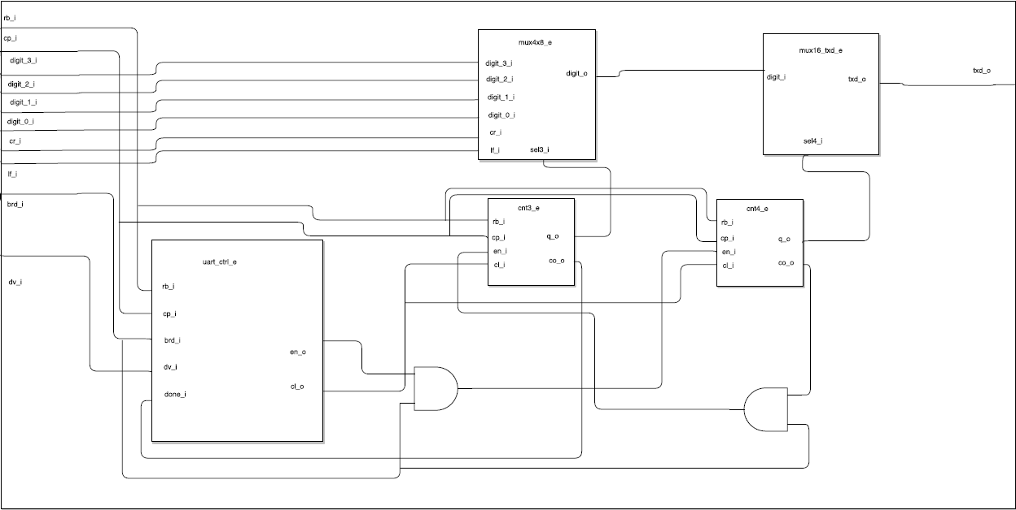
Serial Transmission line

Slide 26
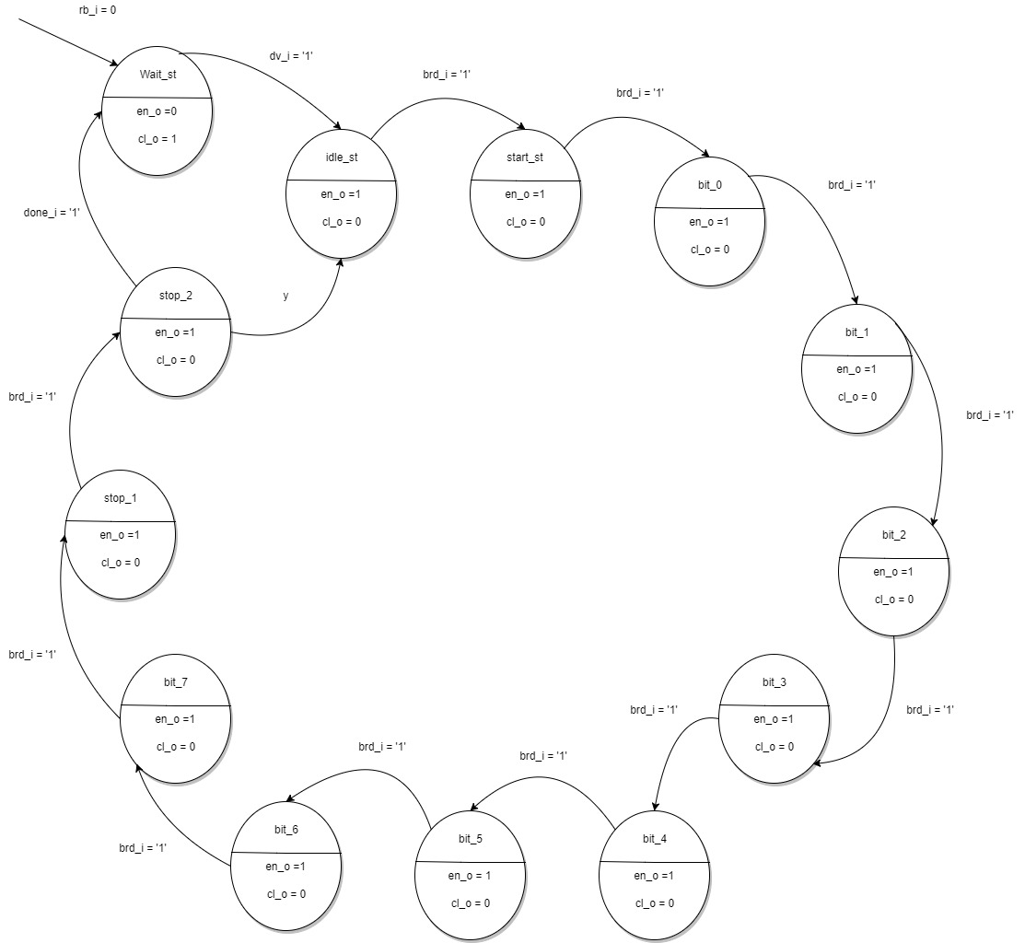
UART controlling FSM
brd_i = ‘1’

Slide 27
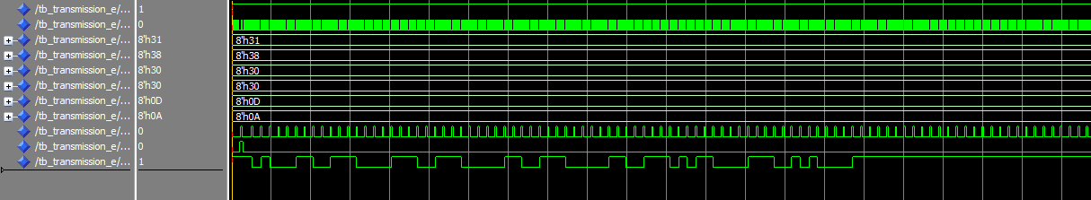
UART controlling FSM : Timing Behaviour

Slide 28
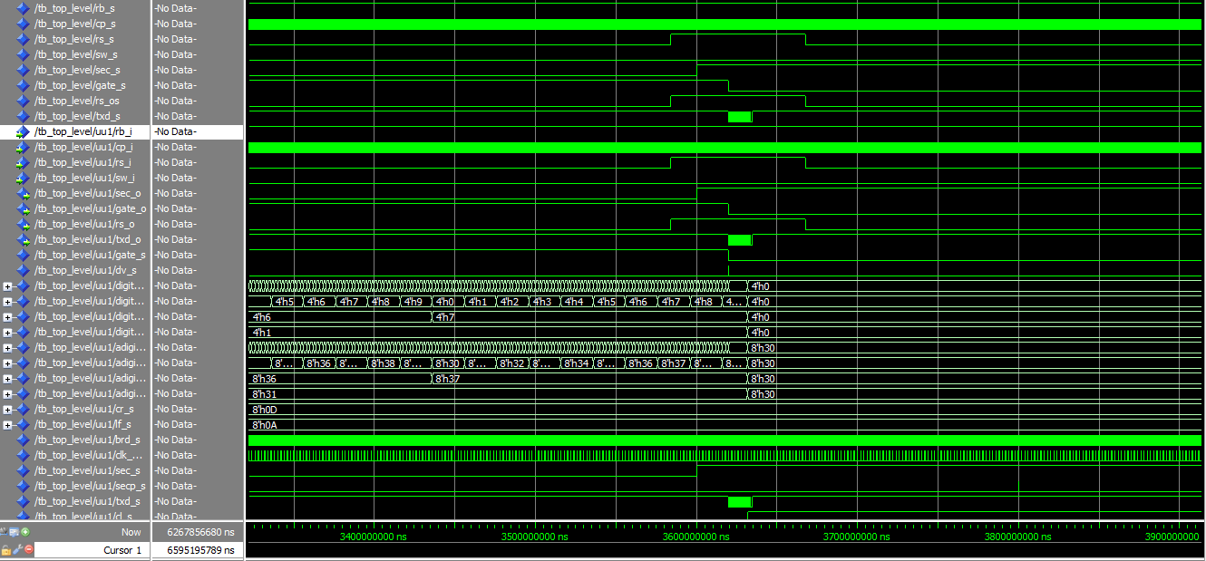
Test and Debug

Slide 29
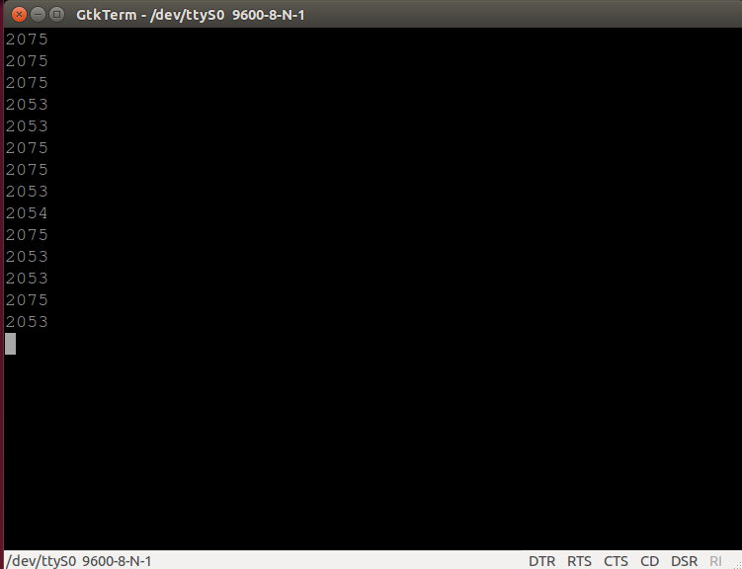
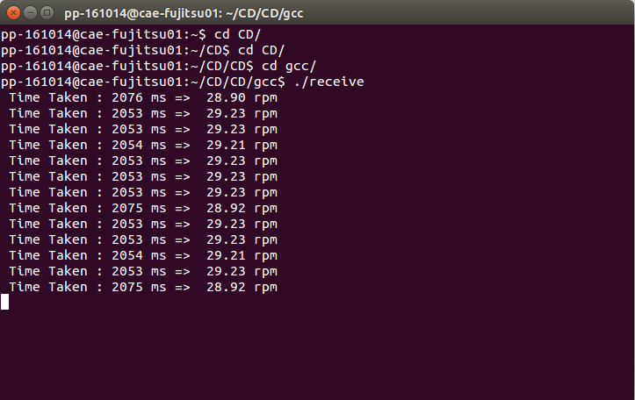
Results

Slide 30

Thank you for your Patience

