Slide 1

Met-Museum
By -
Abhishek
Prithviraj
Santanu
Satyam
Somnath

Slide 2
About Dataset
The Met Collection, also known as The Metropolitan Museum of Art, is a massive art museum located in New York City. It's actually the largest art museum in the Americas, boasting a collection that spans over 5,000 years of art from all over the world [Google Arts & Culture: The Metropolitan Museum of Art].
Collection size: 500 objects, though originally estimated to have over 2 million.
Departments: Divided into 17 curatorial departments, including Greek and Roman Art, Islamic Art, American Art, and more. [Wikipedia: Metropolitan Museum of Art]

Slide 3
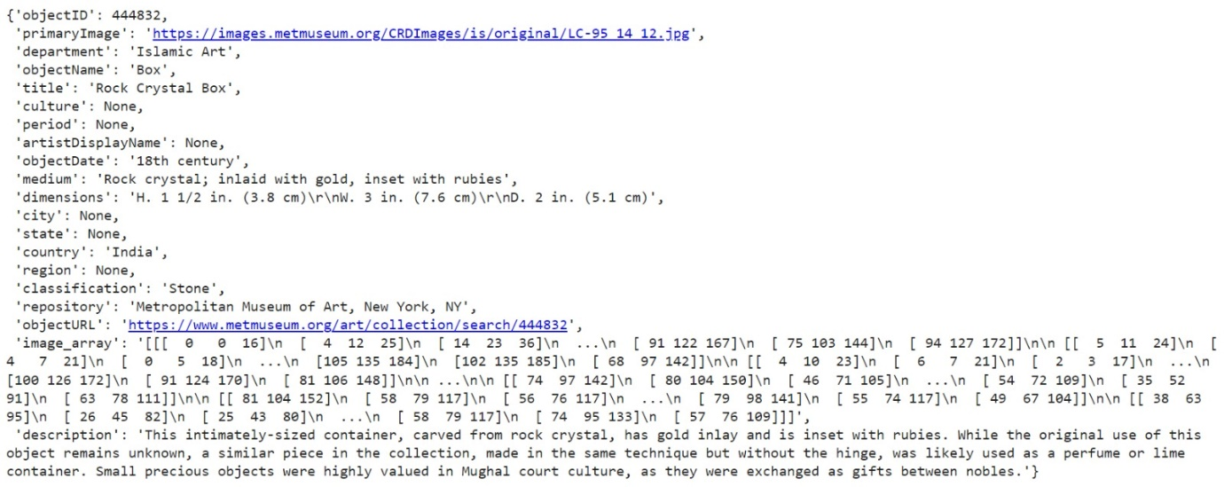
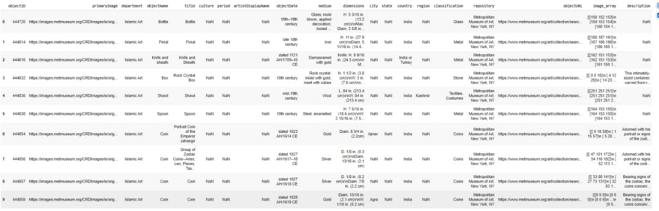
Data Snap

Slide 4
Todo:
Create questions and answer pairs.
Proceed further for modelling.

