Slide 1

SMART WASTE MANAGEMENT SYSTEM USING IOT
Problem Statement: Waste collection services are often inefficient, with trucks following predetermined routes regardless of whether bins are full or not. This results in unnecessary trips, wasted resources, and missed opportunities for recycling. How might we develop an IoT-based waste collection system that uses smart bins to monitor waste levels and dynamically adjust collection routes based on real-time data?

Slide 2
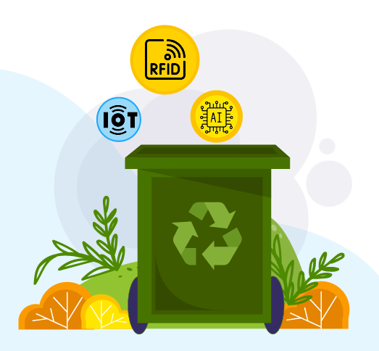
What have we come up with ?
Our Smart Waste Management System aims to enhance waste collection processes through real-time monitoring and data-driven decision-making.
By integrating sensors into waste bins, we can measure fill levels and transmit this information to a cloud platform.
This enables waste collectors to optimize collection schedules, ensuring bins are emptied before they overflow.

Slide 3
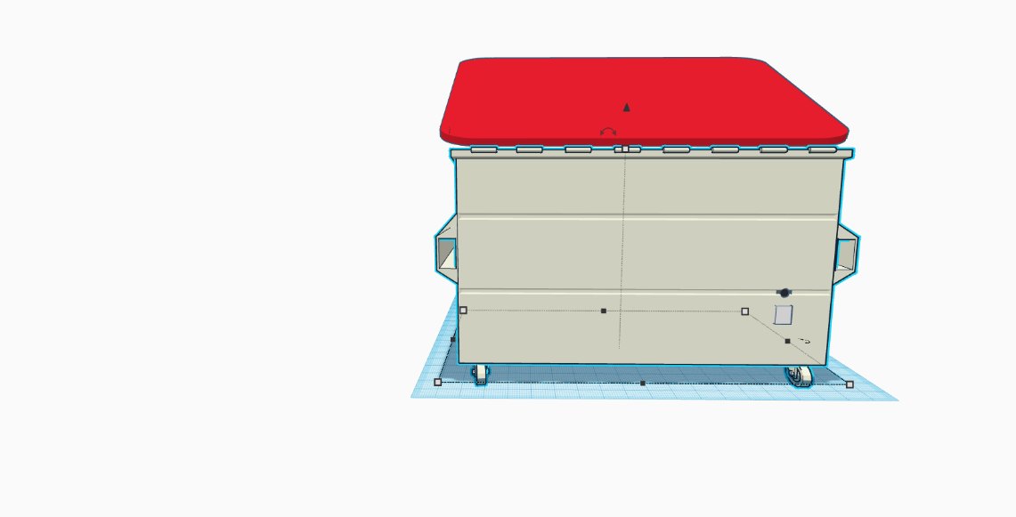
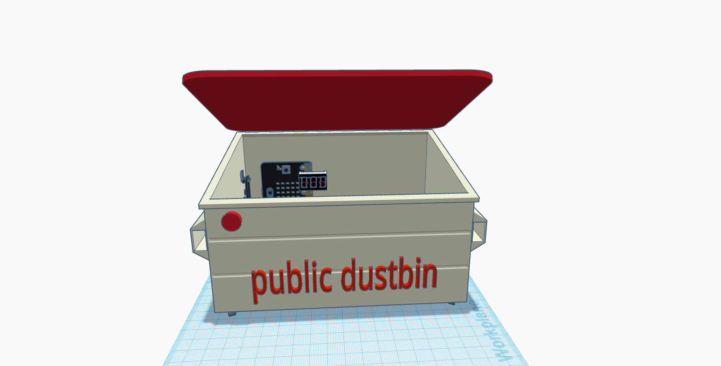
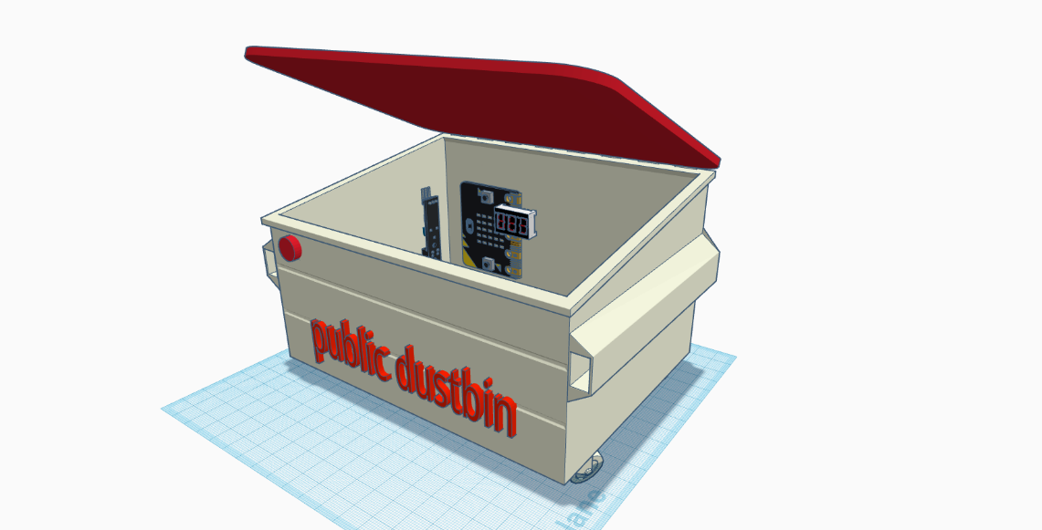
OUR DESIGN

Slide 4
PROPOSED SYSTEM
Smart Bin: Equipped with ultrasonic and infrared sensors to detect the bin’s fill level and ensure the lid closes automatically during rain or inactivity.
Communication Module: A SIM808 GSM module sends SMS notifications to waste collectors, eliminating the need for continuous monitoring.
GPS Integration: Allows real-time tracking of bin locations and aids in optimizing collection routes.
Solar Power: Utilizes energy from streetlights, ensuring sustainability and reduced dependency on external power sources.
AI-Powered Software: Processes sensor data to predict fill times and optimize waste collection schedules and routes.

Slide 5
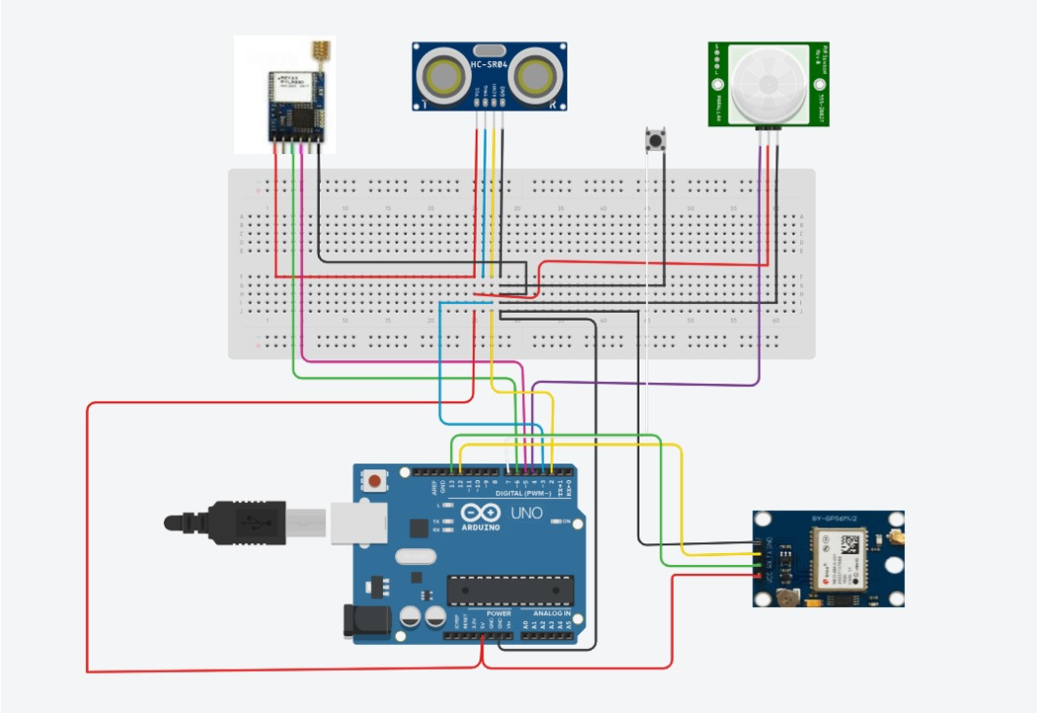
CIRCUIT DIAGRAM

Slide 6
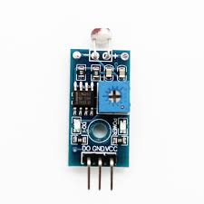
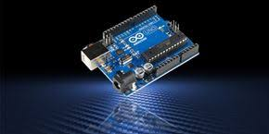
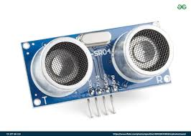
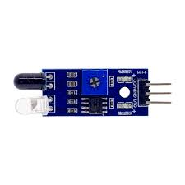
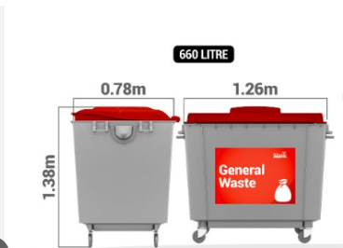
COST ESTIMATION
Arduino UNO board -₹ 3000
Infra red Sensor- ₹ 30
Ultra Sonic Sensor-₹ 150
Button- ₹ 20
GPS – ₹ 400
Lora WAN-₹ 3000
Which brings to a sum of ~7000 approx.

Slide 7
Software Integration
User Dashboard
Route Optimization Engine
Predictive Analytics
Mobile Interface
Alerts and Notifications
Integration Capabilities

Slide 8
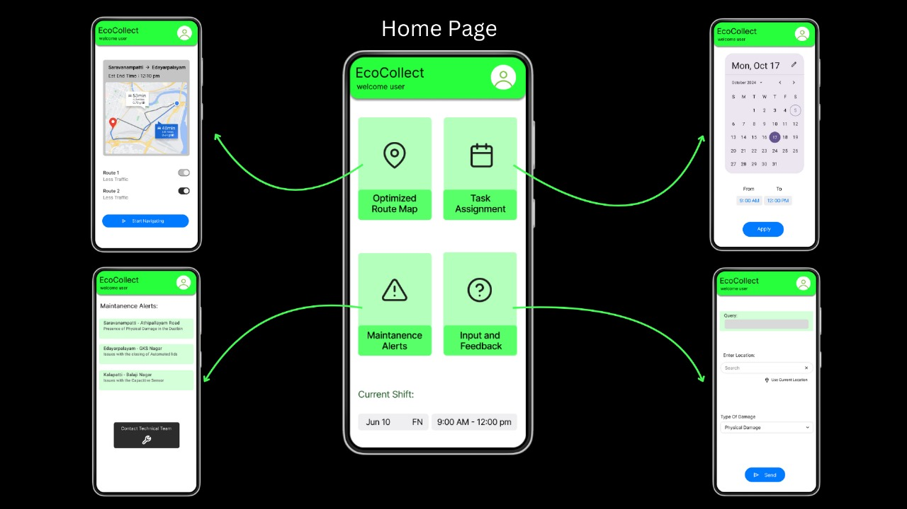
OUR APP

Slide 9

BENEFITS ?
Cost Savings
Environmental Sustainability
Reduced Overflowing Bins
Improved Efficiency
Real-Time Alerts
Integration with Smart City Initiatives
Less Odor and Pollution
Community Awareness
Route Optimization
Fuel consumption

Slide 10
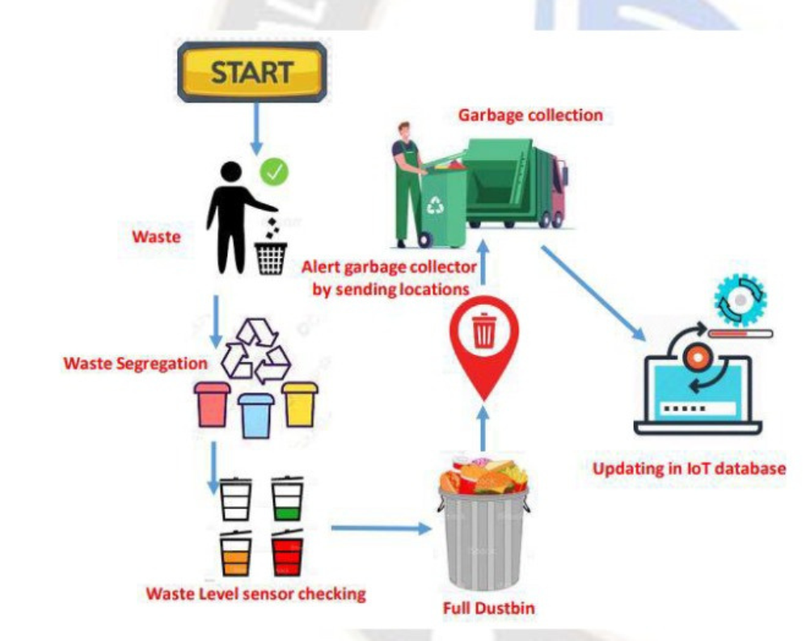
INSIGHTS
A survey of waste collection workers revealed that 40% reported spending more than 30% of their time driving to bins that are not full.
Approximately 70% of waste collection workers believe that implementing technology like real-time tracking would enhance their efficiency and job satisfaction.
A study found that 60% of residents have experienced overflowing bins at least once a month, leading to complaints and a perception of poor service.

Slide 11
THANKYOU!
NIVETHA M
RAKSHITA BHAGYA SHRI P
SIJU N
SRIDHA SRINIVASARAGHAVAN

