Slide 1
SkillSphere Empower your skills , share your knowledge
Group No.64
Apoorva Landge-233136
Prithviraj Patil-233190
Project Guide : Mrs. Manjiri Deshpande Mam

Slide 2
INTRODUCTION
MOTIVATION
OBJECTIVE
TECHNOLOGY USED
DIAGRAM
SCREENSHOTS
S/W AND H/W REQUIREMENTS
FUTURE SCOPE
CONCLUSION
REFERENCES

Slide 3
SkillSphere-Your all-in-one learning and blogging platform
SkillSphere is an Online Web App, which is the ultimate destination for all your learning and blogging needs.
This is a portal which will be available for 24/7.
There are 2 major component of this portal, 1st User and 2nd Visitor.
User can be either a passionate blogger or an aspiring programmer or someone eager to learn and contribute is here to search for the required article or can post it’s own blog.
User can sharpen his/her coding skill with our online compiler, supporting java , c , c++ , python and javascript(Nodejs).

Slide 4
Motivation->Unleash your potential with SkillSphere!
As we know seeking knowledge can be a daunting task. SkillSphere offers a heaven where you can cultivate your skills ,acquire new ones and become the best version of yourself.
This app unable user to delve into topics that cultivates his/her interest , explore diverse fields and sculpt a path that resonate with his/her aspirations.
SkillSphere empowers user to amplify his/her voice , share his/her insights , perspectives and expertise through blog

Slide 5
Our Mission: Empowering Skill and sharing Knowledge
Primary goal of this app is to offer an environment where users can refine and expand their skills like creative writing , programming skills and can share interview experiances.
This app strive to connect like minded individuals , enabling them to exchange ideas , collaborate on projects and engage in meaningful discussion.
App makes learning accessible to everyone, through our user friendly interface and diverse range of topics we intend to break down barriers, empowering individuals of all backgrounds to embark on their learning journey.
Skillsphere encourages users to express themselves through blogs, articles, coding projects and allow them to share interview experiances. Our platform is a canvas where creativity thrives, and ideas take shape – bridging the gap between thought and action.

Slide 6
Technology Used:
Backend- Springboot
Frontend-ReactJS
Database-Mysql

Slide 7
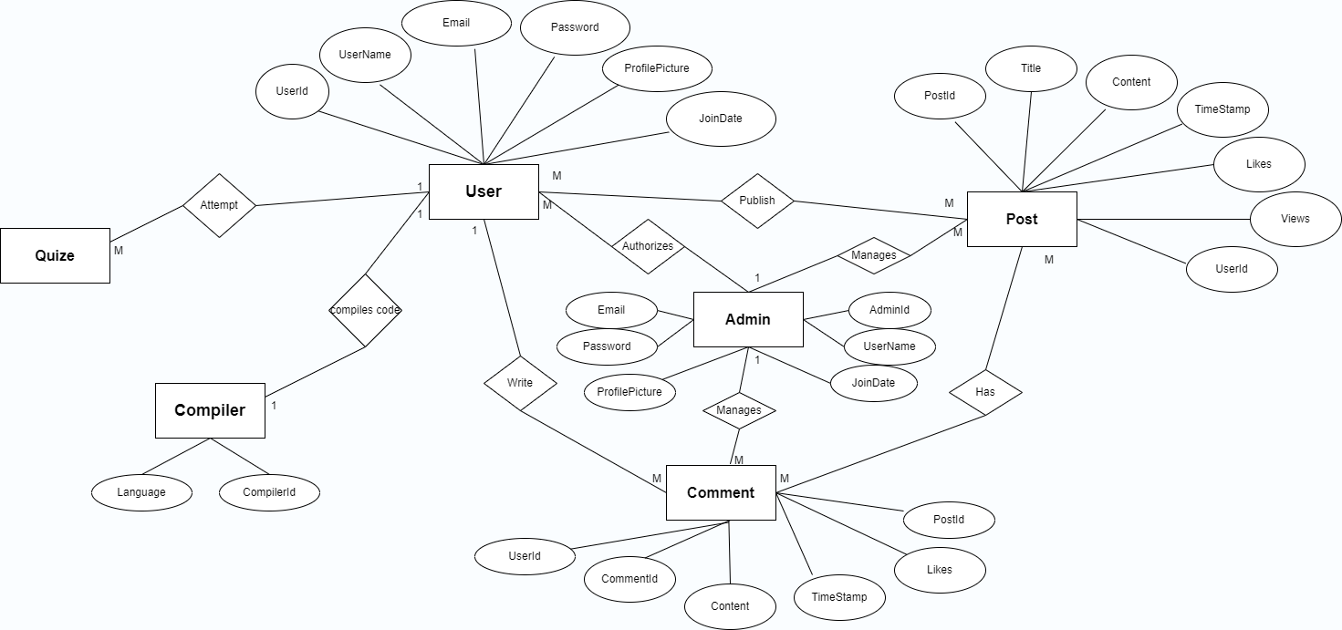
ER Diagram

Slide 8
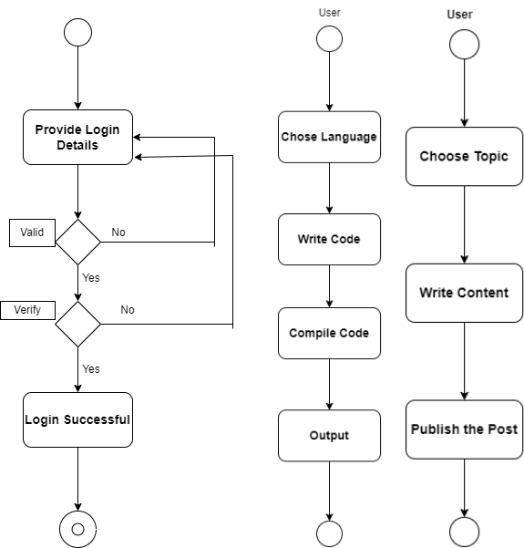
Activity diagram

Slide 9
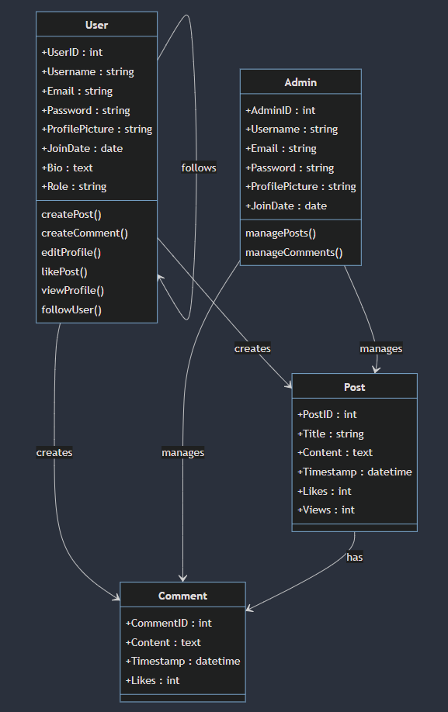
Class Diagram

Slide 10
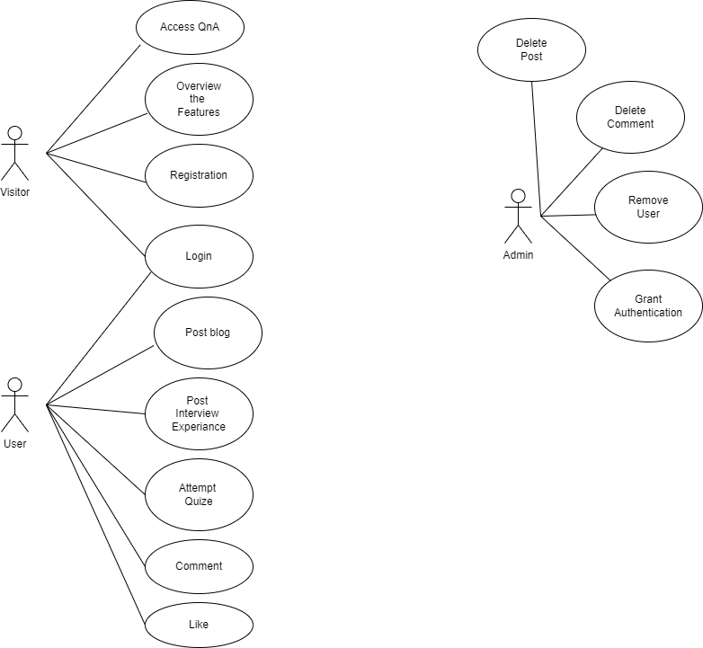
Use Case Diagram

Slide 11
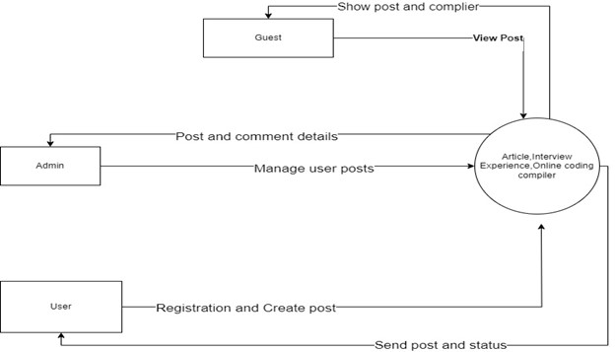
DFD Diagram

Slide 12
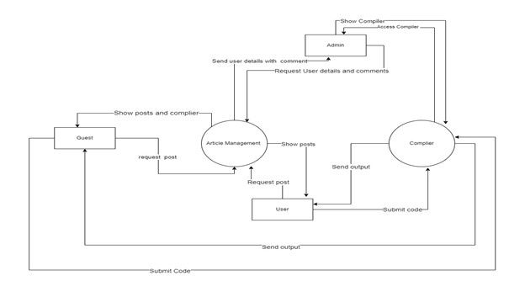
DFD Diagram

Slide 13
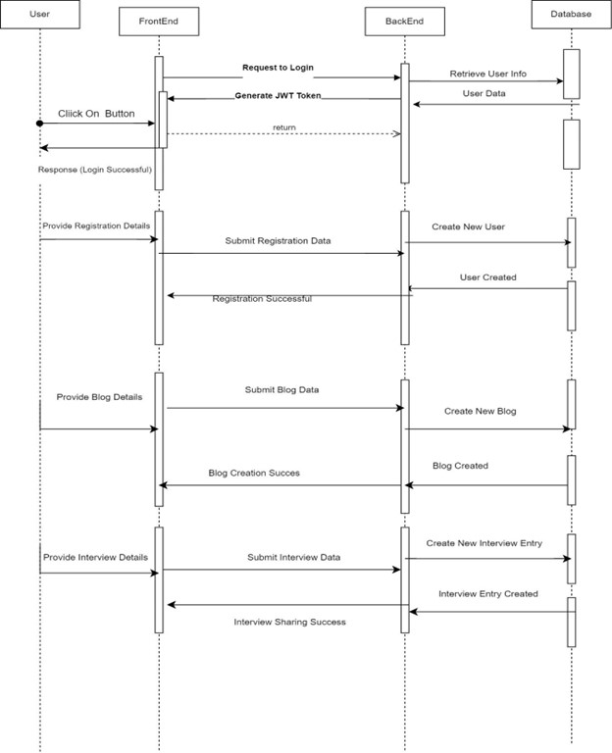
Sequence Diagram

Slide 14
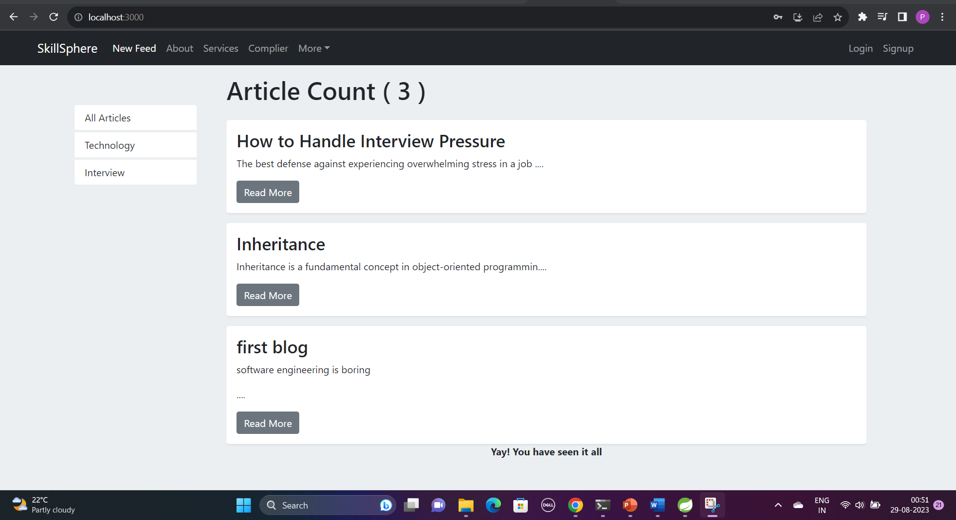
Home Screen for Visitor

Slide 15
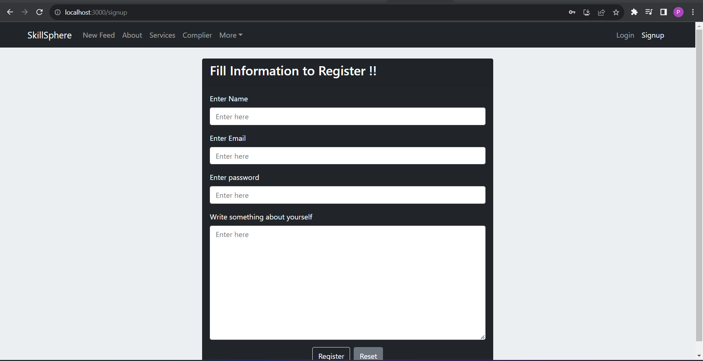
Signup page

Slide 16
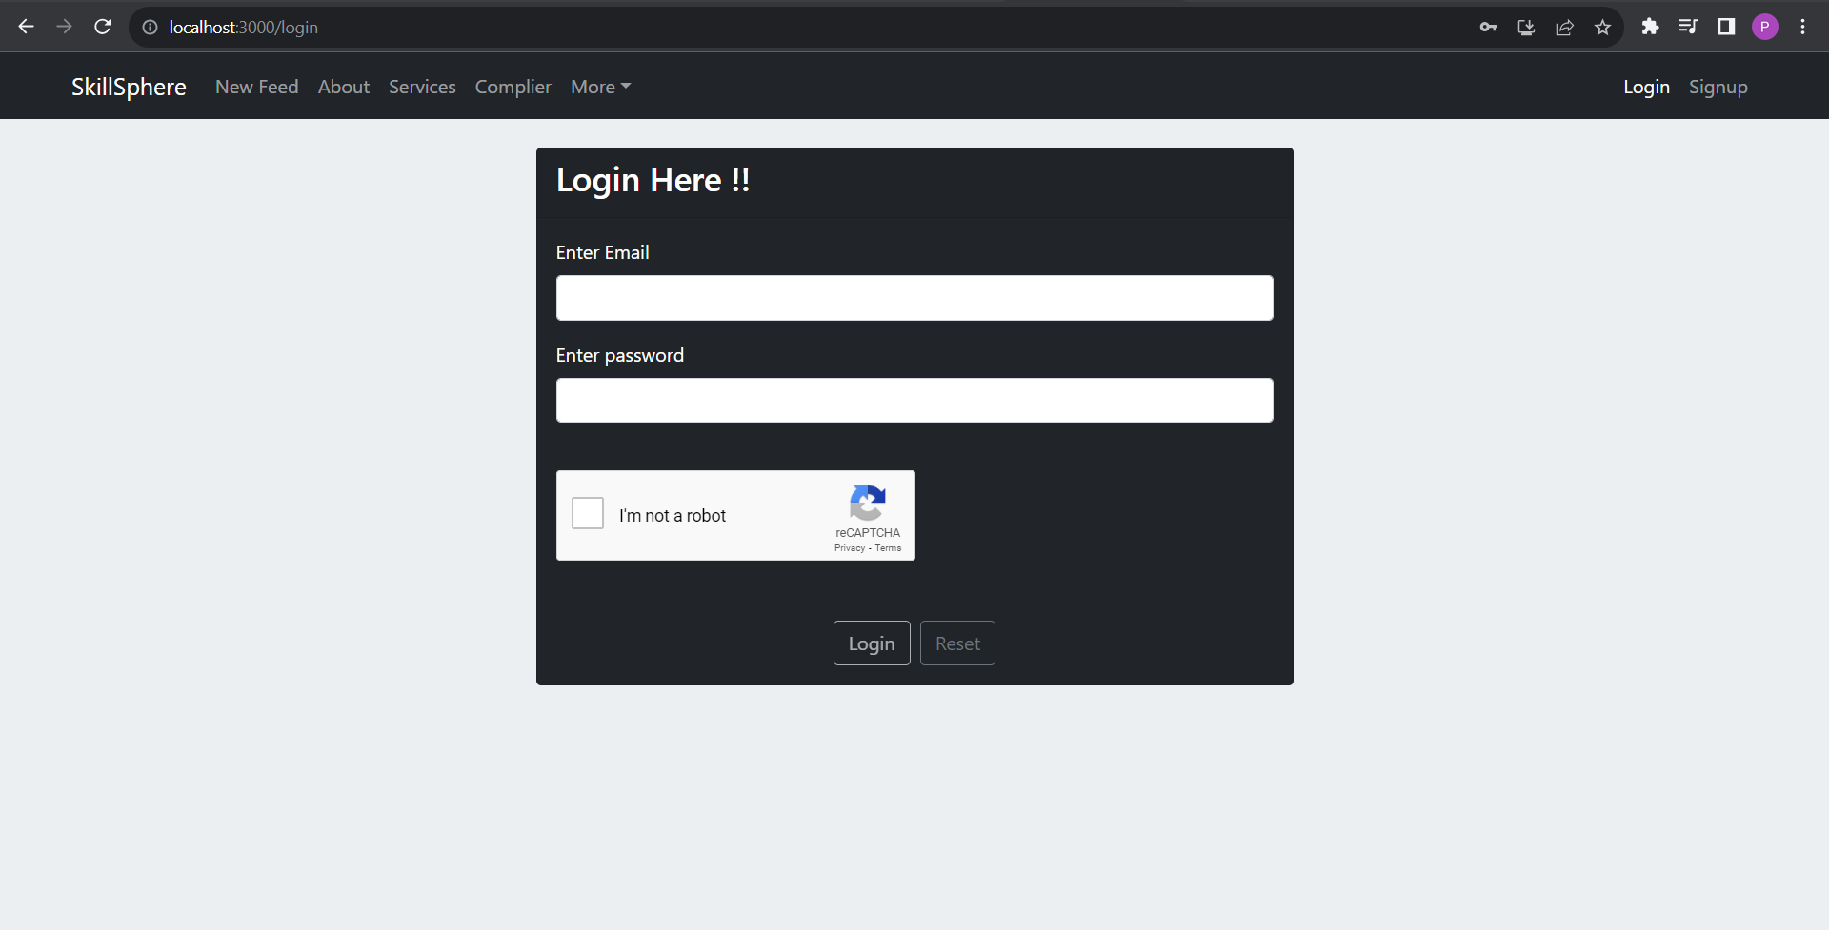
Login page

Slide 17
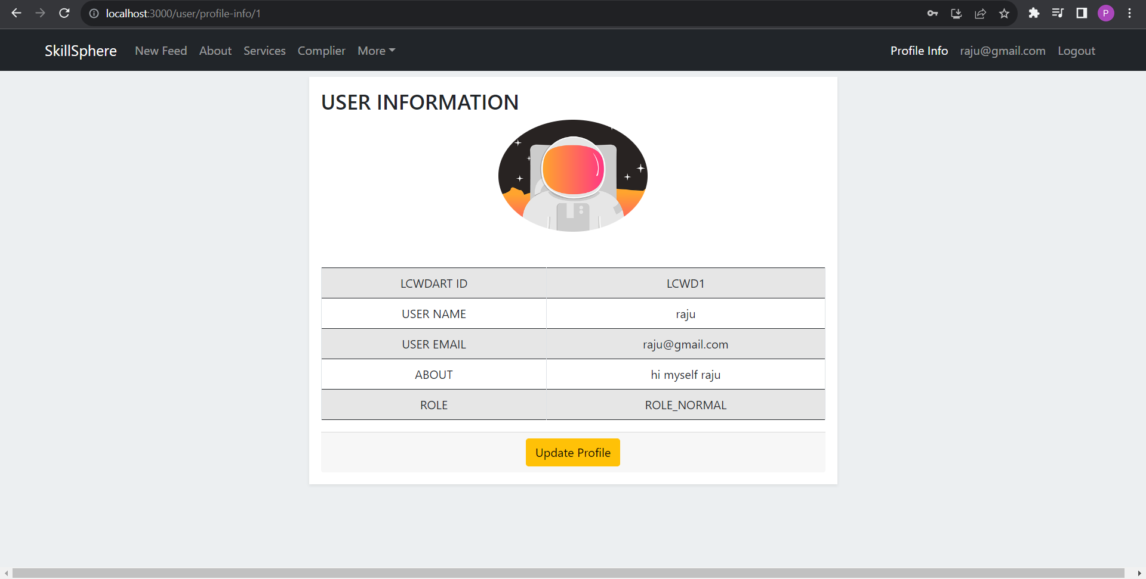
User information

Slide 18
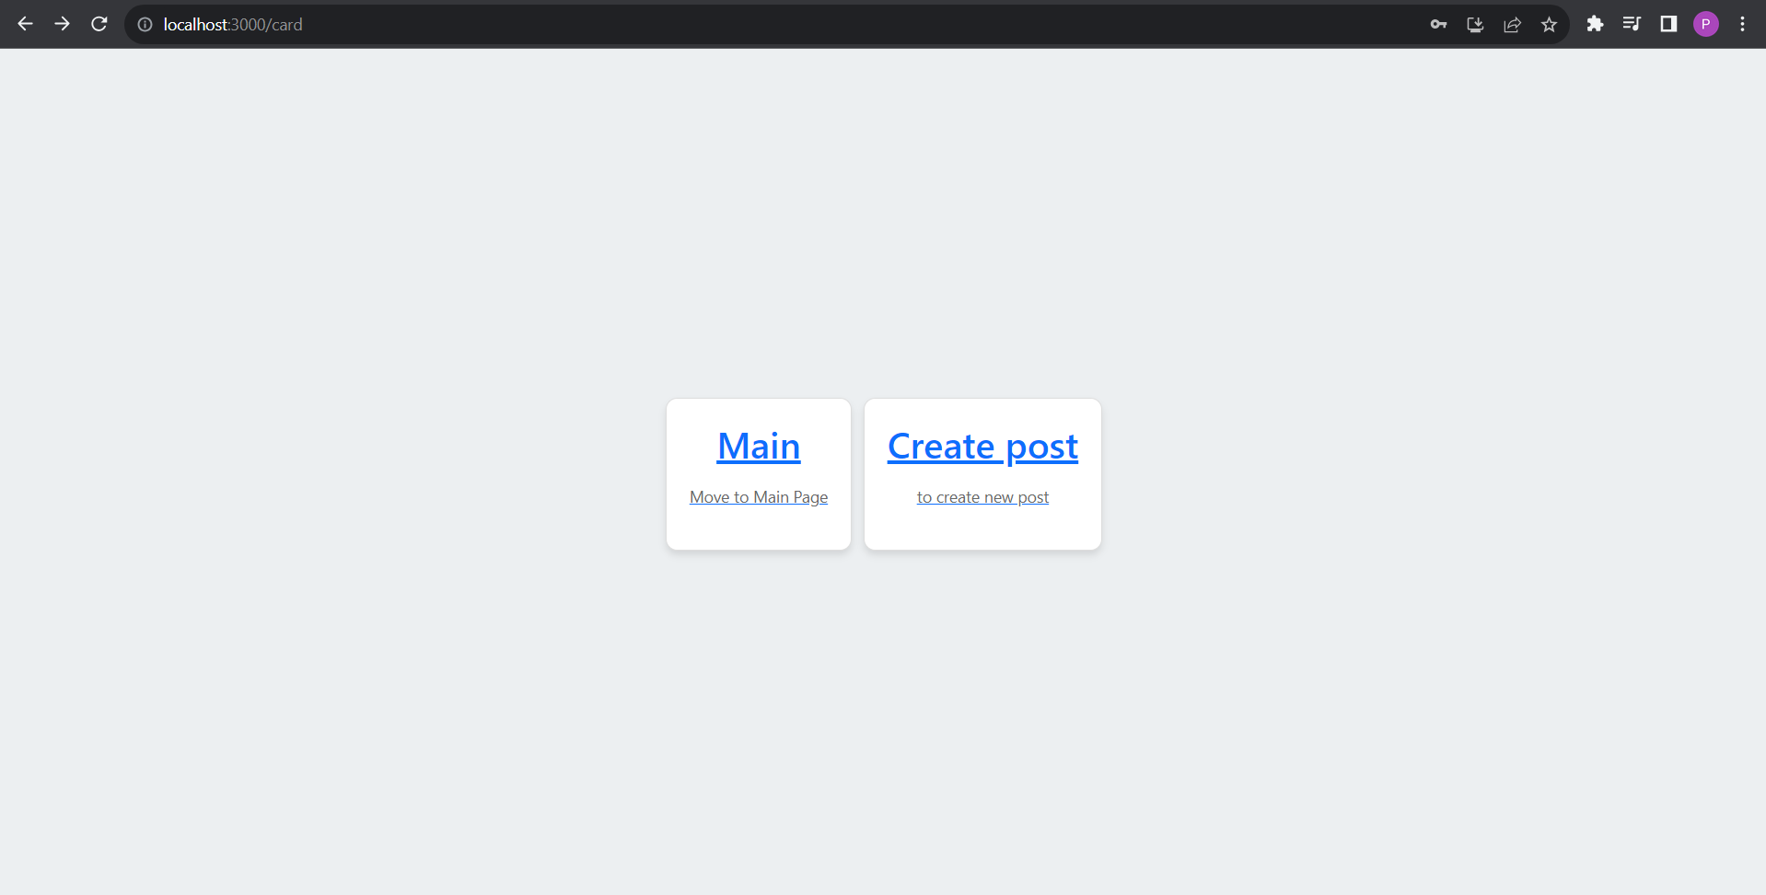
After Login

Slide 19
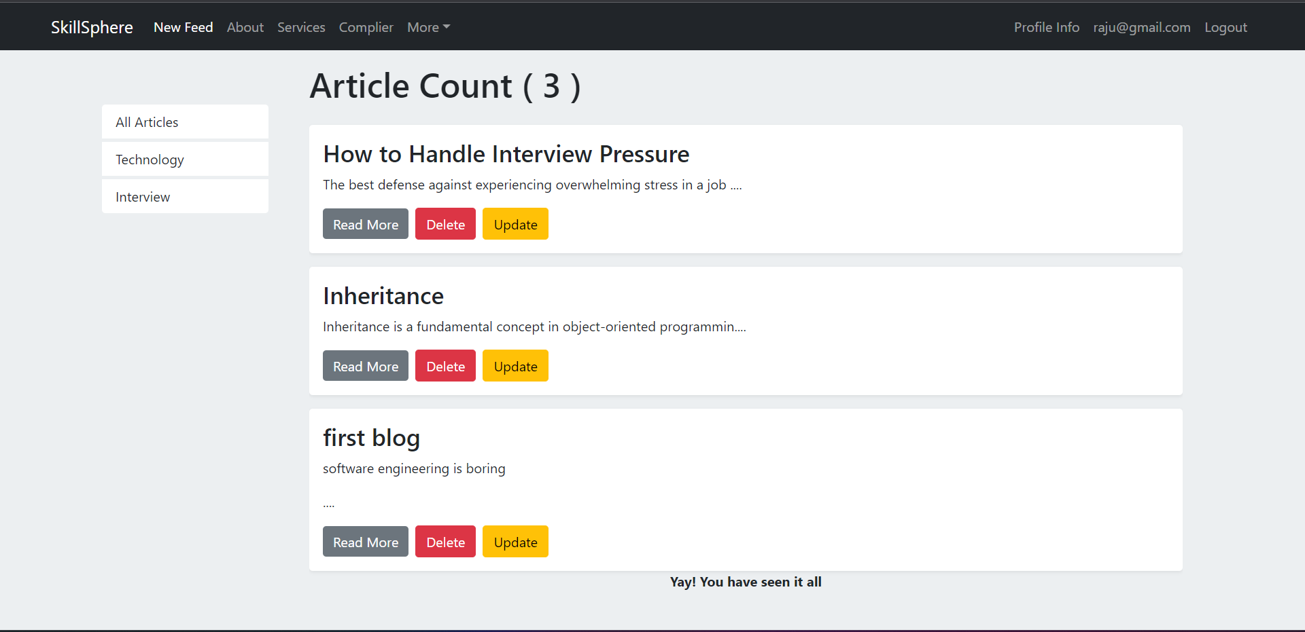
New Feed

Slide 20
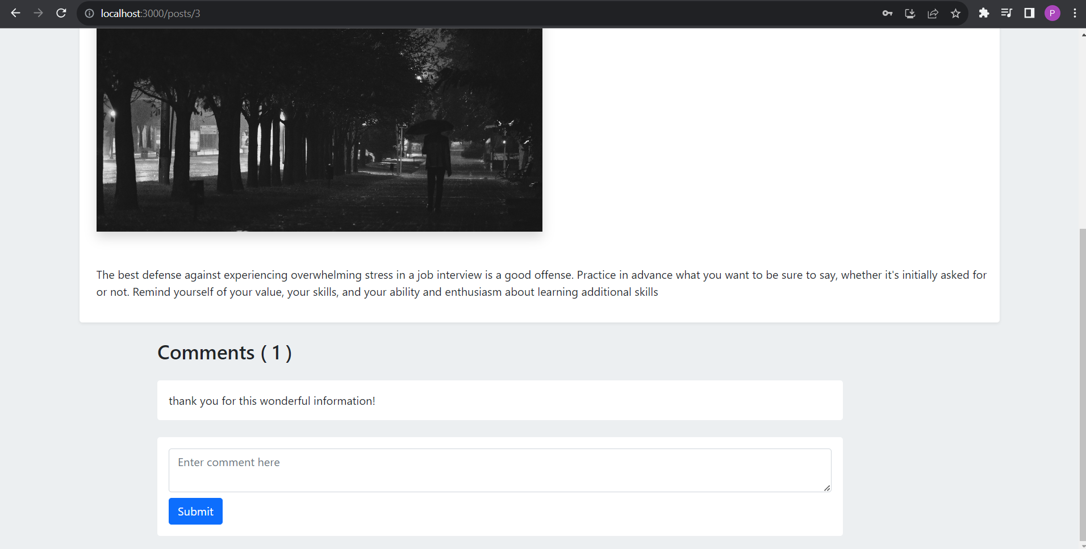
Comments

Slide 21
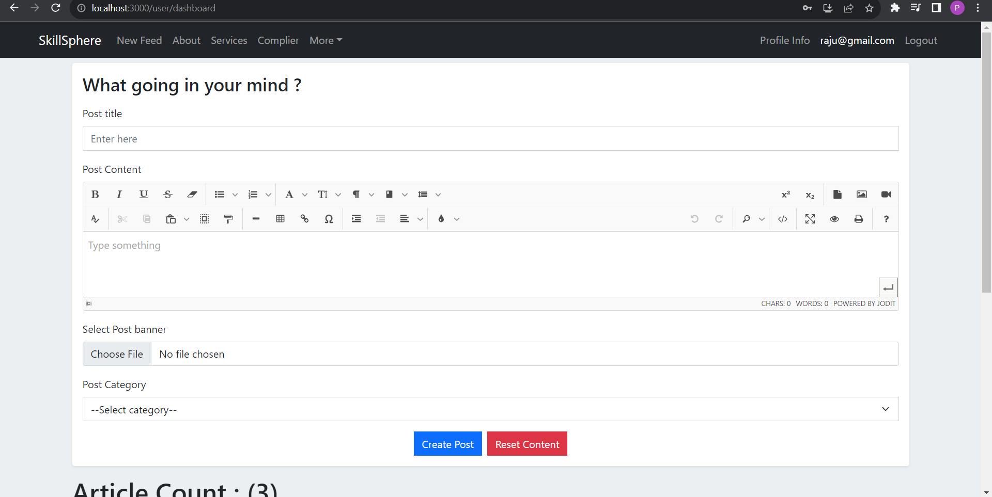
Write Blog

Slide 22
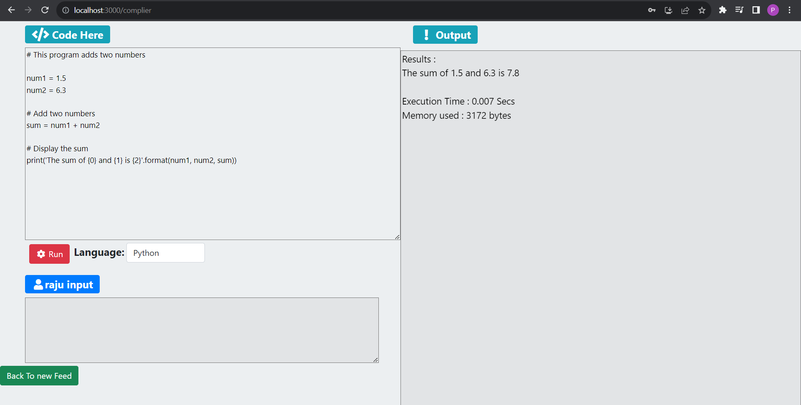
Compiler

Slide 23
S/W and H/W requirement
SERVER SIDE :-
Processor: Intel® Xeon® processor 3500 series
HDD: Minimum 500GB Disk Space
RAM: Minimum 4GB
OS: Windows 10
Database: MySQL
CLIENT SIDE (minimum requirement) :-
Processor: Intel Dual Core
HDD: Minimum 80GB Disk Space
RAM: Minimum 2GB
OS: Windows 7

Slide 24
Future Scope
Incorporate interactive elements like quizzes, coding challenges, and hands-on projects. This enhances engagement and ensures users can apply what they've learned in a practical context.
Implement a certification system to validate users' skills and accomplishments. Offer digital badges and certificates upon completing courses or achieving milestones, adding value to their profiles.
Create a networking feature where users can connect with professionals in their fields of interest. This opens up opportunities for mentorship, advice, and collaboration.
Expand our app's reach by offering content and interfaces in multiple languages, making it accessible to a global audience.

Slide 25
Conclusion
In a world driven by continuous learning and innovation, Skillsphere stands as your beacon of growth, knowledge sharing, and creativity.
Whether you're a budding programmer seeking hands-on experience, a writer eager to share your insights, or someone embarking on a journey of self-improvement, Skillsphere welcomes you with open arms.

Slide 26
Reference
React Tutorial (w3schools.com)
Spring Data JPA - Reference Documentation
React – A JavaScript library for building user interfaces (reactjs.org)
Bootstrap · the most popular HTML, CSS, and JS library in the world. (getbootstrap.com)
Geeksforgeeks

