Slide 1
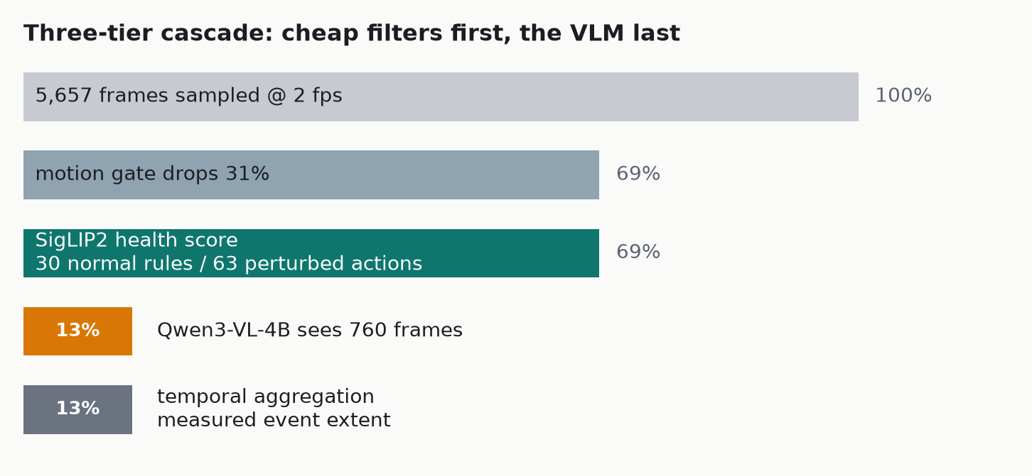
AHC VISUAL INTELLIGENCE HACKATHON
Real-time anomaly detection without training a single weight
MODEL CHOICES, AND WHY
SigLIP2-base as the filter
Scores every surviving frame against 30 written normal rules (+1) and 63 perturbed actions (-1). A sigmoid encoder gives calibrated per-pair scores, so the sum is meaningful; CLIP softmax only ranks.
Qwen3-VL-4B-Instruct as the judge
Chosen over the 3B once the T4 16 GB removed the VRAM constraint. Independently validated for this task: QVAD uses it, and Qwen3-VL took 2nd/3rd in AI City Challenge 2026 Track 3.
Zero training anywhere
Both models are frozen and zero-shot. The only fitted number in the system is one health threshold, calibrated on known-normal clips.
0 / 6
2.8x
87%
83%
28
false alarms on normal videos, every run
faster than realtime on one T4 GPU
of frames never reach the VLM
of wall time is spent inside the VLM
blind eval videos, all answered

Slide 2
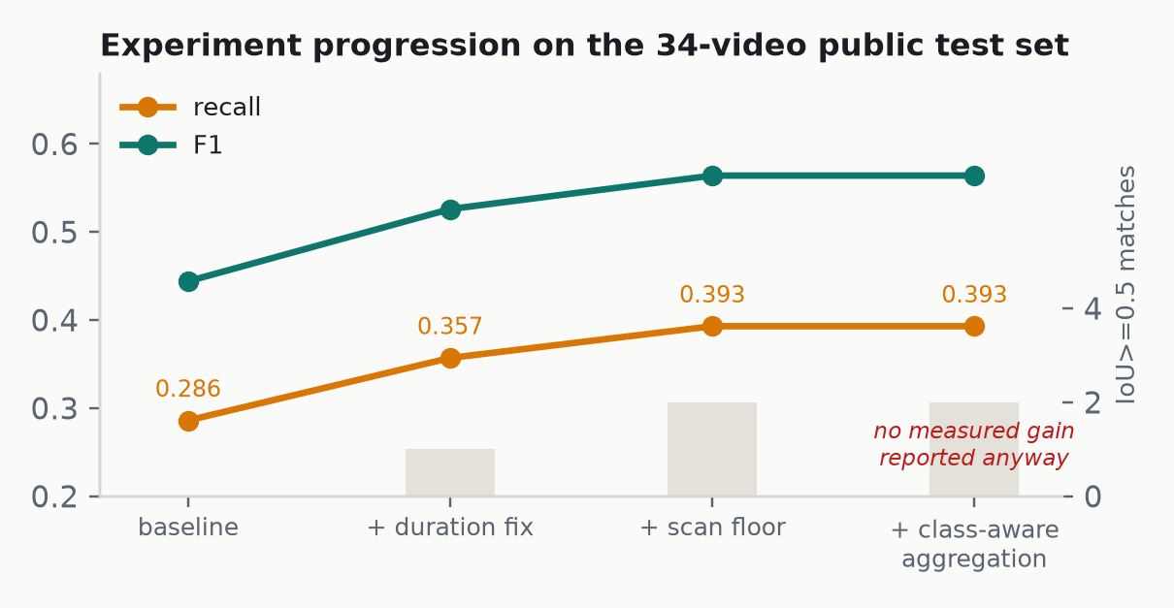
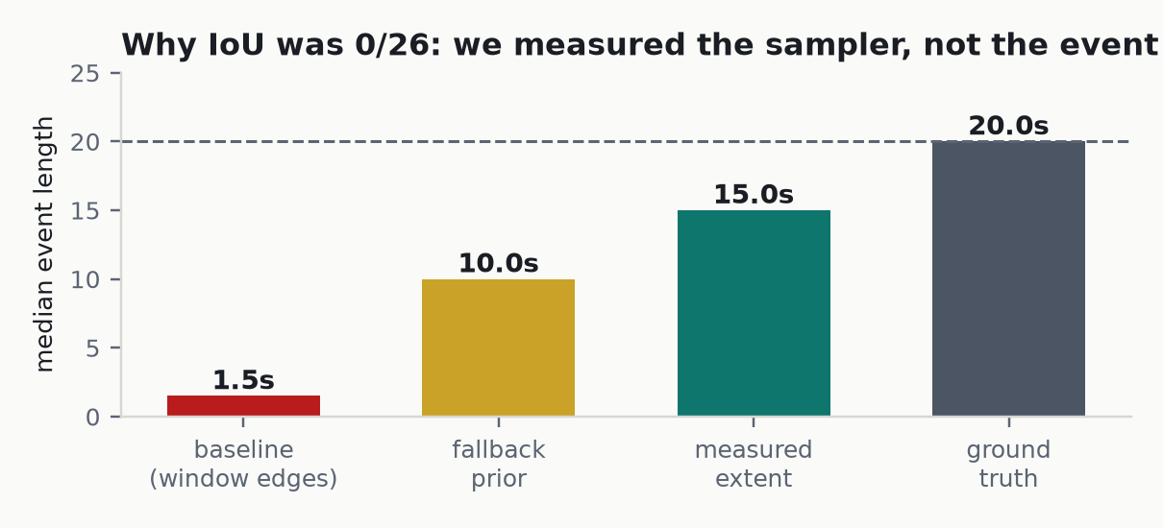
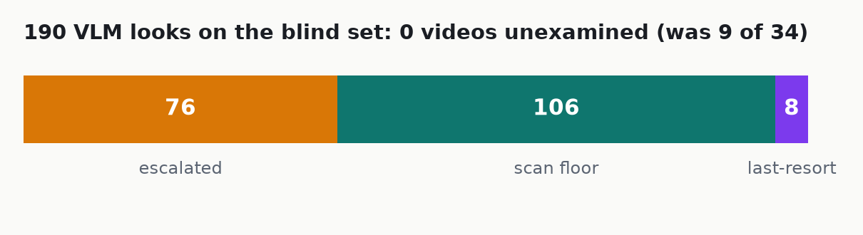
WHAT WE LEARNED
Four experiments, three that worked, one that did not
TWO FINDINGS THAT CHANGED THE DESIGN
We were measuring the sampler, not the event.
Predicted events had a median length of 1.5 s; real ones last 20 s. We were reporting the width of a sampling window as the duration of an incident, so IoU >= 0.5 was unreachable and 75 of the 100 marks were out of reach. Walking the health curve outward to find where the scene returns to normal moved matches from 0 to 2.
Coverage was a silent killer.
The threshold was calibrated on 5-30 s clips, then applied to 240-629 s videos from other cameras. Nine of 34 videos got zero VLM looks; seven were genuinely anomalous, 41% of all misses. A scan floor plus a guaranteed last-resort look took that to zero.
THE REAL BOTTLENECK, AND WHAT WE WOULD DO NEXT
Six of the eight high-value videos returned normal on every window - one on all 35 looks, 26 of which stage 1 had flagged as its most abnormal. The cause is measurable: the median clip we hand the VLM is 2 s wide, judging classes defined by persistence over 20 s. Next: widen stage-2 windows to ~20 s (fewer, cheaper calls), then derive confidence from self-consistency, because every non-normal verdict came back at exactly 0.95 or 0.98 - our thresholds have never once been exercised.

