Slide 1
AHC VISUAL INTELLIGENCE HACKATHON
A three-tier cascade for real-time video anomaly detection
Hosted models help build it, never run inside it. False alarms cost as much as misses. Everything below is zero-shot, nothing fine-tuned, one Kaggle T4.
0 · MOTION GATE
1 · SigLIP2
2 · Qwen3-VL-4B
3 · AGGREGATE
frame-diff @ 2fps
keepalive every 4s
375M, frozen
health = Σ w·sim
frozen, zero-shot
ASK-Hint prompts
per-class duration
hysteresis, no model
~50% dropped
~12% escalate
~5.4GB VRAM
→ timed events
stages 0–1 run per frame · stage 2 runs per escalated window, never per frame · stage 3 runs once per clip
PRECISION (L1)
RECALL (L1)
CLASS ACC.
THROUGHPUT
1.000
0.286
0.500
~7×
0 false alarms / 6 normal
8 / 28 caught
on true positives
faster than real time
github.com/PrithvirajG/ahc-video-anomaly-detection

Slide 2
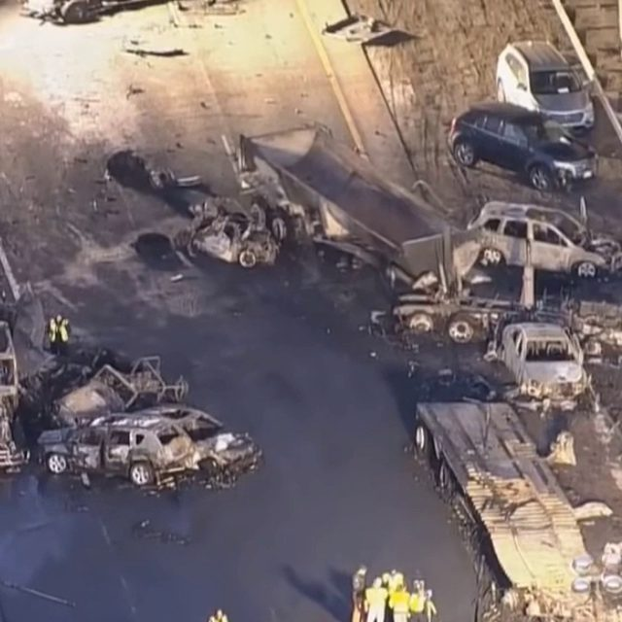
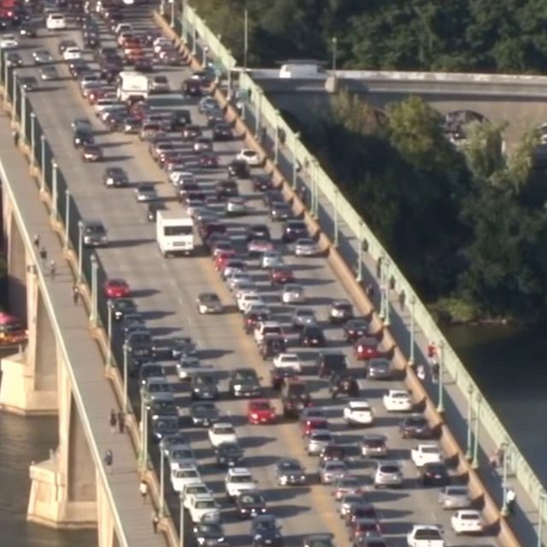
WHAT WE LEARNED
The recall gap has a name: no memory between frames
PATTERN
Every class we catch has a strong single-frame look — flames, haze, standing water, wreckage. Every class we miss is defined by duration, not appearance — stalled vehicles, congestion, loitering.
CHEAP FIX FOUND BY INSPECTION
A normal-rule phrase ("queue at a red light") likely sits too close to congested traffic in embedding space. Rewording it is a minutes-long test, no architecture change.
WITH MORE TIME
A rolling frame buffer so duration-suspect candidates get sampled across 20–30s instead of 2 — letting the VLM compare "same as before" directly, reusing the existing model call.
PRED traffic_accident (0.98)
PRED normal (missed)
TRUTH traffic_accident
TRUTH traffic_congestion
github.com/PrithvirajG/ahc-video-anomaly-detection

