Slide 1
FLOW MODEL WORKING

Slide 2
MODEL SETUP

Slide 3
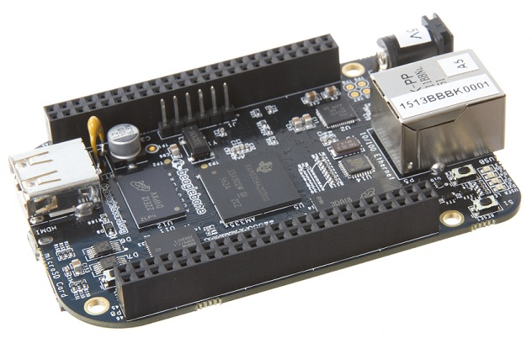
WHY BBB ?
BASIC FEATURES
AM335x 1GHz ARM® Cortex-A8
512MB DDR3 RAM
4GB 8-bit eMMC on-board flash storage
3D graphics accelerator
NEON floating-point accelerator
2x PRU 32-bit microcontrollers
Open Source software – Debian
Pocket sized – small sized

Slide 4
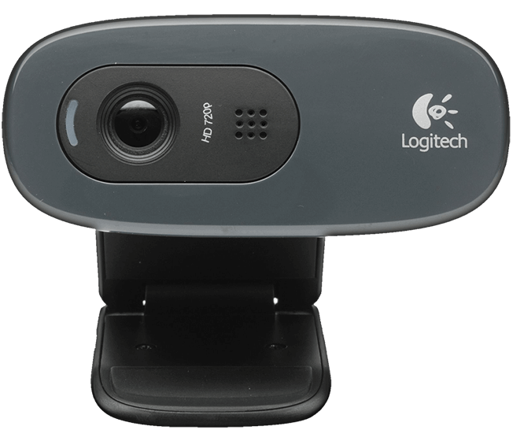
FOR FACE DETECTION AND RECO – WHY LOGITECH C270
Basic specs:
HD video calling (1280 x 720 pixels) with recommended system
Video capture: Up to 1280 x 720 pixels
Photos: Up to 3.0 megapixels (software enhanced)
Built-in mic with noise reduction
Hi-Speed USB 2.0 certified (recommended)
Basic requirements
1 GHz
512 MB RAM or more
200 MB hard drive space
Added Advantage
Two operation modes: YUYV and MJPEG.
AT user end
Luminosity problem minimized
Easy driver availability on open standards
Compression available on hardware

Slide 5
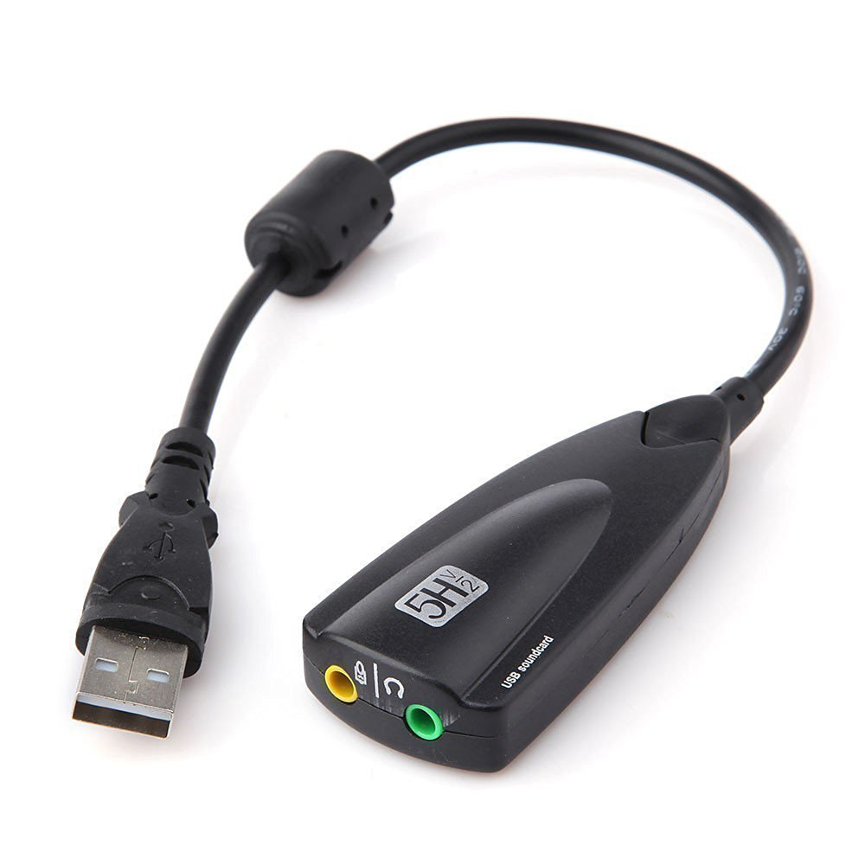
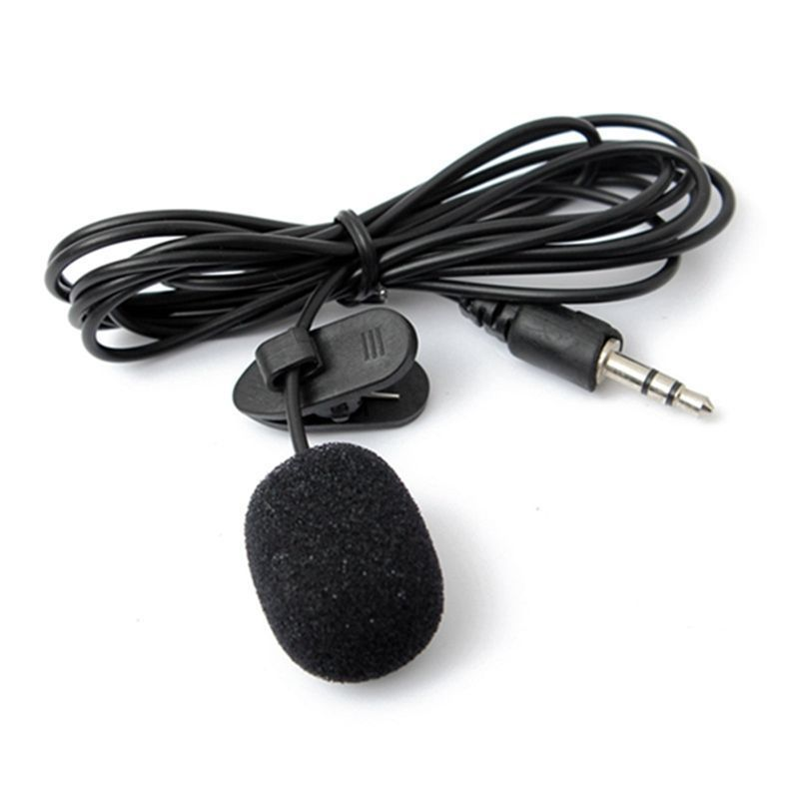
AUDIO TO USB ADAPTER & MIC
ADAPTER SPECIFICATIONS
USB 2.0 Full-Speed (12Mbps), compatible with USB 1.0/ 1.1,Equalizer: 12 channels
Connectors: USB Type-A, Stereo output jack, Mono microphone input jack
Include Xear 3D, the Virtual 7.1 channel
Driverless No driver required for Linux
Functional keys : Microphone-Mute, Speaker-Mute, Volume-Up, Volume-Down
MIC SPECIFICATIONS
A 3.5mm Mic with secure Active Clip
Windscreen Protector to help reduce wind noise
Defense against distorting 'P' and 'B' consonants
Protects your microphone from surplus spit caused by over eager performers
360°Flexible gooseneck holder, convenient for use
Polar pattern : Omni-directional

Slide 6
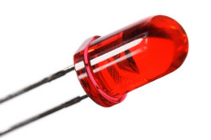
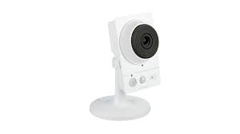


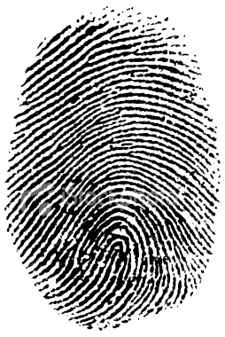
INNOVATION
Standard Definition
Small Sized
Fixed focus

Slide 7
FACE DETECTION
ALGO USED
NN MODEL USED
DEMO

Slide 8
FACE RECOGNITION
TYPES
EIGEN FACES
FISHER FACES
LOCAL BINARY PATTERN HISTOGRAMS
CAMPARISON ADV/DISADV
Why we are going for Local Binary pattern Hist

Slide 9
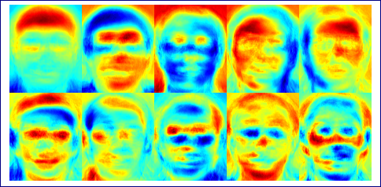
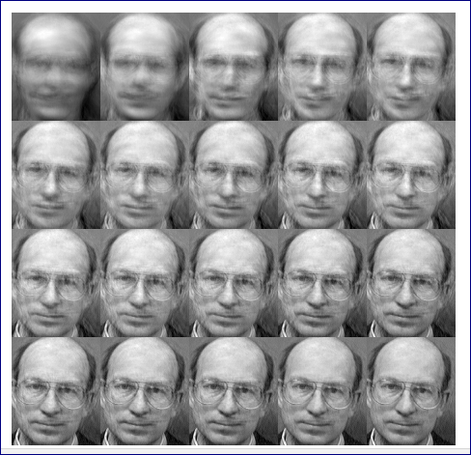
EIGEN FACES

Slide 10
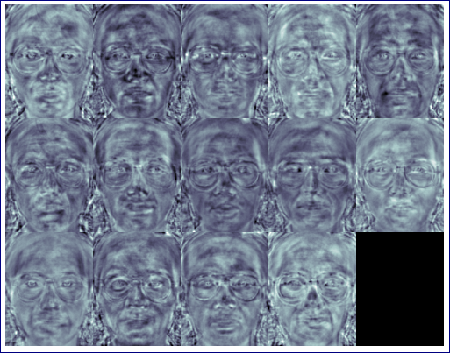
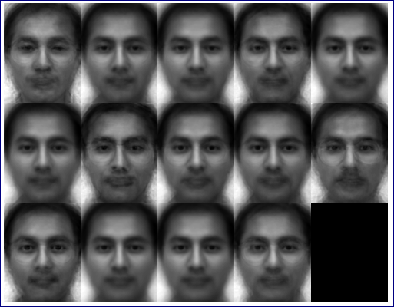
FISHER FACES

Slide 11
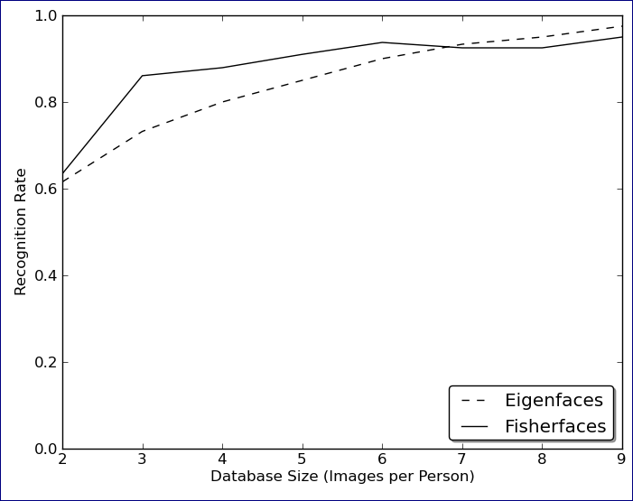
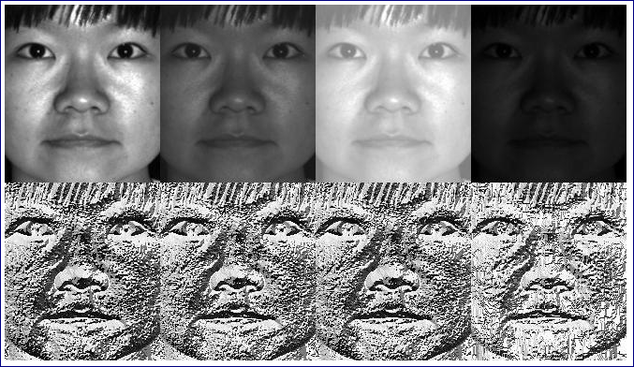
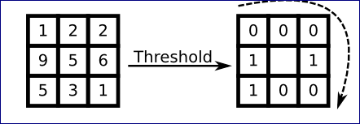

Slide 12
OTHER FACE RECO

Slide 13
VOICE RECO

