Slide 1
Interfacing camera

Slide 2

Ensure that there is sufficient power available to provide enough current to drive both BBB and camera; if not then it will not appear as a brownout problem, it will just result in an IO error between the camera and the BBB. (Don’t debug in software) Verifying the version
Check whether the camera is plugged in or not

Slide 3
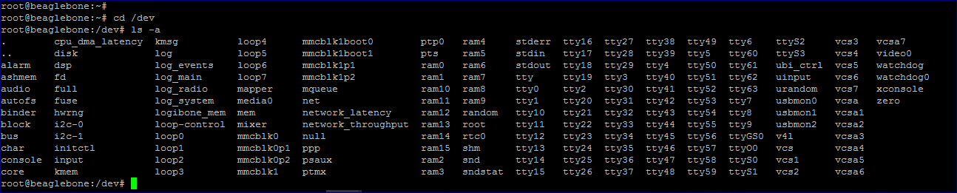
/dev/video0 : refers to the camera
To ensure if the camera is working properly, use V4L (Video for Linux), a video capture application program interface for Linux supporting USB webcams Video4Linux is closely integrated with the kernel and is very stable

Slide 4
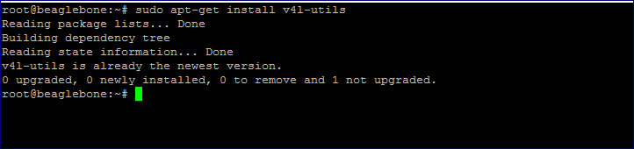
Package installation of v4l-utils – used for configuration of the camera

Slide 5

Detection of the hardware image capturing device

Slide 6
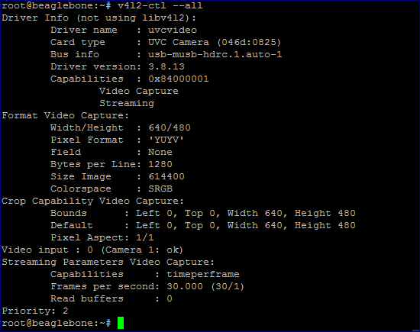
Showing the current configuration on the camera

Slide 7
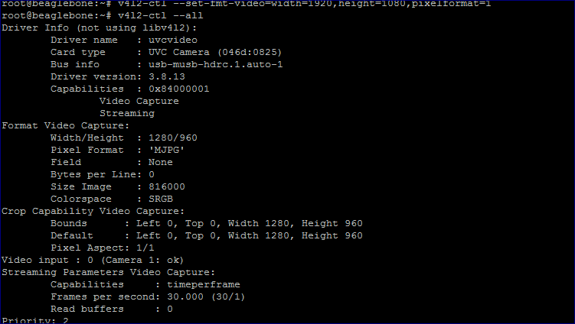
Changing the Width and Height

Slide 8
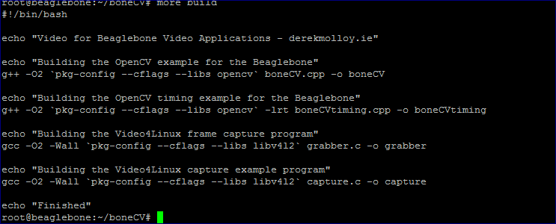
Script for compilation of the OpenCV on BBB

Slide 9
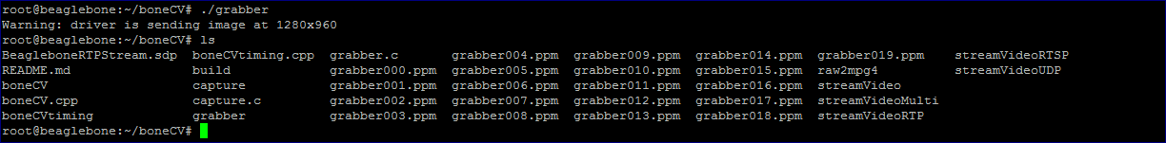
Capturing images and storing them in a file

