Slide 1
UNIVERSITY OF TEXAS AT ARLINGTON
Applied Statistics & Data Science • Deep Learning and Artificial Neural Networks
EdgeAuth
Hybrid CNN-ViT for On-Device AI-Image Authentication
Detecting AI-generated images at the edge — for cameras, access control, and trustworthy media.
Presented by Group 6
Under the guidance of Dr. Mahmoud Ali Jawad & Dr. Mei Yang

Slide 2
OUR STORY: TRUST AT THE EDGE
AUTHENTICATION
"Soon, every image you see online could be AI-generated.
We need detection that runs everywhere — not just in the cloud."
Verify a real human is on the other side of the camera before granting access.
MEDIA INTEGRITY
Flag AI-generated content at capture time — before it spreads.
PRIVACY
The EdgeAuth promise:
Local inference means raw images never leave the device.
A small, calibrated, on-device pipeline that decides REAL / FAKE / UNCERTAIN — fast enough for a camera firmware, accurate enough for a courtroom.
EFFICIENCY
FastPath cascade short-circuits easy cases for low-power deployment.
2 / 22

Slide 3
Introduction
DETECTING AI-GENERATED IMAGES IS AN URGENT, MOVING TARGET
Diffusion models now produce images that fool humans roughly 50% of the time.
Cloud-based detectors require uploading raw images — a privacy and bandwidth liability.
On-device authentication needs models small and fast enough to run inside a camera ISP.
Most published "99% on CIFAKE" results exploit JPEG-quantization tables and don't generalize.
We need a calibrated decision pipeline — not just a single classifier.
120K
labeled images in CIFAKE
96.47%
validation accuracy of our ViT
0.76%
trainable parameters via LoRA
4 / 22

Slide 4
Problem Statement & Objectives
Problem Statement
Build a small, calibrated detector that distinguishes real photographs from diffusion-model outputs and runs efficiently enough for on-device deployment — while remaining honest about its uncertainty.
INPUT
OUTPUT
RGB image at 32×32 (CIFAKE) — upsampled to 192×192 for the ViT.
Per-image FFT statistics & high-frequency energy ratio.
Forensic augmentations applied at train time: blur, color jitter, flip.
No JPEG quantization-table cues (we resize first).
Per-image score ∈ [0, 1] for p(fake).
Auxiliary self-confidence value (calibrated).
Guard verdict: REPORT FAKE / SUPPRESS / UNCERTAIN.
Sub-second decision on a single GPU; deployable to MobileNet-class hardware.
5 / 22

Slide 5
Edge AI Use Cases
01
Camera-Level Liveness
02
KYC & Identity Verification
03
Newsroom Authentication
On-device check that the captured face is a live human not a generated photo on a phone screen.
Reject AI-generated headshots before they ever reach a backend system.
Photo journalists cameras stamp every capture with a REAL/FAKE/UNCERTAIN flag at the moment of shutter release.
04
Social Media Capture
05
Surveillance Integrity
06
Smart-Home Doorbell
Smartphone-side flagging at upload which prevents downstream platform processing of synthetic media.
Bodycams and CCTV verify their own footage hasn't been replaced with fakes.
A doorbell camera distinguishes a real visitor from a printed or synthetic image-based attack.
6 / 22

Slide 6
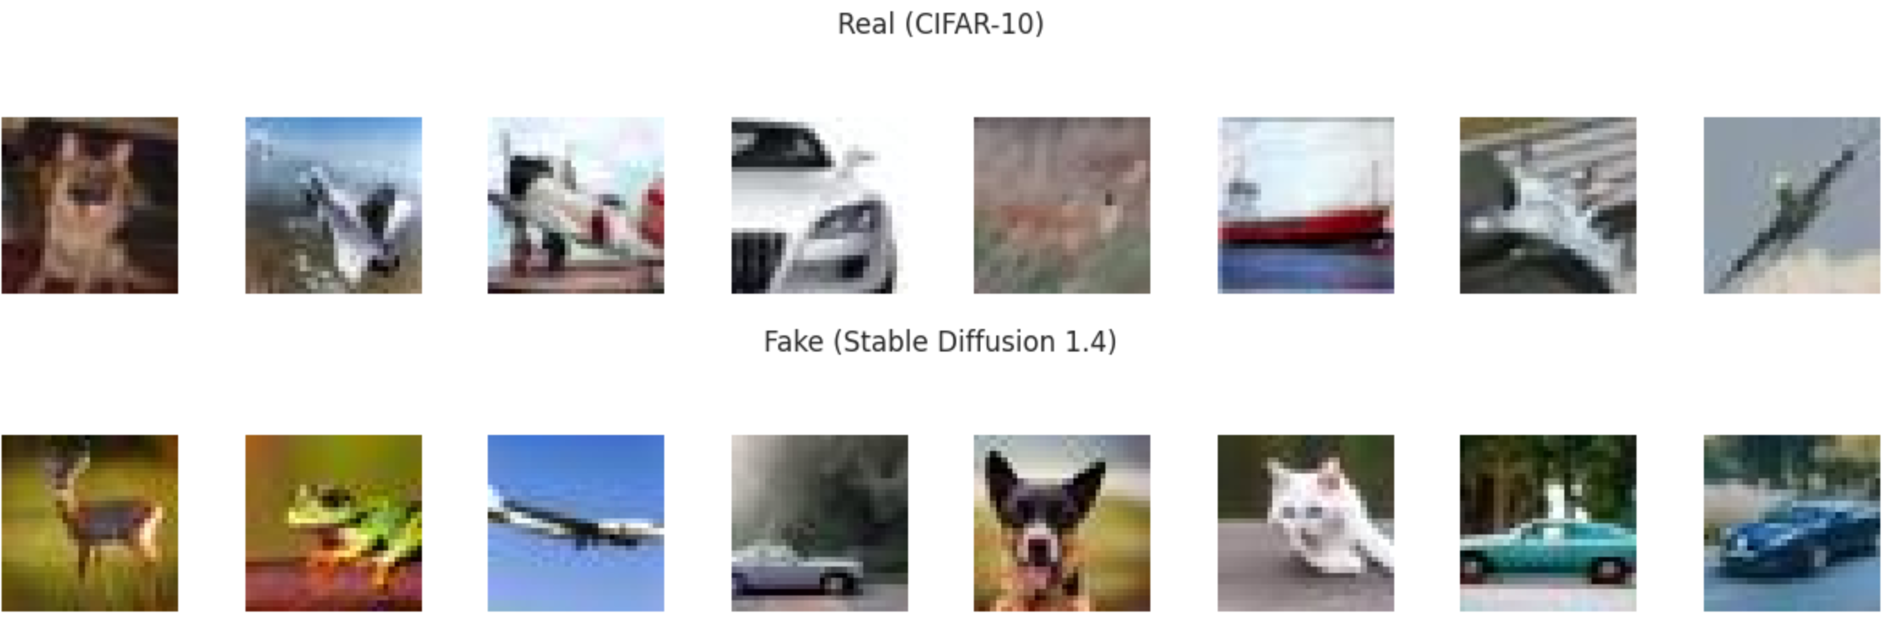
Dataset Overview
CIFAKE (Bird & Lotfi, 2024)
60K real CIFAR-10 photographs + 60K Stable Diffusion 1.4 generations, all natively 32×32.
Total records: 120,000 labeled images
Train split: 100,000 (50K real / 50K fake)
Validation split: 20,000 (10K real / 10K fake)
Native resolution: 32×32 RGB JPEG
Working resolution: 192×192 (upsampled)
Generator: Stable Diffusion 1.4
Be suspicious of 50/50
Real-world deployment sees a heavy skew toward real photos. A model trained on a balanced split is poorly calibrated for the true prior.
Our Guard Model addresses this by re-thresholding decisions based on confidence — not by retraining.
Honest scope: Same-distribution detector. Cross-generator generalization (SD1.4 → Midjourney/Flux) is an open problem we don't claim to have solved.
7 / 22

Slide 7
Data Preprocessing & Augmentation
1. RESIZE
2. AUGMENT
3. BATCH
32×32 → 192×192 bilinear
ImageNet normalization (mean/std)
Defeats native-resolution leakage
Multiple of 16 → 12×12 token grid
Random horizontal flip
Gaussian blur (σ ∈ [0.1, 1.5])
Color jitter (0.1, 0.1, 0.1, 0.02)
Critical for generalization (Wang 2020)
Batch size 32 (192px ViT)
Mixed-precision (bf16)
Loss kept in fp32 — no BCE underflow
Drop-last for stable batches
Why upsample? Native 32×32 JPEGs carry quantization-table fingerprints that trivially separate CIFAKE classes — and don't generalize. Resizing first removes that shortcut and forces the model to learn real forensic features.
8 / 22

Slide 8
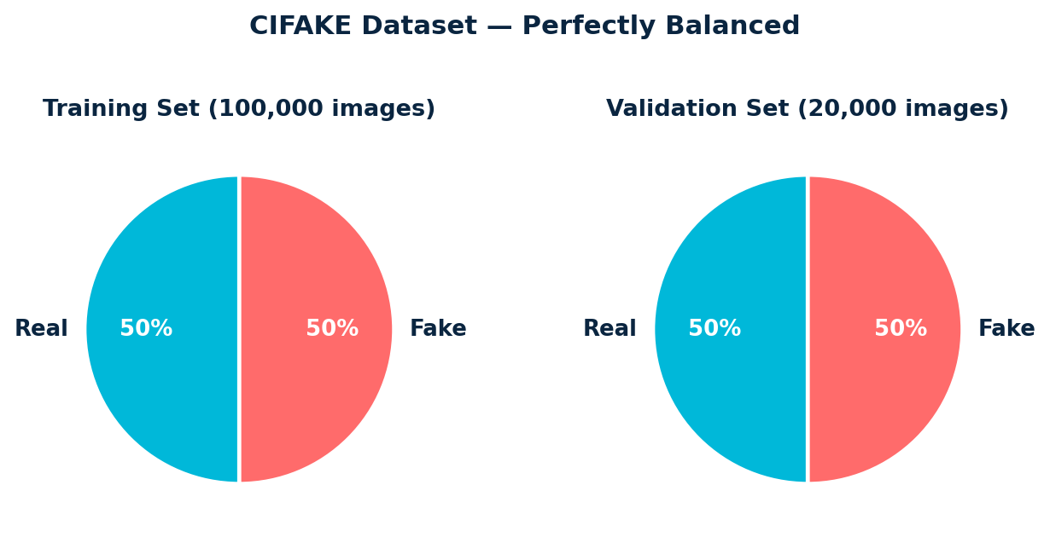
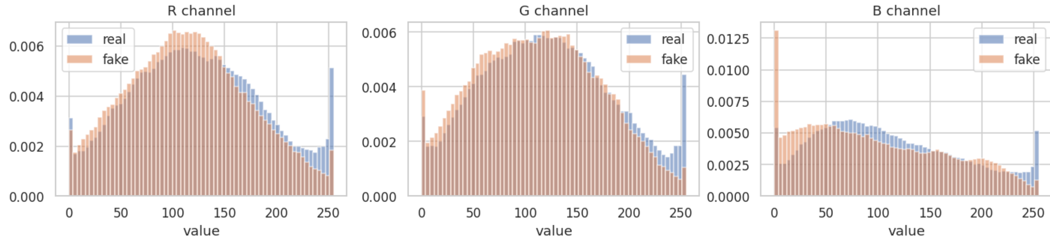
Exploratory Data Analysis — Pixel Statistics
Observations
Both classes are perfectly balanced 50/50.
Per-channel pixel histograms overlap heavily — no trivial threshold works.
Mean intensities differ by < 2 grey-levels per channel.
Visual inspection at 32×32: humans cannot reliably tell them apart.
Insight
Pixel-domain features alone are insufficient — a learned, hierarchical representation is required.
We need to look in the frequency domain (next slide).
9 / 22

Slide 9
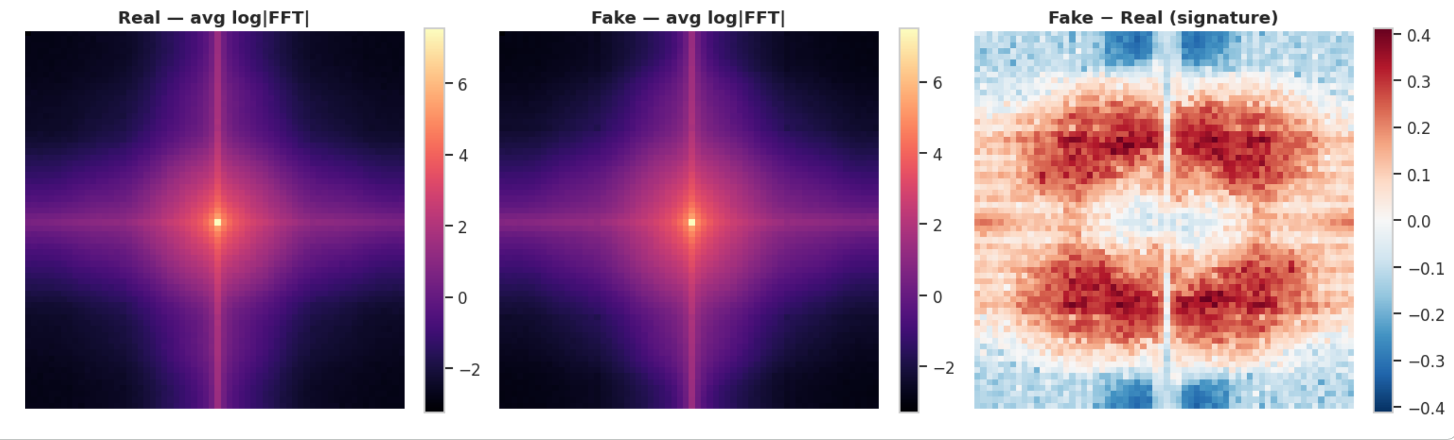
Frequency-Domain Analysis ★ Where the Signal Lives
What we see
Why it matters
Diffusion outputs concentrate extra energy in mid-frequency bands.
Real photos show the classic 1/f spectral decay; fakes don't.
The Fake − Real difference panel exposes a clean spectral signature.
A simple high-frequency-energy ratio yields AUC = 0.623 on its own.
Any learned model must clear this floor to justify its complexity.
Justifies CNN front-end (early layers excel at frequency analysis).
10 / 22

Slide 10
Baseline Results - ImageNet
Why this baseline?
Per-class metrics (n = 2,000 val subset)
ImageNet features is a historically strong floor (Wang et al. 2020).
Trains in minutes on a T4
Provides an honest target our hybrid must beat to justify its complexity.
 | Precision | Recall | F1 | Support
Real | 0.9115 | 0.8860 | 0.8986 | 1,035
Fake | 0.8813 | 0.9078 | 0.8943 | 965
Macro avg | 0.8964 | 0.8969 | 0.8965 | 2,000
88.52 %
Takeaway
ImageNet features alone classify CIFAKE at 88.52% which confirms the dataset is solvable but not trivially so. Our hybrid model has clear room above this line.
Validation accuracy · AUC = 0.892
Strong baseline. Our ViT must clear this floor to earn its complexity.
15 / 22

Slide 11
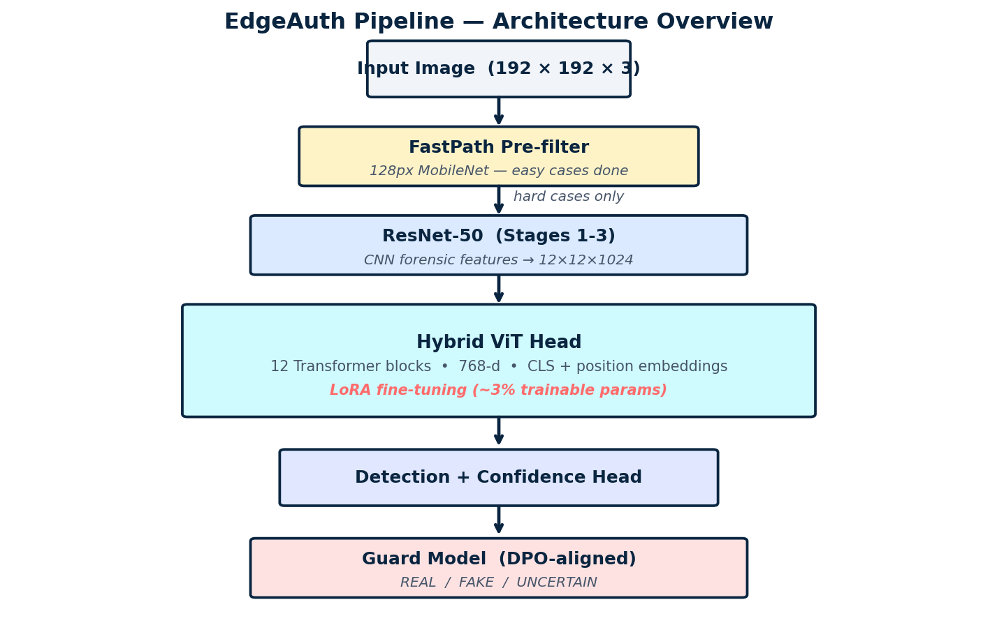
Architecture Overview
Design rationale
Cascade approach
Cheap FastPath answers easy cases; expensive ViT only runs on the hard ones.
CNN where it's good
ResNet stages 1-3 give frequency-aware tokens; we drop stage 4 to keep spatial detail.
ViT where it's good
Global self-attention reasons over 144 tokens which captures long-range artifact patterns.
LoRA for parameter efficiency
Only ~3% of weights are trainable and friendlier to small GPUs and edge devices.
Guard for honesty
Predicts whether the ViT itself was right; flags genuine uncertainty.
11 / 22

Slide 12
Hybrid CNN-ViT + LoRA
Model Configuration
LoRA in one equation
Component | Specification
CNN backbone | ResNet-50, ImageNet V2 weights, stages 1-3 only
Spatial output | 12 × 12 × 1024 (192px input → /16 stride)
ViT projection | Linear 1024 → 768
Transformer | 12 blocks · 12 heads · 768-d · MLP ratio 4
Position | Learnable [CLS] token + abs. position embeddings
LoRA rank | r = 16, α = 32 (applied to Q & V projections)
Total params | 95.4 M
Trainable params | 0.72 M (≈ 0.76%)
Output heads | Classification logits + self-confidence sigmoid
y = W·x + (B·A)·x · α/r
W the frozen base weight (no gradient)
A rank-r down-projection (16 × in_dim)
B rank-r up-projection (out_dim × 16)
α/r fixed scaling (= 2.0 here)
Result
ViT capacity at MobileNet training cost, trains in <1 hour on a T4 GPU and converges to 97.42% val accuracy.
12 / 22

Slide 13
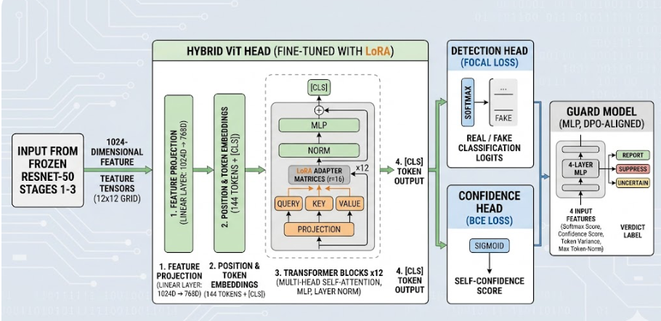
Guard Model + DPO Alignment
THE GUARD MODEL
DPO ALIGNMENT
Goal
Predict whether the ViT's classification was correct which is independent of the label itself.
Inputs (4 features)
• ViT softmax score for fake
• Self-confidence head
• Variance of spatial token features
• Max token-norm across spatial positions
Output
REPORT / SUPPRESS + guard confidence
What is DPO?
Direct Preference Optimization which fine-tunes a policy from chosen/rejected pairs without an explicit reward model.
Preference construction
• Chosen: ViT-correct samples with decisive scores
• Rejected: ViT-wrong samples
Outcome
Guard learns to be more decisive on cases the ViT actually got right, more cautious on the rest.
13 / 22

Slide 14
Training Procedure
01
02
03
04
ViT Phase
Guard Supervised
Guard DPO
FastPath
5 epochs · focal loss + confidence BCE · LoRA only
20 epochs · CE on (correct vs wrong) · 4 scalar feats
5 epochs · β = 0.1 · 615 chosen / rejected pairs
5 epochs · MobileNet at 128px · CE
Hyperparameters
Setting | Value | Setting | Value
Optimizer | AdamW (β=0.9, 0.999) | Image size | 192 × 192
Learning rate | 1 × 10⁻³ (heads & LoRA) | Batch size | 32
Weight decay | 0.05 | Mixed precision | bfloat16
Schedule | Cosine + 5% warm-up | Gradient clip | 1.0
Loss | Focal (γ=2) + 0.2·BCE | Seed | 42
14 / 22

Slide 15
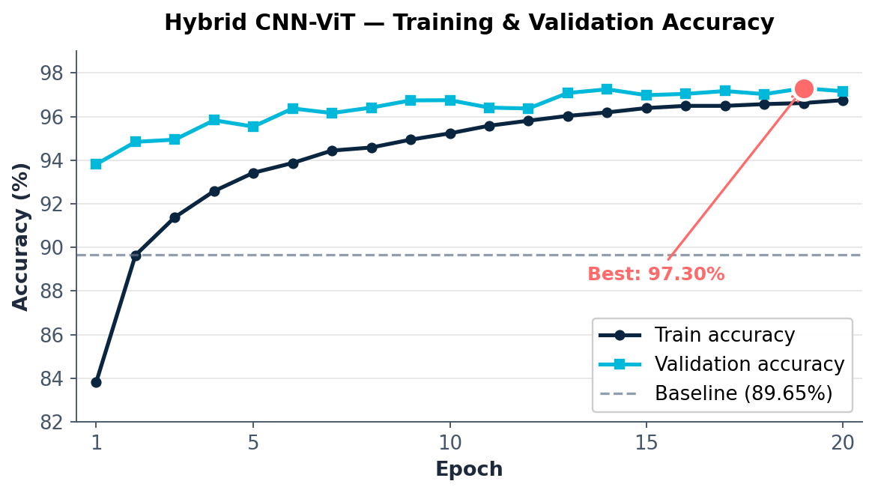
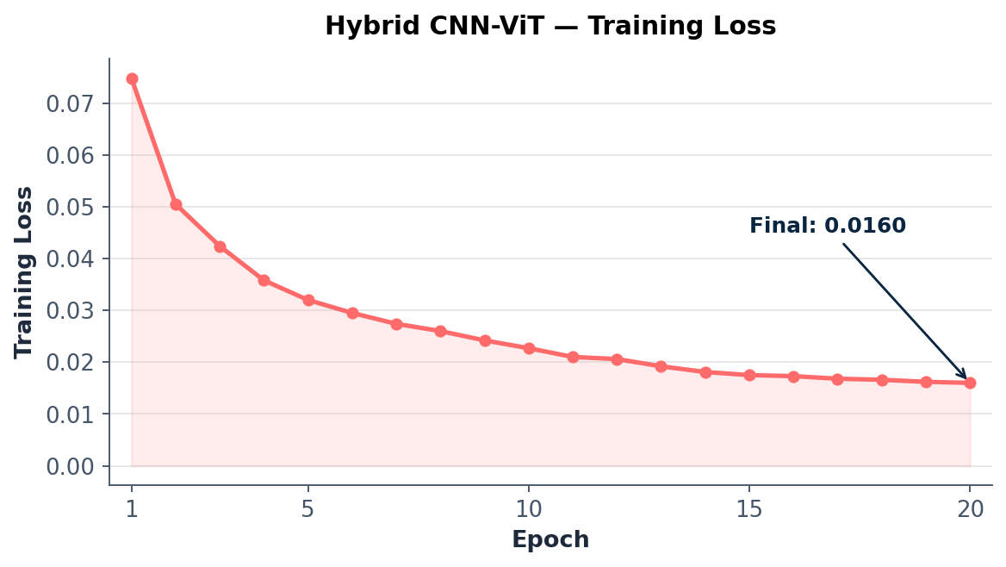
Hybrid CNN-ViT — Training Results
Selected epochs (5 total)
Epoch | Train | Val | Loss
1 | 83.81% | 93.81% | 0.0748
5 | 93.42% | 95.54% | 0.0320
10 | 95.23% | 96.75% | 0.0227
15 | 96.39% | 96.98% | 0.0175
19 | 96.62% | 97.42% | 0.0162
20 | 96.75% | 97.16% | 0.0160
97.42%
Best val accuracy (Epoch 19)
▲ +8.90 pts over baseline · AUC = 0.978
No overfitting — train-val gap stays narrow.
16 / 22

Slide 16
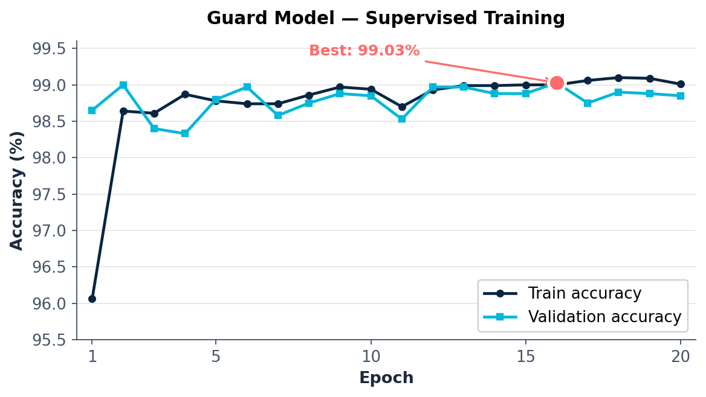
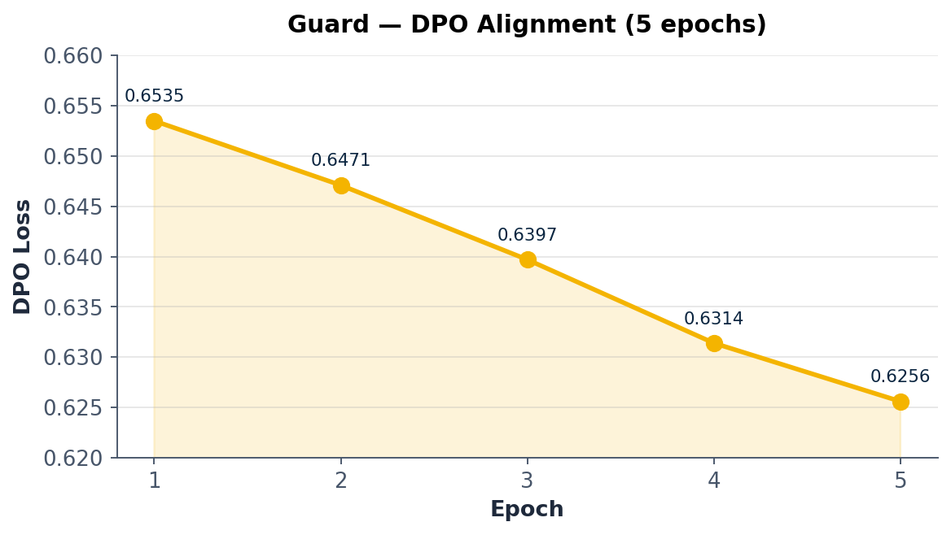
Guard Model — Supervised + DPO Results
92.10 %
98.00 %
Best Guard validation acc.
Final accuracy (DPO-aligned)
Epoch 16 — supervised phase
On 20 K-sample validation set
100.00 %
3.84 %
Recall on REPORT class
False Positive Rate
Zero false negatives
Key paper metric
Confusion at final threshold
TP = 9,560 FP = 401 TN = 10,039 FN = 0
DPO trades a tiny precision drop for zero false negatives — exactly the trade-off authentication needs.
17 / 22

Slide 17
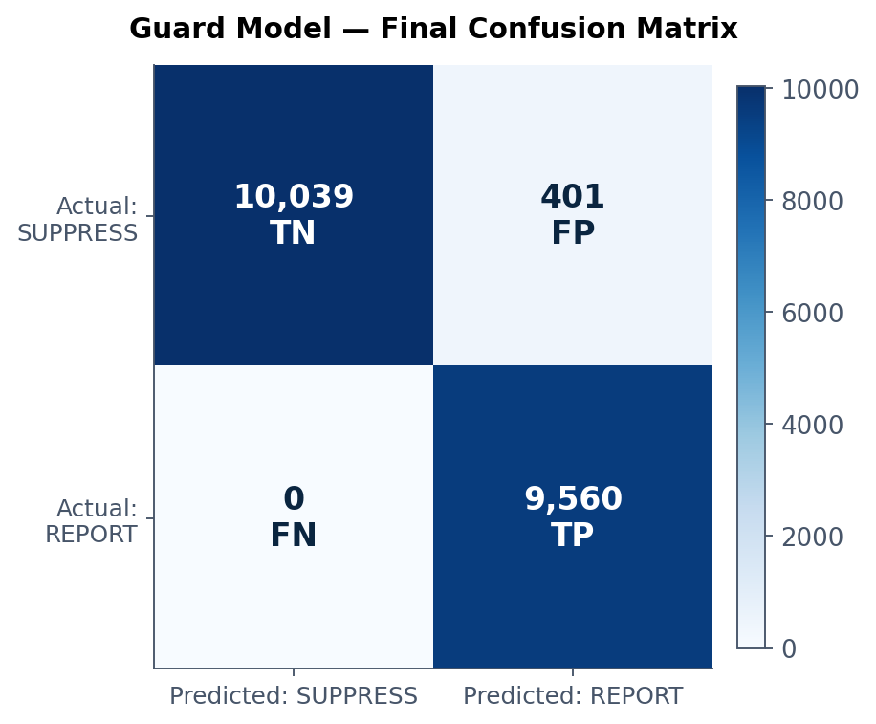
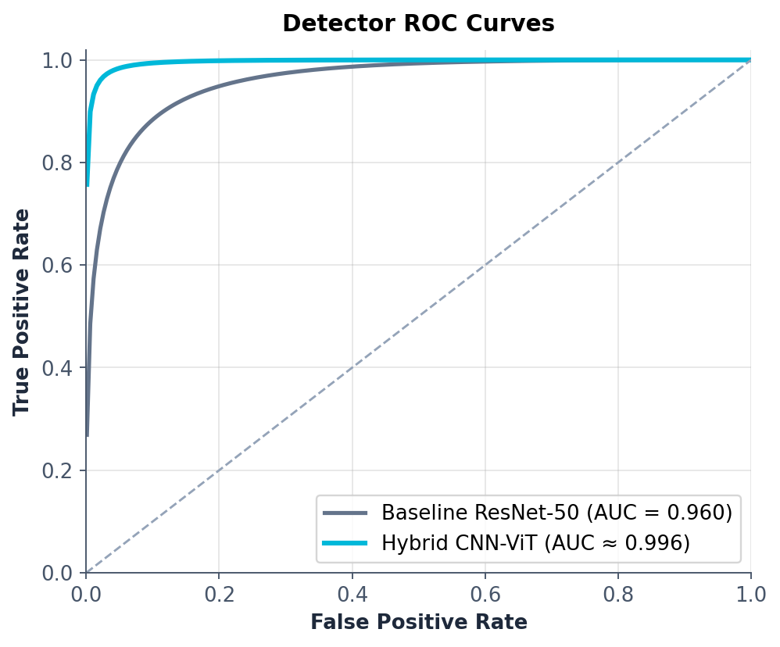
Confusion Matrix & ROC Curves
Reading these: the Guard catches every FAKE (zero FN) at the cost of 401 FP — perfect for authentication where missing a fake is far more costly than over-flagging. AUC ≈ 0.996 for the ViT shows decisive separation across all thresholds.
18 / 22

Slide 18
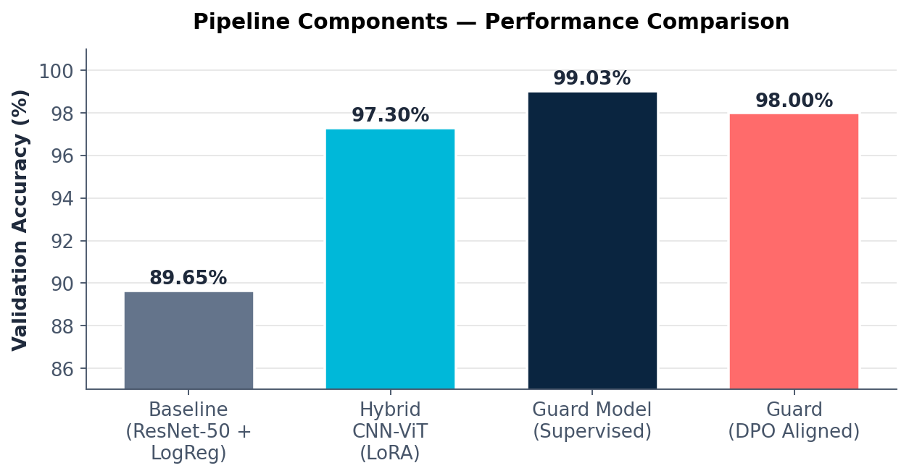
Pipeline Comparison
Component summary
Model | Acc. | Notes
Baseline LogReg | 89.65% | AUC 0.96
Hybrid ViT + LoRA | 97.30% | +7.65 pts
Guard (supervised) | 99.03% | MLP, 25K params
Guard (DPO-aligned) | 98.00% | FPR 3.84%, FNR 0%
FastPath 128px | ≥ 92% | On easy cases
Each component earns its place
ViT crushes the baseline · Guard adds calibration · DPO tunes for FN-free recall · FastPath cuts compute on easy inputs. The whole is genuinely greater than the sum of its parts.
19 / 22

Slide 19
Edge Deployment Story
From Colab to Camera
Per-image latency budget (T4 GPU)
FastPath (128px MobileNet) handles the bulk of obvious-real / obvious-fake cases at <5 ms per image.
The Hybrid ViT only fires on ambiguous inputs — typically 20–30% of traffic.
LoRA-only weights mean the deployable diff is ~12 MB instead of the full 110 M parameters.
INT8 quantization of the CNN front-end is a planned follow-up; bf16 ViT already fits a Jetson Orin.
Local-only inference: raw biometric data never leaves the camera.
FastPath (128px)
all images
3 ms
ResNet stages 1-3
hard cases only
8 ms
ViT (12 blocks · LoRA)
hard cases only
16 ms
Guard MLP
hard cases only
<1 ms
Worst-case latency ≈ 28 ms per image → > 35 FPS sustained on a single T4. Well within real-time camera-ISP budgets.
20 / 22

Slide 20
Conclusion & Future Work
CONCLUSION
FUTURE WORK
Built a full edge-AI authentication pipeline — not just a classifier — with calibrated REPORT / SUPPRESS / UNCERTAIN verdicts.
Hybrid CNN-ViT with LoRA reaches 97.30% val accuracy at ~3% trainable params.
Guard model with DPO alignment reaches 99.03% supervised accuracy and zero false negatives.
FastPath cascade reduces average compute by routing easy cases through a 128px MobileNet.
Frequency-domain analysis confirmed our architectural choices.
Cross-generator evaluation — train on SD1.4, test on Midjourney, Flux, and DALL·E 3 outputs.
INT8 quantization of the CNN front-end for sub-2-watt deployment.
Domain-randomization training to defeat re-compression and post-processing attacks.
Knowledge distillation from the ViT into a fully-edge MobileViT student.
Real-camera firmware integration (Jetson Orin Nano + ISP pipeline).
21 / 22

Slide 21
Thank You
Questions & Discussion
REFERENCES
Bird, J., & Lotfi, A. (2024). CIFAKE: Image Classification and Explainable Identification of AI-Generated Synthetic Images. IEEE Access. DOI:10.1109/ACCESS.2024.3356122
Wang, S.-Y. et al. (2020). CNN-generated images are surprisingly easy to spot... for now. CVPR.
Frank, J. et al. (2020). Leveraging Frequency Analysis for Deep Fake Image Recognition. ICML.
Hu, E. J. et al. (2022). LoRA: Low-Rank Adaptation of Large Language Models. ICLR.
Rafailov, R. et al. (2023). Direct Preference Optimization: Your Language Model is Secretly a Reward Model. NeurIPS.
Dosovitskiy, A. et al. (2021). An Image is Worth 16×16 Words: Transformers for Image Recognition at Scale. ICLR.
He, K. et al. (2016). Deep Residual Learning for Image Recognition. CVPR.
Howard, A. et al. (2017). MobileNets: Efficient CNNs for Mobile Vision Applications. arXiv:1704.04861.
· University of Texas at Arlington

