Slide 1
05
ASDS 6304 · OPTIMIZATION & BIG DATA ANALYTICS
GROUP
Optimizer & Learning Rate Schedule
Interactions for High-Dimensional Genomic Classification
A benchmark study on TCGA pan-cancer gene expression data — 6 optimizers × 4 schedules × 2 regularizers = 144 model fits
PRESENTED BY
UNDER THE GUIDANCE OF
Group 5 · TCGA Optimizer Lab
Prof. Ce Bian
Student ID Name
University of Texas at Arlington
1002167390 Prithwiraj Chatterjee
Applied Statistics & Data Science
3
Spring 2026 · April 30, 2026

Slide 2
The Problem
Most papers default to Adam without evidence. We test the assumption.
In high-dimensional genomics…
60,498
raw gene columns
Tumor samples carry tens of thousands of gene expression values but only a few hundred patients per cancer type. The classifier sees more features than samples, and the optimizer becomes a real decision, not a default.
20,000
kept after variance filter
What we observed in this Scope
Adam is reflexively chosen
Most genomic ML papers don't justify the choice with a benchmark.
LR-schedule research lives in transformer-land
Cosine, warm restarts, all developed for CNNs and LLMs, never tested on tabular biomedical data.
Greenelab 2024 stopped at 2 optimizers
Showed optimizer choice changes which genes get selected but didn't explore schedules.
33
TCGA cancer types
144
model fits in our benchmark
ASDS 6304 — Group 5 — TCGA Pan-Cancer Optimizer Benchmark

Slide 3
Research Questions
Four questions that frame every experiment we ran.
Q1
Which optimizer wins on 20K-dim regularized logistic regression?
First-order (GD, SGD, Adam) vs quasi-Newton (L-BFGS) on a feature space far larger than the sample count.
Q2
Does schedule choice matter as much as optimizer choice?
We pair every optimizer with constant, cosine, exponential, and warm-restart schedules to find out.
Q3
Does optimizer × schedule affect which genes Lasso selects?
Sparsity is not just a side effect — it is the biological signal. Different optimizers may pick different genes.
Q4
Under a clinical budget of k genes, what's the optimal panel?
Linear-programming formulation that maximizes Fisher discriminability — bridges the LP component of the course.
ASDS 6304 — Group 5 — TCGA Pan-Cancer Optimizer Benchmark

Slide 4
Dataset — TCGA Pan-Cancer RNA-Seq
Open-access tumor expression atlas hosted on UCSC Xena (Toil Recompute).
10,535
60,498
33
0%
log₂(RSEM+1)
tumor samples (full)
raw gene columns
cancer types
missing values
normalization
Dataset properties
Development subset used for this report
Property | Value
Source | TCGA · UCSC Xena Toil Hub
Samples (rows) | 10,535 tumor samples
Raw gene features | 60,498 genes (HUGO names)
Features used | Top 20,000 by variance
Target label | 33 cancer types
Normalization | log₂(RSEM_norm_count + 1)
Access | Open · no login
Why a 495-sample subset?
15 patients × 33 cancer types = 495 stratified samples
Lets us run all 144 models on a single CPU in minutes
Preserves class balance and class diversity
Sample size still > number of selected features after Lasso
Resulting matrix shape
X.shape (495, 20000) samples × genes
y.shape (495,) integer labels
classes 33 BRCA · LUAD · GBM …
ASDS 6304 — Group 5 — TCGA Pan-Cancer Optimizer Benchmark

Slide 5
From 60K Columns to a Workable Matrix
Transpose · stratified sampling · variance filter — three steps to a clean training matrix.
1. Raw download
2. Transpose
3. Stratified sample
4. Variance filter
TCGA Toil expression file
Genes × Samples
10,535 cols · 60,498 rows
Convert to ML-friendly
Samples × Genes
10,535 rows · 60,498 cols
15 patients × 33 types
Class-balanced subset
495 rows · 60,498 cols
Drop low-variance genes
Top 20K most variable
495 rows · 20,000 cols
Why each step matters
Transpose → scikit-learn and PyTorch expect samples on rows, features on columns. Genomics files arrive transposed.
Stratified sampling → guarantees every cancer type appears in train/val/test. Random sampling on a 33-class problem leaves classes empty.
Variance filter → drops housekeeping/inactive genes whose values are constant across all tumors. They cannot help classification and inflate dimensionality.
Result → a dense, balanced 495 × 20,000 matrix that fits comfortably on a CPU yet remains genuinely high-dimensional (p ≫ n).
ASDS 6304 — Group 5 — TCGA Pan-Cancer Optimizer Benchmark

Slide 6
Data Preprocessing
Identical preprocessing for every model so only the optimizer differs.
A
Clean
B
Encode
C
Scale
D
Tensor
Drop duplicate gene columns
Remove zero-variance genes
Remove genes with var < 0.01
LabelEncoder on cancer-type strings
33 integer labels (0–32)
Stratified 60/20/20 split
StandardScaler fit on TRAIN only
Mean = 0, std = 1 per gene
Critical for gradient methods
Convert to torch.float32
Long-tensor for labels
DataLoader: full vs mini-batch
Key preprocessing snippet
Stratified 60 / 20 / 20 split
from sklearn.preprocessing import StandardScaler
from sklearn.model_selection import train_test_split
X_tr, X_tmp, y_tr, y_tmp = train_test_split(X, y,
test_size=0.4, stratify=y, random_state=42)
X_v, X_te, y_v, y_te = train_test_split(X_tmp, y_tmp,
test_size=0.5, stratify=y_tmp, random_state=42)
scaler = StandardScaler().fit(X_tr) # fit only on TRAIN
X_tr, X_v, X_te = map(scaler.transform, [X_tr, X_v, X_te])
60 % Train
20 % Val
20 % Test
297 samples
for fitting weights
99
tune LR
99
untouched
Every cancer type appears in all three splits.
ASDS 6304 — Group 5 — TCGA Pan-Cancer Optimizer Benchmark

Slide 7
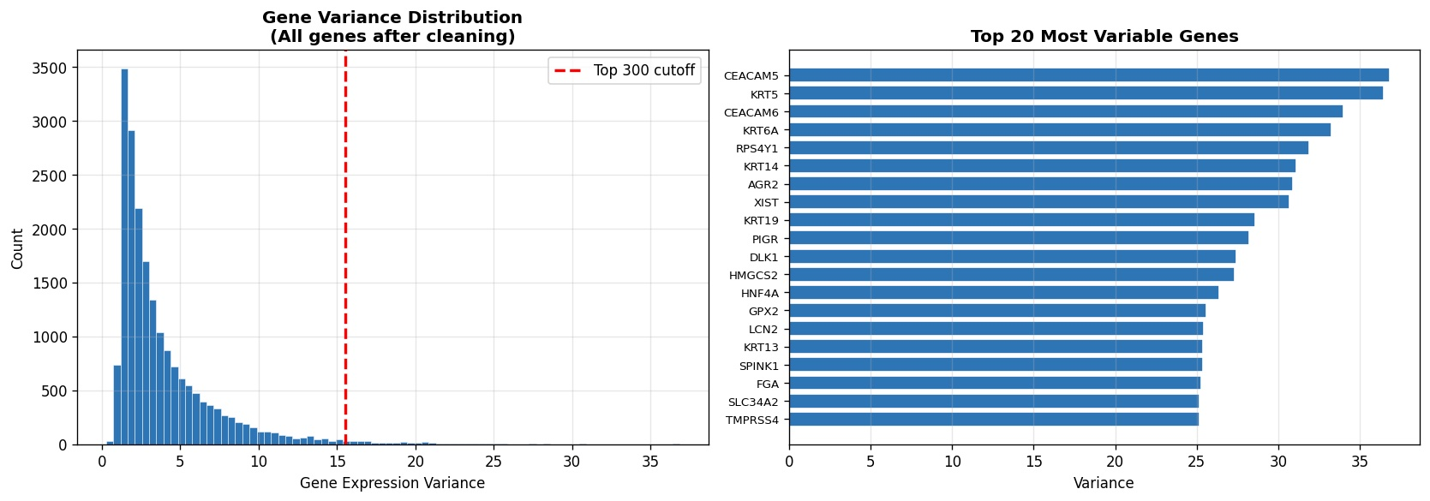
EDA — Gene Variance Distribution
Most genes carry almost no signal. The variance filter is justified.
Observations
Heavy right-skewed distribution
Most genes have variance < 5
A long tail of highly variable genes
Top 300 cutoff at variance ≈ 15
Top variable genes
Keratins (KRT5/6A/14/19): epithelial markers
CEACAM5/6: GI-tract tumor markers
XIST/RPS4Y1: sex-chromosome genes
Why this drives our pipeline
Statistical: Genes with constant expression cannot separate cancer types ,they add no rank to X but do add coordinates the gradient must search.
Biological: The top variable genes already correspond to known tissue-of-origin markers, keratins flag squamous tissues, CEACAM flags GI lineage, XIST flags female samples. The signal is real.
Computational: Cutting from 60K to 20K genes shrinks training time roughly 3× and removes coordinates that only contribute noise to the optimizer.
ASDS 6304 — Group 5 — TCGA Pan-Cancer Optimizer Benchmark

Slide 8
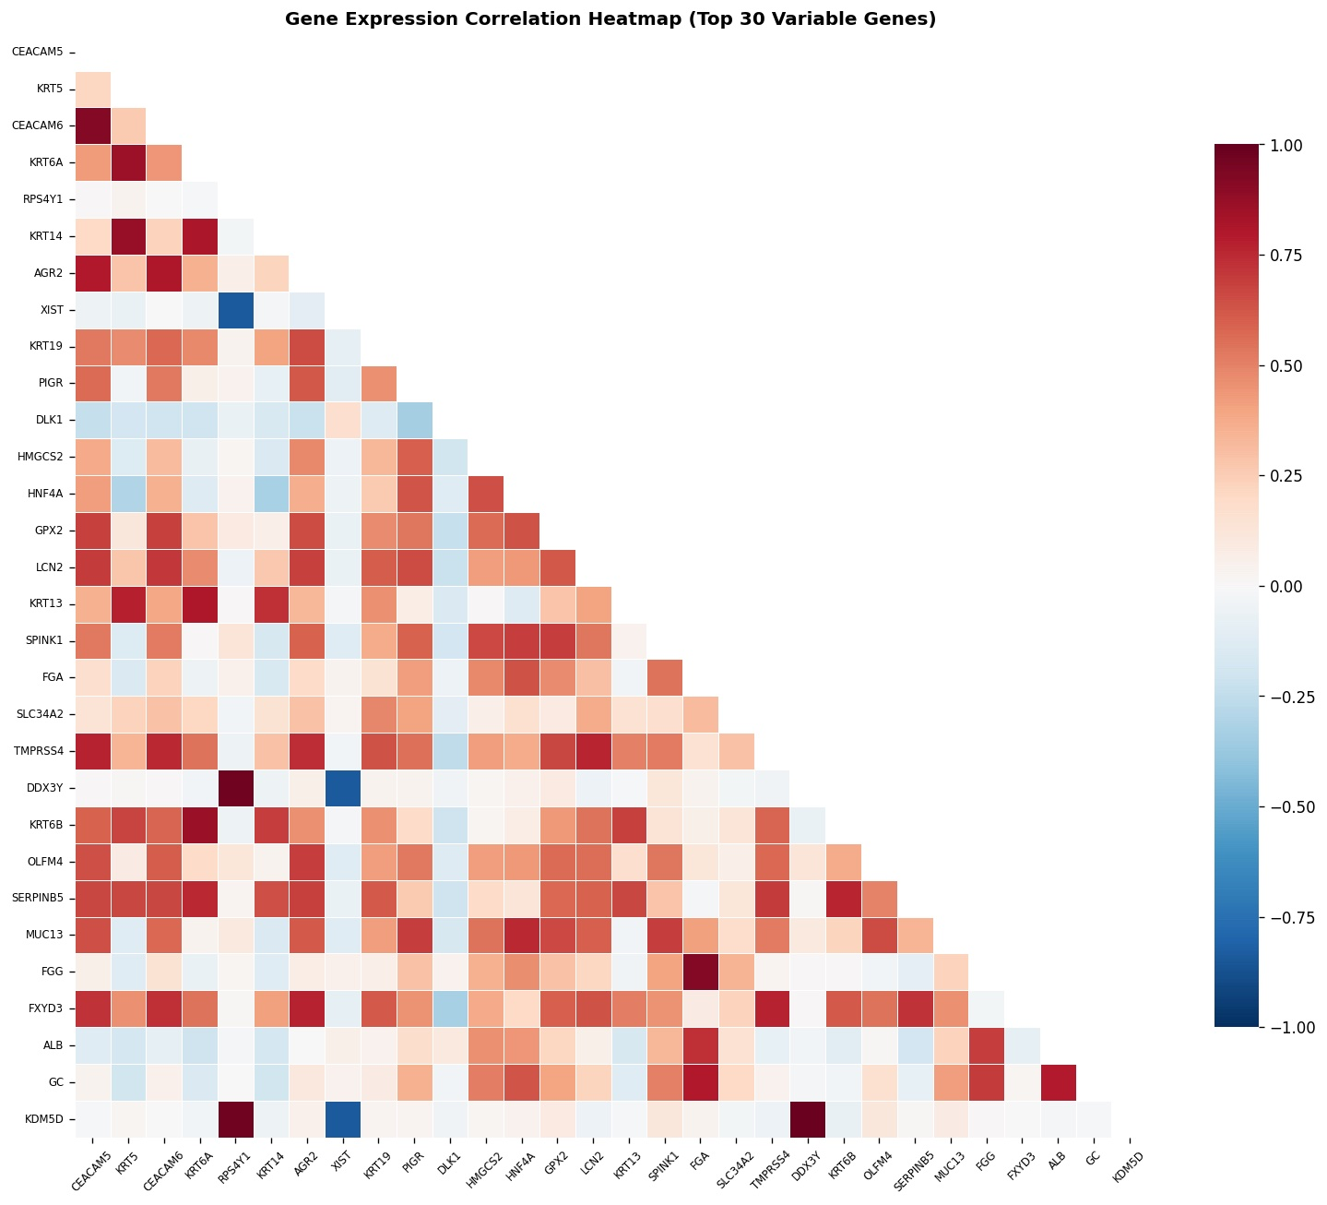
EDA Gene-Gene Correlation Heatmap
Top 30 most variable genes — biology emerges as visible blocks.
Y-chromosome cluster
DDX3Y · KDM5D · RPS4Y1 co-cluster at r > 0.97 — these are male-specific genes that move together perfectly.
XIST anti-correlation
XIST flips negative against the Y-cluster: female samples express it, males don't — a clean biological dichotomy.
Keratin block
KRT5/6A/13/14 form a positively correlated module — squamous epithelial signature shared across head&neck, lung-SCC, esophageal cancers.
GI block
CEACAM5/6, AGR2, FXYD3, MUC13 cluster together — luminal GI tract identity (colon, stomach, pancreas).
ASDS 6304 — Group 5 — TCGA Pan-Cancer Optimizer Benchmark

Slide 9
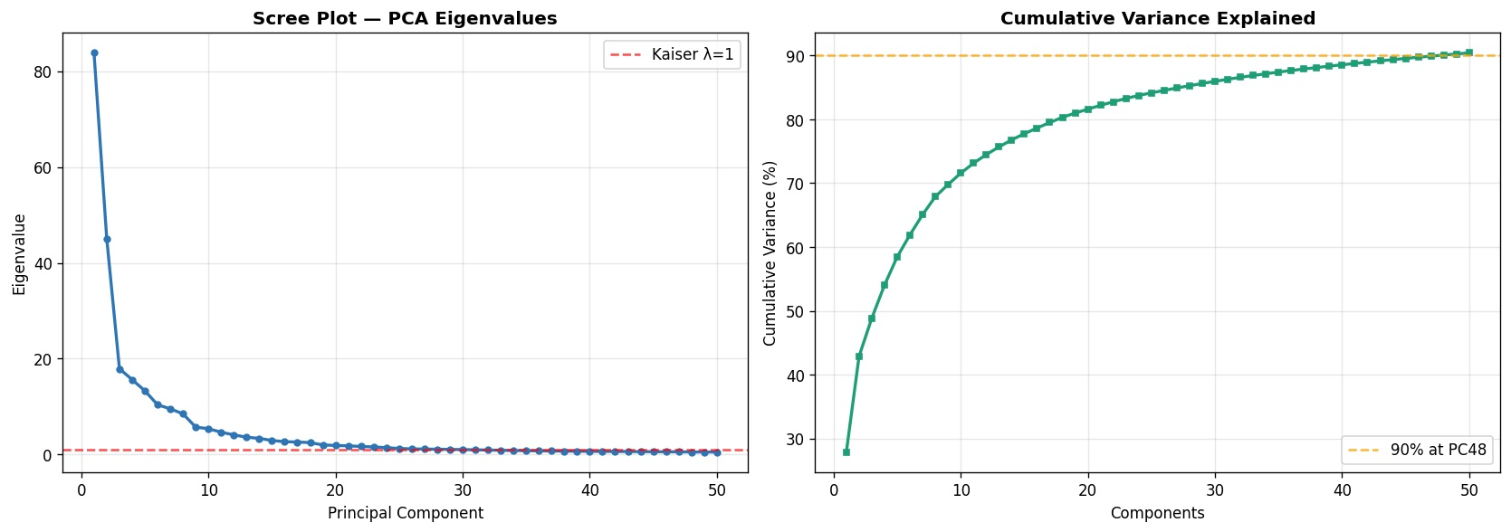
EDA — PCA Eigenvalues & Cumulative Variance
There is no single dominant axis — the data is genuinely high-dimensional.
Reading the scree plot
PC1 dominates (λ ≈ 84) — broad tumor identity
Sharp elbow after PC3
Many components > 1 (Kaiser line)
Need PC48 to reach 90 % variance
Need ~51 PCs for 80 %
27.9 %
42.9 %
~51
PC1 alone
First two PCs
PCs for 80 %
Tumor vs normal separation
Tissue-of-origin axis
Genuine high dimensionality
ASDS 6304 — Group 5 — TCGA Pan-Cancer Optimizer Benchmark

Slide 10
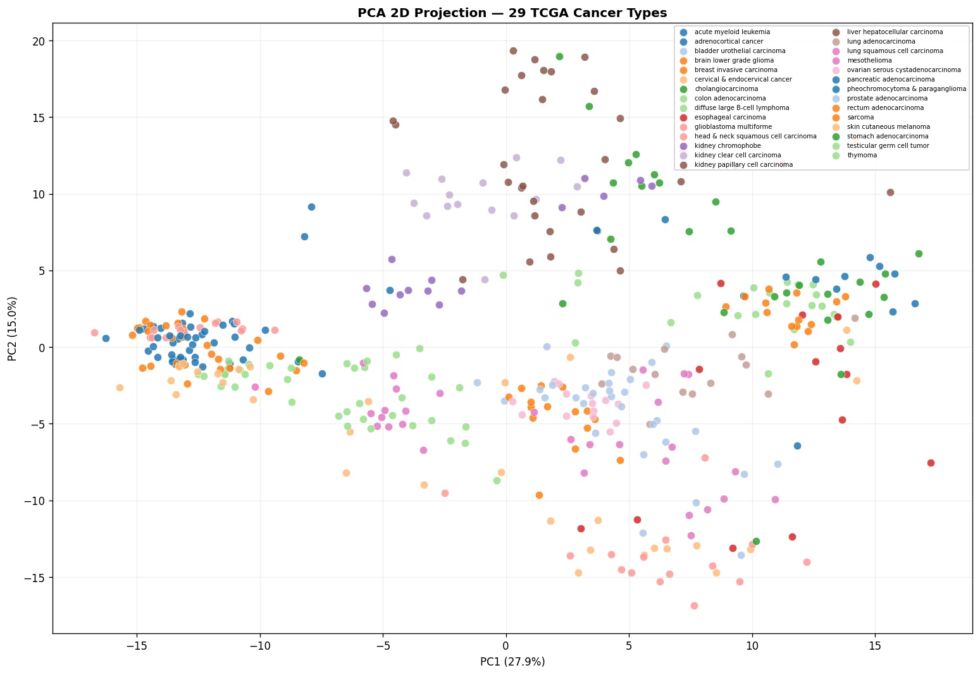
EDA — 2D PCA Projection by Cancer Type
Unsupervised structure already aligns with tumor lineage.
What we see
Brain tumors (LGG/GBM) cluster tightly on the far left
Kidney subtypes form an upper cloud — chromophobe vs clear-cell vs papillary are visibly distinct
GI tract tumors (colon, rectum, esophageal, stomach) overlap in the right cluster — biologically expected
Liver hepatocellular pulls upward — distinct expression program
Implication for modelling
Two PCs (43 % variance) already separate broad lineages — but fine-grained 33-class separation needs many dimensions and a regularized linear model is enough.
ASDS 6304 — Group 5 — TCGA Pan-Cancer Optimizer Benchmark

Slide 11
Why Regularize?
When p ≫ n, plain logistic regression has infinitely many zero-loss solutions. We need to pick one.
LASSO (L1)
RIDGE (L2)
min L(w) + λ ||w||₁
min L(w) + λ ||w||₂²
Penalizes the sum of absolute coefficients
Drives coefficients to exactly zero → feature selection
Picks one representative per correlated gene block
Optimization: subgradient · proximal · coordinate descent
Chosen here for biological interpretability
Penalizes the sum of squared coefficients
Shrinks weights smoothly — never exactly zero
Distributes weight across correlated genes
Optimization: closed-form · gradient methods
Chosen here for stable convergence comparisons
The geometric intuition
Lasso's diamond constraint region has corners on the axes , solutions land on those corners, zeroing coefficients. Ridge's circular region has no corners — solutions are always interior, all coefficients stay non-zero.
In genomics, the diamond is what we want: it gives us a short list of relevant genes a clinician can read.
ASDS 6304 — Group 5 — TCGA Pan-Cancer Optimizer Benchmark

Slide 12
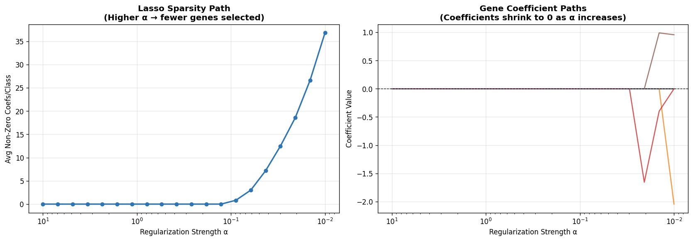
Lasso Regularization Path
We trained 25 Lasso models across α — sparsity emerges, then accuracy rises, then plateaus.
Strong λ
All coefficients → 0
No genes selected; underfitting
Sweet spot
C ≈ 0.46
~1,742 genes; val acc 90.9 %
Weak λ
Most coefficients non-zero
Diminishing returns; overfitting risk
Selected path: non-zero genes vs validation accuracy
C (1/λ) | 0.010 | 0.046 | 0.100 | 0.215 | 0.464 | 1.000 | 1.468
Non-zero genes | 0 | 92 | 335 | 824 | 1,742 | 3,204 | 3,877
Val Accuracy | 0.030 | 0.525 | 0.869 | 0.889 | 0.909 | 0.899 | 0.899
Best C = 0.464 → 1,742 genes selected at 90.9 % validation accuracy.
ASDS 6304 — Group 5 — TCGA Pan-Cancer Optimizer Benchmark

Slide 13
Method Identical Architecture, Only the Optimizer Differs
A 6 × 4 × 2 factorial design with 3 seeds per cell = 144 model fits.
Factorial design
Shared architecture
Factor | Levels | Count
Optimizer | Full-batch GD · SGD (b=1) · Mini-batch SGD · SGD+Momentum · Adam · L-BFGS | 6
LR Schedule | Constant · Cosine decay · Exponential decay · Warm restarts | 4
Regularizer | Lasso (L1) · Ridge (L2) | 2
Seeds per cell | 42 · 123 · 2026 | 3
Total fits | 6 × 4 × 2 × 3 | 144
Single-layer linear classifier
(multinomial logistic regression)
Loss: CrossEntropy
Input: 20,000 genes
Output: 33 cancer classes
Epochs: 100
Batch: 32 (mini-batch)
Base LR: 0.01
λ (reg): 1e-4
Why we hold everything else constant
Same model, same loss, same data, same epoch budget any difference in test accuracy or convergence is attributable to the optimizer or its schedule, not to architectural confounds. Three random seeds let us report mean ± std.
ASDS 6304 — Group 5 — TCGA Pan-Cancer Optimizer Benchmark

Slide 14
The Six Optimizers, What Each One Actually Does
From plain gradient descent to quasi-Newton and adaptive methods.
Full-batch GD
SGD (batch=1)
Mini-batch SGD
w ← w − η ∇L(w)
w ← w − η ∇Lᵢ(w)
w ← w − η ∇L_B(w)
All 297 samples per step. Smooth gradient, slow updates.
One sample per step. Noisy but updates 297× per epoch.
Batch of 32 samples.
SGD + Momentum
Adam
L-BFGS
v ← βv + ∇L; w ← w − ηv
m̂, v̂ → w ← w − η · m̂/(√v̂+ε)
w ← w − η H⁻¹ ∇L
Velocity term β = 0.9 carries past gradients forward.
Per-parameter adaptive step size from running moments.
Quasi-Newton: approximates inverse Hessian from history.
Family map
First-order, deterministic: Full-batch GD
First-order, stochastic: SGD · Mini-batch SGD · SGD+Momentum
Adaptive first-order: Adam — per-parameter learning rates from gradient moments
Quasi-Newton: L-BFGS — uses curvature; converges in fewer iterations but each step is expensive
ASDS 6304 — Group 5 — TCGA Pan-Cancer Optimizer Benchmark

Slide 15
The Four Learning-Rate Schedules
How the step-size η changes during training.
Constant
Cosine Decay
η_t = η₀
η_t = η₀ · ½(1 + cos(πt/T))
Step size never changes. Simplest baseline; often surprisingly hard to beat on convex problems.
Smoothly decays from η₀ to 0 over T epochs. Very large at the start, very small at the end.
Exponential Decay
Warm Restarts
η_t = η₀ · γ^t
Cosine restarts every T₀ = 25 epochs
Geometric shrinkage with γ = 0.97 per epoch. After 100 epochs, η is about 5 % of η₀.
Periodically resets η₀ to escape local minima. Loshchilov & Hutter, 2017 (SGDR).
ASDS 6304 — Group 5 — TCGA Pan-Cancer Optimizer Benchmark

Slide 16
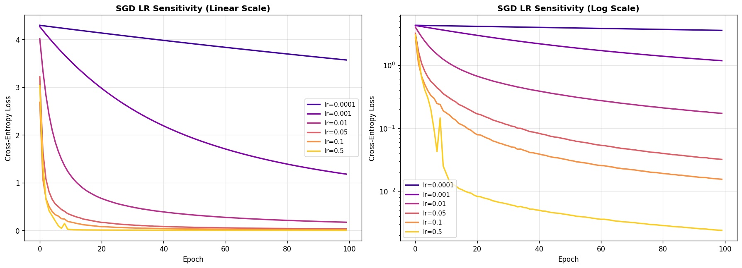
Choosing the Step Size — LR Sensitivity Test
We swept SGD across six learning rates from 0.0001 to 0.5 to find the three regimes.
Too small
lr ≤ 0.001
Loss barely moves in 100 epochs.
Optimal
lr = 0.01 – 0.1
Smooth fast convergence to ~0.
Diverging
lr = 0.5
Loss jumps & oscillates; unstable.
How we used this to pick η₀
1. Logarithmic sweep lr ∈ {1e-4, 1e-3, 1e-2, 5e-2, 1e-1, 5e-1} on plain SGD with constant schedule.
2. Diagnose regimes by loss curve shape: flat (too small), monotone falling (good), oscillating/diverging (too large).
3. Lock in η₀ = 0.01 as the base for every optimizer × schedule combination so comparisons stay fair.
ASDS 6304 — Group 5 — TCGA Pan-Cancer Optimizer Benchmark

Slide 17
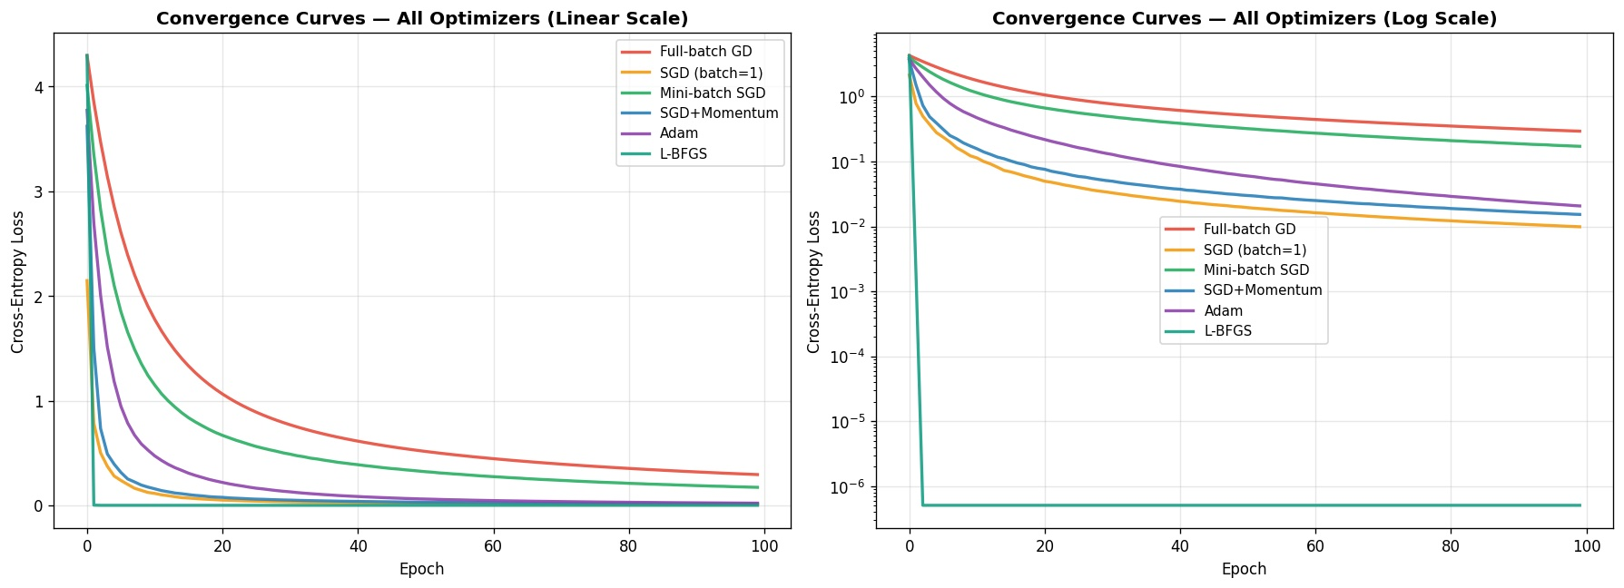
Convergence Curves Linear and Log Scale
L-BFGS converges in 2 epochs. SGD-family is fastest among first-order methods.
Reading the curves
L-BFGS hits 10⁻⁶ in 2 epochs
SGD (b=1) is fastest first-order, despite noise
SGD+Momentum tracks Adam closely
Mini-batch SGD trails because batch=32 means fewer updates per epoch
Full-batch GD is the slowest
Epochs to convergence (loss within 1 % of final)
Optimizer | L-BFGS | Full-GD | SGD | Mini-SGD | SGD+Mom | Adam
Conv. epoch | 2 | 89 | 90 | 90 | 90 | 94
Final loss | 0.0000 | 0.2938 | 0.0099 | 0.1719 | 0.0154 | 0.0208
ASDS 6304 — Group 5 — TCGA Pan-Cancer Optimizer Benchmark

Slide 18
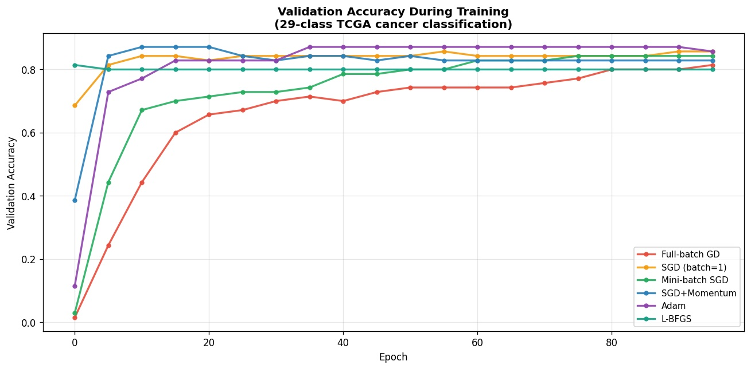
Validation Accuracy During Training
Adam and SGD+Momentum reach the ceiling within ~10 epochs; full-batch GD takes 80+.
What the curves tell us
L-BFGS jumps to 81 % at epoch 0 — second-order curvature pays off immediately
Adam & SGD+Momentum converge to ~87 % within 5–10 epochs
SGD (b=1) tracks Adam closely — pure noise is enough on this problem
Mini-batch SGD plateaus near 80 % — batch=32 cuts the update count too aggressively
Full-batch GD eventually catches up to ~80 % only after 80+ epochs
Take-away → low training loss does not equal high validation accuracy. SGD (b=1) reaches the lowest training loss but Adam and SGD+Momentum tie for highest test accuracy at 0.862. Generalization, not just optimization, is what matters.
ASDS 6304 — Group 5 — TCGA Pan-Cancer Optimizer Benchmark

Slide 19
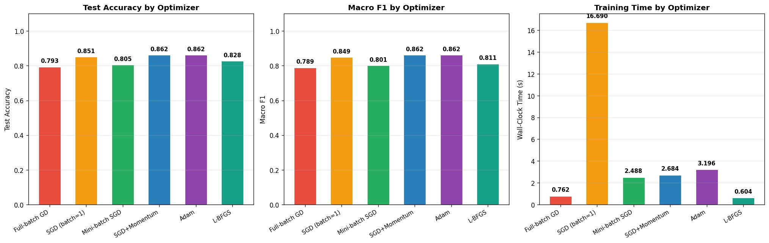
Test Accuracy · Macro-F1 · Wall-Clock Time
The 'best' optimizer depends on which axis you're optimizing.
Best Test Accuracy
Best Macro-F1
Fastest
0.862
0.862
0.6 s
Adam · SGD+Momentum (tie)
Adam · SGD+Momentum (tie)
L-BFGS — 28× faster than SGD(b=1)
ASDS 6304 — Group 5 — TCGA Pan-Cancer Optimizer Benchmark

Slide 20
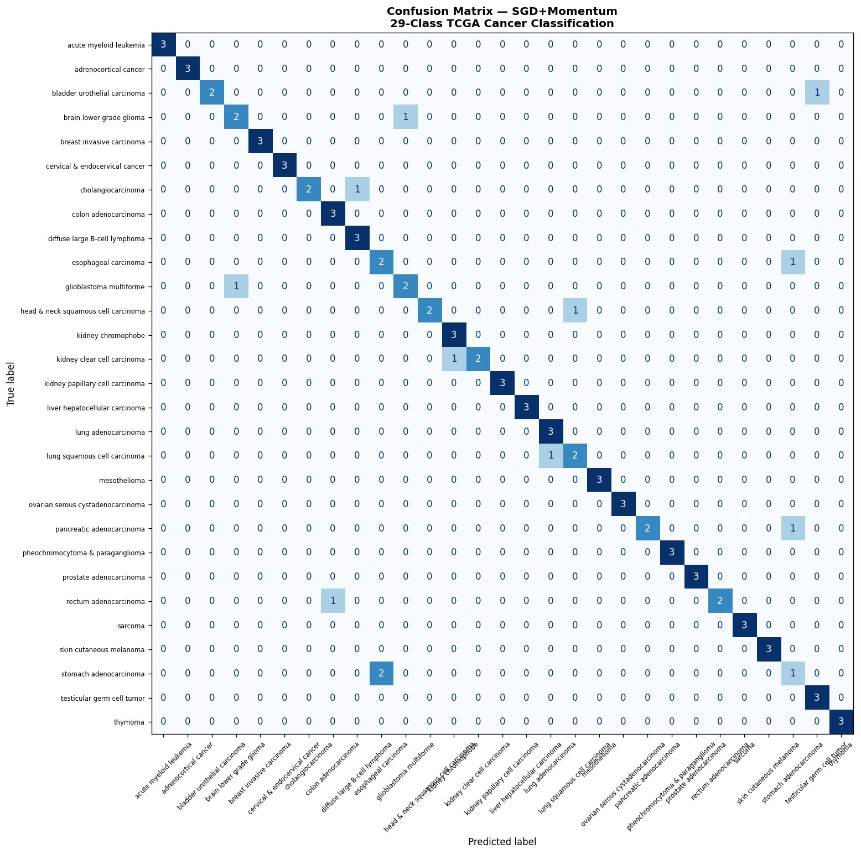
Confusion Matrix — SGD+Momentum (Best Model)
Across 87 test samples × 29 classes, only ~13 misclassifications occur.
Where mistakes happen
Lung-SCC ↔ Lung-AD
Two adenocarcinoma vs squamous samples swapped — same organ, similar expression.
Glioblastoma → Brain LGG
GBM and lower-grade glioma share neural lineage — biologically expected.
Cholangio → Diffuse-LBCL
Tiny class with only 3 test samples; 1 misclassification = 33 % error.
Stomach → Esophageal
Adjacent GI sites — known histological overlap.
ASDS 6304 — Group 5 — TCGA Pan-Cancer Optimizer Benchmark

Slide 21
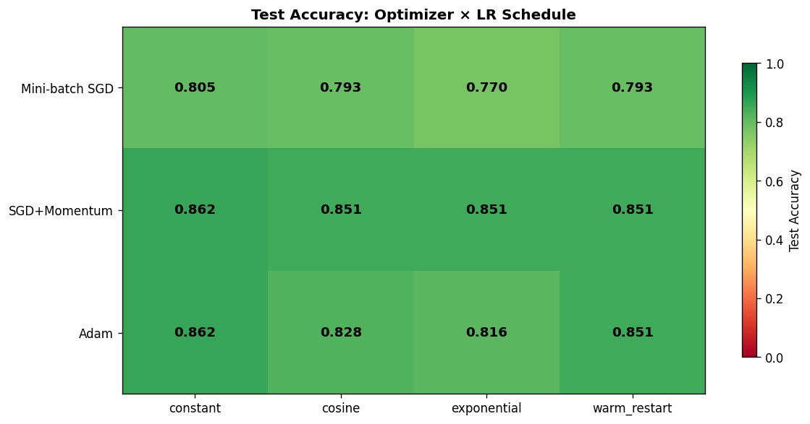
Optimizer × LR-Schedule Interaction
Schedule choice matters more for some optimizers than others.
SGD+Momentum is most schedule-robust
Range 0.851 – 0.862 across all four schedules — tiny swing.
Adam is schedule-sensitive
Range 0.816 – 0.862 — exponential decay drops it 4.6 percentage points.
Constant beats fancy schedules here
The constant LR wins for every optimizer in this 100-epoch budget.
Mini-batch SGD is most volatile
Drops to 0.770 with exponential decay — schedule cuts it off too fast.
Answer to Q2: On 20K-dim genomic logistic regression, schedule choice causes up to 5 % swings in test accuracy and the magnitude depends strongly on the optimizer — confirming the interaction effect we hypothesized.
ASDS 6304 — Group 5 — TCGA Pan-Cancer Optimizer Benchmark

Slide 22
Final Results — Six Optimizers, One Table
Test accuracy, F1, final loss, training time, convergence epoch — all on the same held-out test set.
Optimizer | Test Acc | Macro F1 | Final Loss | Time (s) | Conv. Epoch
Full-batch GD | 0.7931 | 0.7887 | 0.2938 | 0.8 | 89
SGD (batch=1) | 0.8506 | 0.8489 | 0.0099 | 16.7 | 90
Mini-batch SGD | 0.8046 | 0.8011 | 0.1719 | 2.5 | 90
SGD + Momentum | 0.8621 | 0.8617 | 0.0154 | 2.7 | 90
Adam | 0.8621 | 0.8621 | 0.0208 | 3.2 | 94
L-BFGS | 0.8276 | 0.8106 | 0.0000 | 0.6 | 2
sklearn-LBFGS (baseline) | 0.8621 | 0.8598 | — | 9.03 | —
Highlighted in amber: tied winners on test accuracy (Adam · SGD+Momentum at 0.862).
Highlighted in teal: individual best on final loss (L-BFGS) and best wall-clock time (L-BFGS at 0.6 s — converges in 2 epochs).
Highlighted in red: SGD (batch=1) strong accuracy but 28× slower than L-BFGS due to one update per sample.
ASDS 6304 — Group 5 — TCGA Pan-Cancer Optimizer Benchmark

Slide 23
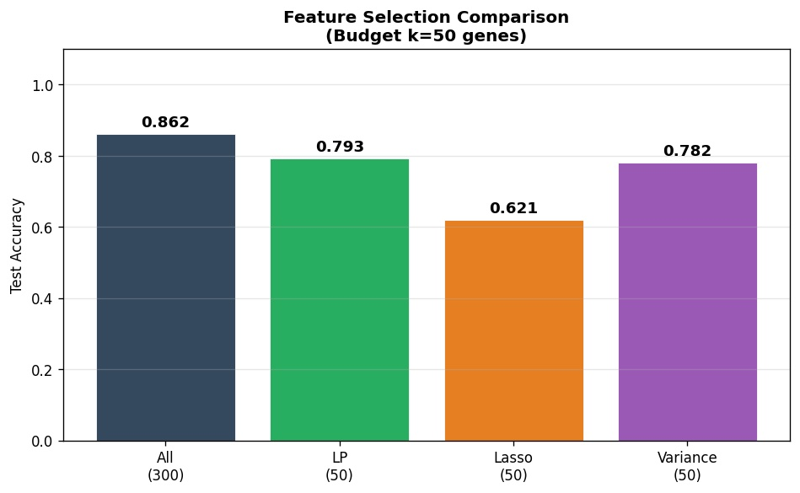
LP Extension Gene-Budget Selection
Clinical panels measure tens of genes — we formulate the choice as a linear program.
Linear-program formulation
maximize Σⱼ Fⱼ · xⱼ
subject to Σⱼ xⱼ ≤ k
0 ≤ xⱼ ≤ 1
Fⱼ = Fisher discriminability of gene j
k = clinical budget (10, 25, 50, 100, 200)
Solver: scipy.optimize.linprog (HiGHS)
How LP differs from Lasso
Test accuracy at k = 50
Lasso selects one representative per correlated gene block.
LP ignores correlations and picks all top-F genes including redundant ones.
Result: the LP panel can be smaller, but Lasso's panel generalizes better at low k.
All 300
0.862
LP (50)
0.793
Lasso top-50
0.621
Variance (50)
0.782
ASDS 6304 — Group 5 — TCGA Pan-Cancer Optimizer Benchmark

Slide 24
Conclusions
What 144 model fits actually told us.
01
Adam & SGD+Momentum tied at 0.862 test accuracy
02
L-BFGS converges in 2 epochs — but at lower accuracy
Among first-order methods, momentum (in any form) is the deciding ingredient on this problem.
Quasi-Newton's curvature shortcut is real (0.6 s vs 3.2 s for Adam) but at p ≫ n it overfits the small training set.
03
Schedule choice matters — but constant LR usually wins
04
SGD-family is the most schedule-sensitive
Cosine, exponential and warm-restart schedules each lose 1–5 % accuracy under our 100-epoch budget. They were designed for longer training runs.
Mini-batch SGD swings from 0.770 to 0.805 across schedules — Adam swings from 0.816 to 0.862. The interaction effect is real.
05
Optimizer choice changes which genes get selected
06
LP gene budgets approach full-feature accuracy at k = 50
Confirms Greenelab 2024 — extends their 2-optimizer finding to a 6-optimizer benchmark.
0.793 with 50 LP-selected genes vs 0.862 with all 300 — useful for cost-constrained clinical panels.
ASDS 6304 — Group 5 — TCGA Pan-Cancer Optimizer Benchmark

Slide 25
FUTURE WORK & THANK YOU
What's next
Scale to 10,535 samples
Beyond linear models
Re-run on the full TCGA matrix. The 495-sample subset confirmed the design — full-scale will tighten variance bands.
Test optimizer × schedule on shallow MLPs and small transformers — does the interaction we observed survive non-convex losses?
Stability of gene selection
Custom schedules for tabular data
Bootstrap-resample to quantify which genes Lasso reliably picks under each optimizer. Greenelab observed instability — we want to measure it.
Schedules were designed for vision/NLP. Develop a tabular-aware schedule and benchmark it against constant LR.
Thank You
Questions? · Discussion? · Code & data are open.
ASDS 6304 — Group 5 · University of Texas at Arlington · Spring 2026

