Slide 1
Smart Home Bio-Analytics
Occupancy Detection · Routine Mining · Energy Forecasting
Presented by
Prithwiraj Chatterjee
Fahad Ullah Syed
Under the Guidance of
Dr. Mahmoud Ali Jawad
University of Texas at Arlington
Applied Statistics and Data Science
5306 Applied Time Series Analysis in Data Analytics

Slide 2
AGENDA
Agenda
1. Introduction & Problem Statement
2. Dataset Overview
3. Data Cleaning & Preprocessing
4. Exploratory Data Analysis (EDA)
5. Feature Engineering & Bio-Analytics
6. Time Series Modeling (SARIMAX)
7. Machine Learning Model (Random Forest)
8. Model Comparison
9. Anomaly Detection
10. Conclusion & Future Work | Q&A

Slide 3
INTRODUCTION
Introduction
The Gap in Current Approaches
Our Unique Contribution
Standard energy forecasting uses weather, time-of-day, and past values
Completely ignores the most critical variable: who is home and what are they doing?
No existing approach extracts human presence from raw sensor physics without a motion sensor
This project addresses that gap
Bio-analytics: infer human presence from thermodynamic sensor fingerprints
People raise humidity (breathing) and temperature (body heat ~80W) measurable in sensor data
Outdoor-corrected signals isolate the human effect from weather
Occupancy scores then directly power energy forecasting models

Slide 4
PROBLEM STATEMENT
Problem Statement & Objectives
"To detect human occupancy per room using only thermodynamic sensor signals, mine household routines, and use this bio-analytics layer to improve energy consumption forecasting."
Input
Output
9 rooms × temperature + humidity sensors (10-min intervals)
Outdoor weather: T_out, RH_out, Windspeed
Lights wattage & appliance energy
19,735 raw readings — Jan to May 2016
Per-room occupancy scores (0–1) every 10 minutes
Household routine calendar (who is home, when)
Anomaly day detection
Energy forecasts from SARIMAX and Random Forest using occupancy as features

Slide 5
DATASET OVERVIEW
Dataset Overview
19,735
29
9
10 min
4.5 mo
Total rows
Columns
Rooms
Resolution
Data span
Room | Sensor | Mean T (°C) | Mean RH (%) | Used?
Kitchen | T1 / RH_1 | 21.7 | 40.3 | ✓ Indoor
Living Room | T2 / RH_2 | 20.3 | 40.4 | ✓ Indoor
Laundry | T3 / RH_3 | 22.3 | 39.2 | ✓ Indoor
Home Office | T4 / RH_4 | 20.9 | 39.0 | ✓ Indoor
Bathroom | T5 / RH_5 | 19.6 | 50.9 | ✓ Indoor (shower signal)
Garage/North | T6 / RH_6 | 7.9 | 54.6 | ✗ Excluded
Bedroom 1 | T7 / RH_7 | 20.3 | 35.4 | ✓ Indoor
Bedroom 2 | T8 / RH_8 | 22.0 | 42.9 | ✓ Indoor
Outside | T_out / RH_out | 7.4 | 79.8 | Reference baseline

Slide 6
DATA CLEANING & PREPROCESSING
Data Cleaning & Preprocessing
Preparing data for reliable modelling
Timestamp Parsing
Lag Feature Creation
01
parse_date_time() with multiple format fallbacks to messy datetime strings. Arranged chronologically, NAs dropped.
04
lag1 = previous hour energy, lag24 = same hour yesterday, roll3 = 3-hour rolling mean. First 24 rows dropped (NA lags removed).
Garage Exclusion
Chronological Split
02
T6/RH_6 avg = 7.9°C ≈ T_out avg = 7.4°C. Confirmed as semi-outdoor space so excluded from all indoor occupancy inference.
05
80% train / 20% test split. Strictly chronological with no shuffling. Train ends early April, test covers May 2016.
Hourly Aggregation
Namespace Pinning
03
10-min rows → hourly via floor_date(). Mean for temperatures, max for occupancy scores (any activity in the hour counts).
06
randomForest masks dplyr verbs. All select/filter/mutate pinned to dplyr:: at load time to prevent silent failures.

Slide 7
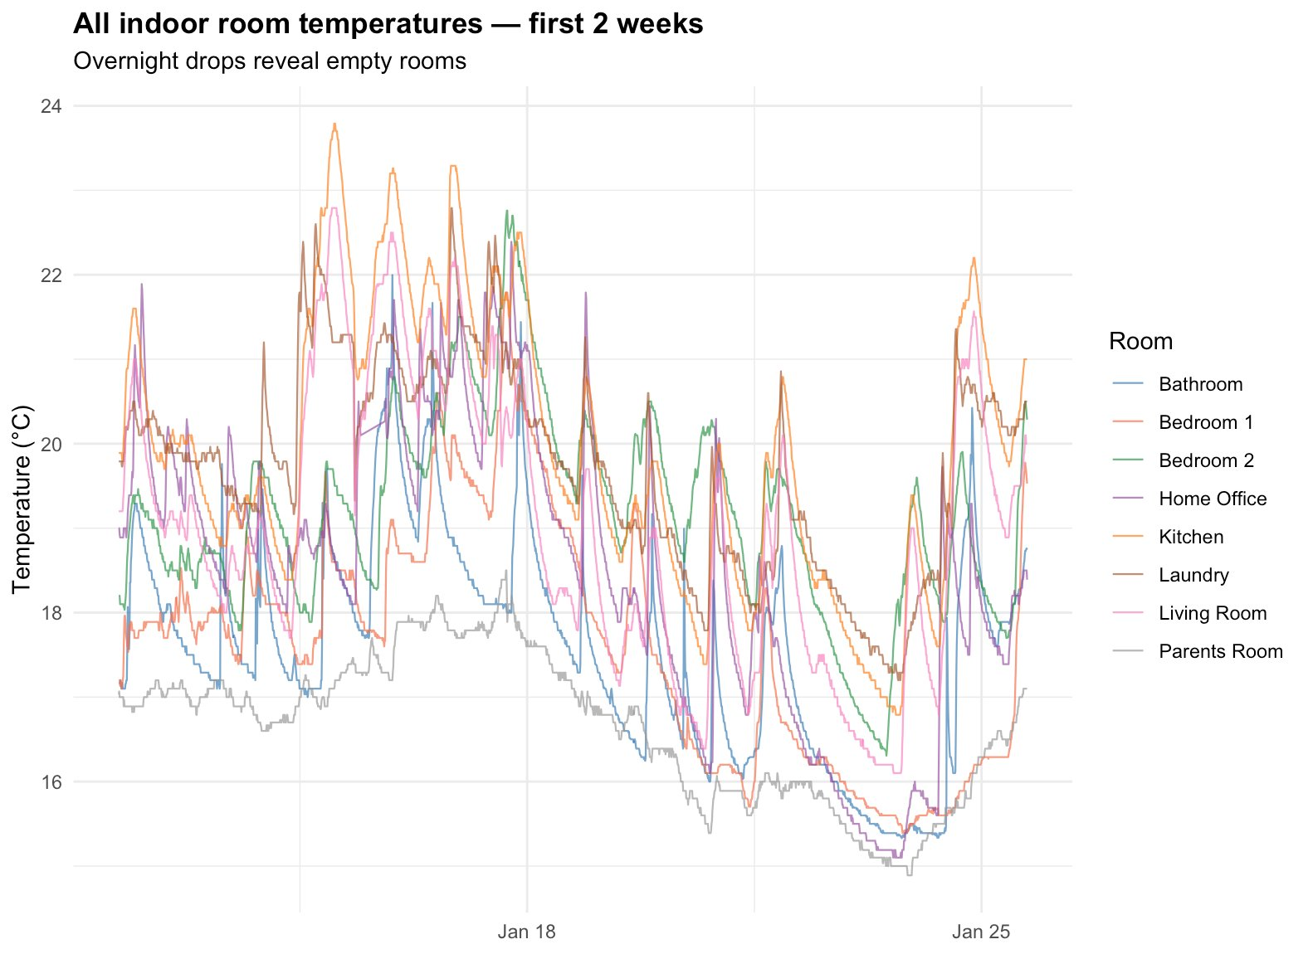
EXPLORATORY DATA ANALYSIS
EDA — Indoor Room Temperatures
First 2 weeks · Overnight drops reveal unoccupied rooms
Observations
All rooms cycle daily between warm (occupied) and cool (empty)
Kitchen (orange) peaks sharply at mealtimes (cooking activity)
Parents Room (gray) stays consistently lowest unheated space
Clear overnight drops across all rooms confirm daily routine
Plot 1 of 20

Slide 8
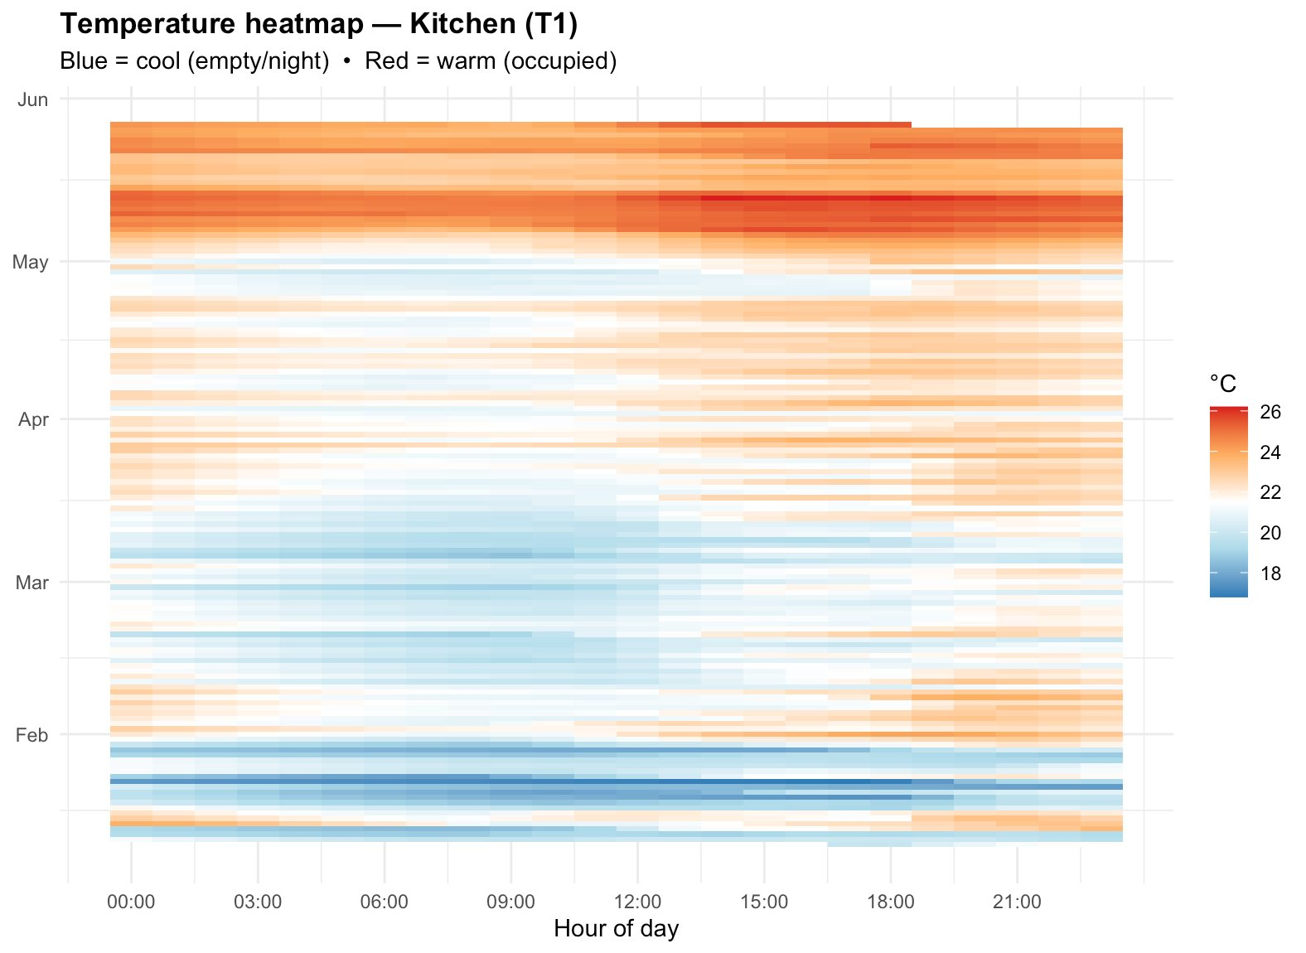
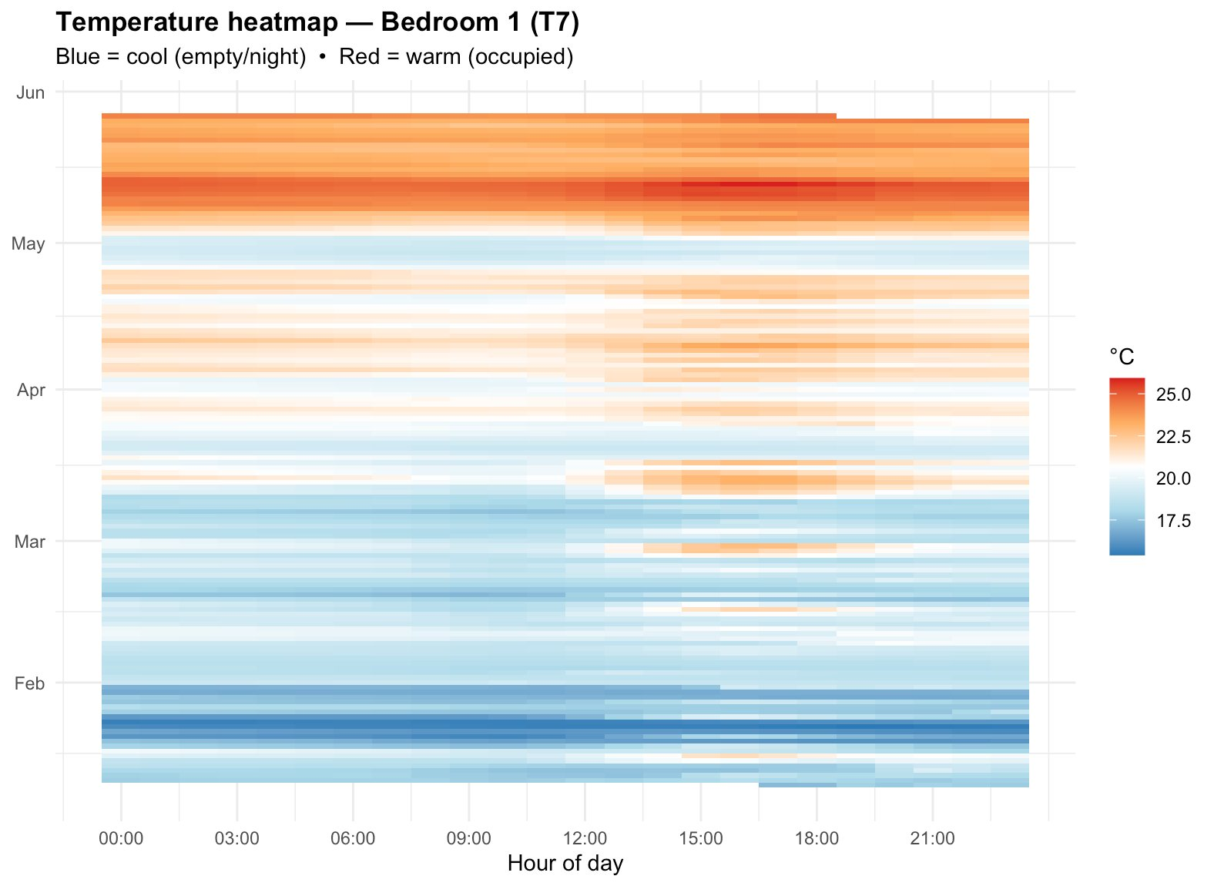
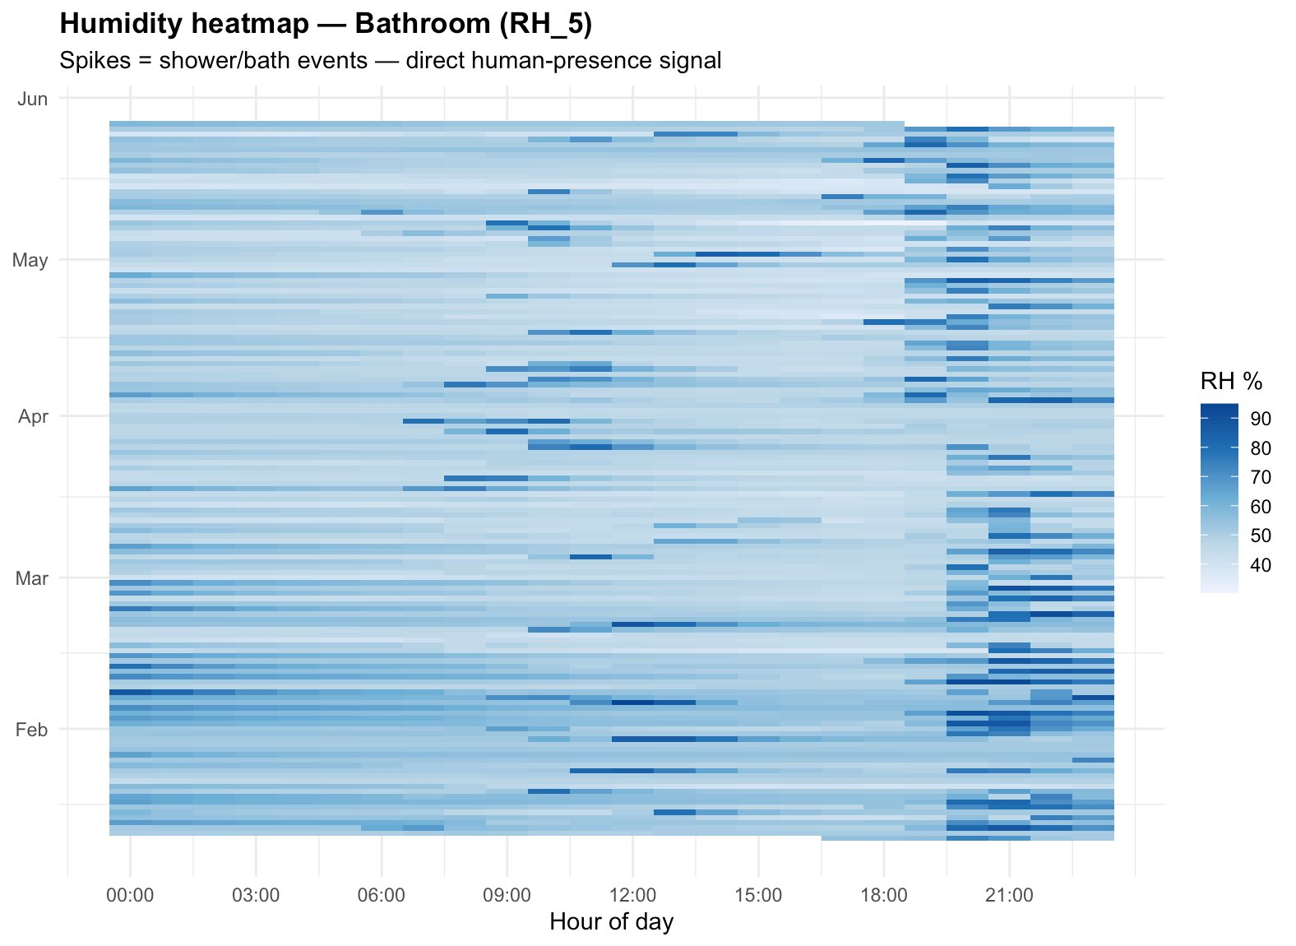
EXPLORATORY DATA ANALYSIS
EDA — Temperature & Humidity Heatmaps
Hour × date patterns expose occupancy without any labels
Kitchen — warms at dinner
Bedroom 1 — warm overnight = sleeping
Bathroom RH — dark spikes = shower events

Slide 9
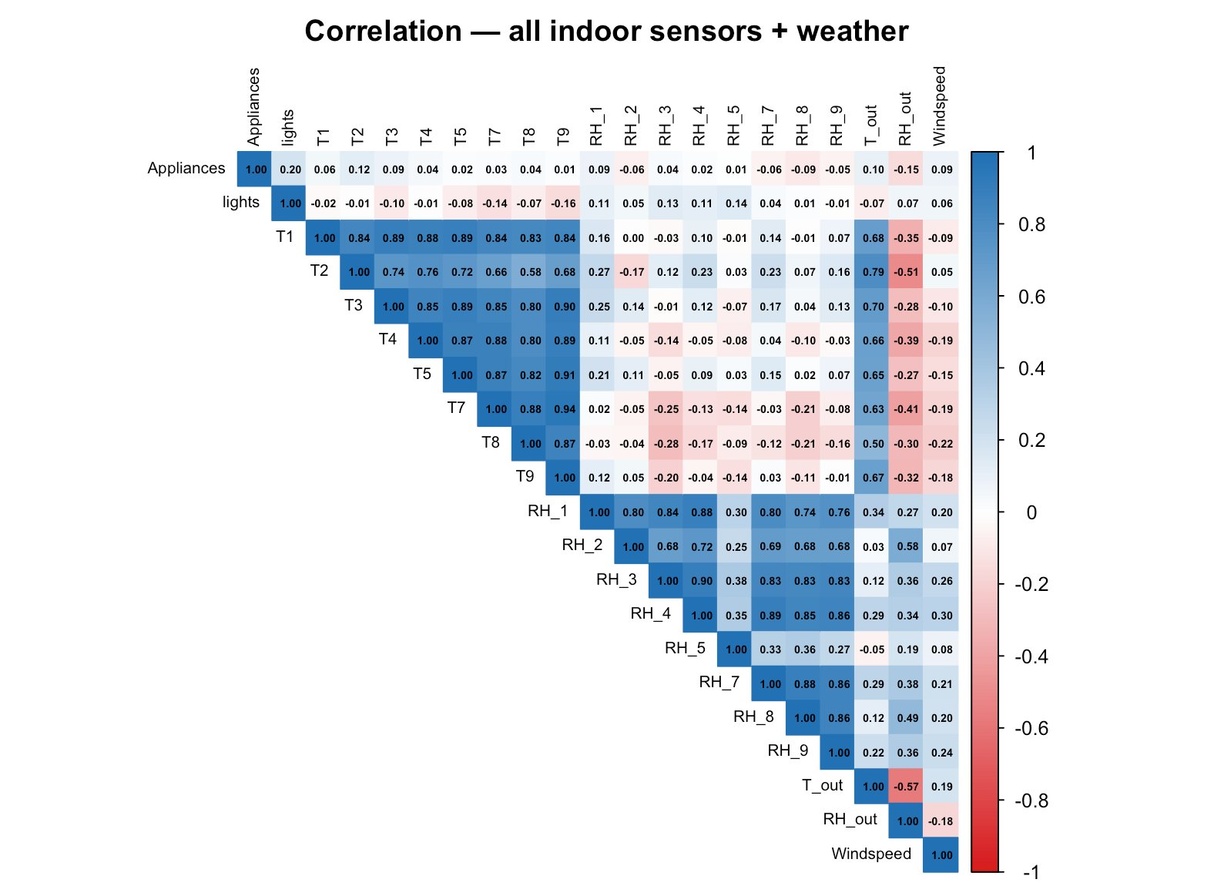
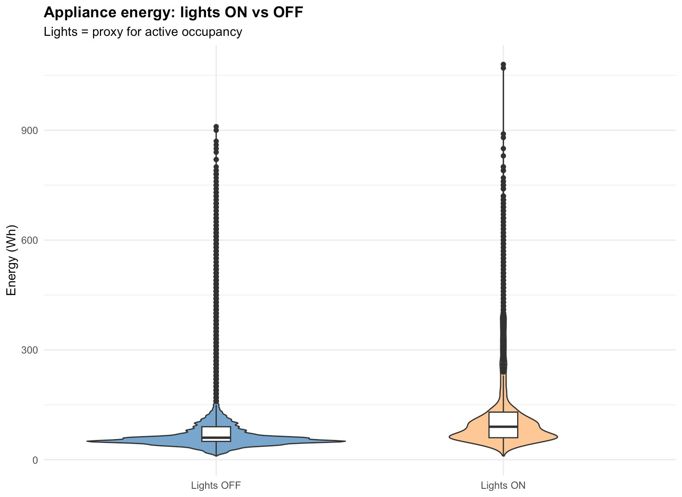
EXPLORATORY DATA ANALYSIS
EDA Correlation & Occupancy Proxies
Key findings: T sensors are correlated 0.8+ (thermally coupled rooms). Lights ON raises median appliance energy ~40%. RH_5 (bathroom) is the least correlated with other rooms — bathroom events are isolated.

Slide 10
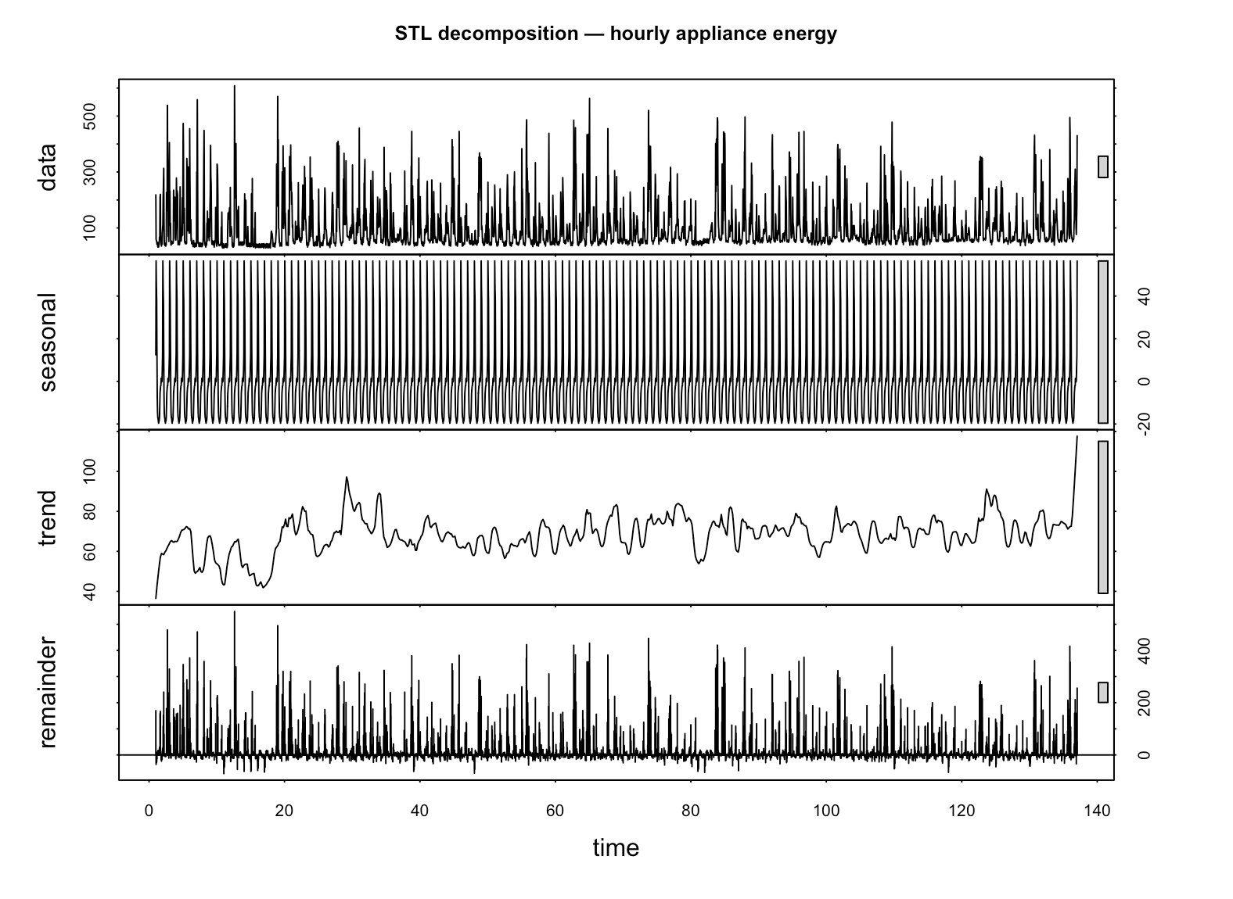
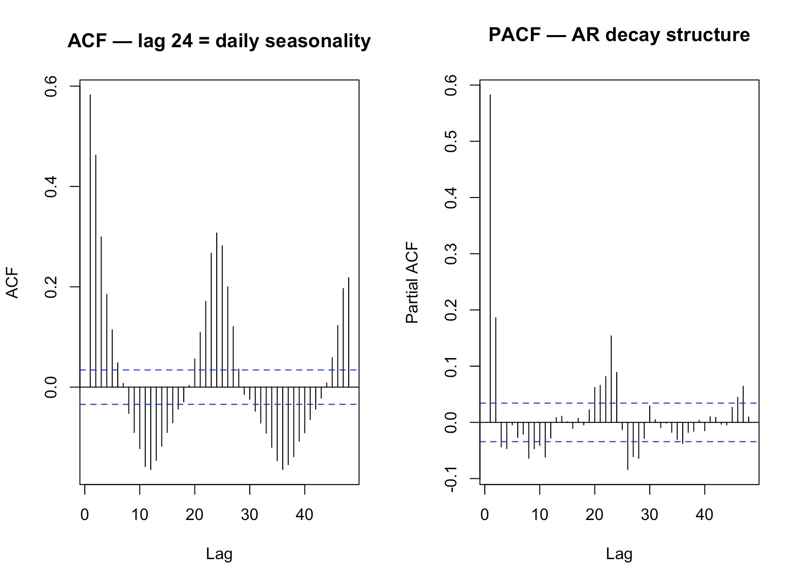
EXPLORATORY DATA ANALYSIS
EDA STL Decomposition & Autocorrelation
Confirms daily seasonality and AR structure before modelling
STL splits series into trend (40–100 Wh, slowly rising), daily seasonal (±40 Wh, freq=24), and remainder (spiky, up to 400 Wh). ACF confirms lag-24 dominates — justifies frequency=24 in SARIMAX.

Slide 11
FEATURE ENGINEERING
Feature Engineering Bio-Analytics Occupancy Scoring
The unique contribution of this project
Occupancy Formula (per room)
Why outdoor correction?
Step 1 — RH signal ΔRH_room − ΔRH_outdoor → breathing signal × 0.4 Step 2 — Temperature signal ΔT_room − ΔT_outdoor → body heat signal × 0.3 Step 3 — Lights signal lights / max_lights → active use signal × 0.3 Score = clip(sum, 0 → 1) per room per 10 min
On a humid rainy day all rooms show rising RH ,but that's weather, not people. Subtracting outdoor rate isolates the indoor-only signal. What remains is the human fingerprint.
Additional features engineered
occ_house = mean of all indoor room scores
lag1 = energy previous hour
lag24 = energy same hour yesterday
roll3 = 3-hour rolling mean of energy

Slide 12
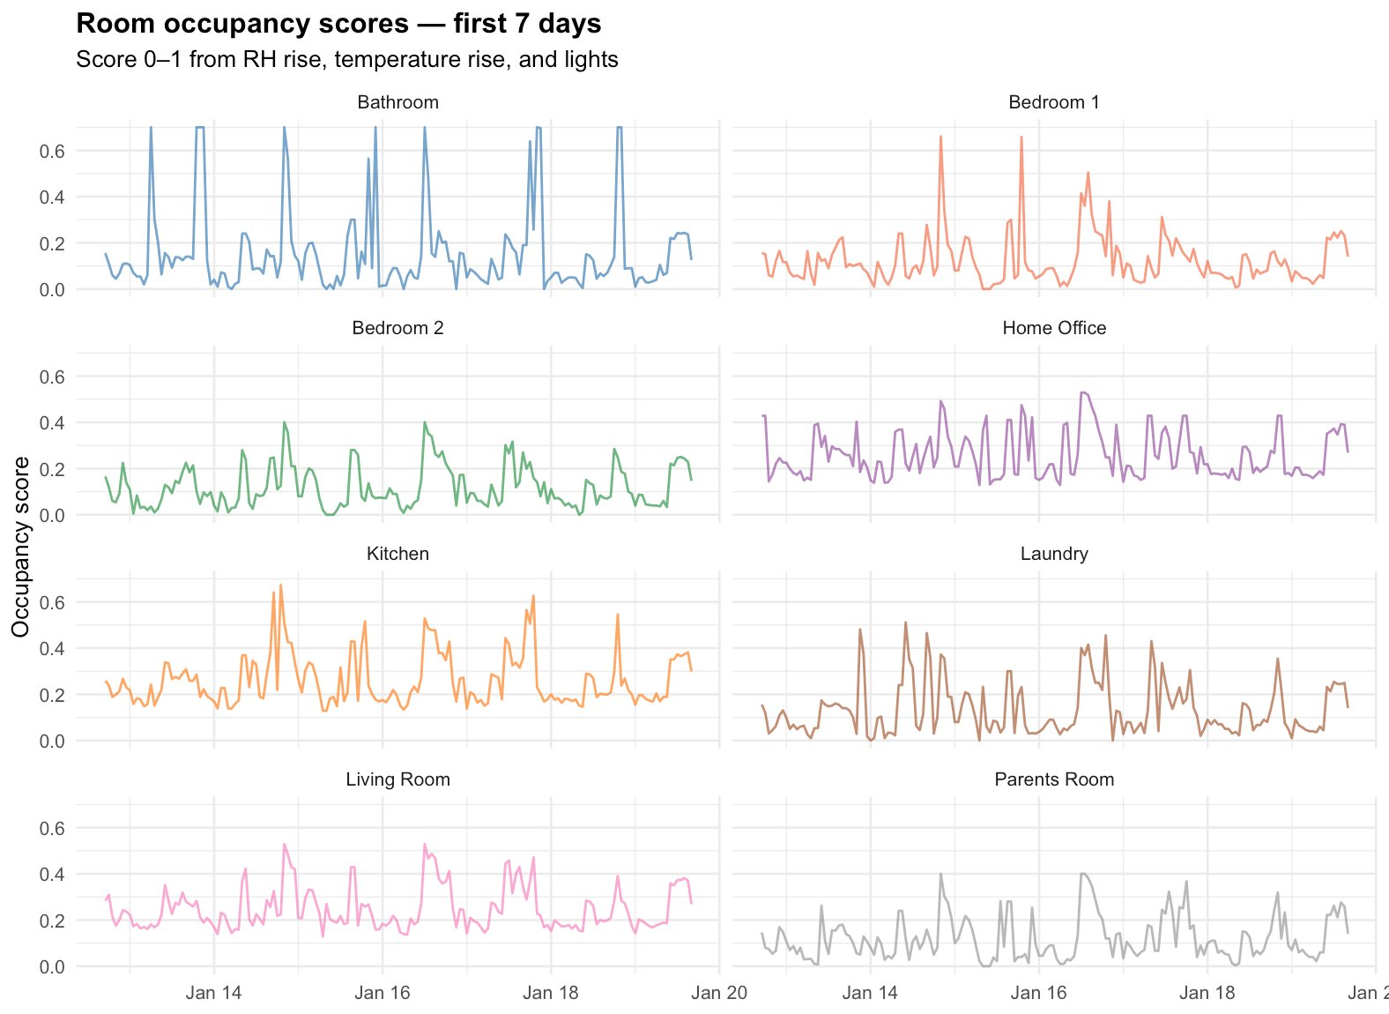
FEATURE ENGINEERING — RESULTS
Occupancy Scores per Room First 7 Days
Score 0–1 computed from sensor physics alone
Bathroom shows sharp isolated spikes (shower events). Kitchen shows meal-time peaks. Home Office has persistent daytime signal. Bedrooms stay low — body heat accumulates slowly.

Slide 13
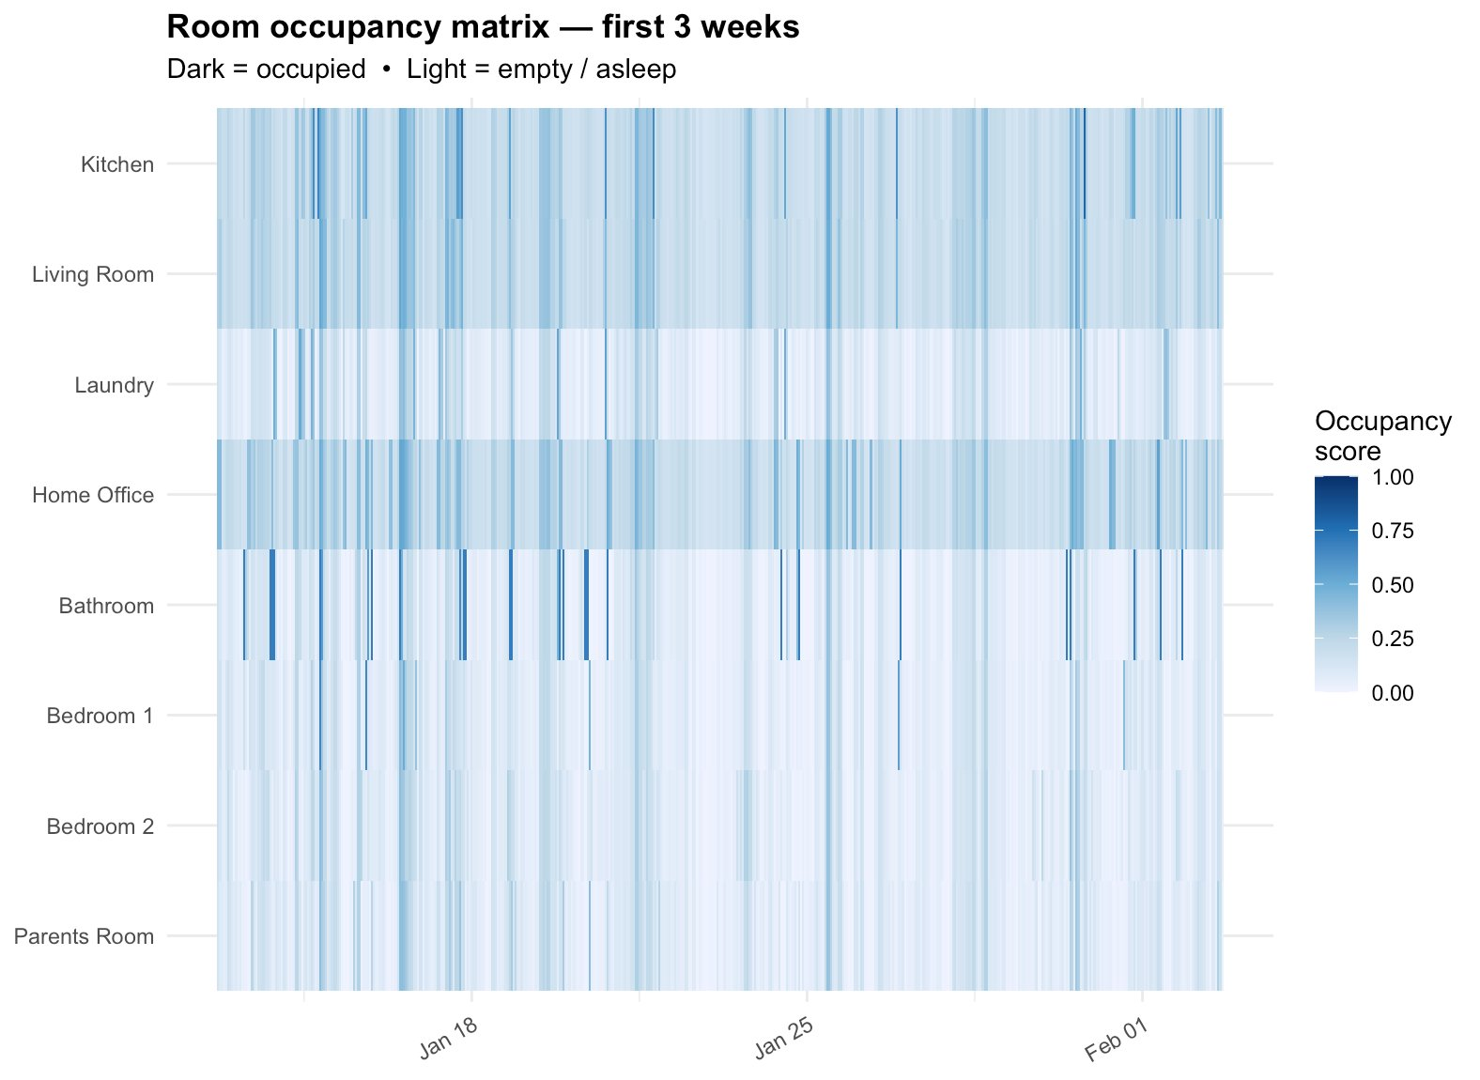
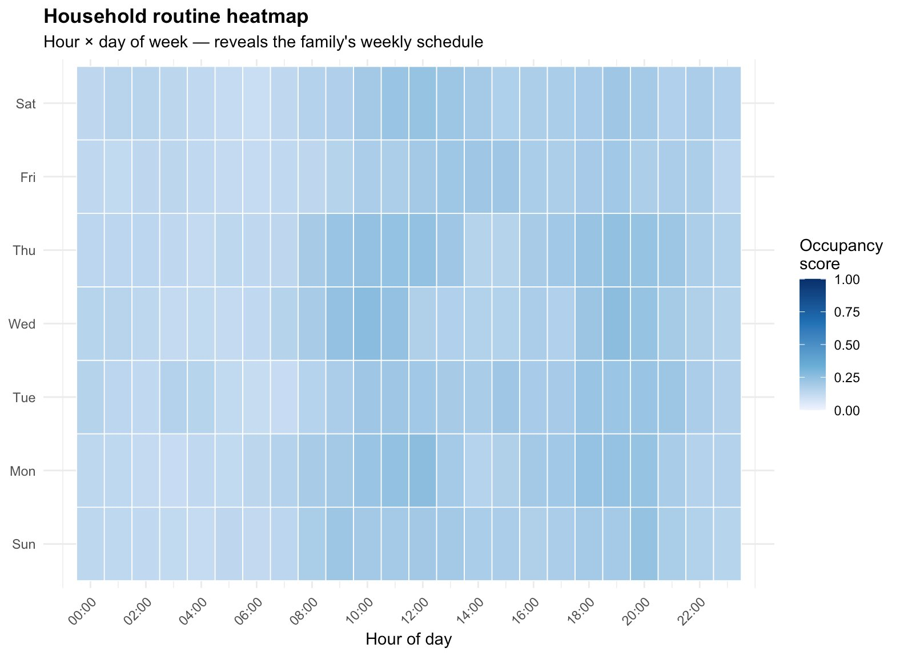
ROUTINE MINING
Room Occupancy Matrix & Household Routine Heatmap
3-week occupancy matrix (dark = occupied)
Routine heatmap — family weekly schedule from sensor data

Slide 14
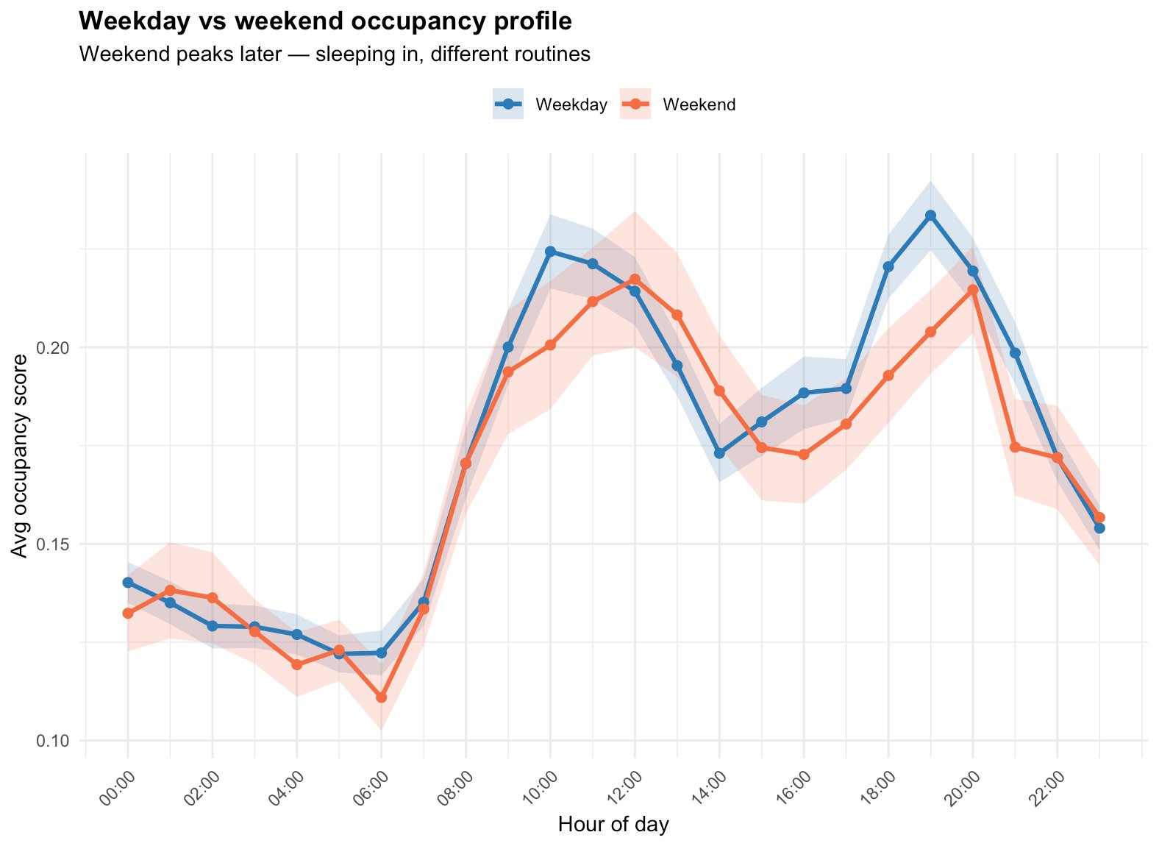
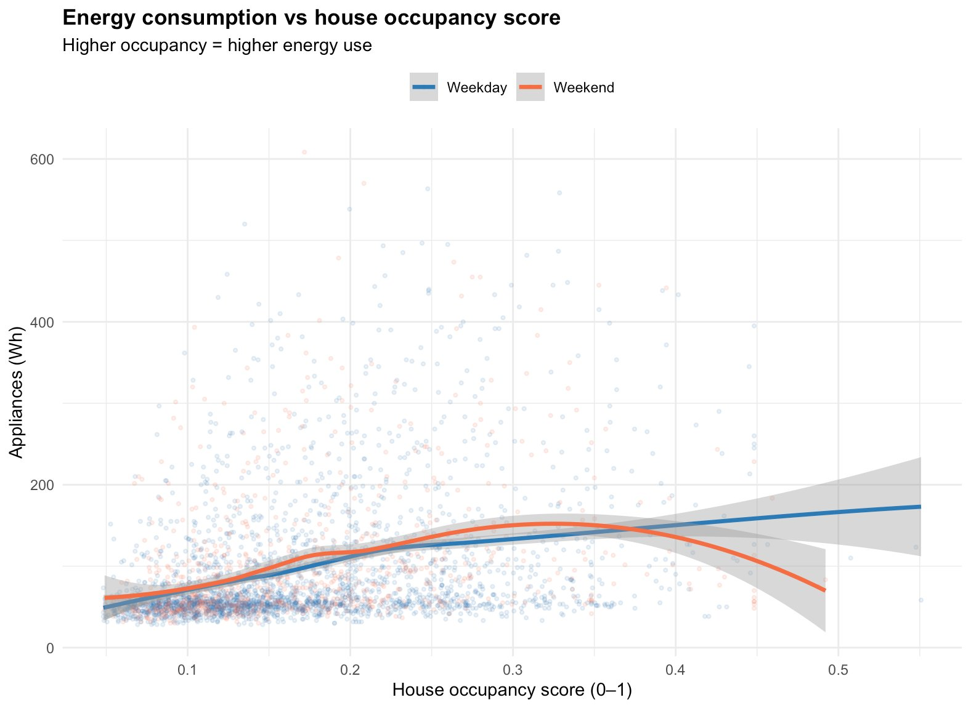
ROUTINE MINING
Weekday vs Weekend & Energy–Occupancy Relationship
Weekday morning peak earlier (commute). Weekend later sleeping-in. Energy rises monotonically with occupancy score up to score ~0.4, then plateaus.

Slide 15
TIME SERIES MODELLING — SARIMAX
Time Series Modelling SARIMAX
Model Selection
Key fix applied vs original code
auto.arima() for automated parameter search
ACF/PACF confirmed lag-24 seasonal period
d=0 enforced — series is mean-reverting, not trending
D=0 — no seasonal differencing needed
stepwise=TRUE, approximation=TRUE for speed
Original SARIMAX chose d=1 (first differencing) which made it predict changes not levels ,MAPE hit 150%
lag24 added to xreg gives the model an observed energy anchor at each forecast step
Why SARIMAX not SARIMA: the 'X' means exogenous variables. We pass weather + occ_house + lag24
Final Model: ARIMA(2,0,0)(2,0,0)[24]
Seasonal component frequency = 24 (daily cycle)

Slide 16
MACHINE LEARNING — RANDOM FOREST
Machine Learning Model Random Forest
Why Random Forest?
Why RF has lag features but SARIMAX uses xreg
Handles non-linear relationships between features
Robust to noise and high-variance appliance data
No stationarity requirement — works on raw levels
Feature importance built-in — validates bio-analytics
200 trees with importance=TRUE
SARIMAX handles temporal dependence internally through its AR/MA orders the 'memory' is built into the model structure
RF has no memory as it sees each row as independent. Without lag columns it cannot know what happened yesterday
So RF is explicitly handed lag1 and lag24 as input features ,this is the same information, just delivered differently
The occupancy scores (occ_1, occ_2 etc.) are unique to this project and no other approach generates these from sensor physics
Feature Set (12 variables)
Temporal lag: lag1, lag24, roll3 Occupancy: occ_house, occ_1, occ_2, occ_7, occ_8 Context: T_out, RH_out, hour, is_weekend

Slide 17
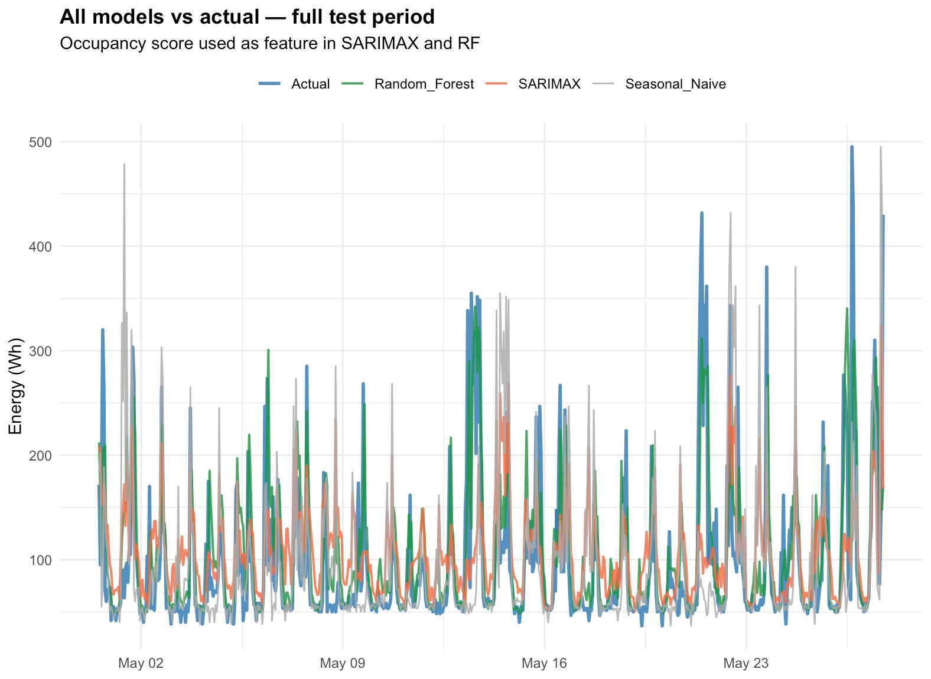
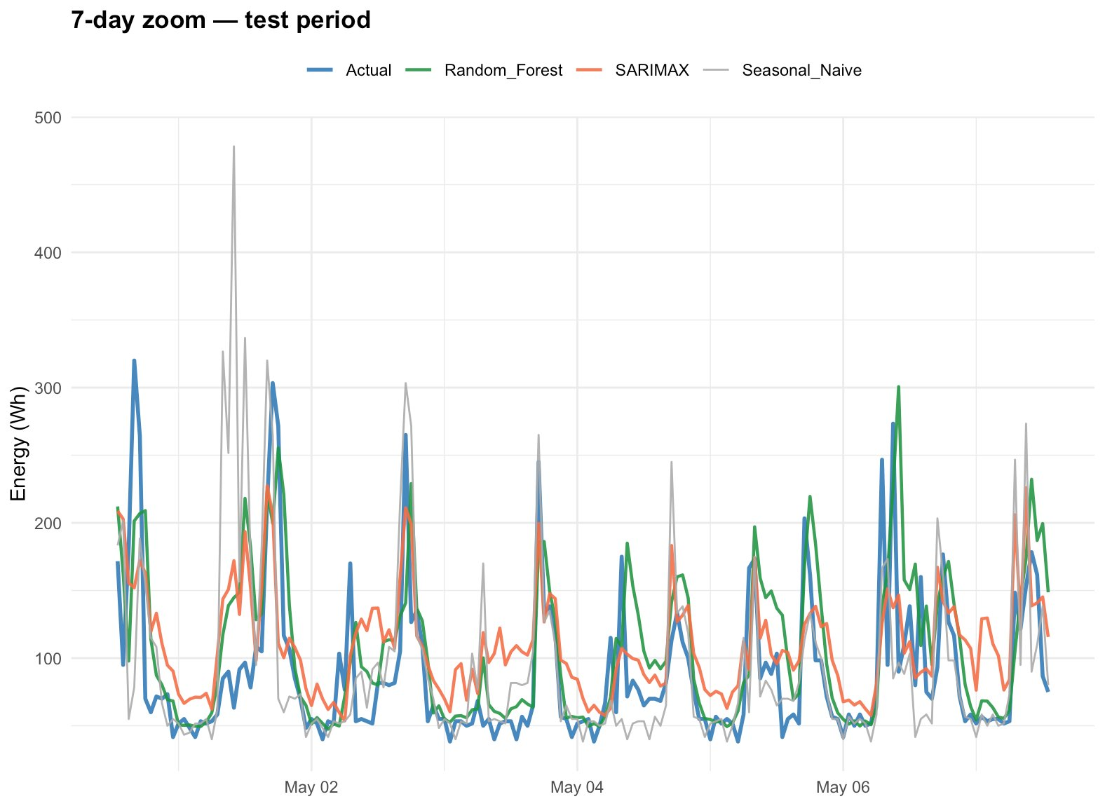
MODEL COMPARISON
Model Comparison — Forecast vs Actual
Full test period (May 2016) + 7-day zoom
RF (green) closely tracks actual peaks and troughs. SARIMAX (orange) produces a smoother forecast — captures trend but misses spikes. Seasonal naive (gray) is surprisingly competitive because energy is highly cyclical.

Slide 18
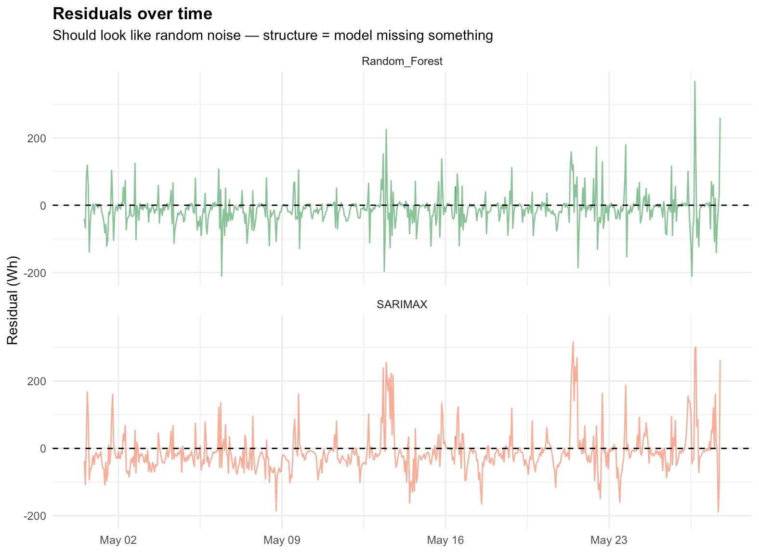
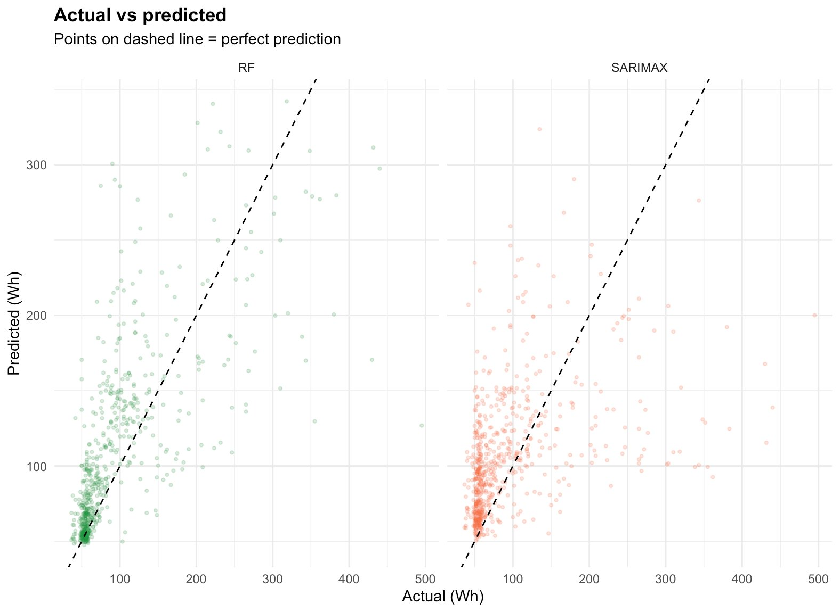
MODEL COMPARISON
Model Comparison Residuals & Actual vs Predicted
RF residuals centre on zero (good). SARIMAX residuals have slight negative bias — occasionally over-predicts low-energy hours. Scatter: RF points cluster closer to the diagonal.

Slide 19
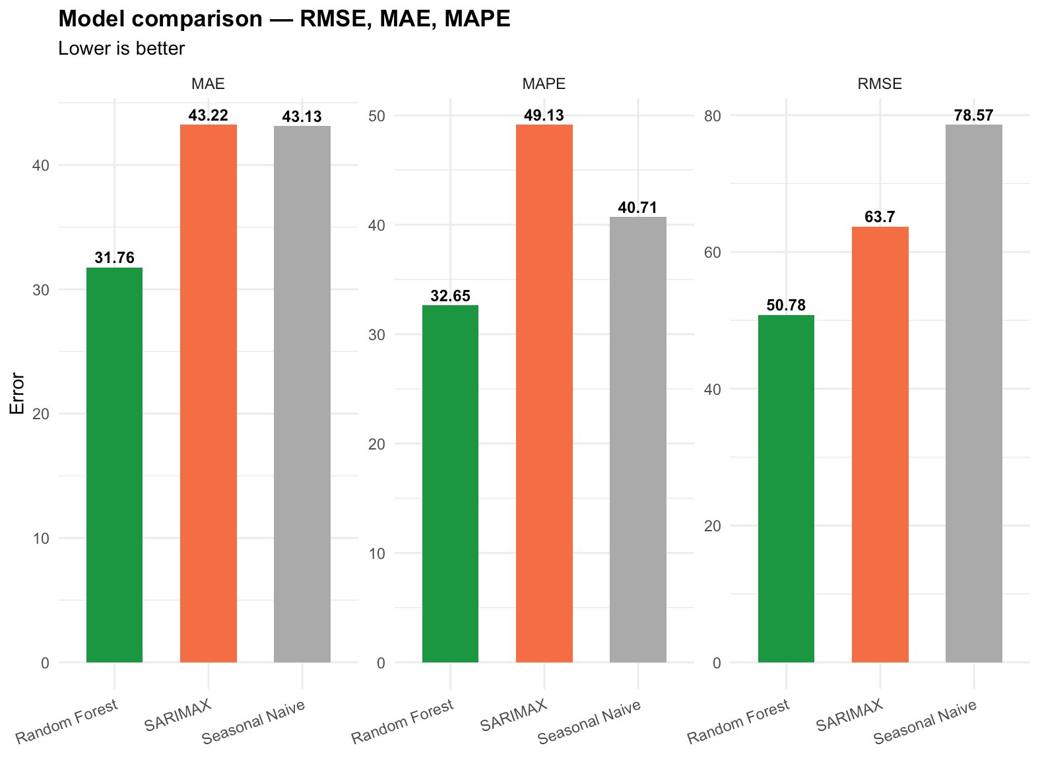
MODEL COMPARISON
Model Comparison Performance Metrics
51.18 Wh
63.7 Wh
78.6 Wh
32.6%
49.1%
RF RMSE
SARIMAX RMSE
Naive RMSE
RF MAPE
SARIMAX MAPE
Model | RMSE (Wh) | MAE (Wh) | MAPE (%) | Verdict
Random Forest | 51.18 | 32.179 | 33.346 | ★ Best
SARIMAX | 63.70 | 43.22 | 49.13 | Competitive
Seasonal Naive | 78.57 | 43.13 | 40.71 | Baseline

Slide 20
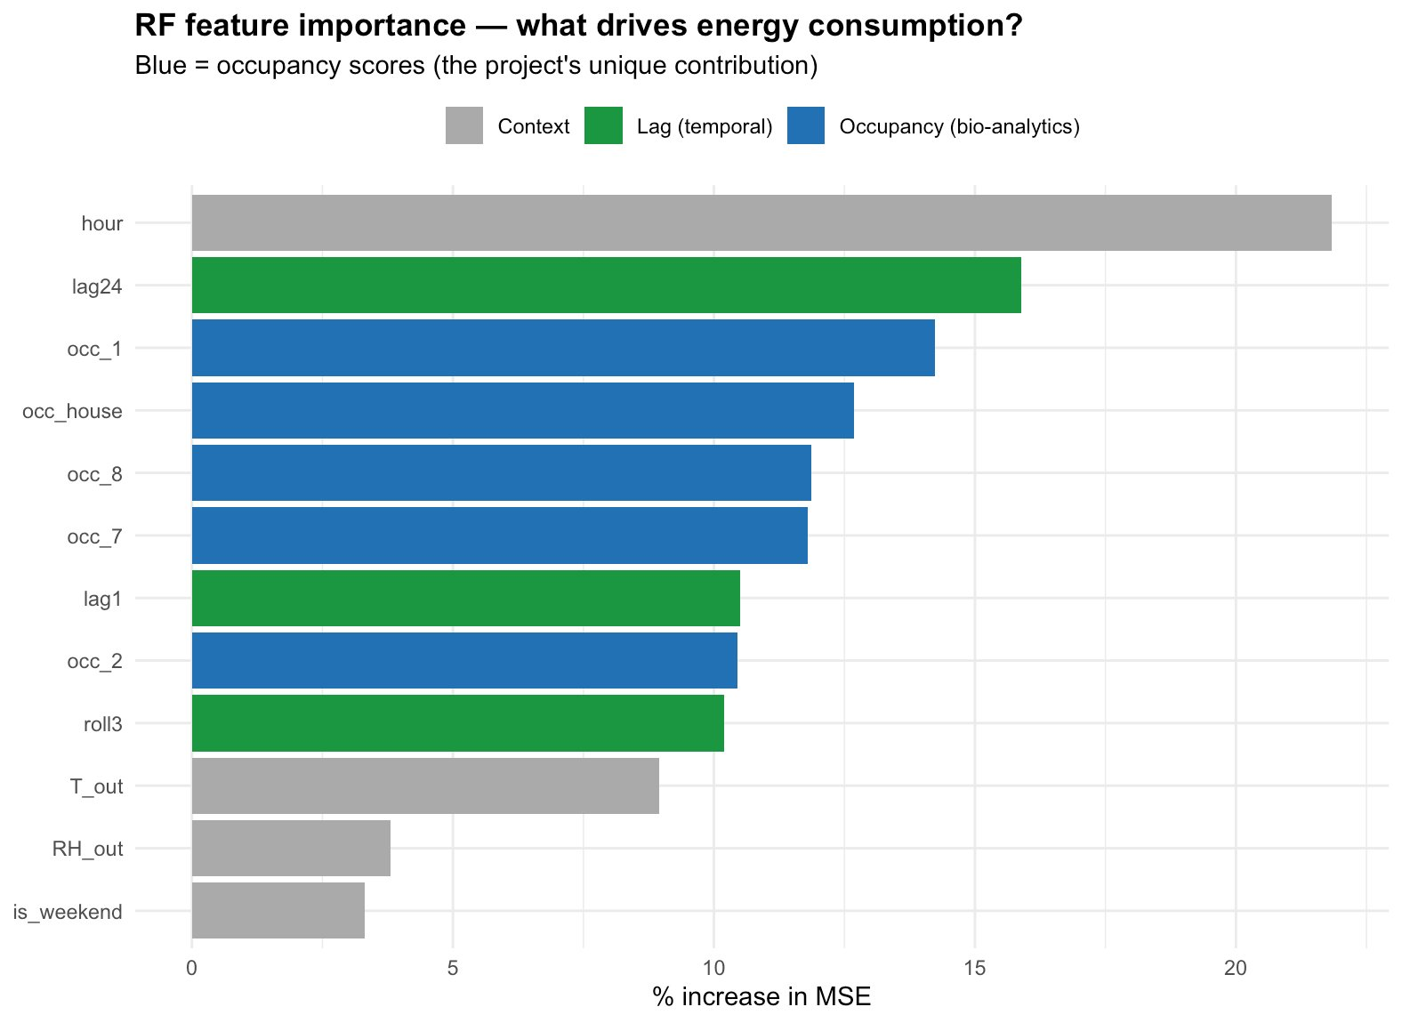
FEATURE IMPORTANCE
RF Feature Importance — What Drives Energy Consumption?
Bio-analytics occupancy scores are 4 of the top 6 features
Key Insight
hour = strongest overall daily cycle
lag24 = same hour yesterday is #2
occ_1 (Kitchen) = #3 cooking drives energy
occ_house, occ_8, occ_7 = #4–6
All 4 occupancy features outrank weather
Bio-analytics directly improved prediction accuracy which validates the entire pipeline
4 of top 6 features are occupancy scores derived from sensor physics

Slide 21
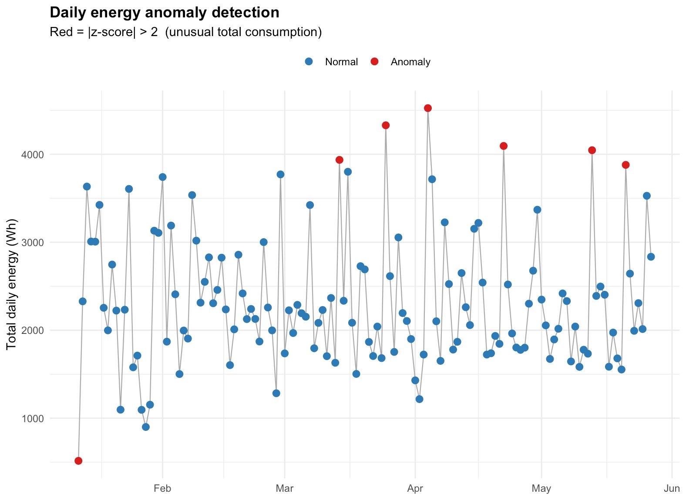
ANOMALY DETECTION
Anomaly Detection
7 anomalous days detected out of 137 total days
Method
Z-score on total daily energy consumption
|z| > 2 flagged as anomaly
7 anomalous days found in 137
April cluster (2 consecutive days) likely a holiday or guest visit
January outlier (low) possible away period
Insight
Anomaly days are harder to forecast they drive most of the remainder in STL
Z-score method is simple, interpretable, and catches meaningful outliers without over-flagging

Slide 22
Conclusion & Future Work
Human presence detectable from physics
Outdoor-corrected humidity and temperature rate signals produce reliable 0–1 occupancy scores per room ,no motion sensor or labelled data required.
Routine mining works from sensor data alone
Weekly schedule, wake time, meal times, and bedtime recoverable from 4.5 months of T/RH readings. Weekday and weekend profiles differ detectably.
Occupancy scores directly improve forecasting
4 of the top 6 RF features are occupancy scores. The bio-analytics pipeline is quantifiably useful — not just descriptive.
RF outperforms SARIMAX on noisy energy data
RMSE.SARIMAX recovered after fixing d=0 and adding lag24 (MAPE 150% → 49%). RF handles non-linear spikes better.
Future Work: LSTM/XGBoost for non-linear forecasting · Ground-truth occupancy validation · Real-time smart home integration · Hybrid model ensemble

Slide 23
Q&A
Questions & Discussion
University of Texas at Arlington | Applied Time Series Analysis in Data Analytics

