Slide 1


CANARA ENGINEERING COLleGe
DEPARTMENT OF COMPUTER SCIENCE AND ENGINEERING TITLE: DESIGN & IMPLEMENTATION OF NEXTGEN SECURED LOCATION TRACKING SYSTEM
Ms. Preksha 4CB21CS075
Mr. Prithwin B U 4CB21CS076
Mr. Rakshan Shetty K 4CB21CS084
Ms. Suhani 4CB21CS113
MENTOR: Shreya
GUIDE: Prof. Alok Ranjan
Date : 30-11-2024

Slide 2
Content
Introduction
Problem Statement
Objectives and scope
Literature survey
Gaps identified
Functional & Non-Functional requirements
Design Constraints
Implementation
Results
Conclusions and Future Work
Bibliography
2

Slide 3
INTRODUCTION
Overview: This system is develops to monitor real-time location of family and friends using modern technologies like Firebase and Google API’s. It allows user to track and share precise location information instantly, ensuring they can stay connected with their loved ones. The interface is user-friendly, making it accessible for everyone. Strong privacy and security measures ensure that only authorized users can access location data. This solution enhances safety and connectivity, keeping loved ones connected efficiently.

Slide 4
Problem Statement
Challenges Faced by Parents:
Difficulty in monitoring children's activities when they are not physically present.
Concerns about children's safety in various environments (school, playground, etc.).
Lack of real-time updates from existing monitoring solutions.
Limitations of Existing Systems:
Many systems lack user-friendly interfaces.
Security vulnerabilities that may expose sensitive data.
Inadequate features for comprehensive monitoring
4

Slide 5
Objectives and Scope
Objectives:
To develop a user-friendly child monitoring system that provides real-time tracking.
To ensure safety by alerting parents of any unusual activities or movements.
To enhance parental control over children's interactions with technology.
Scope:
Target Users: Parents and guardians of children.
Key Features:
Location tracking with geofencing capabilities.
Monitoring of call logs and text messages.
Alerts for entering/exiting designated areas (e.g., school, home).

Slide 6
Literature Survey
Article 1 – Mobile Tracking System Using Web Application and Android Apps
Parents are very much concerned about their children now a days and are compelled to provide an Android phone to their children. They want to monitor children activities and movements, where they are going and what they are doing. But this process is difficult. To solve this problem a Mobile Tracking System has been designed, using this system parents can track children’s location. An Android application (Mobile Tracking System) needs to install in mobile phone of the children and parents have to register this application with a password. After completing the registration, parents can monitor mobile phone’s location of their children through a web site (www.mobiletrackerbd.com) from anywhere.

Slide 7
Article 2 – Survey on Live Tracking Phone No. Via Android /IOS Based App
Under my survey of “Live tracking phone no. via Android / IOS Based app” we will get to see so many innovations that has been done so far. Through the survey many approaches are introduced, but which one is the best and accurate it is not decided yet. So, in this paper we have discussed which will be the feasible app and convenient for all of us to track a cell no. via app. So, many disparities you will notice about hardware and methods because technology getting change on daily basis. Tracking a cell no. is possible but if we investigate not accurate result it will yield us.

Slide 8
Article 3 – Location Based Services using Android Mobile Operating System
The location-based services are offered through the use of GPS and mapping technologies to enrich the experience of the users. Such services make possible various applications, including ride-sharing, food delivery, and location-specific advertising. The availability of location data provides businesses with the ability to align the offerings in light of customer needs, thus enhancing satisfaction and effectiveness in operations. The implementation of GPS technology assists in applications that track location in real time, navigate, and provide personal services

Slide 9
Article 4- Live Location Tracker
The ”Live Location Tracker” project uses GPS for real-time positioning, created using Android Studio. It utilizes the Map SDK for map-based visualization and Firebase’s Real-Time Database for seamless data storage , NEXTGEN SECURED LOCATION TRACKING SYSTEM and retrieval. This makes it possible to enhance user experience with timely updates on location as well as proper handling of data, making the system applicable in environments that focus on logistics, personal safety, and even emergency response

Slide 10

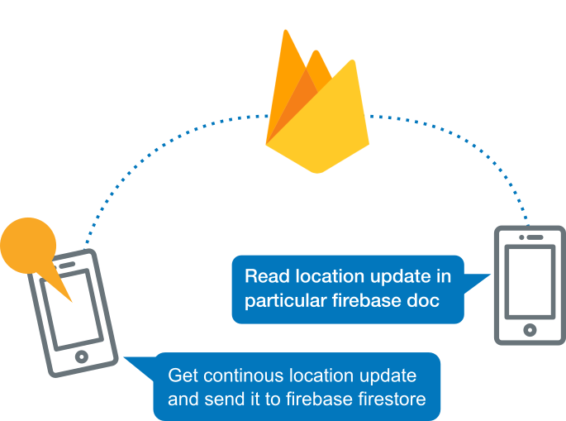
Gaps identified
.
Analysis of Existing Systems:
Many systems do not provide comprehensive monitoring features.
Lack of integration with modern technology (e.g., smartphones).
Specific Gaps:
Insufficient real-time alerts and notifications.
Poor user experience and interface design.
Limited customization options for parents.
Importance of Addressing Gaps:
Filling these gaps will enhance user satisfaction and trust in the system.

Slide 11
Functional & Non-Functional requirements
Functional requirements:
Key Functionalities:
Real-time Location Tracking:
Parents can view their child's current location on a map.
2.Geofencing Alerts:
Notifications when a child enters or exits predefined areas.
3.Activity Logging:
Access to call logs, text messages, and app usage.
4.User Authentication:
Secure login for parents to protect sensitive information.

Slide 12
5.Emergency Alerts:
Quick alert feature for children to notify parents in case of danger.
6. User Customization
Option to enable/disable tracking or limit it to specific areas/times.
7. Location History and Reports
Provide a history of locations and routes taken.
8. Mobile Application Support
Native mobile app support for both Android and iOS.
Allow mobile push notifications for alerts and updates.

Slide 13
Performance Requirements:
The system should respond to user queries within 2 seconds.
Capable of handling multiple users simultaneously without performance degradation.
Usability Requirements:
Intuitive user interface that is easy to navigate for all age groups.
Comprehensive user guide and support documentation.
Security Requirements:
Data encryption for sensitive information.
Regular security updates to protect against vulnerabilities.
Non-Functional Requirements:

Slide 14
Design Constraints
Technical Constraints:
Compatibility with various mobile devices and operating systems (iOS, Android).
Use of specific programming languages and frameworks (Java, Spring).
Budget Constraints:
Limited budget for development and marketing.
Need to prioritize features based on available resources.
Time Constraints:
Project timeline with specific milestones for development phases.

Slide 15
IMPLEMENTATION
Project Implementation Technology :
The Project application is loaded in Android Studio. We used Android Studio for the Design and coding of the project.
Project Implementation Technology
Front-End: XML (for UI design)
Back-End: MSSQL for database management
Programming Language: Java
IDE: Android Studio
Software Requirements
Android Studio for development.
Azure Data Studio for database management.

Slide 16
Hardware Requirements
A PC or laptop with:
Windows 7 or higher.
Intel i3 processor or higher.
Minimum 8GB RAM.
100GB ROM.
Android phone with version 6.0 or higher.
Functional Modules and Features
Parent Module:
Authentication: Allows sign-up/sign-in using Google or regular credentials.
Child Management: Features to add, update, delete, and view child details.
Activity Monitoring: Enables access to child’s call logs, text messages, and contact lists.
Location Tracking: Displays child’s real-time location.

Slide 17
Child Module:
Background Data Collection: Collects data (e.g., calls, messages, location) seamlessly without the child’s awareness.
User-Friendly Front App: A calculator app that masks the monitoring functionalities.
Development Process
The Waterfall Model guided the development:
Requirement Analysis: Analyzed needs for child safety and remote monitoring.
System Design: Created E-R diagrams, use-case diagrams, and activity diagrams for structured development.
Implementation: Used Android Studio for coding the app, MSSQL for backend database, and APIs for communication between modules.
Testing: Conducted unit, integration, system, validation, and user acceptance testing to ensure functionality, reliability, and accuracy.

Slide 18
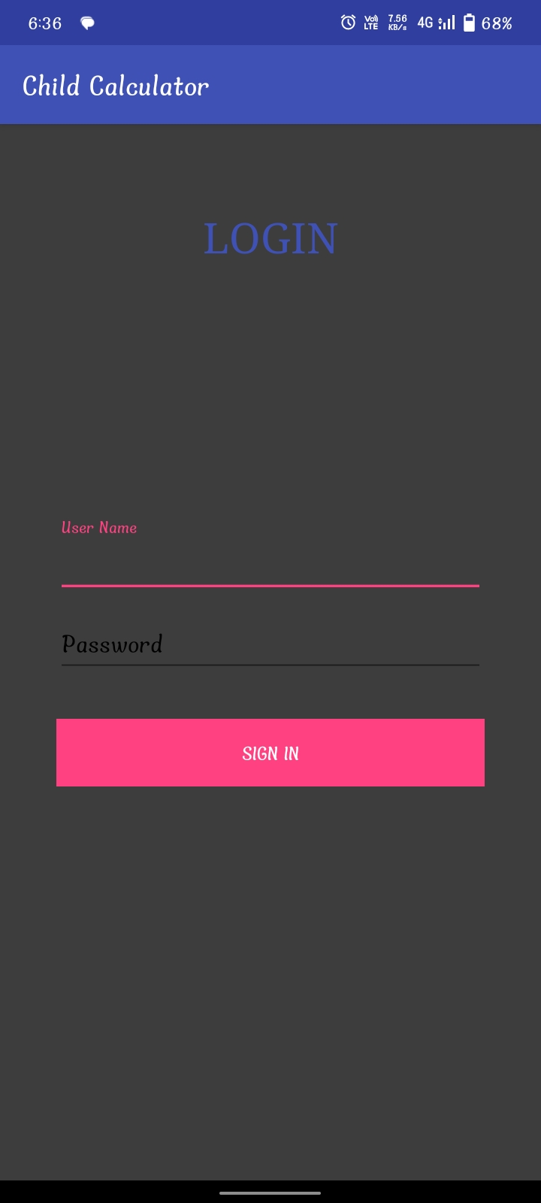
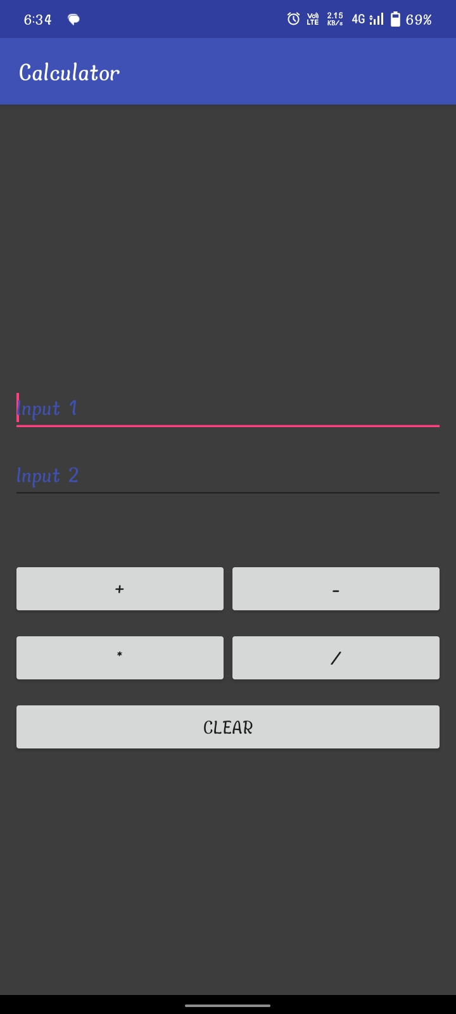
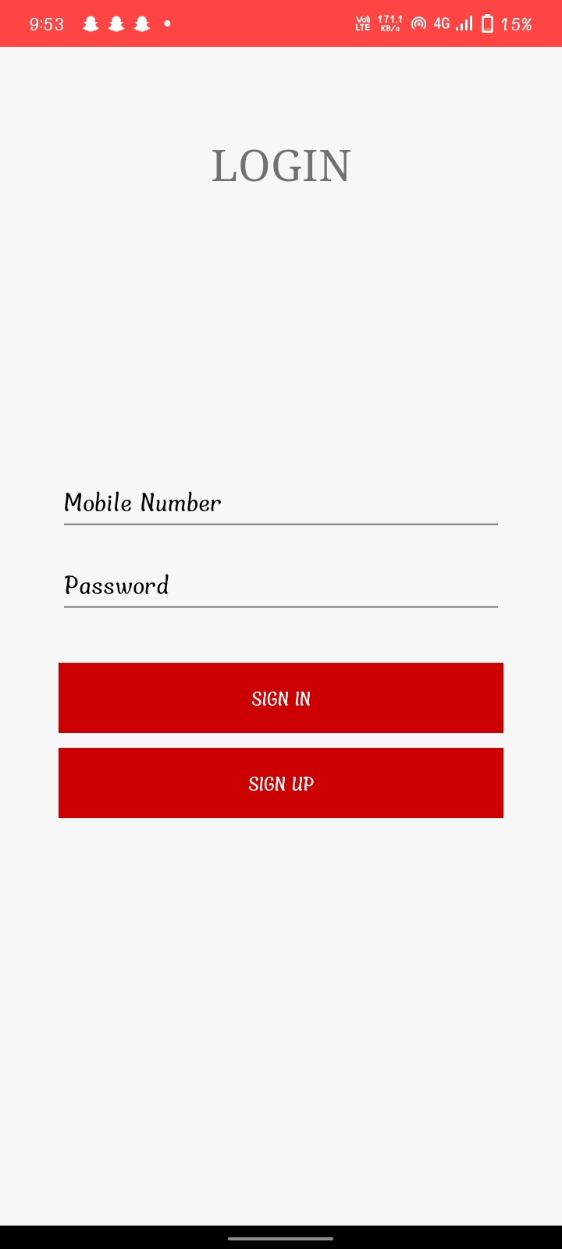
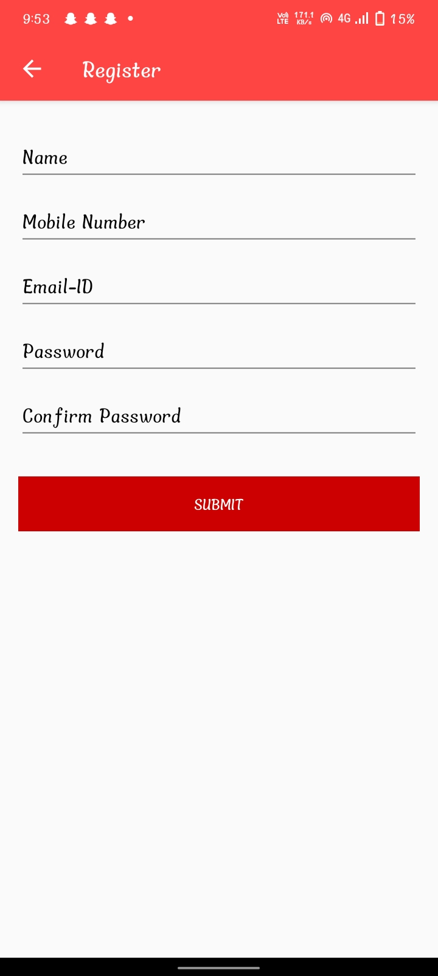
RESULT AND DISCUSSION
Child’s Interface
Parents Interface

Slide 19
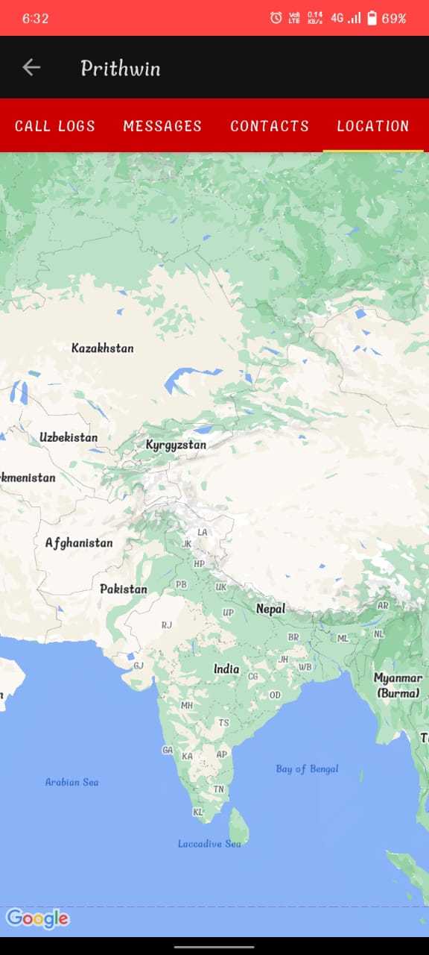
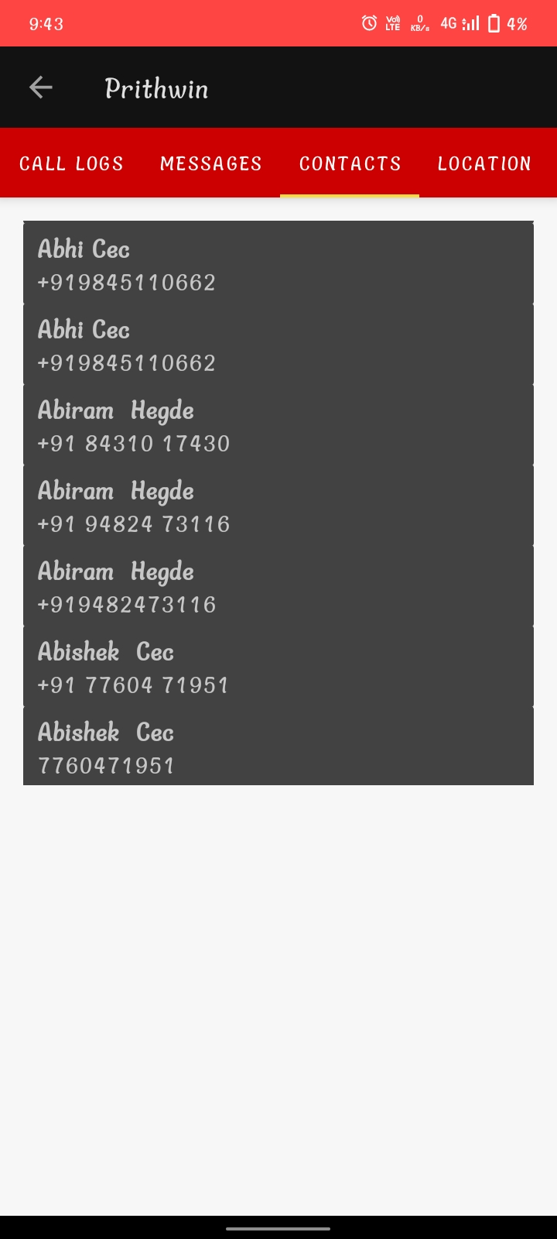
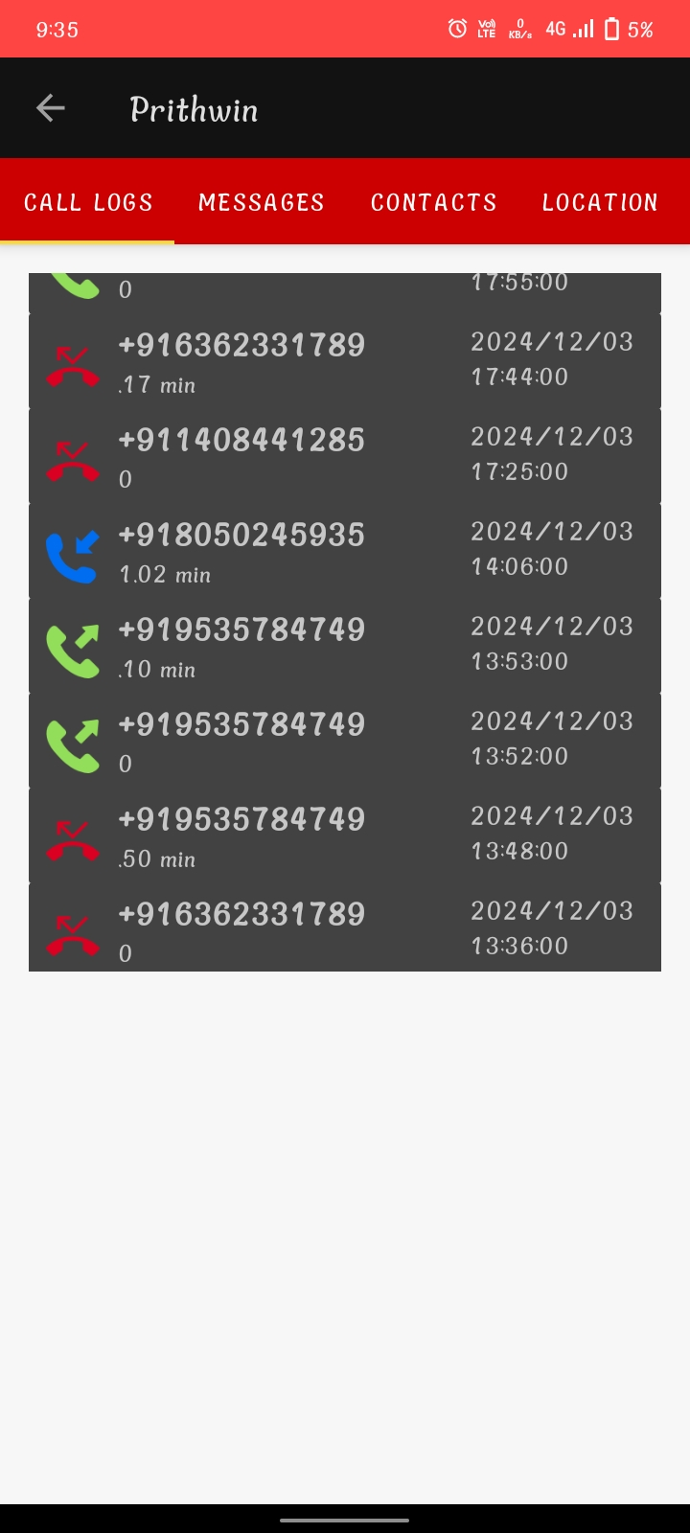
location of child
Contacts
Call logs

Slide 20
CONCLUSION AND FUTURE WORK
The NextGen Secured Location Tracking System project has successfully demonstrated the potential to provide real-time, accurate, and secure location tracking for users. By integrating advanced GPS and mobile network technologies with robust security measures such as user authentication, encryption, and geofencing, the system offers enhanced privacy and control for individuals. The mobile app interface facilitates easy access to location data, while the backend effectively stores and processes real-time information, ensuring the system is both responsive and scalable.

Slide 21
Bibliography
[1] Alam, Mohammad. (2017). Mobile Tracking System using Web Application and Android Apps. 6. 257-261.
[2] Mishra, Aman & Manhar, Advin. (2020). Survey on Live Tracking Phone No. Via Android/IOS Based App. International Journal of Scientific Research in Computer Science, Engineering and Information Technology. 323-327. 10.32628/CSEIT206651.
[3] Paramvir Bahl and Venkata N Padmanabhan. “RADAR: An in-building RF-based user location and tracking system”. In: Proceedings IEEE INFOCOM 2000. Conference on computer communications. Nineteenth annual joint conference of the IEEE computer and communications societies (Cat. No. 00CH37064). Vol. 2. Ieee. 2000,pp. 775–784.
[4] T Sindhu and L SaiRamesh. “REAL TIME VEHICLE TRACKING SCHEME BY
ANALYSING SPATIAL POSITION THROUGH GPS AND GSM.

