Slide 1
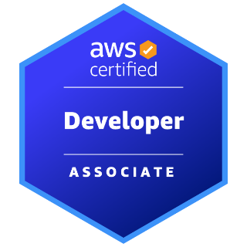
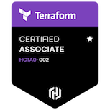
Functional/Technical Competency
AI/ML | DevOps (CI/CD) | Cloud & Infrastructure | Application Development
Deep Learning, NLP , Computer Vision Generative AI | GitHub Actions, Terraform , Ansible Azure DevOps | AWS , Azure Kubernetes Docker | Django , Flask Spring Boot Framework
Prithwish Mandal
Senior Software Engineer
Mobile : +91 9836962341
Email : prithwishm969@gmail.com
Background
A highly skilled software engineer specializing in AI/ML, advanced DSA, Generative AI and dynamic application development. Proficient in building scalable, intelligent systems using frameworks like TensorFlow, PyTorch and LangChain. Expertise in DevOps, AWS, Azure cloud ensures secure, efficient infrastructures with seamless deployments. A Python automation enthusiast, streamlining workflows and driving productivity. An innovative team player, passionate about leveraging emerging technologies to deliver impactful, AI-driven solutions.
Professional experience
Ernst & Young (Jan 2022 – Till Now)
1. Designed an Autogen framework with multi-agent orchestration, NLP, ChromaDB, and seamless API and database integration for
efficient execution.
2. Developed an AI-driven system for survey data processing, analytics, and real-time predictions using AWS Lambda, S3, Glue, Sagemaker, Bedrock.
3. Developed a GenAI agent with Autogen Framework for post-migration anomaly detection, integrating Azure monitoring tools,
Python, KQL, and a Flask-based PostgreSQL system.
4. Experienced in AI-driven AWS monitoring, using CloudWatch, X-Ray, and CloudTrail with ML algorithms for anomaly detection,
trend analysis, and optimized resource management.
5. Built an AI chatbot with LangChain for enterprise support, integrating LLMs and vector databases for smarter, context-aware
responses.
6. Deployed a scalable Django app on AWS using Docker, Helm, EKS, and ECR with CI/CD using GitHub Actions.
7. Built an AI-driven AWS Lambda alerting system using Isolation Forest and K-Means for anomaly detection, with real-time alerts to Microsoft Teams and Email.
8. Developed a deep learning model using PyTorch for image classification, leveraging transfer learning and scikit-learn for data
preprocessing and evaluation.
DataPeace AI Technology Pvt Ltd (Feb 2021 – Dec 2021)
1. Extracted Aadhaar card numbers from images using OCR and deep learning for precise text recognition and parsing.
2. Developed a flight availability prediction API using deep learning, leveraging datasets and weather conditions for accurate
forecasts.
3. Built an NLP chatbot using machine learning, leveraging text preprocessing, sentiment analysis, and LSTM for sentiment-driven
responses.
Education
Holds a Bachelor degree in Computer Science from KIIT UNIVERSITY
Skills
Languages: Java, Spring Boot, Micro Services, Python, Django, Flask., FastAPI.
RDBMS/DB : MySQL, Oracle
CLOUD: AWS & Azure
AI/ML: NLP, DataScience. GenAI, Computer Vision
CI/CD : GitHub Actions, GitLab, Azure DevOps, Terraform
Containerization/Orchestration: Docker, Kubernetes
Agile Tools: JIRA, Confluence

