Slide 1
HYPOTHESES TESTING IN STATISTICS
PRESENTED BY PreetiNanda Parida
CSE Mtech(1st semester)
SSIPMT

Slide 2
1. What is hypothesis testing ?
Hypothesis testing is a statistical method that is used in making statistical decisions using experimental data. Hypothesis Testing is basically an assumption that we make about the population parameter.
Ex : you say avg student in class is 40 or a boy is taller than girls.
, like in court judge make the decision on being guilty or not with enough evidence
all those example we assume need some statistic way to prove those. we need some mathematical conclusion what ever we are assuming is true.

Slide 3
2. why do we use it ?
Hypothesis testing is an essential procedure in statistics. A hypothesis test evaluates two mutually exclusive statements about a population to determine which statement is best supported by the sample data. When we say that a data is statistically significant, it’s all to a hypothesis test.

Slide 4
Types of hypotheses:
1)Null hypothesis :- In inferential statistics, the null hypothesis is a general statement or default position that there is no relationship between two measured phenomena, or no association among groups
In other words it is a basic assumption or made based on domain or problem knowledge.
Ex – according to given evidence a person is not guilty

Slide 5
2)Alternative hypothesis :-
The alternative hypothesis is the hypothesis used in hypothesis testing that is contrary to the null hypothesis. It is usually taken to be that the observations are the result of a real effect (with some amount of chance variation superposed).
when we normally reject Ho then we accept H1.
Example : a company production is !=50 unit/per day etc.

Slide 6
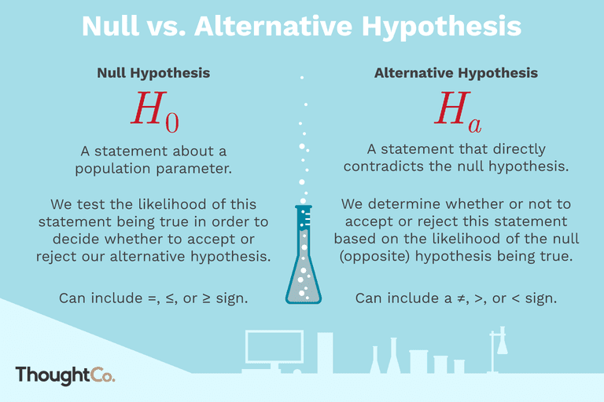





Slide 7

Level of significance: Refers to the degree of significance in which we accept or reject the null-hypothesis. 100% accuracy is not possible for accepting or rejecting a hypothesis, so we therefore select a level of significance that is usually 5%.
This is normally denoted with alpha(maths symbol ) and generally it is 0.05 or 5% , which means your output should be 95% confident to give similar kind of result in each sample.
Type I error: When we reject the null hypothesis, although that hypothesis was true. Type I error is denoted by alpha.
Ex: Ho assumption is that market stock price will crash
H1 assumption is that market stock price will not crash
But sue to lack of evidence of data we go for h1 and reject Ho but although Ho is true .
Type II errors: When we accept the null hypothesis but it is false. Type II errors are denoted by beta.

Slide 8
These are some of widely used hypothesis testing type :-
T Test ( Student T test)
Chi-Square Test
ANOVA Test
Z Test

Slide 9
What Is a T-Test?
A t-test is a type of inferential statistic used to determine if there is a significant difference between the means of two groups, which may be related in certain features. It is mostly used when the data sets, like the data set recorded as the outcome from flipping a coin 100 times, would follow a normal distribution and may have unknown variances. A t-test is used as a hypothesis testing tool, which allows testing of an assumption applicable to a population.

Slide 10
Types and What type of t-test should we use?
When choosing a t-test, you will need to consider two things: whether the groups being compared come from a single population or two different populations, and whether you want to test the difference in a specific direction.
One-sample, two-sample, or paired t-test?
If the groups come from a single population (e.g. measuring before and after an experimental treatment), perform a paired t-test.
If the groups come from two different populations (e.g. two different species, or people from two separate cities), perform a two-sample t-test (a.k.a. independent t-test).
If there is one group being compared against a standard value (e.g. comparing the acidity of a liquid to a neutral pH of 7), perform a one-sample t-test.
One-tailed or two-tailed t-test?
If you only care whether the two populations are different from one another, perform a two-tailed t-test.
If you want to know whether one population mean is greater than or less than the other, perform a one-tailed t-test.
In your test of whether petal length differs by species:
Your observations come from two separate populations (separate species), so you perform a two-sample t-test.
You don’t care about the direction of the difference, only whether there is a difference, so you choose to use a two-tailed t-test.

Slide 11
When to use a t-test
A t-test can only be used when comparing the means of two groups (a.k.a. pairwise comparison). If you want to compare more than two groups, or if you want to do multiple pairwise comparisons, use an ANOVA test or a post-hoc test.
The t-test is a parametric test of difference, meaning that it makes the same assumptions about your data as other parametric tests. The t-test assumes your data:
are independent
are (approximately) normally distributed.
have a similar amount of variance within each group being compared (a.k.a. homogeneity of variance)
If your data do not fit these assumptions, you can try a nonparametric alternative to the t-test, such as the Wilcoxon Signed-Rank test for data with unequal variances.

Slide 12
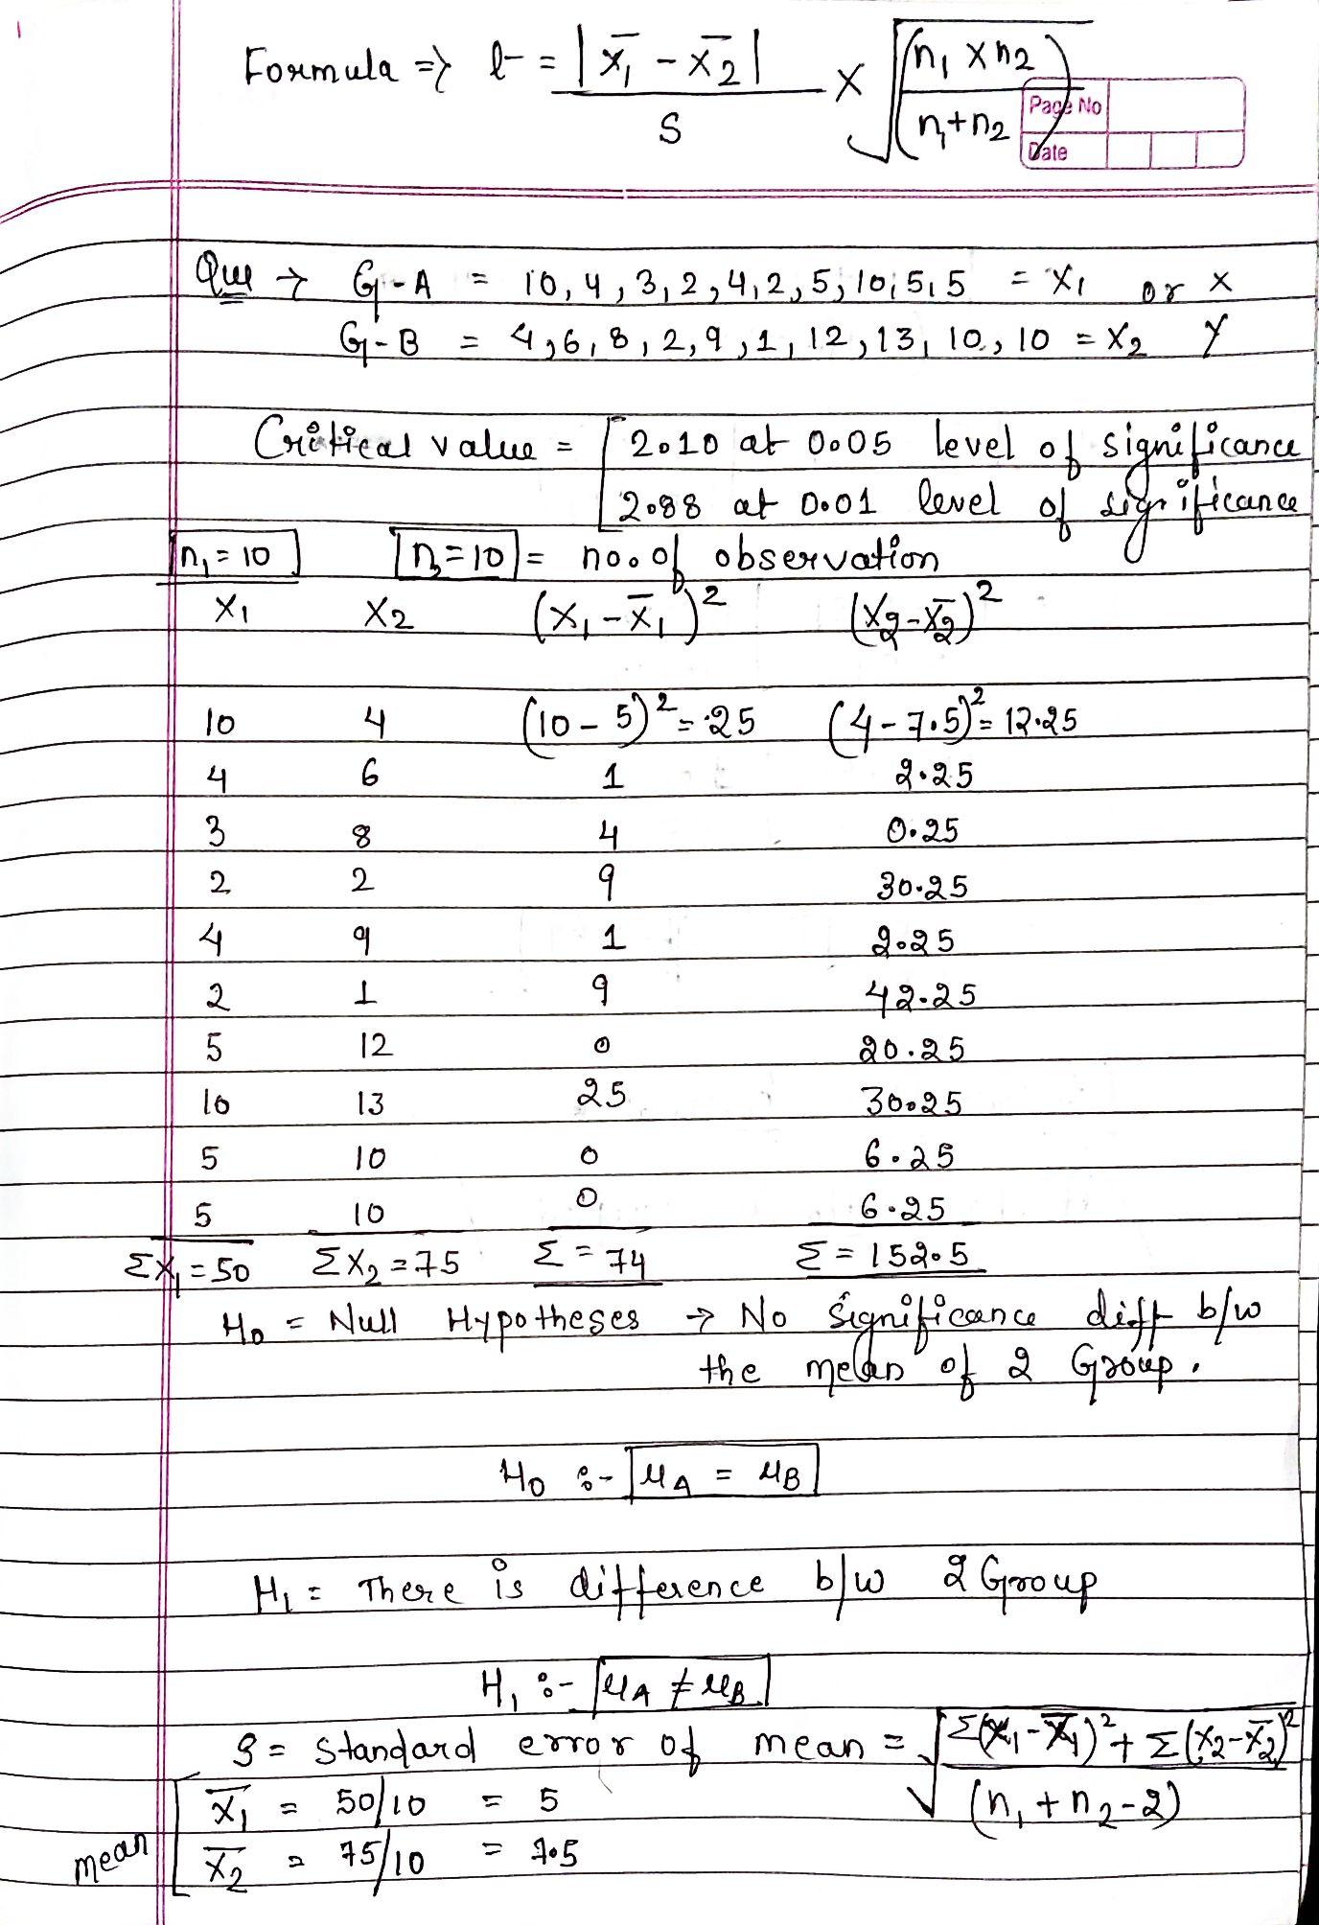

Slide 13
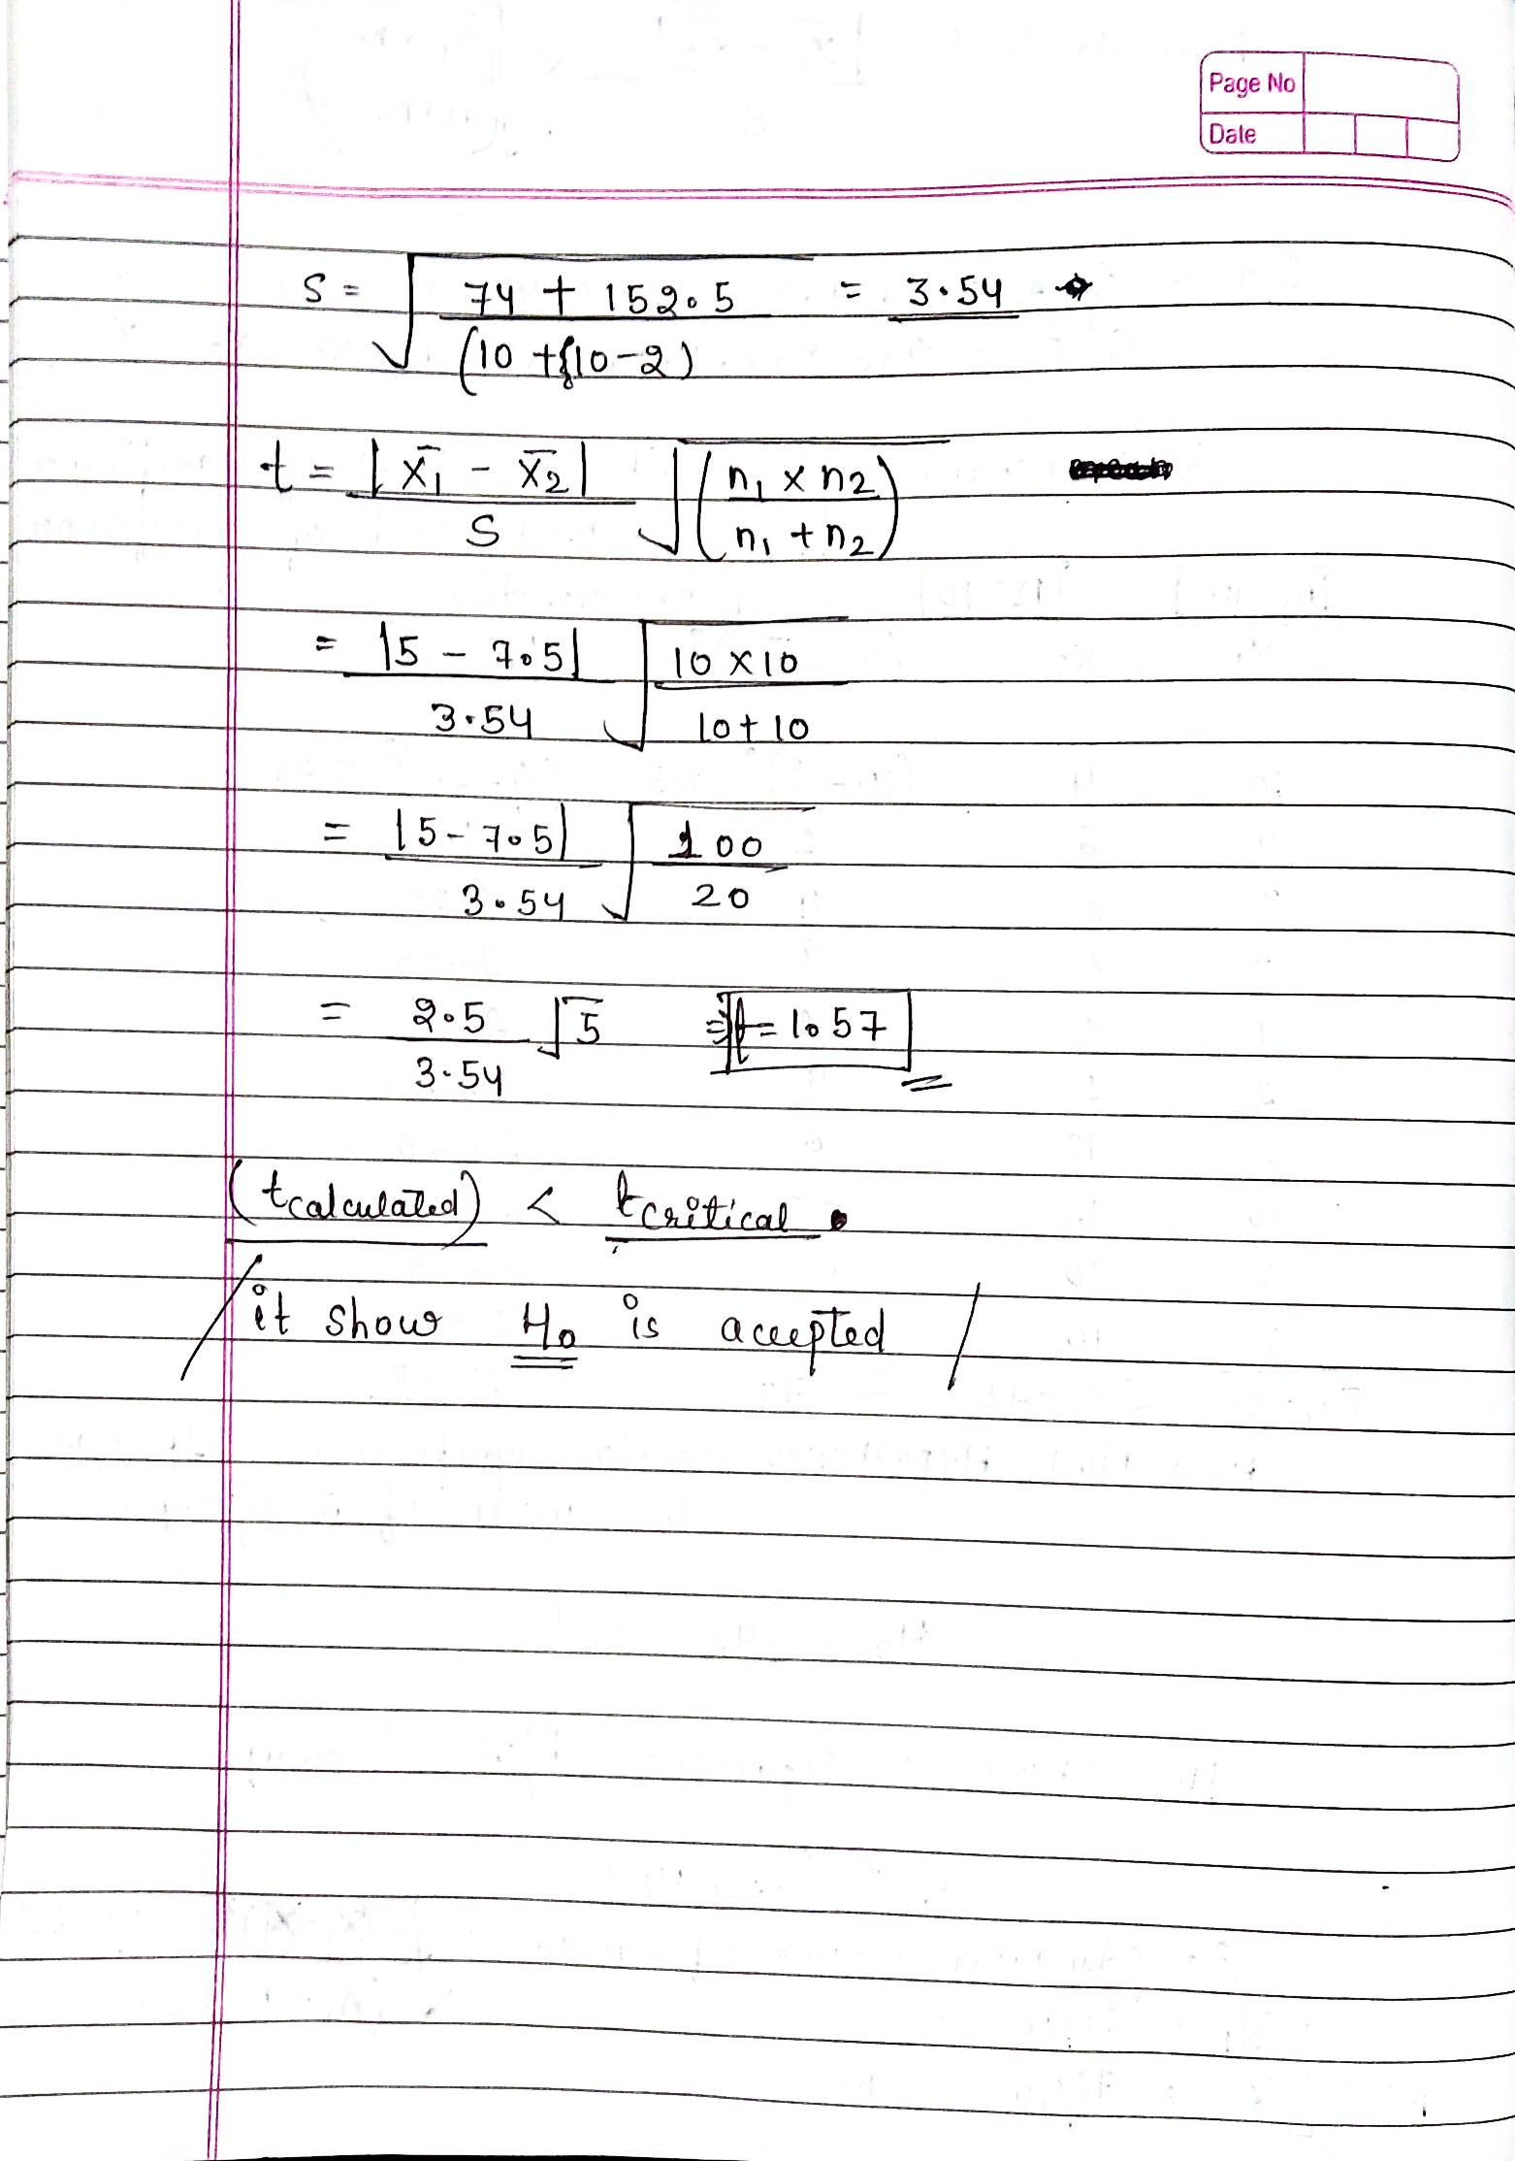

Slide 14
Chi-Square Test- The test is applied when you have two categorical variables from a single population. It is used to determine whether there is a significant association between the two variables.
For example, in an election survey, voters might be classified by gender (male or female) and voting preference (Democrat, Republican, or Independent). We could use a chi-square test for independence to determine whether gender is related to voting preference

Slide 15
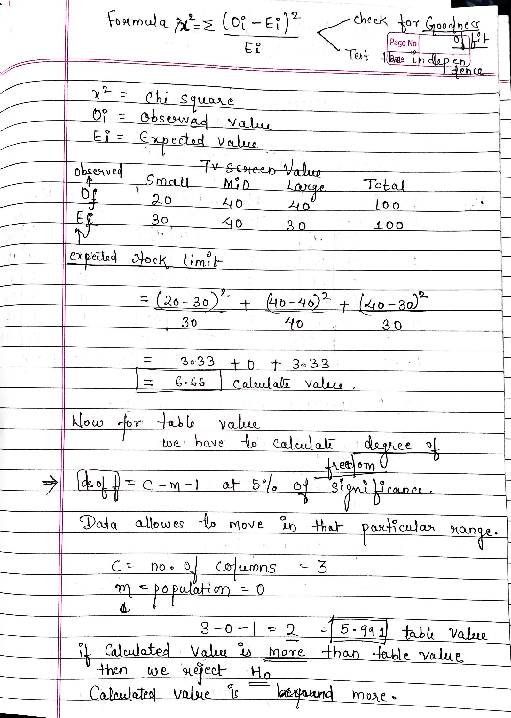
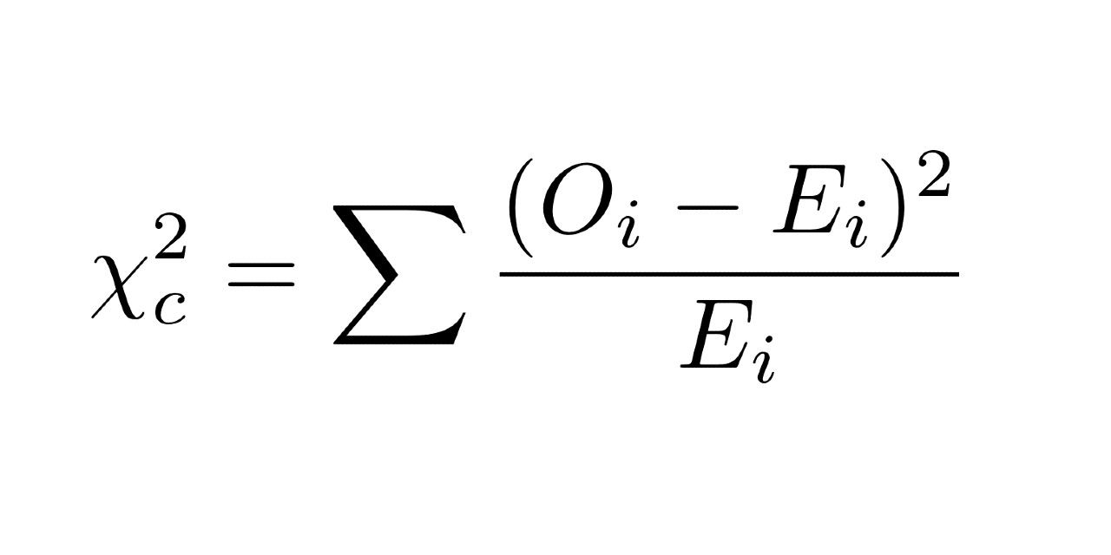
Here
Oi is observation value
Ei is expected value

Slide 16
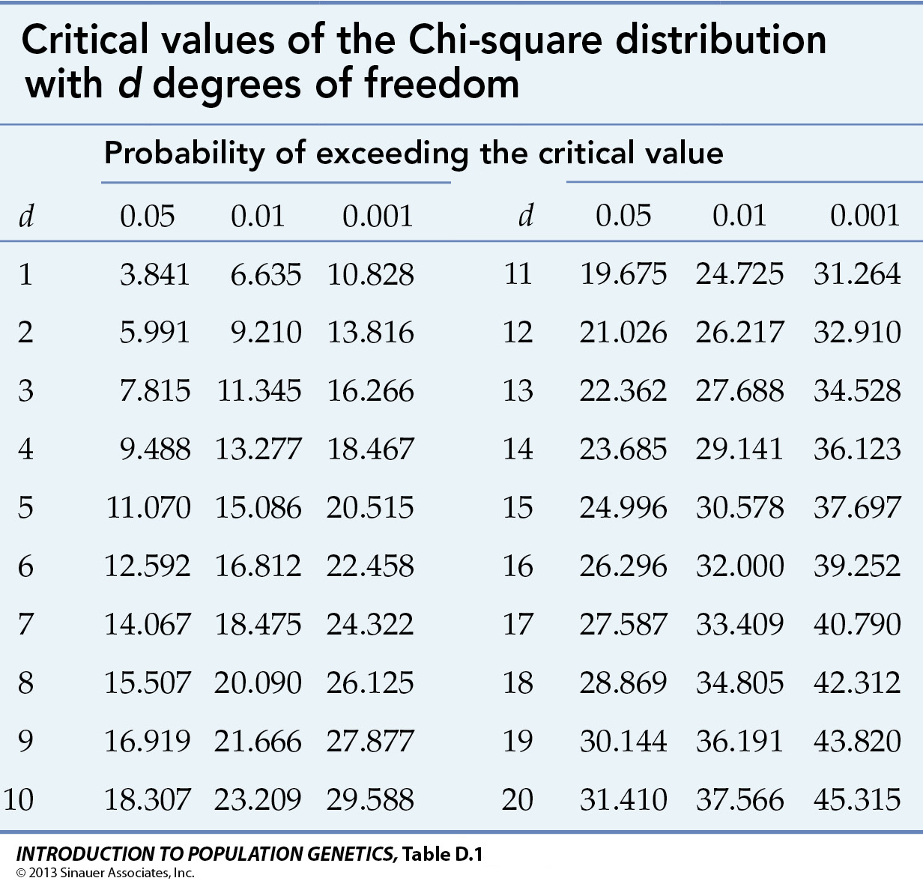

Slide 17
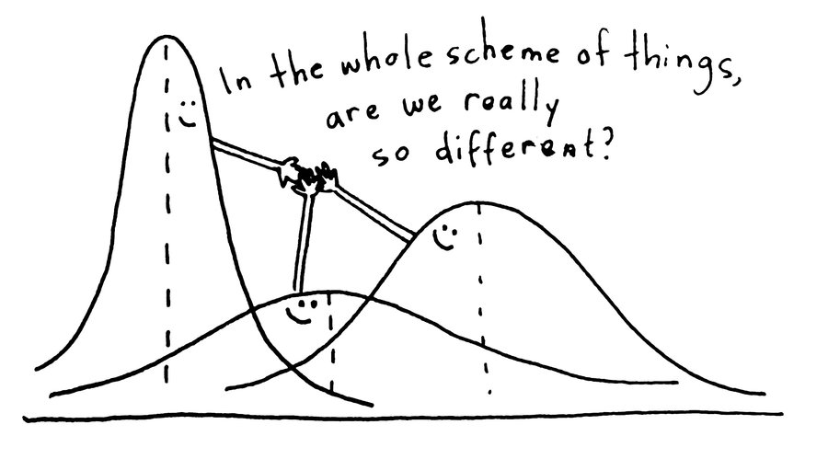
Introduction to ANOVA
A common approach to figure out a reliable treatment method would be to analyse the days it took the patients to be cured. We can use a statistical technique which can compare these three treatment samples and depict how different these samples are from one another. Such a technique, which compares the samples on the basis of their means, is called ANOVA.
Analysis of variance (ANOVA) is a statistical technique that is used to check if the means of two or more groups are significantly different from each other. ANOVA checks the impact of one or more factors by comparing the means of different samples.
Another measure to compare the samples is called a t-test. When we have only two samples, t-test and ANOVA give the same results. However, using a t-test would not be reliable in cases where there are more than 2 samples. If we conduct multiple t-tests for comparing more than two samples, it will have a compounded effect on the error rate of the result.

Slide 18
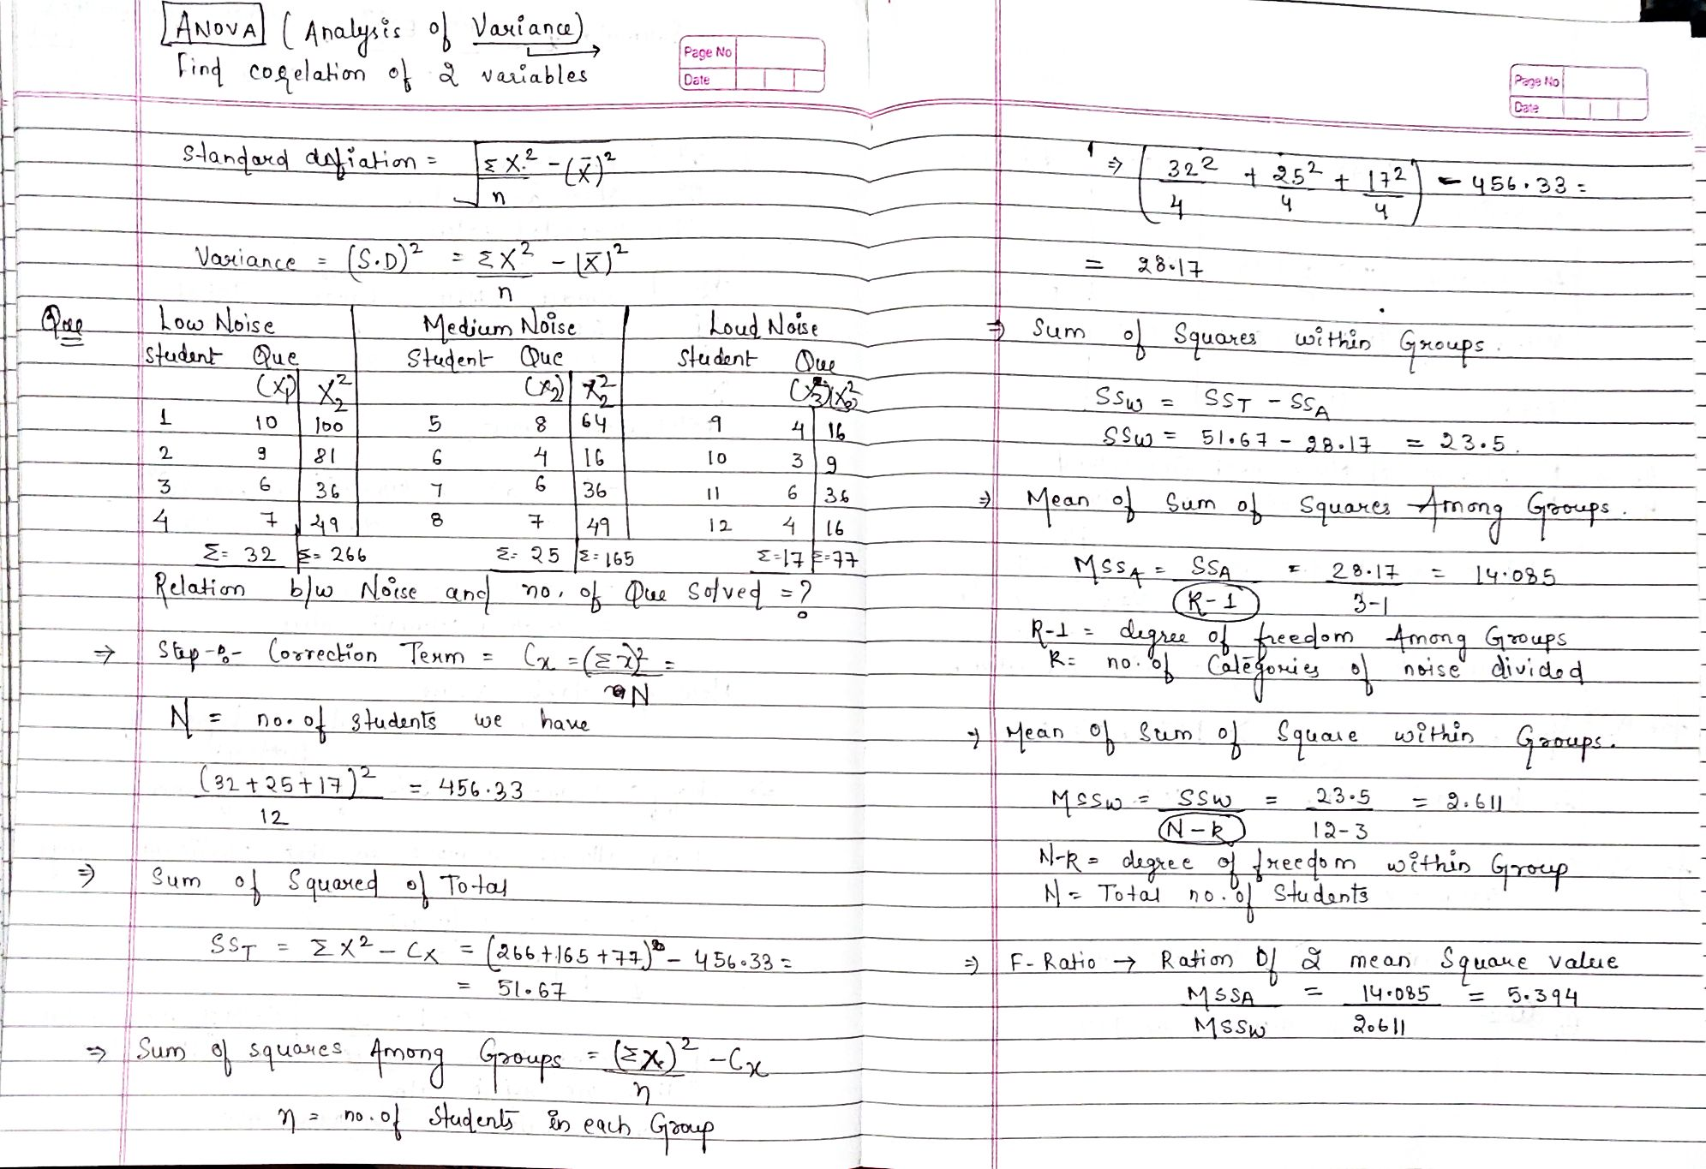

Slide 19
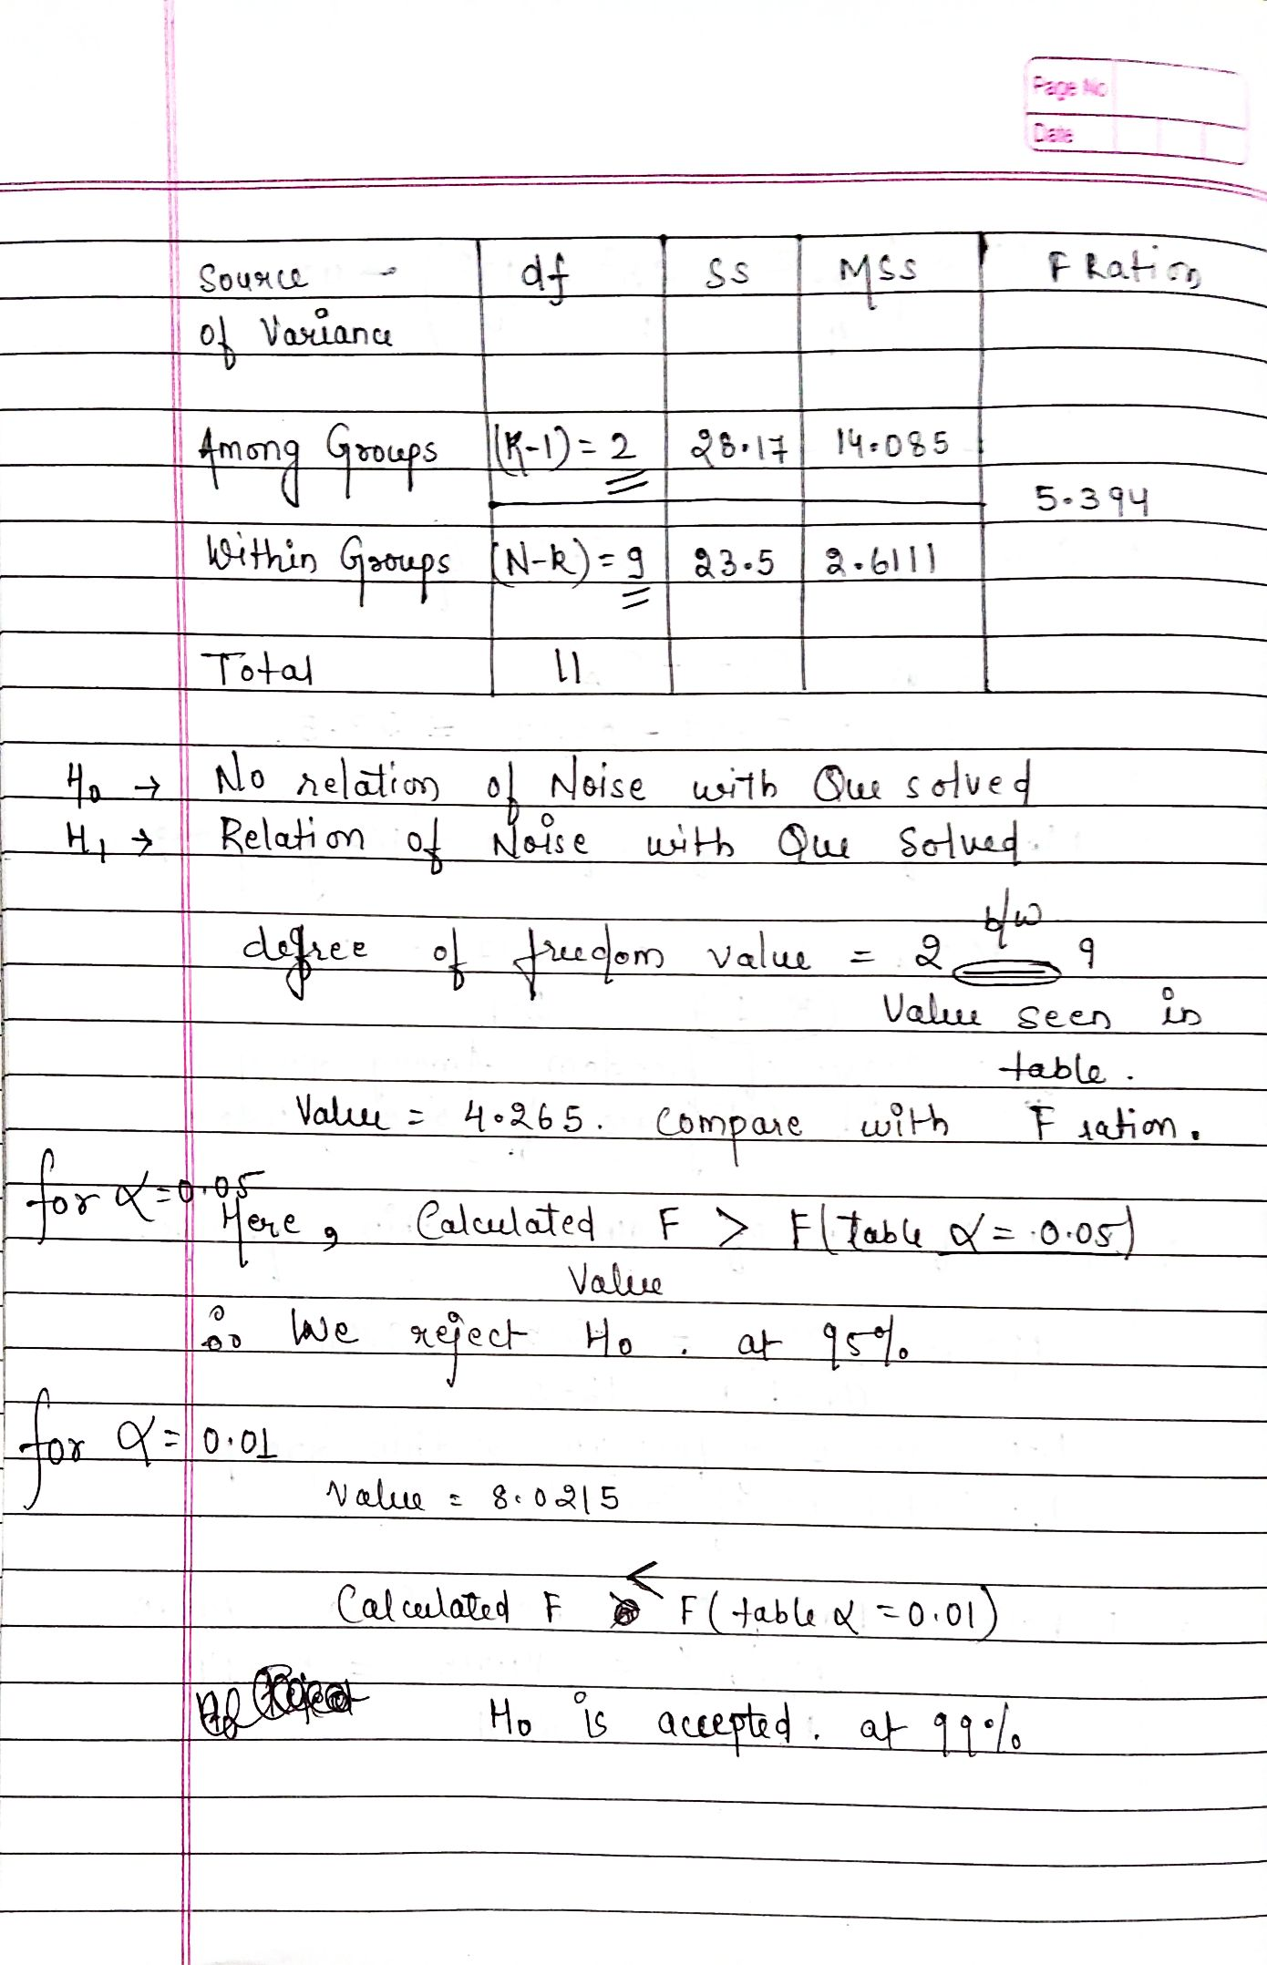

Slide 20
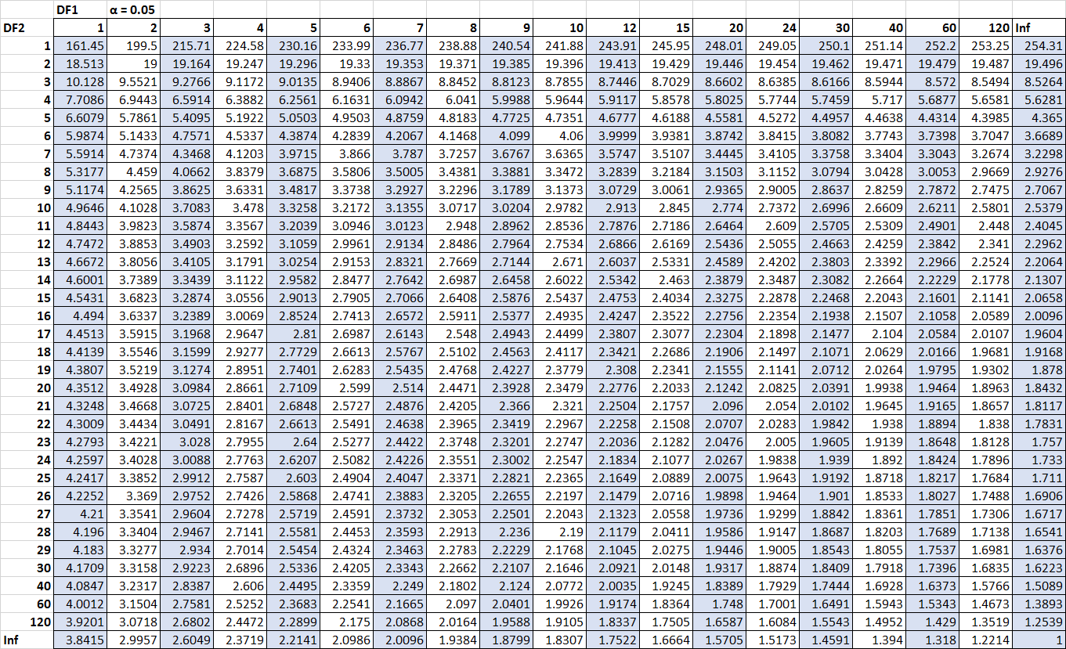

Slide 21
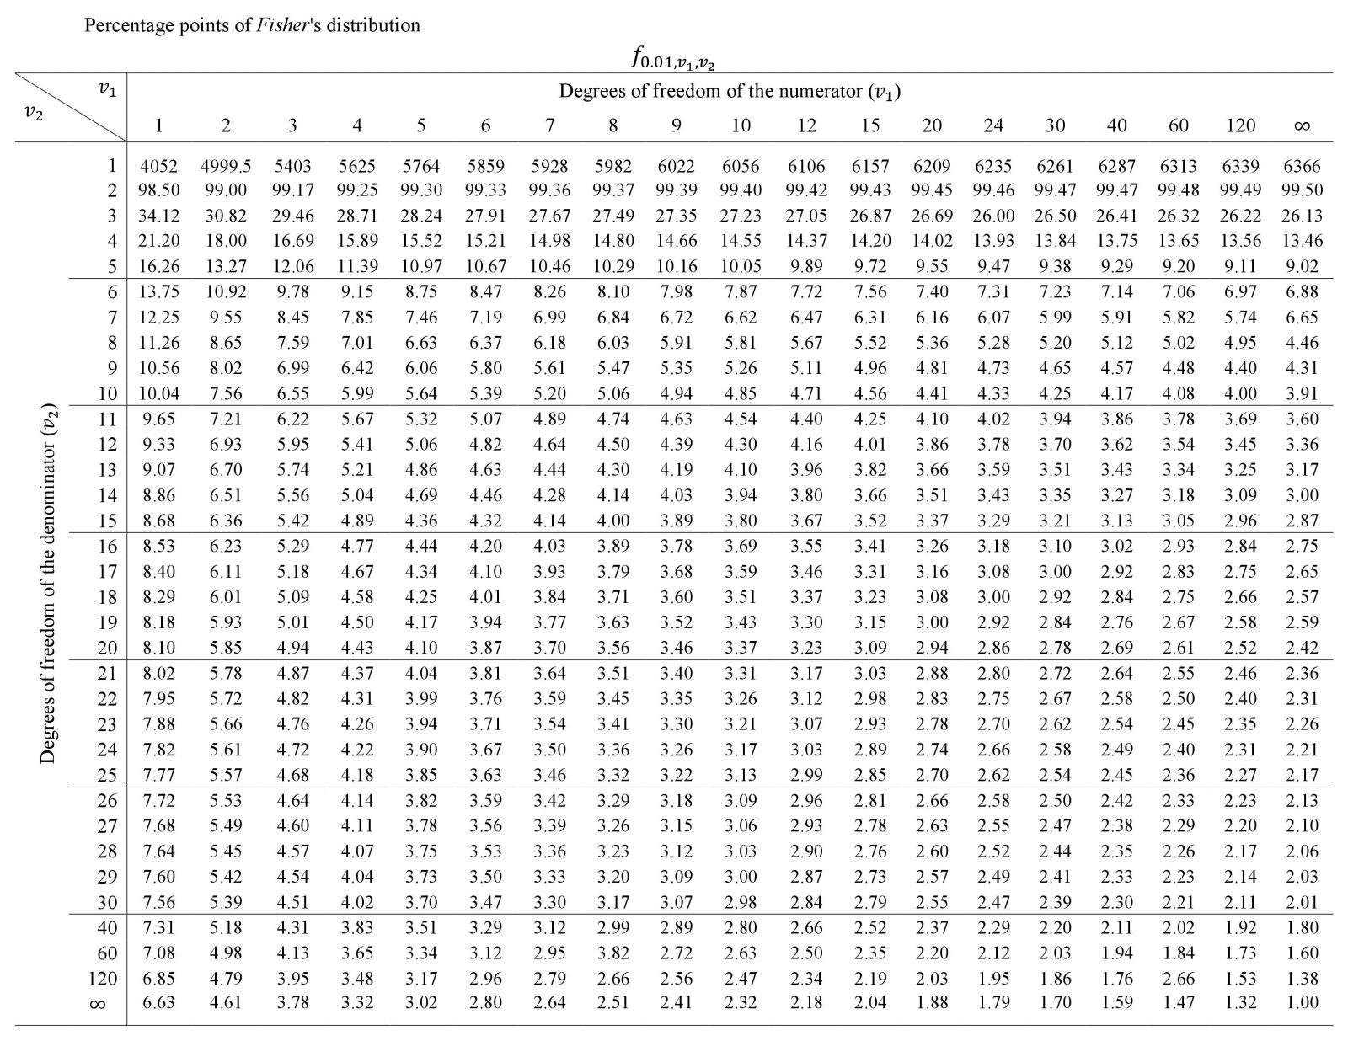

Slide 22
What Is a Z-Test?
A z-test is a statistical test used to determine whether two population means are different when the variances are known and the sample size is large.
What's the Difference Between a T-Test and Z-Test?
Z-tests are closely related to t-tests, but t-tests are best performed when an experiment has a small sample size, less than 30. Also, t-tests assume the standard deviation is unknown, while z-tests assume it is known. If the standard deviation of the population is unknown, but the sample size is greater than or equal to 30, then the assumption of the sample variance equaling the population variance is made while using the z-test.

