Slide 1
CLASS PROJECT Do you really want to buy an house in the Bay Area?
Alexander Lam
Allegra Adinolfi
Priti Dhere
Owen Lawrence

Slide 2
INTRODUCTION
Our Project aims to assist those who are looking to buy a House in order to have an overview on the housing market place and make the best decision.
PROPOSAL
Our Project want to analyze the correlation between school rate scores and median sold price.
Our search combined House Price and School rating score since having a good school close to our house is one of the first goals of people but also the main reason why the price are higher.

Slide 3
Do you want to buy an house?
County - how is the houses sale trend?
Does the school rating has correlation with the price of the houses?
Is the trend changes year by year?
What is the median sold price?

Slide 4
DATASET
Datasets resource: KAGGLE.com
Housing data
https://www.kaggle.com/zillow/zecon
Schools in CA: Public Schools and Districts
https://www.cde.ca.gov/ds/si/ds/pubschls.asp
Notes:
Kaggle is a very good web site who cleans all the public proprietary sources in order to be ready for exploration and assumption.
Full of interesting features

Slide 5
STRUCTURE As starting point of our analysis we have first cleaned and then worked with the 2 dataset separately, only after this process we have merged the data to get our output.
Housing Data
Schools and Districts Data
Download the data
Import all the dependencies needed
Clean the data, dropping inconsistent or not interesting columns and rows
Choose the County of interest
Choose the Date of interest
First Graph: Total Sold Price in relation with Years for the County of interest
Second Graph: Median Sold Price per Sqr Ft in relation with Years for each region of the County of interest
Download the data
Import all the dependencies needed
Clean the data, dropping inconsistent or not interesting columns and rows
Merge last 3 years datasets in order to give consistence to our analysis
Create csv file containing County details and score

Slide 6
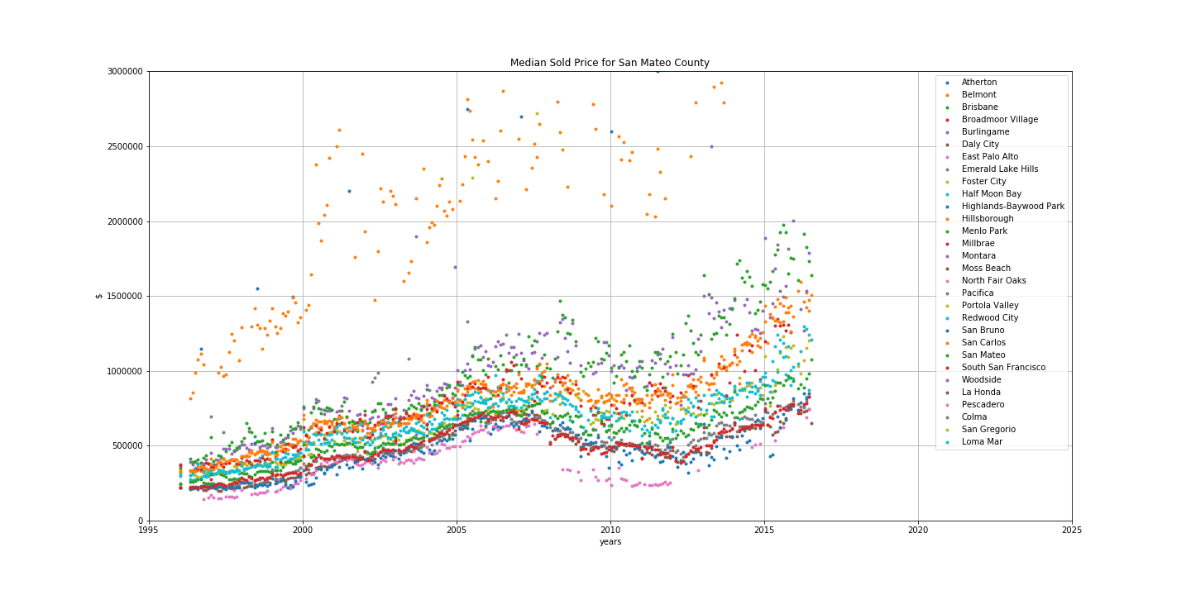
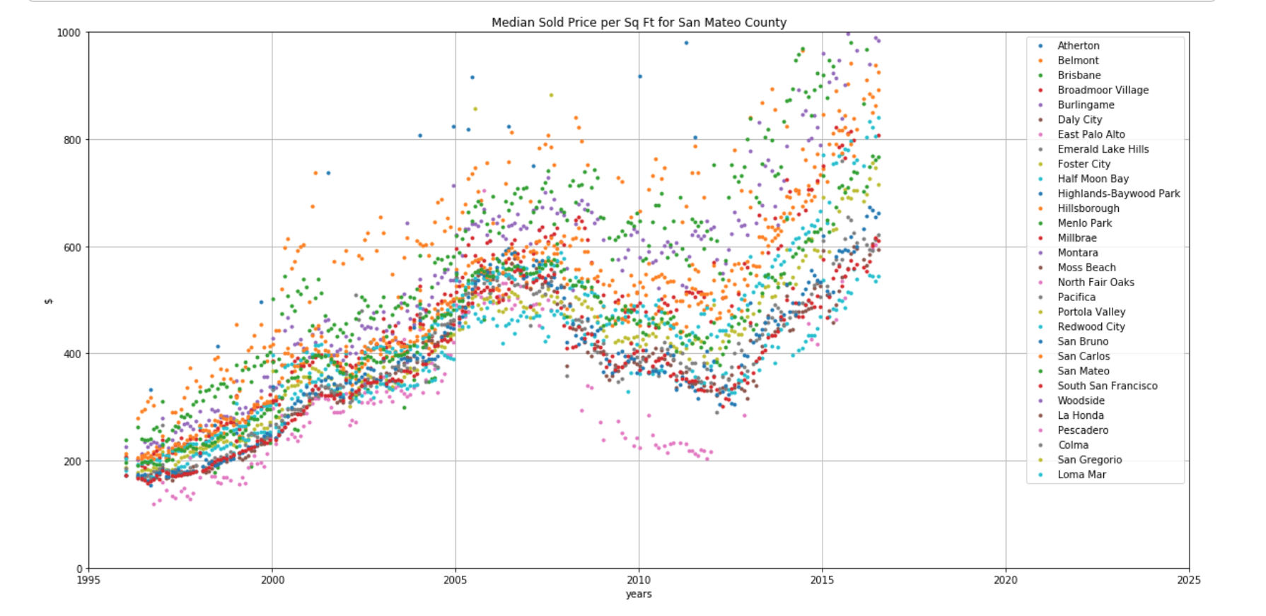
County of San Mateo Median Sold Price vs Median Price per Sq Ft

Slide 7
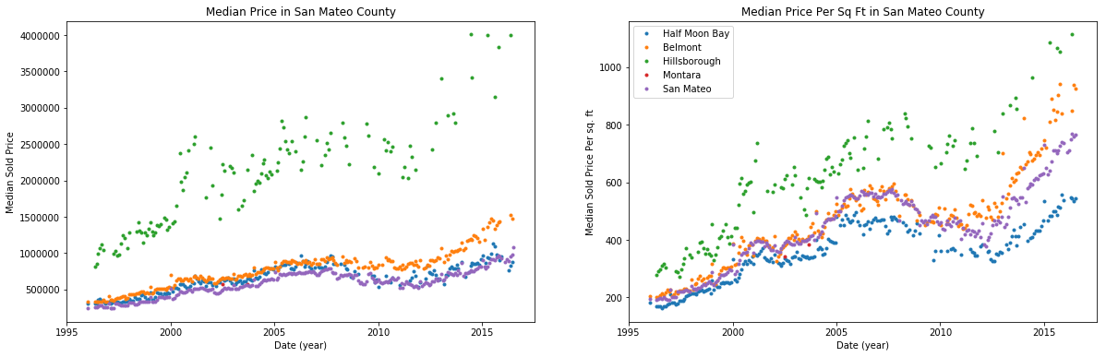
Median Sold Price vs Median Price per Sq Ft by cities

Slide 8
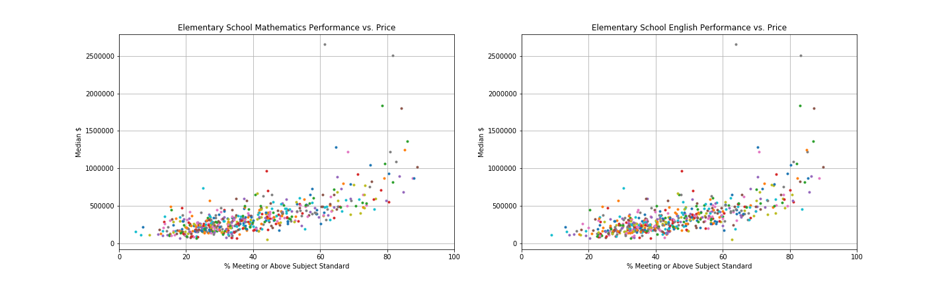
County of San Mateo Total sold price in relation to the school rating score for each region
Notes:
Which years?

Slide 9
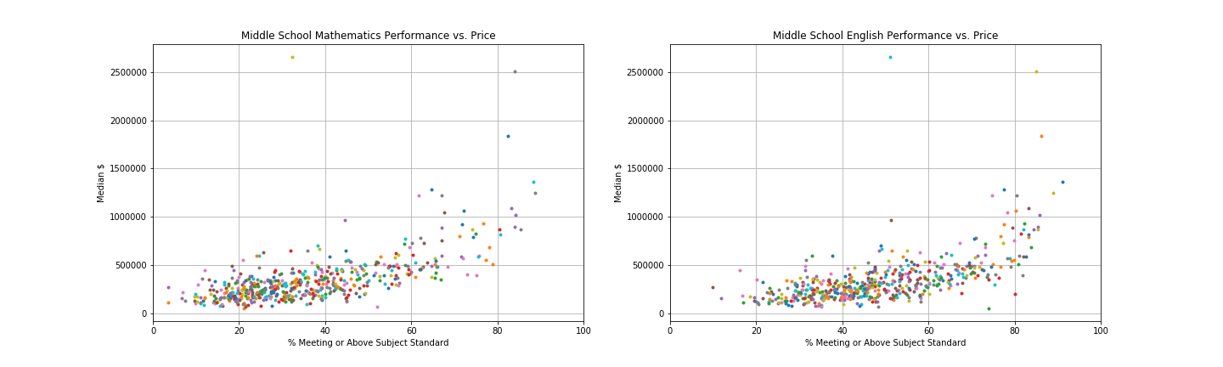

Slide 10
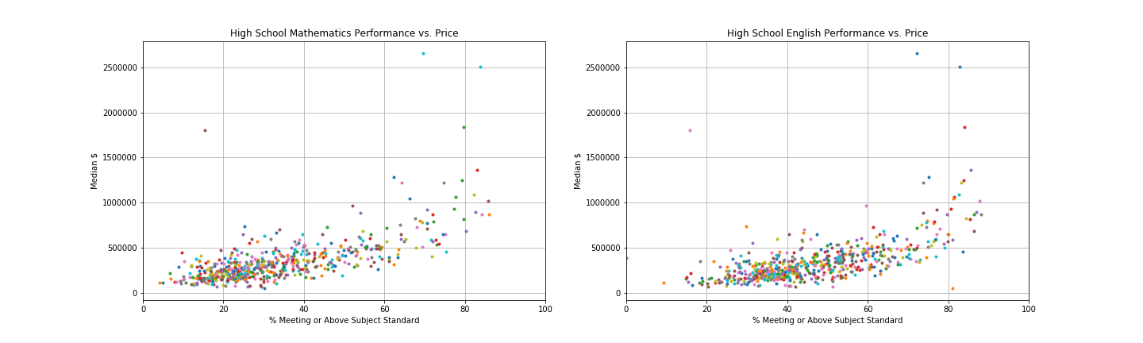

Slide 11
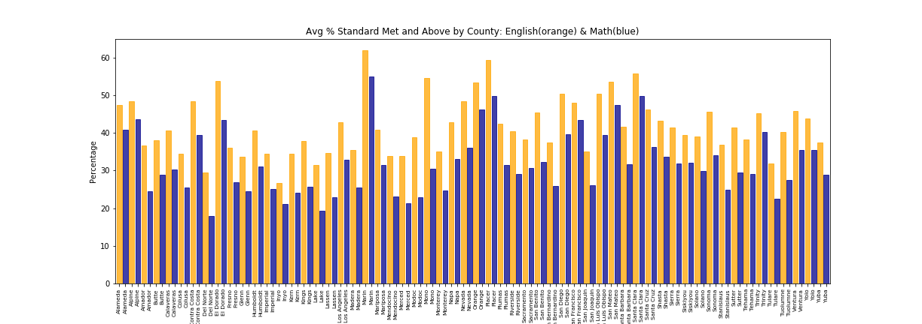
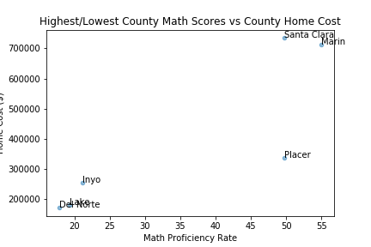

Slide 12
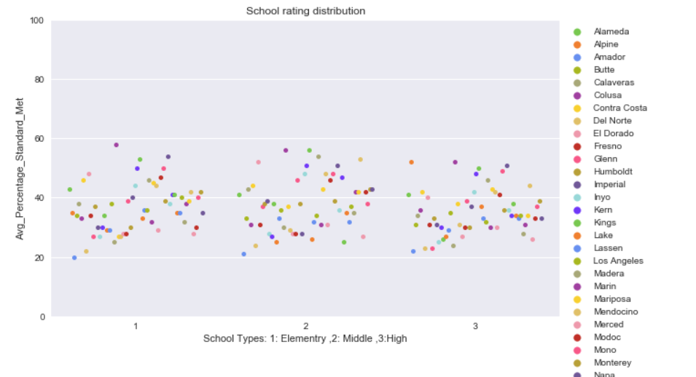
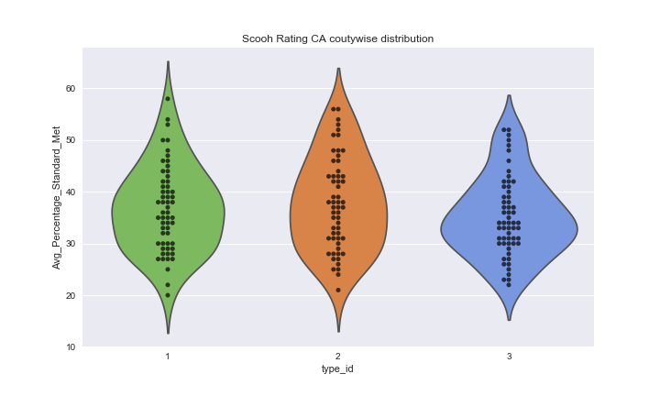

Slide 13
Conclusion based on the Analysis
All Counties exhibit similar trend during the years.
School rating scores have some correlation with the house prices but not that high which we were expecting.
The most expensive city is Hillsborough
The cheapest one is East Palo Alto

Slide 14
Future Investigation
Investigate through the crime data and see if there is any correlation
Where is more convenient buy a house and where to rent?

Slide 15
Functions
Tools to get result in order to have information about a specific County
https://github.com/Priti001/Class_Project/blob/master/housing_utilities.py
Notes:
Introduction to get result in order to have information about a specific county

Slide 16
Our Project Analysis
Housing data manipulation
https://github.com/Priti001/Class_Project/blob/master/Zillow_Explore_avl.ipynb
School data manipulation
https://github.com/Priti001/Class_Project/blob/master/Schools_DataFrame.ipynb
Overall investigation
https://github.com/Priti001/Class_Project/tree/correlation_analysis

