Slide 1
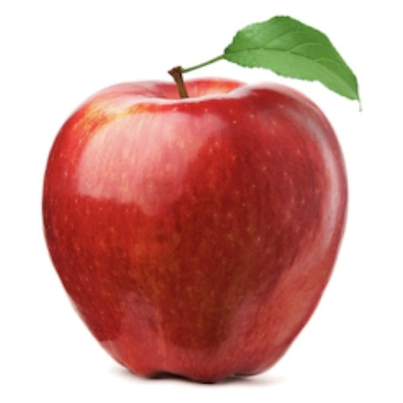
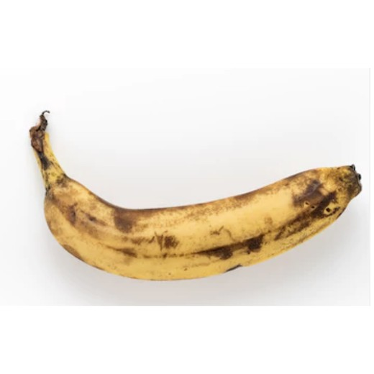
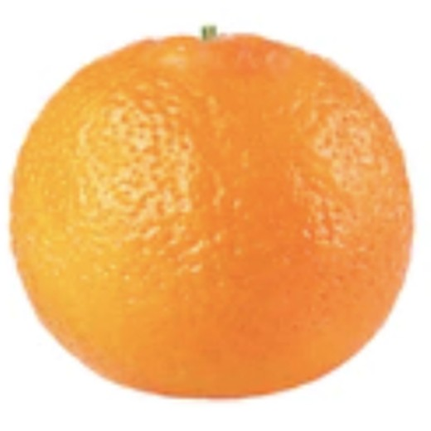
MACHINE LEARNING · COMPUTER VISION
Fruit Ripeness Detection
Classifying fruit as fresh or rotten from a single image using transfer learning with EfficientNet-B0.
Fresh
FRESH
ROTTEN
Rotten
Presented by Priti Final Project — Proof of Concept
Notes:
Title slide. Introduce the project: an image classifier that labels fruit as fresh or rotten using transfer learning with EfficientNet-B0.

Slide 2
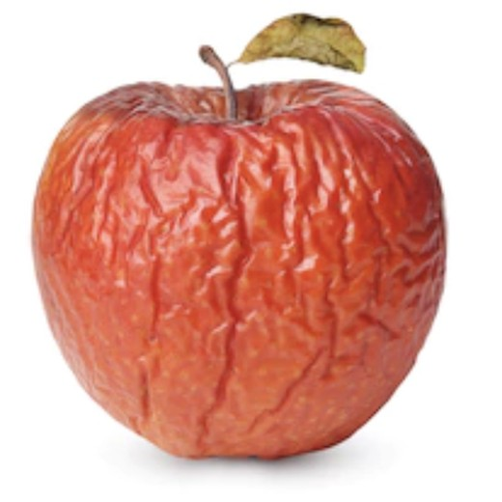
THE PROBLEM
02 / 20
Problem Statement
What we propose
The same fruit, two very different states
An image-based classifier that tells whether a piece of fruit is fresh or rotten from a single photo — instantly and objectively.
Why it matters
Today freshness is judged by hand — slow, subjective, and inconsistent from person to person and store to store.
Fresh
Rotten
The gap
Shoppers, grocers, and supply chains lack a fast, low-cost, repeatable way to check fruit quality at scale.
Color, texture, and surface spots separate fresh fruit from spoiled fruit — exactly the visual cues a vision model can learn.
Notes:
Problem statement: propose an objective fresh/rotten classifier. Manual inspection is slow and subjective; there is a gap for a fast, low-cost tool.

Slide 3
MOTIVATION
03 / 20
Why Ripeness Detection Matters
~1/3
Daily
Manual
Phone
of all food produced is lost or wasted — poor freshness assessment is a major driver.
shoppers guess at fruit quality with no consistent, objective reference.
grocery and supply-chain grading is labor-intensive and varies by inspector.
a camera in every pocket could make quality checks instant and accessible.
Objective, image-based freshness detection addresses waste, consumer confidence, and labor cost at once.
Notes:
Why it matters: food waste (~1/3 of food is lost/wasted per FAO), inconsistent consumer choices, manual grading cost, and the opportunity of ubiquitous cameras.

Slide 4
THE GAP
04 / 20
What Is Missing in the Market
What exists today
What's still missing
Manual visual inspection — subjective and hard to scale.
Industrial optical sorters — accurate but expensive and fixed to a facility.
Generic fruit-type classifiers — they name the fruit, not its condition.
An affordable tool anyone can use — no special hardware.
Freshness-specific decisions: fresh vs. rotten, not just fruit identity.
Works across common fruits (apple, banana, orange) from one model.
Light enough to run on a phone or a small edge device.
Notes:
Market gap: manual inspection, costly industrial sorters, and generic classifiers all fall short. Missing: an affordable, freshness-specific, multi-fruit, lightweight tool.

Slide 5
TECHNICAL APPROACH
05 / 20
How the System Works
1
2
3
4
5
Input image
›
Preprocess
›
EfficientNet-B0
›
Classifier head
›
Prediction
A photo of a single fruit is uploaded.
Resize to 224×224 and normalize to ImageNet statistics.
Pretrained CNN backbone extracts visual features.
A small trained head maps features to a class.
Output: Fresh or Rotten, with a confidence score.
A single supervised image-classification pipeline — trained end-to-end and served behind a simple upload interface.
Notes:
Technical approach: input -> preprocess (224x224, normalize) -> EfficientNet-B0 features -> classifier head -> fresh/rotten prediction with confidence.

Slide 6
THE MODEL
06 / 20
Transfer Learning with EfficientNet-B0
Why start from a pretrained model?
EfficientNet-B0 is pretrained on ImageNet — 1.2M images across 1,000 categories.
Its early layers already recognize edges, texture, and color — the same cues that reveal browning and spots.
We freeze that backbone and attach a new 2-class head for fresh vs. rotten.
Result: strong accuracy with far less data and training time than starting from scratch.
Input image · 224 × 224 × 3
▼
Pretrained EfficientNet-B0 backbone
(frozen — reused ImageNet features)
▼
Dropout (0.3)
▼
New classifier head → 2 classes
Notes:
Transfer learning: reuse EfficientNet-B0 features learned on ImageNet, freeze the backbone, and train a new 2-class head. Less data, faster, more accurate than scratch.

Slide 7
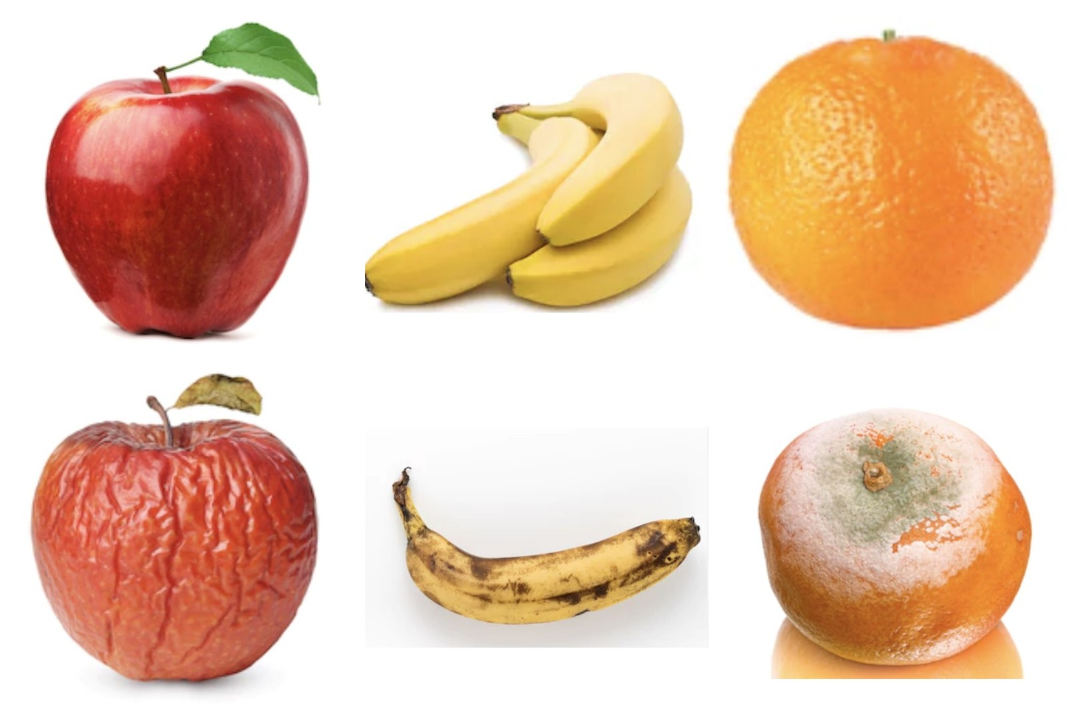
DATA
07 / 20
Dataset Details
13,599
3
labeled images
fruit types
2
70 / 15 / 15
ripeness classes
train / val / test split
Class distribution (apple · banana · orange)
Fresh | 5,904 | 2,088 · 1,962 · 1,854
Rotten | 7,695 | 2,943 · 2,754 · 1,998
Top row: fresh · Bottom row: rotten — apple, banana, orange
Notes:
Dataset: 13,599 fresh/rotten images across apple, banana, orange. Stratified 70/15/15 split. Rotten class is larger, so training uses class-weighted loss.

Slide 8
ARCHITECTURE
08 / 20
Model Architecture
Input
MBConv stages
Global pooling
Dropout 0.3
FC layer
›
›
›
›
224 × 224 × 3
7 blocks, squeeze-
&-excitation
→ 1,280 features
regularization
1,280 → 2
~5.3M
1,280
2
224²
total parameters
feature dimensions
output classes
input resolution
EfficientNet-B0 is compound-scaled for a strong accuracy-to-size ratio — small enough for mobile and edge deployment.
Notes:
Architecture: EfficientNet-B0 (MBConv + SE blocks, ~5.3M params) produces 1,280 features, followed by Dropout(0.3) and a Linear(1280->2) head.

Slide 9
TRAINING
09 / 20
Training Strategy
Optimizer
AdamW · weight decay 1e-4
Two-stage fine-tuning
Stage 1 · Warm-up 5 epochs
Loss
Class-weighted cross-entropy
Freeze the backbone and train only the new classifier head. Learning rate 1e-3.
Scheduler
ReduceLROnPlateau (val accuracy)
Augmentation
Flip · ±15° rotate · color jitter · affine
Stage 2 · Fine-tune 15 epochs
Unfreeze the last two blocks and train them with the head. Backbone LR 1e-5, head LR 1e-4.
Batch / Image
32 · 224 × 224
Checkpoint
Best model saved by validation accuracy
Notes:
Training strategy: two-stage transfer learning (warm-up head, then fine-tune last blocks). AdamW, class-weighted loss to handle imbalance, LR scheduling, augmentation, best-checkpoint on val accuracy. Seed 42.

Slide 10
RESULTS
10 / 20
Results — Overview
Final metrics will be added once training completes. The evaluation below is computed on the held-out test set.
— %
—
2
Test accuracy
Macro F1
Classes
Classification report (to be filled in)
Class | Precision | Recall | F1-score | Support
Fresh | — | — | — | —
Rotten | — | — | — | —
Notes:
Results overview placeholder. Fill test accuracy, macro F1, and the per-class precision/recall/F1 once training is done.

Slide 11
RESULTS
11 / 20
Accuracy
TEST ACCURACY
Training vs. Validation Accuracy
— . — %
accuracy_curve.png
Filled in after evaluation
on the held-out test set
Accuracy across all 20 epochs (5 warm-up + 15 fine-tune) will be plotted here.
Notes:
Accuracy slide: insert the big test-accuracy number and the training/validation accuracy curve (accuracy_curve.png) generated by the script.

Slide 12
RESULTS
12 / 20
Confusion Matrix
Reading the matrix
Predicted
Fresh
Rotten
Rows are the true class, columns are the predicted class.
The diagonal shows correct predictions.
Off-diagonal cells reveal which class the model confuses.
Generated on the test set as confusion_matrix.png.
Fresh
✓
—
True
Rotten
—
✓
Counts populate after test-set evaluation
Notes:
Confusion matrix (2x2, fresh/rotten). Explain rows=true, cols=predicted, diagonal=correct. Insert confusion_matrix.png when available.

Slide 13
RESULTS
13 / 20
Example Predictions
A few test images with the model's predicted label and confidence (values to be filled in).
Predicted: Fresh
Predicted: Rotten
Predicted: Fresh
Predicted: Rotten
Confidence: — %
Confidence: — %
Confidence: — %
Confidence: — %
Notes:
Example predictions: show sample test images with predicted class and confidence. Replace confidence placeholders with real values.

Slide 14
14 / 20
PROOF OF CONCEPT
Demo
Upload a fruit image and get an instant fresh-or-rotten prediction.
Fresh
Notes:
Section divider: live demo. Walk through uploading an image and viewing the prediction.

Slide 15
DEMO · STEP 1
15 / 20
Upload a Fruit Image
Fruit Freshness Checker
The user selects or drags a photo of one fruit into the app.
The image is resized to 224×224 and normalized automatically.
No special equipment — any phone or laptop camera works.
↑
Drag & drop a fruit photo
or click to browse — JPG / PNG
Choose file
Illustrative mockup
Then press “Predict”
Notes:
Demo step 1: upload UI mockup. User drops a fruit photo; it is preprocessed automatically.

Slide 16
DEMO · STEP 2
16 / 20
Show the Prediction Result
Prediction
Under the hood
The image passes once through the trained network.
A softmax turns the outputs into class probabilities.
The higher probability becomes the label — Fresh or Rotten.
The score gives the user a sense of how certain the model is.
FRESH
Confidence (example)
Fresh
92%
Rotten
8%
Values shown are an example layout — the app returns the model's real probabilities.
Notes:
Demo step 2: result view mockup. Shows predicted class, confidence bars, and a short explanation of softmax. Note values are illustrative.

Slide 17
WHAT'S NEXT
17 / 20
Future Product Vision
1
2
3
4
On the phone
At the edge
More fruits
Many at once
A mobile app that checks fruit right at the shelf or in the kitchen.
A low-cost Raspberry Pi kiosk for stores, markets, and warehouses.
Expand beyond apple, banana, and orange to a wider range of produce.
Detect and grade several fruits in one photo, in real time.
Notes:
Future vision: mobile app, edge/Pi deployment, more fruit types, and multi-fruit real-time detection.

Slide 18
ROADMAP
18 / 20
Extend to a Mobile App or Raspberry Pi
📱
Mobile app
🍓
Raspberry Pi kiosk
On-device inference — no server round-trip needed.
Point the camera and get an answer in the store.
Works offline; the model is only a few megabytes.
Convert to TensorFlow Lite / Core ML for phones.
Low-cost edge device for shops and warehouses.
A fixed camera grades produce as it passes.
EfficientNet-B0 is light enough to run on a Pi.
Scales freshness checks without cloud costs.
Notes:
Deployment: EfficientNet-B0's small size makes both an offline mobile app and a Raspberry Pi edge kiosk practical.

Slide 19
ROADMAP
19 / 20
Add Detection for Multiple Fruits
From one fruit per photo to many — and from classification to detection.
Today
Next
Then
One fruit per image
More fruit types
Multi-object detection
›
›
Classify a single cropped fruit as fresh or rotten.
Broaden the dataset and classes to cover more produce.
Locate and grade several fruits in one photo with bounding boxes.
The same transfer-learning backbone extends naturally to object-detection heads (e.g. YOLO / SSD).
Notes:
Multiple fruits: expand classes, then move from single-fruit classification to multi-object detection with bounding boxes.

Slide 20
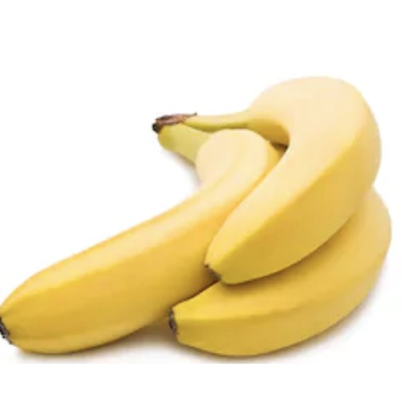
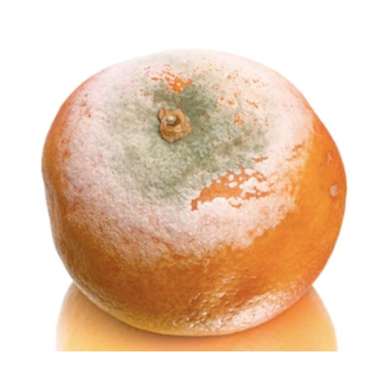
Thank You
Fruit Ripeness Detection — a transfer-learning classifier that tells fresh from rotten, built to grow into a real product.
Fresh
Priti · Questions welcome
Rotten
Notes:
Closing slide. Summarize and invite questions.

