Slide 1
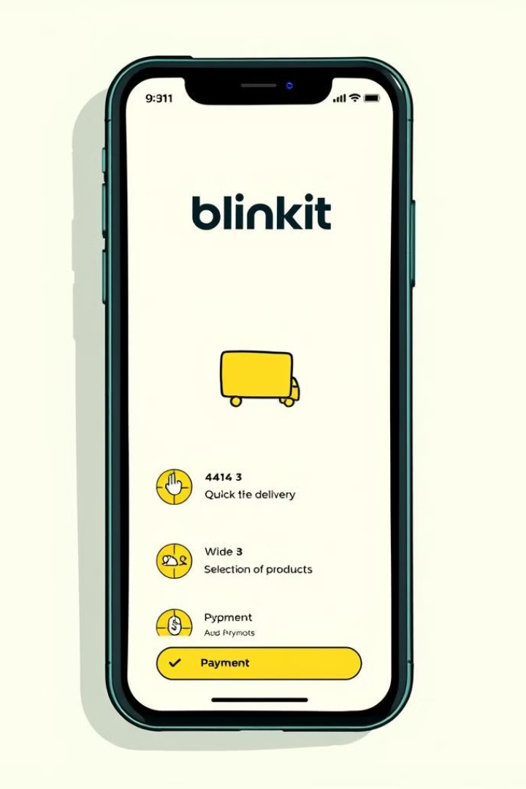
Blinkit Analysis
PRITI PRIYA SAHU
LINKIDIN ID https://www.linkedin.com/in/pritips7/
GITHUB ID https://github.com/Priti1110
Email ID : pritiip110@gmail.com
Notes:
Blinkit is a fast-growing e-commerce platform that offers quick delivery of everyday essentials and groceries The vibrant colors and bustling marketplace in the image represent the rapid growth and expansion of Blinkit's business The large magnifying glass symbolizes the detailed analysis we'll be conducting on Blinkit's performance and growth strategies We'll dive into Blinkit's key metrics, customer trends, and competitive landscape to uncover opportunities for further expansion

Slide 2
INTRODUCTION
Blinkit (formerly Grofers) is an Indian quick-commerce platform that delivers groceries and essentials within minutes. Founded in 2013 by Albinder Dhindsa and Saurabh Kumar, it operates through a network of dark stores to ensure rapid delivery. In 2022, Zomato acquired Blinkit, integrating it into its ecosystem. Blinkit focuses on hyperlocal logistics, offering a seamless shopping experience via its app.

Slide 3
BLINKIT ANALYSIS
STEP IN PROJECT
✔ Requirement Gathering/ Business Requirements
✔ Data Walkthrough
✔ Data Connection
✔ Data Cleaning / Quality Check
✔ Data Modeling
✔ Data Processing
✔ DAX Calculations
✔ Dashboard Lay outing
✔ Charts Development and Formatting
✔ Dashboard / Report Development
✔ Insights Generation

Slide 4
BUSINESS REQUIREMENT
To conduct a comprehensive analysis of Blinkit's sales performance, customer satisfaction, and inventory distribution to identify key insights and opportunities for optimization using various KPIs and visualizations in Power BI.
KPI’s Requirements
Total Sales: The overall revenue generated from all items sold.
Average Sales: The average revenue per sale.
Number of Items: The total count of different items sold.
Average Rating: The average customer rating for items sold.

Slide 5
BUSINESS REQUIRMENT
Chart's Requirements
1 Total Sales by Fat Content:
Objective: Analyze the impact of fat content on total sales.
Additional KPI Metrics: Assess how other KPIs (Average Sales, Number of Items, Average Rating) vary with fat content.
Chart Type: Donut Chart.
2.Total Sales by Item Type:
Objective: Identify the performance of different item types in terms of total sales.
Additional KPI Metrics: Assess how other KPIs (Average Sales, Number of Items, Average Rating) vary with fat content.
Chart Type: Bar Chart.
3.Fat Content by Outlet for Total Sales:
Objective: Compare total sales across different outlets segmented by fat content.
Additional KPI Metrics: Assess how other KPIs (Average Sales, Number of Items, Average Rating) vary with fat content.
Chart Type: Stacked Column Chart.
4. Total Sales by Outlet Establishment:
Objective: Evaluate how the age or type of outlet establishment influences total sales.
Chart Type: Line Chart.
5. Sales by outlet size:
objective: Analyze the correlation between outlet size and total sales
chart Type : Dount / Pie Chart
6. Sales by Outlet Location:
Objective: Assess the geographic distribution of sales across different locations. Chart Type: Funnel Map.
7.All Metrics by Outlet Type:
Objective: Provide a comprehensive view of all key metrics (Total Sales, Average Sales, Number of Items, Average Rating) broken down by different outlet types. Chart Type: Matrix Card.

Slide 6
