Slide 1
LEADING SCORE CASE STUDY

Slide 2
Problem Statement
An education company named X Education sells online courses to industry professionals. On any given day, many professionals who are interested in the courses land on their website and browse for courses.
The company markets its courses on several websites and search engines like Google. Once these people land on the website, they might browse the courses or fill up a form for the course or watch some videos. When these people fill up a form providing their email address or phone number, they are classified to be a lead. Moreover, the company also gets leads through past referrals. Once these leads are acquired, employees from the sales team start making calls, writing emails, etc. Through this process, some of the leads get converted while most do not. The typical lead conversion rate at X education is around 30%.
Now, although X Education gets a lot of leads, its lead conversion rate is very poor. For example, if, say, they acquire 100 leads in a day, only about 30 of them are converted. To make this process more efficient, the company wishes to identify the most potential leads, also known as ‘Hot Leads’. If they successfully identify this set of leads, the lead conversion rate should go up as the sales team will now be focusing more on communicating with the potential leads rather than making calls to everyone.
Fig. Lead Conversion Process

Slide 3
Objectives
To help the company in selecting the most potential leads, also known as ‘Hot Leads’ whose lead conversion rate is around 80%.
To build a model wherein a lead score is assigned to each of the leads such that the customers with higher lead score have a higher conversion chance and the customers with lower lead score have a lower conversion chance.
Help the sales team to divert their focus on potential leads & avoid them from making useless phone calls.

Slide 4
Approach
Analysing Patterns:
Using Exploratory Data Analysis, we have analyzed the patterns present in the Dataset which will provide us intuition that the which features will help in driving the lead conversion.
• Driving Factors:
Looking at the below data we get an intuition that how the variables are distributed.
• Correlations:
Identifying correlations amongst variables to identify the variability in data and identify most important features that can help in driving the conversion of leads.
• Recommendations:
Focus on features that can expedite the conversion of leads.

Slide 5
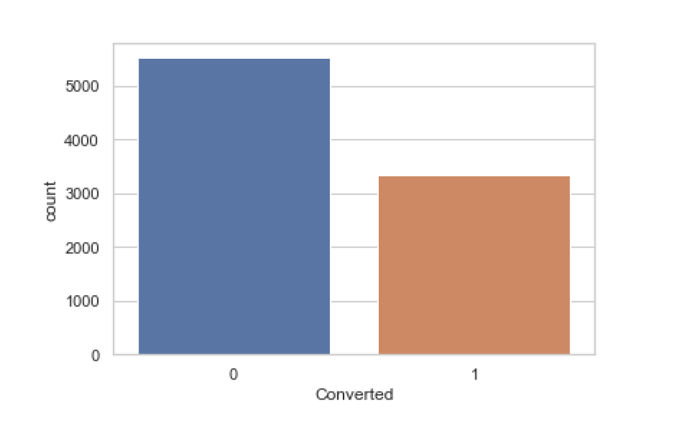
Insights
We have total 9240 entries of unique customers and we needs to identify out of these which have the highest probability of getting converted.
Decision Criteria:
Potential Leads can be bifurcated on the basis of Leads Score (which is probability of getting converted).
Out of 9240 entries we see that around 37% of leads are converted and 73% of leads are not converted.
Task:
Identify solution so that the lead conversion rate could be increased.

Slide 6
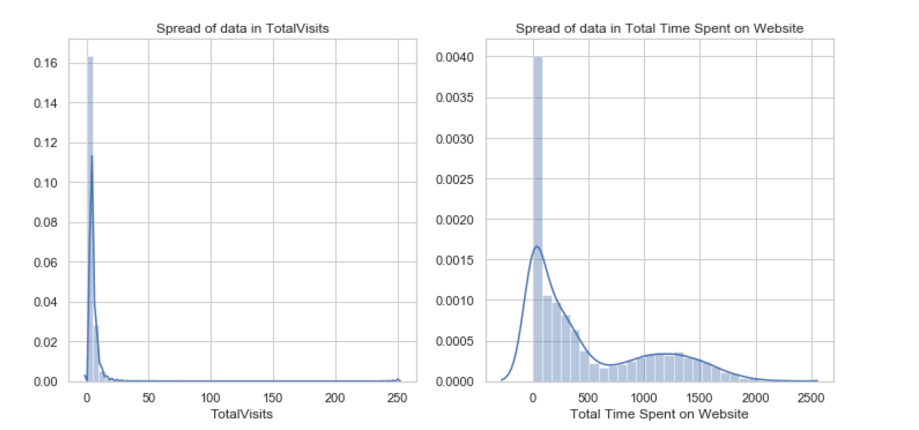
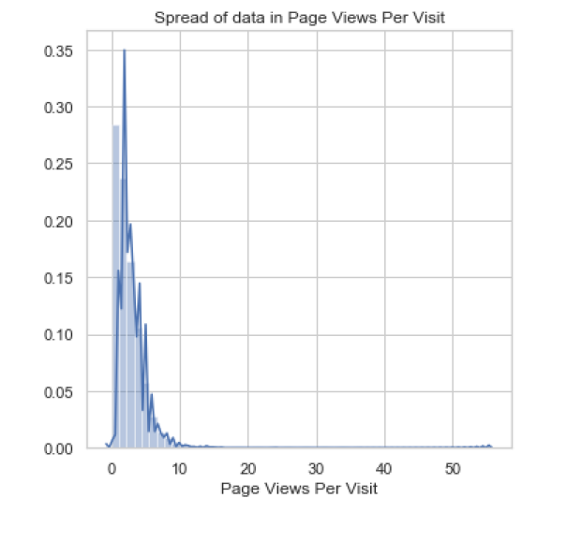
Numeric Analysis
Observations:
We observe that our data is skewed.

Slide 7
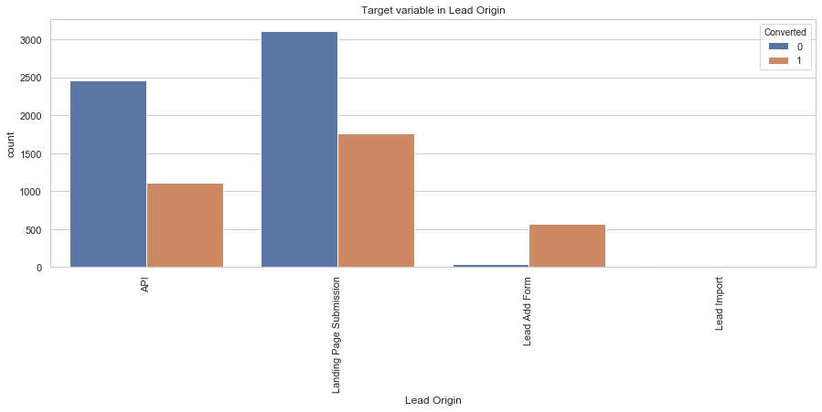
Categorical Columns w.r.t Converted Columns
Lead Origin
Customers who were identified as Leads from Landing Page submission, constitute most of the leads.
Customers originating from Lead Add Form have high probability of conversion. These Customers are very few.
Lead origin-API & Lead Import have the least conversion rate. Customers from Lead Import are very few.
To improve overall lead conversion rate, we need to focus more on improving lead conversion rate of Customers originating from API and Landing Page Submission and generate more leads from Lead Add Form.

Slide 8
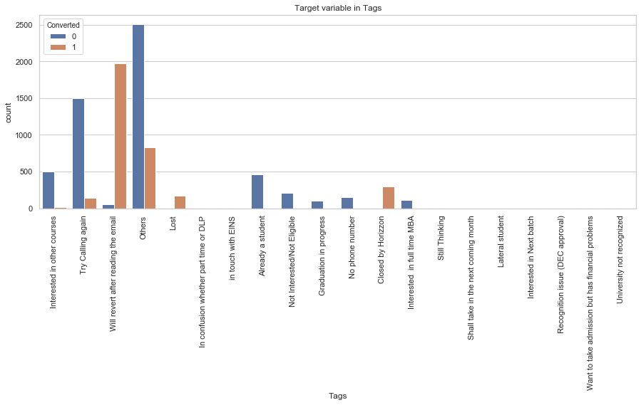
Categorical Columns w.r.t Converted Columns
Tags
More focus shall be given on the leads as will revert after reading the mail & others as these are potential leads and have higher rate of conversion.

Slide 9
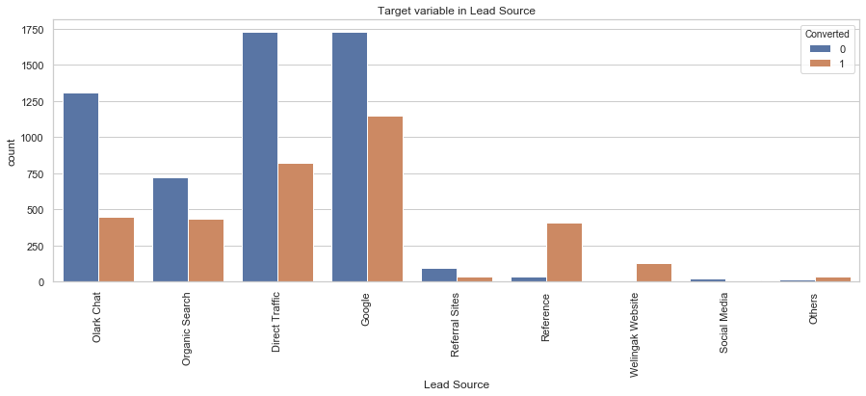
Categorical Columns w.r.t Converted Columns
Lead Source
Majority source of the lead is Google & Direct Traffic.
Lead source from Google has highest probability of conversion.
Leads with source Reference has maximum probability of conversion.

Slide 10
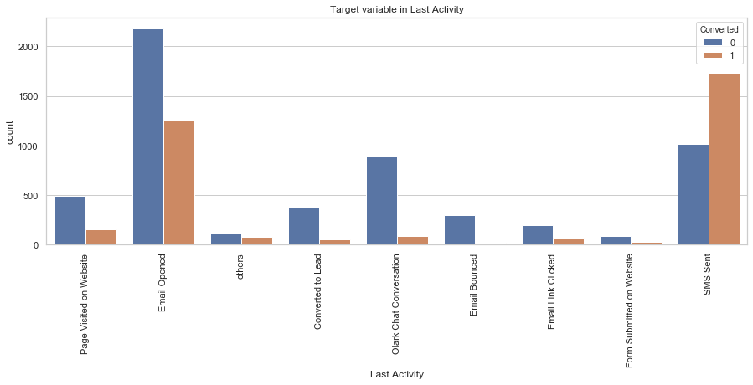
Categorical Columns w.r.t Converted Columns
Last Activity
Customers whose last activity was SMS Sent have higher conversion rate which is around 63%.
Customers who last activity was Email Opened constitute majority of the customers. They have around 36% of conversion rate.
To improve overall lead conversion rate, we need to focus more on improving lead conversion rate of Customers whose last activity was Email Opened and generate more leads from the ones whose last activity was SMS Sent.

Slide 11
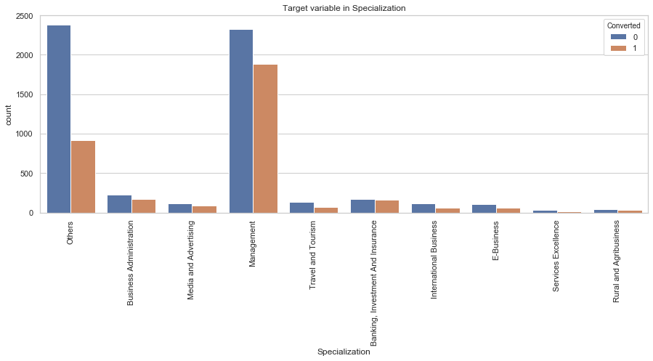
Categorical Columns w.r.t Converted Columns
Specialization
Maximum Leads have specialization as Management & Others.
Leads with specialization as Rural & Agribusiness have least probability of conversion.

Slide 12
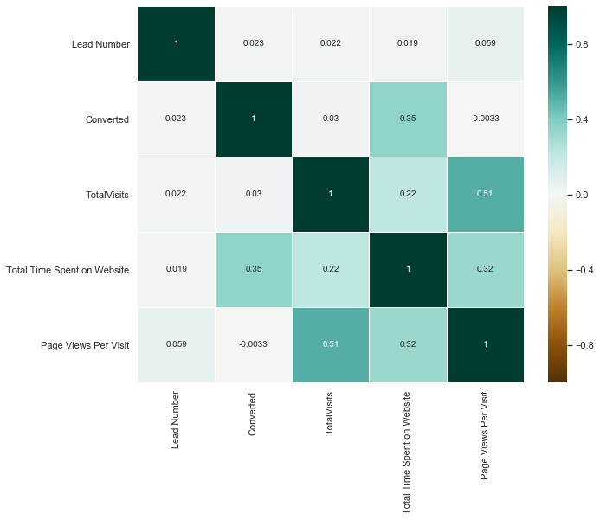
Correlations
We can observe that the variables are not highly correlated with each other. But still there is multicollinearity among some features

Slide 13
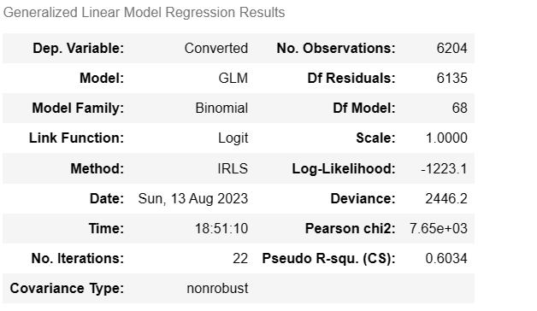
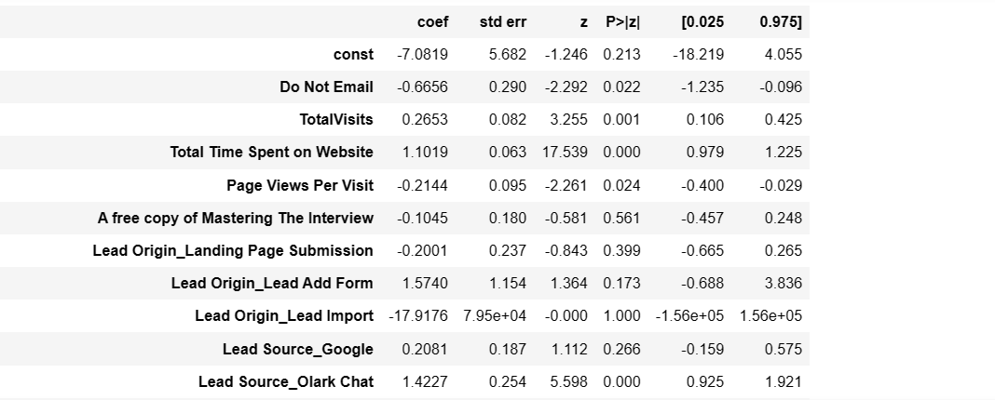
Factors Responsible in Driving Leads

Slide 14
Factors Responsible in Driving Leads
Below features are most important ones which are responsible for leads conversion
'Total Time Spent on Website'
'Lead Origin_Lead Add Form'
'Lead Source_Olark Chat'
'Lead Source_Welingak Website'
'Last Activity_Email Bounced'
'Last Activity_SMS Sent'
'Tags_Closed by Horizzon'
'Tags_Lost'
'Tags_No phone number'
'Tags_Others'
'Tags_Will revert after reading the email'
'Last Notable Activity_Modified'
'Last Notable Activity_Olark Chat Conversation'

Slide 15
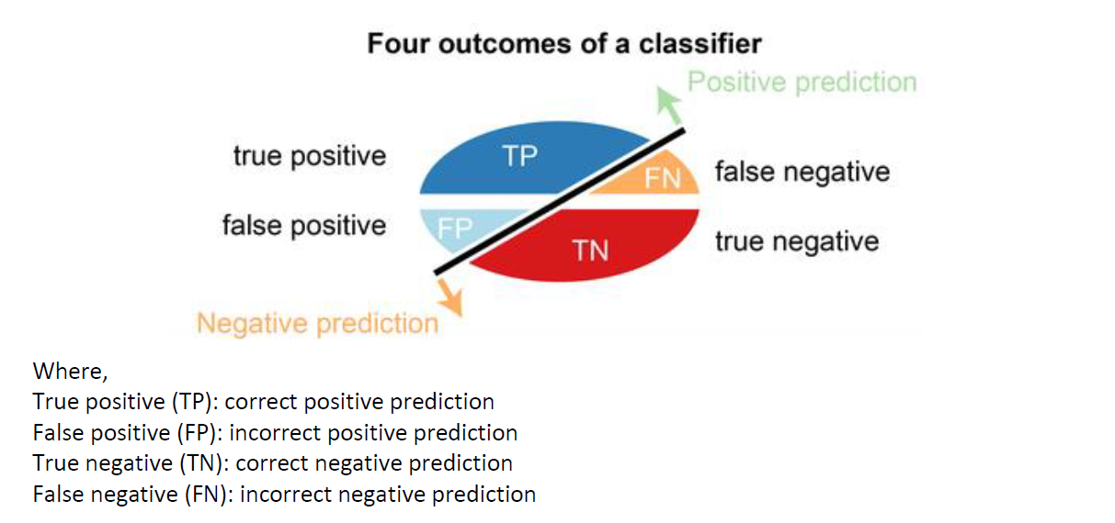
Terminologies Required
Conversion of categorical columns to numerical. This step is done as our algorithm runs only on numerical data.
Feature Scaling. This is done to bring our data into same scale.
Data Splitting: We have split the data into 80:20 and named it as train data and test data. We run model on train data and validate our model on test data.

Slide 16
Terminologies Required
1. Accuracy = (True Negative + True Positive)/Total
This metrics provides the accuracy of the model, where total is TP + FN + FP +FN
2. Sensitivity = True Positive / (True Positive + False Positive)
Sensitivity (SN) is calculated as the number of correct positive predictions divided by the total number of positives. It is also called recall (REC) or true positive rate (TPR). The best sensitivity is 1.0, whereas the worst is 0.0.
3. Specificity = True Negative/ (True Negative + False Negative)
Specificity (SP) is calculated as the number of correct negative predictions divided by the total number of negatives. It is also called true negative rate (TNR). The best specificity is 1.0, whereas the worst is 0.0.
4. Precision = True Positive/ (True Positives +False Positives)
Precision is defined as the number of true positives divided by the number of true positives plus the number of false positives.
5. Recall = True Positives/(True Positives +False Negatives)
The precise definition of recall is the number of true positives divided by the number of true positives plus the number of false negatives. True positives are data point classified as positive by the model that actually are positive (meaning they are correct), and false negatives are data points the model identifies as negative that actually are positive (incorrect).

Slide 17
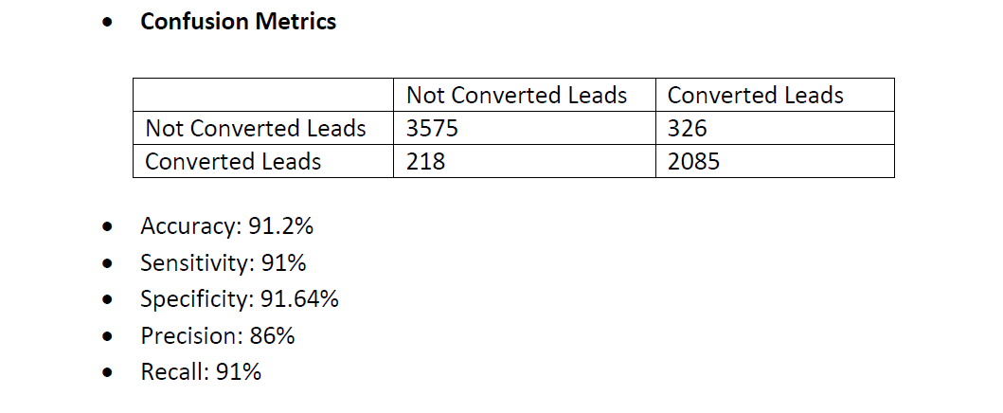
Model Metrix : Train Data

Slide 18
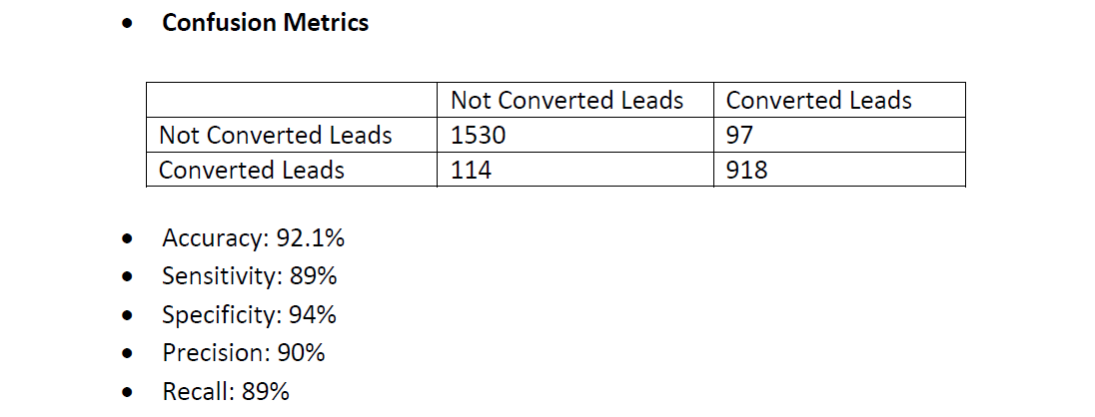
Model Metrix : Test Data

Slide 19
Conclusion
Focus:
Company should focus on following features to increase the leads
Tags_Closed by Horizzon: Leads that have been assigned Tags as ‘closed by horizon’ have the highest probability of conversion.
Tags_Lost: Leads that have been tagged as ‘Lost ‘also contribute to the conversion to a considerable extent.
Tags_Will revert after reading the email: Leads that have been tagged as ‘will revert after reading the mail’ also have significant correlation with the conversion.
Expansion:
Company should also focus on Lead Score (which are the probabilities obtained via algorithm) which are greater than 80% to expedite the conversion rate

