Slide 1

Revolutionizing Communication: Introducing a Streamlit-powered Chat PDF App with Langchain Integration
Revolutionizing Communication: Introducing a Streamlit-powered Chat PDF App with Langchain Integration

Slide 2


Introduction
Revolutionizing Communication with Streamlit-powered Chat PDF App.
This innovative app integrates Langchain for seamless language translation. Experience a new level of communication efﬁciency and convenience.

Slide 3
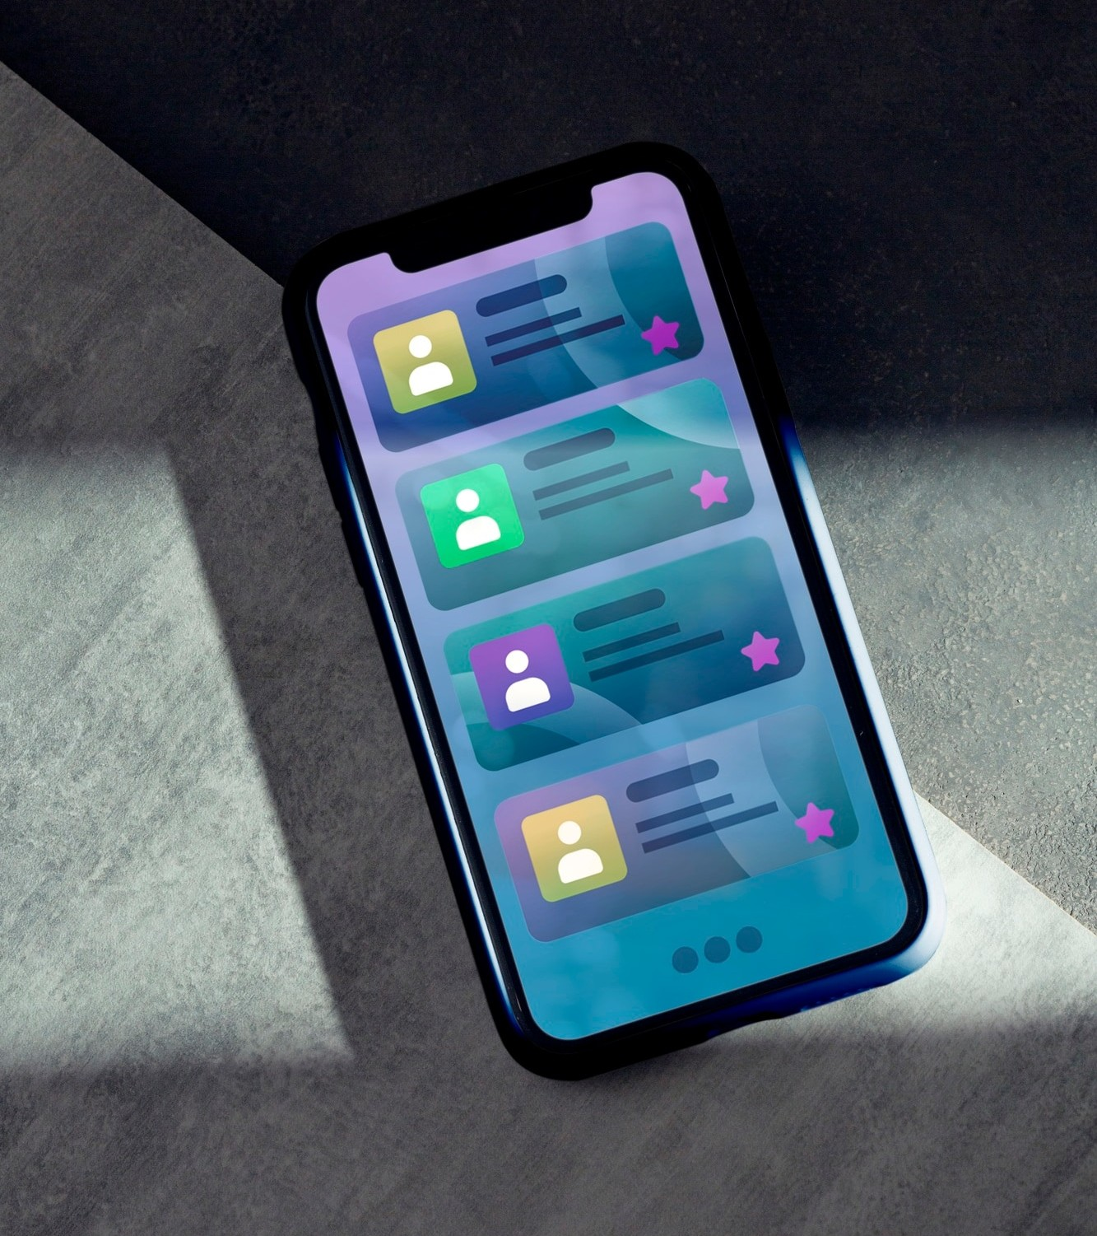
Streamlit-powered Chat PDF App
Streamlit-powered Chat PDF App is a cutting-edge solution that allows real-
time communication and
collaboration. With its user-friendly interface and advanced features, it transforms the way we interact and
share information.

Slide 4
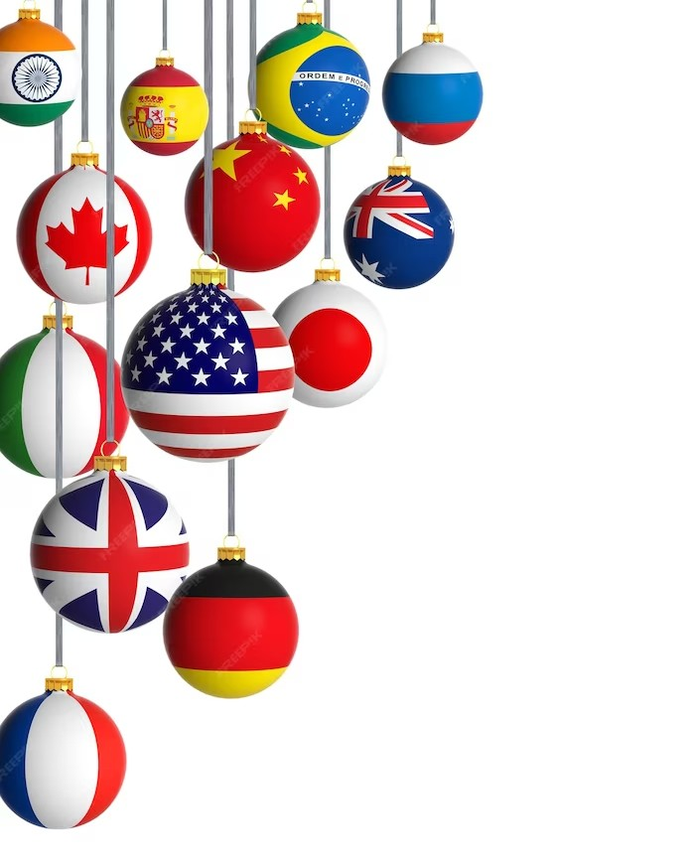
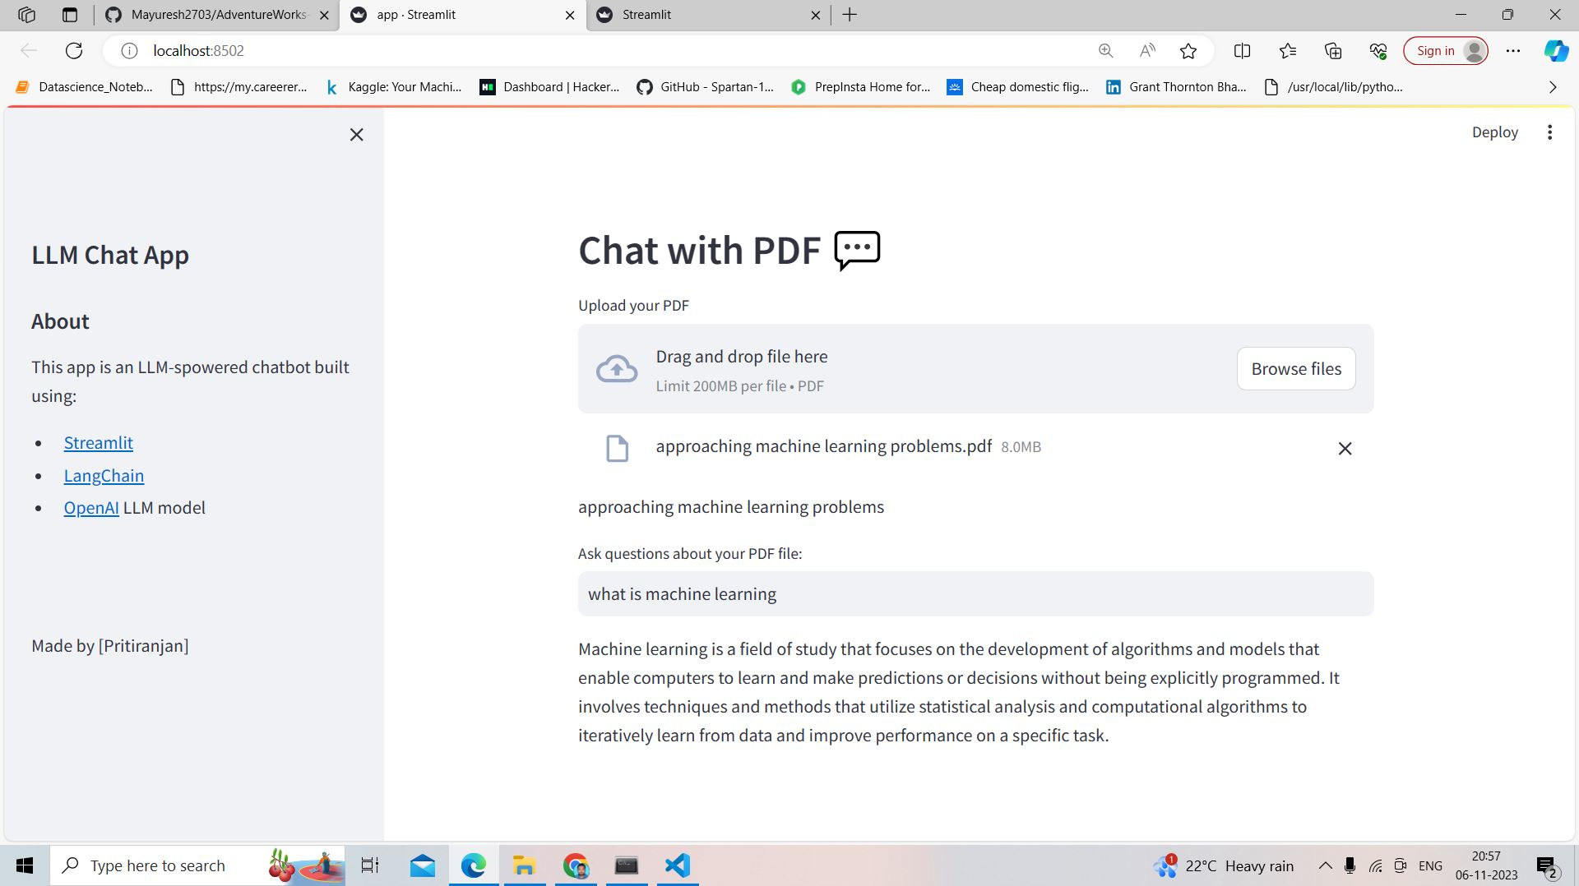
Langchain Integration
Langchain integration enables automatic language translation in the Streamlit-powered Chat PDF App.
Break down language barriers and communicate effortlessly with people from around the world.

Slide 5
Conclusion
The Streamlit-powered Chat PDF App with Langchain integration revolutionizes communication by providing a seamless and efﬁcient platform for global collaboration.
Embrace the power of technology and enhance your communication experience.

Slide 6
Thanks!

