Slide 1





Datatypes in Python
By
Pritiranjan Biswal

Slide 2











Python Built-in Core Data Types
Python offers following built-in core data types :
i) Numbers ii) String iii) List iv) Tuple v) Dictionary
Built-in Core Data Types
Numbers
String
List
Tuple
Dictionary
Integers
Floating-Point
Numbers
Complex
Numbers
Integers(Signed)
Boolean

Slide 3
Integers
Integers are whole numbers. They have no fractional parts.
Integers can be positive or negative.
There are two types of integers in Python:
Integers(Signed) : It is the normal integer representation of whole numbers using the digits 0 to 9. Python provides single int data type to store any integer whether big or small. It is signed representation i.e. it can be positive or negative.
Boolean : These represent the truth values True and False. It is a subtype of integers and Boolean values True and False corresponds to values 1 and 0 respectively

Slide 4
Demonstration of Integer Data Type
#Demonstration of Integer-Addition of two integer number a=int(input("Enter the value of a:"))
b=int(input("Enter the value of b:")) sum=a+b
print("The sum of two integers=",sum)
Output:
Enter the value of a: 45 Enter the value of b: 67
The sum of two integers= 112

Slide 5
Floating Point Numbers
A number having fractional part is a floating point number. It has a decimal point. It is written in two forms :
Fractional Form : Normal decimal notation e.g. 675.456
Exponent Notation: It has mantissa and exponent. e.g. 6.75456E2
Advantage of Floating point numbers:
They can represent values between the integers. They can represent a much greater range of values.
Disadvantage of Floating point numbers:
Floating-point operations are usually slower than integer operations.

Slide 6
Demonstration of Floating Point Data Type
#Demonstration of Float Number- Calculate Simple Interest princ=float(input("Enter the Principal Amount:"))
rate=float(input("Enter the Rate of interest:")) time=float(input("Enter the Time period:")) si=(princ*rate*time)/100
print("The Simple Interest=",si)
Output:
Enter the Principal Amount:5000 Enter the Rate of interest:8.5 Enter the Time period:5.5 Simple Interest= 2337.5

Slide 7
Complex Number
Python represents complex numbers in the form a+bj.
#Demonstration of Complex Number- Sum of two Complex Numbers
a=7+8j b=3.1+6j
c=a+b
print("Sum of two Complex Numbers") print(a,"+",b,"=",c)
Output:
(7+8j) + (3.1+6j) = (10.1+14j)

Slide 8
Strings
A String is a group of valid characters enclosed in Single or Double quotation marks. A string can group any type of known characters i.e. letters ,numbers and special characters.
A Python string is a sequence of characters and each character can be accessed by its index either by forward indexing or by backward indexing.
e.g. subj=“Computer”
Forwar
ackward indexing
d indexing | 0 | 1 | 2 | 3 | 4 | 5 | 6 | 7
Subj | C | o | m | p | u | t | e | r
 | -8 | -7 | -6 | -5 | -4 | -3 | -2 | -1 _{B}

Slide 9
Demonstration of String Data Type
#Demonstration of String- To input string & print it my_name=input("What is your Name? :") print("Greetings!!!")
print("Hello!",my_name) print("How do you do?")
Output :
What is your Name? :Ananya Inkane Greetings!!!
Hello! Ananya Inkane How do you do?

Slide 10
List
The List is Python’s compound data type. A List in Python represents a list of comma separated values of any data type between square brackets. Lists are Mutable. #Demonstration of List- Program to input 2 list & join it List1=eval(input("Enter Elements for List 1:")) List2=eval(input("Enter Elements for List 2:"))
List=List1+List2 print("List 1 :",List1)
print("List 2 :",List2) print("Joined List :",List) Output:
Enter Elements for List 1:[12,78,45,30] Enter Elements for List 2:[80,50,56,77,95] List 1 : [12, 78, 45, 30]
List 2 : [80, 50, 56, 77, 95]
Joined List : [12, 78, 45, 30, 80, 50, 56, 77, 95]

Slide 11
Tuple
The Tuple is Python’s compound data type. A Tuple in Python represents a list of comma separated values of any data type Within parentheses. Tuples are Immutable.
#Demonstration of Tuple- Program to input 2 tuple & join it
tuple1=eval(input("Enter Elements for Tuple 1:")) tuple2=eval(input("Enter Elements for Tuple 2:"))
Tuple=tuple1+tuple2 print(“Tuple 1 :“,tuple1)
print(“Tuple 2 :“,tuple2) print("Joined Tuple :“,Tuple) Output:
Enter Elements for Tuple 1:(12,78,45,30) Enter Elements for Tuple 2:(80,50,56,77,95) List 1 : (12, 78, 45, 30)
List 2 : (80, 50, 56, 77, 95)
Joined List : (12, 78, 45, 30, 80, 50, 56, 77, 95)

Slide 12
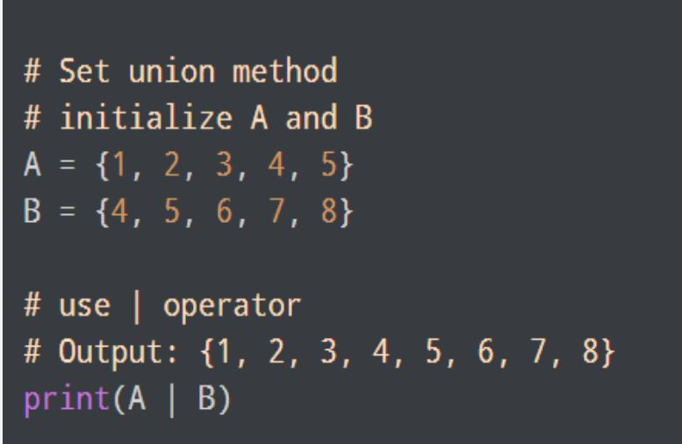
Sets
Sets are used to store multiple items in a single variable. • A set is a collection which is unordered. • Unordered means that the items in a set do not have a defined order. • Sets are unchangeable, meaning that we cannot change the items after the set has been created. • Sets are unindexed. • Sets are written with curly brackets.

Slide 13
Dictionary
Dictionaries are unordered collection of elements in curly braces in the form of a key:value pairs that associate keys to values. Dictionaries are Mutable. As dictionary elements does not have index value ,the elements are accessed through the keys defined in key:value pairs.
#Demonstration of Dictionary- Program to save Phone nos. in dictionary & print it
Phonedict={“Madhav”:9876567843,”Dilpreet”:7650983457,”Murugan”:90672 08769,”Abhinav”:9870987067}
print(Phonedict)
Output:
{'Madhav': 9876567843, 'Dilpreet': 7650983457, 'Murugan': 9067208769,
'Abhinav': 9870987067}

