Slide 1
Welcome
26/08/2019
Topic Name : Image Super Resolution
Presented By-Priti Gajbhare
Guided By-Prof. Amruta Joshi

Slide 2
CONTENT
Introduction
What is SR
Limits of SR
Applications
Conclusion
References

Slide 3
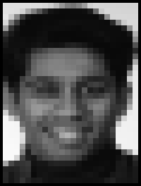
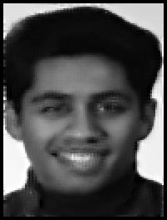
Introduction
Super-resolution is the process of combining multiple low resolution images to form a higher resolution one.
No Cheating!
Resulting image should represent reality better than all the input images.

Slide 4
The highly challenging task of estimating a high-resolution (HR) image from its low-resolution (LR)
Counterpart is referred to as super-resolution (SR).
SR received substantial attention from within the computer vision research community.
Has wide range of community.
Two basic approaches for super resolution:
Reconstruction-based – which simply tries to reverse the imaging process.
Example-based – which uses example images to reconstruct the original image.

Slide 5
What is Super Resolution
Process of combining information of one or many input images with low resolution (LR) from the same scene to reconstruct a high resolution (HR) image is called Image Super Resolution.
Depending on the number of image frames, SR techniques can be classified into two main approaches:
(1) single image SR methods based on one LR image frame which also known as one Input-one Output systems.
(2) SR techniques based on multi image frames which use motion information between different image frames.
As the super resolution reconstruction is an inverse problem, this method consists of three phases up-sampling, deblurring and denoising.
Experimental results show the effectiveness of the proposed method.

Slide 6
Reconstruction-based Super Resolution
Reconstruct hidden HR pixels out of known linear combinations.
LR
LR
LR
LR
LR
LR
LR
LR
LR
LR
LR
LR
LR
LR
LR
LR
HR
HR
HR
HR
HR
HR
HR
HR
HR
HR
HR

Slide 7
Example-Based Super Resolution
Use prior knowledge to reconstruct a High Resolution image.
Prior Knowledge of faces

Slide 8
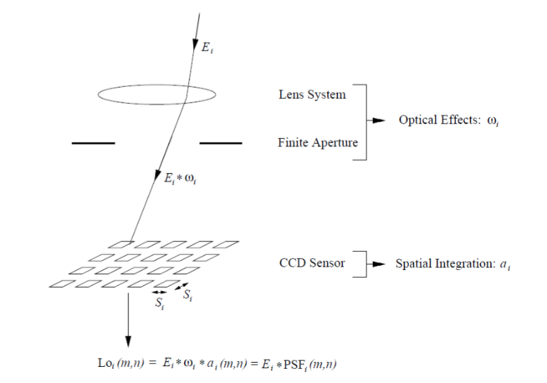
Physical Properties
Each camera suffers from some inherent optical issues:
Finite size of the aperture - generates blur, modeled by the Point-Spread-Function (PSF).
Noise

Slide 9
Large Magnification Factor is Problematic
Large magnification factor causes:
Overly smooth HR image
Fine details are not recovered

Slide 10
Limits of Super-Resolution
Size of LR images: N pixels.
Size of HR image: NM ² pixels.
Each HR pixel can be added noise of amplitude smaller than M ² which wont change the LR image!
Volume of possible HR solutions: O(M ^{2N}) ¹
It can be shown that under practical considerations the effective magnification factor (M) is bounded by 1.6, no matter how many LR images are taken².

Slide 11
Applications
The super resolution is widely applied in:
Remote sensing
Medical imaging
Biometric identification
Satellite imaging
Video application

Slide 12
Conclusion
Having high resolution is an important requirement in many applications, but in most situations because of the limitation of imaging hardware system and environmental operators, it is not satisfied.

Slide 13
References
H. Talebi, X. Zhu and P. Milanfar, "How to SAlF-Iy Boost Denoising Performance," in iEEE Transactions on image Processing, vol. 22, no. 4, pp. 1470-1485, April 2013.
S. Najafi and S. Shirani, "Regularization function for video super resolution using auxiliary high resolution still images," 2012 Conference Record of the Forty Sixth Asilomar Conference on Signals, Systems and Computers (ASILOMAR), Pacific Grove, CA, 2012, pp. 1713-1717

Slide 14
THANK YOU

