Slide 1
Feature Extraction and Price Prediction for Mobile Pones
Name: Priti Mohan Kalaskar
Organization: Nexthikes IT Solutions

Slide 2
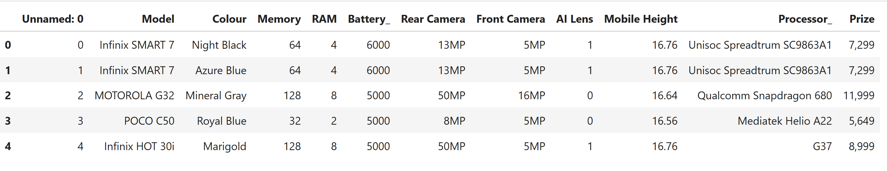
Data Exploration
Shape of Data:
Number of Columns = 12
Number of Columns = 541

Slide 3
Data Preprocessing
Steps:
Missing values
Drop unneccessary columns
Encoding (string to numeric conversion)
Outliers handling

Slide 4
Feature Extraction
Newly extracted features list:
Total_Camera_MP(Rear Camera+ front Camera)
Rear_to_Front_Cam_Ratio(Rear Camera / (front Camera+1))
Performance_Score(RAM * Memory)
Battery_per_Height(Battery / Mobile Height)
Memory_per_Price(Memory / Price)
RAM_per_Price(RAM / Price)

Slide 5
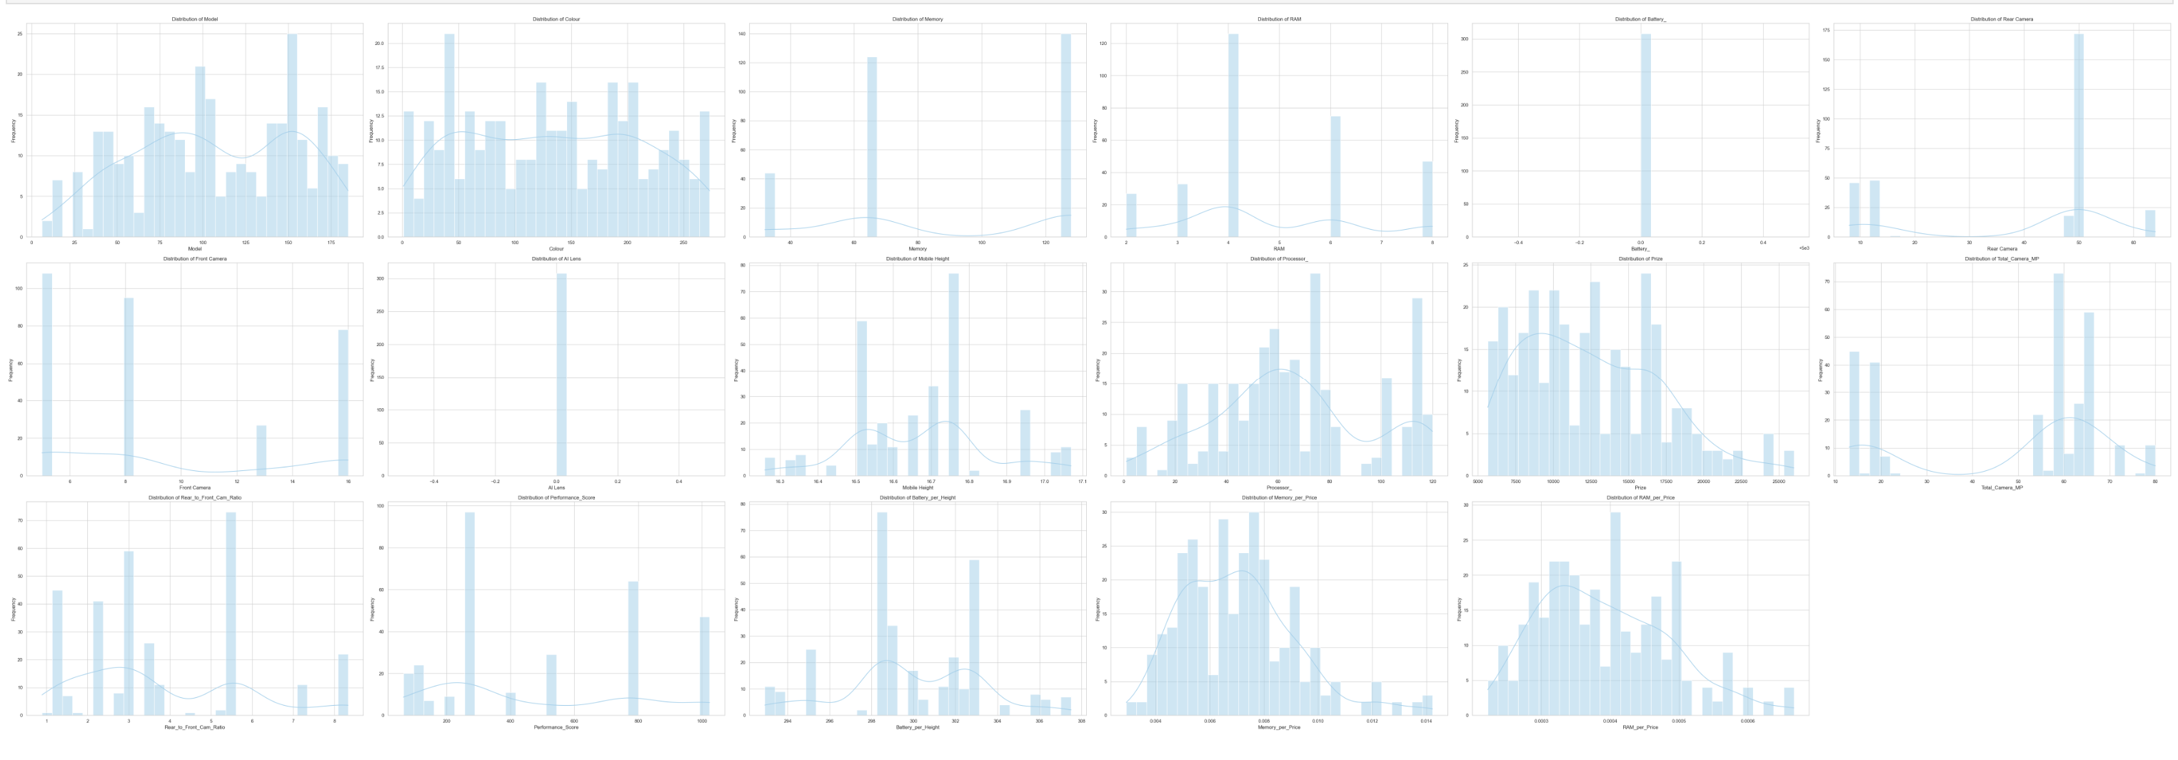
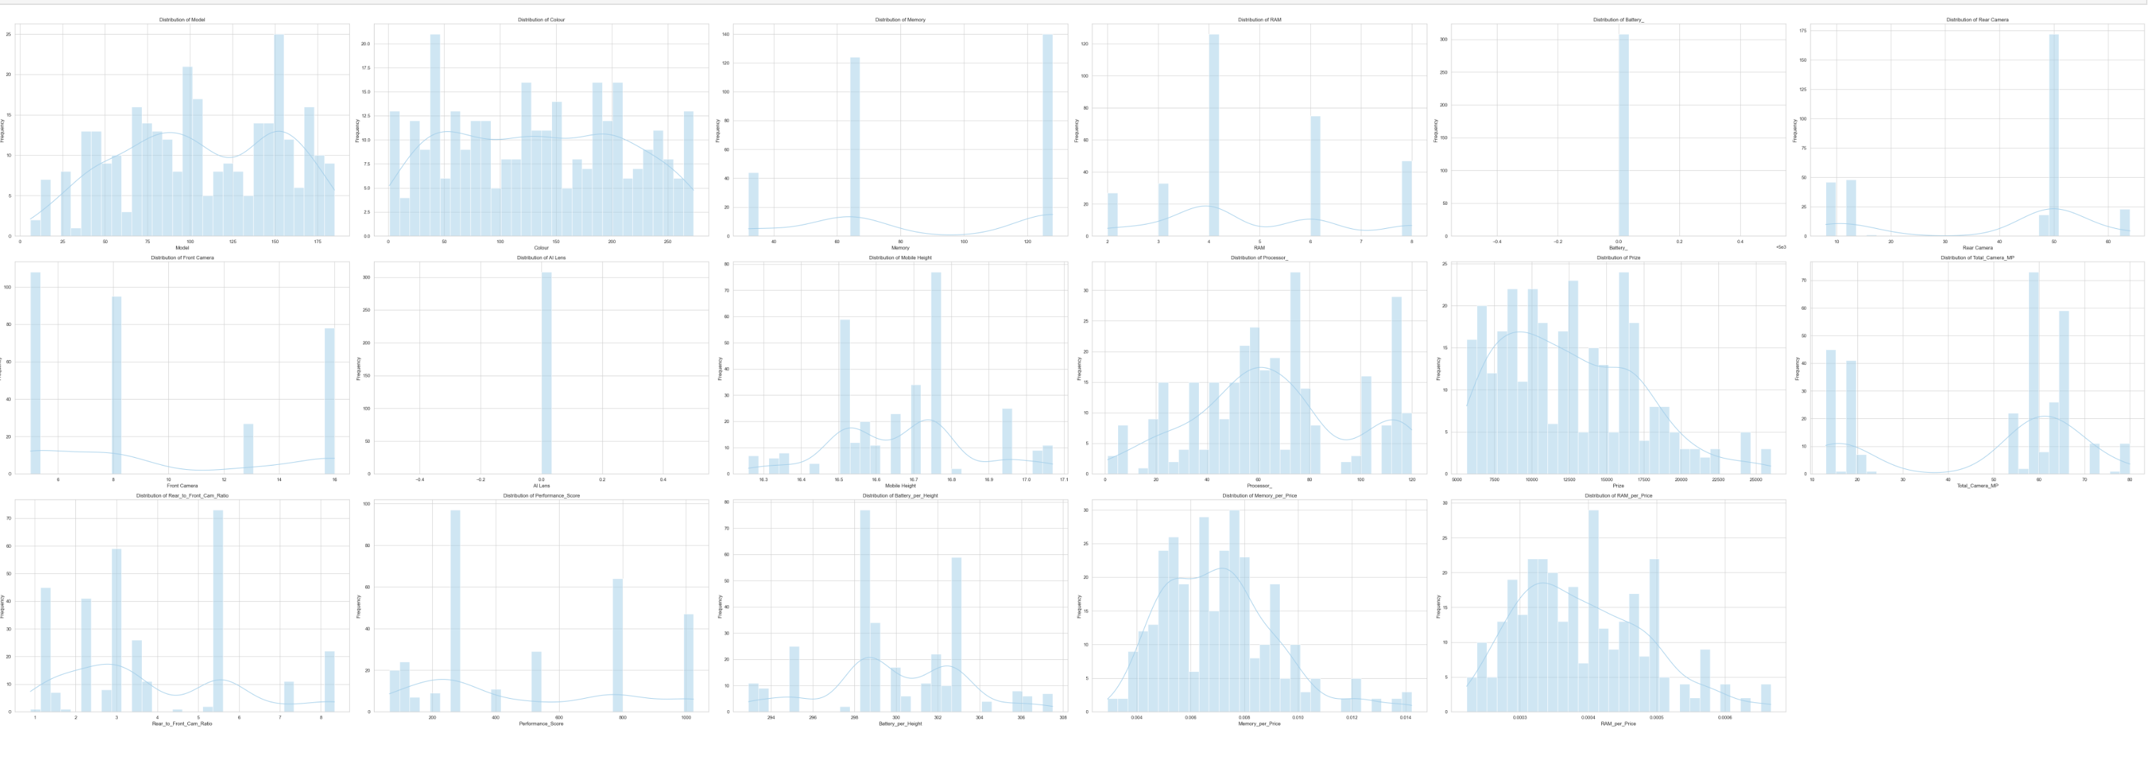
EDA
Univariate Analysis
Bivariate Analysis

Slide 6
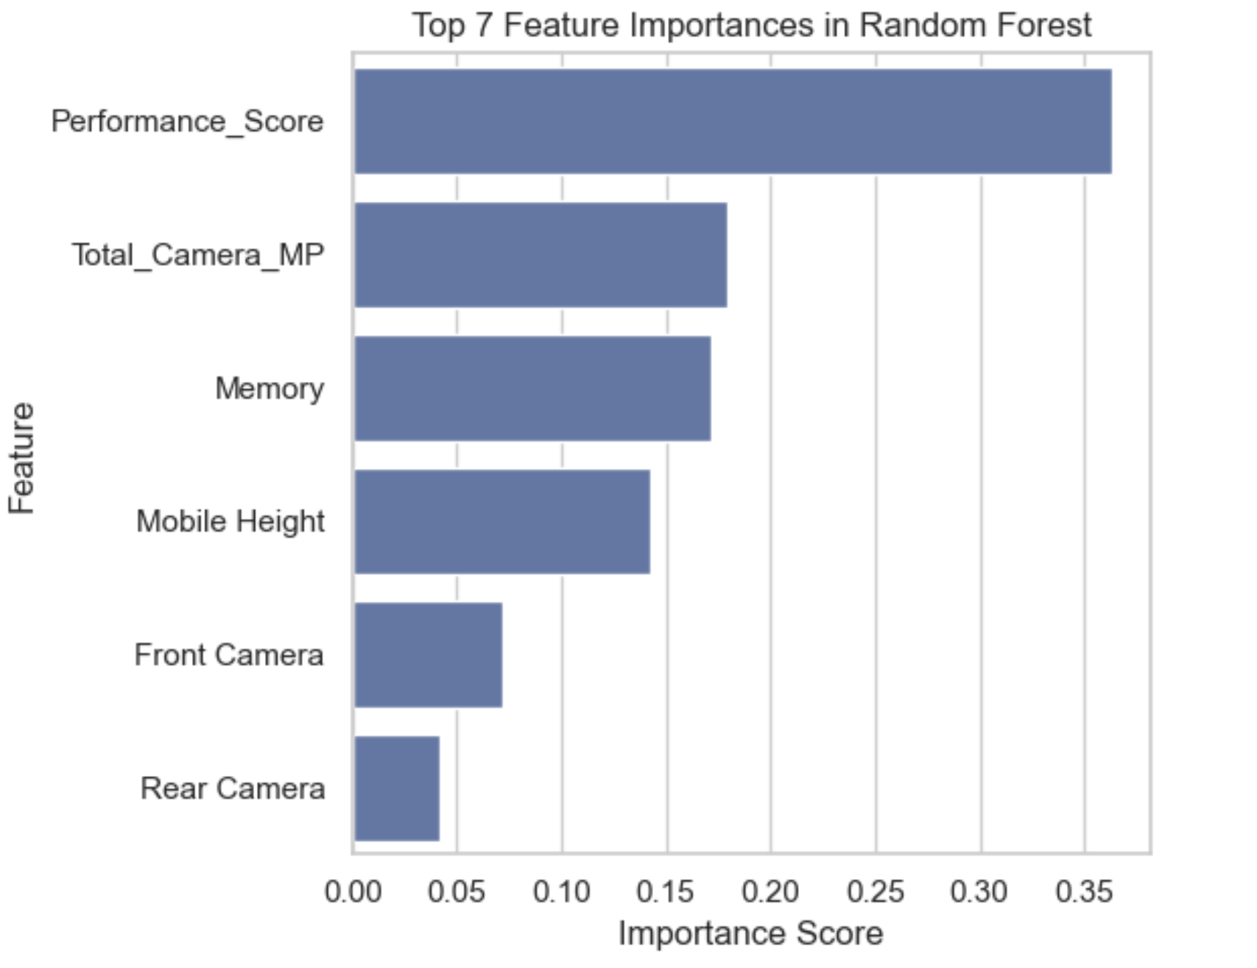
Feature Selection
Target Fearture:
‘Price’
Selected Independent Features list:
'Performance_Score', 'RAM',
'Memory', 'Front Camera',
'Total_Camera_MP',
'Rear Camera', 'Mobile Height'.

Slide 7
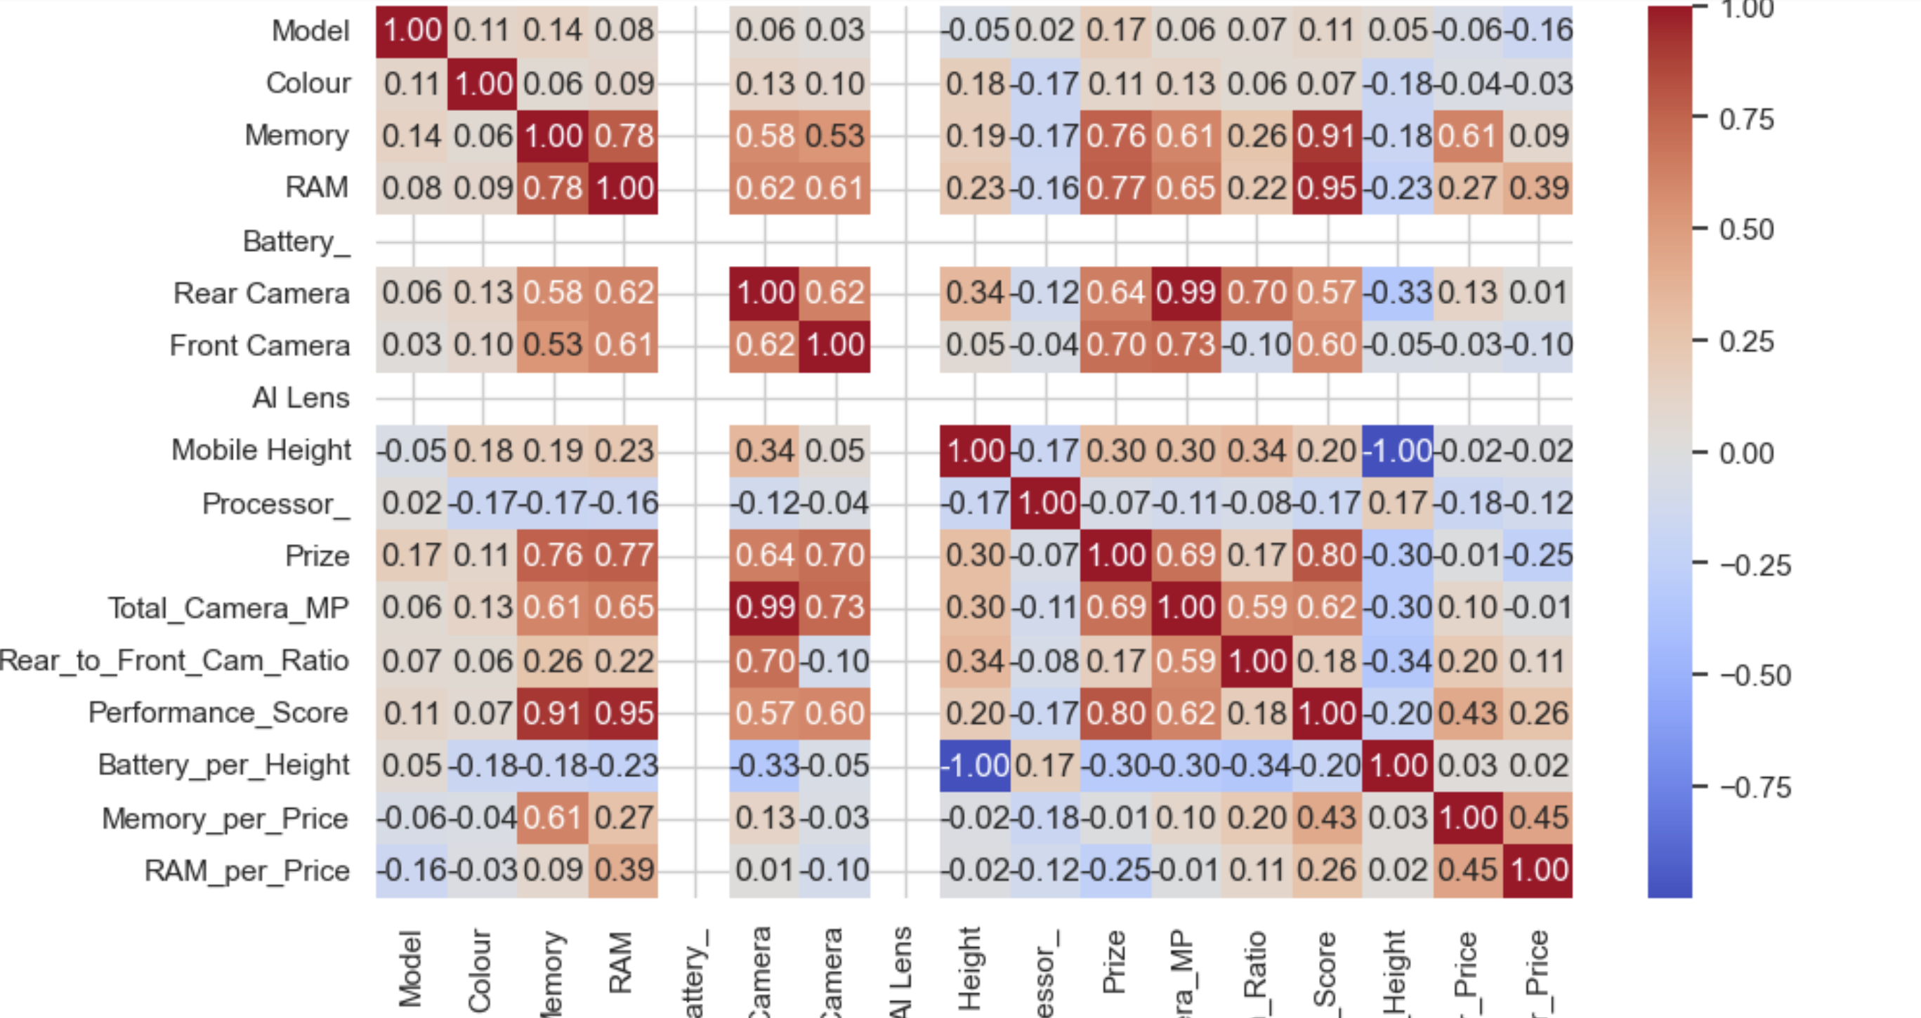
Correlational Matrix

Slide 8
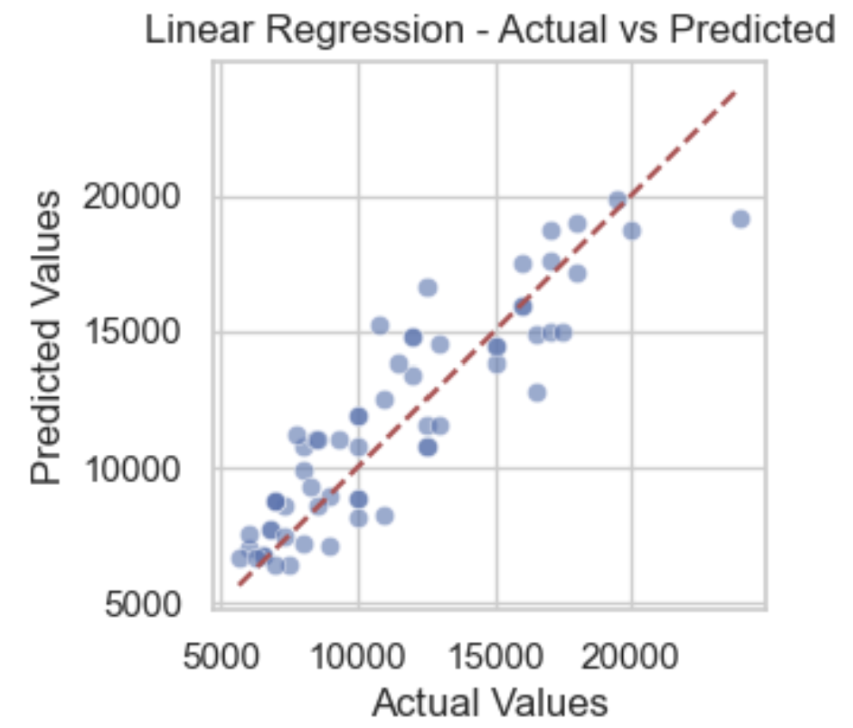
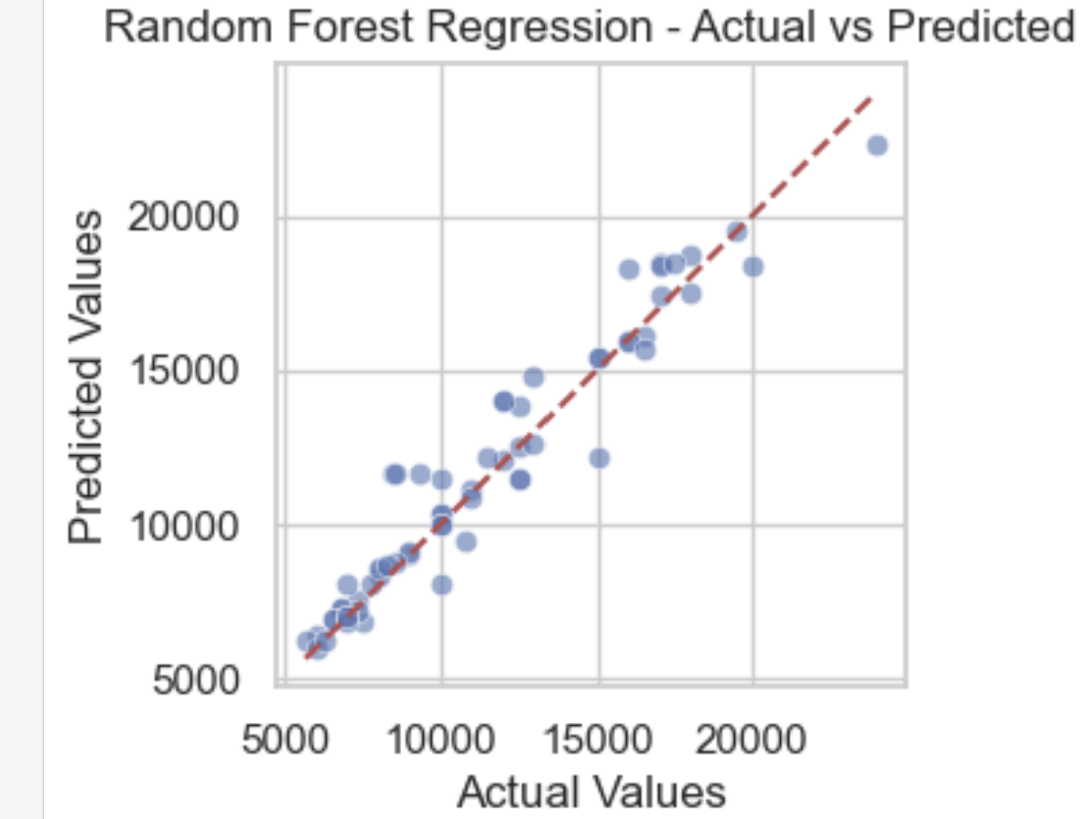
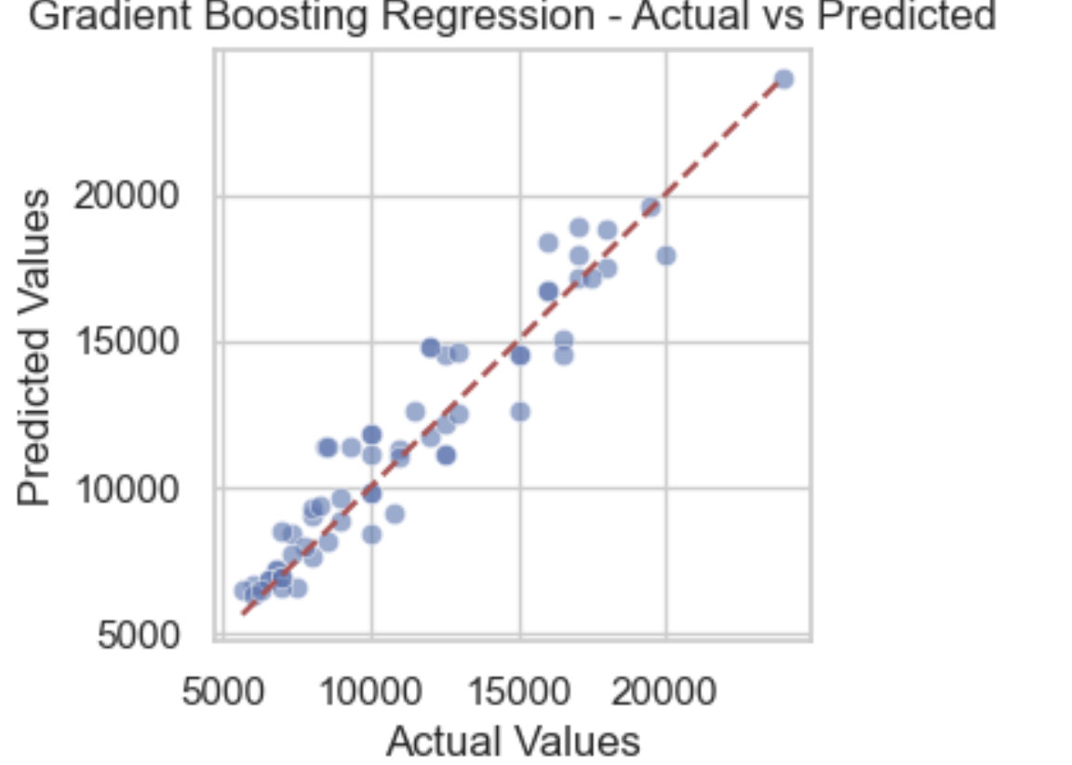
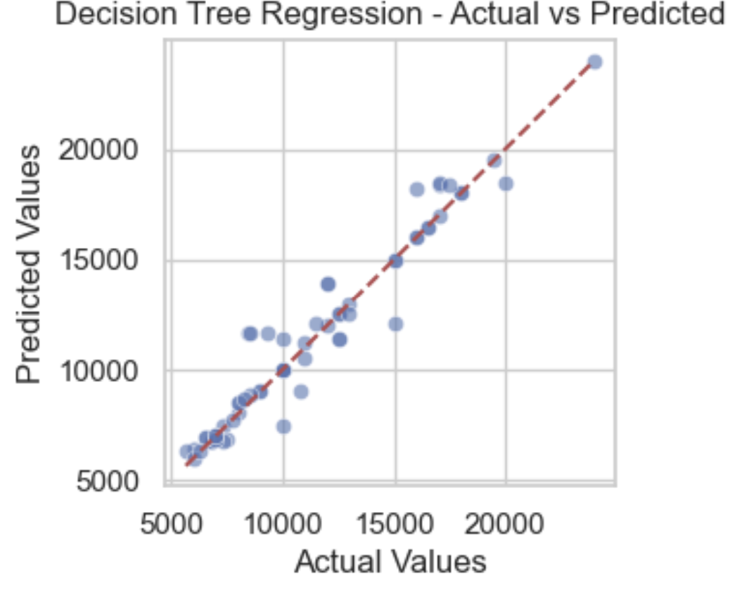
Model Building

Slide 9
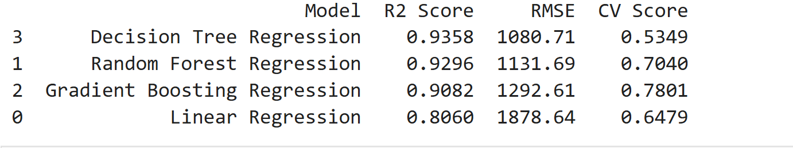
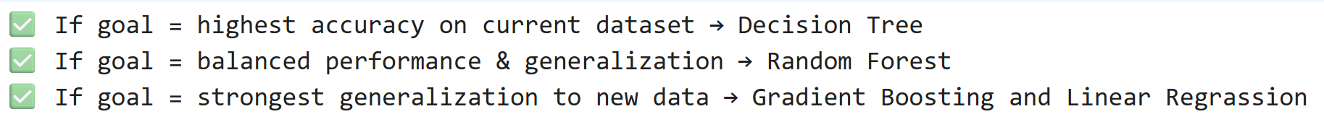
Model Evaluation

Slide 10
Thank You
Thank you for your time and attention!
Suggessions and feedback are welcome.

